Slide 1

Data mining and analytics in nba basketball
A PRESENTATION BY JACOB MITCHELL

Slide 2
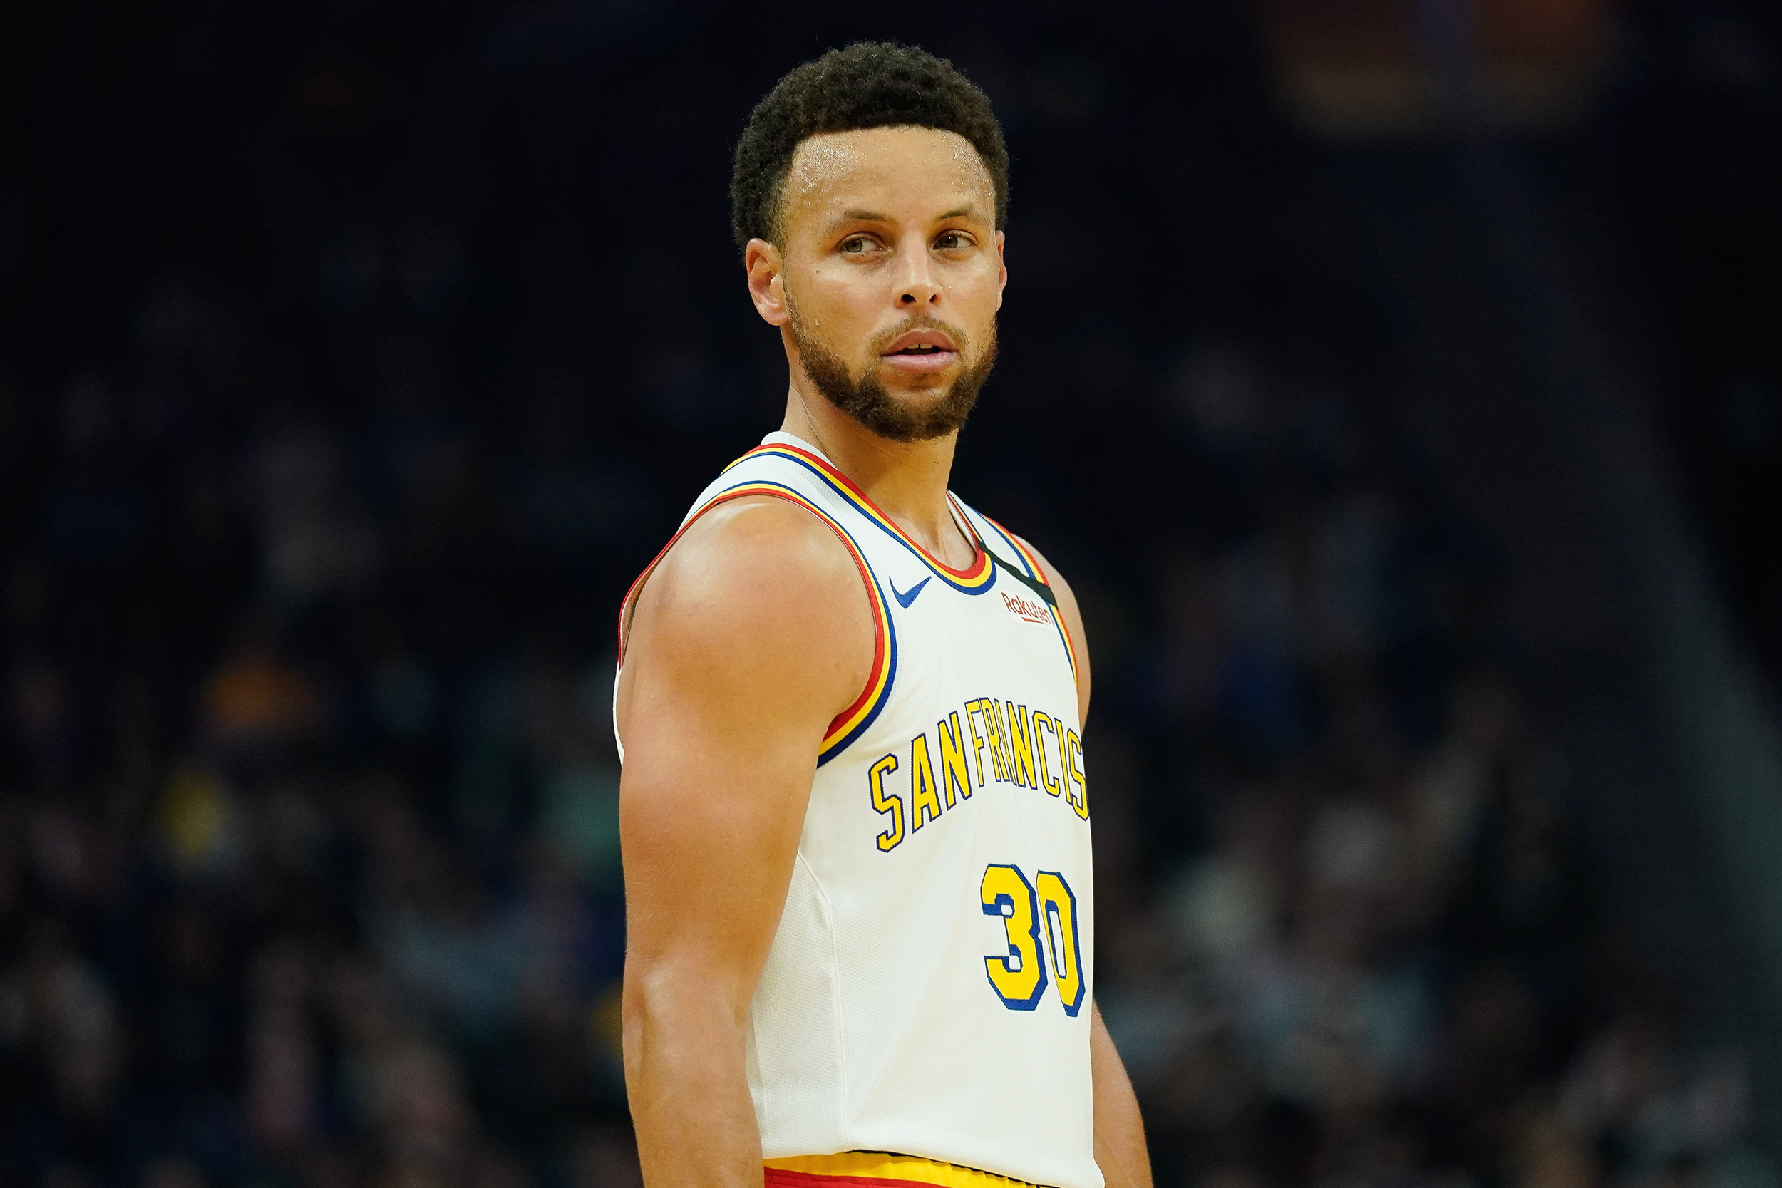
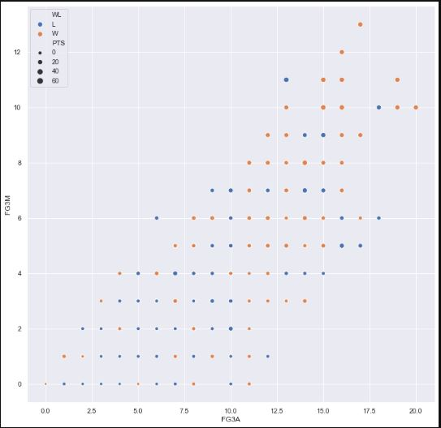
Steph curry fg3m vs fg3a

Slide 3
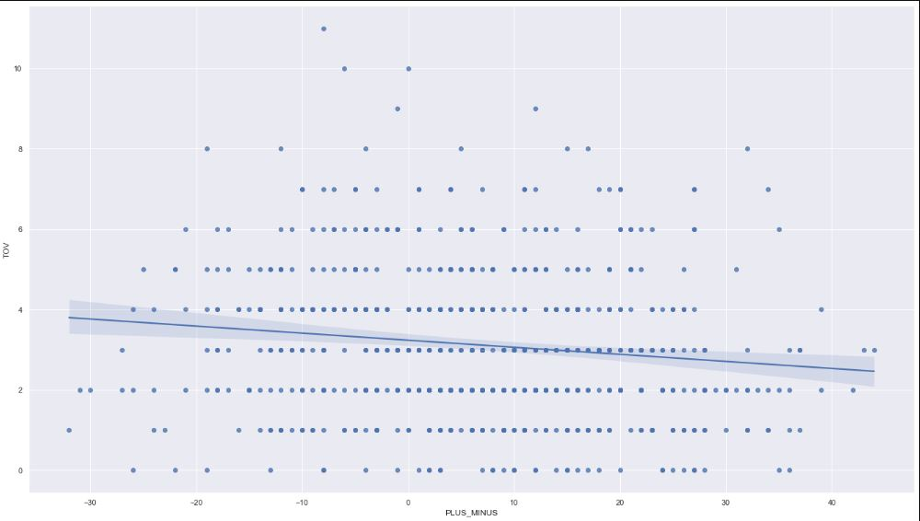
LINEAR REGRESSION OF TURNOVERS VS PLUS MINUS

Slide 4
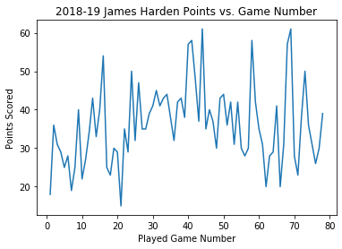
James harden points in a game

Slide 5
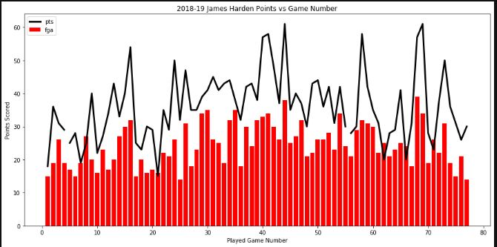

Slide 6
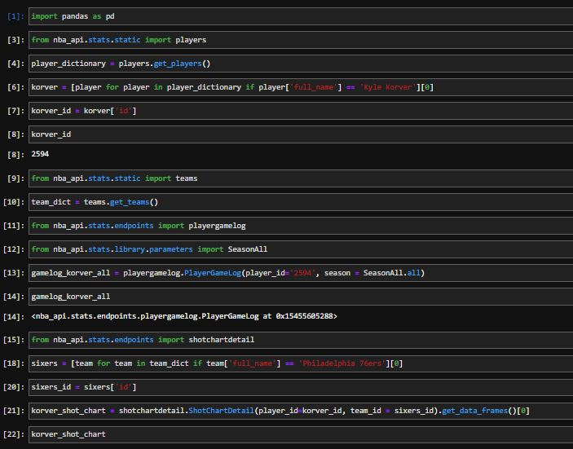
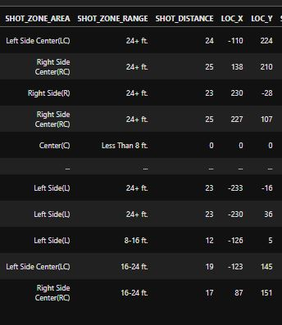
PYTHON NBA_API Kyle Korver shot info

Slide 7
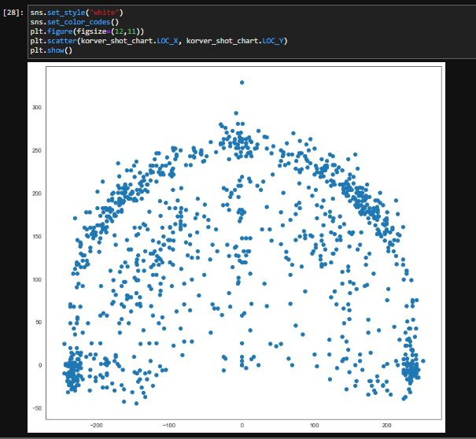
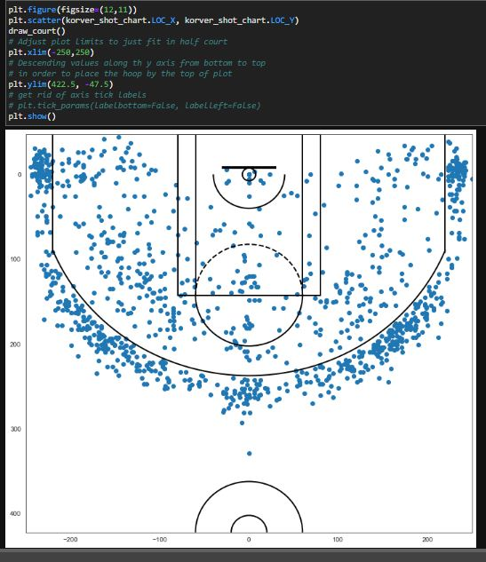

Slide 8
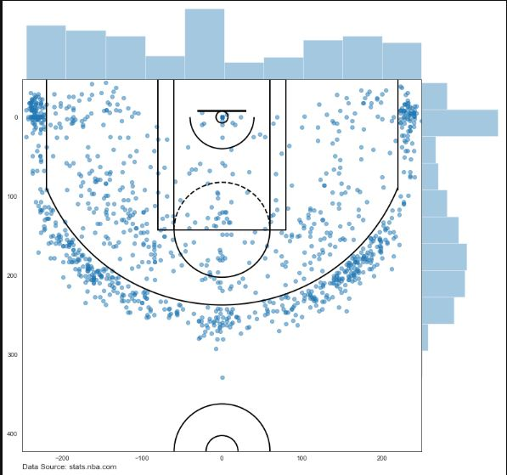
Kyle Korver shot analysis

Slide 9
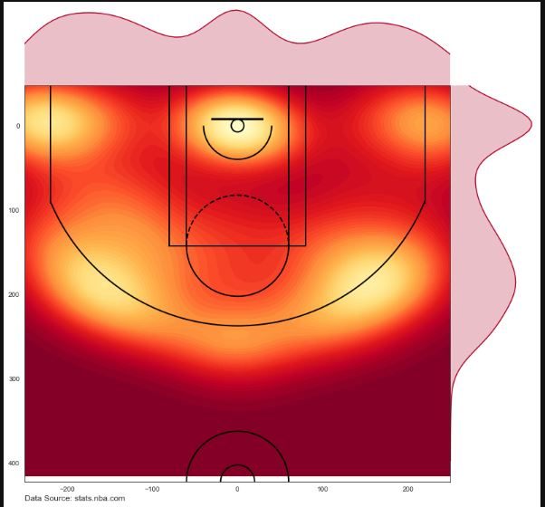

Slide 10
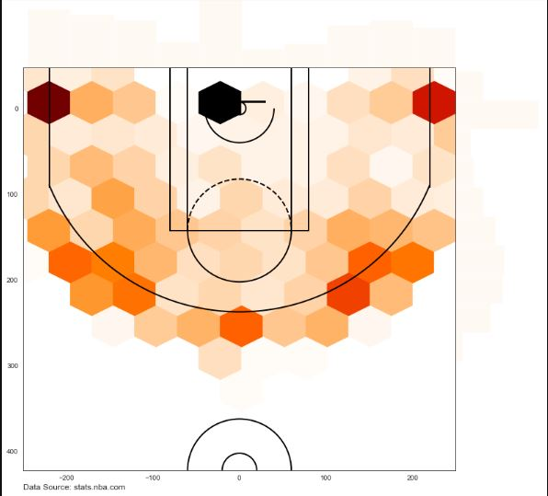
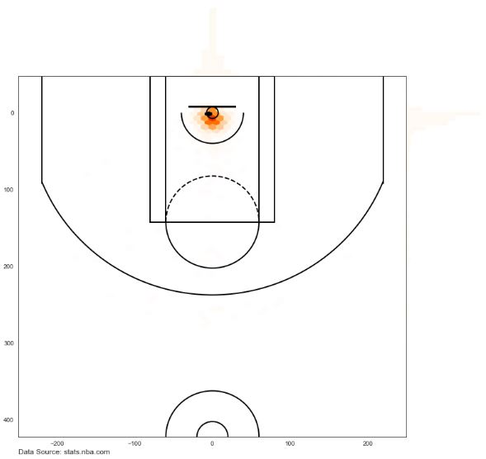
KYLE KORVER VS GIANNIS Antetokounmpo

