Slide 1
Application of big data and data analytics
IMPACT OF DATA AND STATISTICS IN NBA BASKETBALL
A PRESENTATION BY JACOB MITCHELL

Slide 2

What is big data and why is it important?

Slide 3

How Does It relate to sports?

Slide 4
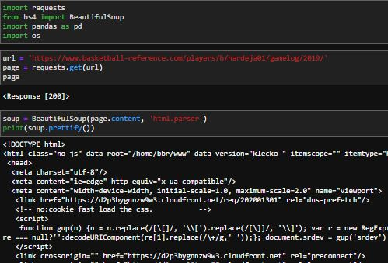
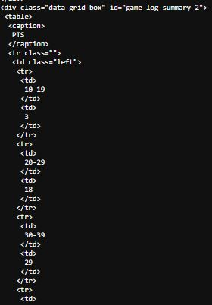
Introduction to web scraping

Slide 5
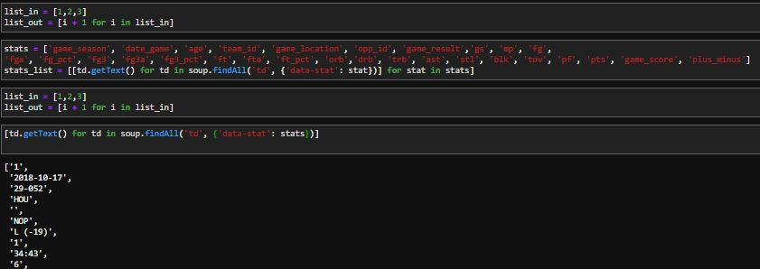
Collecting the data

Slide 6
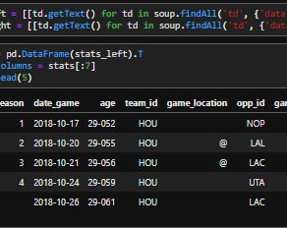
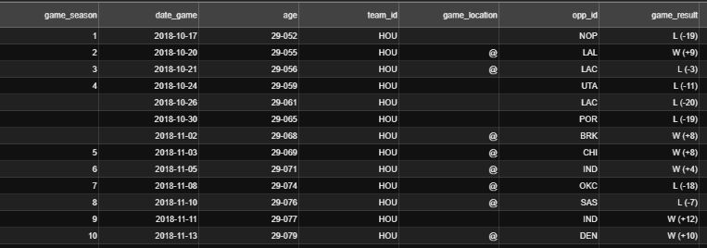
Tidying the data

Slide 7
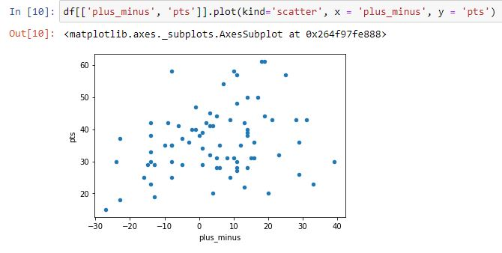
James Harden points versus plus_minus

Slide 8
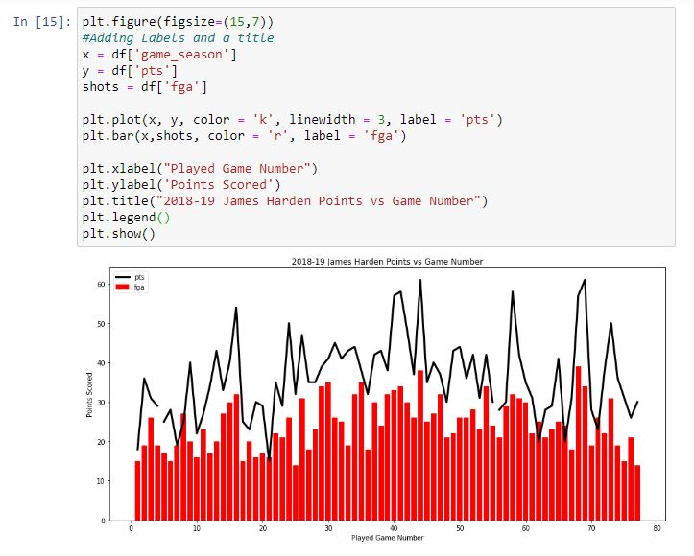

Slide 9
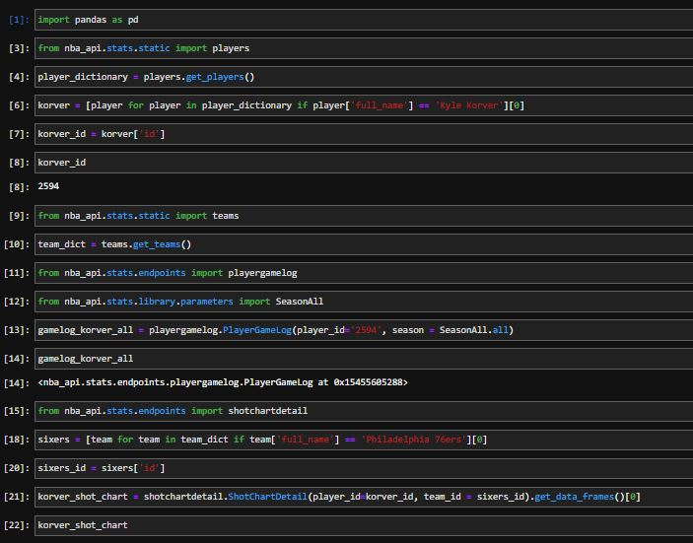
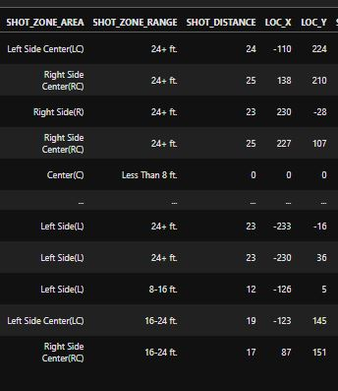
PYTHON NBA_API Kyle Korver shot info

Slide 10
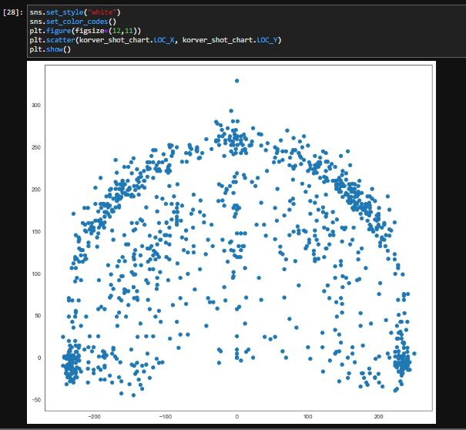
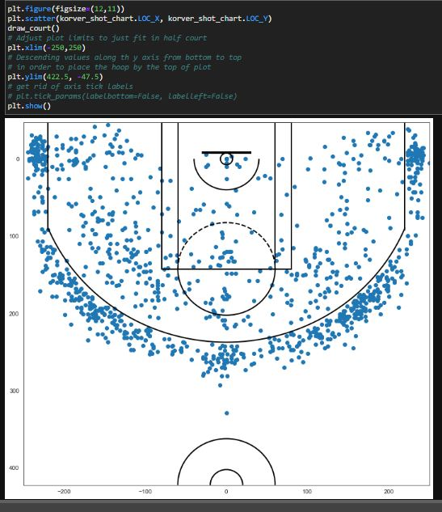

Slide 11
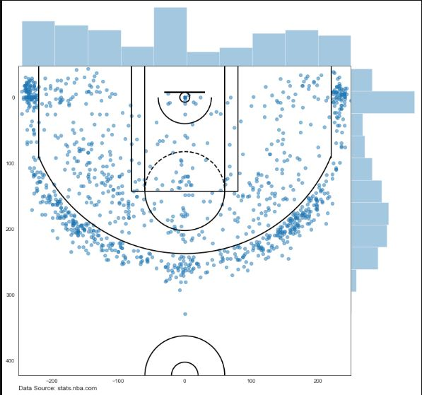
Kyle Korver shot analysis

Slide 12
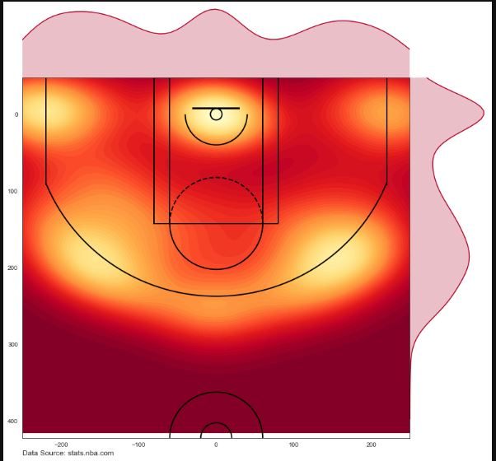

Slide 13
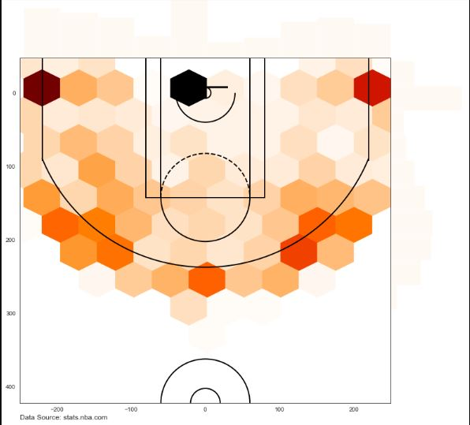
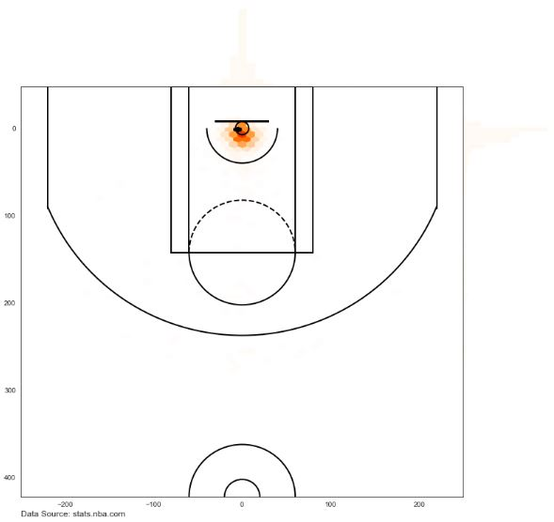
KYLE KORVER VS GIANNIS Antetokounmpo

Slide 14

Practical Application of data science
Why I wanted to learn about data mining and analytics
What I learned about data mining and analytics
Its application to the real world
Trust the Process

