Slide 1
Web Element Locator Strategies

Slide 2
what's in a web page?
A web page is a document on the worldwide web that can be displayed in a browser on a computer or device. Popular websites like Google, Facebook, and Wikipedia all have multiple pages with different content.
Users can find web pages using URL addresses or search engines.
https://es.wikipedia.org/wiki/Selenium
Notes:
There's quite a bit of content on this page:
A title for the article
Paragraphs of text
Pictures of pandas
A search bar
Links to other articles
Users interact with web pages visually. That's an important facet for web pages. They can scroll to read more text in large pictures and even click links to visit new articles.
Users don't need to know any special commands, and websites with good user experience make interactions intuitive and seamless for the users.
So, what makes web pages so visually interactive?
Under the hood, there's quite a bit of code that users never see. There are three main components, HTML, CSS and JavaScript.

Slide 3
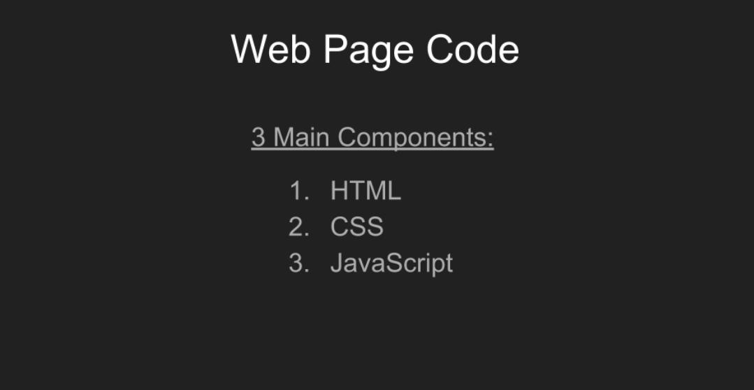
what's in a web page?

Slide 4
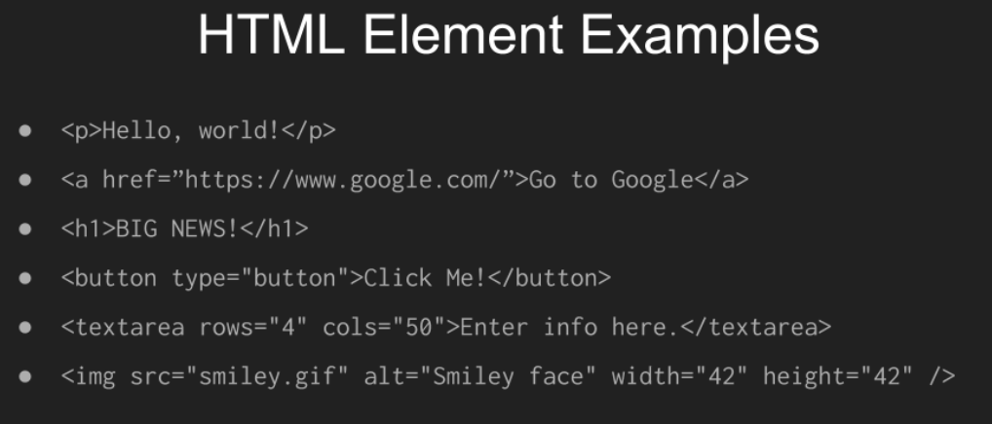
HTML stands for Hypertext Markup Language.
Notes:
Each element has a unique tagName. The element declaration begins and ends with the tagName surrounded by angle brackets <>, but the ending name is prefixed with a forward slash / to indicate that it is the ending.
The starting tag may also include attributes to customize the element. Content may be placed between the tags such as raw text or other nested elements.
Here are some examples of common HTML elements.
The p tag indicates a paragraph of text to be displayed.
The a tag is used for links, or hyper references, as the href indicates. Clicking one of these will take you to the page here as shown such as Google.
Headers for larger text as shown by the h1 tag, will make big letters appear on the page. There are also headers for one, two, three, four and five.
Interactive elements such as a button are meant for clicking.
Text areas (textarea) can be used for large input such as this one here, with four rows and 50 columns.
And of course, we can also display images (img) on the webpage such as a smiley face.
Also, for that image tag, notice how there was no ending tag name with a forward slash. Instead, for this particular element, the first name tag ended with a forward slash. Some tags are like that when they don't have any content.

Slide 5
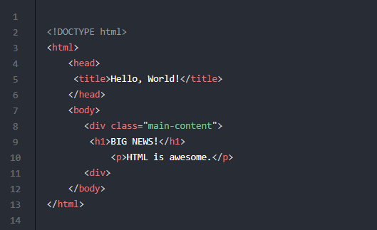
A basic HTML document could look like this.
Notes:
The parent level or root level attributes will be the html tags. There's almost always a head section and a body section.
The head section provides things like links, scripts and titles. And we'll talk about links and scripts in just a moment here.
The body section will contain the main content of the page.
This particular page doesn't have too much content. It just has a div for the main section, as well as a header and a paragraph. Now, if you were to display this document in a browser, it would look pretty boring.
It's black text on a white background. How can we make it pretty? That's where CSS comes in.

Slide 6
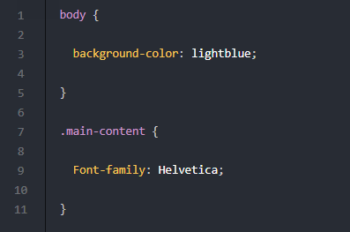
CSS stands for Cascading Style Sheets.
Notes:
f HTML is the skeleton of the page, then CSS is the skin. It controls style and formatting for the appearance of the page. CSS can control things like:
Colors
Size
Font
Position
Layout
Although CSS can be added directly to any HTML element using the style attribute, it is a best practice to put CSS into separate that .css files for reusability.
It is also common to create CSS "classes" to apply the same styles to specific elements. Here's an example of a CSS document.
The body styling will apply to all body elements on an HTML page.
The main-content styling will apply to all elements that use the main content class, like the div element, in our example HTML document.
If we add the following to the head element of our HTML document, this link for linking the style sheets, then we will see the styling applied in the browser.
HTML and CSS work together nicely, but they are static. They don't make changes happen on the webpage.

Slide 7
JavaScript
Dynamic content most come from JavaScript, a programming language that acts like the muscles of the page.
Notes:
Developers can use JavaScript to change elements and styling, handle user input, make service calls to backend systems, and more. Practically all modern web applications use JavaScript to deliver a dynamic user experience on the front end because all major web browsers support it. There are countless, and I mean countless JavaScript frameworks available as well, such as Angular, React and Bootstrap.
JavaScript code can be written directly in HTML files, or as a better practice, in separate .js files.
The web browser is what brings together the HTML, CSS and JavaScript.
The browser itself is an application that loads and renders content from the worldwide web in these file formats. When a user requests a page through a browser, the website will return those three types of documents for the browser to execute and display on the local device. The browser truly brings the page to life.
As a side comment, note that despite language standards, each browser handles things slightly differently. So, watch out for peculiarities.
We could spend days talking about HTML, CSS and JavaScript. Thankfully, for testing and automation, we just need to know the basics to get started. Nevertheless, I strongly encourage you to learn more on your own so you can become an even better engineer.

Slide 8
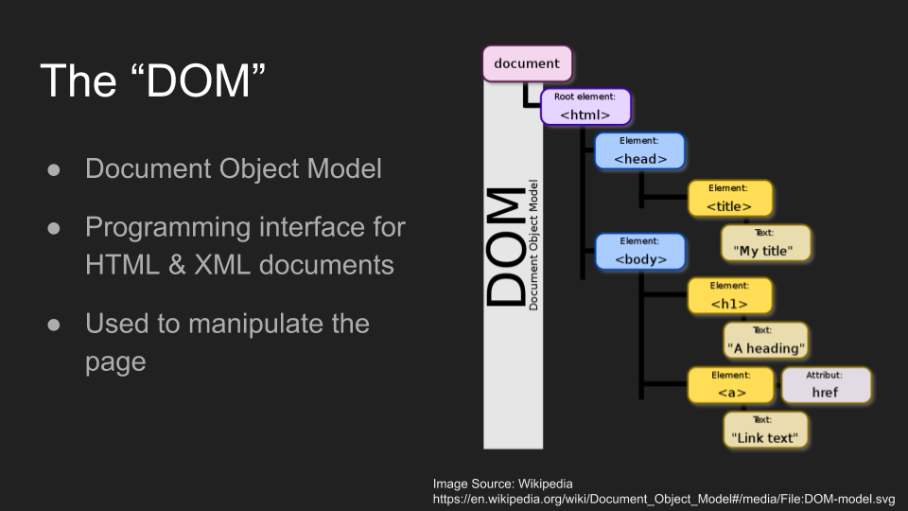
Notes:
The Document Object Model, or DOM for short, is a programming interface for HTML and XML documents.
It enables programmers to manipulate the page in various ways such as:
Searching for elements
Changing element content
Changing the HTML structure of the page
Changing the CSS styling of the page
The DOM is called an "object model" because it presents the page as an object. That document object contains an object representing each element within it. Element objects are nested from a root element to mirror the HTML structure of that page.
What's really nice about the DOM is that it is not dependent upon any one programming language. It's most commonly used by JavaScript to manipulate web pages in a browser, but it could be used by any other language. A good example of this would be using Python to scrape web page contents.
Another good example would be using test automation to "poke and prod" at pages under test. The DOM also works for XML, but for this course we'll focus on HTML.
The first step with DOM programming is getting the elements themselves.
Programming with the DOM makes one thing very clear — there is a difference between an element and its locator.
A web element is an object representing a live rendered HTML element on the page. A Web element locator on the other hand (also sometimes called a "selector") is a query that finds and returns specific elements from the DOM. In short, locators find elements.
Why is this distinction important? Two main reasons:
First, direct paths from root to child would be very long and complicated. It's not uncommon for child elements to be nested under dozens of layers. Imagine programming object references from parent to child for the whole chain. That would be crazy long. It makes much more sense to write smaller, more meaningful locator queries to find the desired elements.
Secondly, there's no guarantee the specific elements will actually appear on the page. Dynamic contents means ever-changing content, and elements can be added, removed or changed on a whim. Developers could also change the HTML structure too, so it makes more sense to try to discover desired elements. Furthermore, errors in the HTML, CSS or JavaScript could cause web elements to not appear on the page at all.
For these reasons we must separate the concerns of the element objects themselves, and the locators used to find them.

Slide 9
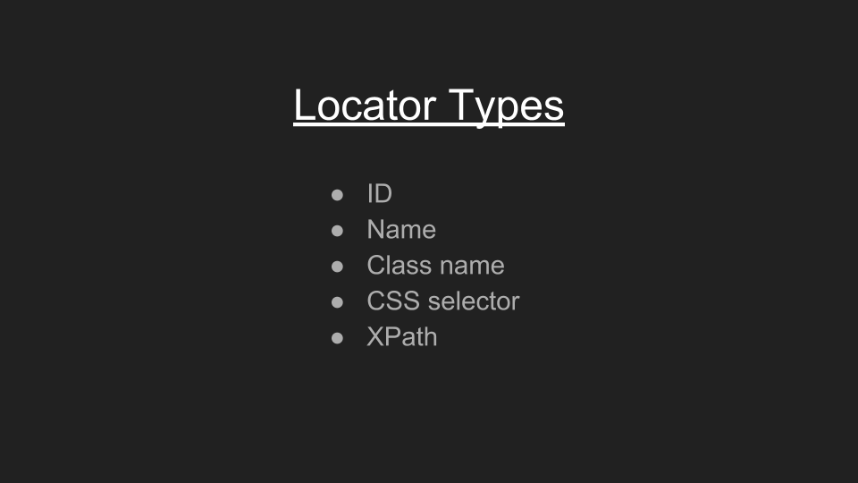
Notes:
There are many types of locators such as IDs, names, class names, CSS selectors, and XPaths.
We'll cover different locator types in great detail in the future chapters, as well as when to use which one. For now, just know the locators are the standard way for finding elements in a web page, and that every element can have a unique locator.
Also, know that a locator can return multiple elements, not just one. It will return all elements found that match its query.

Slide 10
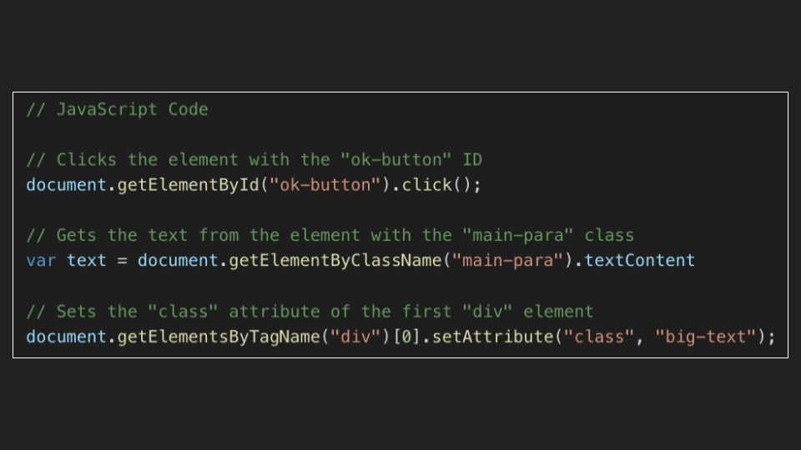
Notes:
Once element objects are obtained, there are many ways to interact with them.
JavaScript specifically provides methods, not only to change the state of the elements, but also to send user like actions to them.
For example, the click() method will programmatically "click" an element as if a user had clicked it visually.
The textContent property will get the text displayed by the element.
The getAttribute() method will "get" a particular element attribute by name (for example, getElementByClassName, in the example above),
And likewise, the setAttribute() method will add or change an element attribute.
Anything a user can do visually in the browser can also be done programmatically with JavaScript actions.
In fact, test frameworks like Jasmine, Mocha, Jest, and Cyprus all rely upon direct JavaScript calls within the browser.
Locators are also crucial for black-box testing of the browser.
Selenium WebDriver relies upon locators to find elements (findElement) and interact with them.
The main difference for WebDriver calls is they cannot change the state of elements. They can only access the state and send interactions.
Furthermore, WebDriver calls don't necessarily call JavaScript directly. They operate using the webDriver protocol as implemented by each browser type.
Regardless, the DOM, and the need for locators are still present with Selenium WebDriver automation, and as a caveat, webDriver can execute JavaScript code directly.
Go to google dev tools
To open DevTools, simply right click anywhere on the page and select "inspect".

