Slide 1
Pruebas automatizadas con Selenium

Slide 2

Selenium WebDriver
Instructor:
Irving Soto
Software QA Engineer
https://www.linkedin.com/in/irving-soto-ortiz
https://github.com/irvingsoto
Dec, 2019

Slide 3
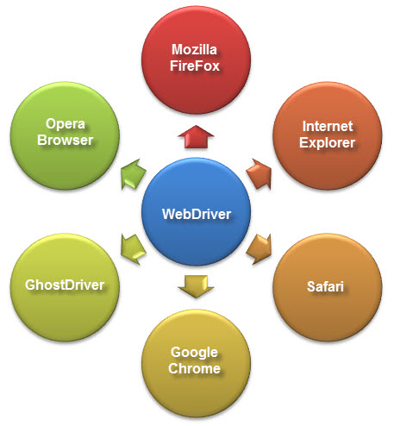
What is WebDriver?
WebDriver is a web automation framework that allows you to execute your tests against different browsers, not just Firefox, Chrome (unlike Selenium IDE).
WebDriver also enables you to use a programming language in creating your test scripts (not possible in Selenium IDE).
You can now use conditional operations like if-then-else or switch-case. You can also perform looping like do-while.

Slide 4
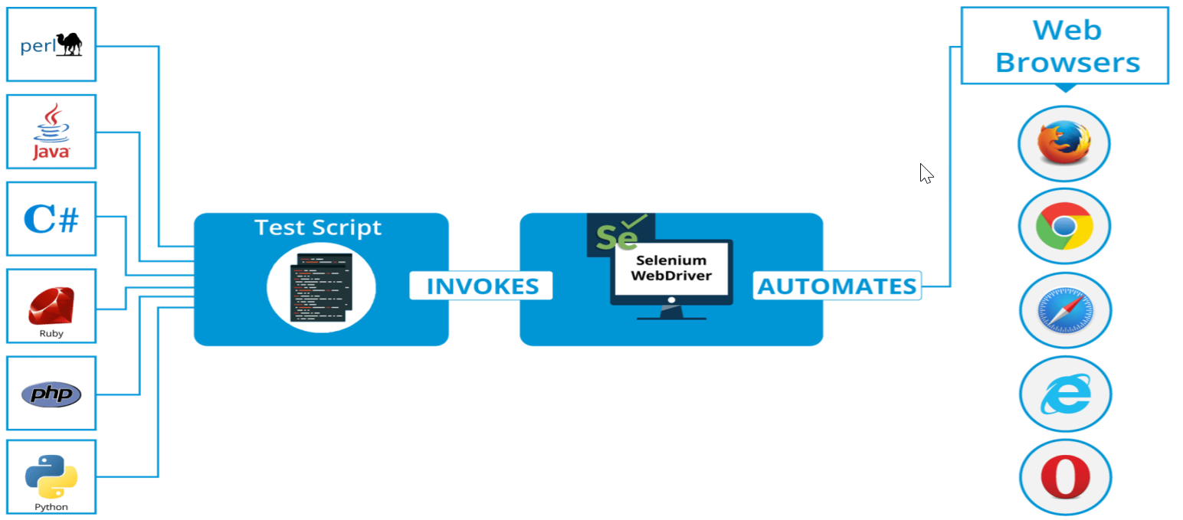
Architecture
Following programming languages are supported by WebDriver:
Java
.Net
PHP
Python
Perl
Ruby
Notes:
You do not have to know all of them. You just need to be knowledgeable in one. However, in this tutorial, we will be using Java with Eclipse as our IDE.

Slide 5


Setup Environment

