Slide 1

By: Muhammad Nurahman @2017

Slide 2
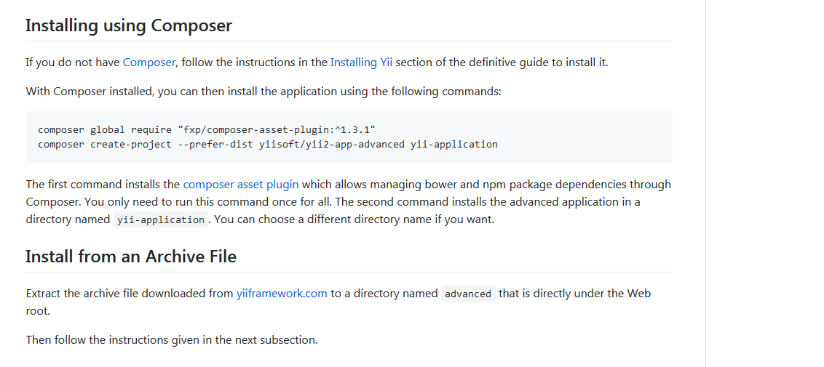
Installing Yii2
https://github.com/yiisoft/yii2-app-advanced/blob/master/docs/guide/start-installation.md

Slide 3
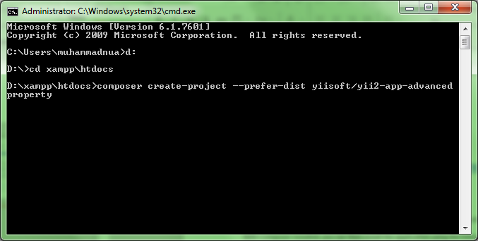
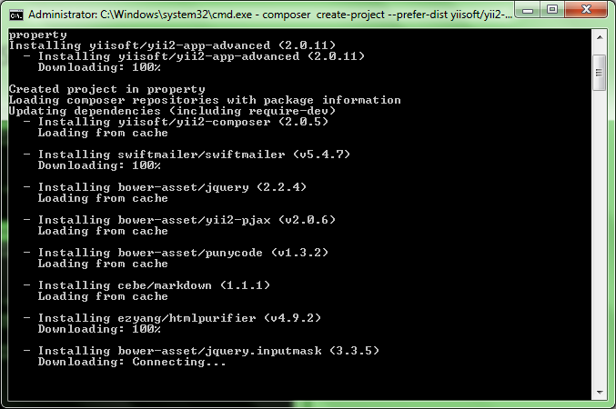
Install Using Composer
Why Using Composer?

Slide 4
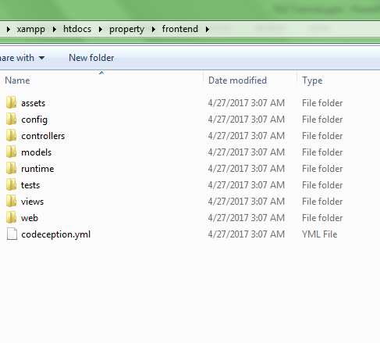
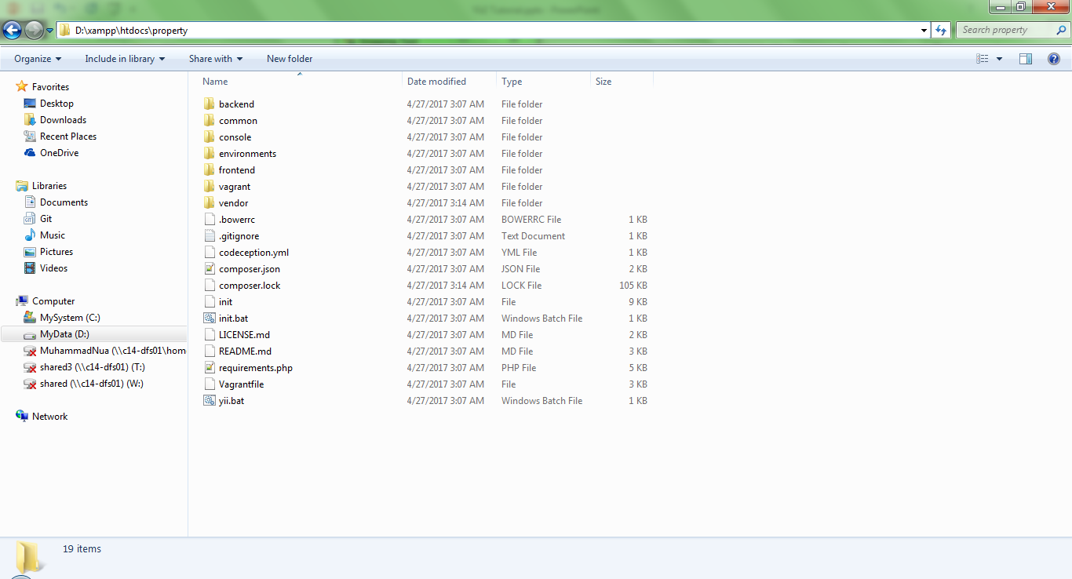

Advanced Structures

Slide 5
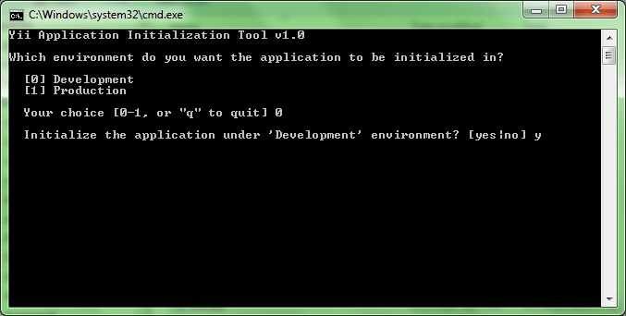
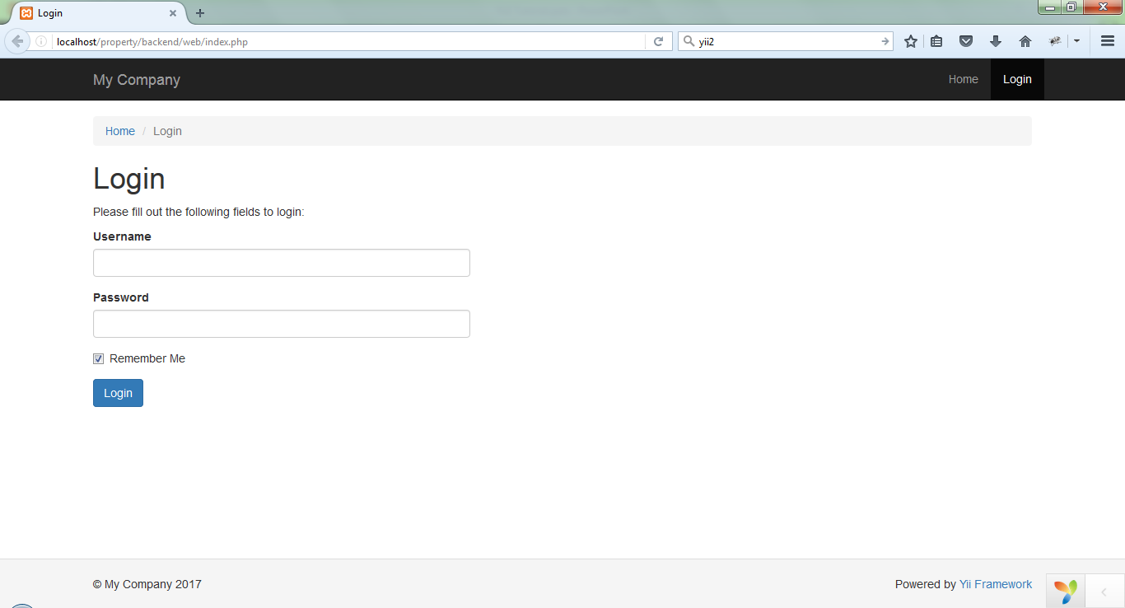
Init
Access Your Applications
http://localhost/property/backend/web/index.php
http://localhost/property/frontend/web/index.php

Slide 6
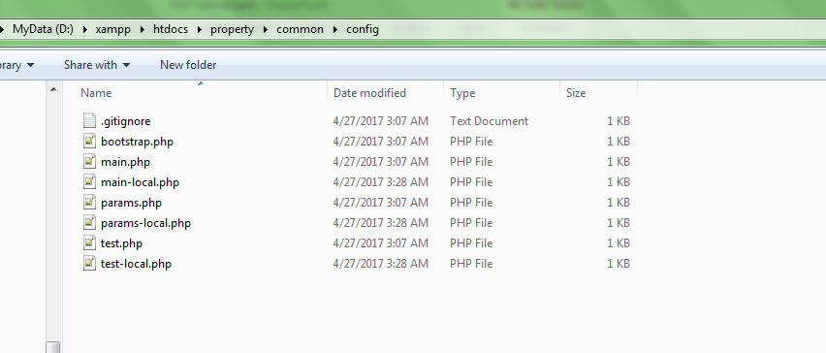
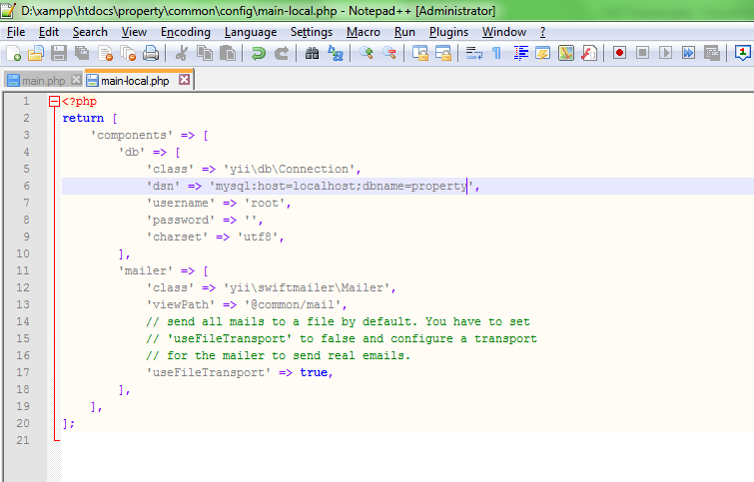
Configuration

Slide 7
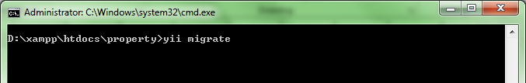
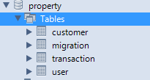
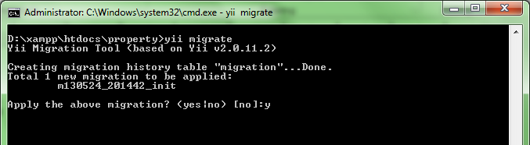
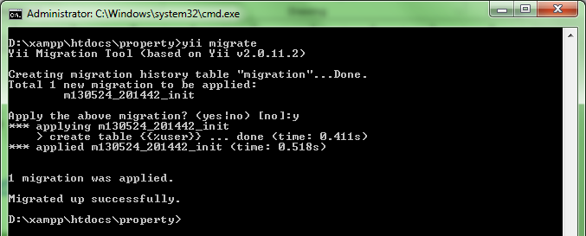
DB Migrations
http://www.yiiframework.com/doc-2.0/guide-db-migrations.html

Slide 8
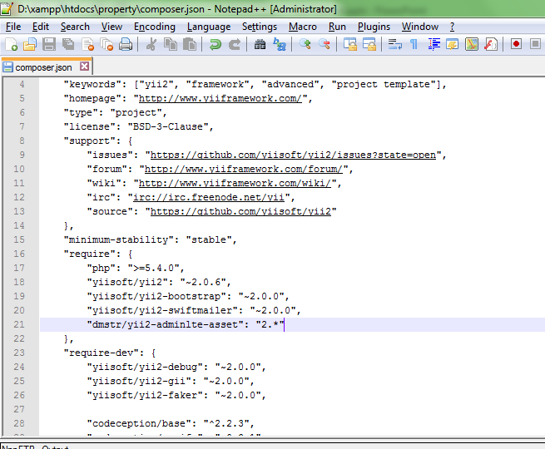
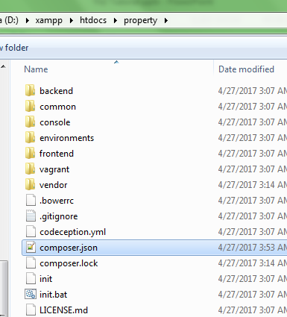
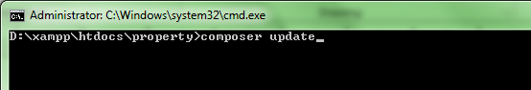
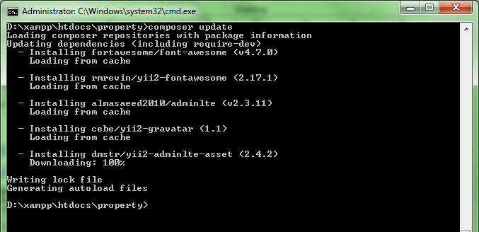
Apply Admin LTE Template
https://github.com/dmstr/yii2-adminlte-asset -> install
https://almsaeedstudio.com/themes/AdminLTE/index2.html -> sample original

Slide 9
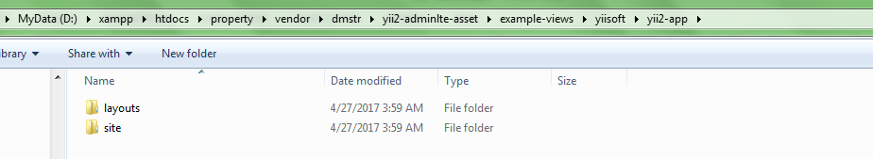
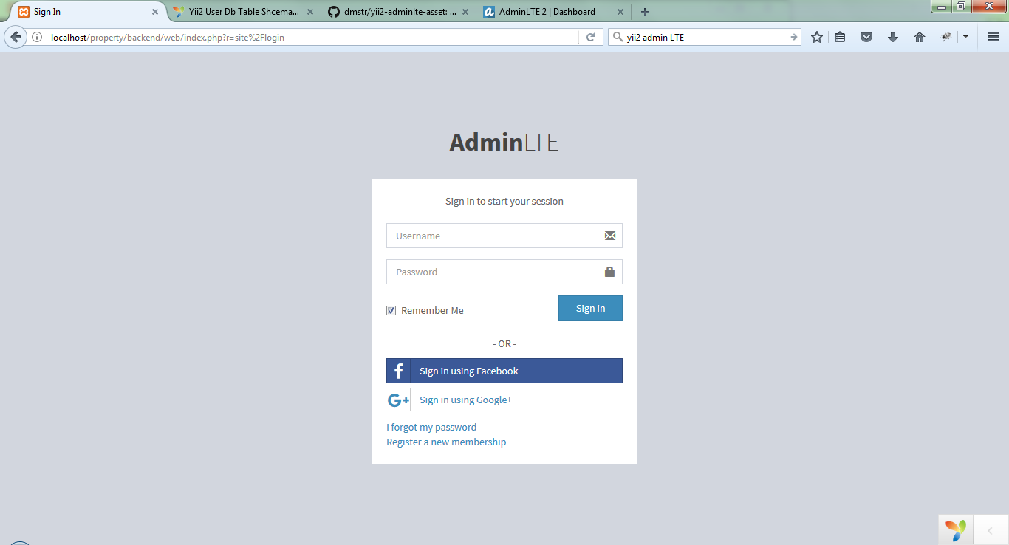
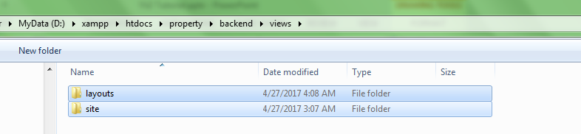
Apply Admin LTE Template
htdocs\property\vendor\dmstr\yii2-adminlte-asset\example-views\yiisoft\yii2-app
Buka path di atas
Copy Folder layouts dan site ke htdocs\property\backend\views
Replace file yang ada

Slide 10
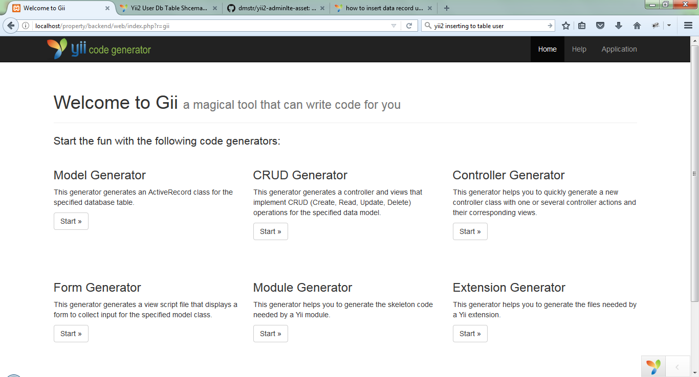
GII (Yii Generator)
http://localhost/property/backend/web/index.php?r=gii
Model Generator
Crud Generator

Slide 11
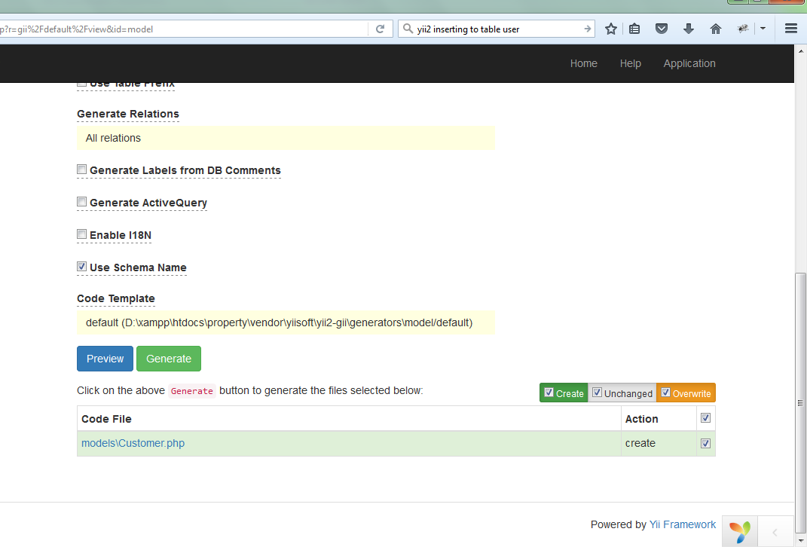
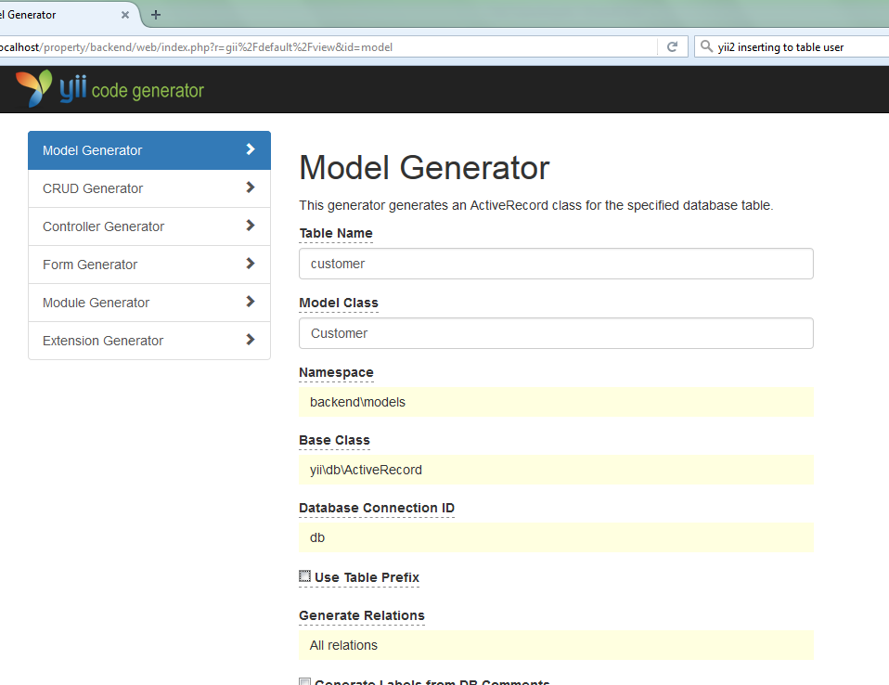
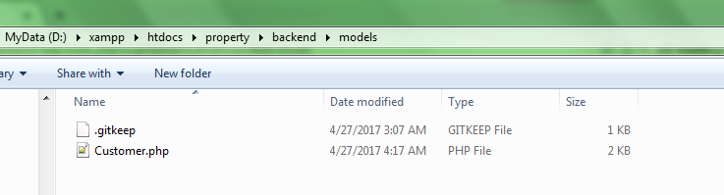
GII (Model Generator)

Slide 12
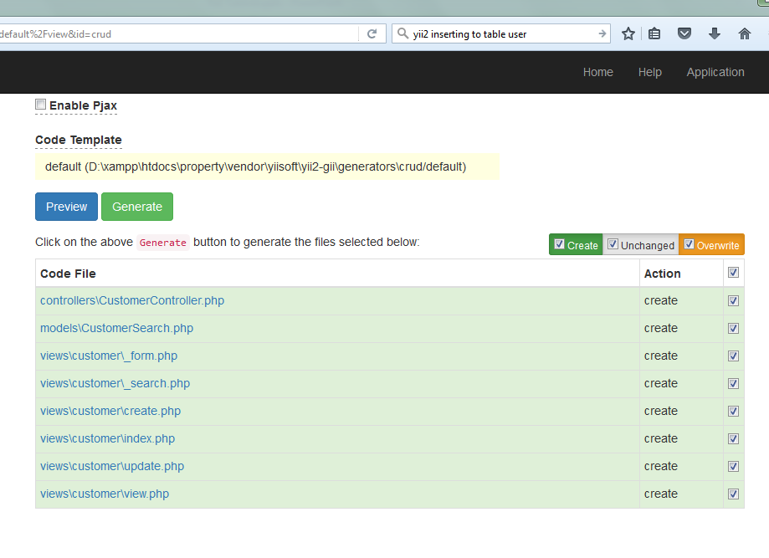
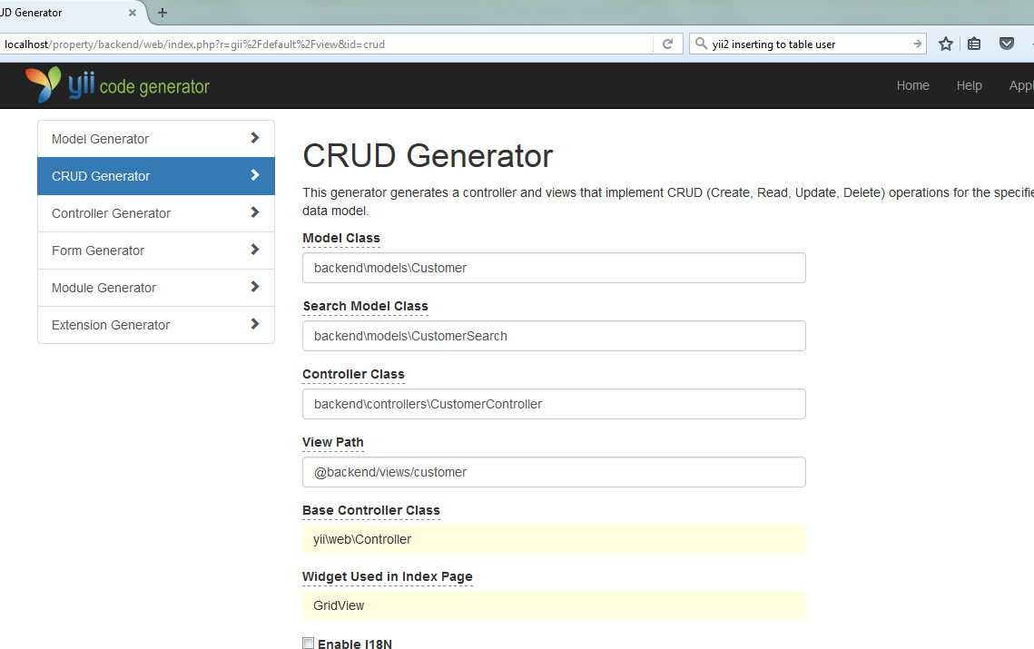
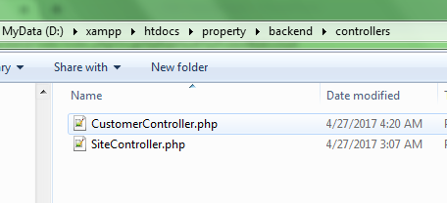
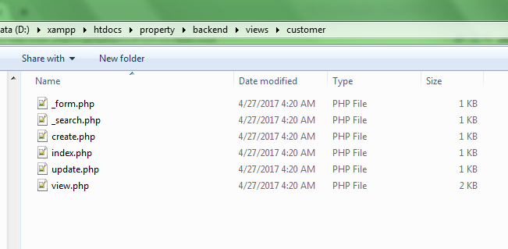
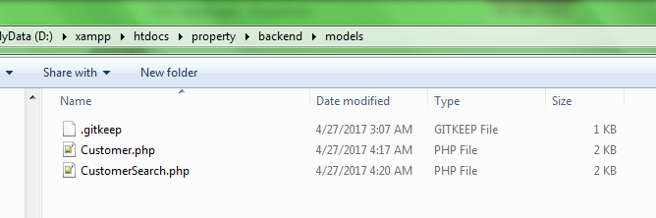
GII (CRUD Generator)

Slide 13
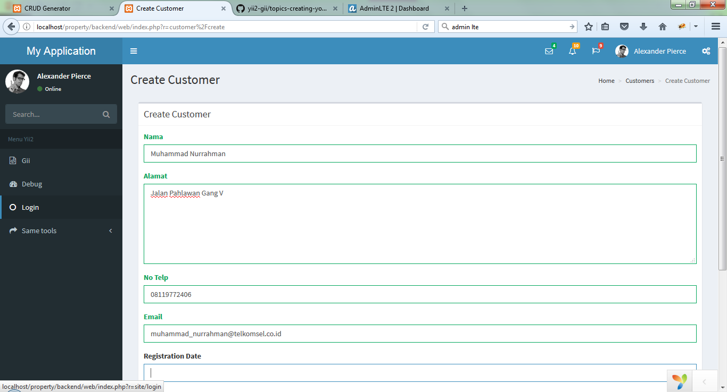
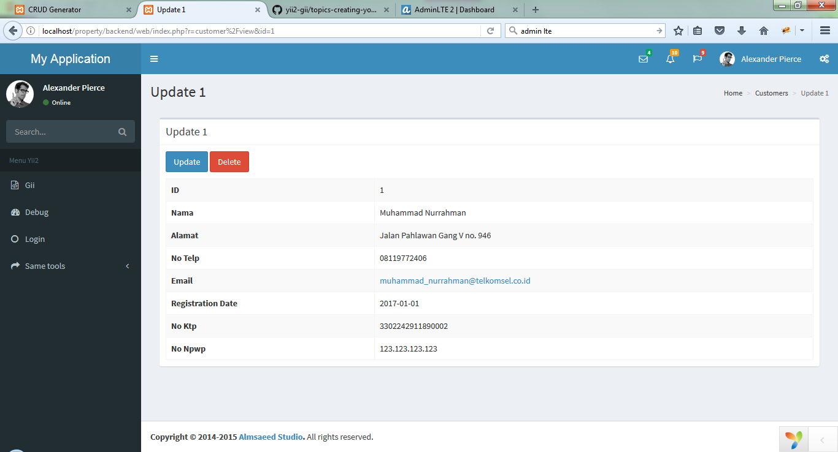
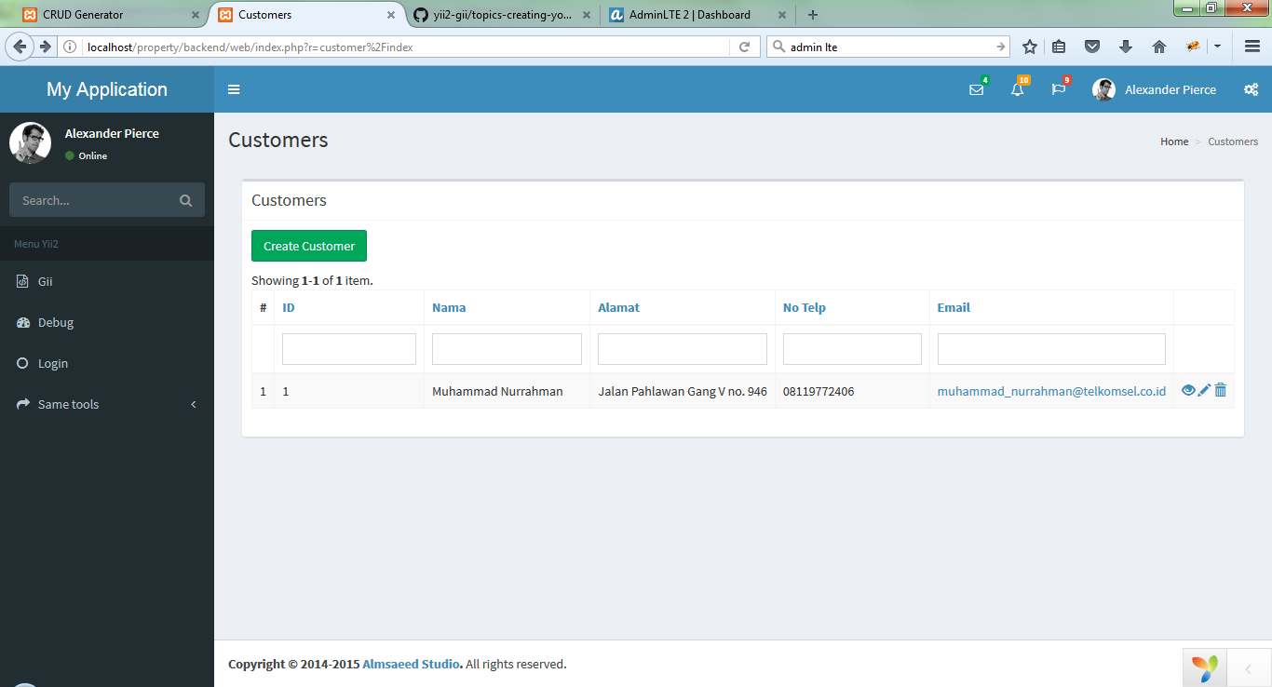
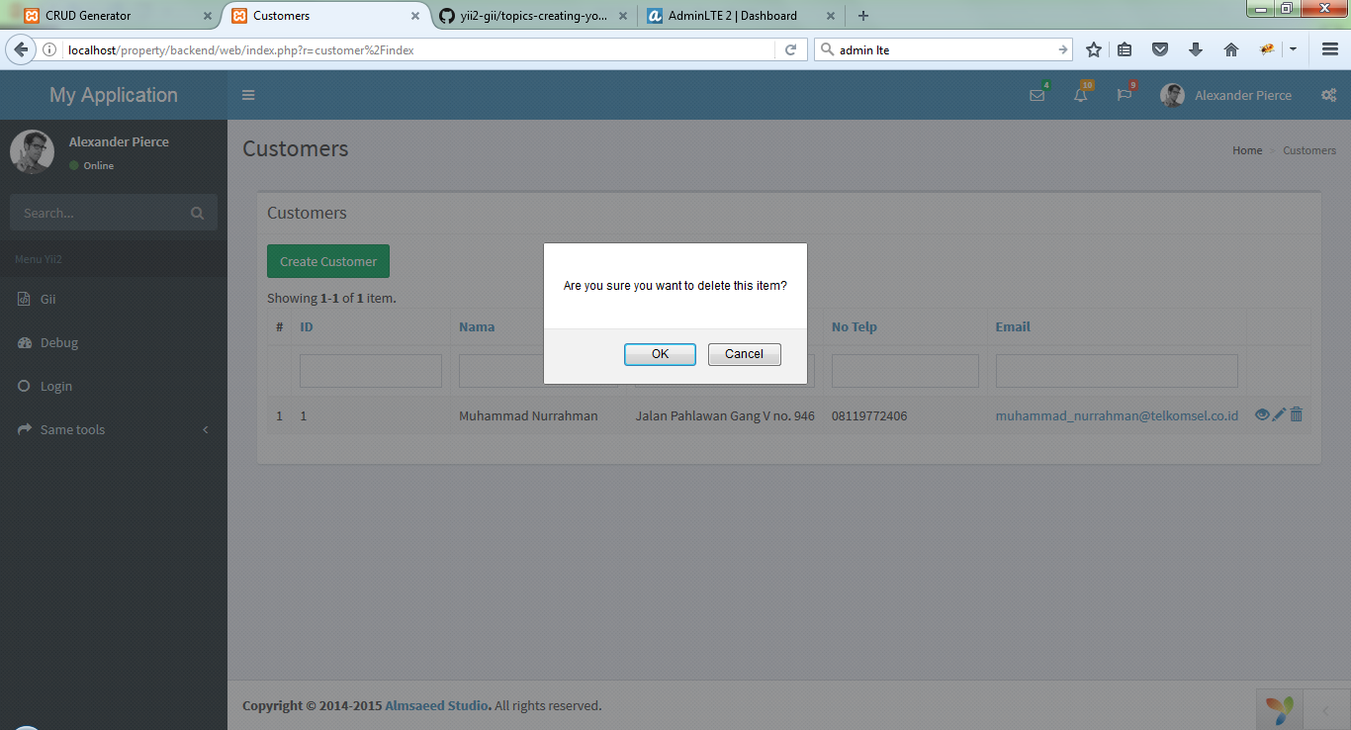
GII (Result)
http://localhost/property/backend/web/index.php?r=customer

Slide 14
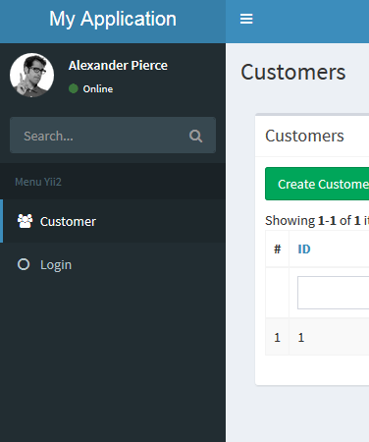
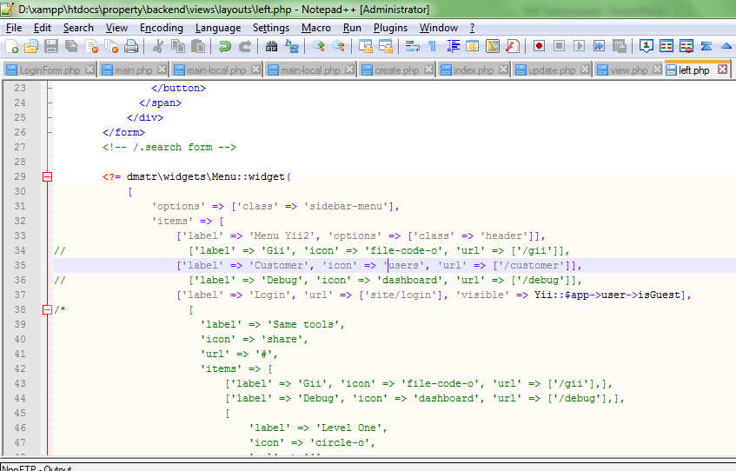
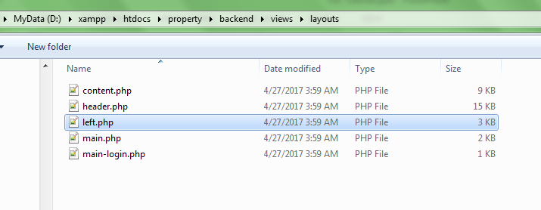
Menu
htdocs\property\backend\views\layouts

Slide 15
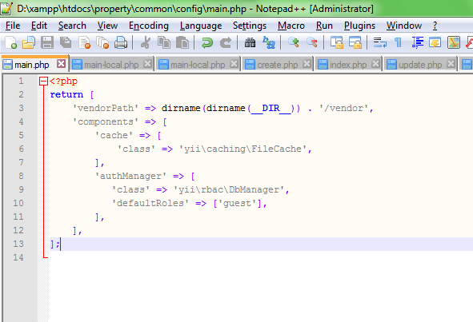
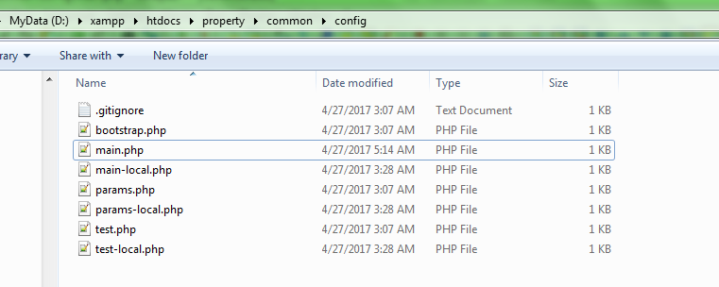
RBAC (Configuration)
'authManager' => [
'class' => 'yii\rbac\DbManager', 'defaultRoles' => ['guest'],
],
htdocs\property\common\config\main.php

Slide 16
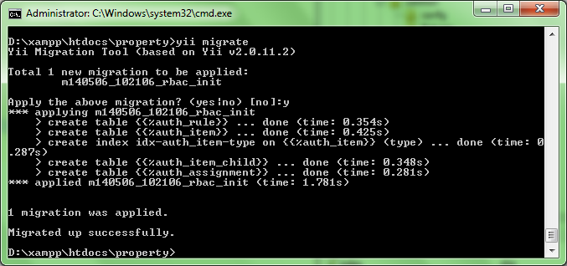
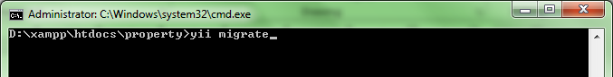
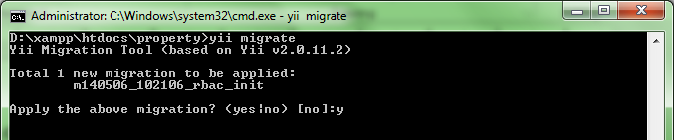
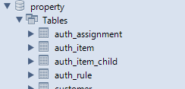
RBAC (Create Table Access Control)
Copy file htdocs\property\vendor\yiisoft\yii2\rbac\migrations m140506_102106_rbac_init
ke
htdocs\property\console\migrations
Lalu jalankan migrate

Slide 17


RBAC (Table Information)
Auth Item
Ini merupakan table master jenis2 role apa saja yang akan di gunakan di sistem
Auth Assignment
Ini merupakan table mapping antara role dengan user.
Sementara ini kita cukup menggunakan 2 table ini dari 4 table yang disediakan.

Slide 18
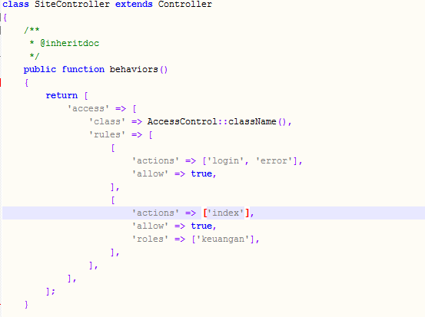
Apply RBAC in Controller

