Slide 1
Quadra Integration Framework

Slide 2
Overview
Quadra Integration Framework (QIF)
is a platform to create middleware application that came with all the basic things so you can focus on the business process

Slide 3
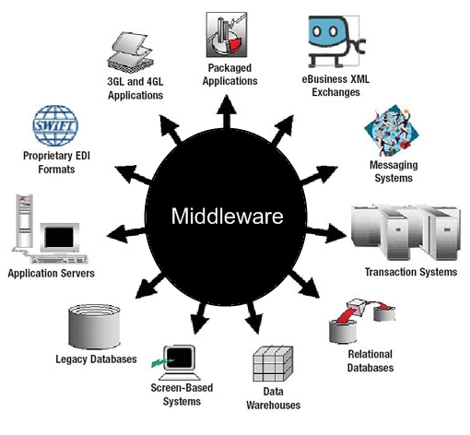
Middleware Overview

Slide 4
Motivation
Why we create another middleware product ?
1. Almost all of the Java middleware product is heavy and complex
2. Too many XML (why do it on XML when you can do it with Java ?)
3. Require extra training just to be able to use it
4. Tight product integration

Slide 5
Components
Event
QIF input, will start a process based on event's configured
Process
Process business orchestration, based on composed Task
Task
Reuseable and small components, that only have one function
Adapter
QIF components to connect to third party application or system

Slide 6
Architecture
Source
Event
Process
3rd DB
Task 1
Adapter
QIF
Task 2
3rd services
Task 3
Adapter
QIF Administration
and Monitoring
QIF
Repo DB

Slide 7
Examples : Transfer Process
Transfer Process
Sender Account Valid
Adapter
Destination Account Valid
DB
Substract Amount
Event
Add Amount
Log Transaction
Message Format
Transformation
File
Report Transaction
Adapter

Slide 8
Examples : Withdraw Money
Reuseable Task
Withdraw Process
Account Valid
Adapter
Substract Amount
DB
Event
Log Transaction
Message Format
Transformation
File
Report Transaction
Adapter

Slide 9
Features
Lightweight, standard Java project
You can leverage your existing Java library or any Java library / framework
Deployed as a web application (war) file on Application Server / Servlet Container (Tomcat, Jetty, Jboss, Glassfish, WebLogic, WebSphere etc)
Code in Java, no need more training, if your developer know Java, then they can work with QIF
Customizable adapter (connector), because they all just pure Java code, everything that Java can connect, then QIF can connect too.

Slide 10
Connector
ISO 8583 : jPOS http://www.jpos.org/
SAP : SAP Java Connector (JCo) http://help.sap.com/SAPhelp_nw04/helpdata/en/6f/1bd5c6a85b11d6b28500508b5d5211/content.htm
Hadoop : Java API http://hadoop.apache.org/docs/current/api/
FTP, SFTP, FTPS : Apache Commons Net http://commons.apache.org/proper/commons-net/

