Slide 1
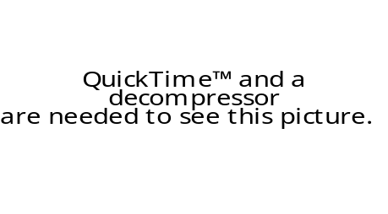
Spirit of the Living God
Spirit of the Living God, Fall afresh on me.
Spirit of the living God, fall afresh on me.
Melt me, mould me, Fill me, use me.
Spirit of the living God, fall afresh on me.

