Slide 1
This slide is hidden.
Insert the starting slides after this slide

Slide 2
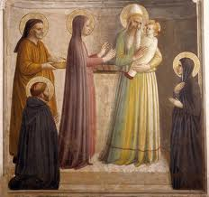
Welcome to St Michael’s
Presentation of the Lord Year A
You have entered a
SACRED SPACE
– a SACRED TIME...
Please ensure all mobile phones
are switched off.
Please be respectfully quiet
as we prepare for our celebration.
Notes:
Saturday 5.30PM First Sunday of Advent
MASTER 14th Sunday in Ord Time
MASTER 14th Sunday in Ord Time

Slide 3
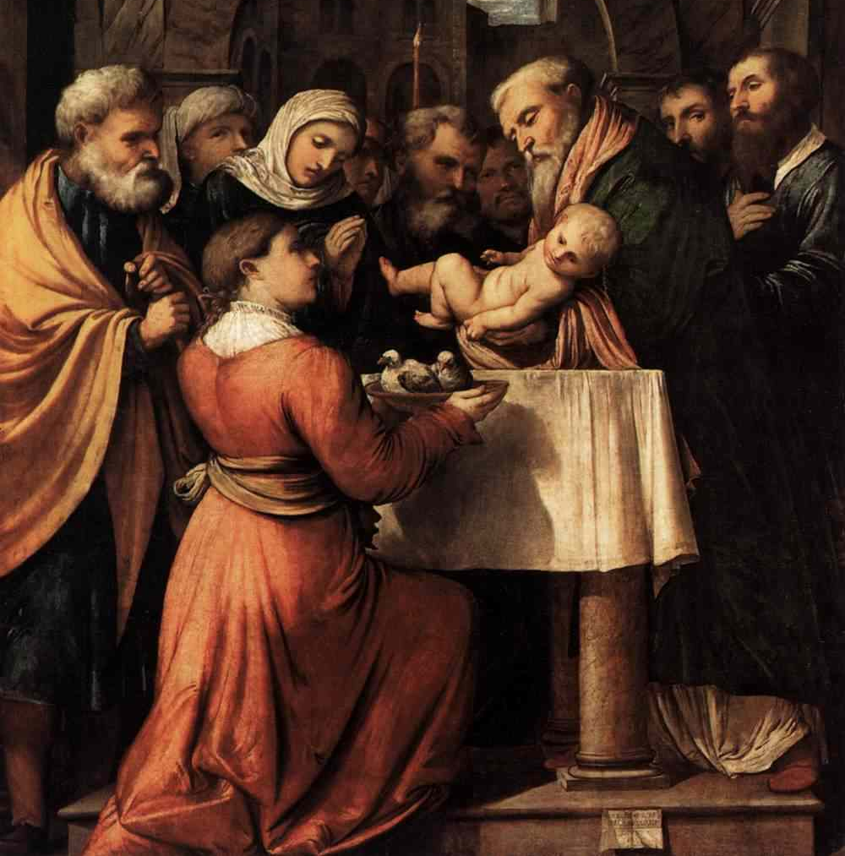
Mary and Joseph brought Jesus up to Jerusalem to present him to the Lord.

Slide 4
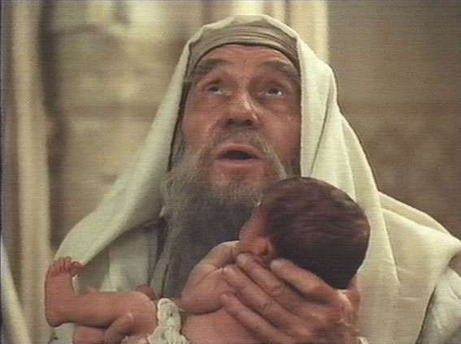
‘This is the light of revelation to the nations,
and the glory of your people, Israel…’

Slide 5
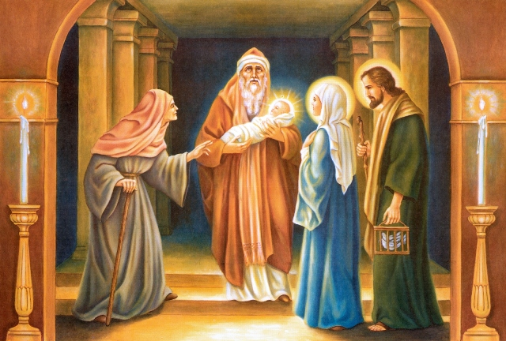
Mary and Joseph stood there wondering at the things that were being said about Jesus …

Slide 6
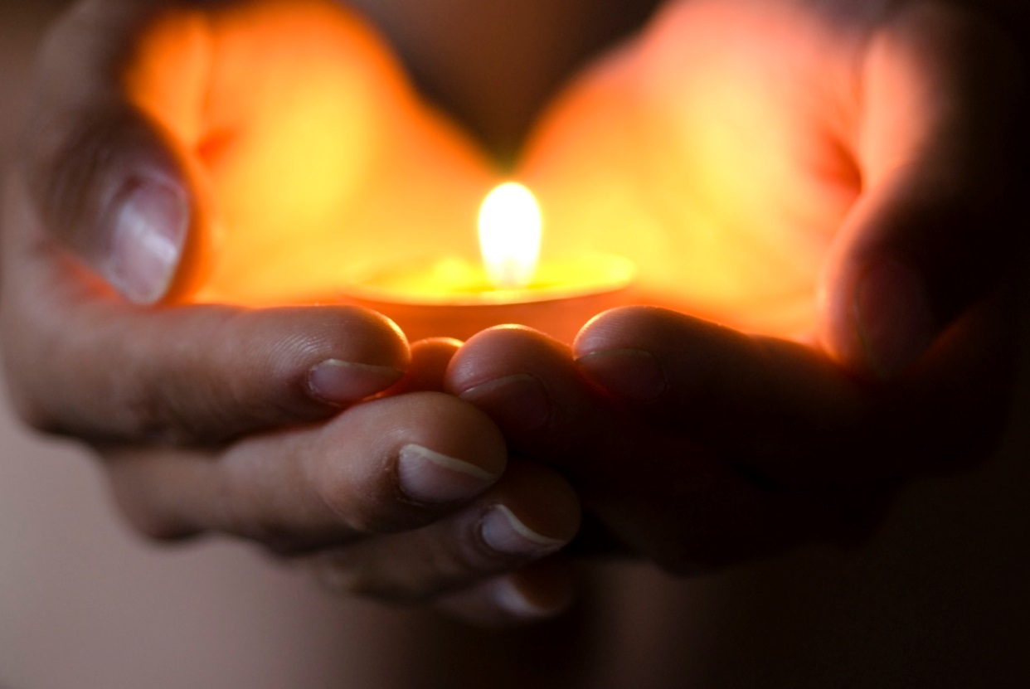
How might you bring the ‘light of Christ’ to others during the coming week?

Slide 7
Please Stand

Slide 8
This slide is hidden.
Insert the Entrance Hymn after this slide

Slide 9
Only by grace
Only by grace can we enter
Only by grace can we stand
Not by our human endeavour
But by the blood of the lamb

Slide 10
Into your presence you call us
Call us to come
Into your presence you draw us
Now by your grace we come
Now by your grace we come

Slide 11
Lord if you mark our transgressions
Who will stand
Thanks to your grace we are cleansed
By the blood of the lamb

Slide 12
Only by grace can we enter
Only by grace can we stand
Not by our human endeavour
But by the blood of the lamb

Slide 13
Into your presence you call us
Call us to come
Into your presence you draw us
Now by your grace we come
Now by your grace we come

Slide 14
Confiteor
I confess to almighty God
And to you, my brothers and sisters,
That I have greatly sinned
In my thoughts and in my words

Slide 15
In what I have done
And in what I have failed to do,
Through my fault,
Through my fault,
Through my most grievous fault;

Slide 16
Therefore I ask blessed Mary ever-Virgin,
All the Angels and Saints,
And you, my brothers and sisters,
To pray for me to the Lord our God.

Slide 18
Kyrie eleison
Kyrie eleison (2)
Christe eleison (2)
Kyrie eleison (2)

Slide 20
Gloria
Glory to God in the highest,
and on earth peace to people of good will.
We praise you, we bless you,
we adore you, we glorify you,

Slide 21
We give you thanks for your great glory,
Lord, God heavenly king,
O God, almighty father

Slide 22
Glory to God in the highest,
and on earth peace to people of good will.

Slide 23
Lord Jesus Christ, Only Begotten Son,
Lord God, Lamb of God, Son of the Father,
you take away the sins of the world,
have mercy on us;

Slide 24
you take away the sins of the world, receive our prayer;
you are seated at the right hand of the Father,
have mercy on us.

Slide 25
Glory to God in the highest,
and on earth peace to people of good will.

Slide 26
For you alone are the Holy One,
you alone are the Lord,
you alone are the Most High,
Jesus Christ,
with the Holy Spirit,
in the glory of God the Father.

Slide 27
Glory to God in the highest,
and on earth peace to people of good will.
Amen.

Slide 28
Glory to God
Glory to God in the highest,
And on earth peace to people of good will.
We praise you, we bless you,
We adore you, we glorify you

Slide 29
We give you thanks for your great glory,
Lord God heavenly King,
O God, almighty Father

Slide 30
Lord Jesus Christ, only begotten Son,
Lord God, Lamb of God,
Son of the Father,

Slide 31
You take away the sins of the world,
Have mercy on us;
You take away the sins of the world,
Receive our prayer;

Slide 32
You are seated
At the right hand of the Father
Have mercy on us

Slide 33
For you alone are the Holy One,
You alone are the Lord
You alone are the most High,
Jesus Christ

Slide 34
With the Holy Spirit,
In the glory of God the Father.
Amen!
Amen!

Slide 36
Responsorial Psalm
Who is this king of glory?
It is the Lord!

Slide 38
Alleluia
Alleluia, alleluia,
alleluia, alleluia

Slide 40
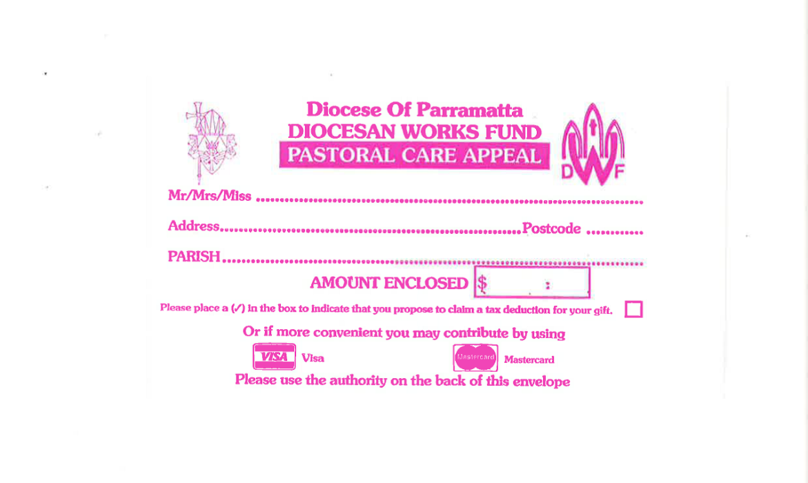
DWF APPEAL 1/2 February
Diocesan Works Fund:
one fund working for the good of all!
Donations of $2.00 and over are tax deductible.

Slide 41
Apostles Creed
I believe in God,
the Father almighty,
Creator of heaven and earth,
and in Jesus Christ, his only Son, our Lord,
(At the words that follow, up to and including the Virgin Mary, all bow.)

Slide 42
who was conceived by the Holy Spirit,
born of the Virgin Mary,
suffered under Pontius Pilate,
was crucified, died and was buried;
he descended into hell;

Slide 43
on the third day he rose again from the dead;
he ascended into heaven,
and is seated at the right hand of God the Father almighty;

Slide 44
from there he will come to judge the living and the dead.
I believe in the Holy Spirit,
the holy catholic Church,

Slide 45
the communion of saints,
the forgiveness of sins,
the resurrection of the body,
and life everlasting.
Amen.

Slide 47
First Collection
This collection goes to the Bishop
for the support of the Diocese.
Thank you for your contribution

Slide 49
This slide is hidden.
Insert the Offertory Hymn after this slide.

Slide 50
His eye is on the sparrow
Why should I feel discouraged,
why should the shadows come,
Why should my heart be lonely,
and long for heaven and home,

Slide 51
When Jesus is my portion
My constant friend is He
His eye is on the sparrow,
and I know He watches me;
His eye is on the sparrow,
and I know He watches me.

Slide 52
“Let not your heart be troubled"
His tender word I hear,
And resting on His goodness,
I lose my doubts and fears;

Slide 53
By the path He leadeth,
but one step I may see;
His eye is on the sparrow,
and I know He watches me;
His eye is on the sparrow,
and I know He watches me.

Slide 54
I sing because I'm happy
I sing because I'm free
His eye is on the sparrow
And I know he watches me

Slide 55
Priest: Pray my brothers and sisters,
that my sacrifice and yours may be
acceptable to God, the almighty Father.
All: May the Lord accept the sacrifice
at your hands for the praise and glory of his name, for our good and the good of all his holy Church.

Slide 56
Priest: The Lord be with you.
All: And with your spirit.
Priest: Lift up your hearts.
All: We lift them up to the Lord.

Slide 57
Priest: Let us give thanks to the
Lord our God.
All: It is right and just.

Slide 59
Holy
Holy, Holy, Holy Lord God of hosts,
Heaven and earth are full of your glory. Hosanna in the highest
Blessed is he who comes
in the name of Lord,
Hosanna in the highest.

Slide 61
Memorial acclamation
Save us saviour of the world,
For by your cross and resurrection,
You have set us free

Slide 62
Memorial acclamation
When we eat this bread
And drink this cup
We proclaim your death O Lord
Until you come again

Slide 63
Memorial acclamation
We proclaim your death O Lord
And profess your resurrection
Until you come again

Slide 65
Amen
Amen, amen.
Amen, amen.

Slide 67
Priest: The Lord be with you.
All: And with your spirit

Slide 69
Peace
May the peace of the Lord be with you
With your friends and your family too
Let it be, let it grow
And everywhere you go
May the peace of the Lord follow you

Slide 70
Lamb of God
Lamb of God, lamb of God
You take away the sins of the world
Have mercy on us, lamb of God

Slide 71
Lamb of God, lamb of God
You take away the sins of the world
Have mercy on us, lamb of God

Slide 72
Lamb of God, lamb of God
You take away the sins of the world
Grant us, grant us peace

Slide 73
Lamb of God
Lamb of God
You take away the sins of the world
Have mercy on us.

Slide 74
Lamb of God
You take away the sins of the world
Have mercy on us

Slide 75
Lamb of God
You take away the sins of the world
Grant us peace

Slide 77
Priest: Behold the Lamb of God, behold him who takes away the sins of the world.
Blessed are those called to the supper of
the Lamb.
All: Lord, I am not worthy
that you should enter under my roof,
but only say the word
and my soul shall be healed.

Slide 78
This slide is hidden.
Insert the Communion Hymns after this slide.

Slide 79
I will pilot thee
Sometimes when my faith would falter
And no sunlight I can see
I just lift mine eyes to Jesus
And I whisper ‘pilot me’

Slide 80
“Fear thou not for I’ll be with thee,
I will still they pilot be,
Never mind the tossing billows,
Take my hand and trust in me”

Slide 81
Often, when my soul is weary
And the day seems oh so long
I just look up to my pilot
And I hear this blessed song

Slide 82
“Fear thou not for I’ll be with thee,
I will still they pilot be,
Never mind the tossing billows,
Take my hand and trust in me”

Slide 83
When temptations ‘round me gather
And I almost loose my way
Somehow, in the raging tempest,
I can hear my saviour say.

Slide 84
“Fear thou not for I’ll be with thee,
I will still they pilot be,
Never mind the tossing billows,
Take my hand and trust in me”

Slide 85
There is none like you
There is none like you
No one else could touch my heart like you do
I could search for all eternity Lord,
And find there is none like you

Slide 86
There is none like you
No one else could touch my heart like you do
I could search for all eternity Lord,
And find there is none like you

Slide 87
Your mercy flows like a river wide,
And healing comes from Your hand.
Suffering children are safe in Your arms,
There is none like You.

Slide 88
There is none like you
No one else could touch my heart like you do
I could search for all eternity Lord,
And find there is none like you

Slide 89
I love you Lord
I love you Lord
And you know I always want to do things right
I love you Lord
When I think of how I've failed you
I could cry

Slide 90
And when I hear you calling
I want to run and hide
Cause you know, I love you so

Slide 91
I love you Lord
Although I know my heart might not seem true
I love you Lord
And I pray for one more chance to prove I do

Slide 92
I want to leave the past behind
And feel your smile again
O Lord you know
I love you so, I love you so

Slide 93
So if you find it in your heart
To let me start again
I'll be your witness Lord
Your witness Lord

Slide 94
Your witness to the end of my life
Let me make it right
Let me try again
I'll be your witness to the end

Slide 95
So if you find it in your heart
To let me start again
I'll be your witness Lord
Your witness Lord

Slide 96
Your witness to the end of my life
Let me make it right
Let me try again
I'll be your witness to the end

Slide 97
Second Collection
What you contribute now
is for the support of our
parish and its mission.
Thank you for your generosity

Slide 98
This slide is hidden.
Insert the Notices for the week after this slide

Slide 99

Liturgical Ministry Formation Courses for Feb - May 2014
Institute For Mission - IFM
1 - 5 Marion Street Blacktown
Monday Evenings 7.00pm - 9.00pm.

Slide 100

Monday, 17th Feb at 7pm,
“Audition Night”
St Michael’s Church
Notes:
Have you ever been complimented on your ability to read aloud in public?
Why not consider utilising this gift to serve the Lord as a 'reader' at Mass?
Christ calls us to demonstrate our love for him through acts of service so here is your opportunity!
Monday, 17th Feb at 7pm, Audition Night.
See the Bulletin for more info.
7am - 14th Sunday in Ord Time
7am - 14th Sunday in Ord Time

Slide 101
SACRAMENTAL PROCESS 2014
Reconciliation (Confession/Penance)
Eucharist (Communion)
Confirmation
Forms available Church Foyers; Parish Offices or Parish Websites

Slide 102

Please take home your bulletin or download it www.stmichaelsparish.com
www.facebook.com/blacktowncatholics
Notes:
7am - 14th Sunday in Ord Time
7am - 14th Sunday in Ord Time

Slide 103
This slide is hidden.
The next slide can be used for videos.
Insert the video into the slide.

Slide 105
Priest: The Lord be with you.
All: And with your spirit.

Slide 107
This slide is hidden.
Insert the Recessional Hymns after this slide.

Slide 108
How great thou art
O Lord my God,
When I in awesome wonder,
Consider all the worlds
Thy Hands have made;

Slide 109
I see the stars,
I hear the rolling thunder,
Thy power throughout
the universe displayed.

Slide 110
Then sings my soul,
My Saviour God, to Thee,
How great Thou art,
How great Thou art.

Slide 111
Then sings my soul,
My Saviour God, to Thee,
How great Thou art,
How great Thou art.

Slide 112
When through the woods,
and forest glades I wander,
And hear the birds
Sing sweetly in the trees.

Slide 113
When I look down,
from lofty mountain grandeur
And see the brook,
and feel the gentle breeze.

Slide 114
Then sings my soul,
My Saviour God, to Thee,
How great Thou art,
How great Thou art.

Slide 115
Then sings my soul,
My Saviour God, to Thee,
How great Thou art,
How great Thou art.

Slide 116
This slide is hidden.
Insert the final slide here.

