Slide 1
This slide is hidden.
Insert the starting slides after this slide

Slide 2

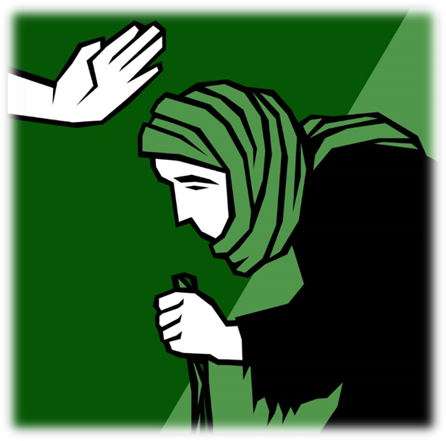
Welcome to St Michael’s
6th Sunday Ordinary Time
Year B
You have entered a
SACRED SPACE
– a SACRED TIME...
Please ensure all mobile phones are switched off.
Please be respectfully quiet
as we prepare for our celebration.
Notes:
Saturday 5.30PM First Sunday of Advent
23rd Sunday in Ord Time
23rd Sunday in Ord Time

Slide 3
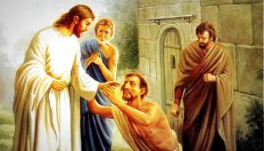
A leper came to Jesus and pleaded on his knees: 'If you want to' he said 'you can cure me.'

Slide 4
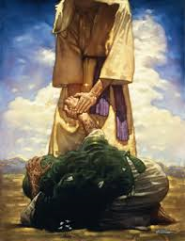
Feeling sorry for him, Jesus stretched out his hand and touched him. 'Of course I want to!' he said. 'Be cured!'

Slide 5
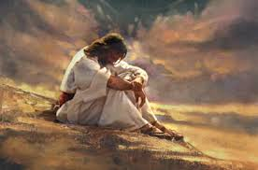
The man went away, but then started talking about it freely and telling the story everywhere …
… Jesus could no longer go openly into any town…

Slide 6
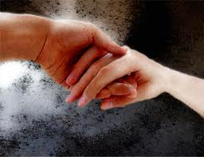
How has an encounter with Jesus changed your life?

Slide 7
Please Stand

Slide 8
This slide is hidden.
Insert the Entrance Hymn after this slide

Slide 9
Shout for joy
Shout for joy and sing
Your praises to the king
Lift your voice and let your
Hallelujahs ring

Slide 10
Come before his throne
To worship and adore
Enter joyfully now
The presence of the Lord

Slide 11
You are my creator
You are my deliverer
You are my redeemer
You are Lord
And you are my healer

Slide 12
You are my provider
You are now my shepherd and my guide
Jesus Lord and king
I worship you

Slide 13
You are my creator
You are my deliverer
You are my redeemer
You are Lord
And you are my healer

Slide 14
You are my provider
You are now my shepherd and my guide
Jesus Lord and king
I worship you

Slide 16
Confiteor
I confess to almighty God
And to you, my brothers and sisters,
That I have greatly sinned
In my thoughts and in my words

Slide 17
In what I have done
And in what I have failed to do,
Through my fault,
Through my fault,
Through my most grievous fault;

Slide 18
Therefore I ask blessed Mary ever-Virgin,
All the Angels and Saints,
And you, my brothers and sisters,
To pray for me to the Lord our God.

Slide 20
Kyrie eleison
Kyrie eleison (2)
Christe eleison (2)
Kyrie eleison (2)

Slide 22
Responsorial Psalm
I turn to you, Lord in time of trouble and you fill me with the joy of salvation

Slide 24
Alleluia
Alleluia, alleluia,
alleluia, alleluia

Slide 26

COMMISSIONING OF CATECHISTS
Marina DeSa (Parish Co-ordinator of Catechists) and the Catechists of Mary Queen of the Family Parish come forward to the front of the Church.
Response: We will

Slide 27
COMMITMENT OF THE COMMUNITY:
Response: We do

Slide 29
Apostles Creed
I believe in God,
the Father almighty,
Creator of heaven and earth,
and in Jesus Christ, his only Son, our Lord,
(At the words that follow, up to and including the Virgin Mary, all bow.)

Slide 30
who was conceived by the Holy Spirit,
born of the Virgin Mary,
suffered under Pontius Pilate,
was crucified, died and was buried;
he descended into hell;

Slide 31
on the third day he rose again from the dead;
he ascended into heaven,
and is seated at the right hand of God the Father almighty;

Slide 32
from there he will come to judge the living and the dead.
I believe in the Holy Spirit,
the holy catholic Church,

Slide 33
the communion of saints,
the forgiveness of sins,
the resurrection of the body,
and life everlasting.
Amen.

Slide 35
This slide is hidden.
Insert the Offertory Hymn after this slide.

Slide 36
First Collection
This collection goes to the Bishop
for the support of the Diocese.
Thank you for your contribution

Slide 37
Take my life
Take my life, O Lord and ever let it stay
Consecrated to your care
Take my life and give me your life abundantly
Make it beautiful in service
Beautiful and free

Slide 38
Lord make my hands the channels of your love
And may my feet walk in your way
Take my voice and let it sing a song of praise
From my lips may your word overflow

Slide 39
Take my life, O Lord and ever let it stay
Consecrated to your care
Take my life and give me your life abundantly
Make it beautiful in service
Beautiful and free

Slide 40
Lord make my body a living sacrifice
Take and anoint it with your love
Let me worship you in spirit and in truth
By your touch may my life be renewed

Slide 41
Take my life, O Lord and ever let it stay
Consecrated to your care
Take my life and give me your life abundantly
Make it beautiful in service
Beautiful and free

Slide 43
Priest: Pray my brothers and sisters,
that my sacrifice and yours may be
acceptable to God, the almighty Father.
All: May the Lord accept the sacrifice
at your hands for the praise and glory of his name, for our good and the good of all his holy Church.

Slide 44
Priest: The Lord be with you.
All: And with your spirit.
Priest: Lift up your hearts.
All: We lift them up to the Lord.

Slide 45
Priest: Let us give thanks to the
Lord our God.
All: It is right and just.

Slide 47
Holy
Holy, Holy, Holy Lord God of hosts,
Heaven and earth are full of your glory. Hosanna in the highest
Blessed is he who comes
in the name of Lord,
Hosanna in the highest.

Slide 49
Memorial acclamation
Save us saviour of the world,
For by your cross and resurrection,
You have set us free

Slide 50
Memorial acclamation
When we eat this bread
And drink this cup
We proclaim your death O Lord
Until you come again

Slide 51
Memorial acclamation
We proclaim your death O Lord
And profess your resurrection
Until you come again

Slide 53
Amen
Amen, amen, amen, amen.
Amen, amen, amen, amen.

Slide 55
Priest: The Lord be with you.
All: And with your spirit

Slide 57
Peace
May the peace of the Lord be with you
With your friends and your family too
Let it be, let it grow
And everywhere you go
May the peace of the Lord follow you

Slide 58
Lamb of God
Lamb of God, lamb of God
You take away the sins of the world
Have mercy on us, lamb of God

Slide 59
Lamb of God, lamb of God
You take away the sins of the world
Have mercy on us, lamb of God

Slide 60
Lamb of God, lamb of God
You take away the sins of the world
Grant us, grant us peace

Slide 62
Priest: Behold the Lamb of God, behold him
who takes away the sins of the world.
Blessed are those called to the supper of the Lamb.
All: Lord, I am not worthy
that you should enter under my roof,
but only say the word
and my soul shall be healed.

Slide 63
This slide is hidden.
Insert the Communion Hymns after this slide.

Slide 64
O Lord I'm not worthy
O Lord, I'm not worthy
Yet you come to live in me
So speak your words of comfort,
By your touch strengthen and heal me

Slide 65
Take and eat my body
And drink my saving blood
Poured out for your redemption
A symbol of my love

Slide 66
O Lord, I'm not worthy
Yet you come to live in me
So speak your words of comfort,
By your touch strengthen and heal me

Slide 67
Called to be God's new people
Made one in Christ the Lord
Let us with hearts united
Bear witness of your love

Slide 68
O Lord, I'm not worthy
Yet you come to live in me
So speak your words of comfort,
By your touch strengthen and heal me

Slide 69
Onward through life we journey
As seekers of the truth
Building each day and new world
Of justice, peace and love

Slide 70
O Lord, I'm not worthy
Yet you come to live in me
So speak your words of comfort,
By your touch strengthen and heal me

Slide 71
The power of your love
Lord I come to you
Let my heart be changed, renewed
Flowing from the grace
That I found in you

Slide 72
And Lord I've come to know
The weaknesses I see in me
Will be stripped away
By the power of your love

Slide 73
Hold me close, let your love surround me
Bring me near, draw me to your side
And as I wait, I'll rise up like the eagle
And I will soar with you
Your spirit leads me on,
In the power of your love

Slide 74
Lord, unveil my eyes
Let me see you face to face
The knowledge of your love
As you live in me

Slide 75
Lord renew my mind
As your will unfolds in my life
In living everyday
By the power of your love

Slide 76
Hold me close, let your love surround me
Bring me near, draw me to your side
And as I wait, I'll rise up like the eagle
And I will soar with you
Your spirit leads me on,
In the power of your love

Slide 77
And I will soar with you
Your spirit leads me on
In the power of your love

Slide 78
Give thanks
Give thanks with a grateful heart
Give thanks to the Holy One
Give thanks because He's given Jesus Christ, His Son

Slide 79
Give thanks with a grateful heart
Give thanks to the Holy One
Give thanks because He's given Jesus Christ, His Son

Slide 80
And now let the weak say, "I am strong"
Let the poor say, "I am rich
Because of what the Lord has done for us"

Slide 81
And now let the weak say, "I am strong"
Let the poor say, "I am rich
Because of what the Lord has done for us"

Slide 82
Give thanks with a grateful heart
Give thanks to the Holy One
Give thanks because He's given Jesus Christ, His Son

Slide 83
Give thanks with a grateful heart
Give thanks to the Holy One
Give thanks because He's given Jesus Christ, His Son

Slide 84
And now let the weak say, "I am strong"
Let the poor say, "I am rich
Because of what the Lord has done for us"

Slide 85
And now let the weak say, "I am strong"
Let the poor say, "I am rich
Because of what the Lord has done for us"
Give thanks.

Slide 87
This slide is hidden.
The next slide can be used for videos.
Insert the video into the slide.

Slide 88
Second Collection
What you contribute now
is for the support of our
parish and its mission.
Thank you for your generosity

Slide 89

MQOF SACRAMENTAL PROCESS 2015
RECONCILIATION
EUCHARIST
CONFIRMATION
Registrations closing
28 February!

Slide 90
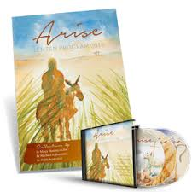
LENTEN GROUPS
9.30am Monday St Patrick’s
7.30pm Thursday St Michael’s
    Sign on sheets at
    Church Entrances

Slide 91

Men’s Ministry
Monthly Gathering
7.00pm 27 February 2015
St Michael’s Church Centre
Weekend Event
2/3 May 2015
Venue to be confirmed
MEET CHRIST: SOMEWHERE BETWEEN THE PUB AND THE PEW

Slide 92
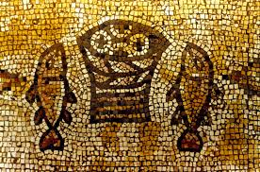
LOAVES AND FISHES
VOLUNTEERS
Can you help for even two hours?
Monday to Friday 9.30am – 2.00pm
Sign on sheets in foyers!
Meeting 10.30am Tuesday 17 February

Slide 93

Celebrating Lent, Holy Week and Easter as one parish…
MASS TIMES ASH WEDNESDAY 18 February 2015
8.00am St Michael’s 7.30pm St Michael’s
9.00am St Patrick’s 7.30pm St Patrick’s
STATIONS OF THE CROSS + MASS
Each Friday night during Lent beginning Friday 20 February
7.00pm Stations of the Cross (St Patrick’s)
7.30pm Mass (St Patrick’s)
Please take home a leaflet Celebrating Lent, Holy Week and Easter as one parish.

Slide 94

PROJECT COMPASSION
Please take home either a Project Compassion envelopes or money box this weekend.

Slide 95
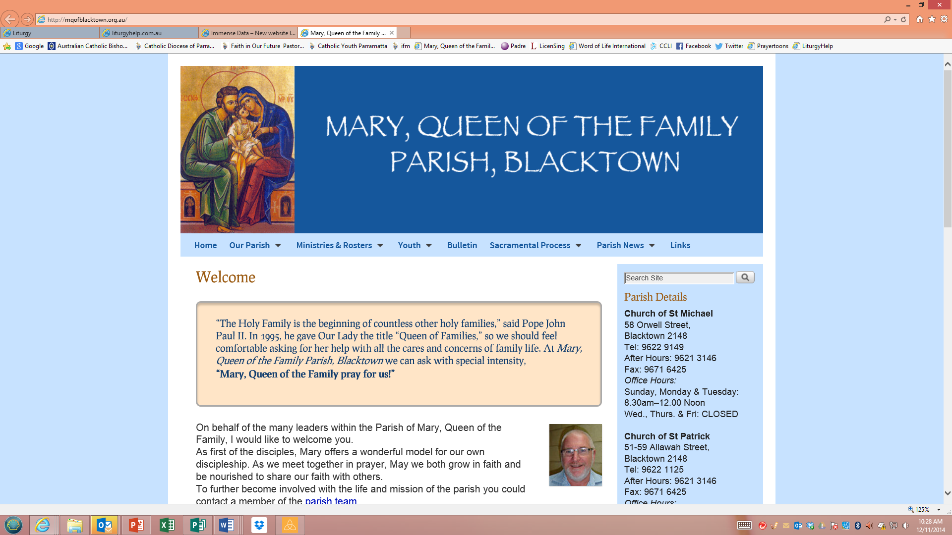


www.mqofblacktown.org.au
    www.facebook.com/blacktowncatholics
@mqofblacktown

Slide 97
Priest: The Lord be with you.
All: And with your spirit.

Slide 99
This slide is hidden.
Insert the Recessional Hymns after this slide.

Slide 100
God is good
God is good all the time
He put a song of praise
In this heart of mine

Slide 101
God is good all the time
Through the darkest night,
His light will shine
God is good,
God is good all the time

Slide 102
If you're walking through the valley
And there are shadows all around
Do not fear, He will guide you
He will keep you safe and sound
'Cause He's promised to never leave you
Nor forsake you and His Word is true

Slide 103
God is good all the time
He put a song of praise
In this heart of mine

Slide 104
God is good all the time
Through the darkest night,
His light will shine
God is good,
God is good all the time

Slide 105
We were sinners - so unworthy
Still for us He chose to die
Filled us with His Holy Spirit
Now we can stand and testify
That His love is everlasting
And His mercies - they will never end

Slide 106
God is good all the time
He put a song of praise
In this heart of mine
God is good all the time
Through the darkest night,
His light will shine

Slide 107
God is good,
God is good,
God is good all the time

Slide 108
This slide is hidden.
Insert the final slide here.

