Slide 1
This slide is hidden.
Insert the starting slides after this slide

Slide 2


Welcome to St Michael’s
3rd Sunday of Easter
You have entered a SACRED SPACE ... A SACRED TIME…
Please ensure all mobile phones are switched off.
Please be respectfully quiet as we prepare for our Celebration.
Notes:
Saturday 5.30PM First Sunday of Advent
7am - 7th Sunday in Ord Time Year B

Slide 3
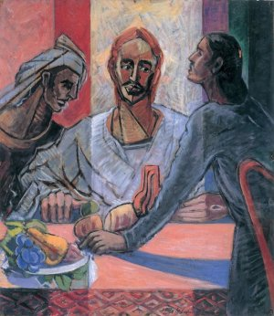
The disciples told their story of what had happened
on the road and
how they had recognised Jesus
at the breaking of bread.

Slide 4
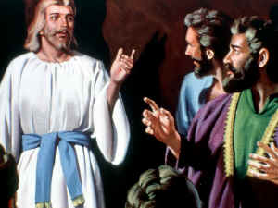
They were still talking about this when Jesus himself stood among them and said to them, 'Peace be with you!'

Slide 5
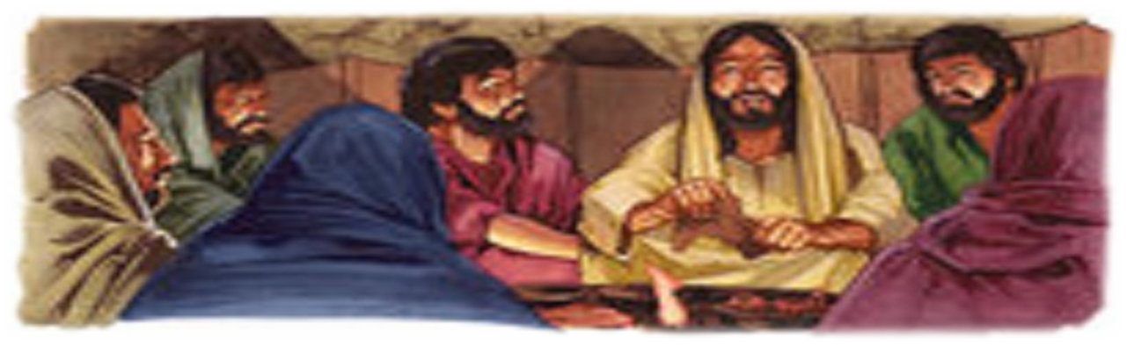
In a state of alarm and fright, they thought they were seeing a ghost.

Slide 6

“Why are you troubled and what are the questions rising in your heart”

Slide 7
PLEASE STAND

Slide 8
This slide is hidden.
Insert the Entrance Hymn after this slide

Slide 9
Lift up your voices
Lift up your voices
With a shout of victory
Jesus has triumphed
Over all our enemies
Licence No. CCLI 312895

Slide 10
Put on the robe of righteousness
Lift up the shield of faith
Jesus has the victory so rejoice in him
Lift your voice in praise (2)
Licence No. CCLI 312895

Slide 11
Lift up your voices
With a shout of victory
Jesus has triumphed
Over all our enemies
Licence No. CCLI 312895

Slide 12
Put on the robe of righteousness
Lift up the shield of faith
Jesus has the victory so rejoice in him
Lift your voice in praise (2)

Slide 14
Confiteor
I confess to almighty God
And to you, my brothers and sisters,
That I have greatly sinned
In my thoughts and in my words

Slide 15
In what I have done
And in what I have failed to do,
Through my fault,
Through my fault,
Through my most grievous fault;

Slide 16
Therefore I ask blessed Mary ever-Virgin,
All the Angels and Saints,
And you, my brothers and sisters,
To pray for me to the Lord our God.

Slide 18
Kyrie eleison
Kyrie eleison (2)
Christe eleison (2)
Kyrie eleison (2)

Slide 20
Responsorial Psalm
Lord let your face shine on us

Slide 22
Alleluia
Alleluia, alleluia,
alleluia, alleluia

Slide 23
Alleluia
Praise and honour to you Lord Jesus Christ (2)

Slide 25
Apostles Creed
I believe in God,
the Father almighty,
Creator of heaven and earth,
and in Jesus Christ, his only Son, our Lord,
(At the words that follow, up to and including the Virgin Mary, all bow.)

Slide 26
who was conceived by the Holy Spirit,
born of the Virgin Mary,
suffered under Pontius Pilate,
was crucified, died and was buried;
he descended into hell;

Slide 27
on the third day he rose again from the dead;
he ascended into heaven,
and is seated at the right hand of God the Father almighty;

Slide 28
from there he will come to judge the living and the dead.
I believe in the Holy Spirit,
the holy catholic Church,

Slide 29
the communion of saints,
the forgiveness of sins,
the resurrection of the body,
and life everlasting.
Amen.

Slide 31
This slide is hidden.
Insert the Offertory Hymn after this slide.

Slide 32
First Collection
This collection goes to the Bishop
for the support of the Diocese.
Thank you for your contribution

Slide 33
Make my life an alleluia
(Ruth Elaine Schram)
Make my life an alleluia,
A song of praise to You each day.
To proclaim Your grace and glory,
Fill my heart with your praise, I pray.
Licence No. CCLI 312895

Slide 34
When I stand at the mountaintop, or the valley of despair,
This will be my cry, my song, my prayer,
Lord, make my life an alleluia.
Licence No. CCLI 312895

Slide 35
Make my life an alleluia,
A gift of love to You, my King.
I will join with all creation
In the song that the heavens sing!
Licence No. CCLI 312895

Slide 36
The earth will turn, and the planets spin,
As the seasons ebb and flow;
Still, Your grace surrounds me as I go.
Lord, make my life an alleluia.
Licence No. CCLI 312895

Slide 37
Make my life an alleluia,
This offering of myself I give to You.
I will share Your grace and mercy
For as long as I shall live.
Licence No. CCLI 312895

Slide 38
When I come to my journey’s end,
May those left behind be reminded,
This has been my cry, my song, my prayer:
Lord, make my life an alleluia!
Lord, make my life an alleluia!
Licence No. CCLI 312895

Slide 40
Priest: Pray my brothers and sisters,
that my sacrifice and yours may be
acceptable to God, the almighty Father.
All: May the Lord accept the sacrifice
at your hands for the praise and glory of his name, for our good and the good of all his holy Church.

Slide 42
Priest: The Lord be with you.
All: And with your spirit.
Priest: Lift up your hearts.
All: We lift them up to the Lord.

Slide 43
Priest: Let us give thanks to the
Lord our God.
All: It is right and just.

Slide 45
Holy
Holy, Holy, Holy Lord God of hosts,
Heaven and earth are full of your glory. Hosanna in the highest
Blessed is he who comes
in the name of Lord,
Hosanna in the highest.
Licence No. CCLI 312895

Slide 47
Memorial acclamation
Save us saviour of the world,
For by your cross and resurrection,
You have set us free

Slide 48
Memorial acclamation
When we eat this bread
And drink this cup
We proclaim your death O Lord
Until you come again

Slide 49
Memorial acclamation
We proclaim your death O Lord
And profess your resurrection
Until you come again
Licence No. CCLI 312895

Slide 51
Amen
Amen, amen, amen, amen.
Amen, amen, amen, amen.
Licence No. CCLI 312895

Slide 53
Priest: The Lord be with you.
All: And with your spirit

Slide 55
Peace
May the peace of the Lord be with you
With your friends and your family too
Let it be, let it grow
And everywhere you go
May the peace of the Lord follow you

Slide 56
Lamb of God
Lamb of God, lamb of God
You take away the sins of the world
Have mercy on us, lamb of God
Licence No. CCLI 312895

Slide 57
Lamb of God, lamb of God
You take away the sins of the world
Have mercy on us, lamb of God
Licence No. CCLI 312895

Slide 58
Lamb of God, lamb of God
You take away the sins of the world
Grant us, grant us peace
Licence No. CCLI 312895

Slide 60
Priest: Behold the Lamb of God, behold him
who takes away the sins of the world.
Blessed are those called to the supper of the Lamb.
All: Lord, I am not worthy
that you should enter under my roof,
but only say the word
and my soul shall be healed.

Slide 61
This slide is hidden.
Insert the Communion Hymns after this slide.

Slide 62
I am the bread of life
I am the bread of life,
He who comes to me shall not hunger,
He who believes in me shall not thirst.
No one can come to me
Unless the Father draw him.
Licence No. CCLI 312895

Slide 63
And I will raise him up,
And I will raise him up,
And I will raise him up on the last day.
Licence No. CCLI 312895

Slide 64
The bread that I will give
Is my flesh for the life of the world,
And he who eats of this bread,
He shall live for ever,
He shall live for ever.
Licence No. CCLI 312895

Slide 65
And I will raise him up,
And I will raise him up,
And I will raise him up on the last day.
Licence No. CCLI 312895

Slide 66
Unless you eat of the flesh
Of the Son of Man,
And drink of His blood
And drink of His blood,
You shall not have life within you
Licence No. CCLI 312895

Slide 67
And I will raise him up,
And I will raise him up,
And I will raise him up on the last day.
Licence No. CCLI 312895

Slide 68
And I will raise him up,
And I will raise him up,
And I will raise him up on the last day.
Licence No. CCLI 312895

Slide 69
You are mine
David Haas
I will come to you in the silence
I will lift you from all your fear
You will hear My voice
I claim you as My choice
Be still, and know I am near

Slide 70
I am hope for all who are hopeless
I am eyes for all who long to see
In the shadows of the night,
I will be your light
Come and rest in Me

Slide 71
Do not be afraid, I am with you
I have called you each by name
Come and follow Me
I will bring you home
I love you and you are mine

Slide 72
I am strength for all the despairing
Healing for the ones who dwell in shame
All the blind will see,
The lame will all run free
And all will know My name

Slide 73
Do not be afraid, I am with you
I have called you each by name
Come and follow Me
I will bring you home
I love you and you are mine

Slide 74
I am the Word that leads all to freedom
I am the peace the world cannot give
I will call your name,
Embracing all your pain
Stand up, now, walk, and live

Slide 75
Do not be afraid, I am with you
I have called you each by name
Come and follow Me
I will bring you home
I love you and you are mine

Slide 76
No one can give to me
No One Can Give to Me that Peace
Which my risen Lord, my risen King can give.
No One Can Give to Me that Peace
Which my risen Lord, my risen King can give.

Slide 77
When I look around and see
All the things that trouble me,
And I seem to lose my peace,
In a world that’s not at ease

Slide 78
No One Can Give to Me that Peace
Which my risen Lord, my risen King can give.
No One Can Give to Me that Peace
Which my risen Lord, my risen King can give.

Slide 79
Says my risen Christ to me,
My true peace I leave with thee,
But not as the world might give,
Is my peace which makes man live.

Slide 80
No One Can Give to Me that Peace
Which my risen Lord, my risen King can give.
No One Can Give to Me that Peace
Which my risen Lord, my risen King can give.

Slide 82
This slide is hidden.
The next slide can be used for videos.
Insert the video into the slide.

Slide 83
Second Collection
What you contribute now
is for the support of our
parish and its mission.
Thank you for your generosity

Slide 84

MORNING TEA ROSTER
Volunteers required to serve tea and coffee after 9.30am Mass & 10.00am Mass about once every two to three months.
Please write your name on the clipboards in church entrances

Slide 85


INFORMATION EVENING
Wednesday 22 April 2015
7.00pm
St Michael’s Meeting Room

Slide 86

Men’s Weekend
2&3 May 2015
Next Meeting
24 April
MEET CHRIST:
BETWEEN ‘THE PUB AND THE PEW’

Slide 87

ANZAC DAY
9.00am Mass
Morning Tea
St Patrick’s Church

Slide 88



JEAN & BETTY’S BUS TRIPS
Tuesday May 12 Tea House Camellia gardens and Cronulla Cruise $70.00
8.30am departs St Patrick’s Church

Slide 89



www.mqofblacktown.org.au
    www.facebook.com/blacktowncatholics
@mqofblacktown

Slide 91
This slide is hidden.
Insert the Recessional Hymns after this slide.

Slide 92
Celebrate Jesus, Celebrate
Celebrate Jesus, celebrate (4)
He is risen(2)
And he lives forever more
He is risen (2)
Come on and celebrate
The resurrection of our Lord

Slide 93
This slide is hidden.
Insert the final slide here.

