Slide 1
This slide is hidden.
Insert the starting slides after this slide

Slide 2


Welcome to St Michael’s
4th Sunday of Advent Year B
You have entered a
SACRED SPACE
– a SACRED TIME...
Please ensure all mobile phones are switched off.
Please be respectfully quiet
as we prepare for our celebration.
Notes:
Saturday 5.30PM First Sunday of Advent
23rd Sunday in Ord Time
23rd Sunday in Ord Time

Slide 3
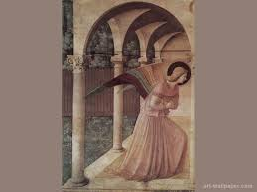
The angel Gabriel was sent by God to a town in Galilee called Nazareth …
Notes:
7am - 14th Sunday in Ord Time
7am - 14th Sunday in Ord Time

Slide 4
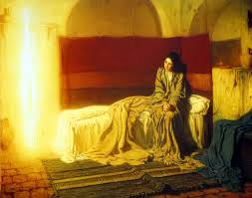
'Rejoice, so highly favoured! The Lord is with you.'

Slide 5
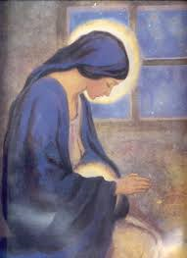
'I am the handmaid of the Lord,' said Mary 'let what you have said be done to me.'

Slide 6

How is God calling you to bring Jesus into the world today?
Notes:
7am - 14th Sunday in Ord Time
7am - 14th Sunday in Ord Time

Slide 7
Please Stand

Slide 8
This slide is hidden.
Insert the Entrance Hymn after this slide

Slide 9
Prepare the way of the Lord
A voice cries out in the wilderness
Prepare the way of the Lord
Prepare the way make straight his paths
Prepare the way of the Lord

Slide 10
Rejoice, so highly favoured!
O come Emmanuel
Keep watch and wait in joyful hope
Prepare the way of the Lord

Slide 11
Be on your guard and stay awake
Prepare the way of the Lord
You do not know when the Master will come
Prepare the way of the Lord

Slide 12
Rejoice, so highly favoured!
O come Emmanuel
Keep watch and wait in joyful hope
Prepare the way of the Lord

Slide 13
The blind shall see and the deaf shall hear
Prepare the way of the Lord
Let us rejoice, the Lord is near
Prepare the way of the Lord

Slide 14
Rejoice so highly favoured!
O come Emmanuel
Keep watch and wait in joyful hope
Prepare the way of the Lord

Slide 16
LIGHTING OF CANDLE
Come. O Wisdom of our God, Most High.
All: Come! Teach us to walk in the paths of truth.
Come, O Morning Star and Radiance of eternal light
All: Come! Enlighten all those who dwell in darkness.
Come! O Emmanuel our long awaited Saviour.
All: Come quickly now! Do not delay!

Slide 17
Like a candle
Hope is like a candle
Shining like a light
In a dark place

Slide 18
Jesus you are
Light in the world
Jesus you light the way

Slide 19
Peace is like a candle
Shining like a light
In a dark place

Slide 20
Jesus you are
Light in the world
Jesus you light the way

Slide 21
Joy is like a candle
Shining like a light
In a dark place

Slide 22
Jesus you are
Light in the world
Jesus you light the way

Slide 23
Love is like a candle
Shining like a light
In a dark place

Slide 24
Jesus you are
Light in the world
Jesus you light the way

Slide 25
Confiteor
I confess to almighty God
And to you, my brothers and sisters,
That I have greatly sinned
In my thoughts and in my words

Slide 26
In what I have done
And in what I have failed to do,
Through my fault,
Through my fault,
Through my most grievous fault;

Slide 27
Therefore I ask blessed Mary ever-Virgin,
All the Angels and Saints,
And you, my brothers and sisters,
To pray for me to the Lord our God.

Slide 29
Kyrie eleison
Kyrie eleison (2)
Christe eleison (2)
Kyrie eleison (2)

Slide 31
Responsorial Psalm
For ever I will sing the goodness of the Lord.

Slide 33
Alleluia
Alleluia, alleluia,
alleluia, alleluia

Slide 35
Apostles Creed
I believe in God,
the Father almighty,
Creator of heaven and earth,
and in Jesus Christ, his only Son, our Lord,
(At the words that follow, up to and including the Virgin Mary, all bow.)

Slide 36
who was conceived by the Holy Spirit,
born of the Virgin Mary,
suffered under Pontius Pilate,
was crucified, died and was buried;
he descended into hell;

Slide 37
on the third day he rose again from the dead;
he ascended into heaven,
and is seated at the right hand of God the Father almighty;

Slide 38
from there he will come to judge the living and the dead.
I believe in the Holy Spirit,
the holy catholic Church,

Slide 39
the communion of saints,
the forgiveness of sins,
the resurrection of the body,
and life everlasting.
Amen.

Slide 41
First Collection
This collection goes to the Bishop
for the support of the Diocese.
Thank you for your contribution

Slide 43
This slide is hidden.
Insert the Offertory Hymn after this slide.

Slide 44

Lord, I offer my life
All that I am, all that I have
I lay them down before you, oh Lord
All my regrets, all my acclaims
The joy and the pain,
I'm making them yours

Slide 45
Lord, I offer my life to you
Everything I've been through
Use it for your glory

Slide 46
Lord I offer my days to you
Lifting my praise to you
As a pleasing sacrifice
Lord I offer you my life

Slide 47
Things in the past, things yet unseen
Wishes and dreams
that are yet to come true
All of my hopes, all of my plans
My heart and my hands are lifted to you

Slide 48
Lord, I offer my life to you
Everything I've been through
Use it for your glory

Slide 49
Lord I offer my days to you
Lifting my praise to you
As a pleasing sacrifice
Lord I offer you my life

Slide 50
What can we give that you have not given?
And what do we have
That is not already yours?
All we possess are these lives we're living
That's what we give to you, Lord

Slide 51
Lord, I offer my life to you
Everything I've been through
Use it for your glory

Slide 52
Lord I offer my days to you
Lifting my praise to you
As a pleasing sacrifice
Lord I offer you my life

Slide 54
Priest: Pray my brothers and sisters,
that my sacrifice and yours may be
acceptable to God, the almighty Father.
All: May the Lord accept the sacrifice
at your hands for the praise and glory of his name, for our good and the good of all his holy Church.

Slide 55
Priest: The Lord be with you.
All: And with your spirit.
Priest: Lift up your hearts.
All: We lift them up to the Lord.

Slide 56
Priest: Let us give thanks to the
Lord our God.
All: It is right and just.

Slide 58
Holy
Holy, Holy, Holy Lord God of hosts,
Heaven and earth are full of your glory. Hosanna in the highest
Blessed is he who comes
in the name of Lord,
Hosanna in the highest.

Slide 60
Memorial acclamation
Save us saviour of the world,
For by your cross and resurrection,
You have set us free

Slide 61
Memorial acclamation
When we eat this bread
And drink this cup
We proclaim your death O Lord
Until you come again

Slide 62
Memorial acclamation
We proclaim your death O Lord
And profess your resurrection
Until you come again

Slide 64
Amen
Amen, amen, amen, amen.
Amen, amen, amen, amen.

Slide 66
Priest: The Lord be with you.
All: And with your spirit

Slide 68
Peace
May the peace of the Lord be with you
With your friends and your family too
Let it be, let it grow
And everywhere you go
May the peace of the Lord follow you

Slide 69
Lamb of God
Lamb of God, lamb of God
You take away the sins of the world
Have mercy on us, lamb of God

Slide 70
Lamb of God, lamb of God
You take away the sins of the world
Have mercy on us, lamb of God

Slide 71
Lamb of God, lamb of God
You take away the sins of the world
Grant us, grant us peace

Slide 73
Priest: Behold the Lamb of God, behold him
who takes away the sins of the world.
Blessed are those called to the supper of the Lamb.
All: Lord, I am not worthy
that you should enter under my roof,
but only say the word
and my soul shall be healed.

Slide 74
This slide is hidden.
Insert the Communion Hymns after this slide.

Slide 75
In love for me
This is my body broken for you
Bringing you wholeness making you free
Take it and eat it, and when you do
Do it in love for me

Slide 76
This is my blood poured out for you
Bringing forgiveness, making you free
Take it and drink it, and when you do
Do it in love for me

Slide 77
This is my body broken for you
Bringing you wholeness making you free
Take it and eat it, and when you do
Do it in love for me

Slide 78
This is my blood poured out for you
Bringing forgiveness, making you free
Take it and drink it, and when you do
Do it in love for me
Do it in love for me

Slide 79
Hail Mary
Hail Mary full of grace,
The lord is with thee,
Blessed are you among women
And blest is the fruit of your womb,
Jesus. (Jesus)

Slide 80
Holy Mary, mother of God
Prayer for us sinner now, and at the hour of our death,
Amen. (Amen)

Slide 81
Gentle woman, quiet light,
Morning star so strong and bright
Gentle Mother, peaceful dove,
Teach us wisdom, teach us love.

Slide 82
You were chosen by the Father;
You were chosen for the Son.
You were chosen from all women
And for woman, shining one.

Slide 83
Gentle woman, quiet light,
Morning star so strong and bright
Gentle Mother, peaceful dove,
Teach us wisdom, teach us love.

Slide 84
Blessed are you among women
Blest in turn, all women too
Blessed they with peaceful spirits
Blessed they with gentle hearts

Slide 85
Gentle woman, quiet light,
Morning star so strong and bright
Gentle Mother, peaceful dove,
Teach us wisdom, teach us love.

Slide 86
Ave Maria
Dominus tecum benedicta tu
As I kneel before you
As I bow my head in prayer
Take this day, make it yours
And fill me with your love

Slide 87
Ave Maria, gratia plena
Dominus tecum benedicta tu

Slide 88
All I have I give you,
Every dream and wish are yours.
Mother of Christ, Mother of mine
Present them to my Lord

Slide 89
Ave Maria, gratia plena
Dominus tecum benedicta tu

Slide 90
As I kneel before you,
And I see your smiling face
Every thought, every word,
Is lost in your embrace.

Slide 91
Ave Maria, gratia plena
Dominus tecum benedicta tu
Dominus tecum benedicta tu

Slide 93
Second Collection
What you contribute now
is for the support of our
parish and its mission.
Thank you for your generosity

Slide 94
This slide is hidden.
Insert the Notices for the week after this slide

Slide 95

SACRAMENTAL PROCESS 2015
If you wish to prepare your
child for Reconciliation,
First Communion or
Confirmation in 2015
please fill out an
Expression of Interest form
which is in both foyers.
More information in the bulletin.

Slide 96

Men’s Ministry
Monthly Gathering
7.00pm 27 February 2015
St Michael’s Church Centre
Weekend Event
2/3 May 2015
Venue to be confirmed
MEET CHRIST: SOMEWHERE BETWEEN THE PUB AND THE PEW

Slide 97
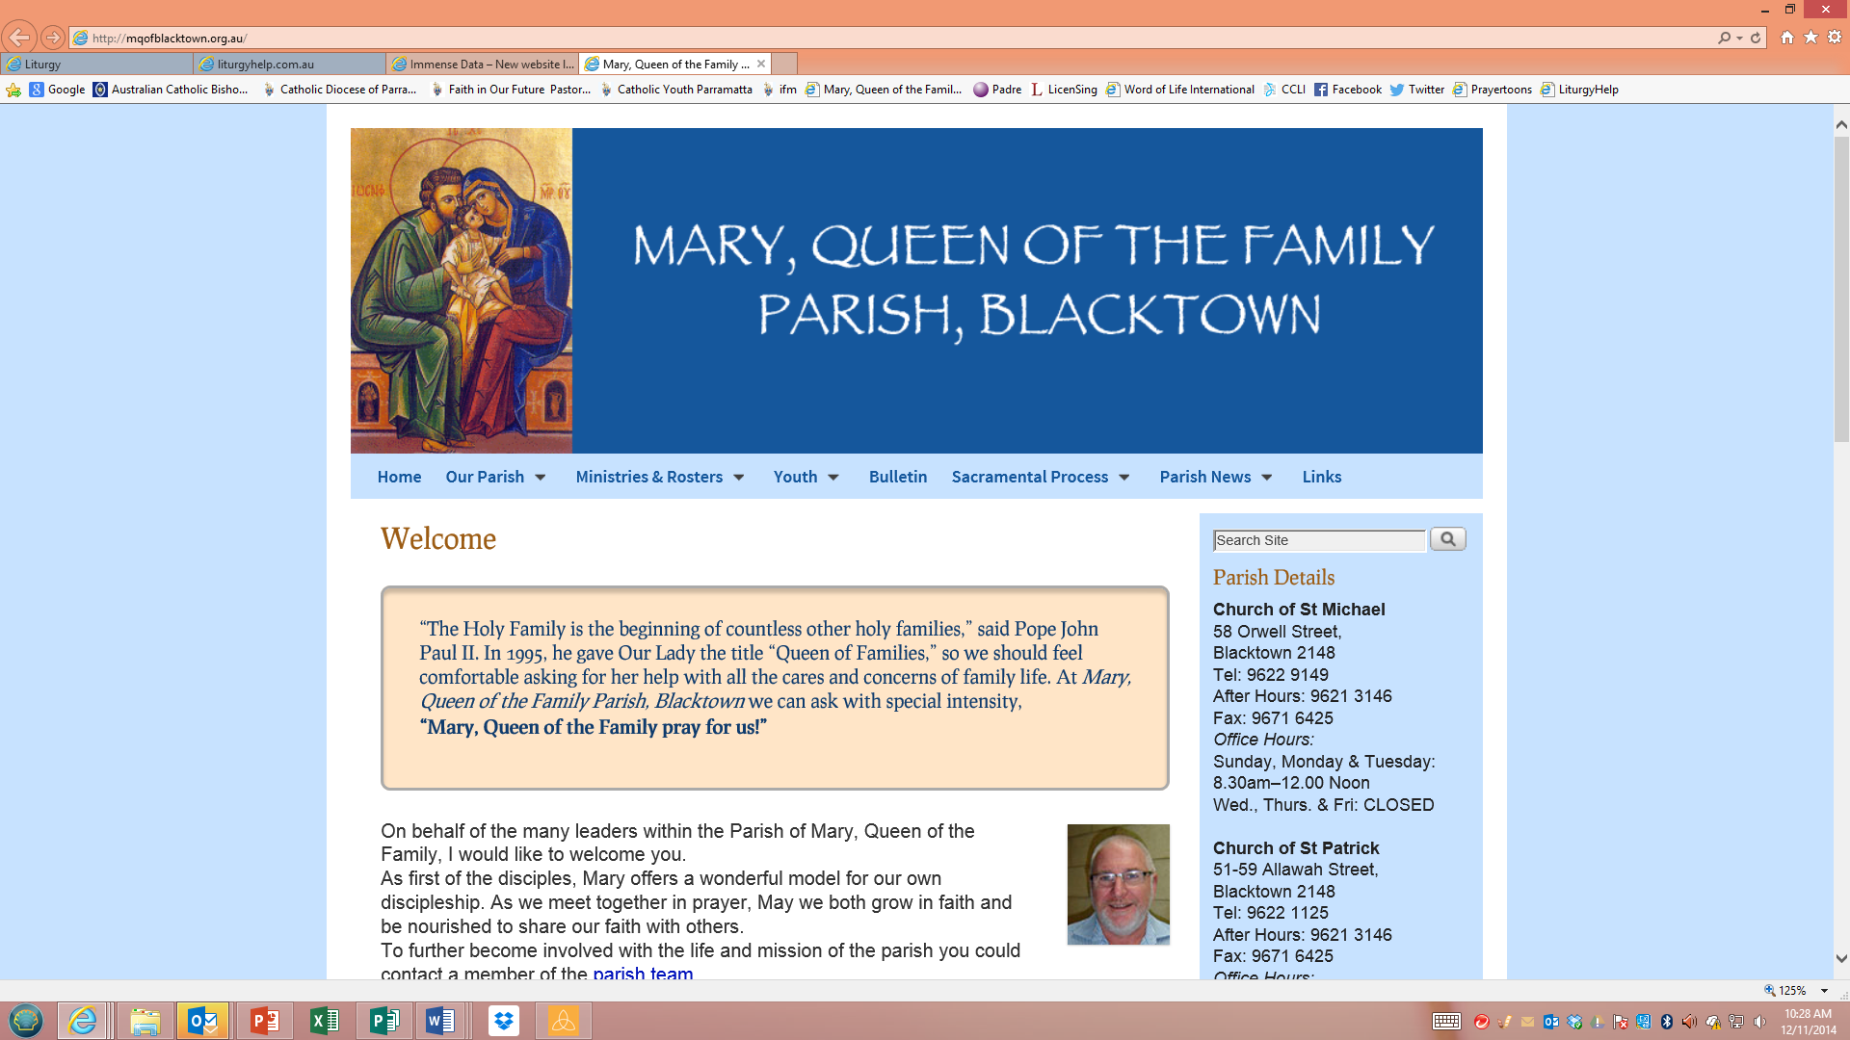
NEW WEBSITE!
www.mqofblacktown.org.au

Slide 98
This slide is hidden.
The next slide can be used for videos.
Insert the video into the slide.

Slide 100
Priest: The Lord be with you.
All: And with your spirit.

Slide 102
This slide is hidden.
Insert the Recessional Hymns after this slide.

Slide 103
City of God
Awake from your slumber
Arise from your sleep
A new day is dawning
For all those who weep

Slide 104
The people in darkness
Have seen a great light
The Lord of our longing
Has conquered the night

Slide 105
Let us build the city of God.
May our tears be turned into dancing!
For the Lord, our light and our love,
has turned the night into day!

Slide 106
We are sons of the morning
We are daughters of day.
The One who has loved us
Has brightened our way.

Slide 107
The Lord of all kindness
Has called us to be
A light for his people
To set their hearts free.

Slide 108
Let us build the city of God.
May our tears be turned into dancing!
For the Lord, our light and our love,
has turned the night into day!

Slide 109
This slide is hidden.
Insert the final slide here.

