Slide 1
This slide is hidden.
Insert the starting slides after this slide

Slide 2

Welcome to St Michael’s
Saints Peter & Paul
Apostles
You have entered a
SACRED SPACE
– a SACRED TIME...
Please ensure all
mobile phones
are switched off.
Please be respectfully quiet
as we prepare for our celebration.
Notes:
Saturday 5.30PM First Sunday of Advent
MASTER 14th Sunday in Ord Time
MASTER 14th Sunday in Ord Time

Slide 3
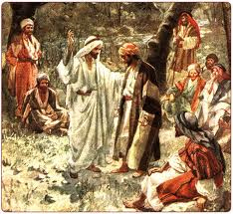
'Who do people say the
Son of Man is?
'Some say he is John the Baptist, some Elijah, and others Jeremiah or one of the prophets.'
Notes:
7am - 14th Sunday in Ord Time
7am - 14th Sunday in Ord Time

Slide 4
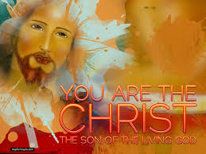
Then Simon Peter spoke up, 'You are the Christ,' he said, 'the Son of the living God..
Notes:
7am - 14th Sunday in Ord Time
7am - 14th Sunday in Ord Time

Slide 5
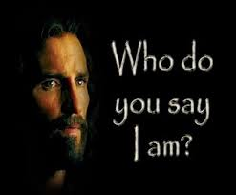
'But you,' he said, 'who do you say I am?'
Notes:
7am - 14th Sunday in Ord Time
7am - 14th Sunday in Ord Time

Slide 6
Please Stand

Slide 7
This slide is hidden.
Insert the Entrance Hymn after this slide

Slide 8
I will call upon the Lord
I will call upon the Lord,
Who is worthy to be praised,
So shall I be free from my enemies,
I will call upon the Lord.

Slide 9
The Lord liveth
And blessed be the rock.
Let the god of my salvation be exalted.

Slide 10
I will call upon the Lord,
Who is worthy to be praised,
So shall I be free from my enemies,
I will call upon the Lord.

Slide 12
Confiteor
I confess to almighty God
And to you, my brothers and sisters,
That I have greatly sinned
In my thoughts and in my words

Slide 13
In what I have done
And in what I have failed to do,
Through my fault,
Through my fault,
Through my most grievous fault;

Slide 14
Therefore I ask blessed Mary ever-Virgin,
All the Angels and Saints,
And you, my brothers and sisters,
To pray for me to the Lord our God.

Slide 16
Kyrie eleison
Kyrie eleison (2)
Christe eleison (2)
Kyrie eleison (2)

Slide 18
Gloria
Glory to God in the highest,
and on earth peace to people of good will.
We praise you, we bless you,
we adore you, we glorify you,

Slide 19
We give you thanks for your great glory,
Lord, God heavenly king,
O God, almighty father

Slide 20
Glory to God in the highest,
and on earth peace to people of good will.

Slide 21
Lord Jesus Christ, Only Begotten Son,
Lord God, Lamb of God, Son of the Father,
you take away the sins of the world,
have mercy on us;

Slide 22
you take away the sins of the world, receive our prayer;
you are seated at the right hand of the Father,
have mercy on us.

Slide 23
Glory to God in the highest,
and on earth peace to people of good will.

Slide 24
For you alone are the Holy One,
you alone are the Lord,
you alone are the Most High, Jesus Christ,
with the Holy Spirit,
in the glory of God the Father.

Slide 25
Glory to God in the highest,
and on earth peace to people of good will.
Amen.

Slide 27
Responsorial Psalm
The Lord set me free
from all my fears.

Slide 29
Alleluia
Alleluia, alleluia,
alleluia, alleluia

Slide 31
Apostles Creed
I believe in God,
the Father almighty,
Creator of heaven and earth,
and in Jesus Christ, his only Son, our Lord,
(At the words that follow, up to and including the Virgin Mary, all bow.)

Slide 32
who was conceived by the Holy Spirit,
born of the Virgin Mary,
suffered under Pontius Pilate,
was crucified, died and was buried;
he descended into hell;

Slide 33
on the third day he rose again from the dead;
he ascended into heaven,
and is seated at the right hand of God the Father almighty;

Slide 34
from there he will come to judge the living and the dead.
I believe in the Holy Spirit,
the holy catholic Church,

Slide 35
the communion of saints,
the forgiveness of sins,
the resurrection of the body,
and life everlasting.
Amen.

Slide 37
First Collection
This collection goes to the Bishop
for the support of the Diocese.
Thank you for your contribution

Slide 39
This slide is hidden.
Insert the Offertory Hymn after this slide.

Slide 40
Blessed be God
Blest are you Lord, God of all creation
Thanks to your goodness
This bread we offer
Fruit of the earth, work of our hands
It will become the bread of life

Slide 41
Blessed be God, blessed be God
Blessed be God forever, amen
Blessed be God, blessed be God
Blessed be God forever, amen

Slide 42
Blest are you Lord God or all creation
Thanks to your goodness
This wine we offer
Fruit of the vine, work of our hands
It will become the cup of joy

Slide 43
Blessed be God, blessed be God
Blessed be God forever, amen
Blessed be God, blessed be God
Blessed be God forever, amen

Slide 45
Priest: Pray my brothers and sisters,
that my sacrifice and yours may be
acceptable to God, the almighty Father.
All: May the Lord accept the sacrifice
at your hands for the praise and glory of his name, for our good and the good of all his holy Church.

Slide 46
Priest: The Lord be with you.
All: And with your spirit.
Priest: Lift up your hearts.
All: We lift them up to the Lord.

Slide 47
Priest: Let us give thanks to the
Lord our God.
All: It is right and just.

Slide 49
Holy
Holy, Holy, Holy Lord God of hosts,
Heaven and earth are full of your glory. Hosanna in the highest
Blessed is he who comes
in the name of Lord,
Hosanna in the highest.

Slide 51
Memorial acclamation
Save us saviour of the world,
For by your cross and resurrection,
You have set us free

Slide 52
Memorial acclamation
When we eat this bread
And drink this cup
We proclaim your death O Lord
Until you come again

Slide 53
Memorial acclamation
We proclaim your death O Lord
And profess your resurrection
Until you come again

Slide 55
Amen
Amen, amen, amen, amen.
Amen, amen, amen, amen.

Slide 57
Priest: The Lord be with you.
All: And with your spirit

Slide 59
Peace
May the peace of the Lord be with you
With your friends and your family too
Let it be, let it grow
And everywhere you go
May the peace of the Lord follow you

Slide 60
Lamb of God
Lamb of God, lamb of God
You take away the sins of the world
Have mercy on us, lamb of God

Slide 61
Lamb of God, lamb of God
You take away the sins of the world
Have mercy on us, lamb of God

Slide 62
Lamb of God, lamb of God
You take away the sins of the world
Grant us, grant us peace

Slide 64
Priest: Behold the Lamb of God, behold him
who takes away the sins of the world.
Blessed are those called to the supper of the Lamb.
All: Lord, I am not worthy
that you should enter under my roof,
but only say the word
and my soul shall be healed.

Slide 65
This slide is hidden.
Insert the Communion Hymns after this slide.

Slide 66
In love for me
This is my body broken for you
Bringing you wholeness making you free
Take it and eat it, and when you do
Do it in love for me

Slide 67
This is my blood poured out for you
Bringing forgiveness, making you free
Take it and drink it, and when you do
Do it in love for me

Slide 68
This is my body broken for you
Bringing you wholeness making you free
Take it and eat it, and when you do
Do it in love for me

Slide 69
This is my blood poured out for you
Bringing forgiveness, making you free
Take it and drink it, and when you do
Do it in love for me
Do it in love for me

Slide 70
I love you Lord
I love you Lord
And you know I always want to do things right
I love you Lord
When I think of how I've failed you
I could cry

Slide 71
And when I hear you calling
I want to run and hide
Cause you know, I love you so

Slide 72
I love you Lord
Although I know my heart might not seem true
I love you Lord
And I pray for one more chance to prove I do

Slide 73
I want to leave the past behind
And feel your smile again
O Lord you know
I love you so, I love you so

Slide 74
So if you find it in your heart
To let me start again
I'll be your witness Lord
Your witness Lord

Slide 75
Your witness to the end of my life
Let me make it right
Let me try again
I'll be your witness to the end

Slide 76
So if you find it in your heart
To let me start again
I'll be your witness Lord
Your witness Lord

Slide 77
Your witness to the end of my life
Let me make it right
Let me try again
I'll be your witness to the end

Slide 78
There is none like you
There is none like you
No one else could touch my heart like you do
I could search for all eternity Lord,
And find there is none like you

Slide 79
There is none like you
No one else could touch my heart like you do
I could search for all eternity Lord,
And find there is none like you

Slide 80
Your mercy flows like a river wide,
And healing comes from Your hand.
Suffering children are safe in Your arms,
There is none like You.

Slide 81
There is none like you
No one else could touch my heart like you do
I could search for all eternity Lord,
And find there is none like you

Slide 83
Second Collection
What you contribute now
is for the support of our
parish and its mission.
Thank you for your generosity

Slide 84
This slide is hidden.
Insert the Notices for the week after this slide

Slide 85

Please collect your
PLANNED GIVING ENVELOPES today!

Slide 86

SVDP PANTRY
Sugar
Baked Beans
Pasta Sauce
Tinned Fruit
Tinned Meat (corned beef, leg ham)
Thank you for your generosity!

Slide 87
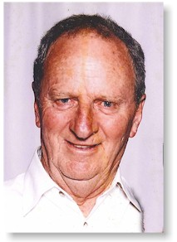
Fr Kevin Dadswell
Anniversary Mass
Wednesday 9th July
7.30pm
St Michael’s Church
All Welcome!

Slide 88
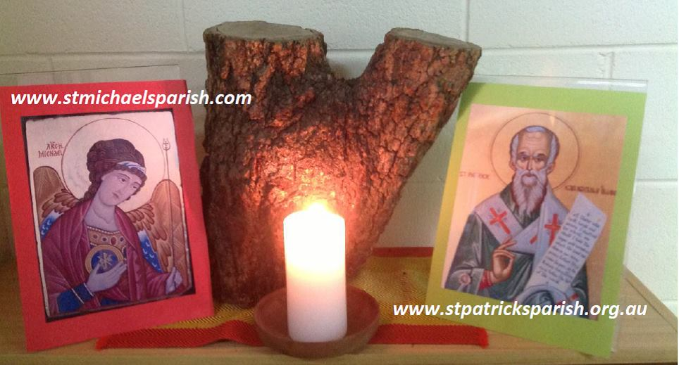
Please take home your bulletin or download it
www.stmichaelsparish.com
Visit us on Facebook
www.facebook.com/blacktowncatholics

Slide 89
This slide is hidden.
The next slide can be used for videos.
Insert the video into the slide.

Slide 91
Priest: The Lord be with you.
All: And with your spirit.

Slide 93
This slide is hidden.
Insert the Recessional Hymns after this slide.

Slide 94
Galilee Song
Deep within my heart, I feel
Voices whispering to me.
Words that I can’t understand;
Meanings I can’t clearly hear!

Slide 95
Calling me to follow close,
lest I leave myself behind!
Calling me to walking into
evening shadows one more time!

Slide 96
So I leave my boats behind!
Leave them on familiar shores!
Set my heart upon the deep!
Follow you again, my Lord!

Slide 97
In my memories, I know
how you send familiar rains
falling gently on my days,
dancing patterns on my pain!

Slide 98
And I need to learn once more
in the fortress of my mind,
to believe in falling rain
as I travel deserts dry!

Slide 99
So I leave my boats behind!
Leave them on familiar shores!
Set my heart upon the deep!
Follow you again, my Lord!

Slide 100
So I leave my boats behind!
Leave them on familiar shores!
Set my heart upon the deep!
Follow you again, my Lord!

Slide 101
This slide is hidden.
Insert the final slide here.

