Slide 1
This slide is hidden.
Insert the starting slides after this slide

Slide 2
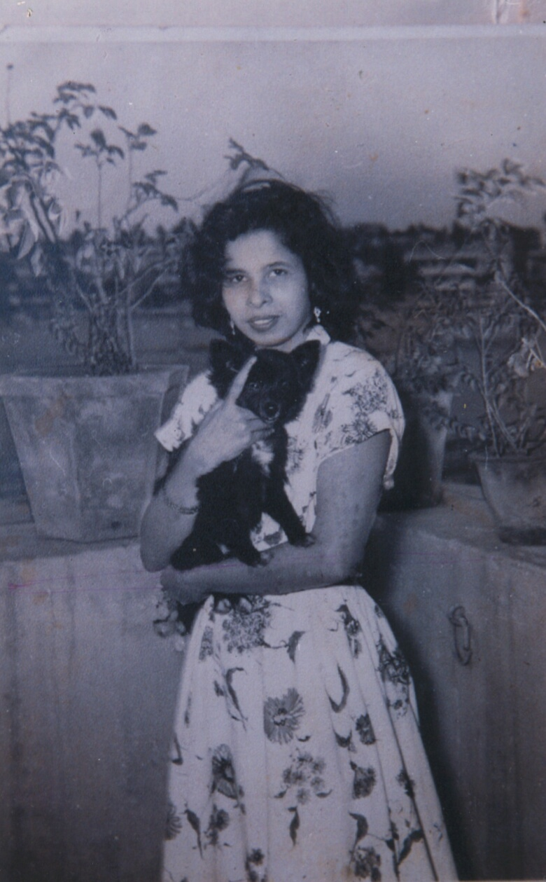
In loving memory of
Elvina Heredia who came to life on
16th September 1977 and was called to eternal rest on
6th February 2016
St Michaels Catholic Church, Blacktown
Friday, 12th February 2016

Slide 3
As I kneel before you
(Maria Parkinson)
Dominus tecum benedicta tu
As I kneel before you
As I bow my head in prayer
Take this day, make it yours
And fill me with your love

Slide 4
Ave Maria, gratia plena
Dominus tecum benedicta tu

Slide 5
All I have I give you,
Every dream and wish are yours.
Mother of Christ, Mother of mine
Present them to my Lord

Slide 6
Ave Maria, gratia plena
Dominus tecum benedicta tu

Slide 7
As I kneel before you,
And I see your smiling face
Every thought, every word,
Is lost in your embrace.

Slide 8
Ave Maria, gratia plena
Dominus tecum benedicta tu
Dominus tecum benedicta tu
Words & music by Maria Parkinson
© 1978 Kevin Mayhew Ltd
Used by Permission. CCLI License #89350

Slide 10
Please Stand

Slide 11
This slide is hidden.
Insert the Entrance Hymn after this slide

Slide 12
Amazing Grace(My chains are gone)
Amazing grace how sweet the sound
That saved a wretch like me
I once was lost, but now I'm found
Was blind, but now I see

Slide 13
'Twas grace that taught my heart to fear
And grace my fears relieved
How precious did that grace appear
The hour I first believed

Slide 14
My chains are gone I've been set free
My God, my Savior has ransomed me
And like a flood His mercy reigns
Unending love, Amazing grace

Slide 15
The Lord has promised good to me
His word my hope secures
He will my shield and portion be
As long as life endures

Slide 16
The earth shall soon dissolve like snow
The sun forbear to shine
But God, Who called me here below
Will be forever mine (3)

Slide 18
Confiteor
I confess to almighty God
And to you, my brothers and sisters,
That I have greatly sinned
In my thoughts and in my words
Text: The English translation of The Roman Missal © 2010 ICEL
CCLI Licence #312895

Slide 19
In what I have done
And in what I have failed to do,
Through my fault,
Through my fault,
Through my most grievous fault;

Slide 20
Therefore I ask blessed Mary ever-Virgin,
All the Angels and Saints,
And you, my brothers and sisters,
To pray for me to the Lord our God.

Slide 22
Kyrie eleison
Kyrie eleison (2)
Christe eleison (2)
Kyrie eleison (2)

Slide 24
Gloria
Glory to God in the highest,
and on earth peace to people of good will.
We praise you, we bless you,
we adore you, we glorify you,
Music © 2004, 2010 Paul Mason
Text: Excerpts from the English translation of The Roman Missal © 2010 ICEL;
CCLI Licence #89350

Slide 25
We give you thanks for your great glory,
Lord, God heavenly king,
O God, almighty father

Slide 26
Glory to God in the highest,
and on earth peace to people of good will.

Slide 27
Lord Jesus Christ, Only Begotten Son,
Lord God, Lamb of God, Son of the Father,
you take away the sins of the world,
have mercy on us;

Slide 28
you take away the sins of the world, receive our prayer;
you are seated at the right hand of the Father,
have mercy on us.

Slide 29
Glory to God in the highest,
and on earth peace to people of good will.

Slide 30
For you alone are the Holy One,
you alone are the Lord,
you alone are the Most High,
Jesus Christ,
with the Holy Spirit,
in the glory of God the Father.

Slide 31
Glory to God in the highest,
and on earth peace to people of good will.
Amen.

Slide 32
Glory to God
Glory to God in the highest,
And on earth peace to people of good will.
We praise you, we bless you,
We adore you, we glorify you

Slide 33
We give you thanks for your great glory,
Lord God heavenly King,
O God, almighty Father

Slide 34
Lord Jesus Christ, only begotten Son,
Lord God, Lamb of God,
Son of the Father,

Slide 35
You take away the sins of the world,
Have mercy on us;
You take away the sins of the world,
Receive our prayer;

Slide 36
You are seated
At the right hand of the Father
Have mercy on us

Slide 37
For you alone are the Holy One,
You alone are the Lord
You alone are the most High,
Jesus Christ

Slide 38
With the Holy Spirit,
In the glory of God the Father.
Amen!
Amen!

Slide 40
Responsorial Psalm
The Lord is my Shepherd,
and I want to follow,
wherever he leads me,
wherever he goes.

Slide 41
Over the mountains,
the waters and by-ways,
valleys and highways
he’s waiting for me.

Slide 42
I want to go to meet him there,
to lay myself down in his love.

Slide 43
The Lord is my shepherd,
and I want to follow,
wherever he leads me,
wherever he goes.

Slide 44
And while on the journey
to where we are going,
he promised to be there
to help us along.

Slide 45
And over the mountains
we’ll walk on together,
to know all the wonders
he’s given to me

Slide 46
I want to go to meet him there,
to lay myself down in his love.

Slide 47
The Lord is my shepherd,
and I want to follow,
wherever he leads me,
wherever he goes.

Slide 49
Alleluia
Alleluia, alleluia,
alleluia, alleluia
Music:© 2004, 2010 Paul Mason
Text: The English translation of The Roman Missal © 2010 ICEL
CCLI Licence #89350

Slide 51
Apostles Creed
I believe in God,
the Father almighty,
Creator of heaven and earth,
and in Jesus Christ, his only Son, our Lord,

Slide 52
(At the words that follow, up to and including the Virgin Mary, all bow.)
who was conceived by the Holy Spirit,
born of the Virgin Mary,
suffered under Pontius Pilate,
was crucified, died and was buried;
he descended into hell;

Slide 53
on the third day he rose again from the dead;
he ascended into heaven,
and is seated at the right hand of God the Father almighty;

Slide 54
from there he will come to judge the living and the dead.
I believe in the Holy Spirit,
the holy catholic Church,

Slide 55
the communion of saints,
the forgiveness of sins,
the resurrection of the body,
and life everlasting.
Amen.
Text: The English translation of The Roman Missal © 2010 ICEL

Slide 57
This slide is hidden.
Insert the Offertory Hymn after this slide.

Slide 58
Make me like you
(Carol Owens/Jimmy Owens)
Lord make me like you
Please make me like you
You are a servant
Make me one too

Slide 59
O Lord I am willing
Do what you must do
To make me like you Lord
Please make me like you

Slide 60
Lord make me like you
Please make me like you
You are a servant
Make me one too

Slide 61
O Lord I am willing do what you must do
To make me like you Lord
Please make me like you
Whatever you do Lord
Please make me like you
“Make me like you” words and music by Carol Owens, Jimmy Owens
©1978 Bud John Songs, Inc. (Admin. by Crossroad Distributors Pty. Ltd.)
Used by Permission. CCLI License #89350

Slide 63
Priest: Pray my brothers and sisters,
that my sacrifice and yours may be
acceptable to God, the almighty Father.
All: May the Lord accept the sacrifice
at your hands for the praise and glory of his name, for our good and the good of all his holy Church.

Slide 65
Priest: The Lord be with you.
All: And with your spirit.
Priest: Lift up your hearts.
All: We lift them up to the Lord.

Slide 66
Priest: Let us give thanks to the
Lord our God.
All: It is right and just.

Slide 68
Holy
Holy, Holy, Holy Lord God of hosts,
Heaven and earth are full of your glory. Hosanna in the highest
Blessed is he who comes
in the name of Lord,
Hosanna in the highest.
Music © 2004, 2010 Paul Mason
Text: Excerpts from the English translation of The Roman Missal © 2010 ICEL;
Used by permission CCLI Licence #89350

Slide 70
Memorial acclamation
Save us saviour of the world,
For by your cross and resurrection,
You have set us free

Slide 71
Memorial acclamation
When we eat this bread
And drink this cup
We proclaim your death O Lord
Until you come again
Music © 2004, 2010 Paul Mason
Text: Excerpts from the English translation of The Roman Missal © 2010 ICEL;
Used by permission CCLI Licence #89350

Slide 72
Memorial acclamation
We proclaim your death O Lord
And profess your resurrection
Until you come again

Slide 74
Amen
Amen, amen.
Amen, amen.
Music © 2004, 2010 Paul Mason
Text: Excerpts from the English translation of The Roman Missal © 2010 ICEL;
Used by permission CCLI Licence #89350

Slide 76
Peace
May the peace of the Lord be with you
With your friends and your family too
Let it be, let it grow
And everywhere you go
May the peace of the Lord follow you

Slide 77
Lamb of God
Lamb of God, lamb of God
You take away the sins of the world
Have mercy on us, lamb of God
Music © 2004, 2010 Paul Mason
Text: Excerpts from the English translation of The Roman Missal © 2010 ICEL;
CCLI Licence #312895

Slide 78
Lamb of God, lamb of God
You take away the sins of the world
Have mercy on us, lamb of God

Slide 79
Lamb of God, lamb of God
You take away the sins of the world
Grant us, grant us peace

Slide 80
Lamb of God
Lamb of God
You take away the sins of the world
Have mercy on us.

Slide 81
Lamb of God
You take away the sins of the world
Have mercy on us

Slide 82
Lamb of God
You take away the sins of the world
Grant us peace

Slide 84
Priest: Behold the Lamb of God, behold him who takes away the sins of the world.
Blessed are those called to the supper of
the Lamb.
All: Lord, I am not worthy
that you should enter under my roof,
but only say the word
and my soul shall be healed.

Slide 85
This slide is hidden.
Insert the Communion Hymns after this slide.

Slide 86
You are mine
I will come to you in the silence
I will lift you from all your fear
You will hear My voice
I claim you as My choice
Be still, and know I am near

Slide 87
I am hope for all who are hopeless
I am eyes for all who long to see
In the shadows of the night,
I will be your light
Come and rest in Me

Slide 88
Do not be afraid, I am with you
I have called you each by name
Come and follow Me
I will bring you home
I love you and you are mine

Slide 89
I am strength for all the despairing
Healing for the ones who dwell in shame
All the blind will see,
The lame will all run free
And all will know My name

Slide 90
Do not be afraid, I am with you
I have called you each by name
Come and follow Me
I will bring you home
I love you and you are mine

Slide 91
I am the Word that leads all to freedom
I am the peace the world cannot give
I will call your name,
Embracing all your pain
Stand up, now, walk, and live

Slide 92
Do not be afraid, I am with you
I have called you each by name
Come and follow Me
I will bring you home
I love you and you are mine
Words & music by David Haas, 1991
© 2011 Hope Publishing Company
Used by Permission CCLI License #89350

Slide 93
This slide is hidden.
Insert the Notices for the week after this slide

Slide 94
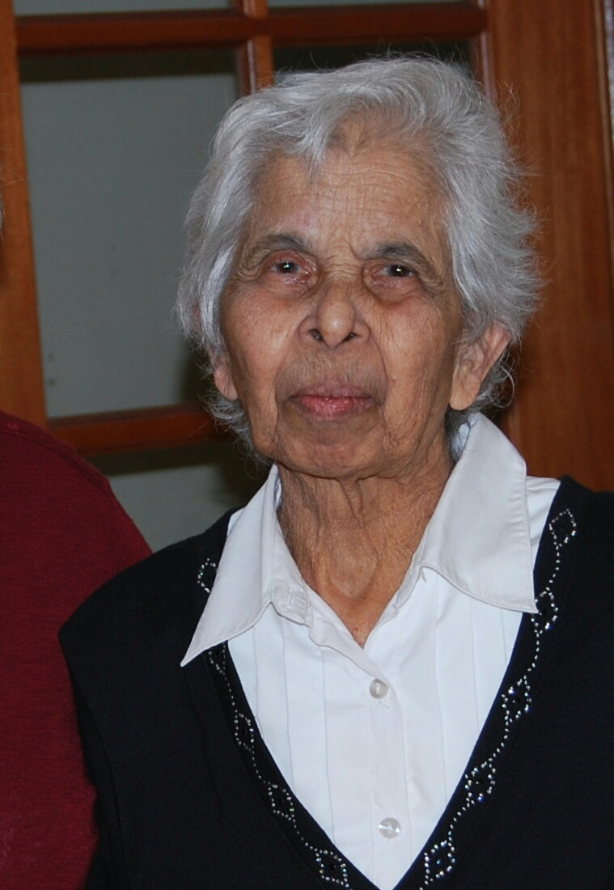

Slide 95
This slide is hidden.
The next slide can be used for videos.
Insert the video into the slide.

Slide 97
Priest: The Lord be with you.
All: And with your spirit.

Slide 99
This slide is hidden.
Insert the Recessional Hymns after this slide.

Slide 100
Thank you, Jesus
Thank you jesus
Your love truly binds us
Hallelujah
Thank you for your love

Slide 101
Thank you Jesus
Your love truly guides us
Hallelujah
Thank you for your love

Slide 102
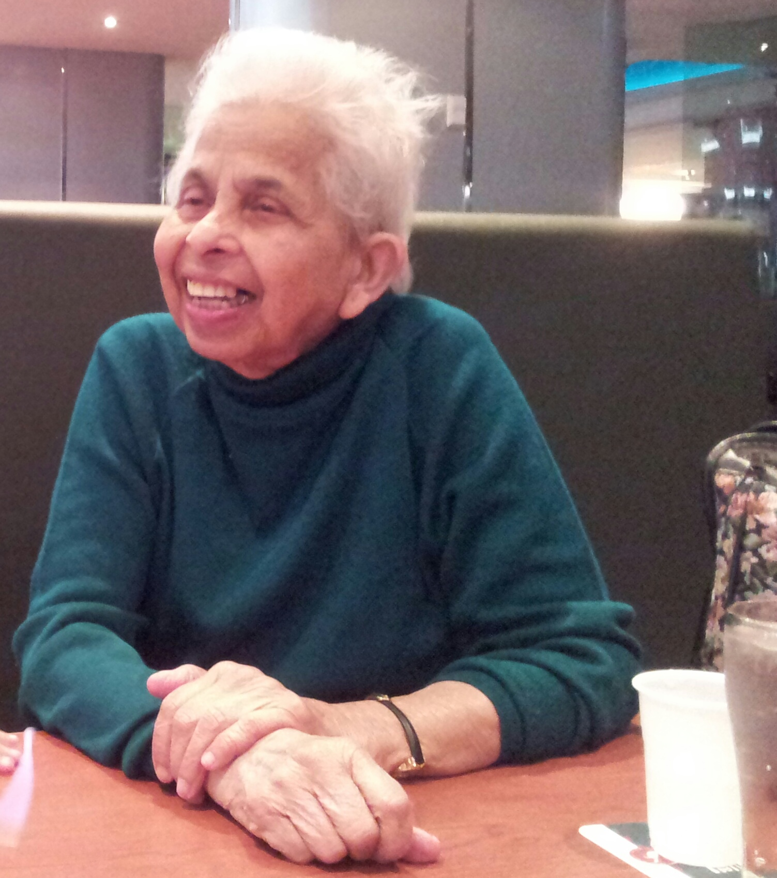

Slide 103
This slide is hidden.
Insert the final slide here.

