Slide 1
This slide is hidden.
Insert the starting slides after this slide

Slide 2
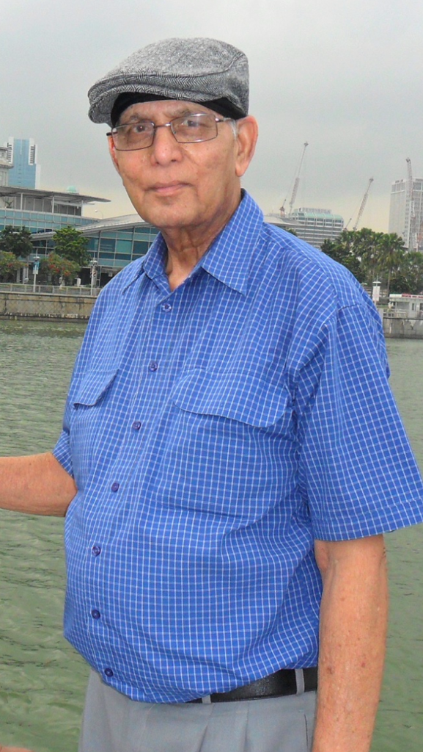
In loving memory of
Joseph Benedict Rego
Born 13th February 1932
Entered eternal life 3rd January 2015
St. Agatha's Catholic Church, Pennant Hills
Saturday, 10th January 2015

Slide 3
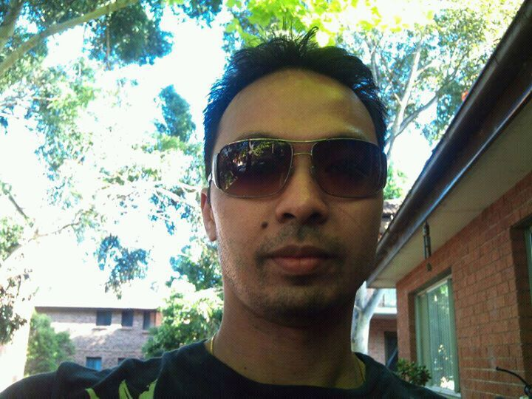
In loving memory of
Mark 'Ritchie' Uvera
Born:
Entered eternal life
St Michaels Catholic Church, Blacktown
Saturday, 30th May 2015

Slide 4
Please Stand

Slide 5
This slide is hidden.
Insert the Entrance Hymn after this slide

Slide 6
Here I am Lord
I, the Lord of sea and sky,
I have heard my people cry.
All who dwell in dark and sin,
My hand will save.
Words and Music by Daniel L Schulte
© 1981
CCLI Licence #312895

Slide 7
Here I am, Lord. Is it I, Lord?
I have heard you calling in the night.
I will go, Lord, if you lead me.
I will hold your people in my heart.

Slide 8
I, who made the stars of night,
I will make their darkness bright.
Who will bear my light to them?
Whom shall I send?

Slide 9
Here I am, Lord. Is it I, Lord?
I have heard you calling in the night.
I will go, Lord, if you lead me.
I will hold your people in my heart.

Slide 10
I, the Lord of snow and rain,
I have borne my people’s pain.
I have wept for love of them.
They turn away.

Slide 11
Here I am, Lord. Is it I, Lord?
I have heard you calling in the night.
I will go, Lord, if you lead me.
I will hold your people in my heart.

Slide 13
Confiteor
I confess to almighty God
And to you, my brothers and sisters,
That I have greatly sinned
In my thoughts and in my words
Text: The English translation of The Roman Missal © 2010 ICEL
CCLI Licence #312895

Slide 14
In what I have done
And in what I have failed to do,
Through my fault,
Through my fault,
Through my most grievous fault;

Slide 15
Therefore I ask blessed Mary ever-Virgin,
All the Angels and Saints,
And you, my brothers and sisters,
To pray for me to the Lord our God.

Slide 17
Kyrie eleison
Kyrie eleison (2)
Christe eleison (2)
Kyrie eleison (2)

Slide 19
Gloria
Glory to God in the highest,
and on earth peace to people of good will.
We praise you, we bless you,
we adore you, we glorify you,
Music © 2004, 2010 Paul Mason
Text: Excerpts from the English translation of The Roman Missal © 2010 ICEL;
CCLI Licence #312895

Slide 20
We give you thanks for your great glory,
Lord, God heavenly king,
O God, almighty father

Slide 21
Glory to God in the highest,
and on earth peace to people of good will.

Slide 22
Lord Jesus Christ, Only Begotten Son,
Lord God, Lamb of God, Son of the Father,
you take away the sins of the world,
have mercy on us;

Slide 23
you take away the sins of the world, receive our prayer;
you are seated at the right hand of the Father,
have mercy on us.

Slide 24
Glory to God in the highest,
and on earth peace to people of good will.

Slide 25
For you alone are the Holy One,
you alone are the Lord,
you alone are the Most High,
Jesus Christ,
with the Holy Spirit,
in the glory of God the Father.

Slide 26
Glory to God in the highest,
and on earth peace to people of good will.
Amen.

Slide 27
Glory to God
Glory to God in the highest,
And on earth peace to people of good will.
We praise you, we bless you,
We adore you, we glorify you

Slide 28
We give you thanks for your great glory,
Lord God heavenly King,
O God, almighty Father

Slide 29
Lord Jesus Christ, only begotten Son,
Lord God, Lamb of God,
Son of the Father,

Slide 30
You take away the sins of the world,
Have mercy on us;
You take away the sins of the world,
Receive our prayer;

Slide 31
You are seated
At the right hand of the Father
Have mercy on us

Slide 32
For you alone are the Holy One,
You alone are the Lord
You alone are the most High,
Jesus Christ

Slide 33
With the Holy Spirit,
In the glory of God the Father.
Amen!
Amen!

Slide 35
Responsorial Psalm
The Lord is my Shepherd,
and I want to follow,
wherever he leads me,
wherever he goes.

Slide 36
Over the mountains,
the waters and by-ways,
valleys and highways
he’s waiting for me.

Slide 37
I want to go to meet him there,
to lay myself down in his love.

Slide 38
The Lord is my shepherd,
and I want to follow,
wherever he leads me,
wherever he goes.

Slide 39
And while on the journey
to where we are going,
he promised to be there
to help us along.

Slide 40
And over the mountains
we’ll walk on together,
to know all the wonders
he’s given to me

Slide 41
I want to go to meet him there,
to lay myself down in his love.

Slide 42
The Lord is my shepherd,
and I want to follow,
wherever he leads me,
wherever he goes.

Slide 44
Alleluia
Alleluia, alleluia,
alleluia, alleluia
Music:© 2004, 2010 Paul Mason
Text: The English translation of The Roman Missal © 2010 ICEL
CCLI Licence #312895

Slide 46
Apostles Creed
I believe in God,
the Father almighty,
Creator of heaven and earth,
and in Jesus Christ, his only Son, our Lord,
Text: The English translation of The Roman Missal © 2010 ICEL
CCLI Licence #312895

Slide 47
(At the words that follow, up to and including the Virgin Mary, all bow.)
who was conceived by the Holy Spirit,
born of the Virgin Mary,
suffered under Pontius Pilate,
was crucified, died and was buried;
he descended into hell;

Slide 48
on the third day he rose again from the dead;
he ascended into heaven,
and is seated at the right hand of God the Father almighty;

Slide 49
from there he will come to judge the living and the dead.
I believe in the Holy Spirit,
the holy catholic Church,

Slide 50
the communion of saints,
the forgiveness of sins,
the resurrection of the body,
and life everlasting.
Amen.

Slide 52
This slide is hidden.
Insert the Offertory Hymn after this slide.

Slide 53

Lord, I offer my life
All that I am, all that I have
I lay them down before you, oh Lord
All my regrets, all my acclaims
The joy and the pain,
I'm making them yours
Words and Music by CLONINGER, CLAIRE D./MOEN, DON
©Warner/Chappell Music, Inc 2004
CCLI Licence #312895

Slide 54
Lord, I offer my life to you
Everything I've been through
Use it for your glory

Slide 55
Lord I offer my days to you
Lifting my praise to you
As a pleasing sacrifice
Lord I offer you my life

Slide 56
Things in the past, things yet unseen
Wishes and dreams
that are yet to come true
All of my hopes, all of my plans
My heart and my hands are lifted to you

Slide 57
Lord, I offer my life to you
Everything I've been through
Use it for your glory

Slide 58
Lord I offer my days to you
Lifting my praise to you
As a pleasing sacrifice
Lord I offer you my life

Slide 59
What can we give that you have not given?
And what do we have
That is not already yours?
All we possess are these lives we're living
That's what we give to you, Lord

Slide 60
Lord, I offer my life to you
Everything I've been through
Use it for your glory

Slide 61
Lord I offer my days to you
Lifting my praise to you
As a pleasing sacrifice
Lord I offer you my life

Slide 63
Priest: Pray my brothers and sisters,
that my sacrifice and yours may be
acceptable to God, the almighty Father.
All: May the Lord accept the sacrifice
at your hands for the praise and glory of his name, for our good and the good of all his holy Church.

Slide 64
Priest: The Lord be with you.
All: And with your spirit.
Priest: Lift up your hearts.
All: We lift them up to the Lord.

Slide 65
Priest: Let us give thanks to the
Lord our God.
All: It is right and just.

Slide 67
Holy
Holy, Holy, Holy Lord God of hosts,
Heaven and earth are full of your glory. Hosanna in the highest
Blessed is he who comes
in the name of Lord,
Hosanna in the highest.
Music © 2004, 2010 Paul Mason
Text: Excerpts from the English translation of The Roman Missal © 2010 ICEL;
CCLI Licence #312895

Slide 69
Memorial acclamation
Save us saviour of the world,
For by your cross and resurrection,
You have set us free

Slide 70
Memorial acclamation
When we eat this bread
And drink this cup
We proclaim your death O Lord
Until you come again
Music © 2004, 2010 Paul Mason
Text: Excerpts from the English translation of The Roman Missal © 2010 ICEL;
CCLI Licence #312895

Slide 71
Memorial acclamation
We proclaim your death O Lord
And profess your resurrection
Until you come again

Slide 73
Amen
Amen, amen.
Amen, amen.
Music © 2004, 2010 Paul Mason
Text: Excerpts from the English translation of The Roman Missal © 2010 ICEL;
CCLI Licence #312895

Slide 75
Priest: The Lord be with you.
All: And with your spirit

Slide 77
Peace
May the peace of the Lord be with you
With your friends and your family too
Let it be, let it grow
And everywhere you go
May the peace of the Lord follow you

Slide 78
Lamb of God
Lamb of God, lamb of God
You take away the sins of the world
Have mercy on us, lamb of God
Music © 2004, 2010 Paul Mason
Text: Excerpts from the English translation of The Roman Missal © 2010 ICEL;
CCLI Licence #312895

Slide 79
Lamb of God, lamb of God
You take away the sins of the world
Have mercy on us, lamb of God

Slide 80
Lamb of God, lamb of God
You take away the sins of the world
Grant us, grant us peace

Slide 81
Lamb of God
Lamb of God
You take away the sins of the world
Have mercy on us.

Slide 82
Lamb of God
You take away the sins of the world
Have mercy on us

Slide 83
Lamb of God
You take away the sins of the world
Grant us peace

Slide 85
Priest: Behold the Lamb of God, behold him who takes away the sins of the world.
Blessed are those called to the supper of
the Lamb.
All: Lord, I am not worthy
that you should enter under my roof,
but only say the word
and my soul shall be healed.

Slide 86
This slide is hidden.
Insert the Communion Hymns after this slide.

Slide 87
I am the bread of life
I am the bread of life,
He who comes to me shall not hunger,
He who believes in me shall not thirst.
No one can come to me
Unless the Father draw him.
Words and Music by Suzanne Toolan b. 1927
©GIA Publications, Inc 1970
CCLI Licence #312895

Slide 88
And I will raise him up,
And I will raise him up,
And I will raise him up on the last day.

Slide 89
The bread that I will give
Is my flesh for the life of the world,
And he who eats of this bread,
He shall live for ever,
He shall live for ever.

Slide 90
And I will raise him up,
And I will raise him up,
And I will raise him up on the last day.

Slide 91
Unless you eat of the flesh
Of the Son of Man,
And drink of His blood
And drink of His blood,
You shall not have life within you

Slide 92
And I will raise him up,
And I will raise him up,
And I will raise him up on the last day.

Slide 93
And I will raise him up,
And I will raise him up,
And I will raise him up on the last day.

Slide 94
Ave Maria
Ave Maria, gratia plena
Dominus tecum,
Ave Maria
Words and Music by Charles Gounod/Johann Sebastian Bach
CCLI Licence #312895

Slide 95
Benedicta tu
Benedicta tu in mulieribus
Et benedictus
Fructus ventris tui Jesus

Slide 96
Ave Maria,
Ave Maria

Slide 97
Santa Maria
Mater dei
Ora pro nobis peccatoribus

Slide 98
Nunc et in hora
Mortis nostrae amen

Slide 99
Ave Maria
Ave Maria
Ave

Slide 100
This slide is hidden.
Insert the Notices for the week after this slide

Slide 101
This slide is hidden.
The next slide can be used for videos.
Insert the video into the slide.

Slide 103
Priest: The Lord be with you.
All: And with your spirit.

Slide 105
This slide is hidden.
Insert the Recessional Hymns after this slide.

Slide 106
How great thou art
O Lord my God,
When I in awesome wonder,
Consider all the worlds
Thy Hands have made;
Words and Music by Stuart K. Hine/Carl G. Boberg
CCLI Licence #312895

Slide 107
I see the stars,
I hear the rolling thunder,
Thy power throughout
the universe displayed.

Slide 108
Then sings my soul,
My Saviour God, to Thee,
How great Thou art,
How great Thou art.

Slide 109
Then sings my soul,
My Saviour God, to Thee,
How great Thou art,
How great Thou art.

Slide 110
When through the woods,
and forest glades I wander,
And hear the birds
Sing sweetly in the trees.

Slide 111
When I look down,
from lofty mountain grandeur
And see the brook,
and feel the gentle breeze.

Slide 112
Then sings my soul,
My Saviour God, to Thee,
How great Thou art,
How great Thou art.

Slide 113
Then sings my soul,
My Saviour God, to Thee,
How great Thou art,
How great Thou art.

Slide 114
This slide is hidden.
Insert the final slide here.

