Slide 1
Forecasting future cash rates
Factors that influence the RBA cash rate
Project 1 Group 7
Notes:
TITLE SLIDE
A clear and concise title slide clearly conveying the topic of the presentation and grabs the attention of the audience, be easy to read and visually appealing.

Slide 2
Australia’s cash interest rate
The central bank of a country sets it’s Cash Interest Rate, to control inflation & promote economic growth.
Banks use the rate to borrow/lend to each other, influencing borrowing costs for individuals & businesses.
Key factors the Reserve Bank of Australia (RBA) consider when setting the cash interest rate include:
Inflation (CPI)
Economic growth (GDP)
International economic conditions (exchange rates and commodities)
Financial stability (bank interest rates and unemployment)
Exploring relationships between these factors and the cash rate we sought to answer the questions:
How do these factors influence the RBA cash rate decision?
Which one of these factors is the biggest influencer for the cash rate?
Which of these factors has positive influence and/or negative influence to the cash rate?
What will be the future cash rate based on these 4 factors?
Notes:
2. Introduction - Topic & Objectives
Provide context about the importance of the topic
Outline the objectives of the presentation and what the audience can expect to learn from it.
These questions were of interest due to the direct influence the cash rate has on borrowing costs for individuals & businesses.
When the central bank lowers the cash rate, it makes it cheaper for banks to borrow money, which can lead to lower interest rates for borrowers.
Conversely, when the central bank raises the cash rate, it makes it more expensive for banks to borrow money, which can lead to higher interest rates for borrowers.

Slide 3
Data
are from the time period 2010
Datasets used:
RBA cash rate dataset
RBA monthly CPI dataset
RBA quarterly GDP dataset
RBA monthly exchange rate dataset
RBA commodities dataset
Commbank Standard variable rate (principal and interest rate) dataset
Unemployment job data dataset

Slide 4
regression analysis
Regression analysis is a statistical method to investigate relationships between two or more variables.
The purpose of regression analysis is to identify patterns and trends in data.
Variables used in the research being presented:
RBA Cash Rate
RBA CPI
RBA GDP
RBA Exchange Rate (AUD/USD)
RBA Commodities Index
Unemployment
Commbank Standard Variable Rate (principle & interest)
Detail the dependent and independent variables in the analysis, and how they are related.

Slide 5
DATA
Notes:
3. Present the Data
Use graphs, charts, tables, and other visual aids to present your data.
Make sure your visuals are easy to read and understand.
Label your axes, provide units of measurement, and use appropriate colors to make your data stand out.

Slide 6
Data Analysis
Notes:
4. Data Analysis
Provide analysis of the data and conclusions.
Explain the findings and insights it provides.

Slide 7
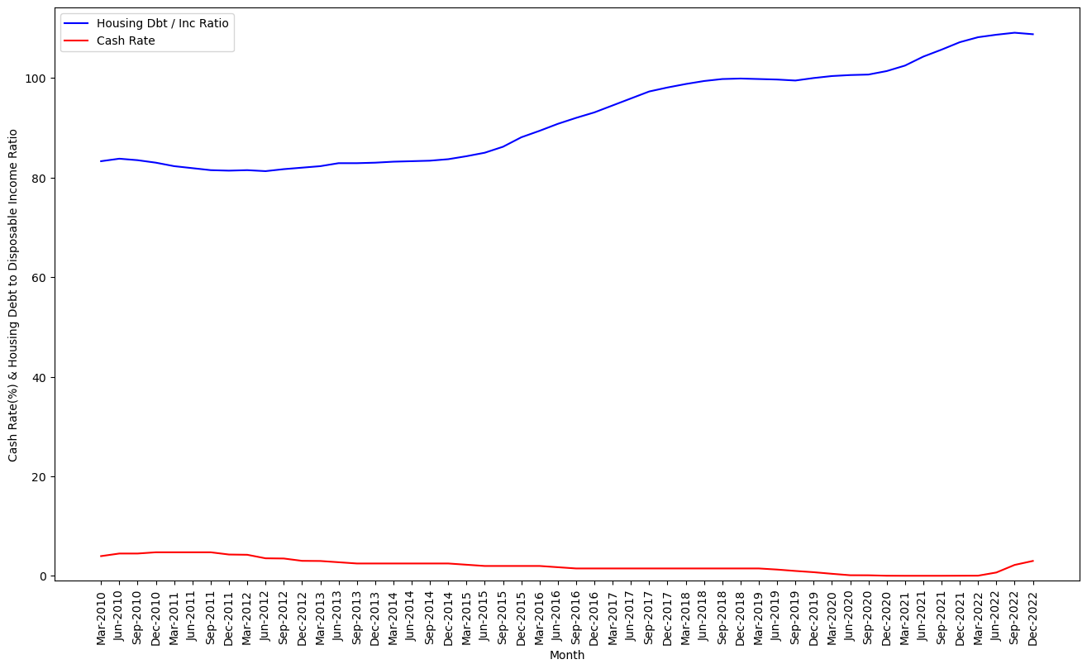
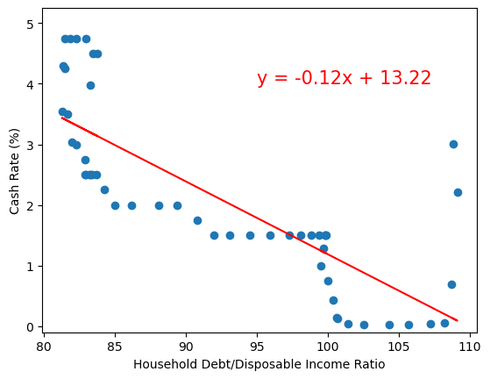
Debt-Income Ratio & Cash Rate
EXAMPLE SLIDE

Slide 8
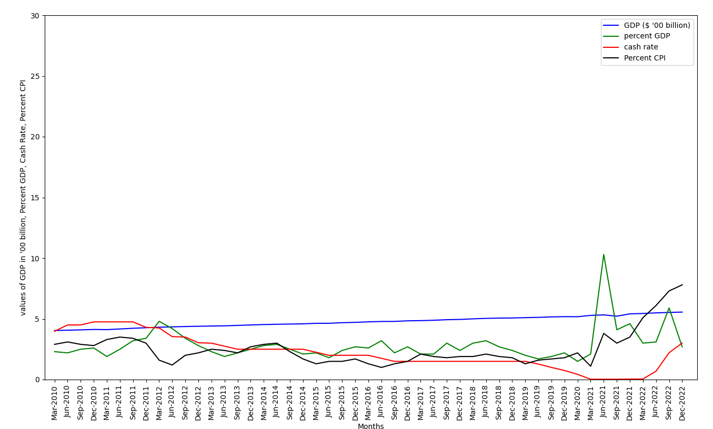
GDP_CPI post 2010
EXAMPLE SLIDE

Slide 9
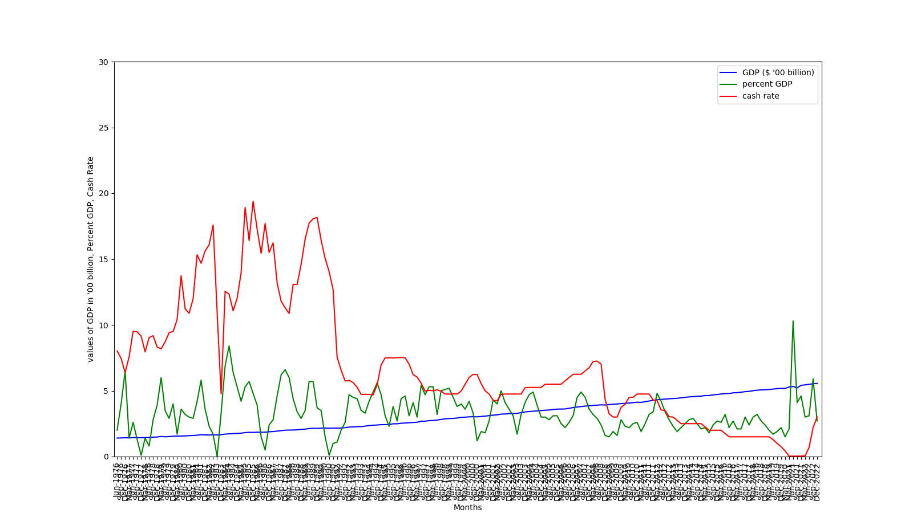
GDP & CASH RATE
EXAMPLE SLIDE
Notes:
Cash rate have general downward trend which can be attributed to the increasing GDP of the country.
However, even though decreasing, the cash rate still fluctuates from month to month, which can be attributed on the % GDP.
The change in %GDP has the opposite effect on the cash rate – the dips on the % GDP cause spikes on the cash rates, and the other way around.
Since GDP is the measure of the country’s economic health, it shows that Australia’s economy is growing, and more money is readily available to be borrowed. Ideally, this is should mean that interest rates should be lower. Hence, the opposite effect on the cash rate for every movement of the GDP.

Slide 10
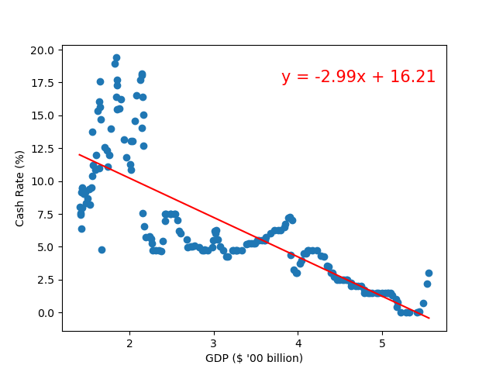
GDP & CASH RATE
Regression Analysis:
R-squared = 0.6192786496983532
Pearson Correlation:
R = -0.79
Notes:
The regression analysis between the GDP value and the cash rate produces a linear model with an r-squared of 0.62. This means that the model is a good enough fit to predict the relationship between the GDP value and the cash rate.
It also has a Pearson correlation coefficient of -0.79, which is a good indicator of the strong negative correlation of the cash rate with the GDP value. This just means that when there is an increase in the GDP, the cash rate will definitely decrease.

Slide 11
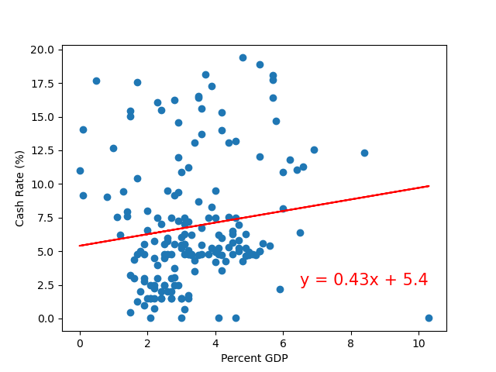
GDP & CASH RATE
Regression Analysis:
R-squared = 0.019360098089405642
Pearson Correlation:
R = 0.14
Notes:
The regression analysis produces an r-squared of 0.019, which is too low to consider the linear model as a good fit to represent the relationship between the % GDP and the cash rate.
It has a Pearson correlation coefficient of 0.14, which shows a very weak correlation between these 2 factors.
It can be inferred, considering the 2 graphs (GDP value and %GDP vs cash rate) that GDP value would actually be a better indicator to predict the next cash rate. However, plotting the % GDP vs the cash rate, as well, would actually allow a better understanding as to why the cash rate increased or decreased to a certain value. (Anyhow, we could always get the predicted % GDP once we have the current GDP value data and the predicted GDP value data)

Slide 12

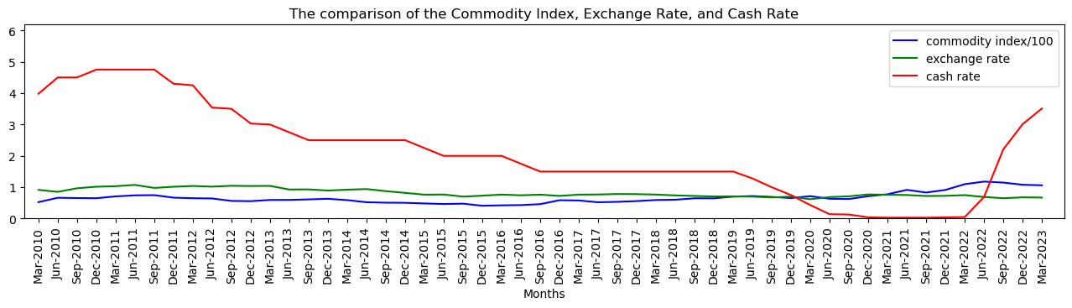
COMMODITY INDEX & EXCHANGE RATE VS CASH RATE

Slide 13
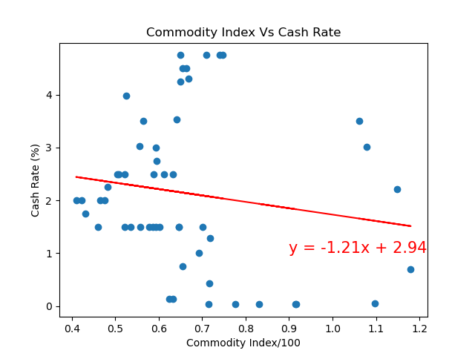
Commodity index vs cash rate
Regression Analysis:
R-squared ≈ 0.0235
Pearson Correlation:
R = -0.15 (very weak)
Linear regression:
y = -1.21x + 2.94

Slide 14
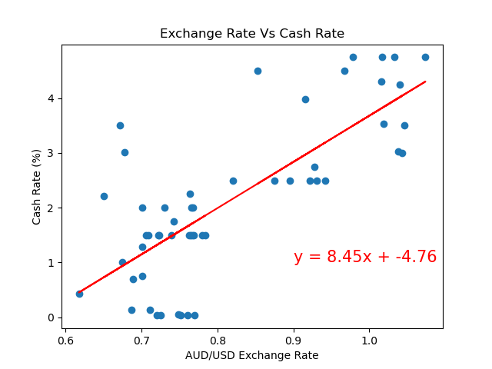
EXCHANGE RATE VS CASH RATE
Regression Analysis:
R-squared ≈ 0.5816
Pearson Correlation:
R = 0.76 (strong)
Linear regression:
y = 8.45X – 4.76

Slide 15
Recommendations
Notes:
5. Recommendations
What, if any, recommendations can be made from the data analysis findings?
Can actions be taken to address issues/minimize risks from the findings?
If so, provide specific, actionable steps.

Slide 16
Summary/conclusion
What are the practical implications of the findings and what they mean for individuals and businesses in the real world.
Notes:
6. Summary/Conclusion
Conclude the presentation by stating the findings with a clear, concise summary of the main points, their implications and any recommendations/actions.
Cover the limitations of the analysis and factors that can provide context.

