Slide 1
Forecasting future cash rates
Factors that influence the RBA cash rate
Project 1 Group 7
Notes:
TITLE SLIDE
A clear and concise title slide clearly conveying the topic of the presentation and grabs the attention of the audience, be easy to read and visually appealing.

Slide 2
Project 1 Group 7
Group Members
Barsha Basel
Ma France Columbino
Siyuan Zhu
Rachel Drayton
Irwine Young

Slide 3
Australia’s cash interest rate
The central bank of a country sets its Cash Interest Rate, to control inflation & promote economic growth.
Banks use the rate to borrow/lend to each other, influencing borrowing costs for individuals & businesses.
Key factors the Reserve Bank of Australia (RBA) consider when setting the cash interest rate include:
Inflation (CPI)
Economic growth (GDP)
International economic conditions (exchange rates and commodities)
Financial stability (household debt/income ratio and unemployment)
Exploring relationships between these factors and the cash rate we sought to answer the questions:
How do these factors influence the RBA cash rate decision?
Which one of these factors is the biggest influencer for the cash rate?
Which of these factors has positive influence and/or negative influence to the cash rate?
What will be the future cash rate based on these 4 factors?
Notes:
2. Introduction - Topic & Objectives
Provide context about the importance of the topic
Outline the objectives of the presentation and what the audience can expect to learn from it.
These questions were of interest due to the direct influence the cash rate has on borrowing costs for individuals & businesses.
When the central bank lowers the cash rate, it makes it cheaper for banks to borrow money, which can lead to lower interest rates for borrowers.
Conversely, when the central bank raises the cash rate, it makes it more expensive for banks to borrow money, which can lead to higher interest rates for borrowers.

Slide 4
Data
Project Analysis time period beginning 2010
Variable | Definition | Source & Dataset
CASH RATE | The cash rate is the market interest rate for overnight loans between financial institutions. | RBA - Cash Rate - Quarterly
CONSUMER PRICE INDEX (CPI) | A measure of the average change overtime in the price paid by urban consumers for a market basket of consumer goods and services. | RBA - CPI – Monthly
EXCHANGE RATE | Relative price of one country expressed in terms of another currency. | RBA - Exchange Rate - Monthly
GROSS DOMESTIC PRODUCT (GDP) | The monetary value of all finished goods and services made within a country during a specific period | RBA - GDP - Quarterly
COMMODITY INDEX | A commodity index is an index that tracks the price of a basket of commodities. | RBA - Commodities - Monthly
UNEMPLOYMENT | The labour force who is willing and able to work but unable to find jobs. | RBA - Unemployment - Quarterly
HOUSING DEBT/DISPOSABLE INCOME RATIO | The money that owner occupier households earns, or gains, each year after taxes and transfers. | RBA - Household Finance - Quarterly
Notes:
RBA cash rate dataset
RBA monthly CPI dataset
RBA quarterly GDP dataset
RBA monthly exchange rate dataset
RBA commodities dataset
RBA Unemployment job data dataset
RBA Housing Debt to Income Ratio

Slide 5
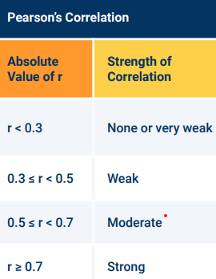
regression analysis
Regression analysis is a statistical method to investigate relationships between two or more variables.
The purpose of regression analysis is to identify patterns and trends in data.
Variables used in the research being presented:
RBA Cash Rate
RBA CPI
RBA GDP
RBA Exchange Rate
RBA Commodities
Unemployment
Housing Debt/Income Ratio
Details the dependent and independent variables in the analysis, and how they are related.

Slide 6
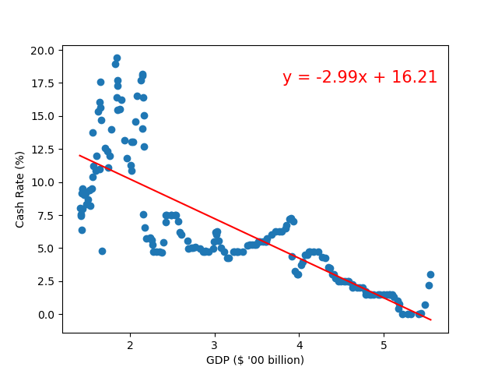
Data Analysis
Which of these factors is the biggest influencer of the cash rate?
GDP ($ ‘00 billion)
Regression Analysis:
R-squared ≈ 0.62
Pearson Correlation:
R = -0.79 (Strong)
Linear regression:
y = -2.99x + 16.21
Notes:
4. Data Analysis
Provide analysis of the data and conclusions.
Explain the findings and insights it provides.
Cash rate have general downward trend which can be attributed to the increasing GDP of the country. Since GDP is the measure of the country’s economic health, it shows that Australia’s economy is growing, and more money is readily available to be borrowed. Ideally, this is should mean that interest rates should be lower. Hence, the opposite effect on the cash rate for every movement of the GDP.
The regression analysis between the GDP value and the cash rate produces a linear model with an r-squared of 0.62. This means that the model has a good enough fit to predict the relationship between the GDP value and the cash rate.
It also has a Pearson correlation coefficient of -0.79, which is a good indicator of the strong negative correlation of the cash rate with the GDP value. This just means that when there is an increase in the GDP, the cash rate will definitely decrease.
However, even though decreasing, the cash rate still fluctuates from month to month, which can be attributed on the % GDP. The the dips on the % GDP cause spikes on the cash rates, and the other way around.
(Plotting the % GDP vs the cash rate would actually allow a better understanding as to why the cash rate increased or decreased to a certain value. (Anyhow, we could always get the predicted % GDP once we have the current GDP value data and the predicted GDP value data))
Q2. Which one of these factors is the biggest influencer for the cash rate?
Economic growth (GDP)

Slide 7
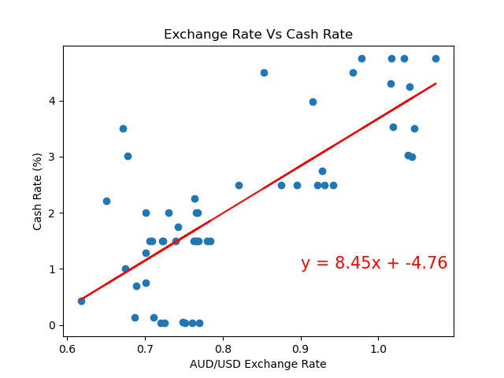
Data Analysis
Which factors have positive and/or negative influence to the cash rate?
Pos
AUD/USD Exchange Rate
Regression Analysis:
R-squared ≈ 0.58
Pearson Correlation:
R = 0.76 (Strong)
Linear regression:
y = 8.45x + -4.76
Notes:
4. Data Analysis
Provide analysis of the data and conclusions.
Explain the findings and insights it provides.
Q3. Which of these factors has positive influence and/or negative influence to the cash rate?
Inflation (CPI)
Economic growth (GDP)
International economic conditions (exchange rates and commodities)
Financial stability (bank interest rates and unemployment

Slide 8
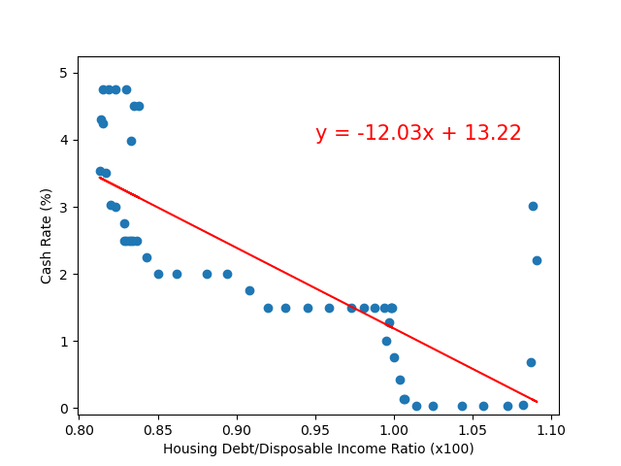
Data Analysis
Which factors have positive and/or negative influence to the cash rate?
Neg
Housing Debt/Disposable Income
Regression Analysis:
R-squared ≈ 0.63
Pearson Correlation:
R = -0.79 (Strong)
Linear regression:
y = -12.03x + 13.22
*Lagging Indicator
Notes:
How the variables in these 4 factors influence the RBA cash rate decision?
4. Data Analysis
Provide analysis of the data and conclusions.
Explain the findings and insights it provides.
Q3. Which of these factors has positive influence and/or negative influence to the cash rate?
Inflation (CPI)
Economic growth (GDP)
International economic conditions (exchange rates and commodities)
Financial stability (bank interest rates and unemployment

Slide 9
Summary/conclusion
Our analysis implies that each factor might have its own “weighting” based on the Pearson Correlation for the RBA cash rate decision.
Trends for GDP ($) and CPI(%) suggests that these factors are leading indicators.
Trends for housing debt/income ratio and exchange suggest that these factors are lagging indicators.
Very weak to no correlation for unemployment, commodity index and % GDP.
You can easily forecast the direction of the cash rate based on these factors.
Factor vs Cash Rate | Pearson Correlation: R = | Strength | Influence Rank
Unemployment Rate | 0.08 | None/Very Weak | 7
Housing Debt / Disposable Income Ratio | -0.79 | Strong - | 1*
Exchange Rate | 0.76 | Strong + | 3*
Commodity Index | -0.15 | None/Very Weak | 5
GDP ($) | -0.79 | Strong - | 1
GDP (%) | 0.14 | None/Very Weak | 6
CPI (%) | 0.69 | Moderate | 4
*NB. lagging indicator
Notes:
How the variables in these 4 factors influence the RBA cash rate decision?
What will be the future cash rate based on these 4 factors?
6. Summary/Conclusion
Leading indicator – predictive indicator (GDP, CPI?) – normally CPI is a lagging indicator, but at this instance, the data shows CPI is one of the leading indicator that influences the recent cash rate decision.
Lagging indicator – output measurement (debt/income ratio, exchange rate), we can also include unemployment rate.
So, can we actually forecast the cash rate based on these dataset? Yes and no. No, for short term time horizon (6-12mo) forecasting as there are other recent factors that can influence the cash rate decision. Yes for long term time (1-5yrs) horizon forecasting.
Which lead us to recommendation and limitation to our analysis.
GDP is the leading indicator affecting the Cash Rate
Housing Debt/Disposable Income Ratio is a lagging indicator of the effect of the Cash Rate

Slide 10
Recommendations/Limitations
RBA datasets for each factors are not complete as initial data dates vary:
1922 (CPI)
1976 (Cash rate)
2013 (unemployment)
Private entities will have a more complete database for these datasets.
Machine learning can assist to forecast the interest based on the dataset.
Recent events heavily influencing the recent cash rate decision:
Global politics (Ukraine war)
Supply chain issues (oil price hike, grain export)
Logistic issues (lockdowns)
Covid19
Notes:
Private entities like banks, hedge fund, fund managers will have more complete database, as such, are able to forecast the cash rate better than using RBA datasets
Using a more complete database to do machine learning can also greatly assist in forecasting the cash rate
Global geopolitics
Supply chain issues – oil/energy (EU), grain export
Logistics issues – early 2021/2022, lockdowns

Slide 11
Thank You
Project 1 Group 7
Notes:
FINAL SLIDE

Slide 12
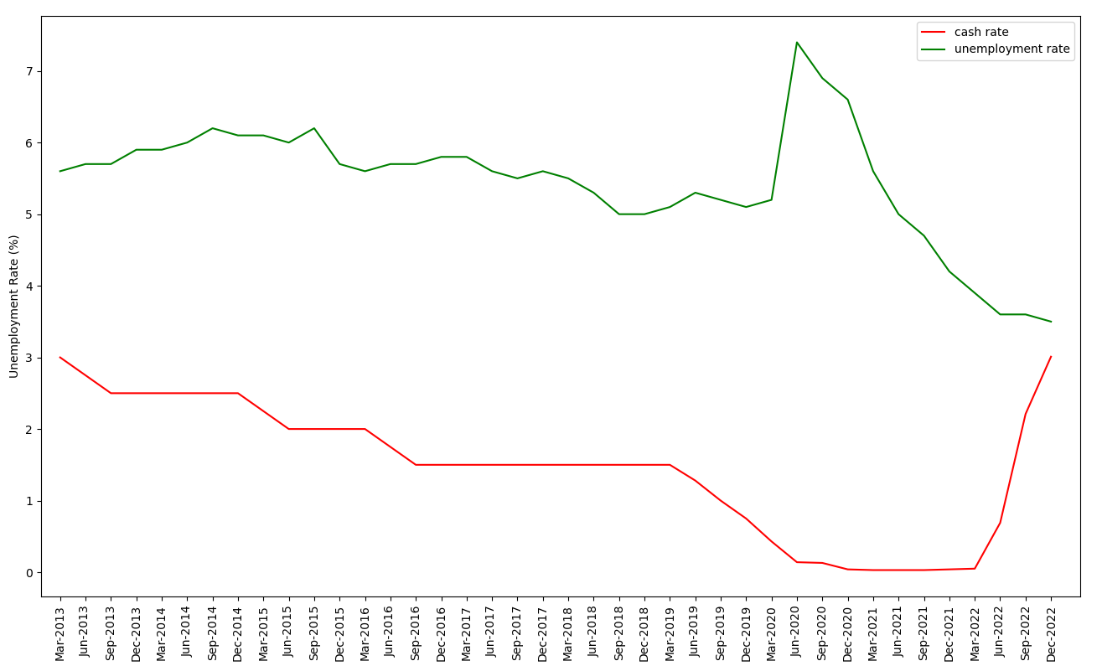
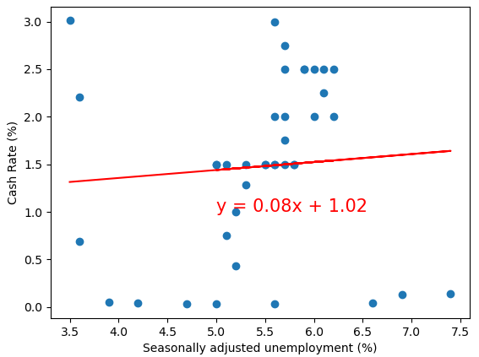
UNEMPLOYMENT & Cash Rate
Regression Analysis: R-squared ≈ 0.005
Pearson Correlation: R = 0.08 (None/Very Weak)
Linear Regression: y = 0.08x + 1.02

Slide 13
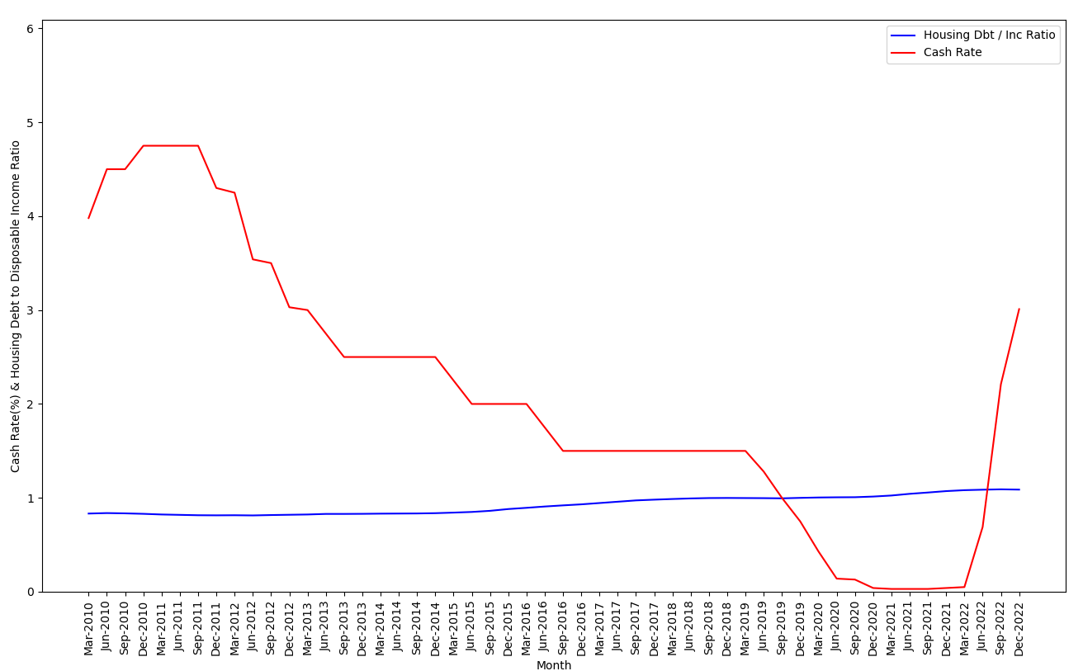
DEBT-INCOME RATIO & Cash Rate
Regression Analysis: R-squared ≈ 0.63
Pearson Correlation: R = -0.79 (Strong)
Linear Regression: y = -12.03x + 13.22

Slide 14
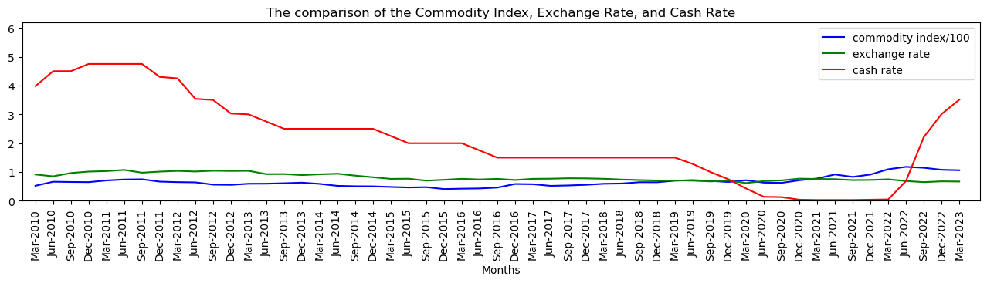
EXCHANGE RATE & Cash Rate
Regression Analysis: R-squared ≈ 0.58
Pearson Correlation: R = 0.76 (Strong)
Linear regression: y = 8.45x + -4.76

Slide 15
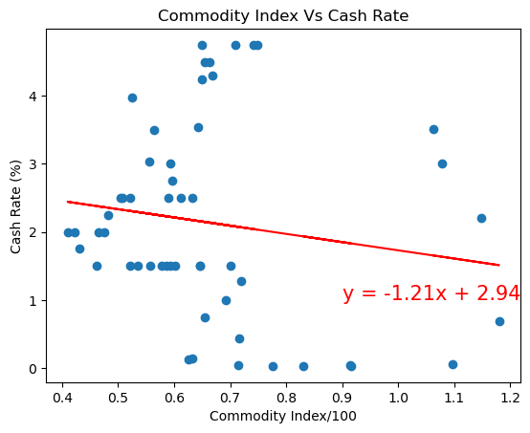
COMMODITY INDEX & Cash Rate
Regression Analysis: R-squared ≈ 0.023
Pearson Correlation: R = -0.15 (None/Very weak)
Linear regression: y = -1.21x + 2.94

Slide 16
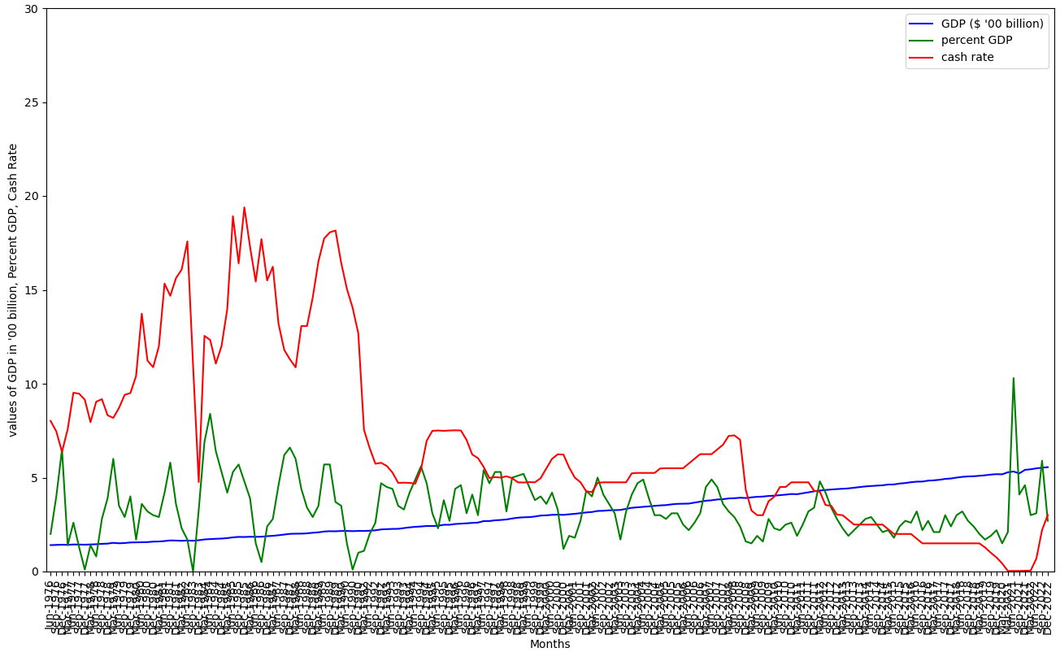
GDP ($) & Cash Rate
Regression Analysis: R-squared ≈ 0.62
Pearson Correlation: R = -0.79 (Strong)
Linear Regression: y = -2.99x + 16.21

Slide 17
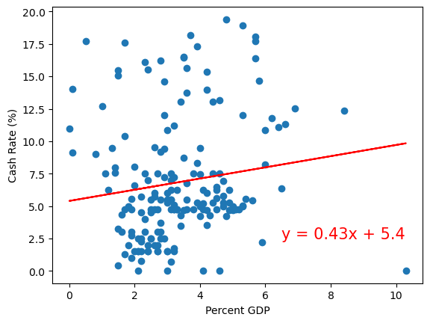
GDP (%) & Cash Rate
Regression Analysis: R-squared ≈ 0.019
Pearson Correlation: R = -0.14 (None/Very weak)
Linear Regression: y = 0.43x + 5.4

Slide 18
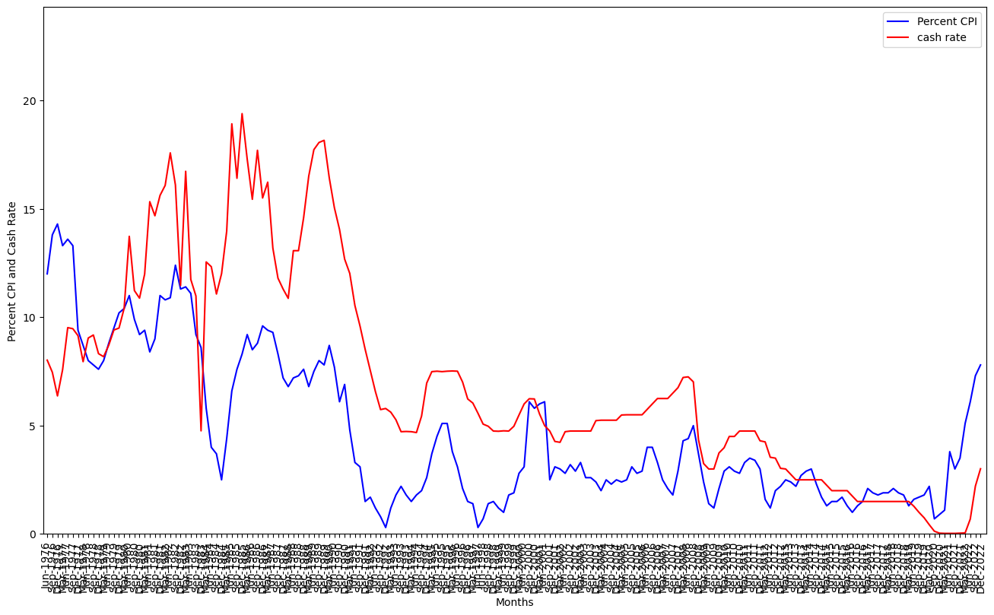
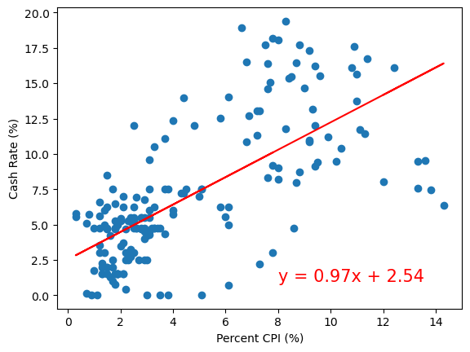
CPI (%) & Cash Rate
Regression Analysis: R-squared ≈ 0.47
Pearson Correlation: R = 0.69 (Moderate)
Linear Regression: y = 0.97x + 2.54

