Slide 1
Code, Train, Deploy: The AI Engineer’s Path to Success
All Hands-on from Algorithms, Programming to Real Projects
INSTRUCTOR VIVIAN ARANHA

Slide 2
WEEK 1: Python Programming Basics
Day 1
Introduction to Python and Development Setup
Day 2
Control Flow in Python
Day 3
Functions and Modules
Day 4
Data Structures (Lists, Tuples, Dictionaries, Sets)
Day 5
Working with Strings
Day 6
File Handling
Day 7
Pythonic Code and Project Work

Slide 3
Day 01
Introduction to Python and Development Setup

Slide 4
Overview of Python and its Role in AI
Why Python for AI
Applications of Python in AI
Machine Learning
Deep Learning
Data Science and Analytics
Natural Language Processing (NLP)
Automation and Scripting

Slide 5
Installing Python and Setting Up a Coding Environment
Installing Python
Setting Up a Coding Environment
Jupyter Notebooks
Visual Studio Code

Slide 6
Introduction to Basic Python Syntax, Variables, and Data Types
Basic Syntax
Variables
Data Types
Integers | Floats | Strings | Lists | Tuples | Dictionaries | Booleans
Examples of Using Variables and Data Types

Slide 7
Hands-On Exercise
Exercise 1: Write a Python script to print a message
Exercise 2: Practice Creating and Manipulating Variables of Different Data Types

Slide 8
Day 02
Control Flow in Python

Slide 9
Conditional Statements
Syntax:
if: Executes code if a condition is True
elif: Adds additional conditions after the initial if
else: Executes code if none of the previous conditions are met

Slide 10
Loops
for Loop
Iterates over a sequence
while Loop
Executes as long as a condition is True

Slide 11
Using break and continue for Control Flow
break
Terminates the loop prematurely when a condition is met
continue
Skips the current iteration and proceeds to the next

Slide 12
Hands-On Exercise
Exercise 1: Check if a Number is Prime
Exercise 2: Create a Menu-Driven Calculator
Additional Practice:
Write a program to calculate the factorial of a number using a while loop
Create a program to find the largest number in a list using a for loop

Slide 13
Day 03
Functions and Modules in Python

Slide 14
Defining Functions with def
What are Functions?
Defining a Function
Examples

Slide 15
Scope and Lifetime of Variables
Scope
Local Scope
Global Scope
Lifetime
Examples

Slide 16
Importing and Using Modules
What are Modules?
Importing Modules
Import an entire module
Import specific functions
Use aliases
Creating Custom Modules

Slide 17
Hands-On Exercises
Exercise 1: Create a Function to Calculate Factorials
Exercise 2: Build a Custom Python Module
Additional Practice:
Exercise 1: Write a function to check if a number is even or odd and call it within another function
Exercise 2: Create a module for string operations, including functions to reverse a string, count vowels, and check for palindromes. Import it into a script and test the functions

Slide 18
Day 04
Data Structures (Lists, Tuples, Dictionaries, Sets)

Slide 19
Lists
What are Lists?
Creating Lists
Accessing Elements
Access by index
Negative indexing
Modifying Lists
Slicing Lists

Slide 20
Tuples
What are Tuples?
Creating Tuples
Accessing Elements
Immutability

Slide 21
Dictionaries
What are Dictionaries?
Creating Dictionaries
Accessing and Modifying Data
Access
Add or Update
Remove
Iteration

Slide 22
Sets
What are Sets?
Creating Sets
Adding and Removing Elements
Set Operations
Union
Intersection
Difference

Slide 23
Hands-On Exercises
Exercise 1: Manipulate Data in a Dictionary
Exercise 2: Word Frequency Counter
Additional Practice
Write a program to reverse a list and remove duplicates using a set
Create a program that stores student grades in a dictionary and calculates the average grade

Slide 24
Day 05
Working with Strings

Slide 25
String Manipulation
Concatenation
Slicing
Formatting

Slide 26
Common String Methods
split()
join()
replace()
strip()

Slide 27
Regular Expressions for Pattern Matching
What are Regular Expressions?
Using the re Module
Common Functions
re.search(pattern, string)
re.findall(pattern, string)
re.sub(pattern, replacement, string)
Examples

Slide 28
Hands-On Exercises
Exercise 1: Create a Text Cleaner
Exercise 2: Check if a String is a Palindrome
Additional Practice
Write a program to count the number of vowels in a string
Create a program to find and replace all email addresses in a text using regex
Write a program to reverse the words in a sentence (not the letters)

Slide 29
Day 06
File Handling

Slide 30
Reading and Writing Text Files
Opening Files
Use the built-in open() function to open a file
r | w | a | r+
Reading Files
.read() | .readline() | .readlines()
Writing to Files
.write() | .writelines()

Slide 31
Using ‘with’ Statements for File Management
What is the with Statement?
Ensures files are properly closed after operations, even if an exception occurs
Advantages
Simplifies code
Reduces the risk of file corruption

Slide 32
Basic Exception Handling for File Operations
Why Use Exception Handling?
Prevents the program from crashing due to file-related errors (e.g., file not found)
Using try-except Blocks
Common File Handling Exceptions
FileNotFoundError
PermissionError
IOError

Slide 33
Hands-On Exercises
Exercise 1: Count Words and Lines in a File
Exercise 2: Write and Read a List of Items
Additional Practice
Write a program to copy the contents of one file to another
Create a program that counts the number of occurrences of a specific word in a text file
Write a program to log messages with timestamps into a file

Slide 34
Day 07
Pythonic Code and Project Work

Slide 35
Writing Clean, “Pythonic” Code
What is Pythonic Code?
Best Practices
Use descriptive variable names
Write modular code with functions and classes
Follow PEP 8 style guidelines
Avoid redundancy; leverage Python’s powerful built-ins

Slide 36
List Comprehensions
What Are List Comprehensions?
A concise way to create lists using a single line of code
Examples

Slide 37
Lambda Functions
What Are Lambda Functions?
Anonymous, single-expression functions defined using the lambda keyword
Examples

Slide 38
map(), filter(), and reduce()
map()
Applies a function to each item in an iterable
filter()
Filters items based on a condition
reduce()
Reduces an iterable to a single value

Slide 39
Python’s os and sys Modules
os Module
Provides functions to interact with the operating system
sys Module
Provides access to system-specific parameters and functions

Slide 40
Hands-On Project
Command-Line Task Manager
Additional Features to Add
Add deadlines or priorities for tasks
Export tasks to a JSON or CSV file
Support command-line arguments for quicker task management

Slide 41
WEEK 2: Data Science Essentials
Day 1
Introduction to NumPy for Numerical Computing
Day 2
Advanced NumPy Operations
Day 3
Introduction to Pandas for Data Manipulation
Day 4
Data Cleaning and Preparation with Pandas
Day 5
Data Aggregation and Grouping in Pandas
Day 6
Data Visualization with Matplotlib and Seaborn
Day 7
Exploratory Data Analysis (EDA) Project

Slide 42
Day 01
Introduction to NumPy for Numerical Computing

Slide 43
Understanding the Role of NumPy in Data Science and AI
What is NumPy?
Why Use NumPy in AI?
Performance
Ease of Use
Integration

Slide 44
Creating and Manipulating NumPy Arrays
Import NumPy
Creating Arrays
From a list
Using built-in functions
Manipulating Arrays
Change shape
Add dimensions

Slide 45
Basic Operations on Arrays
Element-wise Operations
Mathematical Operations

Slide 46
Array Indexing, Slicing, and Reshaping
Indexing
Slicing
Reshaping

Slide 47
Hands-On Exercises
Exercise 1: Generate Arrays for Basic Mathematical Operations
Exercise 2: Create a 3x3 Matrix and Perform Operations
Additional Practice
Create a 4x4 matrix and calculate the sum of its rows and columns
Write a program to normalize an array (scale values between 0 and 1)
Generate a random array and find the minimum and maximum values

Slide 48
Day 02
Advanced NumPy Operations

Slide 49
Broadcasting in NumPy
What is Broadcasting?
Rules of Broadcasting
Dimensions are aligned from the right
A dimension is compatible if:
It matches the other array’s dimension
One of the dimensions is 1

Slide 50
Aggregation Functions
Aggregation functions compute summary statistics for arrays
Common Functions

Slide 51
Boolean Indexing and Filtering
What is Boolean Indexing?
Examples

Slide 52
Random Number Generation and Setting Seeds
Random Number Generation
np.random
Setting Random Seeds

Slide 53
Hands-On Exercises
Exercise 1: Broadcasting Operations
Exercise 2: Generate and Filter a Random Dataset
Additional Practice
Create a 3D random array and compute statistics along specific axes
Write a program to generate a dataset of random floats and normalize the values between 0 and 1
Implement conditional replacement to create a binary mask for values above a threshold

Slide 54
Day 03
Introduction to Pandas for Data Manipulation

Slide 55
Introduction to Pandas Data Structures
What is Pandas?
Pandas Data Structures
Series
DataFrame

Slide 56
Loading Data from CSV, Excel, and Other Sources
Common Data Loading Methods
From CSV
From Excel
From a Dictionary
Saving Data
Save to CSV
Save to Excel

Slide 57
Basic DataFrame Operations
Viewing Data
Selecting and Indexing
Selecting columns
Filtering rows
Selecting by position
Selecting by label

Slide 58
Hands-On Exercises
Exercise 1: Load and Explore a Sample Dataset
Exercise 2: Select Specific Columns and Filter Rows
Additional Practice
Load a local Excel file and explore its structure
Create a DataFrame from a dictionary and add a new calculated column
Save filtered data to a new CSV file

Slide 59
Day 04
Data Cleaning and Preparation with Pandas

Slide 60
Handling Missing Values
Why Handle Missing Values?
Methods to Handle Missing Values
Drop Missing Values
Fill Missing Values
Interpolation

Slide 61
Data Transformations
Renaming Columns
Changing Data Types
Creating or Modifying Columns

Slide 62
Combining and Merging DataFrames
Concatenation
Merging
Joining

Slide 63
Hands-On Exercises
Exercise 1: Clean a Dataset by Handling Missing Values and Renaming Columns
Exercise 2: Merge Two Datasets and Perform Data Transformations
Additional Practice
Drop columns with more than 50% missing values
Merge three datasets and analyze relationships between them
Convert categorical data to numerical using one-hot encoding

Slide 64
Day 05
Data Aggregation and Grouping in Pandas

Slide 65
Grouping Data by Categories
Why Group Data?
groupby in Pandas
Operations
Iterate over groups
Apply aggregation

Slide 66
Aggregation Functions
Using groupby
Using pivot_table
Custom Aggregation
Apply custom functions using .agg()

Slide 67
Calculating Summary Statistics for Grouped Data
Common Statistics
Mean
Max
Min
Multi-Aggregation

Slide 68
Hands-On Exercises
Exercise 1: Group Data by a Categorical Column
Exercise 2: Calculate Summary Statistics for Grouped Data
Additional Practice
Create a dataset of sales data and group it by region or product category
Use pivot_table to calculate total sales per region and per year
Create a custom aggregation function to calculate the variance for each group

Slide 69
Day 06
Data Visualization with Matplotlib and Seaborn

Slide 70
Introduction to Matplotlib for Plotting
What is Matplotlib?
Basic Syntax

Slide 71
Basic Plots
Line Plot
Bar Chart
Histogram
Scatter Plot

Slide 72
Customizing Plots
Add titles, axis labels, and legends
Adjust colors and styles

Slide 73
Introduction to Seaborn for Advanced Visualizations
What is Seaborn?
Common Seaborn Plots
Heatmap
Pairplot

Slide 74
Hands-On Exercises
Exercise 1: Create Basic Plots with Matplotlib
Exercise 2: Create a Heatmap with Seaborn
Additional Practice
Create a histogram with multiple datasets overlaid
Use Seaborn to create a violin plot or box plot for visualizing distributions
Combine multiple plots in a single figure using Matplotlib's subplot

Slide 75
Day 07
Exploratory Data Analysis (EDA) Project

Slide 76
Applying Data Manipulation and Visualization for EDA
What is EDA?
Steps in EDA
Data Cleaning
Data Transformation
Aggregation and Filtering

Slide 77
Identifying Patterns, Trends, and Correlations
Visual Tools for Insights:
Line plots for trends over time
Bar charts for categorical comparisons
Scatter plots for relationships
Heatmaps for correlation analysis
Key Patterns to Look For:
Relationships between variables (correlations)
Distribution of variables (histograms, boxplots)
Outliers or anomalies

Slide 78
Summary Statistics, Visual Insights, and Hypothesis Generation
Summary Statistics
Hypothesis Generation

Slide 79
Hands-On Project: EDA on a Sample Dataset
Task 1: Perform Data Cleaning, Aggregation, and Filtering
Task 2: Generate Visualizations to Illustrate Key Insights
Task 3: Identify and Interpret Patterns or Anomalies
Task 4: Summarize Findings in a Report
Additional Practice
Use another dataset and apply the same EDA steps
Explore advanced visualizations like boxplots or pairplots in Seaborn
Create a dashboard for your findings using Plotly or Dash.

Slide 80
WEEK 3: Mathematics for Machine Learning
Day 1
Linear Algebra Fundamentals
Day 2
Advanced Linear Algebra Concepts
Day 3
Calculus for Machine Learning - Derivatives
Day 4
Calculus for Machine Learning - Integrals and Optimization
Day 5
Probability Theory and Distributions
Day 6
Statistics Fundamentals
Day 7
Math-Driven Mini Project – Linear Regression from Scratch

Slide 81
Day 01
Linear Algebra Fundamentals

Slide 82
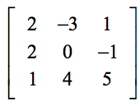
Vectors and Matrices
Vector
Example:[2,3,4]
Matrix
Properties

Slide 83

Matrix Operations
Addition and Subtraction
Scalar Multiplication
Matrix Multiplication

Slide 84
Special Matrices
Identity Matrix (𝐼)
𝐼 ⋅ A = A
Zero Matrix (0)
Diagonal Matrix

Slide 85
Hands-On Exercises
Exercise 1: Create Vectors and Matrices Using NumPy
Exercise 2: Implement Matrix-Vector Multiplication
Exercise 3: Explore Special Matrices
Additional Practice
Compute the determinant and inverse of a 2×2 matrix using NumPy
Verify properties of matrix multiplication
Create a block diagonal matrix using NumPy

Slide 86
Day 02
Advanced Linear Algebra Concepts

Slide 87
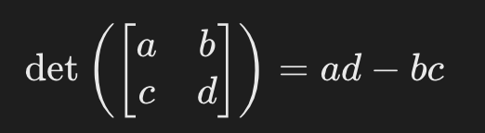
Determinants and Inverse of a Matrix
Determinants
Scalar value that provides information about a matrix’s properties
Only for square matrices
det(A) = 0, the matrix A is singular
det(A) != 0, A is invertible
Geometric Interpretation
For a 2×2 matrix, the determinant represents the scaling factor of the area formed by its column vectors
Formula for 2 × 2 Matrix:

Slide 88
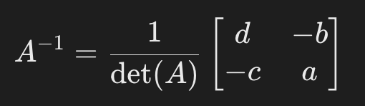
Determinants and Inverse of a Matrix
Inverse of a Matrix
denoted as A⁻¹
Product of a matrix and its inverse is the identity matrix: A x A⁻¹ = I
Matrix is invertible only if det ( 𝐴 ) ≠ 0
Formula for 2 × 2 2×2 Matrix

Slide 89
Eigenvalues and Eigenvectors
What are Eigenvalues and Eigenvectors?
If 𝐴 ⋅ 𝑣 = 𝜆 ⋅ 𝑣, then
𝑣 is an eigenvector
λ is the eigenvalue
Geometric Interpretation
Eigenvectors point in the direction where the matrix transformation stretches or compresses vectors
Eigenvalues indicate the factor of stretching or compression
Properties
Matrix of size 𝑛 × 𝑛 has 𝑛 n eigenvalues and eigenvectors
Eigenvalues can be real or complex
For a symmetric matrix, eigenvalues are always real.
Computing Eigenvalues and Eigenvectors in NumPy

Slide 90
Introduction to Matrix Decomposition
What is Matrix Decomposition?
Process of breaking a matrix into simpler components to analyze or solve problems
Singular Value Decomposition (SVD)
SVD decomposes a matrix 𝐴 A into three matrices: 𝐴 = 𝑈 ⋅ Σ ⋅ 𝑉^{T}
U: Left singular vectors (orthogonal matrix)
Σ: Diagonal matrix of singular values (non-negative).
𝑉^{T}: Right singular vectors (orthogonal matrix).
Applications of SVD
Computing SVD in NumPy

Slide 91
Hands-On Exercises
Exercise 1: Calculate Determinant and Inverse of a Matrix
Exercise 2: Compute Eigenvalues and Eigenvectors
Exercise 3: Perform Singular Value Decomposition
Additional Practice
Compute eigenvalues and eigenvectors for larger matrices
Use SVD to reduce the dimensionality of a dataset
Verify the property of eigenvalues: det ( 𝐴 − 𝜆 𝐼 ) = 0

Slide 92
Day 03
Calculus for Machine Learning (Derivatives)

Slide 93


Introduction to Derivatives and Their Role in Optimization
What are Derivatives?
Measures the rate at which a function changes with respect to its input
For a function 𝑓 ( 𝑥 ), the derivative 𝑓 ′ ( 𝑥 ) indicates the slope of the tangent line at a point 𝑥
Role in Optimization
Common Derivatives

Slide 94
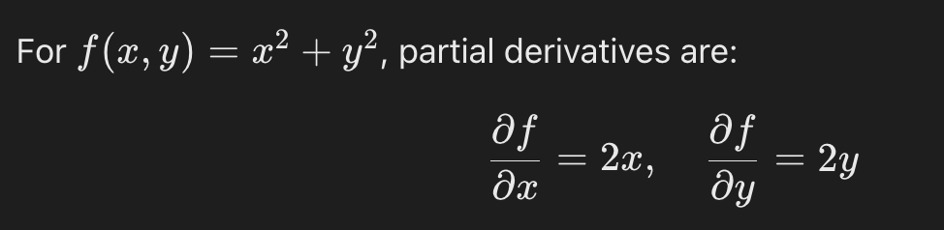
Partial Derivatives
Partial Derivatives
Measures how a function changes with respect to one variable while keeping other variables constant

Slide 95
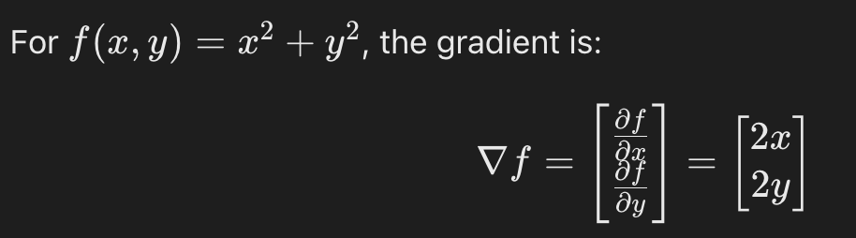
Gradients
Gradient
Vector of all partial derivatives, indicating the direction of the steepest ascent

Slide 96
Gradient Descent Optimization Algorithm
What is Gradient Descent?
Iterative optimization algorithm used to minimize a function
Updates parameters in the direction of the negative gradient to find the minimum
Update Rule: θ = θ − α∇f(θ)
θ: Parameters of the model
α: Learning rate (step size)
Why is Gradient Descent Important in Machine Learning?

Slide 97
Hands-On Exercises
Exercise 1: Compute Derivatives of Basic Functions
Exercise 2: Compute Gradients
Exercise 3: Implement Gradient Descent for Linear Regression
Additional Practice
Use sympy to compute second-order derivatives (Hessian matrix)
Implement gradient descent with multiple learning rates and compare convergence speeds
Visualize the gradient descent process on a quadratic function.

Slide 98
Day 04
Calculus for Machine Learning (Integrals and Optimization)

Slide 99
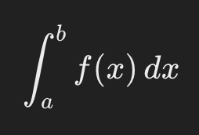
Understanding Integrals and their Applications in ML
What Are Integrals?
Compute the area under a curve, representing accumulation
The definite integral of 𝑓 ( 𝑥 ) from 𝑎 to 𝑏:
Applications in ML
Probability Distributions
Cost Functions

Slide 100
Optimization Concepts
Local vs. Global Minima
Local Minimum
Global Minimum
Convex Functions
f (λx1 ​+ (1 − λ) x2) ≤ λf(x1) + (1 − λ) f(x2) for all λ ∈ [0, 1]
Ensure that any local minimum is also a global minimum
Non-Convex Functions in ML
Most neural network loss functions

Slide 101
Stochastic Gradient Descent (SGD) and Its Variants
What is Stochastic Gradient Descent?
Optimization algorithm that uses random subsets (mini-batches) of the data to compute gradients and update parameters
Why Use SGD?
Variants of SGD
Mini-Batch SGD
Momentum
Adam Optimizer

Slide 102
Hands-On Exercises
Exercise 1: Calculate Integrals of Simple Functions
Exercise 2: Implement Stochastic Gradient Descent for a Linear Model
Additional Practice
Visualize the loss function’s surface and the SGD optimization path
Implement Mini-Batch SGD and compare it with vanilla SGD
Use Adam optimizer for a more complex dataset

Slide 103
Day 05
Probability Theory and Distributions

Slide 104
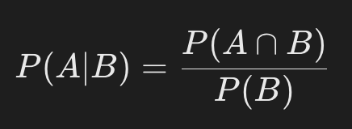
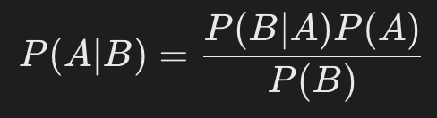
Probability Basics
Conditional Probability
The probability of an event 𝐴 given that event 𝐵 has occurred
Bayes’ Theorem
P( 𝐴 ) Prior probability
𝑃 ( 𝐵 ∣ 𝐴 ) Likelihood
𝑃 ( 𝐵 ) Evidence

Slide 105
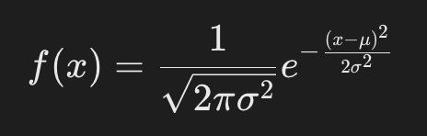
Common Probability Distributions
Gaussian (Normal) Distribution
Bell-shaped curve with mean (𝜇) and standard deviation (𝜎)
Bernoulli Distribution
Describes outcomes of a binary experiment

Slide 106
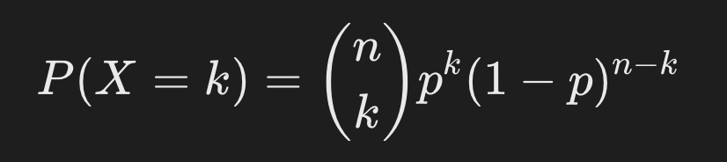
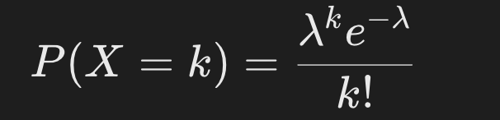
Common Probability Distributions
Binomial Distribution
Models the number of successes in 𝑛 independent Bernoulli trials
Poisson Distribution
Models the number of events in a fixed interval of time or space

Slide 107
Applications in Machine Learning
Gaussian Distribution
Used in Gaussian Naive Bayes and kernel density estimation
Bernoulli Distribution
Models binary classification problems
Binomial Distribution
Used in logistic regression to model binary outcomes.
Poisson Distribution
Models count data

Slide 108
Hands-On Exercises
Exercise 1: Calculate Probabilities Using Bayes’ Theorem
Exercise 2: Plot and Explore Different Probability Distributions
Additional Practice
Create and visualize a multinomial distribution for multi-class data
Compare Gaussian and uniform distributions for continuous data
Use probability distributions to simulate and analyze real-world datasets

Slide 109
Day 06
Statistics Fundamentals

Slide 110
Measures of Central Tendency and Dispersion
Central Tendency
Mean: The average value of a dataset
Median: The middle value when data is sorted
Mode: The most frequently occurring value
Dispersion
Variance: The average squared deviation from the mean
Standard Deviation: The square root of variance, indicating the spread of data. python Copy code

Slide 111
Hypothesis Testing
What is Hypothesis Testing?
Steps
Formulate Hypotheses
Null Hypothesis
Alternative Hypothesis
Calculate Test Statistic
Determine P-Value
Interpret Results

Slide 112
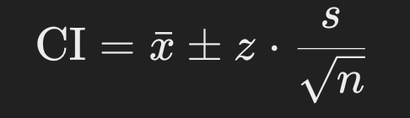
Confidence Intervals and Statistical Significance
Confidence Interval
Range of values within which the true population parameter is expected to lie
x: Sample mean
𝑧: Z-score
𝑠: Standard deviation
Statistical Significance

Slide 113
Hands-On Exercises
Exercise 1: Calculate Mean, Variance, and Standard Deviation
Exercise 2: Perform a T-Test
Additional Practice
Visualize the distribution of data and highlight mean, median, and mode using Matplotlib
Perform hypothesis testing on real-world datasets (e.g., comparing exam scores of two groups)
Calculate confidence intervals for proportions in a dataset.

Slide 114
Day 07
Math-Driven Mini Project Linear Regression from Scratch

Slide 115
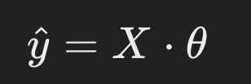
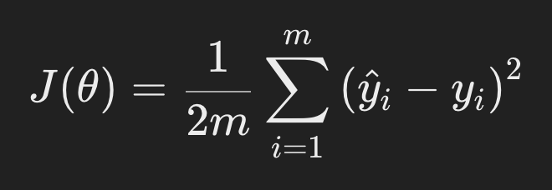
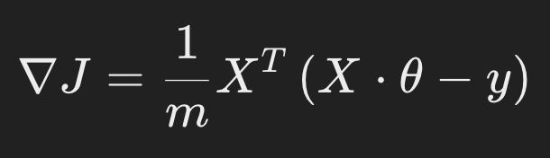
Applying Linear Algebra, Calculus, and Statistics
Linear Algebra
Mathematical Model:
X: Feature matrix (with bias term) | 𝜃: Parameters (weights and bias) | 𝑦^: Predicted values.
Calculus
Optimization of 𝜃 involves minimizing the loss function
Gradient of 𝐽 (𝜃):
Statistics
Metrics like Mean Squared Error (MSE) and 𝑅² are used to evaluate model performance

Slide 116
Using Gradient Descent for Parameter Optimization
Gradient Descent Algorithm
Iteratively update 𝜃 using θ := θ − α⋅∇J
α: Learning rate
Key Steps
Initialize parameters (𝜃)
Compute gradients (∇𝐽)
Update parameters using the gradient descent rule

Slide 117
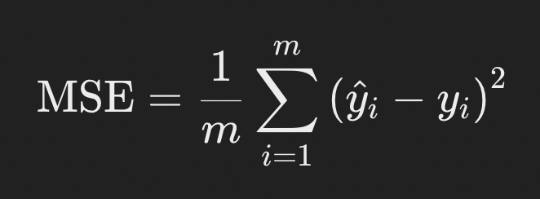
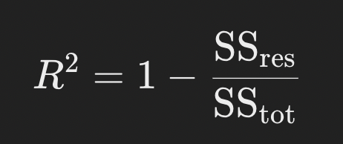
Evaluating the Model Using Statistical Metrics
Mean Squared Error (MSE)
Measures the average squared error
R-squared (𝑅²)
Measures how well the regression line explains the variance in the data

Slide 118
Hands-On Project: Linear Regression from Scratch
Task 1: Implement the Mathematical Formula for Linear Regression
Task 2: Use Gradient Descent to Optimize the Model Parameters
Task 3: Calculate Evaluation Metrics

Slide 119
WEEK 4: Probability and Statistics for Machine Learning
Day 1
Probability Theory and Random Variables
Day 2
Probability Distributions in Machine Learning
Day 3
Statistical Inference - Estimation and Confidence Intervals
Day 4
Hypothesis Testing and P-Values
Day 5
Types of Hypothesis Tests
Day 6
Correlation and Regression Analysis
Day 7
Statistical Analysis Project – Analyzing Real-World Data

Slide 120
Day 01
Probability Theory and Random Variables

Slide 121
Basic Probability Concepts
Sample Space and Events
Sample Space: The set of all possible outcomes of a random experiment
Events: A subset of the sample space
Conditional Probability
The probability of an event 𝐴 occurring, given that 𝐵 has occurred
Independence
Two events 𝐴 and 𝐵 are independent if
P(A∩B) = P(A) ⋅ P(B)
Example with Python

Slide 122
Random Variables
What are Random Variables?
Maps outcomes of a random experiment to numerical values
Types: Discrete | Continuous
Probability Mass Function (PMF)
Probability distribution of a discrete random variable
Probability Density Function (PDF)
Probability distribution of a continuous random variable

Slide 123
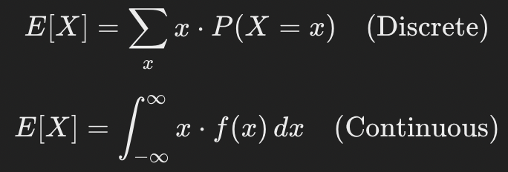


Expectation, Variance, and Standard Deviation
Expectation (𝐸 [𝑋])
Weighted average of a random variable’s possible values
Variance (𝑉𝑎𝑟[𝑋])
Measures the spread of a random variable
Standard Deviation (𝜎𝑋)
Square root of variance:

Slide 124
Hands-On Exercises
Exercise 1: Simulate Dice Rolls and Calculate Probabilities
Exercise 2: Create and Analyze Random Variables
Additional Practice
Simulate flipping a coin 10,000 times and calculate probabilities of heads/tails
Compute the expectation and variance of a weighted die (biased probabilities)
Explore other distributions (e.g., normal, binomial) using Python

Slide 125
Day 02
Probability Distributions in Machine Learning

Slide 126
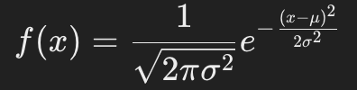
Common Probability Distributions
Gaussian (Normal) Distribution
Bell-shaped curve characterized by mean (𝜇) and standard deviation (𝜎)
Probability Density Function (PDF)
Properties
Symmetric about the mean
Mean, median, and mode are the same
Application in ML
Common assumption in many algorithms (e.g., Naive Bayes)
Used in feature scaling (e.g., standardization)

Slide 127
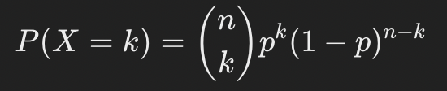
Common Probability Distributions
Binomial Distribution
Models the number of successes in 𝑛 n independent Bernoulli trials
Probability Mass Function (PMF)
Properties
Discrete distribution
Parameters: 𝑛(number of trials), 𝑝(probability of success)
Application in ML
Logistic regression assumes a binomial distribution for binary classification

Slide 128
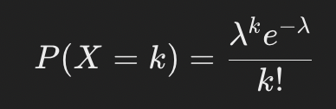
Common Probability Distributions
Poisson Distribution
Models the number of events in a fixed interval
Probability Mass Function (PMF)
Properties
Discrete distribution
Parameter: 𝜆 (average rate of occurrence)
Application in ML
Used in event modeling

Slide 129
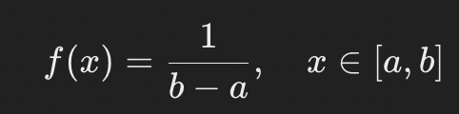
Common Probability Distributions
Uniform Distribution
Equal probability for all outcomes in a range
Probability Density Function (PDF)
Properties
Continuous distribution
Parameters: 𝑎(lower bound), 𝑏(upper bound)
Application in ML
Random initialization of weights in neural networks

Slide 130
Application of Distributions in Machine Learning
Gaussian Distribution
Used in algorithms like Naive Bayes and Gaussian Mixture Models
Assumed in statistical tests
Binomial Distribution
Foundational for logistic regression and other binary classification models
Poisson Distribution
Applied in modeling count data
Uniform Distribution
Commonly used in random sampling and initialization of parameters

Slide 131
Visualizing Distributions and Understanding Their Properties
Visualization helps understand skewness, kurtosis, and outliers
Skewness
Measure of symmetry: Positive skew | Negative skew
Kurtosis
Measure of the "tailedness" of the distribution: High kurtosis | Low kurtosis

Slide 132
Hands-On Exercises
Exercise 1: Plot and Explore Various Distributions
Exercise 2: Analyze a Dataset’s Distribution
Additional Practice
Compare the effects of skewness and kurtosis on different datasets
Simulate random variables from custom distributions
Explore datasets with real-world applications of distributions

Slide 133
Day 03
Statistical Inference - Estimation and Confidence Intervals

Slide 134
Introduction to Statistical Inference
What is Statistical Inference?
Process of making conclusions about a population based on sample data
Population vs. Sample
Goal
Estimate population parameters and assess the reliability of these estimates

Slide 135
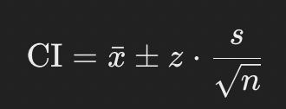
Point Estimation and Interval Estimation
Point Estimation
Single value estimate of a population parameter
Interval Estimation
Provides a range of values within which the population parameter is likely to lie
Confidence Interval (CI):
xˉ: Sample mean
𝑧: Z-score corresponding to the confidence level
𝑠:Sample standard deviation
𝑛: Sample size

Slide 136
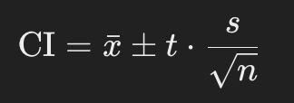
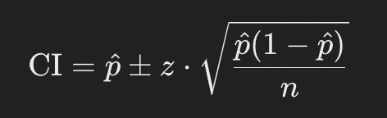
Constructing Confidence Intervals
For Means
When the population standard deviation (𝜎) is unknown
Use the t-distribution for small samples ( 𝑛 < 30 )
For Proportions
p^​: Sample proportion

Slide 137
Hands-On Exercises
Exercise 1: Calculate Confidence Intervals for Sample Data
Exercise 2: Conduct Sampling and Create a Report
Additional Practice
Create confidence intervals for other statistics
Perform stratified sampling and compare intervals across strata
Visualize confidence intervals for multiple samples using Matplotlib

Slide 138
Day 04
Hypothesis Testing and P-Values

Slide 139
Introduction to Hypothesis Testing
What is Hypothesis Testing?
Statistical method to determine if there is enough evidence in a sample to infer a conclusion about the population
Key Components
Null Hypothesis: Assumes no effect or no difference
Alternative Hypothesis: Indicates an effect or difference
Steps in Hypothesis Testing
Formulate Null Hypothesis and Alternative Hypothesis
Choose a significance level (𝛼) — common values are 0.05 or 0.01
Calculate the test statistic
Determine the p-value
Compare the p-value to 𝛼:
If 𝑝 ≤ 𝛼, reject Null Hypothesis | If 𝑝 > 𝛼 , fail to reject Null Hypothesis

Slide 140
Understanding P-Values and Significance Levels
P-Value
The probability of observing results as extreme as the test statistic under Null Hypothesis
Smaller p-values indicate stronger evidence against Null Hypothesis
Significance Level (𝛼)
Threshold for deciding whether to reject
Example: 𝛼 = 0.05 means a 5% risk of rejecting Null Hypothesis when it is true
Decision Rule
Reject Null Hypothesis: 𝑝 ≤ 𝛼
Fail to Reject Null Hypothesis: 𝑝 > 𝛼

Slide 141
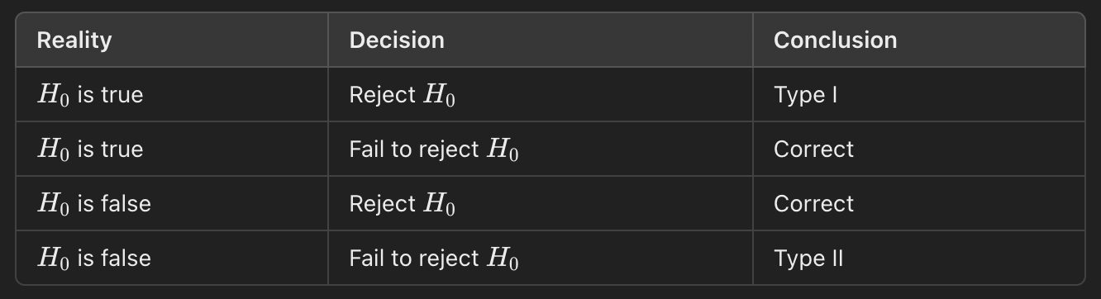
Types of Errors
Type I Error (𝛼)
Incorrectly rejecting​ Null Hypothesis when it is true
Example: Concluding a drug is effective when it is not
Type II Error ( 𝛽 )
Failing to reject Null Hypothesis when it is false
Example: Concluding a drug is not effective when it is
Example:

Slide 142
Hands-On Exercises
Exercise 1: Perform a Hypothesis Test
Exercise 2: Two-Sample T-Test
Additional Practice
Perform a z-test for large sample sizes
Use the Iris dataset to test if the mean sepal length differs between two species
Perform hypothesis testing on proportions using the binomial distribution

Slide 143
Day 05
Types of Hypothesis Tests

Slide 144
T-Tests
Purpose: Test whether the means of one or more groups differ significantly
Types
One-Sample T-Test: Tests if the mean of a sample differs from a known value or population mean
Two-Sample T-Test (Independent T-Test): Compares the means of two independent groups
Paired Sample T-Test: Compares means of two related groups (e.g., pre-test vs. post-test)
Example Use Cases
One-Sample: Testing if the average test score of a class differs from the national average
Two-Sample: Comparing test scores between two classes
Paired Sample: Comparing weight before and after a diet program

Slide 145
Chi-Square Test
Purpose: Test for independence or goodness-of-fit in categorical data
Chi-Square Test of Independence: Tests if two categorical variables are independent
Example Use Case: Testing if gender is independent of preference for a product
Steps
Create a contingency table
Calculate expected frequencies
Compute 𝜒2 statistic and p-value
Python Implementation

Slide 146
ANOVA (Analysis of Variance)
Purpose: Compare the means of three or more groups
Hypotheses
Null: All group means are equal
Alternative: At least one group mean is different
Example Use Case: Testing if the mean scores of students from three different schools differ
Python Implementation

Slide 147
Hands-On Exercises
Exercise 1: Conduct T-Tests
Exercise 2: Perform a Chi-Square Test
Exercise 3: Conduct ANOVA
Additional Practice
Perform a two-way ANOVA to test for interaction effects
Use real-world datasets (e.g., student scores by gender and class) for hypothesis testing
Visualize test results using boxplots or bar plots.

Slide 148
Day 06
Correlation and Regression Analysis

Slide 149
Understanding Correlation
What is Correlation?
Measures the strength and direction of the relationship between two variables
Values range from − 1 to 1, with 0 indicating no correlation
Types of Correlation
Pearson Correlation Coefficient (𝑟)
Spearman Correlation Coefficient (𝜌)

Slide 150
Linear Regression Basics
What is Linear Regression?
Method to model the relationship between a dependent variable (𝑦) and one or more independent variables (𝑥)
Formula for simple linear regression: y = β0 ​ + β1 ​x + ϵ
β0 : Intercept
β1 : Slope
ϵ : Error term

Slide 151
Linear Regression Basics
Key Metrics
Slope (𝛽1)
Intercept (𝛽0)
R-Squared (𝑅²)

Slide 152
Interpreting Regression Results
Slope (𝛽1)
Indicates the magnitude and direction of the relationship
Intercept (𝛽0)
Starting point of the regression line
R-Squared (𝑅²)
Closer to 1 indicates better fit

Slide 153
Hands-On Exercises
Exercise 1: Calculate Correlation Between Features
Exercise 2: Fit a Simple Linear Regression Model
Additional Practice
Fit a multiple linear regression model with multiple independent variables
Compare correlation and regression results for non-linear relationships
Use real-world datasets (e.g., housing prices) for regression analysis

Slide 154
Day 07
Statistical Analysis Project – Analyzing Real-World Data

Slide 155
Applying Probability and Statistical Concepts
Previously learned statistical methods to draw meaningful insights from real-world data
Apply
Probability concepts to understand distributions
Hypothesis testing to identify significant relationships or differences
Regression analysis to explore and quantify relationships between variables

Slide 156
Performing Exploratory Data Analysis (EDA)
Steps in EDA
Load and inspect the dataset
Check for missing or inconsistent data
Visualize distributions and relationships using histograms, scatter plots, and correlation heatmaps
Key Goals
Understand the data structure
Identify patterns, trends, and outliers

Slide 157
Conducting Hypothesis Testing
Steps
Formulate null and alternative hypotheses
Choose and perform an appropriate hypothesis test
Interpret p-values and test results
Example: Comparing Tip Amounts by Gender

Slide 158
Applying Linear Regression
Steps
Select dependent and independent variables
Fit a regression model to the data
Interpret coefficients and the 𝑅² value
Example: Analyzing Relationship Between Total Bill and Tip

Slide 159
Hands-On Project
Statistical Analysis of Real-World Data
Perform Exploratory Data Analysis
Conduct Hypothesis Tests
Apply Linear Regression
Additional Practice
Extend the project by exploring additional relationships (e.g., day of the week vs. tip amount).
Perform multiple linear regression with additional variables (e.g., include smoking status).
Use another real-world dataset (e.g., healthcare or sales data) to apply similar techniques.

Slide 160
WEEK 5: Introduction to Machine Learning
Day 1
Machine Learning Basics and Terminology
Day 2
Introduction to Supervised Learning and Regression Models
Day 3
Advanced Regression Models – Polynomial Regression and Regularization
Day 4
Introduction to Classification and Logistic Regression
Day 5
Model Evaluation and Cross-Validation
Day 6
k-Nearest Neighbors (k-NN) Algorithm
Day 7
Supervised Learning Mini Project

Slide 161
Day 01
Machine Learning Basics and Terminology

Slide 162
What is Machine Learning?
Machine Learning
Real-World Applications
Healthcare
Finance
E-commerce
Autonomous Vehicles
Natural Language Processing
Why is ML Important?

Slide 163
Types of Machine Learning
Supervised Learning
Model is trained on labeled data
Model learns to map inputs (features) to outputs (target)
Examples: Classification | Regression
Key Features
Requires labeled data
Accuracy depends heavily on the quality of the training data

Slide 164
Types of Machine Learning
Unsupervised Learning
Model works on unlabeled data to find hidden patterns or structures
Examples: Clustering | Dimensionality Reduction
Key Features
No labeled data is needed
Focused on exploratory analysis and identifying patterns

Slide 165
Types of Machine Learning
Reinforcement Learning
An agent interacts with an environment and learns by trial and error to maximize cumulative rewards
Examples: Robotics | Gaming | Dynamic Systems
Key Features
Goal-oriented learning based on rewards and penalties
Suitable for sequential decision-making problems

Slide 166
Key Concepts
Features
The input variables (independent variables) used to train the model
Example: In predicting house prices, features could include the number of bedrooms, size, and location
Target
The output variable (dependent variable) the model predicts
Example: House price is the target variable
Training and Testing Datasets
The data is split into two subsets: Training Set | Testing Set
A typical split is 80% training and 20% testing

Slide 167
Key Concepts
Overfitting
Model learns noise and details in the training data, performing poorly on new data
Model becomes too complex for the dataset
Underfitting
Model is too simple to capture the underlying patterns in the data
Example: Fitting a linear model to non-linear data
Bias-Variance Tradeoff
Bias: The error introduced by assuming a simplified model
Variance: Error introduced by the model's sensitivity to small changes in the training data
Goal: Balance bias and variance to achieve optimal performance.

Slide 168
Hands-On Exercise
Define Features and Target Variables
Split Data into Training and Testing Sets
Visualize the Dataset

Slide 169
Day 02
Introduction to Supervised Learning and Regression Models

Slide 170
Overview of Supervised Learning
Key Characteristics of Supervised Learning
Labeled Data
Supervised learning requires a dataset with labeled examples
Example: Inputs | Outputs
Objective
Minimize the error between the predicted output and the actual output
Types of Supervised Learning
Regression: Predicts continuous outputs
Classification: Predicts discrete outputs

Slide 171
Overview of Supervised Learning
Applications of Supervised Learning
Healthcare
Predicting patient outcomes based on medical data
Finance
Fraud detection in transactions, credit risk assessment
Retail
Personalized product recommendations based on customer behavior
Autonomous Vehicles
Object detection and lane tracking using image classification

Slide 172
Introduction to Regression Analysis
Linear Regression
Assumes a linear relationship between the dependent variable (𝑦) and the independent variable (𝑥)
Equation of a Line: y = β₀ ​+ β₁x + ϵ
β₀: Intercept of the line
β₁: Slope of the line
ϵ: Error term representing the difference between the observed and predicted values
Steps in Linear Regression
Fit the Model
Predict
Evaluate
Applications of Regression Models
Predicting Sales, Healthcare, Real Estate

Slide 173
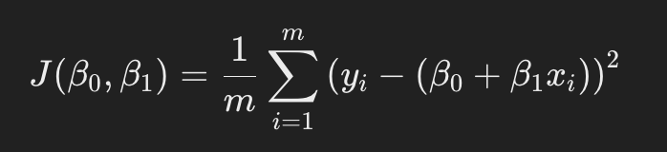
Cost Function and Optimization in Linear Regression
Linear regression aims to minimize the error between the predicted and actual values of the target variable. This is achieved using a cost function
Cost Function
Measures how far the predictions are from the actual values
Most common cost function is the Mean Squared Error (MSE)
m: Number of data points
𝑦_{𝑖} : Actual value of the target for the 𝑖-th data point
𝛽₀ + 𝛽₁𝑥_{𝑖}: Predicted value for the 𝑖 i-th data point
Objective
Minimize 𝐽 (𝛽₀, 𝛽₁) to find the best-fitting line

Slide 174
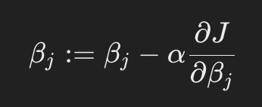
Cost Function and Optimization in Linear Regression
Optimization with Gradient Descent
Gradient Descent Algorithm
Iteratively updates 𝛽₀ and 𝛽₁ to minimize the cost function
Update Rule
α: Learning rate controlling the step size
Convergence
Algorithm stops when the updates become very small or a predefined number of iterations is reached
Visualizing Optimization
The optimization process can be visualized as finding the lowest point on a cost surface

Slide 175
Hands-On Exercise
Implement a Simple Linear Regression Model Using Scikit-Learn
Visualize the Regression Line and Analyze Performance

Slide 176
Day 03
Advanced Regression Models Polynomial Regression and Regularization

Slide 177

Polynomial Regression for Modeling Non-Linear Relationships
Polynomial regression is an extension of linear regression that models non-linear relationships by introducing higher-order terms of the input features.
What is Polynomial Regression?
In a typical linear regression
In polynomial regression, we extend this to include higher-degree terms
The inclusion of higher-order terms allows the model to capture non-linear patterns in the data.

Slide 178
Polynomial Regression for Modeling Non-Linear Relationships
Steps in Polynomial Regression
Feature Transformation
Create polynomial features from the original input data
Example:𝑥→[𝑥,𝑥²,𝑥³]
Model Training
Perform linear regression on the transformed features
Evaluation
Assess the model's ability to capture the data's non-linear structure
Advantages
Captures non-linear relationships effectively
Limitations
Prone to overfitting with high-degree polynomials
May require regularization to avoid overfitting
Example Use Case: Predicting growth patterns in biological systems where relationships are non-linear

Slide 179
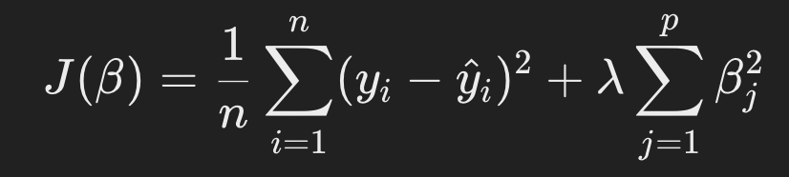
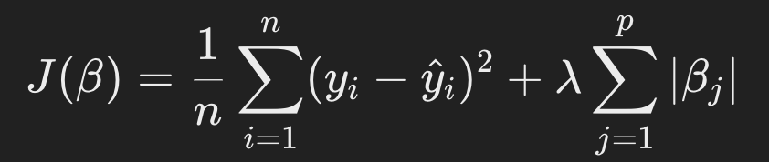
Introduction to Regularization Techniques: Lasso and Ridge Regression
What is Regularization?
Technique used to prevent overfitting by adding a penalty term to the cost function of a regression model
Types of Regularization
Ridge Regression (L2 Regularization)
Adds the sum of the squared coefficients to the cost function
λ parameter controls the strength of the penalty
Lasso Regression (L1 Regularization)
Adds the sum of the absolute coefficients to the cost function
Encourages sparsity in the coefficients, effectively performing feature selection
Key Differences
Ridge shrinks coefficients but does not eliminate them
Lasso can shrink some coefficients to zero, removing irrelevant features.

Slide 180
Avoiding Overfitting with Regularization
Regularization reduces the risk of overfitting by controlling the complexity of the model
The regularization parameter λ (also called 𝛼 in some libraries) plays a critical role:
A high λ value increases the penalty, forcing smaller coefficients and reducing overfitting
A low λ value allows the model to fit the training data more closely, increasing the risk of overfitting
Example Code for Lasso and Ridge Regression

Slide 181
Hands-On Exercise
Implement Polynomial Regression and Visualize the Fit
Use Lasso and Ridge Regression
Additional Experiments
Vary Regularization Parameters:
Experiment with different values of 𝛼 (e.g., 0.1, 1, 10) for Ridge and Lasso regression
Observe how the model's coefficients and performance change
Use Multiple Features:
Include more features (e.g., HouseAge, AveRooms) and observe the impact on model performance
Feature Importance with Lasso:
Use Lasso regression to perform feature selection and identify the most relevant predictors

Slide 182
Day 04
Introduction to Classification and Logistic Regression

Slide 183
Classification Problems and Common Use Cases
What is Classification?
Types of Classification
Binary Classification
Multi-Class Classification
Multi-Label Classification
Common Use Cases
Healthcare | Finance | Retail | Natural Language Processing | Autonomous Systems

Slide 184
Logistic Regression for Binary Classification
What is Logistic Regression?
The Logistic Regression Model
Equation
Logistic regression applies the sigmoid function to a linear equation
Where:
𝑃 ( 𝑦 = 1 ∣ 𝑥 ): Probability of the positive class
𝜎 ( 𝑧 ): Sigmoid function

Slide 185
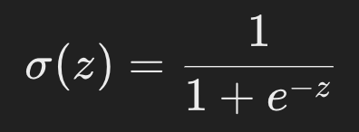
Logistic Regression for Binary Classification
The Logistic Regression Model
Sigmoid Function
Maps the output to a range between 0 and 1
If 𝑃 ( 𝑦 = 1 ∣ 𝑥 ) ≥ 0.5, the prediction is class 1; otherwise, it is class 0
Decision Boundary
The threshold (default is 0.5) used to classify instances
Decision boundaries can be adjusted to optimize for precision or recall
Interpretation of Coefficients:
𝛽₀: Intercept, the baseline probability.
𝛽_{𝑖}: Effect of feature 𝑥_{𝑖} ​on the log-odds of the positive class

Slide 186
Sigmoid Function, Decision Boundary, and Interpretation
Sigmoid Function in Action
The sigmoid function ensures outputs are interpretable as probabilities
Visualization of the sigmoid function can illustrate how probabilities are mapped from raw model predictions
Decision Boundary
Default threshold is 0.5
Adjusting the threshold can balance precision and recall depending on the use case

Slide 187
Hands-On Exercise
Implement a logistic regression model to classify a dataset (e.g., predicting if a customer will make a purchase)
Analyze model performance

Slide 188
Day 05
Model Evaluation and Cross-Validation

Slide 189
Model Evaluation Metrics for Regression and Classification
Model Evaluation for Regression
Mean Squared Error (MSE)
Measures the average squared difference between predicted and actual values
Sensitive to outliers due to squaring of errors
Mean Absolute Error (MAE)
Measures the average absolute difference between predicted and actual values
Provides a more interpretable measure but less sensitive to outliers
Root Mean Squared Error (RMSE)
Square root of MSE, providing errors in the same units as the target variable

Slide 190
Model Evaluation Metrics for Regression and Classification
Model Evaluation for Classification
Accuracy
Proportion of correctly predicted instances
Useful when the dataset is balanced
Precision
Fraction of positive predictions that are correct
Important for applications like fraud detection, where false positives are costly
Recall (Sensitivity)
Fraction of actual positives that are correctly identified
Useful in cases where missing positive instances is critical
F1 Score
Harmonic mean of precision and recall
Balances precision and recall, especially useful for imbalanced datasets

Slide 191
Introduction to Cross-Validation
Key Cross-Validation Techniques
K-Fold Cross-Validation
Splits the dataset into 𝐾 equal parts
Trains the model on 𝐾 − 1 folds and tests on the remaining fold, repeating the process 𝐾 times
The average of the 𝐾 test scores provides the final evaluation metric
Stratified K-Fold
Ensures each fold has a proportional representation of classes in classification problems
Leave-One-Out Cross-Validation (LOOCV)
Trains the model on 𝑛 − 1 samples and tests on the remaining one. Repeated for all samples
Computationally expensive for large datasets
Advantages
Reduces the risk of overfitting by testing on multiple subsets of data
Provides a more generalized evaluation of model performance.

Slide 192
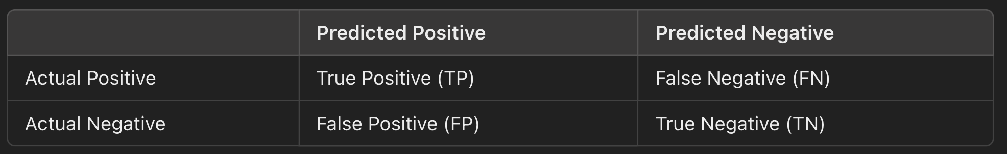
Understanding the Confusion Matrix
The confusion matrix is a table that summarizes the performance of a classification model by comparing predicted and actual values
Structure of a Confusion Matrix
Key Metrics Derived
True Positive Rate (TPR)
Same as recall
False Positive Rate (FPR)
Proportion of negatives incorrectly classified as positives
Specificity
Proportion of negatives correctly classified.

Slide 193
Hands-On Exercise
Evaluate a model using cross-validation to obtain a more accurate estimate of model performance
Generate and interpret a confusion matrix for a classification model

Slide 194
Day 06
k-Nearest Neighbors (k-NN) Algorithm

Slide 195
Introduction to k-Nearest Neighbors (k-NN) Algorithm and Its Applications
What is k-Nearest Neighbors?
Key Characteristics
Instance-Based Learning
Distance Metric
Classification
Regression
Applications
Image Recognition
Recommendation Systems
Medical Diagnosis
Customer Segmentation

Slide 196
How k-NN Works for Classification and Regression
Step-by-Step Process
Feature Scaling
Calculate Distances
Identify 𝑘 Nearest Neighbors
Make Predictions
Classification
Regression

Slide 197
Choosing the Optimal Value of 𝑘
Choosing 𝑘
Small 𝑘
High sensitivity to noise
Captures local variations in data
Large 𝑘
Smoother decision boundaries but can miss finer details
Common Practices
Use cross-validation to determine the optimal value of 𝑘
A common starting point is 𝑘 = √𝑛, where 𝑛 is the number of training samples

Slide 198
Understanding the Model’s Limitations
Computationally Expensive
Predictions require distance computation for all training samples
Feature Scaling Dependence
Requires proper scaling to avoid feature dominance
Not Robust to Imbalanced Data
Classes with more samples can dominate predictions

Slide 199
Hands-On Exercise
Implement k-NN for a classification task, experimenting with different values of k
Compare k-NN results to logistic regression, analyzing accuracy and other metrics

Slide 200
Day 07
Supervised Learning Mini Project

Slide 201
Building an End-to-End Supervised Learning Project
Key Steps:
Define the Problem
Identify the objective: Regression or Classification
Data Preparation
Exploratory Data Analysis (EDA)
Understand the structure of the dataset
Visualize data distributions and relationships
Preprocessing
Handle missing values
Scale features for algorithms like k-NN
Encode categorical variables

Slide 202
Building an End-to-End Supervised Learning Project
Key Steps:
Model Selection
Choose appropriate models based on the problem
Model Evaluation
Use performance metrics like Mean Squared Error (MSE) for regression or Accuracy, Precision, Recall, and F1 Score for classification
Comparison
Compare multiple models to identify the best-performing one

Slide 203
Applying Regression and Classification Models on a Real-World Dataset
Dataset Options
Regression Example
Predict house prices using features like square footage, number of rooms, and location
Dataset: California Housing Dataset or any housing dataset
Classification Example
Classify customer churn based on customer demographics and behavior
Dataset: Telco Customer Churn Dataset

Slide 204
Evaluating and Comparing Model Performance
Steps
Evaluate models using cross-validation
Generate performance metrics
Summarize findings to identify strengths and weaknesses of each model

Slide 205
Hands-On Project
Mini Project: Building a Supervised Learning Model
Tasks
Task 1: Perform Exploratory Data Analysis and Preprocessing
Task 2: Train and Evaluate Multiple Models
Task 3: Summarize Findings in a Report

Slide 206
WEEK 6: Feature Engineering and Model Evaluation
Day 1
Introduction to Feature Engineering
Day 2
Data Scaling and Normalization
Day 3
Encoding Categorical Variables
Day 4
Feature Selection Techniques
Day 5
Creating and Transforming Features
Day 6
Model Evaluation Techniques
Day 7
Cross-Validation and Hyperparameter Tuning

Slide 207
Day 01
Introduction to Feature Engineering

Slide 208
Importance of Feature Engineering in Machine Learning
What is Feature Engineering?
Process of transforming raw data into meaningful inputs for machine learning models
Why is Feature Engineering Important?
Improves Model Accuracy
Reduces Model Complexity
Enables Model Interpretability
Handles Data Challenges
Key Applications
Finance | Healthcare | E-Commerce

Slide 209
Types of Features: Categorical, Numerical, Ordinal
Categorical Features
Represent discrete categories or labels
Encoding Techniques
One-Hot Encoding
Label Encoding
Numerical Features
Represent continuous or discrete numbers
Preprocessing Techniques
Scaling
Ordinal Features
Represent categorical data with a meaningful order
Encoding Techniques
Ordinal Encoding

Slide 210
Overview of Feature Engineering Techniques
Scaling
Ensures all features contribute equally to the model
Techniques: Min-Max Scaling | Standardization
Encoding
Converts categorical data into numerical format
Techniques: One-Hot Encoding | Label Encoding
Transformation
Applies mathematical functions to modify features
Examples: Log Transformation | Polynomial Features
Feature Selection
Reduces the number of input features to improve model performance
Techniques: Statistical Methods | Recursive Feature Elimination (RFE)

Slide 211
Hands-On Exercise
Load a dataset and explore its features, identifying categorical and numerical features
Plan which feature engineering techniques might be most suitable for the dataset

Slide 212
Day 02
Data Scaling and Normalization

Slide 213
Importance of Scaling and Normalization in Machine Learning
What is Scaling and Normalization?
Preprocessing techniques used to transform numerical features to a common range or distribution
Why is Scaling and Normalization Important?
Improves Algorithm Performance
Ensures Fair Comparisons
Stabilizes Training

Slide 214
Methods: Min-Max Scaling, Standardization (Z-Score Scaling)
Min-Max Scaling
Transforms features to a specified range, typically [0, 1]
Ensures all feature values are within the same range
Use Cases: k-NN or neural networks
Limitations: Sensitive to outliers, as extreme values can distort the scale
Standardization (Z-Score Scaling)
Centers the data around zero and scales it to have a standard deviation of 1
Ensures a standard normal distribution for each feature
Use Cases: SVM, logistic regression, and PCA
Advantages: Handles outliers better than Min-Max scaling

Slide 215
When to Use Scaling and Normalization for Different Algorithms
Algorithms That Require Scaling
Distance-Based Algorithms
k-NN, SVM, K-Means clustering
Gradient-Based Models
Linear regression, logistic regression, and neural networks
Algorithms Less Sensitive to Scaling
Tree-Based Models
Decision Trees, Random Forests, Gradient Boosting

Slide 216
Hands-On Exercise
Apply Min-Max scaling and standardization to a dataset using scikit-learn
Observe the effects of scaling on model performance by training a k-NN classifier before and after scaling

Slide 217
Day 03
Encoding Categorical Variables

Slide 218
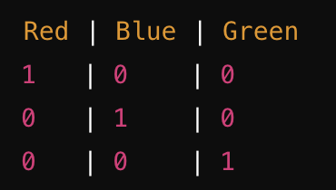
One-Hot Encoding, Label Encoding
What Are Categorical Variables?
Binary Categorical Features: Gender (Male/Female)
Multi-Class Categorical Features: Country (USA, Canada, UK).
One-Hot Encoding
Creates binary columns for each category in a categorical feature
Each row is marked with a 1 for its respective category and 0 elsewhere
Example: Feature: Color = ['Red', 'Blue', 'Green’]
Applications
Categorical features with a small number of unique categories
Tree-based models, logistic regression, and neural networks

Slide 219
One-Hot Encoding, Label Encoding
Label Encoding
Label Encoding assigns a unique integer to each category
Example: Red = 0, Blue = 1, Green = 2.
Applications:
Ordinal features where the order matters
Can introduce unintended ordinal relationships for nominal features
Limitations
Can mislead algorithms into interpreting categories as ordered, especially when the variable is nominal

Slide 220
Dealing with High-Cardinality Categorical Features
High-cardinality categorical features contain a large number of unique categories
Challenges
Dimensionality
Sparse Representation
Solutions
Frequency Encoding
Replace categories with their occurrence frequency in the dataset
Example: City = ['NY', 'LA', 'NY', 'SF', 'LA'] Encoded: NY = 2, LA = 2, SF = 1.
Target Encoding
Replace categories with the mean of the target variable for each category

Slide 221
When to Use Different Encoding Techniques
Encoding Technique | Use Case
One-Hot Encoding | Nominal features with a small number of unique categories
Label Encoding | Ordinal features or when used with algorithms like tree-based models
Frequency Encoding | High-cardinality features in both regression and classification tasks
Target Encoding | High-cardinality features in supervised learning tasks

Slide 222
Hands-On Exercise
Apply One-Hot Encoding and Label Encoding to a dataset with categorical variables
Experiment with different encoding techniques and observe their impact on model performance

Slide 223
Day 04
Feature Selection Techniques

Slide 224
Introduction to Feature Selection
What is Feature Selection?
Process of identifying and retaining the most relevant features (input variables) in a dataset while discarding irrelevant or redundant ones
Why is Feature Selection Important?
Improves Model Performance
Reduces Overfitting
Enhances Interpretability
Increases Computational Efficiency
When to Use Feature Selection?
High-Dimensional Data
Correlated Features
Reducing Complexity

Slide 225
Techniques for Feature Selection
Filter Methods
Evaluate the relevance of features by analyzing their statistical properties in relation to the target variable
Examples: Correlation | Mutual Information
When to Use: Quick evaluation of features before training a model
Wrapper Methods
Iteratively selects features by training and evaluating a model
Examples: Forward Selection | Backward Elimination
When to Use: Useful when feature interactions are important but computationally expensive
Embedded Methods
Perform feature selection as part of the model training process
Examples: Lasso Regression | Tree-Based Models
When to Use: Effective when training tree-based models or regularized regression

Slide 226
Hands-On Exercise
Use correlation and mutual information to select important features from a dataset
Apply a tree-based model (e.g., Random Forest) to identify the most important features

Slide 227
Day 05
Creating and Transforming Features

Slide 228
Feature Creation
What is Feature Creation?
Feature creation involves deriving new, meaningful features from existing ones to enhance a model's ability to capture important patterns in the data
Examples of Feature Creation
Date-Time Features
Interaction Features
Aggregations
Importance
Adds domain knowledge to the dataset
Captures hidden patterns and trends not evident in the original features

Slide 229
Transforming Features
What is Feature Transformation?
Feature transformation modifies existing features to better suit the learning algorithm
Common Transformations
Logarithmic Transformation
Reduces skewness in highly skewed distributions
Square Root Transformation
Moderately reduces skewness, often used for count data
Polynomial Transformation
Adds higher-order terms ( 𝑥², 𝑥³ ) to capture non-linear relationships
Importance
Enhances the model's ability to fit non-linear relationships
Makes distributions more normal-like, aiding algorithms that assume normality

Slide 230
Importance of Feature Transformations in Non-Linear Relationships
Transformations allow linear models to handle non-linear relationships
For example:
Polynomial transformations enable linear regression to model quadratic patterns
Logarithmic transformations stabilize variance and handle skewness
By transforming features, models become more robust and capable of capturing complex patterns in data.

Slide 231
Hands-On Exercise
Create new features from a date column (e.g., day of the week, month, year)
Apply polynomial transformations to a dataset and compare model performance before and after transformation

Slide 232
Day 06
Model Evaluation Techniques

Slide 233
Evaluation Metrics for Regression
Regression Metrics
Mean Absolute Error (MAE)
Measures the average magnitude of errors without considering their direction
Use Case: Suitable when all errors have equal importance
Mean Squared Error (MSE)
Measures the average of squared differences between actual and predicted values
Use Case: Penalizes larger errors more than MAE, making it sensitive to outliers
Root Mean Squared Error (RMSE)
Square root of MSE, providing errors in the same units as the target variable
Use Case: A common metric for interpretability in real-world units
R-squared (𝑅²)
Measures how well the model explains the variability of the target variable
Use Case: Indicates the proportion of variance explained by the model

Slide 234
Evaluation Metrics for Classification
Classification Metrics
Accuracy
Percentage of correctly classified instances
Use Case: Suitable for balanced datasets but misleading for imbalanced data
Precision
Fraction of true positive predictions among all positive predictions
Use Case: Important when false positives are costly (e.g., spam detection)
Recall (Sensitivity)
Fraction of true positives identified among all actual positives
Use Case: Critical in situations where missing positives is costly (e.g., medical diagnosis)
F1 Score
Harmonic mean of precision and recall
Use Case: Useful for imbalanced datasets
ROC-AUC
Measures the ability of the model to distinguish between classes
Use Case: Important for evaluating binary classifiers

Slide 235
Understanding When to Use Each Metric
Regression
Use MAE for interpretability and uniform importance of errors
Use MSE/RMSE when larger errors need greater penalization
Use 𝑅² to explain variance but not as a sole performance metric
Classification
Use accuracy for balanced datasets
Use precision and recall for imbalanced datasets, depending on the problem's focus (e.g., minimizing false positives or false negatives)
Use F1 score for a balanced evaluation of precision and recall
Use ROC-AUC for overall model performance evaluation in binary classification

Slide 236
Hands-On Exercise
Exercise 1: Classification Model Evaluation
Objective
Train a classification model, calculate confusion matrix, and interpret precision, recall, and F1 score
Exercise 2: Regression Model Evaluation
Objective
Train a regression model and evaluate its performance using MAE, MSE, and 𝑅²

Slide 237
Day 07
Cross-Validation and Hyperparameter Tuning

Slide 238
Introduction to Cross-Validation
What is Cross-Validation?
Technique used to assess how well a machine learning model generalizes to an independent dataset
Types of Cross-Validation
K-Fold Cross-Validation
Splits the dataset into 𝐾 folds of approximately equal size
The model is trained on 𝐾 − 1 folds and validated on the remaining fold
This process is repeated 𝐾 times, and the average performance is computed
Stratified K-Fold
Ensures that each fold maintains the same class distribution as the original dataset
Useful for imbalanced datasets
Leave-One-Out Cross-Validation (LOOCV)
Uses a single data point for validation and the rest for training
Repeats this process for all data points
Computationally expensive but provides the most robust evaluation

Slide 239
Hyperparameter Tuning
What is Hyperparameter Tuning?
Hyperparameters are parameters that are not learned by the model but are set before training, tuning these hyperparameters is crucial for optimizing model performance
Techniques for Hyperparameter Tuning
Grid Search
Exhaustively searches over a predefined hyperparameter space
Example: Testing all combinations of values for max_depth and learning_rate
Random Search
Randomly samples combinations of hyperparameters from the predefined space
More efficient than Grid Search when the parameter space is large
Importance of Hyperparameter Tuning
Prevents overfitting and underfitting by selecting the best configuration
Enhances model performance by optimizing critical settings.

Slide 240
Importance of Tuning Hyperparameters for Model Performance
Without tuning, the model might not reach its optimal performance, leading to:
Underfitting: Model fails to capture the underlying patterns.
Overfitting: Model memorizes the training data and performs poorly on unseen data

Slide 241
Hands-On Project: Feature Engineering and Model Evaluation
Objective
Perform end-to-end feature engineering, model evaluation, and hyperparameter tuning on a dataset
Tasks
Task 1: Perform Feature Engineering
Task 2: Train and Evaluate Models
Task 3: Apply Grid Search for Hyperparameter Tuning

Slide 242
WEEK 7: Advanced Machine Learning Algorithms
Day 1
Introduction to Ensemble Learning
Day 2
Bagging and Random Forests
Day 3
Boosting and Gradient Boosting
Day 4
Introduction to XGBoost
Day 5
LightGBM and CatBoost
Day 6
Handling Imbalanced Data
Day 7
Ensemble Learning Project – Comparing Models on a Real Dataset

Slide 243
Day 01
Introduction to Ensemble Learning

Slide 244
Concept of Ensemble Learning
What is Ensemble Learning?
Machine learning technique that combines the predictions of multiple models to produce a final output
Why Does Ensemble Learning Improve Performance?
Reduces Variance
Reduces Bias
Improves Robustness
Applications
Fraud detection, medical diagnoses, recommendation systems, and predictive analytics

Slide 245
Types of Ensemble Methods
Bagging (Bootstrap Aggregating)
Trains multiple models independently on different subsets of data created through bootstrapping
Combines predictions by averaging (regression) or majority voting (classification)
Example: Random Forest
Strengths: Reduces variance without increasing bias
Boosting
Trains models sequentially, where each model focuses on correcting the errors made by the previous ones
Combines predictions through weighted averaging or voting
Examples: AdaBoost, Gradient Boosting, XGBoost, LightGBM
Strengths: Reduces both bias and variance by focusing on hard-to-predict instances

Slide 246
Types of Ensemble Methods
Stacking
Combines predictions from multiple base models (of different types) using a meta-model to learn how to best combine their outputs
Strengths: Can utilize diverse model types to maximize performance

Slide 247
Overview of Commonly Used Ensemble Methods
Random Forest
Combines multiple decision trees using bagging
Reduces overfitting common in individual decision trees
Gradient Boosting
Sequentially builds models that minimize errors in the previous ones
Suitable for both regression and classification tasks
AdaBoost
Adjusts model weights based on performance
Focuses on misclassified instances
XGBoost
Optimized version of gradient boosting, known for speed and accuracy
Voting Classifier
Combines predictions of multiple models using majority voting or averaging

Slide 248
Hands-On Exercise
Build a basic ensemble model combining predictions from Linear Regression, Decision Tree, and k-NN to observe the impact on accuracy

Slide 249
Day 02
Bagging and Random Forests

Slide 250
Understanding Bagging (Bootstrap Aggregating)
What is Bagging?
Ensemble learning technique that trains multiple models on different subsets of the data, created by random sampling with replacement
Regression: Average the predictions of individual models
Classification: Use majority voting to determine the final class
Why Use Bagging?
Reduces Variance
Improves Robustness
Applications
Bagging is commonly used with decision trees, which are prone to high variance

Slide 251
Introduction to Random Forests
What is a Random Forest?
Ensemble learning method that builds multiple decision trees using bagging
Key Features of Random Forests
Bootstrap Sampling
Feature Randomness
Prediction Aggregation
Advantages
Handles both regression and classification tasks effectively
Works well with high-dimensional data
Reduces overfitting compared to single decision trees

Slide 252
Key Parameters in Random Forests
Number of Trees (n_estimators)
The number of decision trees in the forest
Larger values reduce variance but increase computational cost
Maximum Depth (max_depth)
Limits the depth of each tree to prevent overfitting
Shallower trees generalize better but may underfit
Feature Selection (max_features)
Number of features to consider when looking for the best split
Options
sqrt | log2 | None
Minimum Samples per Leaf (min_samples_leaf)
Minimum number of samples required in a leaf node
Prevents overly complex trees by ensuring each leaf contains enough samples.

Slide 253
Hands-On Exercise
Train a Random Forest classifier on a dataset, tune its parameters, and evaluate its performance

Slide 254
Day 03
Boosting and Gradient Boosting

Slide 255
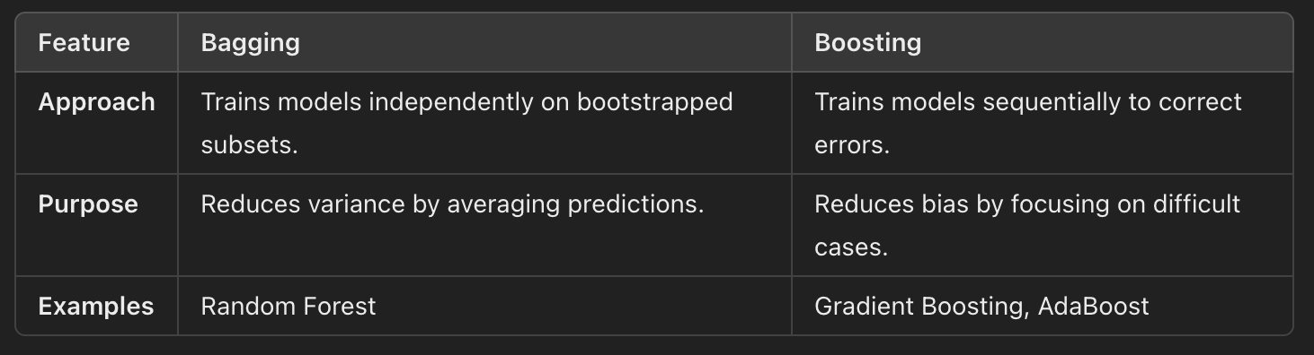
Concept of Boosting
What is Boosting?
Ensemble technique that sequentially combines weak learners to form a strong learner
Each subsequent model focuses on correcting the errors made by previous models
How Does Boosting Differ from Bagging?

Slide 256
Gradient Boosting
What is Gradient Boosting?
Boosting algorithm that builds models sequentially by minimizing a loss function using gradient descent
Iteratively adds weak learners to improve overall model performance
How Gradient Boosting Works
Initialize Model: Start with a simple model, often predicting the mean of the target variable
Compute Residuals: Calculate the difference between the actual and predicted values
Fit Weak Learner: Train a weak model to predict the residuals
Update Prediction: Add the predictions of the weak learner to the overall model
Repeat: Continue adding weak learners until the desired number of iterations or a stopping criterion is reached

Slide 257
Gradient Boosting
Key Parameters in Gradient Boosting
Learning Rate
Determines the contribution of each weak learner
Smaller values reduce overfitting but require more iterations
Number of Estimators
The number of weak learners (trees) added sequentially
Larger values improve learning but increase computation time
Regularization
Techniques like limiting tree depth or adding penalties to prevent overfitting

Slide 258
Understanding the Key Parameters
Learning Rate (learning_rate)
Lower values improve model performance by reducing overfitting but require more iterations
Typical range: 0.01 to 0.3
Number of Estimators (n_estimators)
Represents the number of trees added to the ensemble
Larger values can improve performance but risk overfitting
Tree Depth (max_depth)
Limits the complexity of individual trees
Shallower trees generalize better but might underfit.

Slide 259
Hands-On Exercise
Train and evaluate a Gradient Boosting model on a dataset, tune key parameters, and compare its performance with a Random Forest model

Slide 260
Day 04
Introduction to XGBoost

Slide 261
Overview of XGBoost
What is XGBoost?
Advanced implementation of the Gradient Boosting algorithm designed for speed and performance
It introduces various enhancements that make it faster, more efficient, and capable of handling complex datasets
Improvements Over Traditional Gradient Boosting
Speed
Handling Missing Data
Regularization
Custom Loss Functions
Tree Pruning

Slide 262
Key Features of XGBoost
Handling Missing Data
Automatically assigns missing values to the branch that minimizes the loss function
Reduces preprocessing steps for datasets with missing values
Regularization
Includes penalties for overly complex models, reducing overfitting
Hyperparameters
lambda: L2 regularization term
alpha: L1 regularization term
Parallel Processing
Splits calculations for tree construction across multiple cores, significantly improving training time

Slide 263
Hyperparameters in XGBoost and How to Tune Them
Key Hyperparameters
Learning Rate (eta)
Controls the contribution of each tree to the model
Typical range: 0.01–0.3
Number of Trees (n_estimators)
Determines the number of boosting rounds
Larger values may improve performance but increase computation time
Tree Depth (max_depth)
Limits the depth of trees, balancing bias and variance
Shallower trees generalize better, while deeper trees may overfit
Subsample
Fraction of data used to train each tree
Helps reduce overfitting; typical range: 0.5–1.0
Colsample_bytree
Fraction of features used for each tree split
Typical range: 0.5–1.0
Regularization Parameters: lambda and alpha control L2 and L1 regularization, respectively

Slide 264
Hands-On Exercise
Train an XGBoost model on a dataset, tune hyperparameters using cross-validation, and compare its performance with a Gradient Boosting model

Slide 265
Day 05
LightGBM and CatBoost

Slide 266
Introduction to LightGBM
What is LightGBM?
Implementation of Gradient Boosting designed to handle large datasets and high-dimensional data with speed and accuracy
Key Features of LightGBM:
Histogram-Based Splitting
Leaf-Wise Tree Growth
Support for GPU Training
Handling Sparse Data
Advantages
Faster training than XGBoost
Handles large datasets effectively
Reduces memory usage with histogram-based splitting
When to Use LightGBM
Large datasets with numerical features
Time-sensitive tasks requiring fast training

Slide 267
Overview of CatBoost
What is CatBoost?
Gradient Boosting library developed specifically to handle categorical features without the need for preprocessing like one-hot encoding
Key Features of CatBoost:
Native Support for Categorical Data
Ordered Boosting
Robust to Overfitting
Advantages
Eliminates the need for manual encoding of categorical data
Reduces overfitting with robust boosting techniques
Easy to implement for datasets with many categorical features
When to Use CatBoost
Datasets with a high proportion of categorical features
Applications where overfitting is a concern

Slide 268
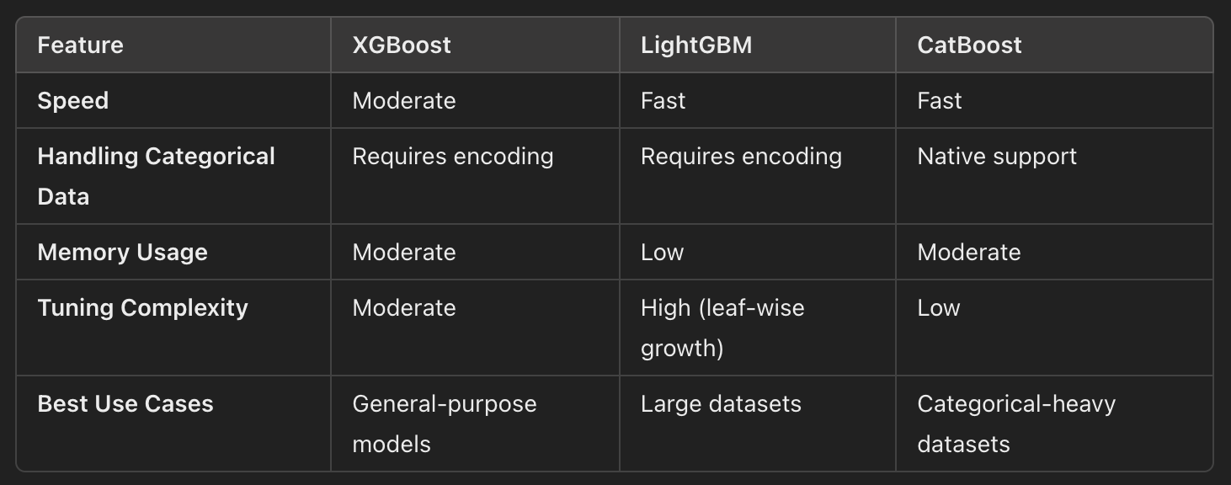
XGBoost, LightGBM, and CatBoost

Slide 269
Hands-On Exercise
Train and compare LightGBM, CatBoost, and XGBoost models on a dataset, focusing on their ability to handle large datasets and categorical data

Slide 270
Day 06
Handling Imbalanced Data

Slide 271
Problems Caused by Imbalanced Data in Classification Tasks
What is Imbalanced Data?
Refers to datasets where one class significantly outnumbers the other(s)
Challenges with Imbalanced Data
Bias Toward Majority Class:
Machine learning models tend to prioritize the majority class due to its frequency
Misleading Evaluation Metrics
Metrics like accuracy can be misleading, as they do not account for class imbalance
Limited Information for Minority Class
Insufficient samples for the minority class can lead to underfitting
Applications with Imbalanced Data
Fraud detection, medical diagnosis, and anomaly detection

Slide 272
Techniques to Handle Imbalanced Data
Resampling Techniques
Oversampling
Increase the number of minority class samples by duplicating or synthesizing new samples
Example: SMOTE (Synthetic Minority Over-sampling Technique), which generates synthetic examples
Undersampling
Reduce the number of majority class samples to balance the dataset
Risk: Loss of valuable information from majority class.

Slide 273
Techniques to Handle Imbalanced Data
Algorithmic Solutions
Class Weights
Assign higher weights to the minority class during model training
Many algorithms (e.g., Logistic Regression, Random Forest) have built-in support for class weights
Anomaly Detection Models
Treat the minority class as anomalies, focusing the model on detecting them.

Slide 274
Techniques to Handle Imbalanced Data
Evaluation Metrics for Imbalanced Data
F1-Score
Harmonic mean of precision and recall, focusing on both false positives and false negatives
ROC-AUC
Measures the ability to distinguish between classes across various threshold values
Precision-Recall Curve
Focuses on performance for the positive class

Slide 275
Hands-On Exercise
Apply SMOTE to handle class imbalance, train a classifier, and evaluate its performance using metrics like ROC-AUC and F1-score

Slide 276
Day 07
Ensemble Learning Project – Comparing Models on a Real Dataset

Slide 277
Building and Evaluating Multiple Ensemble Models
Why Compare Ensemble Models?
Excel in different scenarios
Helps identify the most effective model for a specific dataset or problem
Ensemble Methods to Consider:
Bagging (e.g., Random Forest)
Reduces variance by averaging predictions from multiple independent models
Works well with high-variance models like decision trees.
Boosting (e.g., Gradient Boosting, XGBoost, LightGBM)
Reduces bias by sequentially correcting errors from previous models
Effective for complex patterns and imbalanced datasets.

Slide 278
Comparing Bagging and Boosting
Bagging
Builds models independently using random subsets of data
Robust against overfitting with strong base learners
Boosting
Sequentially builds models, focusing on hard-to-predict samples
Requires careful tuning to prevent overfitting.

Slide 279
Model Performance on Balanced vs. Imbalanced Data
Challenges with Imbalanced Data
Models may prioritize the majority class, leading to poor performance on the minority class
Evaluation Metrics
Accuracy
May not reflect true performance for imbalanced datasets
F1-Score
Balances precision and recall, focusing on the minority class
ROC-AUC
Evaluates the model's ability to distinguish between classes across thresholds

Slide 280
Hands-On Project
Ensemble Learning and Model Comparison
Train and compare multiple ensemble models on a real-world dataset, analyzing their performance under balanced and imbalanced conditions

Slide 281
WEEK 8: Model Tuning and Optimization
Day 1
Introduction to Hyperparameter Tuning
Day 2
Grid Search and Random Search
Day 3
Advanced Hyperparameter Tuning with Bayesian Optimization
Day 4
Regularization Techniques for Model Optimization
Day 5
Cross-Validation and Model Evaluation Techniques
Day 6
Automated Hyperparameter Tuning with GridSearchCV and RandomizedSearchCV
Day 7
Optimization Project – Building and Tuning a Final Model

Slide 282
Day 01
Introduction to Hyperparameter Tuning

Slide 283
Parameters and Hyperparameters
What are Parameters?
Values learned by a machine learning model during training
Adjusted to minimize the loss function and optimize predictions
Examples
Coefficients in Linear Regression
Weights and biases in Neural Networks
What are Hyperparameters?
Settings defined before training that influence how the model learns from data
Not learned from the data but instead control the training process
Examples
Tree Depth
Learning Rate
Number of Estimators

Slide 284
Importance of Tuning Hyperparameters
Why Tune Hyperparameters?
Improve Model Performance
Optimal hyperparameters help models generalize better, reducing overfitting and underfitting
Enhance Efficiency
Proper tuning can reduce training time and computational resources
Adapt to Problem-Specific Needs
Tailoring hyperparameters ensures the model fits the dataset's characteristics

Slide 285
Common Hyperparameters in Popular Models
Decision Trees and Random Forests
Max Depth: Limits the depth of trees to avoid overfitting
Min Samples Split: Minimum samples required to split an internal node
Number of Estimators: Total number of trees in Random Forest
Gradient Boosting Models
Learning Rate: Determines the contribution of each tree
Subsample: Fraction of training data used to train each tree
Max Depth: Limits the complexity of individual trees
Neural Networks
Learning Rate: Step size for weight updates
Number of Layers: Determines the depth of the network
Batch Size: Number of samples per gradient update.

Slide 286
Hands-On Exercise
Objective
Train a model with default hyperparameters, evaluate its performance, and manually adjust a few hyperparameters to observe their impact on results

Slide 287
Day 02
Grid Search and Random Search

Slide 288
Introduction to Grid Search and Random Search
What is Grid Search?
Method of hyperparameter tuning that systematically evaluates all possible combinations of hyperparameter values within a specified grid
How It Works:
Define a range of values for each hyperparameter
Train and evaluate the model on each combination of hyperparameter values
Select the combination that yields the best performance
What is Random Search?
Alternative method where hyperparameter combinations are sampled randomly from the specified ranges
How It Works
Define ranges or distributions for each hyperparameter
Randomly sample a specified number of combinations
Train and evaluate the model for each sampled combination

Slide 289
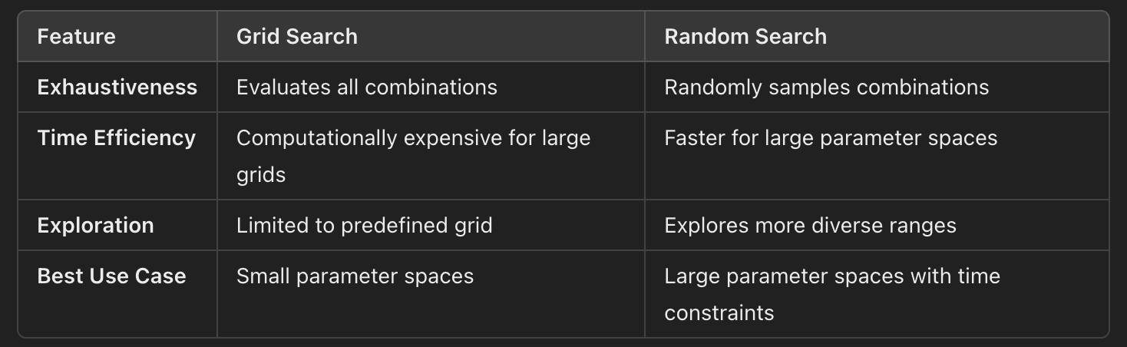
Pros and Cons of Each Method

Slide 290
Practical Guidance on Choosing Search Ranges
Start with Broad Ranges
Use Random Search to explore large parameter spaces and identify promising ranges
Refine with Grid Search
Narrow the search space based on Random Search results and perform exhaustive Grid Search for fine-tuning
Understand Model Sensitivity
Some hyperparameters (e.g., learning rate) require fine granularity, while others (e.g., number of trees) can have coarser steps.

Slide 291
Hands-On Exercise
Objective
Implement both Grid Search and Random Search for hyperparameter tuning, compare their efficiency, and analyze the impact on model performance

Slide 292
Day 03
Advanced Hyperparameter Tuning with Bayesian Optimization

Slide 293
Introduction to Bayesian Optimization
What is Bayesian Optimization?
Advanced method for hyperparameter tuning that balances exploration (searching new regions) and exploitation (refining promising regions)
Uses a probabilistic model to guide the search for optimal hyperparameters
How It Works
Surrogate Model
Builds a probabilistic model (e.g., Gaussian Process) of the objective function based on prior evaluations
Acquisition Function
Balances exploration and exploitation by choosing the next hyperparameters to evaluate based on predicted performance and uncertainty
Iterative Refinement
Updates the surrogate model after each evaluation, refining the search
Why Use Bayesian Optimization?
Efficient for high-dimensional and expensive-to-evaluate functions
Reduces the number of evaluations required to find near-optimal hyperparameters

Slide 294
Using Libraries for Bayesian Optimization
Popular Libraries
Hyperopt
Simplifies Bayesian Optimization for hyperparameter tuning
Works with fmin to minimize objective functions over a parameter space
Optuna
Flexible and user-friendly library for hyperparameter optimization
Supports dynamic search spaces and pruning of unpromising trials

Slide 295
Understanding Exploration vs. Exploitation
Exploration
Focuses on sampling hyperparameters from unexplored regions
Useful for identifying new areas of high potential
Exploitation
Focuses on refining the search around regions with known high performance
Useful for fine-tuning near-optimal hyperparameters
Bayesian Optimization’s Advantage
Balances these approaches using the acquisition function to minimize unnecessary evaluations while improving results.

Slide 296
Hands-On Exercise
Objective
Apply Bayesian Optimization using Optuna to tune an XGBoost model and compare the results with Grid Search and Random Search

Slide 297
Day 04
Regularization Techniques for Model Optimization

Slide 298
Understanding Overfitting and Underfitting
Overfitting
Occurs when a model learns the noise in the training data along with the patterns, leading to poor generalization on unseen data
Symptoms
High training accuracy but low test accuracy
Large differences between training and validation losses
Underfitting
Occurs when a model is too simple to capture the underlying patterns in the data
Symptoms
Low accuracy on both training and test sets
High bias in predictions

Slide 299
Regularization Techniques
Regularization introduces a penalty term to the loss function during model training to prevent overfitting by discouraging overly complex models
L1 Regularization (Lasso)
Adds the absolute values of coefficients to the loss function
Encourages sparsity by setting some coefficients to zero, effectively selecting features.
L2 Regularization (Ridge)
Adds the squared values of coefficients to the loss function
Shrinks coefficients toward zero but does not set them to zero.
Elastic Net
Combines L1 and L2 regularization
Useful when there are correlated predictors and when feature selection is desired

Slide 300
Practical Applications of Regularization
Prevent Overfitting
Penalizes large coefficients, reducing model complexity
Handle Multicollinearity
Ridge regularization is effective when predictors are highly correlated
Feature Selection
Lasso automatically performs feature selection by setting some coefficients to zero

Slide 301
Hands-On Exercise
Objective
Apply Lasso and Ridge regularization on a linear regression model, compare performance, and analyze the effects on coefficients

Slide 302
Day 05
Cross-Validation and Model Evaluation Techniques

Slide 303
Importance of Cross-Validation in Model Evaluation
What is Cross-Validation?
Statistical method used to evaluate the performance of a model by partitioning the data into training and validation subsets multiple times
It helps ensure that the model's performance generalizes well to unseen data
Why Use Cross-Validation?
Prevents Overfitting
By evaluating the model on multiple subsets, cross-validation provides a more robust measure of its performance
Reliable Performance Estimate
Reduces the variance of performance metrics compared to a single train-test split
Optimizes Model Selection
Helps in comparing and selecting the best model or hyperparameter configuration.

Slide 304
Types of Cross-Validation
K-Fold Cross-Validation
Splits the dataset into 𝐾 equal-sized folds
Trains the model on 𝐾 − 1 folds and validates on the remaining fold
Repeats the process 𝐾 times, ensuring each fold is used as a validation set once
Best For: General-purpose datasets.
Stratified K-Fold Cross-Validation
Ensures that each fold maintains the same class distribution as the original dataset
Particularly useful for imbalanced datasets
Best For: Classification tasks with imbalanced data
Leave-One-Out Cross-Validation (LOOCV)
Uses a single data point as the validation set and the rest as the training set
Repeats the process for each data point
Pros: Maximizes training data for each fold
Cons: Computationally expensive for large datasets
Best For: Small datasets where maximizing training data is critical

Slide 305
Practical Guidance on Cross-Validation
Choose K Based on Dataset Size
𝐾 = 5 or 𝐾 = 10 are commonly used for large datasets
Use LOOCV for small datasets
Stratification for Imbalanced Data
Always prefer Stratified K-Fold for imbalanced classification tasks to ensure fair evaluation
Combine with Hyperparameter Tuning
Integrate cross-validation into Grid or Random Search for robust hyperparameter tuning

Slide 306
Hands-On Exercise
Objective
Evaluate a classification model using K-Fold and Stratified K-Fold Cross-Validation
Compare the results to demonstrate the importance of stratification for imbalanced datasets

Slide 307
Day 06
Automated Hyperparameter Tuning with GridSearchCV and RandomizedSearchCV

Slide 308
Using GridSearchCV and RandomizedSearchCV in scikit-learn
What is GridSearchCV?
Exhaustive search over a specified parameter grid
Trains and evaluates a model for every combination of hyperparameters in the grid using cross-validation
What is RandomizedSearchCV?
Selects a fixed number of random combinations from a parameter distribution
Faster than GridSearchCV for large hyperparameter spaces while still providing good results

Slide 309
Using GridSearchCV and RandomizedSearchCV in scikit-learn
Key Features
Automates Hyperparameter Tuning
Combines model training, evaluation, and hyperparameter search into a single step
Cross-Validation Integration
Ensures robust performance metrics by using cross-validation
Result Interpretation
Provides the best hyperparameter combination and associated metrics

Slide 310
Integrating Cross-Validation with Hyperparameter Tuning
Cross-Validation
Ensures that the hyperparameters selected generalize well to unseen data
Benefits
Reduces overfitting to the training dataset
Provides robust estimates of model performance

Slide 311
Interpreting Results and Selecting the Best Model
Best Parameters
Access the optimal hyperparameter combination using .best_params_
Best Estimator
Retrieve the model trained with the best hyperparameters using .best_estimator_
Performance Metrics
Use .best_score_ to evaluate the performance of the best hyperparameters.

Slide 312
Hands-On Exercise
Objective
Use GridSearchCV and RandomizedSearchCV to tune hyperparameters of Gradient Boosting and Support Vector Machine models, and compare results

Slide 313
Day 07
Optimization Project – Building and Tuning a Final Model

Slide 314
Applying All Learned Tuning and Optimization Techniques
Comprehensive Model Optimization
Data Preprocessing:
Ensure data is clean, scaled, and encoded appropriately
Feature Engineering
Derive new features and select the most important ones
Regularization
Avoid overfitting by penalizing complex models
Cross-Validation
Use techniques like K-Fold or Stratified K-Fold for robust performance metrics
Hyperparameter Tuning
Use methods like GridSearchCV, RandomizedSearchCV, or Bayesian Optimization

Slide 315
Evaluating and Interpreting Model Performance
Performance Metrics
Classification
Accuracy, Precision, Recall, F1-Score, ROC-AUC
Regression
Mean Squared Error (MSE), Mean Absolute Error (MAE), 𝑅²
Importance of Interpretability
Use feature importance and coefficient analysis for transparency

Slide 316
Hands-On Project
Objective
Build, tune, and optimize a machine learning model using a structured process and evaluate its performance comprehensively

Slide 317
WEEK 9: Neural Networks and Deep Learning Fundamentals
Day 1
Introduction to Deep Learning and Neural Networks
Day 2
Forward Propagation and Activation Functions
Day 3
Loss Functions and Backpropagation
Day 4
Gradient Descent and Optimization Techniques
Day 5
Building Neural Networks with TensorFlow and Keras
Day 6
Building Neural Networks with PyTorch
Day 7
Neural Network Project – Image Classification on CIFAR-10

Slide 318
Day 01
Introduction to Deep Learning and Neural Networks

Slide 319
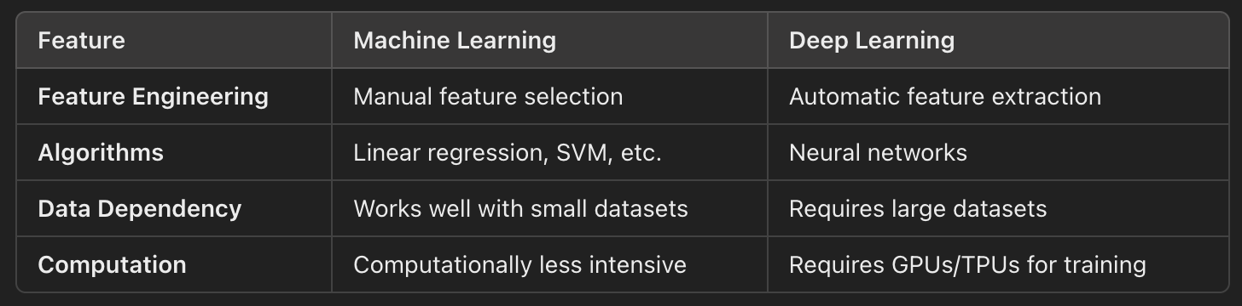
What is Deep Learning?
What is Deep Learning?
Subset of Machine Learning that uses artificial neural networks (ANNs) with multiple layers (deep architectures) to model and learn complex patterns in data
Key Feature
Automatically extracts relevant features from raw data, eliminating the need for manual feature engineering
Machine Learning vs. Deep Learning

Slide 320
Overview of Artificial Neural Networks (ANNs)
Structure of a Neural Network
Input Layer
Accepts input data features
Hidden Layers
Perform computations to extract patterns
Output Layer
Produces predictions or classifications
Key Components
Neurons
Basic units of computation that take inputs, apply weights and biases, and produce outputs using an activation function
Weights and Biases
Weights determine the importance of each input
Bias shifts the output of the activation function
Activation Functions
Add non-linearity to the model (e.g., ReLU, Sigmoid, Tanh).

Slide 321
Overview of Artificial Neural Networks (ANNs)
How Neural Networks Work
Forward Propagation
Data flows through the network to generate predictions
Loss Calculation
Compares predictions with actual labels to compute the error
Backpropagation
Adjusts weights and biases using gradient descent to minimize the loss

Slide 322
Applications of Deep Learning
Domains and Use Cases
Computer Vision
Image classification (e.g., recognizing objects in images)
Object detection (e.g., autonomous vehicles)
Natural Language Processing (NLP)
Text generation (e.g., GPT models)
Sentiment analysis
Healthcare
Disease diagnosis (e.g., identifying tumors in X-rays)
Drug discovery
Speech Processing
Speech-to-text systems (e.g., virtual assistants)
Voice recognition

Slide 323
Hands-On Exercise
Objective
Familiarize yourself with common datasets in deep learning and set up an environment to work with TensorFlow or PyTorch
Step 1: Explore Common Datasets
MNIST: Handwritten digit dataset (28x28 grayscale images, 10 classes)
CIFAR-10: 60,000 32x32 color images across 10 classes
ImageNet: Large dataset for image classification with millions of labeled images

Slide 324
Day 02
Forward Propagation and Activation Functions

Slide 325
Understanding Forward Propagation
What is Forward Propagation?
Process by which input data flows through the layers of a neural network to produce an output
Input Layer
Accepts input features and passes them to the next layer
Hidden Layers
Compute weighted sums of inputs, apply biases, and pass the result through activation functions
Output Layer
Produces predictions, typically using an activation function suitable for the task.

Slide 326
Understanding Forward Propagation
Steps in Forward Propagation
Compute Weighted Sum
𝑧 = 𝑊 ⋅ 𝑋 + 𝑏
𝑊: Weights | 𝑋: Inputs | 𝑏: Bias
Apply Activation Function
𝑎 = 𝜎 ( 𝑧 )
σ: Activation function
Repeat for Each Layer
Outputs of one layer become inputs to the next.

Slide 327
Common Activation Functions
Sigmoid
Use Case: Binary classification in the output layer
Limitation: Can suffer from vanishing gradients for large positive/negative 𝑧
Tanh (Hyperbolic Tangent)
Use Case: Hidden layers where zero-centered outputs are preferred
Limitation: Also prone to vanishing gradients
ReLU (Rectified Linear Unit)
Use Case: Most commonly used in hidden layers due to simplicity and efficiency
Limitation: Can suffer from the "dying ReLU" problem (neurons stuck at zero)
Softmax
Use Case: Multi-class classification in the output layer

Slide 328
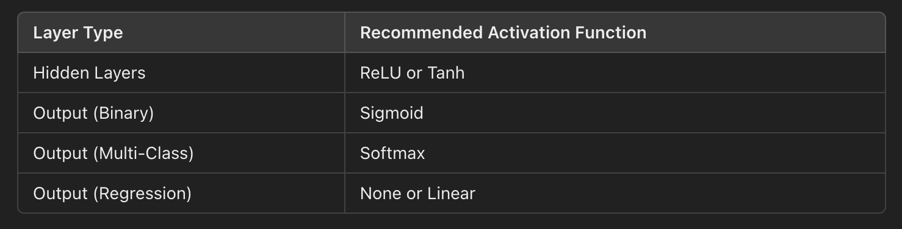
Choosing Activation Functions

Slide 329
Hands-On Exercise
Objective
Implement forward propagation for a simple neural network in Python and experiment with different activation functions.

Slide 330
Day 03
Loss Functions and Backpropagation

Slide 331
Understanding Loss Functions
What Are Loss Functions?
Quantify the difference between the predicted output of a model and the actual target value
Guide the training process by providing a metric to minimize during optimization
Role in Neural Networks
Error Measurement
Evaluate the accuracy of predictions
Feedback for Optimization
Provide gradients for weight updates via backpropagation

Slide 332
Understanding Loss Functions
Common Types of Loss Functions
Mean Squared Error (MSE)
Commonly used for regression tasks
Penalizes larger errors more heavily than smaller ones
Cross-Entropy Loss
Used for classification tasks
Measures the difference between true labels and predicted probabilities

Slide 333
Introduction to Backpropagation
What Is Backpropagation?
Process of computing gradients for each weight and bias in a neural network, enabling optimization algorithms (like gradient descent) to minimize the loss function
Steps in Backpropagation
Forward Pass: Compute the output and loss for the current weights
Backward Pass: Calculate the gradient of the loss with respect to each parameter
Weight Update: Use the gradients to update parameters
Key Concepts
Gradient: The rate of change of the loss with respect to a parameter
Gradient Descent: An optimization algorithm that minimizes the loss by updating parameters in the direction of the negative gradient

Slide 334
Hands-On Exercise
Objective
Implement basic loss functions, calculate gradients manually, and visualize the effects of different loss functions

Slide 335
Day 04
Gradient Descent and Optimization Techniques

Slide 336
Gradient Descent and Its Variants
What is Gradient Descent?
Optimization algorithm used to minimize the loss function by iteratively adjusting the model's parameters in the direction of the negative gradient
Variants of Gradient Descent
Batch Gradient Descent
Uses the entire dataset to compute gradients at each step
Pros: Accurate gradients
Cons: Computationally expensive for large datasets.
Stochastic Gradient Descent (SGD)
Updates parameters using one data point at a time
Pros: Faster updates
Cons: High variance in updates; can lead to oscillations.
Mini-batch Gradient Descent
Updates parameters using a small subset (batch) of the dataset
Pros: Combines the efficiency of SGD with the stability of Batch Gradient Descent

Slide 337
Advanced Optimization Techniques
Adagrad
Adapts learning rates for each parameter by scaling inversely with the sum of gradients squared
Pros: Suitable for sparse data
Cons: Learning rate decreases too aggressively over time
RMSprop
Modifies Adagrad by using an exponentially weighted moving average of squared gradients
Pros: Addresses Adagrad’s aggressive learning rate decay; works well for non-convex problems
Adam (Adaptive Moment Estimation)
Combines momentum and RMSprop to adapt learning rates for each parameter
Pros: Works well in practice for most problems; computationally efficient

Slide 338
Importance of Learning Rate and Choosing the Right Optimizer
Learning Rate
Determines the step size for parameter updates
Too High: May overshoot the minimum or cause divergence
Too Low: Leads to slow convergence
Choosing the Right Optimizer
SGD: Works well for simple, convex problems
Adam: Generally performs well across tasks
RMSprop: Often preferred for RNNs and sequence-based tasks

Slide 339
Hands-On Exercise
Objective
Implement gradient descent to update model weights and experiment with different optimizers using TensorFlow and/or PyTorch

Slide 340
Day 05
Building Neural Networks with TensorFlow and Keras

Slide 341
Introduction to TensorFlow and Keras
What is TensorFlow?
Open-source library for numerical computation and machine learning
Provides tools for building and training deep learning models
What is Keras?
High-level API integrated with TensorFlow that simplifies the process of creating and training neural networks
Key Features of Keras
User-Friendly: Intuitive syntax for rapid prototyping
Modular: Building blocks for defining layers, optimizers, and loss functions
Integration: Compatible with TensorFlow for scalable deep learning tasks

Slide 342
Defining Layers, Models, and Compiling Networks in Keras
Defining Layers
Layers are the building blocks of neural networks. Common types include:
Dense (Fully Connected) Layers
Each neuron is connected to every neuron in the previous layer
Dropout Layers
Randomly drops connections to prevent overfitting
Activation Layers
Apply activation functions to introduce non-linearity

Slide 343
Defining Layers, Models, and Compiling Networks in Keras
Building a Model
Keras supports two primary ways to define models
Sequential API: A linear stack of layers
Functional API: More flexible, allows for complex architectures
Compiling a Model
Specifies
Optimizer: Algorithm to update weights
Loss Function: Metric to minimize during training
Metrics: Additional performance measures

Slide 344
Training, Evaluating, and Saving a Model
Training
Fit the model to data using model.fit()
Evaluation
Test the model on unseen data using model.evaluate()
Saving and Loading
Save a trained model using model.save() and reload it with keras.models.load_model()

Slide 345
Hands-On Exercise
Objective
Build, train, evaluate, and save a simple neural network to classify digits from the MNIST dataset

Slide 346
Day 06
Building Neural Networks with PyTorch

Slide 347
Introduction to PyTorch and Its Core Components
What is PyTorch?
Open-source deep learning framework that provides flexibility and dynamic computation for building and training machine learning models
Core Components of PyTorch
Tensors: Multi-dimensional arrays similar to NumPy arrays but with GPU support for accelerated computation
Autograd: Automatic differentiation engine that computes gradients for optimization
torch.nn Module: Provides tools to define and train neural networks with layers, activation functions, and loss functions.

Slide 348
Building a Neural Network in PyTorch
Steps
Define the Model
Use torch.nn.Module to create a neural network with layers and forward propagation
Define the Loss Function
Use built-in loss functions like Cross-Entropy Loss
Define the Optimizer
Use optimizers like SGD or Adam for weight updates

Slide 349
Training, Evaluating, and Saving a Model in PyTorch
Training
Forward pass to compute predictions
Compute loss and gradients using backpropagation
Update weights using an optimizer
Evaluation
Test the model on unseen data and calculate metrics like accuracy
Saving and Loading
Save the model's parameters using torch.save() and load them using torch.load()

Slide 350
Hands-On Exercise
Objective
Build, train, evaluate, and save a neural network for MNIST digit classification using PyTorch.

Slide 351
Day 07
Neural Network Project – Image Classification on CIFAR-10

Slide 352
Applying Learned Concepts to a More Complex Dataset
Why CIFAR-10?
The CIFAR-10 dataset is a challenging benchmark dataset for image classification. It contains 60,000 32x32 color images across 10 classes (e.g., airplane, car, bird, dog)
Unlike MNIST, CIFAR-10 involves more complex patterns and requires robust neural network architectures

Slide 353
Building and Optimizing a Neural Network for Image Classification
Key Steps:
Preprocess the dataset for training (e.g., normalization, one-hot encoding)
Define a neural network with convolutional layers for feature extraction
Optimize the network using techniques like learning rate adjustment and dropout.

Slide 354
Analyzing Model Performance and Experimenting with Hyperparameters
Performance Analysis
Evaluate accuracy and loss curves during training
Use test set metrics to measure generalization
Experimentation
Try different activation functions (e.g., ReLU, Tanh)
Test optimizers like SGD, Adam, and RMSprop
Adjust the learning rate and regularization techniques (e.g., dropout, weight decay).

Slide 355
Hands-On Project
Objective
Build, train, and optimize a neural network for CIFAR-10 image classification, experimenting with hyperparameters to improve performance

Slide 356
WEEK 10: Convolutional Neural Networks (CNNs)
Day 1
Introduction to Convolutional Neural Networks
Day 2
Convolutional Layers and Filters
Day 3
Pooling Layers and Dimensionality Reduction
Day 4
Building CNN Architectures with Keras and TensorFlow
Day 5
Building CNN Architectures with PyTorch
Day 6
Regularization and Data Augmentation for CNNs
Day 7
CNN Project – Image Classification on Fashion MNIST or CIFAR-10

Slide 357
Day 01
Introduction to Convolutional Neural Networks

Slide 358
Overview of CNNs and Their Role in Image Processing
What are Convolutional Neural Networks (CNNs)?
Specialized type of neural network designed for processing structured grid data, such as images
Particularly effective for image-related tasks like classification, object detection, and segmentation
Why CNNs for Image Processing?
Spatial Hierarchies
CNNs capture spatial and hierarchical patterns in images
Convolutional layers extract features like edges, textures, and complex structures
Parameter Efficiency
Unlike fully connected networks, CNNs use fewer parameters due to shared weights, reducing computation and memory requirements

Slide 359
CNN Architecture
Key Components of a CNN
Convolutional Layers
Perform convolution operations to extract features
Kernel/Filter
A small matrix (e.g., 3x3) that slides over the input image to detect patterns
Output
Feature maps highlighting specific patterns in the input
Pooling Layers
Downsample feature maps to reduce dimensions and computation
Types
Max Pooling: Takes the maximum value in a region
Average Pooling: Takes the average value in a region
Fully Connected Layers
Combine extracted features for final predictions
Act as a "classifier" in the network
Basic CNN Workflow: Input Image → Convolution → Activation → Pooling → Fully Connected Layer → Output

Slide 360
Key Advantages of CNNs Over Fully Connected Networks for Images
Translation Invariance
CNNs can detect patterns irrespective of their position in the image
Reduced Parameters
Shared weights and local connectivity make CNNs computationally efficient
Automatic Feature Extraction
CNNs learn to identify meaningful patterns like edges, shapes, and textures directly from data

Slide 361
Hands-On Exercise
Objective
Visualize images in a dataset, explore their pixel data, and set up an environment for building CNNs using TensorFlow or PyTorch

Slide 362
Day 02
Convolutional Layers and Filters

Slide 363
Convolution Operations, Filters, and Feature Maps
What is a Convolution Operation?
Mathematical operation where a small matrix (kernel or filter) slides over the input image to extract features like edges, textures, or patterns
Key Concepts
Kernel (Filter)
A small matrix (e.g., 3 × 3 3×3) used to extract features
Each element of the kernel is a weight learned during training
Feature Map
The output of a convolution operation
Highlights specific patterns detected by the filter
Channels
For RGB images, convolution processes each color channel separately and combines results

Slide 364
Concepts of Kernel Size, Stride, and Padding
Kernel Size
The dimensions of the filter (e.g., 3 × 3 3×3, 5 × 5 5×5)
Smaller Kernels: Capture fine details
Larger Kernels: Detect broader features
Stride
Defines the step size of the filter as it slides across the input
Larger Strides: Reduce the feature map size, improving computation efficiency
Smaller Strides: Retain more detail but increase computation
Padding
Adds extra pixels around the input to control the size of the output
Valid Padding: No padding; the feature map shrinks
Same Padding: Adds enough padding to keep the output size equal to the input size

Slide 365
Visualizing How Convolution Extracts Features
Edge Detection
Kernels like Sobel or Prewitt highlight edges in images
Feature Extraction
Initial layers focus on edges; deeper layers capture abstract patterns.

Slide 366
Hands-On Exercise
Objective
Understand convolution operations by implementing and visualizing their effects using TensorFlow and PyTorch

Slide 367
Day 03
Pooling Layers and Dimensionality Reduction

Slide 368
Introduction to Pooling Layers
What Are Pooling Layers?
Used to reduce the dimensions of feature maps while retaining the most important information
Help make the network computationally efficient and robust to variations in the input
Types of Pooling
Max Pooling
Selects the maximum value from each region of the input feature map
Captures the strongest activations (features)
Average Pooling
Computes the average value for each region of the input feature map
Provides a more generalized summary of features.

Slide 369
Role of Pooling in Reducing Dimensionality
Dimensionality Reduction
Pooling reduces the spatial dimensions (height and width) of feature maps, resulting in fewer parameters and faster computations
Robustness
Makes the model invariant to small translations or distortions in the input image

Slide 370
Combining Convolution and Pooling Layers
Pooling layers typically follow convolutional layers to downsample the feature maps
This combination helps extract hierarchical features
Early layers focus on simple features (e.g., edges)
Deeper layers capture complex patterns (e.g., objects)

Slide 371
Hands-On Exercise
Objective
Implement max pooling and average pooling layers on feature maps and observe their effects on size and representation.

Slide 372
Day 04
Building CNN Architectures with Keras and TensorFlow

Slide 373
Building a CNN Architecture in Keras
Steps to Build a CNN
Convolutional Layers: Extract features from the input images
Pooling Layers: Downsample feature maps to reduce dimensions and retain key features
Dense (Fully Connected) Layers: Combine features for final predictions
Basic CNN Architecture
Input Layer → Convolutional Layer → Activation → Pooling → Fully Connected Layer → Output Layer
Repeat convolution and pooling layers for deeper networks

Slide 374
Compiling, Training, and Evaluating a CNN
Steps
Compile the Model
Define loss, optimizer, and metrics
Example loss functions
Categorical Cross-Entropy: Multi-class classification
Example optimizers
Adam: Efficient optimization for large networks
Example metrics: Accuracy
Train the Model
Use model.fit() with training data, validation data, epochs, and batch size
Evaluate the Model
Use model.evaluate() with test data to calculate metrics

Slide 375
Introduction to Popular CNN Architectures
LeNet
One of the earliest CNNs for handwritten digit classification (e.g., MNIST)
AlexNet
Revolutionized deep learning for image classification in 2012
Introduced ReLU activation and dropout for regularization
VGG
Uses deep networks with small filters (e.g., 3 × 3 3×3)
Known for its simplicity and effectiveness

Slide 376
Hands-On Exercise
Objective
Build, train, and evaluate a CNN for image classification on the MNIST or CIFAR-10 dataset using Keras and TensorFlow

Slide 377
Day 05
Building CNN Architectures with PyTorch

Slide 378
Building CNN Architectures in PyTorch Using the nn Module
Key Steps
Define a Model
Use torch.nn.Module to build CNN layers like convolutional, pooling, and fully connected layers
Forward Pass
Define how input flows through the layers to produce output
Model Summary
Inspect the structure and learnable parameters

Slide 379
Training and Evaluating CNNs in PyTorch
Training
Perform forward and backward passes, calculate loss, and update weights using an optimizer
Evaluation
Test the model on unseen data and compute metrics like accuracy and loss.

Slide 380
Experimenting with CNN Model Design and Tuning Hyperparameters
Experimentation Areas
Layer Depth
Add or remove convolutional and pooling layers to observe the impact
Filter Size
Experiment with kernel sizes (e.g., 3 × 3, 5 × 5)
Learning Rate
Adjust the learning rate to improve convergence speed and accuracy

Slide 381
Hands-On Exercise
Objective
Build, train, evaluate, and experiment with CNNs for CIFAR-10 classification using PyTorch

Slide 382
Day 06
Regularization and Data Augmentation for CNNs

Slide 383
Overfitting in CNNs and Methods to Prevent It
What Is Overfitting?
Occurs when a model performs well on the training data but fails to generalize to unseen data
In CNNs, overfitting is common due to the large number of parameters in deep networks
Methods to Prevent Overfitting
Dropout
Randomly sets a fraction of neurons to zero during training
Prevents co-adaptation of neurons
Controlled by a dropout rate (e.g., 0.5)
Batch Normalization
Normalizes the input of each layer to stabilize training
Reduces internal covariate shift and allows higher learning rates
Data Augmentation
Increases dataset size artificially by applying transformations to images
Examples: rotation, flipping, scaling, cropping, brightness adjustment.

Slide 384
Introduction to Data Augmentation Techniques
Common Techniques
Rotation
Rotates the image by a specified angle range (e.g., -30° to 30°)
Flipping
Horizontally or vertically flips the image
Scaling
Resizes the image by zooming in or out
Cropping
Extracts random portions of the image

Slide 385
Implementing Regularization and Data Augmentation in CNN Training
Why Use Both?
Regularization reduces the complexity of the model
Data augmentation increases the diversity of the training data, improving generalization

Slide 386
Hands-On Exercise
Objective
Apply dropout, batch normalization, and data augmentation to improve CNN performance

Slide 387
Day 07
CNN Project Image Classification on Fashion MNIST or CIFAR-10

Slide 388
Applying CNN Architecture to a Larger Dataset
Why Larger Datasets?
Larger datasets like CIFAR-10 or Fashion MNIST represent more realistic and diverse challenges compared to toy datasets like MNIST
They require deeper architectures, careful regularization, and augmentation for optimal performance

Slide 389
Experimenting with Architecture Design, Regularization, and Augmentation
Key Techniques to Improve Performance
Architectural Modifications
Add more convolutional layers or change kernel sizes
Use more filters in deeper layers to capture complex features
Regularization
Apply dropout in dense layers and batch normalization in convolutional layers
Prevent overfitting in deeper models
Data Augmentation
Use techniques like random flipping, cropping, and rotation to improve generalization

Slide 390
Analyzing Model Performance and Tuning
Evaluation Metrics
Accuracy: Overall classification correctness
Loss: Measures the difference between predictions and ground truth
Confusion Matrix: Highlights misclassified classes for deeper insights

Slide 391
Hands-On Exercise
Objective
Build, train, and optimize a CNN for Fashion MNIST or CIFAR-10 image classification, experimenting with regularization and data augmentation to achieve the best performance

Slide 392
WEEK 11: Recurrent Neural Networks (RNNs) and Sequence Modeling
Day 1
Introduction to Sequence Modeling and RNNs
Day 2
Understanding RNN Architecture and Backpropagation Through Time (BPTT)
Day 3
Long Short-Term Memory (LSTM) Networks
Day 4
Gated Recurrent Units (GRUs)
Day 5
Text Preprocessing and Word Embeddings for RNNs
Day 6
Sequence-to-Sequence Models and Applications
Day 7
RNN Project – Text Generation or Sentiment Analysis

Slide 393
Day 01
Introduction to Sequence Modeling and RNNs

Slide 394
Overview of Sequence Modeling
What is Sequence Modeling?
Involves predicting or generating outputs based on sequential data
Capture temporal or contextual dependencies
Why Is Sequence Modeling Important?
Natural Language Processing (NLP)
Tasks like language modeling, machine translation, and sentiment analysis depend on understanding sequential relationships in text
Time-Series Analysis
Sequence models are essential for tasks like stock price prediction, weather forecasting, and sensor data analysis

Slide 395
Introduction to Recurrent Neural Networks (RNNs)
What Are RNNs?
Specialized neural networks for sequence modeling
They include recurrent connections that allow them to maintain a "memory" of previous inputs
Structure of an RNN
Input Layer
Processes sequential data one step at a time
Hidden State
Maintains information about past inputs
Recurrent Connections
Pass hidden states from one time step to the next

Slide 396
Introduction to Recurrent Neural Networks (RNNs)
Key Concepts in RNNs:
Hidden States
Represent memory at each time step
Recurrent Connections
Enable information sharing across time steps
Vanishing Gradient Problem
Challenges in training long sequences due to diminishing gradients

Slide 397
Key Applications of RNNs in Machine Learning
Text Generation
Generate new text based on learned patterns
Language Translation
Convert text from one language to another
Stock Price Prediction
Predict future stock prices using historical data
Speech Recognition
Understand spoken words and phrases
Video Frame Prediction
Anticipate future frames in video sequences

Slide 398
Hands-On Exercise
Objective
Preprocess a text dataset for use in RNNs and set up an environment in TensorFlow or PyTorch for building RNNs

Slide 399
Day 02
Understanding RNN Architecture and Backpropagation Through Time (BPTT)

Slide 400
Detailed Architecture of RNNs
Components of an RNN
Input Layer
Takes sequential data as input at each time step
Hidden Layer
Maintains a "memory" of past inputs through recurrent connections. The hidden state at time 𝑡(ℎ_{𝑡}) is calculated as
ℎ_{𝑡} = 𝑓 ( 𝑊_{ℎ} ⋅ ℎ_{𝑡−1} + 𝑊_{𝑥} ⋅ 𝑥_{𝑡} + 𝑏_{ℎ})
​𝑊_{ℎ} : Weight matrix for recurrent connections
𝑊_{𝑥} ​: Weight matrix for input connections
𝑏_{ℎ} : Bias term
𝑓 : Non-linear activation function (e.g., tanh, ReLU)
Output Layer
Produces output 𝑦_{𝑡} ​ based on the hidden state ℎ_{𝑡}
𝑦_{𝑡} = 𝑔 ( 𝑊_{𝑦} ⋅ ℎ_{𝑡} + 𝑏_{𝑦} )
𝑔: Activation function (e.g., softmax for classification)

Slide 401
Backpropagation Through Time (BPTT)
What is BPTT?
Extension of standard backpropagation to handle sequential data in RNNs
It calculates gradients for each time step and propagates them backward through the sequence
Steps of BPTT
Unroll the RNN across the sequence for a fixed number of time steps
Compute the loss for each time step
Backpropagate the errors across all time steps to update weights
Challenges in BPTT
Vanishing Gradient Problem
Gradients diminish exponentially as they are propagated back through time
Leads to difficulty in learning long-term dependencies
Exploding Gradient Problem
Gradients grow exponentially, causing numerical instability during training
Solutions
Use gradient clipping to handle exploding gradients
Use architectures like Long Short-Term Memory (LSTM) or Gated Recurrent Units (GRU) to mitigate the vanishing gradient problem

Slide 402
Limitations of Vanilla RNNs
Short-Term Memory
Struggle to learn dependencies in long sequences due to vanishing gradients
Sequential Computation
Cannot parallelize training across time steps, making them computationally expensive
Sensitive Initialization
Performance depends heavily on proper weight initialization and learning rates

Slide 403
Hands-On Exercise
Objective
Build a simple RNN model for text classification using TensorFlow or PyTorch
Train the RNN and observe how it captures sequence patterns

Slide 404
Day 03
Long Short-Term Memory (LSTM) Networks

Slide 405
Introduction to LSTMs and How They Address RNN Limitations
What Are LSTMs?
Type of Recurrent Neural Network (RNN) specifically designed to handle long-term dependencies
LSTMs mitigate the vanishing gradient problem by using specialized gates to manage the flow of information
Key Features of LSTMs
Memory Cells
Maintain a long-term memory state across sequences
Gated Mechanism
Regulates how much information to keep, update, or forget at each time step
Effective for Long Sequences
Handles sequential data with dependencies across many time steps.

Slide 406
Introduction to LSTMs and How They Address RNN Limitations
Advantages Over Vanilla RNNs
Retains long-term dependencies
Prevents gradient-related issues during training
Outperforms RNNs on tasks like language modeling, speech recognition, and time-series forecasting

Slide 407
LSTM Cell Structure: Input, Forget, and Output Gates
Forget Gate
Decides what information to discard from the cell state
f_{t} = σ ( W_{f} . dot [h_{t-1}, x_{t}] + b_{f}) ]
W_{f}: Weight matrix for the forget gate
𝑓_{𝑡}: Forget gate output
𝑥_{𝑡}: Input
ℎ_{𝑡− 1} : Previous hidden state
Input Gate
Decides what new information to add to the cell state
i_{t} ​ = σ (W_{i} ​⋅ [h_{t−1}​, x_{t}​] + b_{i}​)
σ: Sigmoid activation function
𝑊_{𝑖} : Weight matrix for the input gate
ℎ_{𝑡 − 1} : Hidden state from the previous time step
𝑥_{𝑡} : Current input
𝑏 _{𝑖}: Bias for the input gate

Slide 408
LSTM Cell Structure: Input, Forget, and Output Gates
Cell State Update
Combines the forget gate and input gate results to update the cell state
C_{t}​ = f_{t} . dot C_{t-1} + i_{t} . dot C_{t’}
Output Gate
Decides what information to output at each time step
o_{t}​ = σ (W_{o} ​ ⋅ [h_{t−1} ​, x_{t}​ ] + b_{o}​)
W_{o}: Weight matrix for the output gate
𝑏_{𝑜} : Bias for the output gate

Slide 409
Applications of LSTMs
Natural Language Processing (NLP)
Sentiment analysis, machine translation, text generation
Time-Series Forecasting
Predicting stock prices, weather patterns, or sales trends
Speech Recognition
Converting spoken words into text
Anomaly Detection
Identifying unusual patterns in sequential data

Slide 410
Hands-On Exercise
Objective
Build an LSTM model for sentiment analysis on the IMDB Movie Reviews Dataset and compare its performance with a basic RNN model

Slide 411
Day 04
Gated Recurrent Units (GRUs)

Slide 412
Introduction to Gated Recurrent Units (GRUs)
What Are GRUs?
Simplified variant of Long Short-Term Memory (LSTM) networks
Designed to retain long-term dependencies while reducing computational complexity by having fewer parameters
Key Features of GRUs
Simpler Architecture
GRUs have two gates (update and reset) compared to LSTMs' three gates (input, forget, output)
Efficiency
Fewer parameters make GRUs computationally faster and less prone to overfitting on smaller datasets
Retains Performance
Comparable to LSTMs in terms of capturing sequential dependencies.

Slide 413
GRU Cell Structure: Update and Reset Gates
Update Gate
Determines how much of the previous hidden state to retain and how much to update with new information
Reset Gate
Controls how much of the past information to forget when combining with new input.
Hidden State Update
Combines the new information and the past hidden state based on the reset and update gates

Slide 414
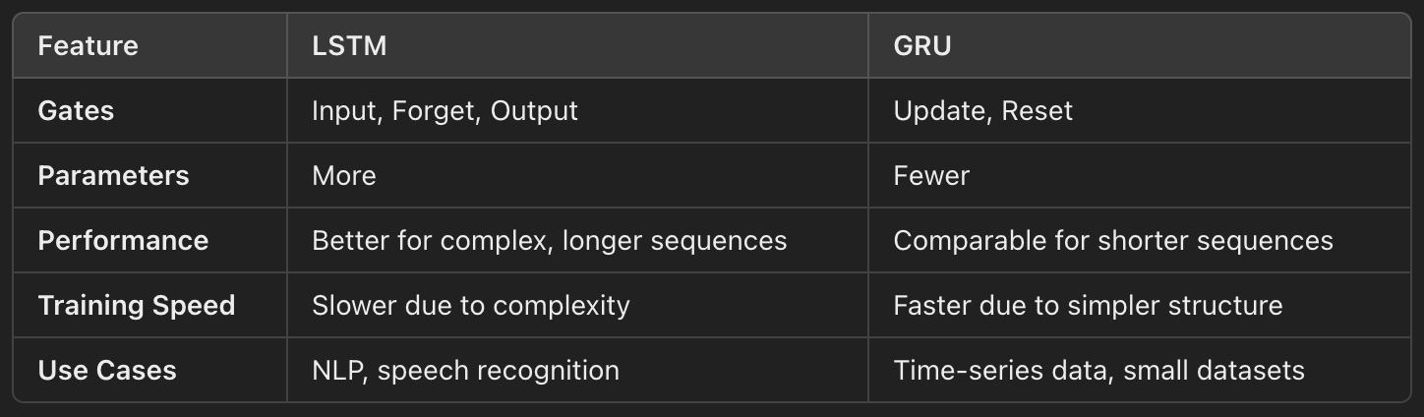
When to Use GRUs vs. LSTMs

Slide 415
Hands-On Exercise
Objective
Build a GRU-based model for the IMDB Movie Reviews Dataset and compare its performance with the LSTM model

Slide 416
Day 05
Text Preprocessing and Word Embeddings for RNNs

Slide 417
Importance of Text Preprocessing
What is Text Preprocessing?
Involves cleaning and preparing raw text data to make it suitable for machine learning models
Critical step for achieving high performance in Natural Language Processing (NLP) tasks
Key Steps
Tokenization: Splits text into individual units (e.g., words, sentences)
Example: "I love NLP" → ["I", "love", "NLP"]
Stemming: Reduces words to their root form by removing suffixes
Example: "running", "runner" → "run"
Lemmatization: Converts words to their base form using a vocabulary
Example: "better" → "good”
Why is Preprocessing Important?
Reduces noise in the data
Standardizes input for models
Improves feature extraction and model accuracy

Slide 418
Introduction to Word Embeddings
What Are Word Embeddings?
Dense vector representations of words that capture semantic meaning
Represent words in a continuous vector space
Popular Word Embedding Models
Word2Vec:
Models: Continuous Bag of Words (CBOW) and Skip-gram
Captures word relationships based on context
GloVe (Global Vectors for Word Representation)
Uses word co-occurrence statistics to generate embeddings
Represents global semantic relationships
Pre-trained Embeddings in Frameworks
Frameworks like TensorFlow and PyTorch offer pre-trained embeddings for quick integration
Benefits of Word Embeddings
Reduce dimensionality | Capture semantic similarity | Improve model generalization

Slide 419
Using Pre-trained Embeddings for NLP Tasks
Why Use Pre-trained Embeddings?
Saves computational resources
Leverages large, well-trained models
Boosts performance for downstream tasks
Popular Pre-trained Embeddings
GloVe: Pre-trained on datasets like Wikipedia and Common Crawl
FastText: Handles out-of-vocabulary (OOV) words through subword embeddings
Embedding Layers in deep learning frameworks like TensorFlow and PyTorch

Slide 420
Hands-On Exercise
Objective
Preprocess a text dataset and integrate word embeddings (e.g., GloVe) into an LSTM model for sentiment analysis

Slide 421
Day 06
Sequence-to-Sequence Models and Applications

Slide 422
Sequence-to-Sequence (Seq2Seq) Models and Their Architecture
What Are Seq2Seq Models?
Map an input sequence to an output sequence of different lengths
Widely used for tasks like language translation, text summarization, speech-to-text, and chatbots
Architecture
Encoder
Processes the input sequence and encodes it into a fixed-length vector (context vector)
Decoder
Takes the context vector as input and generates the output sequence, step by step

Slide 423
Encoder-Decoder Framework for Seq2Seq Tasks
How It Works
Encoder
Sequentially processes the input sequence using RNN, LSTM, or GRU
Produces a context vector representing the entire input sequence
Decoder
Initializes its hidden state with the encoder's context vector
Generates the output sequence one token at a time
Predicts the next token using the previously generated tokens

Slide 424
Attention Mechanism Overview
Why Attention?
Standard Seq2Seq models compress the entire input sequence into a fixed-length vector, which can lead to information loss for long sequences
Attention Mechanism dynamically focuses on different parts of the input sequence when generating each output token
How Attention Works
Calculates a weight (or score) for each input token based on its relevance to the current decoder state
Outputs a weighted sum of the encoder outputs, creating a context vector for each decoder step

Slide 425
Hands-On Exercise
Objective
Build a basic Seq2Seq model using LSTMs for translation and experiment with hyperparameters

Slide 426
Day 07
RNN Project Sentiment Analysis

Slide 427
Applying RNN, LSTM, and GRU Models to a Complete Task
Project Overview
Choose a task: Sentiment Analysis
Sentiment Analysis: Classify text into categories like positive or negative sentiment
Use RNN, LSTM, or GRU models to solve the chosen task
Focus on preprocessing, embedding integration, model architecture, and hyperparameter tuning

Slide 428
Analyzing Model Performance
Key Metrics
For Sentiment Analysis
Accuracy, Precision, Recall, F1 Score
Tuning Hyperparameters
Embedding size
Number of hidden units
Learning rate and optimizer choice
Sequence length and batch size

Slide 429
Experimenting with Architectures and Techniques
Architectural Variations
Single-Layer vs. Multi-Layer RNNs
Bidirectional RNNs for improved context capture
Preprocessing Techniques
Tokenization, stemming, lemmatization
Padding for sequence uniformity

Slide 430
Hands-On Project
Objective
Build, train, and optimize RNN, LSTM, or GRU models for Sentiment Analysis

Slide 431
WEEK 12: Transformers and Attention Mechanisms
Day 1
Introduction to Attention Mechanisms
Day 2
Introduction to Transformers Architecture
Day 3
Self-Attention and Multi-Head Attention in Transformers
Day 4
Positional Encoding and Feed-Forward Networks
Day 5
Hands-On with Pre-Trained Transformers – BERT and GPT
Day 6
Advanced Transformers – BERT Variants and GPT-3
Day 7
Transformer Project – Text Summarization or Translation

Slide 432
Day 01
Introduction to Attention Mechanisms

Slide 433
Understanding the Limitations of RNNs and the Need for Attention
Challenges of RNNs
Sequential Processing
Long-Term Dependency Problems
Fixed Context Vector
The Role of Attention Mechanisms
Attention overcomes these limitations by allowing the model to focus on specific parts of the input sequence dynamically during each output generation step
Instead of relying on a single context vector, attention provides a weighted combination of all input tokens relevant to the current output token

Slide 434
Basics of the Attention Mechanism
Core Components
Queries ( 𝑄 )
Represents the current focus of the model (e.g., the current decoder state in Seq2Seq tasks)
Keys ( 𝐾 )
Encoded representations of the input sequence
Values ( 𝑉 )
Additional information associated with the keys.

Slide 435
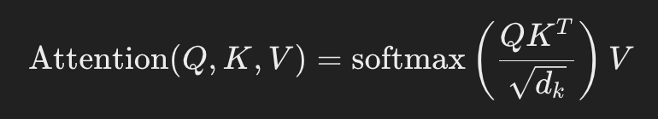
Basics of the Attention Mechanism
Attention Mechanism
The attention score is computed using the dot product of the query and keys, followed by a softmax function to normalize into a probability distribution
The weighted sum of the values forms the context vector

Slide 436
Types of Attention
Self-Attention
The query, key, and value all come from the same input sequence
Widely used in Transformer models for learning interdependencies within a sequence
Multi-Head Attention
Extends self-attention by applying multiple attention mechanisms in parallel
Captures different aspects of relationships in the sequence
MultiHead ( 𝑄 , 𝐾 , 𝑉 ) = Concat ( head₁ , head₂ , . . . , head_{ℎ} ) 𝑊^{𝑂}
where each head computes attention with different learned projections of 𝑄, 𝐾, and 𝑉

Slide 437
Hands-On Exercise
Objective
Implement a basic Attention Mechanism using NumPy or PyTorch and visualize its impact on a simple sequence task

Slide 438
Day 02
Introduction to Transformers Architecture

Slide 439
Overview of the Transformer Architecture
What is a Transformer?
Neural network architecture introduced in the paper "Attention is All You Need”
It relies entirely on the attention mechanism to process sequential data without using recurrence or convolution
Transformative for NLP tasks like translation, summarization, and text generation

Slide 440
Overview of the Transformer Architecture
Components of the Transformer
Encoder
Processes the input sequence and generates a contextualized representation
Consists of multiple identical layers, each with
Self-Attention Mechanism: Captures dependencies between all input tokens
Feed-Forward Neural Network (FFNN): Processes the attention outputs
Decoder
Generates the output sequence one token at a time
Consists of multiple identical layers, each with
Masked Self-Attention Mechanism: Prevents the decoder from attending to future tokens
Encoder-Decoder Attention: Attends to encoder outputs
Feed-Forward Neural Network
Workflow: Input sequence → Encoder → Context vectors → Decoder → Output sequence

Slide 441
Detailed Breakdown of the Transformer Model Layers
Self-Attention Layer
Captures relationships between all tokens in the input sequence
Computes the importance of each token to all other tokens
Positional Encoding
Since Transformers lack recurrence, positional encoding injects information about the token order into the model
Feed-Forward Neural Network
Applies a position-wise FFNN to the outputs of the attention layer
Non-linear transformation enhances the representation
Layer Normalization
Stabilizes training by normalizing inputs within each layer
Multi-Head Attention
Combines multiple self-attention mechanisms to learn various aspects of relationships within the sequence

Slide 442
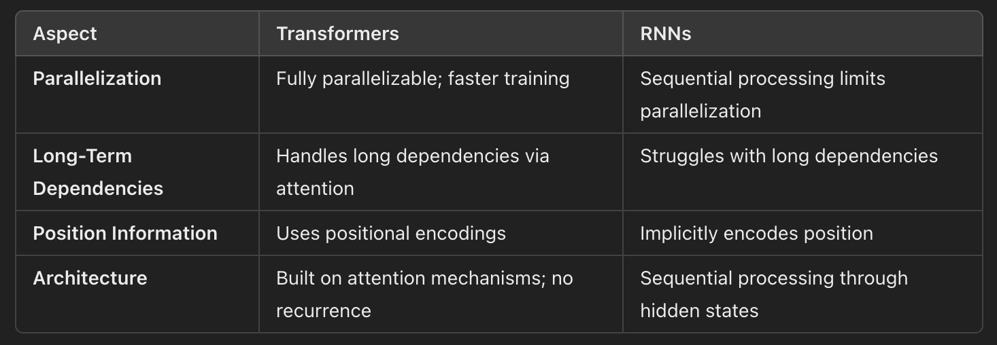
Key Differences Between Transformers and RNNs

Slide 443
Hands-On Exercise
Objective
Visualize the architecture of a Transformer model and set up an environment for working with Transformers using PyTorch and/or TensorFlow

Slide 444
Day 03
Self-Attention and Multi-Head Attention in Transformers

Slide 445
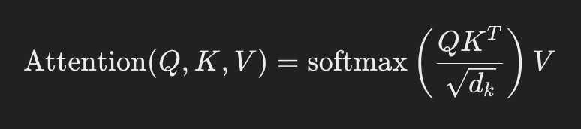
Self-Attention Mechanism
What is Self-Attention?
Allows a model to dynamically focus on different parts of an input sequence when encoding a token
It captures dependencies across all tokens in a sequence, enabling context-aware representations
Steps in Self-Attention
Compute Attention Scores:
Calculate dot products between the query ( 𝑄 ) and key ( 𝐾 ) vectors for all tokens
Scale by the square root of the key dimension ( 𝑑_{𝑘} ​ ) to stabilize gradients
Apply the softmax function to convert scores into probabilities
Weight Values
Use the attention scores to compute a weighted sum of value ( 𝑉 ) vectors

Slide 446
Multi-Head Attention
What is Multi-Head Attention?
Applies several attention mechanisms in parallel
Each attention "head" focuses on different aspects of the sequence
Steps
Linear Projections
Project 𝑄, 𝐾, and 𝑉 into multiple subspaces using learned weight matrices
Apply Self-Attention
Perform self-attention for each head independently
Concatenate Outputs
Combine outputs from all heads
Final Linear Projection
Project concatenated outputs back into the original dimension
MultiHead ( 𝑄 , 𝐾 , 𝑉 ) = Concat ( head₁ , head₂ , . . . , head_{ℎ} ) 𝑊_{𝑂}

Slide 447
Applications of Multi-Head Attention in NLP
Machine Translation
Captures dependencies across languages for better translations
Text Summarization
Identifies key phrases to generate concise summaries
Named Entity Recognition
Focuses on contextual clues to detect entities in text

Slide 448
Hands-On Exercise
Objective
Implement a simplified Self-Attention and Multi-Head Attention mechanism and visualize their effects on text sequences

Slide 449
Day 04
Positional Encoding and Feed-Forward Networks

Slide 450
Understanding the Role of Positional Encoding in Transformers
Why Positional Encoding?
Unlike RNNs, Transformers do not process sequences sequentially
They process all tokens in parallel
Transformers lack inherent knowledge of token positions, which is crucial for tasks like translation or sequence modeling
What is Positional Encoding?
Positional encoding introduces information about the order of tokens in a sequence
It allows the model to differentiate between identical tokens in different positions.

Slide 451
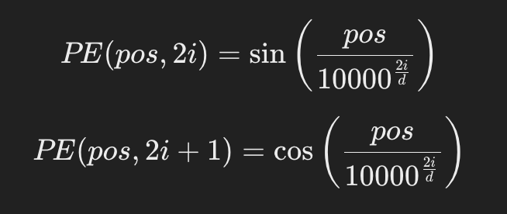
Mathematical Foundation and Implementation of Positional Encoding
Sinusoidal Positional Encoding
Encodes positional information using sine and cosine functions
Formula for positional encoding
Where: 𝑝𝑜𝑠: Position of the token in the sequence
𝑖: Index of the embedding dimension
𝑑: Total embedding dimension
Why Sinusoidal Functions?
Provides unique encoding for each position.
Allows generalization to longer sequences not seen during training

Slide 452
The Feed-Forward Network
What is a Feed-Forward Network (FFN)?
FFNs are fully connected layers applied to each token independently and identically within a Transformer layer
Adds non-linear transformation to the output of the attention mechanism
Role in Transformers
Captures token-specific transformations
Enhances representational capacity
Structure
Linear transformation
Non-linear activation (e.g., ReLU)
Another linear transformation
𝐹𝐹𝑁 (𝑥) = ReLU ( 𝑥𝑊₁ + 𝑏₁ ) 𝑊₂ + 𝑏₂

Slide 453
Hands-On Exercise
Objective
Implement positional encoding and integrate it with a basic Transformer model
Experiment with different positional encoding methods and observe the effects

Slide 454
Day 05
Hands-On with Pre-Trained Transformers BERT and GPT

Slide 455
Introduction to BERT and GPT
What is BERT?
BERT (Bidirectional Encoder Representations from Transformers)
Developed by Google AI
Processes input sequences bidirectionally, enabling it to capture context from both directions
Pre-trained on tasks like Masked Language Modeling (MLM) and Next Sentence Prediction (NSP)
Key Features of BERT
Bidirectional: Understands context from both left and right sides of a word
Transformer Encoder-Based: Optimized for understanding input text
Applications: Sentiment analysis, named entity recognition, question answering

Slide 456
What is GPT?
GPT (Generative Pretrained Transformer)
Developed by OpenAI
Processes input sequences unidirectionally (left-to-right), focusing on generative tasks
Pre-trained using causal language modeling
Key Features of GPT
Unidirectional: Processes text from left to right, focusing on text generation
Transformer Decoder-Based: Optimized for generating coherent text
Applications: Text generation, chatbots, summarization

Slide 457
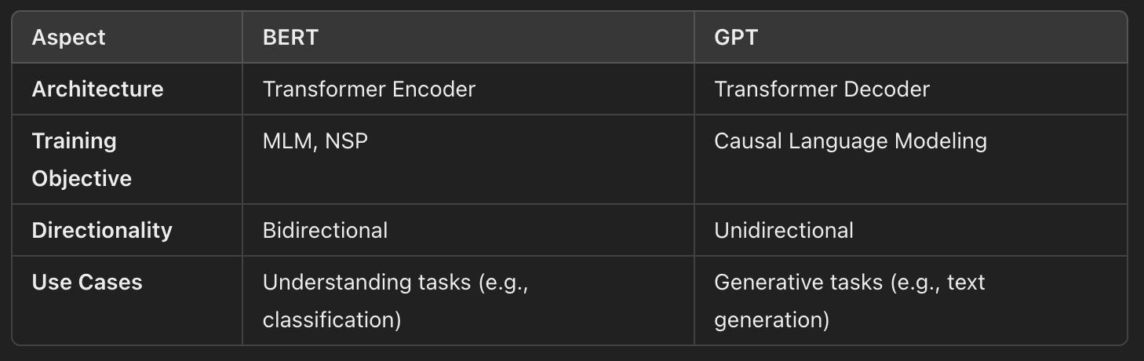
Key Differences Between BERT and GPT

Slide 458
Fine-Tuning Pre-Trained Models for Downstream Tasks
Why Fine-Tune?
Pre-trained models are trained on large generic datasets
Fine-tuning adapts them to specific tasks like sentiment analysis or classification
Steps to Fine-Tune
Load a Pre-Trained Model
Use libraries like Hugging Face to load a pre-trained BERT or GPT model
Prepare Dataset
Format the dataset for the specific task (e.g., tokenization for text classification)
Train and Evaluate
Fine-tune the model using task-specific data

Slide 459
Hands-On Exercise
Objective
Use Hugging Face’s Transformers library to fine-tune a pre-trained BERT or GPT model for a text classification task

Slide 460
Day 06
Advanced Transformers BERT Variants and GPT-3

Slide 461
Exploration of BERT Variants
Why BERT Variants?
While BERT is powerful, it has limitations like large computational requirements and inefficiencies in capturing certain nuances
BERT variants optimize the model for specific tasks, improve performance, or reduce computational overhead
Key BERT Variants
RoBERTa (Robustly Optimized BERT)
Removes Next Sentence Prediction (NSP) task for better efficiency
Trains on more data with larger batch sizes
Use Case: Superior performance in tasks requiring deeper context
DistilBERT
A distilled (smaller) version of BERT that retains 97% of BERT’s performance while being 60% faster
Use Case: Ideal for real-time applications and resource-constrained environments
ALBERT (A Lite BERT)
Reduces memory consumption by factorizing embeddings and sharing parameters across layers
Use Case: Suitable for large-scale pre-training and downstream tasks with memory limitations
BERTweet
Fine-tuned on Twitter data
Use Case: Social media sentiment analysis, hashtag prediction.

Slide 462
Introduction to GPT-3
What is GPT-3?
GPT-3 (Generative Pretrained Transformer 3)
Developed by OpenAI
A massive model with 175 billion parameters trained on diverse datasets
Excels at generating coherent and contextually relevant text
Key Features of GPT-3
Zero-shot and Few-shot Learning
Can perform tasks with minimal or no fine-tuning
Versatility
Used for text generation, summarization, question answering, and conversational AI
Applications
Conversational AI: Chatbots and virtual assistants
Content Generation: Articles, scripts, code snippets
Creative Writing: Poems, stories, and creative ideas

Slide 463
Transfer Learning in NLP with Transformer Models
What is Transfer Learning?
Transfer learning involves pre-training a model on a large dataset and fine-tuning it for specific downstream tasks
Advantages
Reduces the need for task-specific labeled data
Speeds up training and improves performance on specialized tasks

Slide 464
Hands-On Exercise
Objective
Experiment with a BERT variant (e.g., RoBERTa) and fine-tune it on an NLP task. Use the GPT-3 API for text generation and analyze the quality of the generated text

Slide 465
Day 07
Transformer Project – Text Summarization or Translation

Slide 466
Applying Transformer-Based Models to Advanced NLP Tasks
Text Summarization
The process of condensing a piece of text while retaining the key information
Two types
Extractive Summarization: Selects key phrases or sentences from the original text
Abstractive Summarization: Generates new sentences that capture the meaning of the original text
Text Translation
Converts text from one language to another while maintaining meaning and grammar
Examples
English to French translation
Multi-lingual translations with models like T5 or mT5

Slide 467
Fine-Tuning and Optimizing Models
Pre-Trained Models for Summarization and Translation
T5 (Text-to-Text Transfer Transformer)
Treats every NLP problem as a text-to-text task
Fine-tuned for summarization and translation tasks
BART (Bidirectional and Auto-Regressive Transformer)
Combines BERT-like encoder and GPT-like decoder
Pre-trained for denoising and fine-tuned for summarization and translation
Optimization Techniques
Learning rate scheduling
Hyperparameter tuning (batch size, optimizer type, maximum sequence length)

Slide 468
Analyzing Model Performance
Evaluation Metrics
Text Summarization
ROUGE (Recall-Oriented Understudy for Gisting Evaluation)
BLEU (Bilingual Evaluation Understudy) for generated summaries
Text Translation
BLEU score for translation quality
Perplexity to measure model performance

Slide 469
Hands-On Project
Objective
Fine-tune a pre-trained Transformer model (e.g., T5 or BART) for text summarization or translation and evaluate its performance

Slide 470
WEEK 13: Transfer Learning and Fine-Tuning
Day 1
Introduction to Transfer Learning
Day 2
Transfer Learning in Computer Vision
Day 3
Fine-Tuning Techniques in Computer Vision
Day 4
Transfer Learning in NLP
Day 5
Fine-Tuning Techniques in NLP
Day 6
Domain Adaptation and Transfer Learning Challenges
Day 7
Transfer Learning Project – Fine-Tuning for a Custom Task

Slide 471
Day 01
Introduction to Transfer Learning

Slide 472
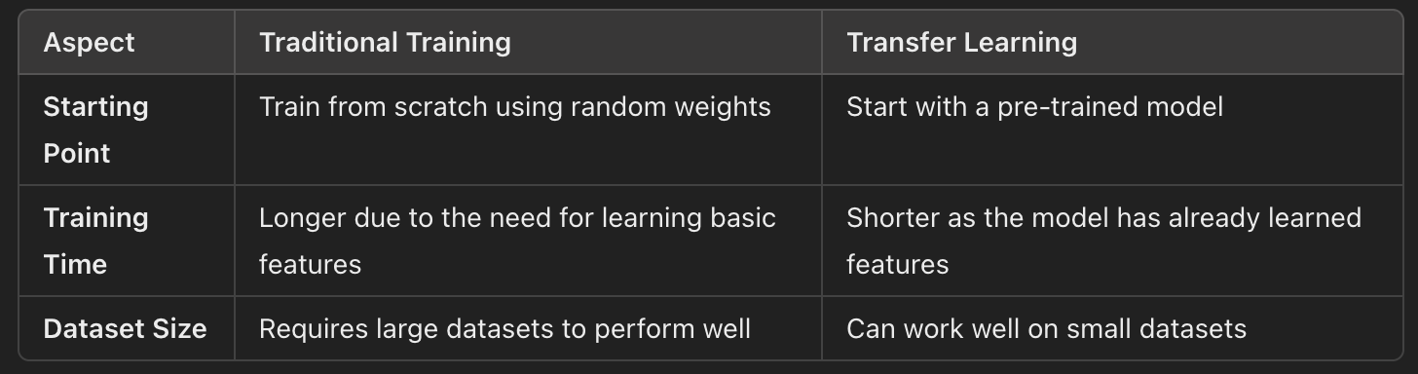
What is Transfer Learning?
A machine learning technique where a model trained on one task is reused as a starting point for another related task
Instead of training a model from scratch, pre-trained models are fine-tuned on a smaller dataset for a new task
How It Differs from Traditional Training:

Slide 473
Benefits of Transfer Learning
Reduced Training Time
Pre-trained models already capture foundational features, so fewer epochs are needed
Improved Performance on Small Datasets
Transfer learning allows effective training even when data is limited
Leverages Generalization
Pre-trained models generalize better across tasks due to exposure to large-scale datasets

Slide 474
Applications of Transfer Learning
In Computer Vision
Pre-trained models like ResNet, VGG, Inception, EfficientNet are used for
Object detection
Image classification
Image segmentation
In NLP
Models like BERT, GPT, T5 are fine-tuned for
Text classification
Sentiment analysis
Named entity recognition
Question answering

Slide 475
Hands-On Exercise
Objective
Set up a transfer learning environment, load a pre-trained model, and explore its architecture and layers

Slide 476
Day 02
Transfer Learning in Computer Vision

Slide 477
Popular Pre-Trained Models for Vision Tasks
VGG
VGG16/VGG19: Deep networks with 16 or 19 layers
Known for simplicity in architecture: stack of convolutional layers followed by fully connected layers
Applications: General-purpose image classification and feature extraction
ResNet
Residual Networks: Introduced residual connections (skip connections) to tackle vanishing gradients
Popular variants: ResNet18, ResNet50, ResNet101
Applications: Large-scale image classification tasks, object detection.
Inception
InceptionV3: Known for inception modules, which allow for multi-scale feature extraction in one layer
Applications: Scene recognition, fine-grained image classification
EfficientNet
Family of models that scales network depth, width, and resolution efficiently
Provides better performance with fewer parameters
Applications: Resource-constrained environments requiring high accuracy

Slide 478
Freezing and Unfreezing Layers for Fine-Tuning
Why Freeze Layers?
Early layers in pre-trained models capture general features
Freezing these layers reduces training time and prevents overfitting on small datasets
Why Unfreeze Layers?
Later layers learn task-specific features
Unfreezing layers allows the model to adapt to the new task
Approach
Initial Training
Freeze most layers and train the last few layers
Fine-Tuning
Gradually unfreeze layers and reduce the learning rate for fine-tuning

Slide 479
Using Transfer Learning for Image Classification Tasks
Steps
Load a pre-trained model (e.g., ResNet, VGG)
Replace the last layer with a task-specific classifier (e.g., softmax for multi-class classification)
Fine-tune the model on the new dataset

Slide 480
Hands-On Exercise
Objective
Load a pre-trained ResNet or VGG model and fine-tune it for a new image classification task (e.g., classifying animals or plants)
Experiment with freezing and unfreezing layers and observe the impact on performance

Slide 481
Day 03
Fine-Tuning Techniques in Computer Vision

Slide 482
Choosing Layers to Fine-Tune and Understanding the Feature Extraction Process
Feature Extraction in Pre-Trained Models
Early layers capture low-level features (e.g., edges, textures)
Middle layers capture mid-level features (e.g., shapes, parts of objects)
Late layers capture high-level features (e.g., specific objects, task-specific patterns)
Choosing Layers to Fine-Tune
Freeze Early Layers: Retain general features learned during pre-training
Unfreeze Late Layers: Allow the model to adapt high-level features to the new task
Best Practices
For small datasets: Fine-tune only the last few layers
For large datasets: Unfreeze more layers and fine-tune with a smaller learning rate

Slide 483
Data Augmentation for Improving Generalization
What is Data Augmentation?
Artificially increase the diversity of training data by applying transformations like:
Rotation | Horizontal/vertical flipping | Scaling/zooming | Cropping | Color jittering
Why Use Data Augmentation?
Reduces overfitting by introducing variability
Improves the model's ability to generalize to unseen data
Examples of Augmentation
Rotation: Rotate images by random degrees (e.g., ±15°)
Flip: Apply horizontal/vertical flips
Zoom: Randomly zoom in/out on images

Slide 484
Hyperparameter Tuning for Transfer Learning
Key Hyperparameters
Learning Rate
A smaller learning rate is recommended for fine-tuning pre-trained models
Too large: Overshoots the optimal solution
Too small: Slow convergence
Batch Size
Larger batches stabilize training but require more memory
Smaller batches may lead to noisier updates but help with resource constraints
Optimizer
SGD: Works well with transfer learning when paired with momentum
Adam: Faster convergence but may require fine-tuning for stability
Tuning Process
Start with default settings (e.g., learning rate: 1 𝑒 − 4 1e −4 , batch size: 32)
Experiment with one hyperparameter at a time to isolate its effect.

Slide 485
Hands-On Exercise
Objective
Apply data augmentation to a dataset and train a fine-tuned model. Experiment with hyperparameters to observe their impact on performance

Slide 486
Day 04
Transfer Learning in NLP

Slide 487
Popular Pre-Trained NLP Models
BERT (Bidirectional Encoder Representations from Transformers)
Architecture: Transformer-based encoder model
Training Tasks
Masked Language Modeling (MLM)
Next Sentence Prediction (NSP)
Applications
Text classification, sentiment analysis, question answering
GPT (Generative Pretrained Transformer)
Architecture: Transformer-based decoder model
Training Task
Causal Language Modeling (predicting next word)
Applications
Text generation, summarization, dialogue systems

Slide 488
Popular Pre-Trained NLP Models
T5 (Text-to-Text Transfer Transformer)
Treats all NLP tasks as text-to-text transformations
Applications
Summarization, translation, text classification
RoBERTa (Robustly Optimized BERT)
Removes Next Sentence Prediction
Pre-trained on a larger dataset with optimized training strategies
Applications
Similar to BERT but with better performance on downstream tasks

Slide 489
Tokenization and Text Preprocessing for Fine-Tuning NLP Models
Tokenization
Converts raw text into numerical representations
Types
WordPiece Tokenization: Used in BERT
Byte-Pair Encoding (BPE): Used in GPT and RoBERTa
Text Preprocessing
Cleaning
Remove unnecessary characters (e.g., URLs, special symbols)
Normalization
Convert text to lowercase
Remove stopwords if necessary
Tokenization
Break text into tokens compatible with the pre-trained model

Slide 490
Adapting Pre-Trained Models for NLP Tasks
Common Tasks
Text Classification
Categorize text into predefined labels (e.g., positive/negative sentiment)
Sentiment Analysis
Determine the sentiment polarity of text (e.g., positive, neutral, negative)
Summarization
Generate concise summaries from lengthy texts
Steps
Load pre-trained model
Add a task-specific head (e.g., classification layer)
Fine-tune the model on task-specific data.

Slide 491
Hands-On Exercise
Objective
Fine-tune a pre-trained BERT or T5 model for sentiment analysis using Hugging Face’s Transformers library
Preprocess the text data, tokenize it, and evaluate the model

Slide 492
Day 05
Fine-Tuning Techniques in NLP

Slide 493
Fine-Tuning Methods for NLP Tasks
Discriminative Fine-Tuning
Different layers of a pre-trained model capture different types of information
Approach
Use different learning rates for different layers of the model
Lower learning rates for early layers (general features)
Higher learning rates for later layers (task-specific features).
Slanted Triangular Learning Rates (STLR)
Dynamically adjusts learning rates during training to balance exploration and convergence
Phases
Warm-Up: Gradually increase the learning rate to promote exploration
Decay: Slowly decrease the learning rate to ensure convergence
Use Case
Effective for fine-tuning pre-trained models like BERT and GPT

Slide 494
Regularization and Dropout for Preventing Overfitting in NLP Models
Regularization
L1 Regularization: Encourages sparsity by penalizing absolute weights
L2 Regularization (Ridge): Penalizes large weights to improve generalization
Dropout
Randomly drops units (along with their connections) during training
Prevents over-reliance on specific neurons
Commonly used in Transformer-based models

Slide 495
Evaluating Model Performance with NLP-Specific Metrics
Key Metrics
F1-Score
Harmonic mean of precision and recall
Suitable for classification tasks with imbalanced datasets
BLEU Score
Evaluates the quality of generated text against reference text
Commonly used for translation and summarization tasks
ROUGE Score
Measures overlap between generated and reference text
Used for summarization tasks

Slide 496
Hands-On Exercise
Objective
Experiment with advanced fine-tuning techniques (e.g., STLR) on an NLP model and evaluate its performance using F1-score or BLEU score

Slide 497
Day 06
Domain Adaptation and Transfer Learning Challenges

Slide 498
Understanding Domain Adaptation and Handling Domain-Specific Data
What is Domain Adaptation?
Domain adaptation involves transferring a model trained on one domain (source domain) to perform tasks in a different domain (target domain)
Example
Source domain: General news articles
Target domain: Medical text

Slide 499
Understanding Domain Adaptation and Handling Domain-Specific Data
Why Domain Adaptation?
Many real-world tasks involve domain-specific data
Pre-trained models on general datasets might not perform optimally without adaptation
Steps in Domain Adaptation
Fine-tune the pre-trained model on a domain-specific dataset
Incorporate domain-specific embeddings or vocabulary
Apply additional pre-training on the domain data if necessary

Slide 500
Challenges in Transfer Learning
Data Mismatch
The source domain may not represent the target domain adequately
Example: General text (Wikipedia) vs. technical medical jargon
Catastrophic Forgetting
During fine-tuning, the model may forget the knowledge learned from the source domain
Computational Constraints
Fine-tuning large pre-trained models (e.g., BERT, GPT) requires significant computational resources

Slide 501
Strategies to Address Challenges
Transfer Learning from Related Domains
Fine-tune on an intermediate domain dataset before adapting to the target domain
Data Augmentation
Generate synthetic domain-specific data to augment the target dataset
Example
Use paraphrasing techniques to increase dataset diversity
Domain-Specific Embeddings
Use pre-trained embeddings tailored to the target domain (e.g., BioBERT for biomedical data, LegalBERT for legal text)

Slide 502
Hands-On Exercise
Objective
Fine-tune a pre-trained model on a domain-specific dataset (e.g., BERT for medical text classification) and experiment with domain-specific embeddings

Slide 503
Day 07
Transfer Learning Project Fine-Tuning for a Custom Task

Slide 504
Applying Transfer Learning Techniques to a Custom Project
Project Objective
Leverage transfer learning to solve a specific task in either computer vision or NLP
Fine-tune a pre-trained model for domain-specific data to achieve optimal performance
Steps to Follow
Dataset Selection
Computer Vision: Custom image dataset (e.g., animal species classification)
NLP: Text classification task (e.g., sentiment analysis, product categorization)
Pre-Trained Model
Computer Vision: Models like ResNet, EfficientNet, or MobileNet
NLP: BERT, RoBERTa, or T5
Fine-Tuning Techniques
Regularization, hyperparameter tuning, data augmentation, discriminative learning rates

Slide 505
Analyzing Fine-Tuning Techniques
Fine-Tuning Process
Freeze the pre-trained layers and train the custom classifier head first
Unfreeze some pre-trained layers for domain adaptation
Gradually reduce the learning rate to avoid catastrophic forgetting
Key Techniques
Regularization
Dropout, L2 regularization to prevent overfitting
Data Augmentation
Enhance diversity in training data (rotation, cropping, or text paraphrasing)
Hyperparameter Tuning
Experiment with learning rate, batch size, and optimizer

Slide 506
Documenting Results and Baseline Comparisons
Steps
Evaluate the baseline performance of the pre-trained model without fine-tuning
Track performance improvements after fine-tuning and hyperparameter optimization
Use metrics like accuracy, F1-score, BLEU, or ROC-AUC to compare results

Slide 507
Hands-On Exercise
Objective
Fine-tune a pre-trained model (ResNet for computer vision or BERT for NLP) to solve a custom task
Evaluate and document results against a baseline

Slide 508
WEEK 14: Model Deployment and Serving
Day 1
Introduction to Model Deployment
Day 2
Creating REST APIs for Local Model Serving
Day 3
Containerizing Machine Learning Models with Docker
Day 4
Automating Model Deployment with Scripts
Day 5
Scaling Model Serving Locally
Day 6
Monitoring and Debugging Deployed Models Locally
Day 7
Local Deployment Capstone Project

Slide 509
Day 01
Introduction to Transfer Learning

Slide 510
Hands-On Project
Objective
Fine-tune a pre-trained Transformer model (e.g., T5 or BART) for text summarization or translation and evaluate its performance

Slide 511
WEEK 15: Advanced Topics in Machine Learning Deployment
Day 1
Versioning Models for Continuous Deployment
Day 2
Securing Machine Learning APIs
Day 3
Optimizing Inference for Low Latency
Day 4
Handling Drift and Model Retraining
Day 5
Monitoring and Logging in Production
Day 6
Automating Workflows with Local CI/CD
Day 7
End-to-End Local Deployment System

Slide 512
WEEK 16: Real-Time ML and Advanced Serving Techniques
Day 1
Introduction to Real-Time Machine Learning
Day 2
Stream Processing for Machine Learning
Day 3
Optimizing Real-Time Inference
Day 4
Designing Real-Time Recommendation Systems
Day 5
Advanced Model Serving with Local Message Queues
Day 6
Edge Deployment for Real-Time Applications
Day 7
Real-Time ML Capstone Project

