Slide 1
SPACEX
Falcon 9 First Stage Landing Prediction
IBM Data Science Professional Certificate — Capstone Project
Irwin
February 2026
GitHub: irwinhentriansa/Applied-Data-Science-Project

Slide 2
OUTLINE
01
Executive Summary
Project overview and key findings
02
Introduction
Background, objectives, and problem statement
03
Methodology
Data collection, wrangling, EDA, and ML pipeline
04
Results
Visualizations, SQL insights, maps, and dashboards
05
Predictive Analysis
Classification model comparison and best model
06
Conclusions
Key takeaways and recommendations
SpaceX Falcon 9 Landing Prediction | 2

Slide 3
EXECUTIVE SUMMARY
90
66.7%
83.3%
3
Falcon 9
Launches
Overall
Success Rate
Best Model
Accuracy
Launch
Sites
Project Goal: Predict whether the Falcon 9 first stage will land successfully, enabling cost estimation ($62M vs $165M+ for competitors).
Methodology:
Collected data via SpaceX REST API → EDA with visualization & SQL → Interactive Folium maps & Plotly Dash dashboards → Trained 4 classification models with GridSearchCV.
Key Finding:
Logistic Regression, SVM, and KNN all achieved 83.3% test accuracy. Launch success increases with flight number and strongly correlates with launch site and orbit type. KSC LC-39A has the highest success rate.
SpaceX Falcon 9 Landing Prediction | 3

Slide 4
INTRODUCTION
Project Background
Problem Statement
SpaceX has revolutionized space travel by reusing the Falcon 9 first stage, reducing launch costs from $165M to just $62M.
Predicting landing success is crucial for accurate launch cost estimation — a key factor for companies bidding against SpaceX.
The first stage accounts for most of the launch cost. If it lands successfully, the rocket can be refurbished and reused, dramatically lowering the price.
Can we predict if the Falcon 9 first stage will land successfully?
Key Questions:
→ Which factors influence landing success?
→ Does payload mass affect outcome?
→ Which launch site has highest success?
→ Which orbits are most successful?
→ Has success rate improved over time?
→ Which ML model best predicts landing?
SpaceX Falcon 9 Landing Prediction | 4

Slide 5
METHODOLOGY
Data Collection → Wrangling → EDA → Interactive Analytics → Predictive Analysis

Slide 6
METHODOLOGY OVERVIEW
1
2
3
4
5
→
→
→
→
Data
Collection
Data
Wrangling
EDA
Interactive
Analytics
Predictive
Analysis
SpaceX REST API
& Web Scraping
Missing values,
Label creation
Visualization
& SQL Analysis
Folium Maps
& Plotly Dash
4 ML Models
GridSearchCV
Tools & Technologies
Python • Pandas • NumPy • Matplotlib • Seaborn • Scikit-learn • Folium • Plotly Dash • SQL (SQLite) • SpaceX REST API • BeautifulSoup • Jupyter Notebook
SpaceX Falcon 9 Landing Prediction | 6

Slide 7
DATA COLLECTION — SpaceX API
1
GET Request
2
Parse JSON
3
Enrich Data
→
→
api.spacexdata.com
/v4/launches/past
json_normalize()
to DataFrame
API calls for rocket,
launchpad, payload, cores
Helper Functions for Data Enrichment
getBoosterVersion()
Rocket name from /v4/rockets/{id}
getLaunchSite()
Site name, lat, long from /v4/launchpads/{id}
getPayloadData()
Mass & orbit from /v4/payloads/{id}
getCoreData()
Landing outcome, type, flights, gridfins, legs, block, serial
Final dataset: 90 Falcon 9 launches with 17 features (Falcon 1 filtered out)
SpaceX Falcon 9 Landing Prediction | 7

Slide 8
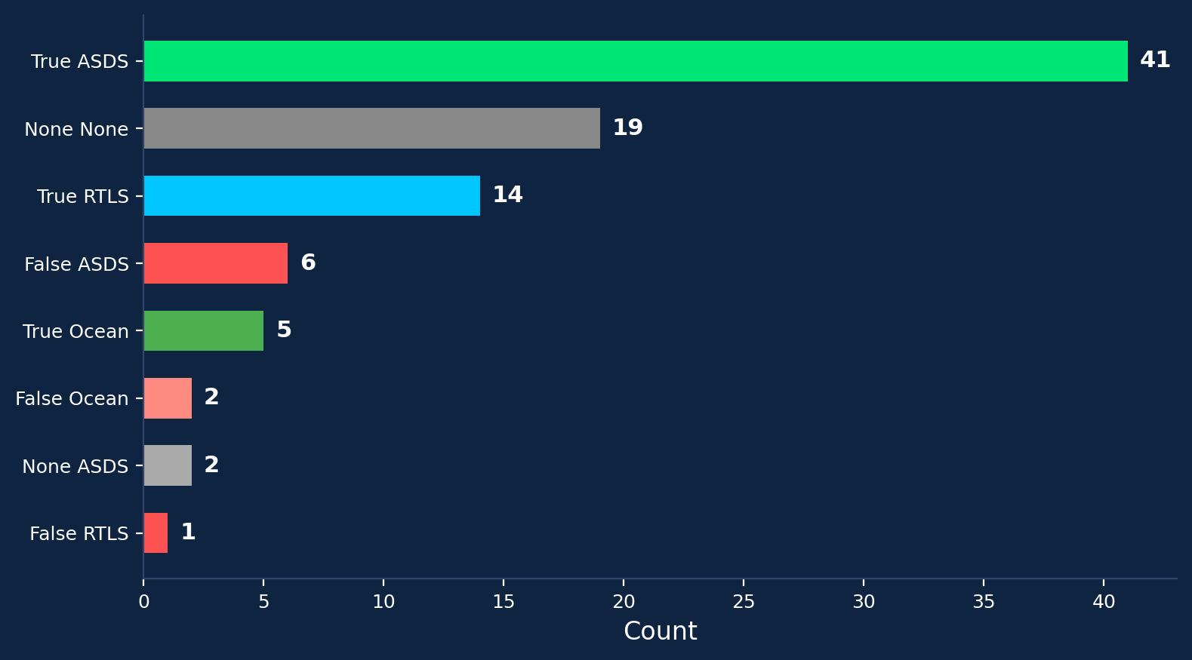
DATA WRANGLING
Handling Missing Values
Binary Classification Label
PayloadMass: 5 missing values replaced with column mean
LandingPad:
26 None values retained (no landing pad used)
All other columns:
No missing values detected
Created 'Class' column:
Class = 1 (Success):
True ASDS, True RTLS, True Ocean
Class = 0 (Failure):
False ASDS/RTLS/Ocean, None None/ASDS
Overall success rate:
66.7%
SpaceX Falcon 9 Landing Prediction | 8

Slide 9
EDA WITH VISUALIZATION
Flight Number vs Launch Site
Payload vs Launch Site
Higher flight numbers show more success, especially at KSC LC-39A
VAFB SLC-4E has no heavy payload launches (>10,000 kg)
Success Rate vs Orbit Type
Flight Number vs Orbit Type
ES-L1, GEO, HEO achieve 100% success; SO has 0%
LEO success correlates with flight count; GTO shows no pattern
Payload vs Orbit Type
Launch Success Yearly Trend
Heavy payloads succeed more in Polar, LEO, and ISS orbits
Success rate steadily increased from 0% (2010) to 87% (2020)
Feature Engineering: OneHotEncoding on categorical columns → 80 features, all cast to float64
SpaceX Falcon 9 Landing Prediction | 9

Slide 10
EDA WITH SQL
10 SQL queries on SpaceX launch data using SQLite:
1
SELECT DISTINCT Launch_Site — Identified 3 unique launch sites
2
SELECT * WHERE Launch_Site LIKE 'CCA%' LIMIT 5 — Cape Canaveral records
3
SUM(Payload_Mass) WHERE Customer='NASA (CRS)' — Total NASA payload
4
AVG(Payload_Mass) WHERE Booster='F9 v1.1' — Avg F9 v1.1 payload
5
MIN(Date) WHERE Landing='Success (ground pad)' — First ground landing
6
Boosters with drone ship success & payload 4000–6000 kg
7
COUNT by Mission_Outcome — Success vs failure totals
8
Boosters carrying MAX payload (subquery)
9
Failed drone ship landings in 2015 with booster & site info
10
Ranked landing outcomes between 2010-06-04 and 2017-03-20
SpaceX Falcon 9 Landing Prediction | 10

Slide 11
INTERACTIVE VISUAL ANALYTICS
Folium Interactive Maps
Plotly Dash Dashboard
Task 1: Marked all launch sites with Circle markers and labeled popups
Task 2:
Color-coded outcomes — green (success) / red (failure) — using MarkerCluster
Task 3:
Calculated distances from CCAFS SLC-40 to coastline (0.86 km), highway, railway, and city using Haversine formula
Key Insight:
All sites near coast and close to equator (except VAFB in California)
Component 1: Dropdown for launch sites — pie chart of success count
Component 2:
Range slider for payload (0–10,000 kg) — filters scatter plot dynamically
Component 3:
Scatter plot colored by Booster Version showing payload vs. outcome
Key Insight:
KSC LC-39A has highest success ratio. Payload 2000–4000 kg is the sweet spot
SpaceX Falcon 9 Landing Prediction | 11

Slide 12
PREDICTIVE ANALYSIS — METHODOLOGY
Standardize
Train/Test Split
GridSearchCV
Evaluate
→
→
→
StandardScaler on
80 one-hot features
80/20 split
(72 train / 18 test)
10-fold CV for
hyperparameter tuning
Test accuracy &
confusion matrix
Model | Hyperparameters Tuned | Best Parameters | CV Acc
Logistic Regression | C: [0.01, 0.1, 1] | C=0.01, penalty=l2 | 84.6%
SVM | C, gamma, kernel | C=1.0, gamma=0.032, sigmoid | 84.8%
Decision Tree | criterion, max_depth, splitter | entropy, depth=12, random | 87.5%
KNN | n_neighbors, algorithm, p | n=10, auto, p=1 | 84.8%
SpaceX Falcon 9 Landing Prediction | 12

Slide 13
RESULTS
EDA Visualizations • SQL Analysis • Interactive Maps • Dashboard • Prediction

Slide 14
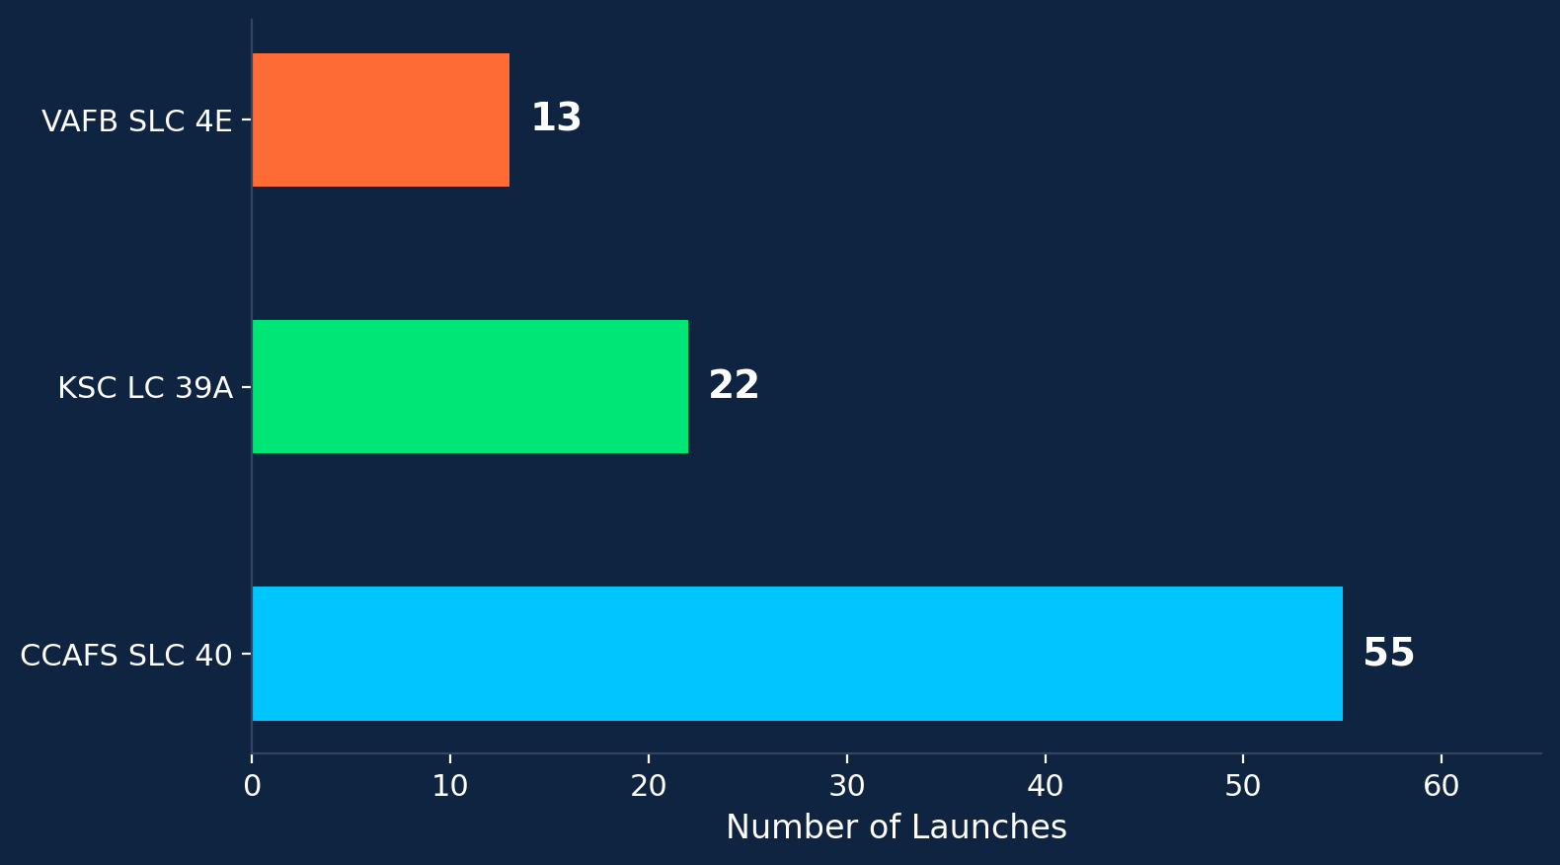
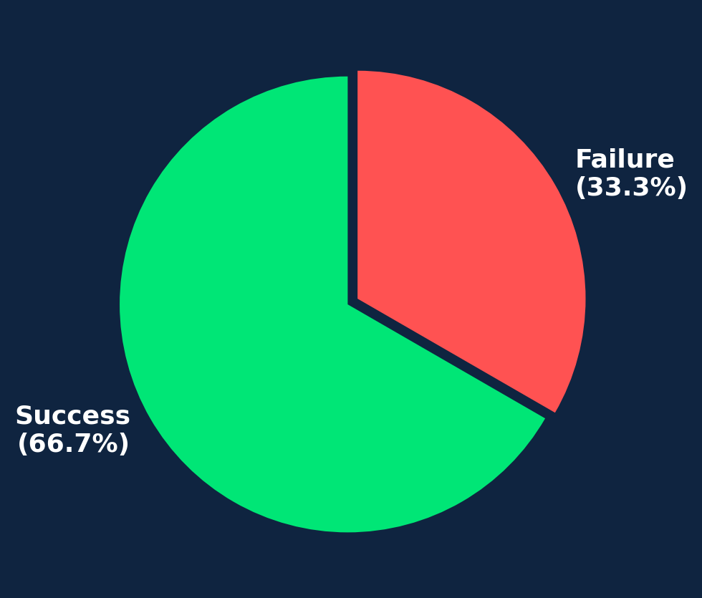
RESULTS — Launch Site Analysis
Key Findings
CCAFS SLC 40 dominates with 55 launches (61%), mainly early missions
KSC LC-39A
has highest success rate, with later, more reliable missions
VAFB SLC-4E
is for polar orbits only, 13 flights, no heavy payloads >10,000 kg
Overall: 66.7% success rate across 90 Falcon 9 launches
SpaceX Falcon 9 Landing Prediction | 14

Slide 15
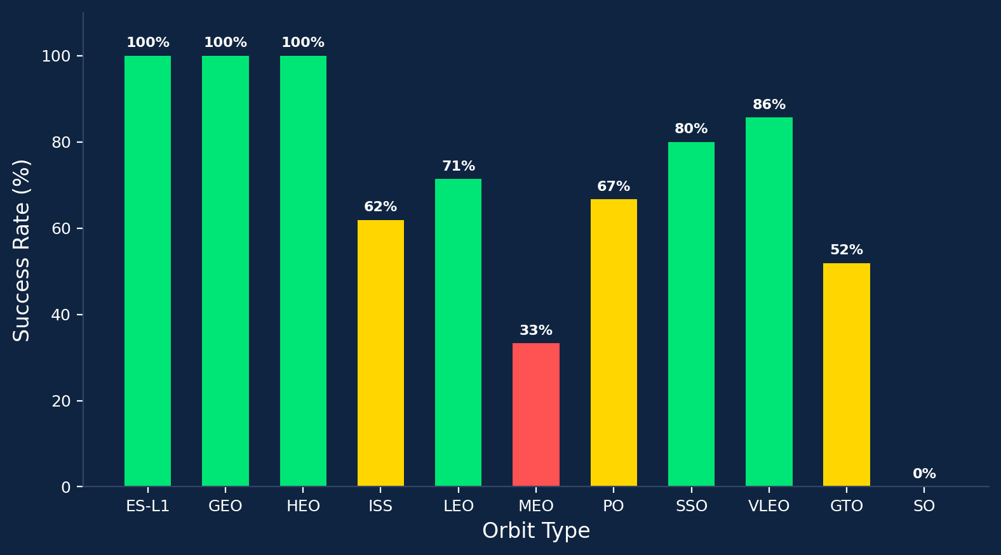
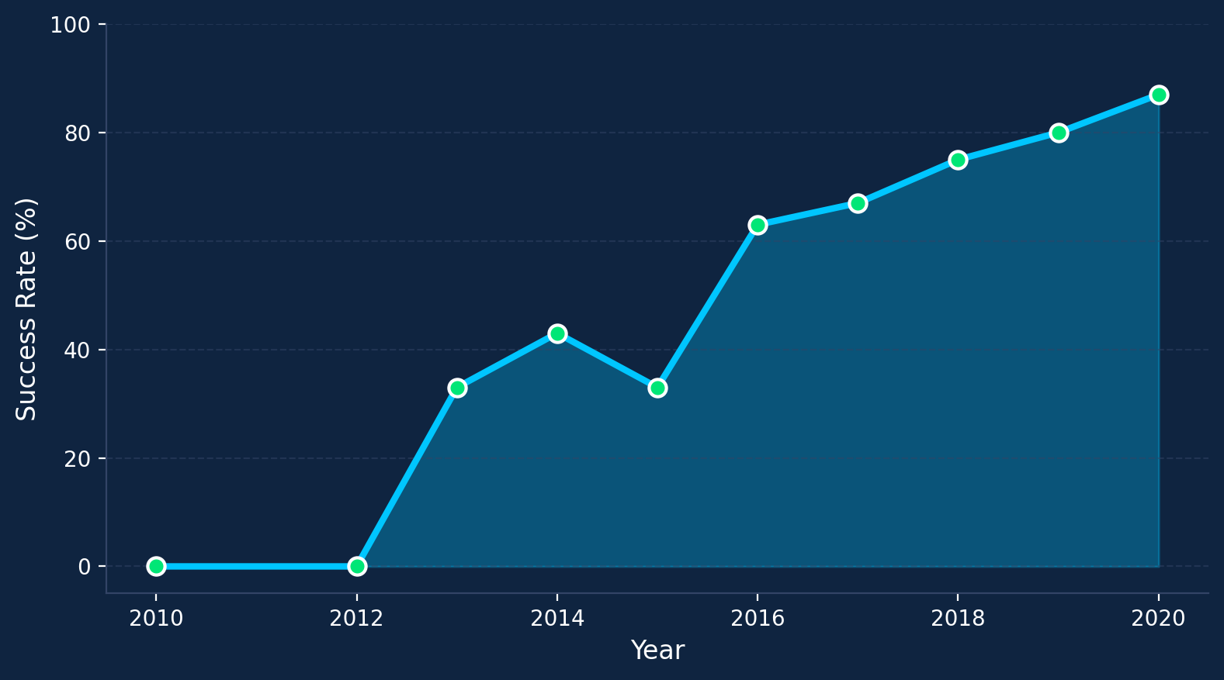
RESULTS — Orbit Success & Yearly Trend
Orbit Success: ES-L1, GEO, HEO achieve 100%. GTO (27 launches) has ~52%. SO is 0%.
Yearly Trend: Success improved from 0% (2010) to ~87% (2020). Steepest growth in 2015–2017, coinciding with reusability tech advances.
SpaceX Falcon 9 Landing Prediction | 15

Slide 16
RESULTS — SQL Analysis Highlights
Unique Launch Sites
Total NASA (CRS) Payload
Avg F9 v1.1 Payload
CCAFS SLC-40, KSC LC-39A,
VAFB SLC-4E
45,596 kg
across all CRS missions
2,928.4 kg
average per launch
First Ground Landing
Max Payload Boosters
Ranked Outcomes (2010–2017)
2015-12-22
(historic milestone!)
F9 B5 B1048.4,
F9 B5 B1049.4, and more
No Attempt: 10, Failure: 5,
Success (drone): 5, Ground: 3
SpaceX Falcon 9 Landing Prediction | 16

Slide 17
RESULTS — Interactive Map with Folium
Launch Site Markers
Success/Failure Map
Proximity Analysis
4 sites pinned on global map. Florida east coast cluster (CCAFS LC-40, CCAFS SLC-40, KSC LC-39A) and California (VAFB SLC-4E).
MarkerCluster with green/red markers. KSC LC-39A shows highest density of green. CCAFS has mix of early failures and later successes.
CCAFS SLC-40 is 0.86 km from coastline. PolyLines to nearest highway, railway, city. All sites have nearby infrastructure.
All sites near coastline for abort safety
KSC LC-39A is the most successful site
Strategic coastal + infrastructure positioning
Coordinates: CCAFS LC-40 (28.56°N) | CCAFS SLC-40 (28.56°N) | KSC LC-39A (28.57°N) | VAFB SLC-4E (34.63°N)
SpaceX Falcon 9 Landing Prediction | 17

Slide 18
RESULTS — Plotly Dash Dashboard
Pie Chart — All Sites
Pie Chart — Success Ratio
Scatter — Payload vs Outcome
KSC LC-39A contributes the most successful launches, followed by CCAFS SLC-40.
KSC LC-39A shows ~76.7% success rate, significantly outperforming other sites.
Payload 2000–4000 kg has highest success. FT and B5 boosters dominate heavy successes.
KSC LC-39A: Highest success count
KSC LC-39A: ~76.7% success rate
Mid-range payloads most successful
Innovative Insight: Very light (<1000 kg) and very heavy (>9000 kg) payloads both show lower success than mid-range (2000–6000 kg), suggesting an optimal payload 'sweet spot' for landing, likely tied to fuel margin and re-entry dynamics.
SpaceX Falcon 9 Landing Prediction | 18

Slide 19
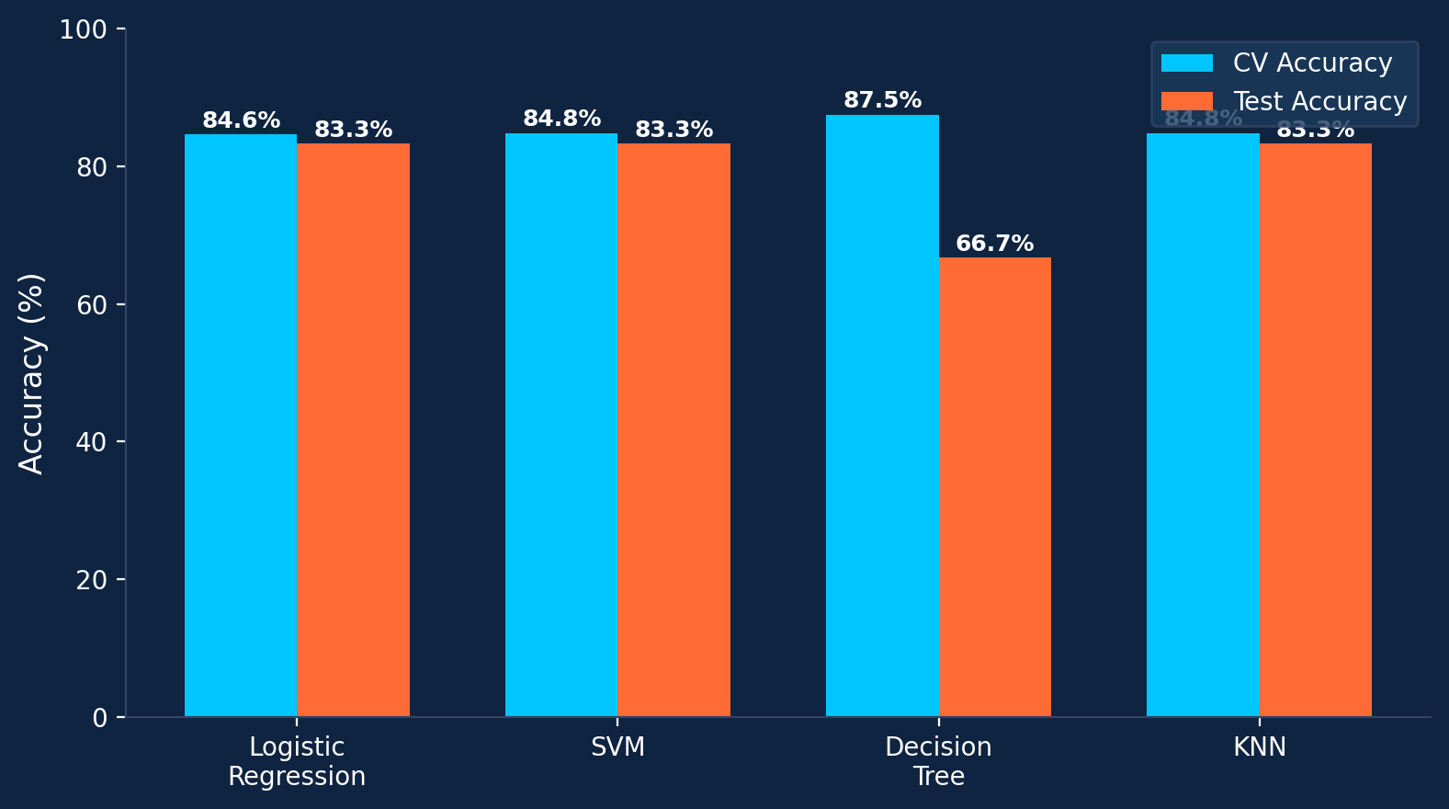
RESULTS — Classification Accuracy
Model Comparison
Three models tied at 83.3%:
LR, SVM, KNN
Decision Tree: highest CV (87.5%) but worst test (66.7%) —
overfitting.
Recommended: Logistic Regression
→ Competitive accuracy (83.3%)
→ High interpretability
→ Fastest inference time
→ Stable generalization
Innovative Insight: Small test set (18 samples) limits differentiation — 1 misclassification changes accuracy by ~5.5%. Bootstrap CI or larger test sets would improve robustness.
SpaceX Falcon 9 Landing Prediction | 19

Slide 20
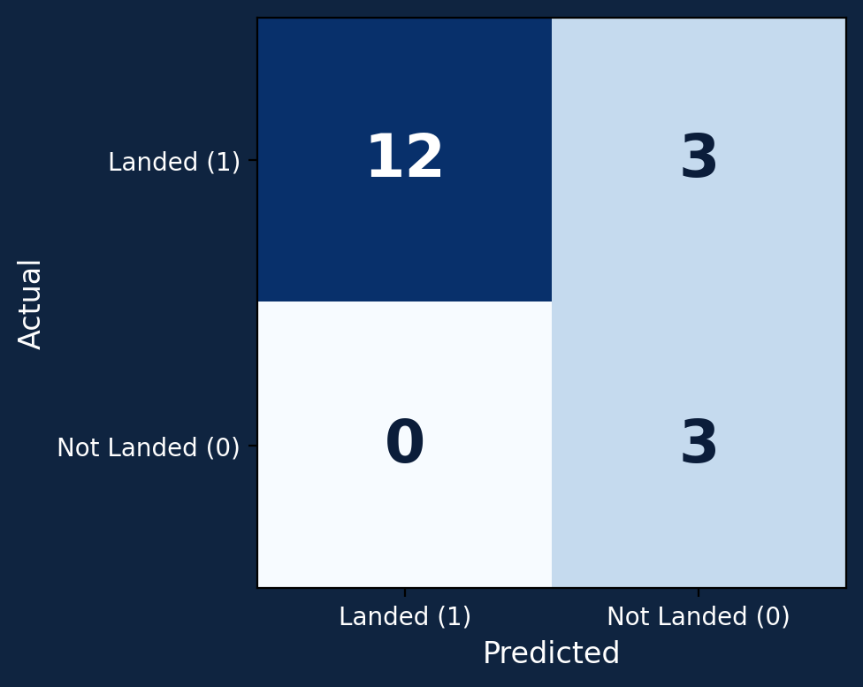
RESULTS — Confusion Matrix (Best Model)
Confusion Matrix Breakdown
12
True Positive
Correctly predicted successful landing
3
False Positive
Predicted success, actually failed
3
True Negative
Correctly predicted failed landing
0
False Negative
No missed successful landings!
Precision: 80% | Recall: 100% | F1-Score: 88.9% | Accuracy: 83.3%
SpaceX Falcon 9 Landing Prediction | 20

Slide 21
CONCLUSIONS
Success Rate Trends Upward
Launch Site Matters
From 0% (2010) to ~87% (2020), demonstrating continuous reusability improvement.
KSC LC-39A achieves ~76.7% success. All sites near coastlines for safety.
Orbit Type Affects Outcomes
Payload Sweet Spot Exists
ES-L1, GEO, HEO: 100% success. GTO ~52%, SO 0%.
2,000–6,000 kg payloads show highest success rates.
ML Models Achieve 83.3%
Cost Estimation is Feasible
LR, SVM, KNN tied. DT overfits. LR recommended for interpretability.
Predicting landing success enables $62M vs $165M cost estimation for competitors.
SpaceX Falcon 9 Landing Prediction | 21

Slide 22
THANK YOU
SpaceX Falcon 9 First Stage Landing Prediction
IBM Data Science Professional Certificate — Capstone Project
Appendix — Notebook References
1. Data Collection (SpaceX API) — jupyter_labs_spacex_data_collection_api.ipynb
2. Data Wrangling — labs-jupyter-spacex-Data_wrangling.ipynb
3. EDA with Visualization — edadataviz.ipynb
4. EDA with SQL — jupyter_labs_eda_sql_coursera_sqllite.ipynb
5. Interactive Maps (Folium) — lab_jupyter_launch_site_location.ipynb
6. Machine Learning Prediction — SpaceX_Machine_Learning_Prediction_Part_5.ipynb

