Slide 1
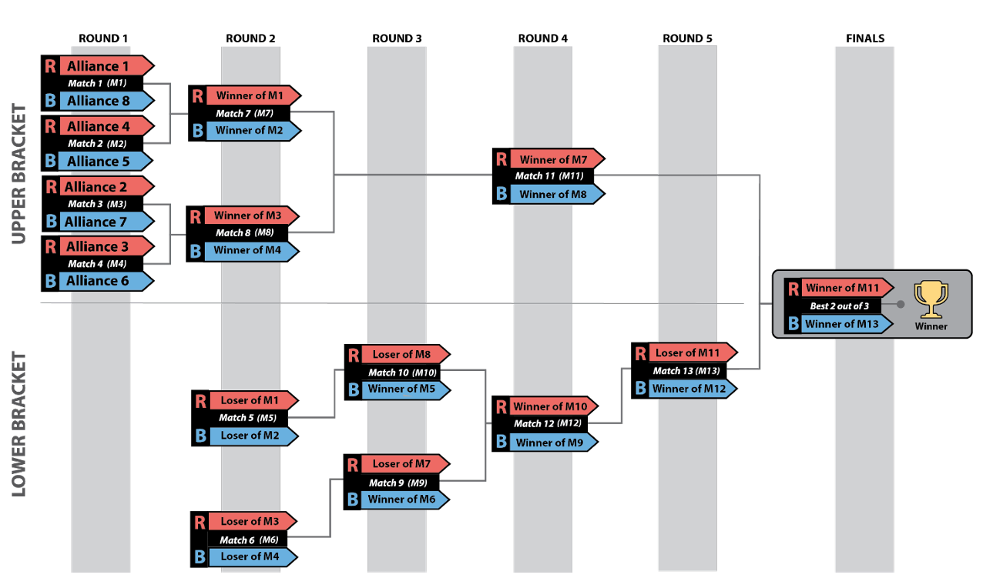
Finals winner receives 30 district points
Teams that do not advance past round 3 receive 0 district points
Finals loser receives 20 district points
Match 13 loser receives 13 district points
Match 12 loser receives 7 district points

