Slide 1
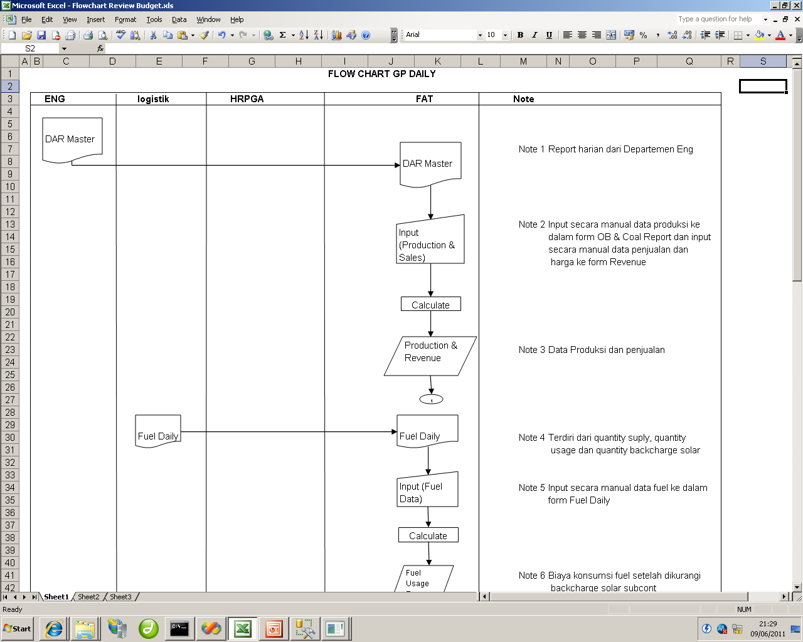
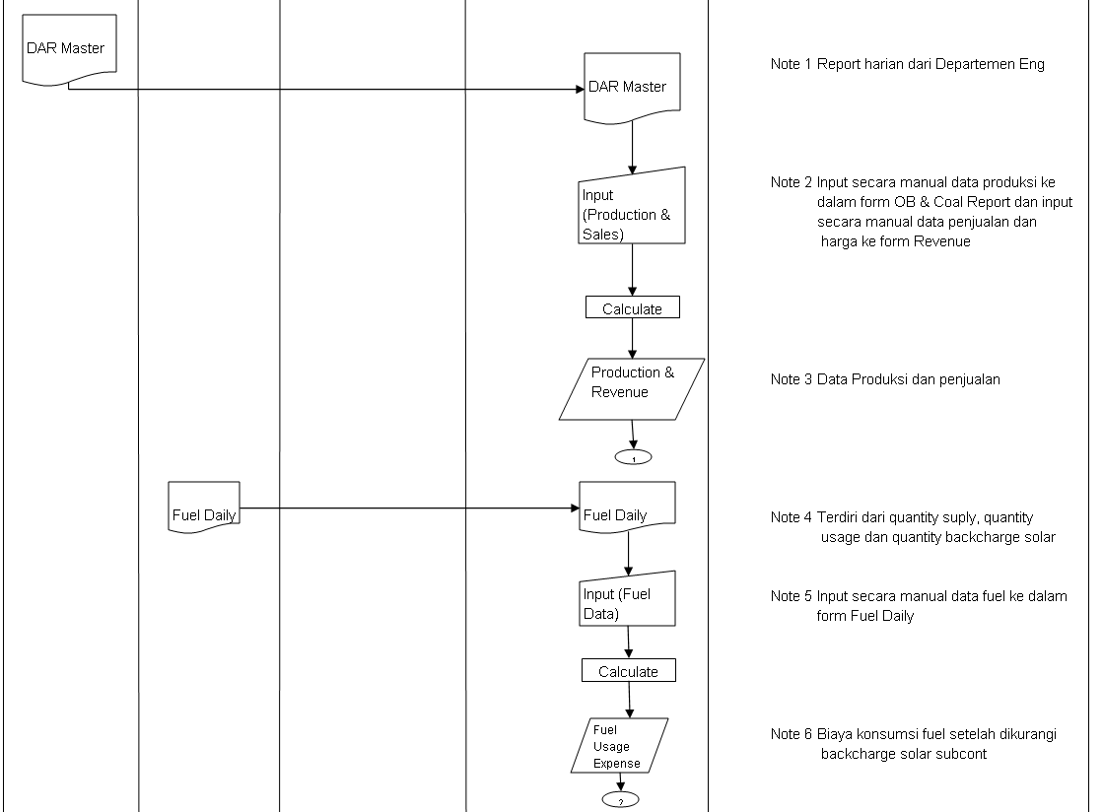
Start Server Schedulle Daily
IntegratingDataExcel (Mining,Hauling,Barging)
Reporting All Rev
IntegratingDataExcel (Fuel Consum)
1
Reporting Cost Fuel
2

Slide 2
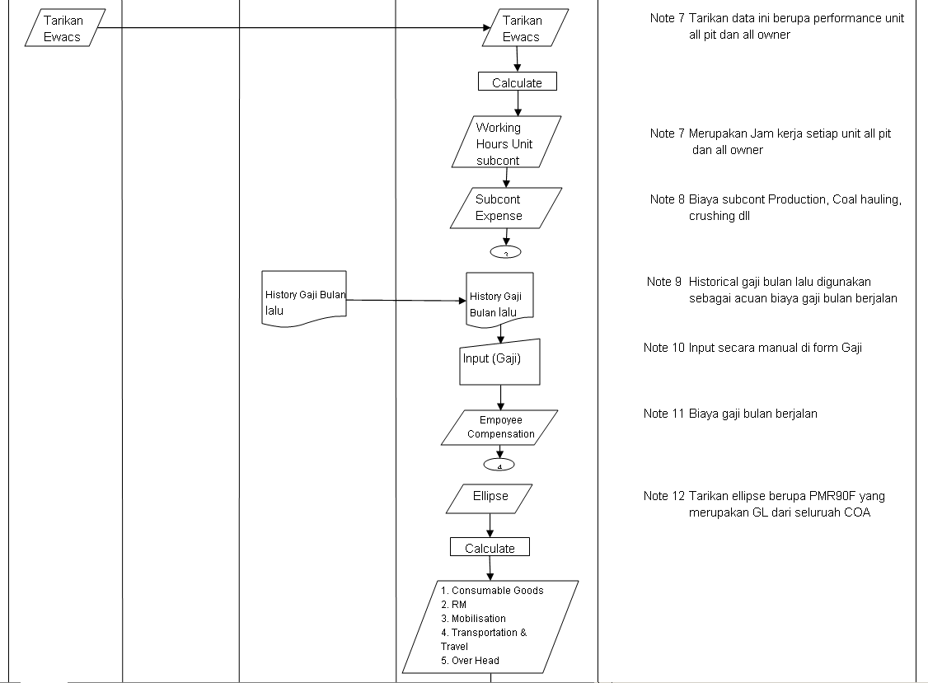
Server Schedulle Daily
Reporting Cost SubCont
IntegratingDataExcel (WH SubCont)
3
Reporting Cost
IntegratingDataExcel (Salary&Compensation)
4
Reporting Cost RM
IntegratingDataExcel (PMR)
5

Slide 3
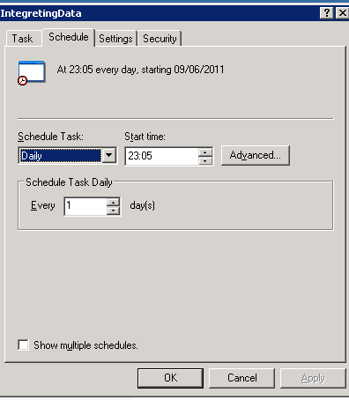
Calculate
ENG
LOG
EWACS
HRPGA
ELLIPSE
1
2
3
4
5
GP Daily

Slide 4
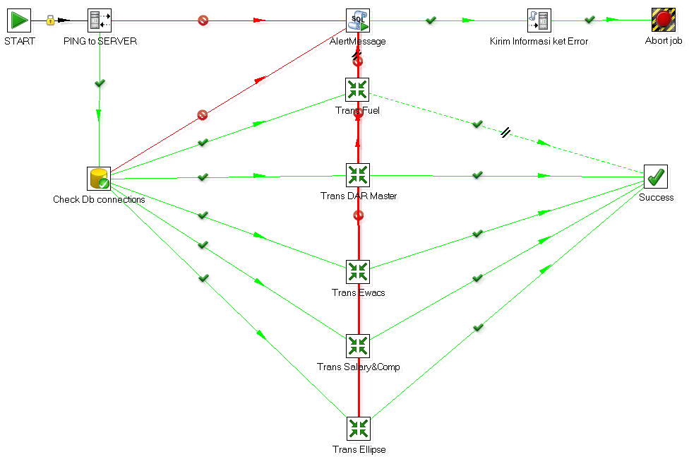
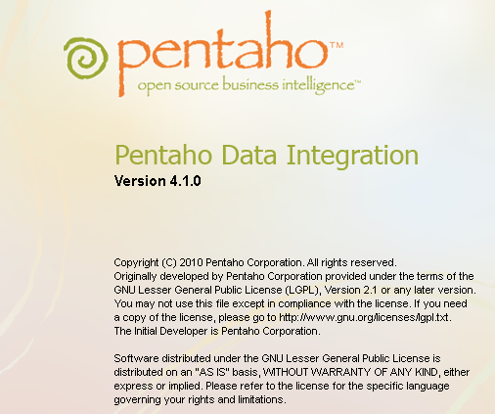
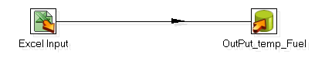
Integrating With (PENTAHO)
Trans Fuel
Trans Dar
Trans Ewacs
Trans SalCom
Trans Ellipse

Slide 5
