Slide 1

GA DSI-10 CAPSTONE PROJECT
Predicting Whether Insurance Underwriting Gain Will Be Negative
(with not such great data)
Irwin Wei
5 December 2019

Slide 2
INSURANCE MONEY: INs & OUTs
Re-Insurance
Expenses
General Insurer
Premiums
Claims Paid
Claims Reserves
Future Liabilities
Financial Instruments

Slide 3
INSURANCE MONEY: INs & OUTs
Re-Insurance
Operating Result
Expenses
UW Gain/Loss
General Insurer
Premiums
Claims Paid
Investment Profit/Loss
Claims Reserves
Liabilities
Financial Instruments

Slide 4
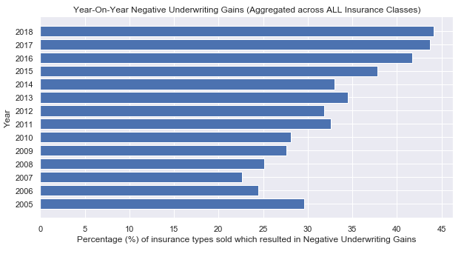
The Rising Trend of Underwriting Losses

Slide 5
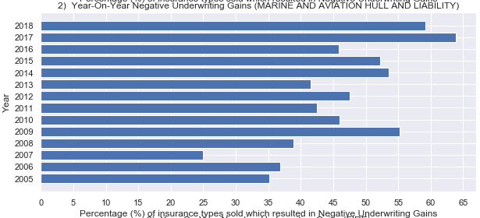
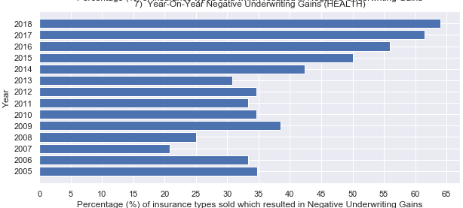
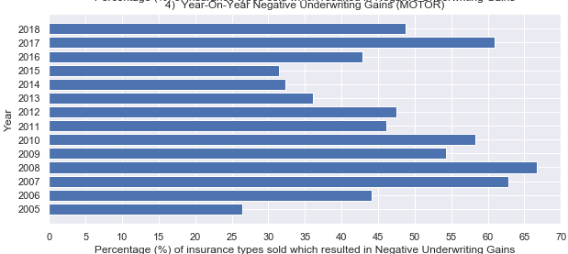
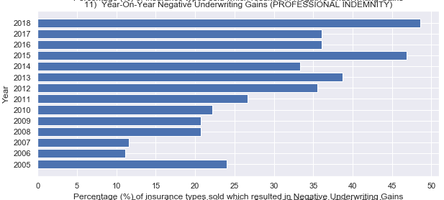
Losers …
Ships, Planes
Group Health
Negligence by professionals
Motor

Slide 6
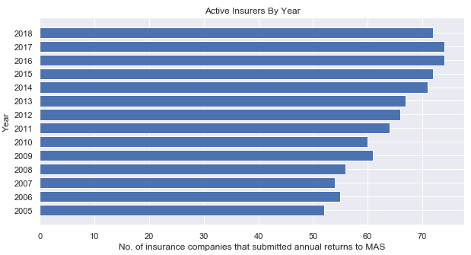
… and yet… More Insurers!

Slide 8
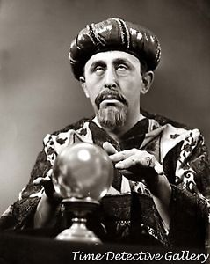
Problem Statement
To implement a proof-of-concept, employing only publicly available data, to predict whether the underwriting performance of any given insurance class is likely to result in an underwriting loss at the end of the current 12-month reporting period.
Value Proposition
With such predictions, underwriters can place more focus on certain insurance classes and review their underwriting approach, and/or take necessary risk management measures such as re-insuring more.

Slide 9
Caveat
Publicly available data is very coarse. Only shows the start/end state of a 12-month period.
Insurers have much higher quality, high-resolution data concerning underwriting and claims details.

Slide 10
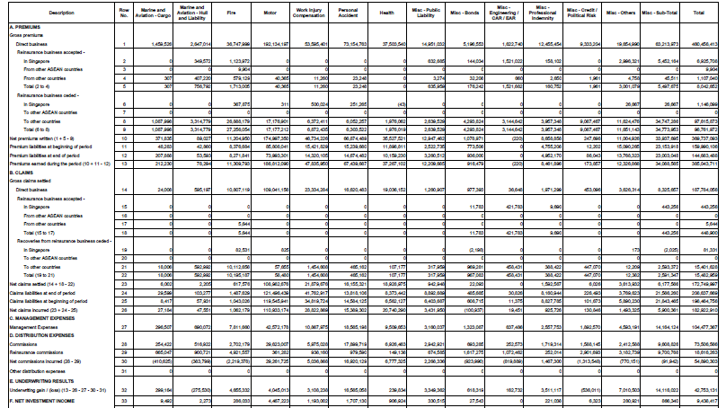
Annual Returns Submitted to MAS – Table “FORM 6 (SIF)”

Slide 11
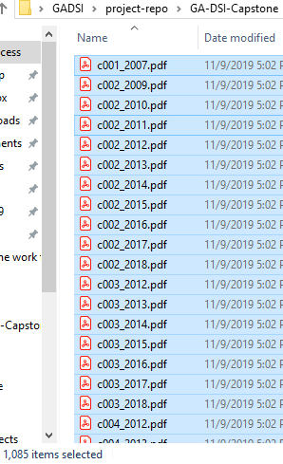
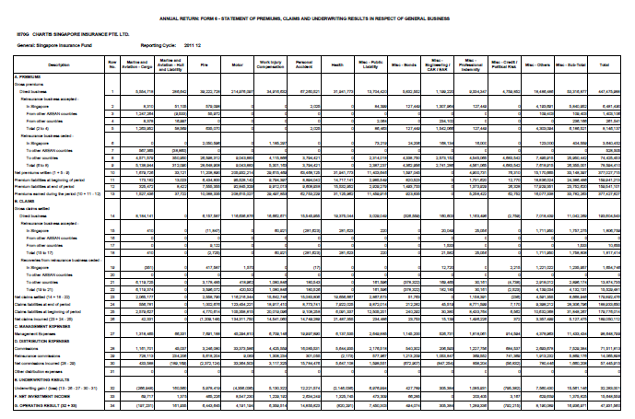
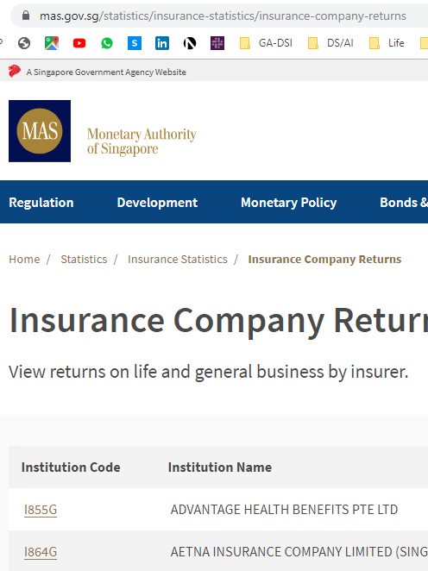

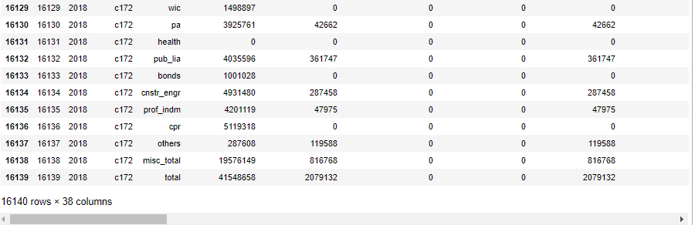
Get data …
pdfminer
pyPDF4
tabula

Slide 12
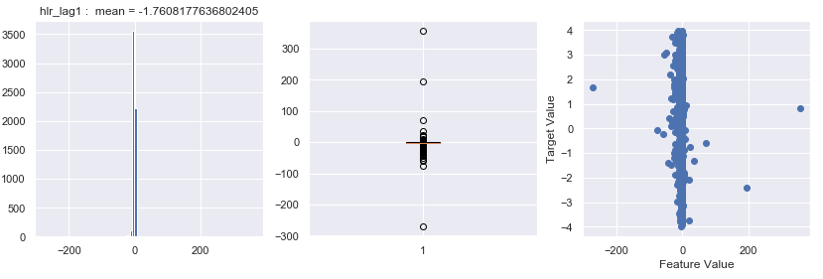

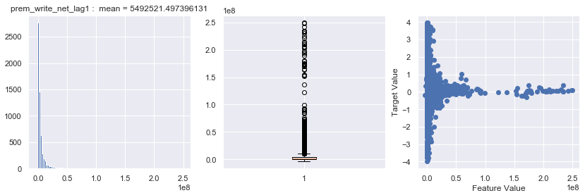
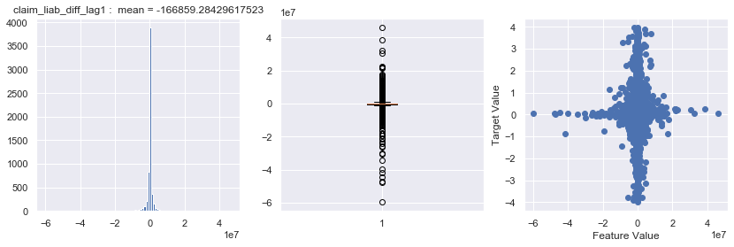
The horror.
Box
~ 9,000 rows

Slide 13
FEATURE ENGINEERING
Calculated ratios in order to normalize data
Used exponential weighted means on time-lag data (up to 5 years’ history)
Reduced to 5 features, then built them up again
+/- polarity of features depending on whether it represented incoming/outgoing money

Slide 14
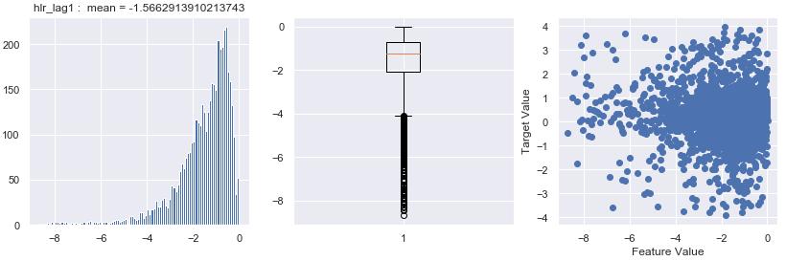

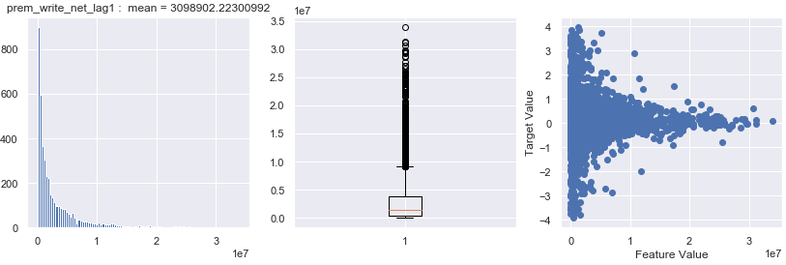
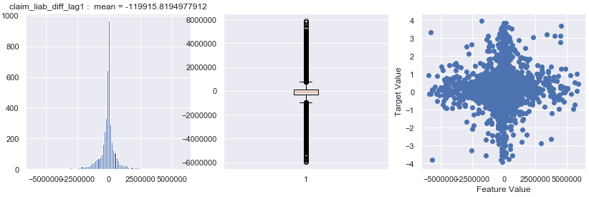
After trimming away Extreme Outliers
&
Feature Engineering
~ 4,400 rows

Slide 15
REGRESSION MODELS
UNSUPERVISED LEARNING
Linear Regression
Decision Tree
Random Forest
Extra Trees
Ada Boost
Gradient Boosting
K-Means
DBSCAN
Hierarchical
Feature
Re-re-
Engineering
No meaningful or interpretable clusters…

Slide 16
REGRESSION MODELS
UNSUPERVISED LEARNING
Linear Regression
Decision Tree
Random Forest
Extra Trees
Ada Boost
Gradient Boosting
K-Means
DBSCAN
Hierarchical
Feature
Re-re- Engineering
No meaningful or interpretable clusters…
Best R2 Score => 0.53 (only)

Slide 17
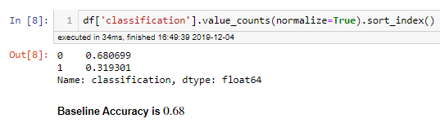
CLASSIFICATION
Positive Case (1) ➔ Underwriting Gain < 0
Negative Case (0) ➔ Underwriting Gain >= 0

Slide 18
CLASSIFICATION MODELS
METRICS:
Recall
Accuracy
Logistic Regression
Decision Tree
Random Forest
Extra Trees
Ada Boost
Gradient Boosting
K Nearest Neighbors
Support Vector Machine

Slide 19
CLASSIFICATION MODELS
METRICS:
Recall
Accuracy
Logistic Regression
Decision Tree
Random Forest
Extra Trees
Ada Boost
Gradient Boosting
K Nearest Neighbors
Support Vector Machine

Slide 20
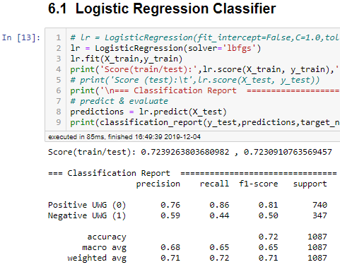

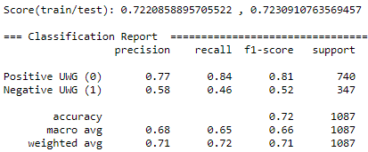
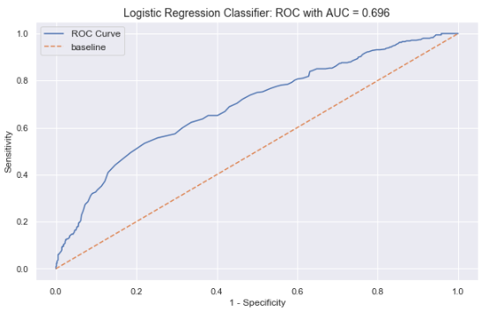
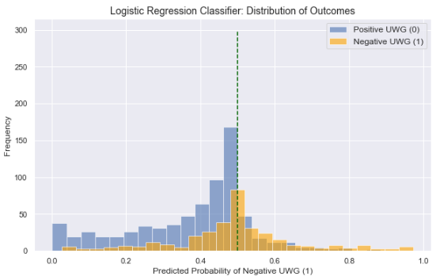
After Tuning
{'C': 1.0, 'fit_intercept': True, 'max_iter': 5000, 'penalty': 'l2', 'solver': 'sag', 'tol': 0.1}

Slide 21
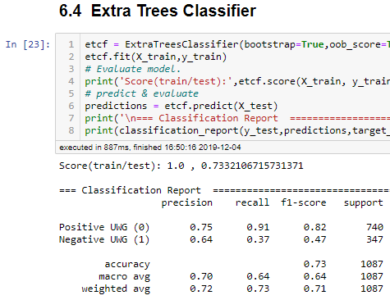
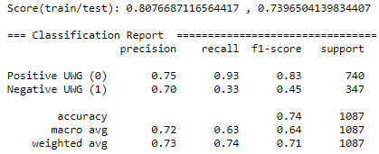
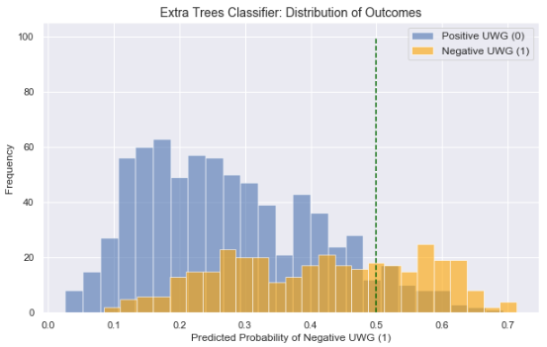
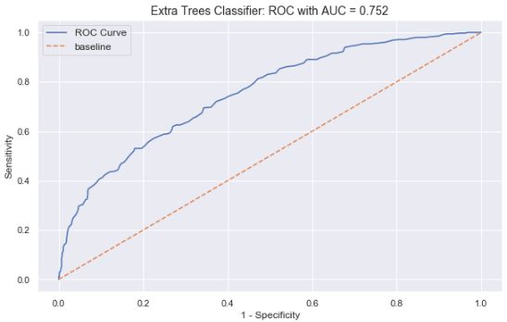
After Tuning
{'bootstrap': True, 'max_depth': 31, 'min_samples_split': 27, 'n_estimators': 150, 'oob_score': True}

Slide 22
Comparison
Logistic
Regressor
Extra
Trees

Slide 23
Conclusion
Whilst Extra Trees did slightly better in accuracy, Logistic Regression performed much better on Recall ⬅ and that’s the most important metric for the problem statement.
Using coarse-grained data from the annual returns, the classification model was able to out-perform the baseline accuracy. Imagine what more a GA DSI Graduate with access to underwriting and claims data can do for an insurer.

Slide 24
What the moral of the story?

Slide 25

… blood from stone
Us
Data
Value

