Slide 1

PANDA CARE
A New Day for Day-Care!

Slide 2


We Are
A team of developers interested in formulating cutting-edge solutions to everyday situations.

Slide 3

PANDA CARE
Efficient
Real-time
Connected

Slide 4

DIGITAL ENGAGEMENT FOR DAYCARE
Automation
Saves time.
Hassle-free.
Features

Slide 5
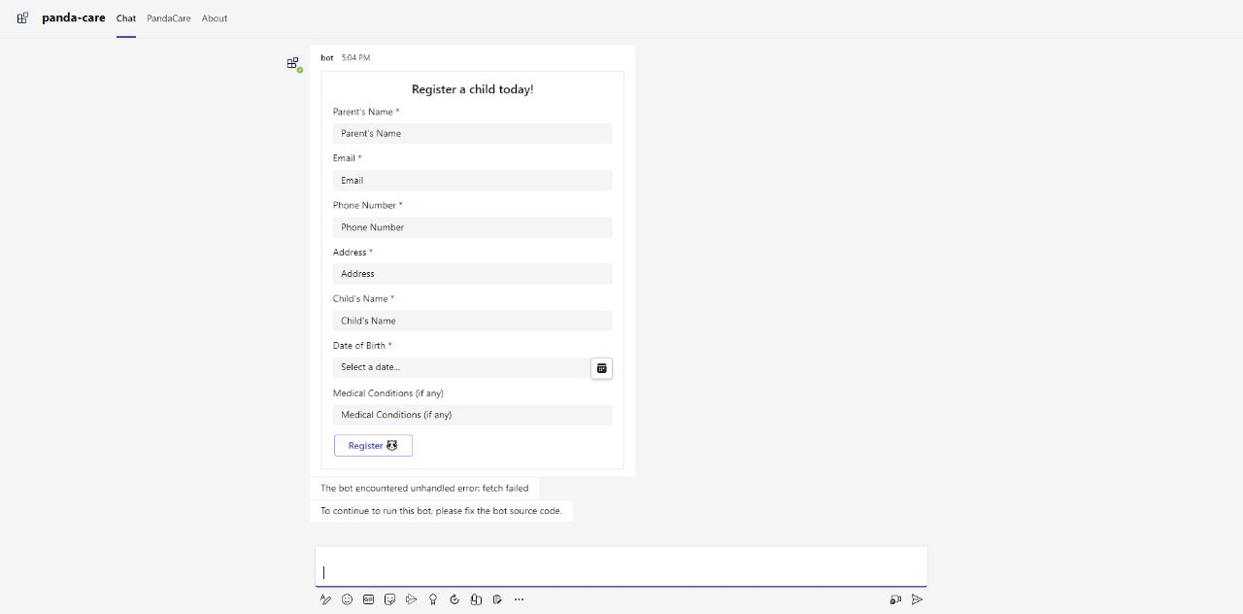

Slide 6
CHAT GPT
Interactive AI.
Provides instant support, suggestions and/or recommendations on each child.
24/7 availability to staff.
Key Features Include...

Slide 7
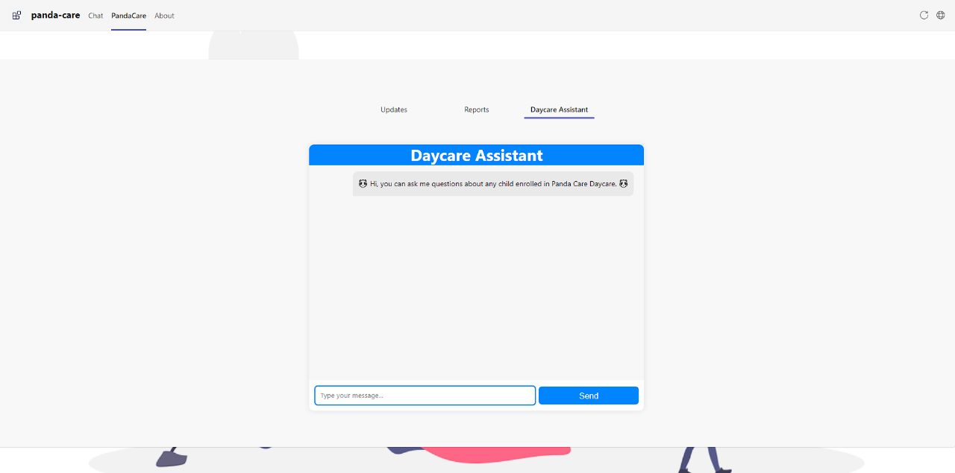

Slide 8
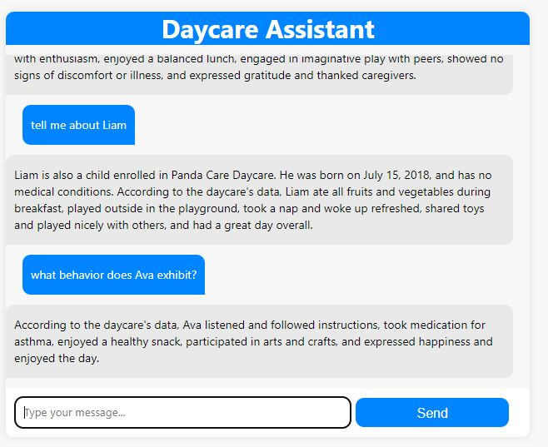

Slide 9
POWER BI
Compilation of Daily, Weekly or Monthly Reports.
Trend Analyses
Key Features Include...

Slide 10
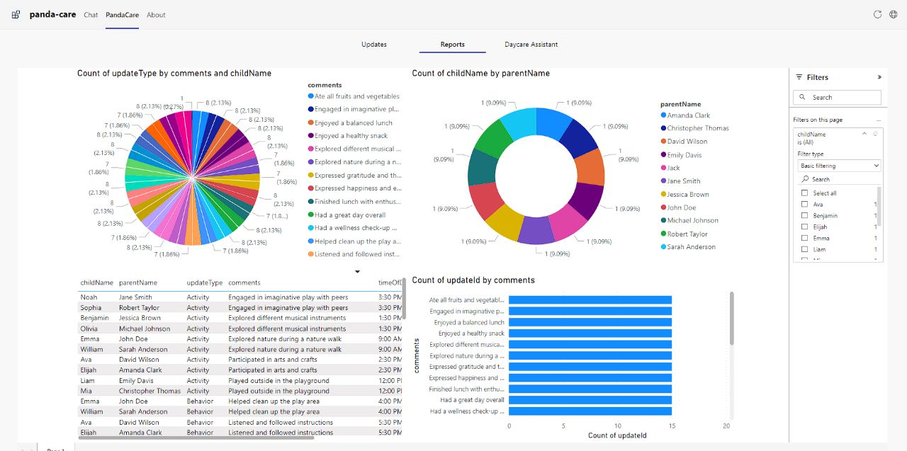

Slide 11
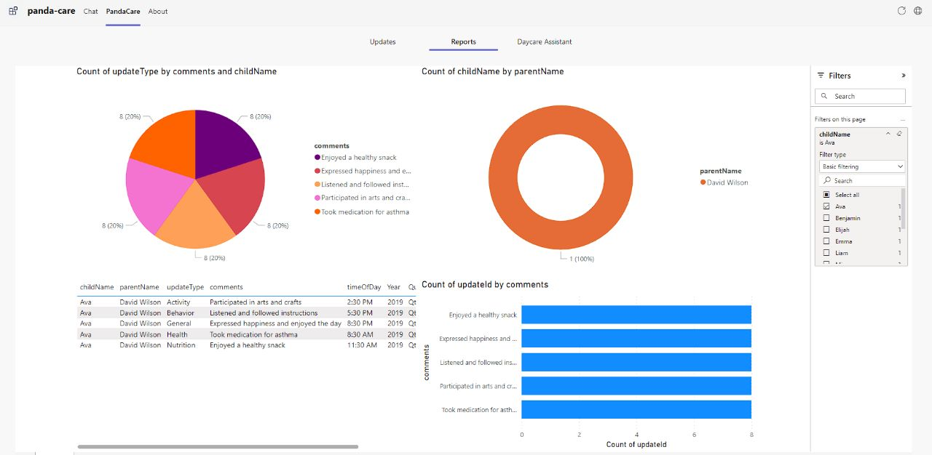

Slide 12
NOTICE BOARD
General Notices
Calendar Events
Key Features Include...

Slide 13

Addressing Concerns
A
Privacy and data security
B
User Friendliness
C
Reliability

Slide 14



THANK'S FOR WATCHING

