Slide 1
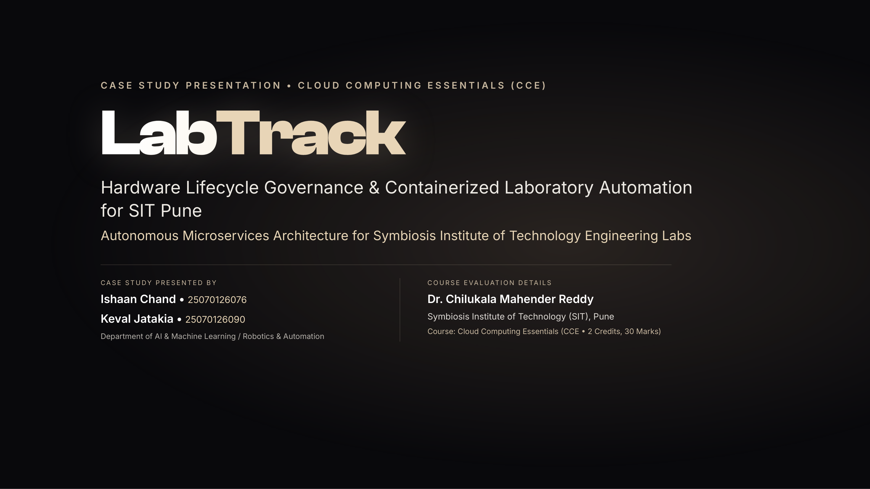
Notes:
Good morning Dr. Mahender Reddy and committee members. Today we present LabTrack, a centralized hardware lifecycle governance and tracking system engineered specifically for SIT Pune engineering laboratories. LabTrack replaces fragmented paper registers with containerized cloud workflows, deterministic FIFO reservation queues, and transactional event reliability.

Slide 2
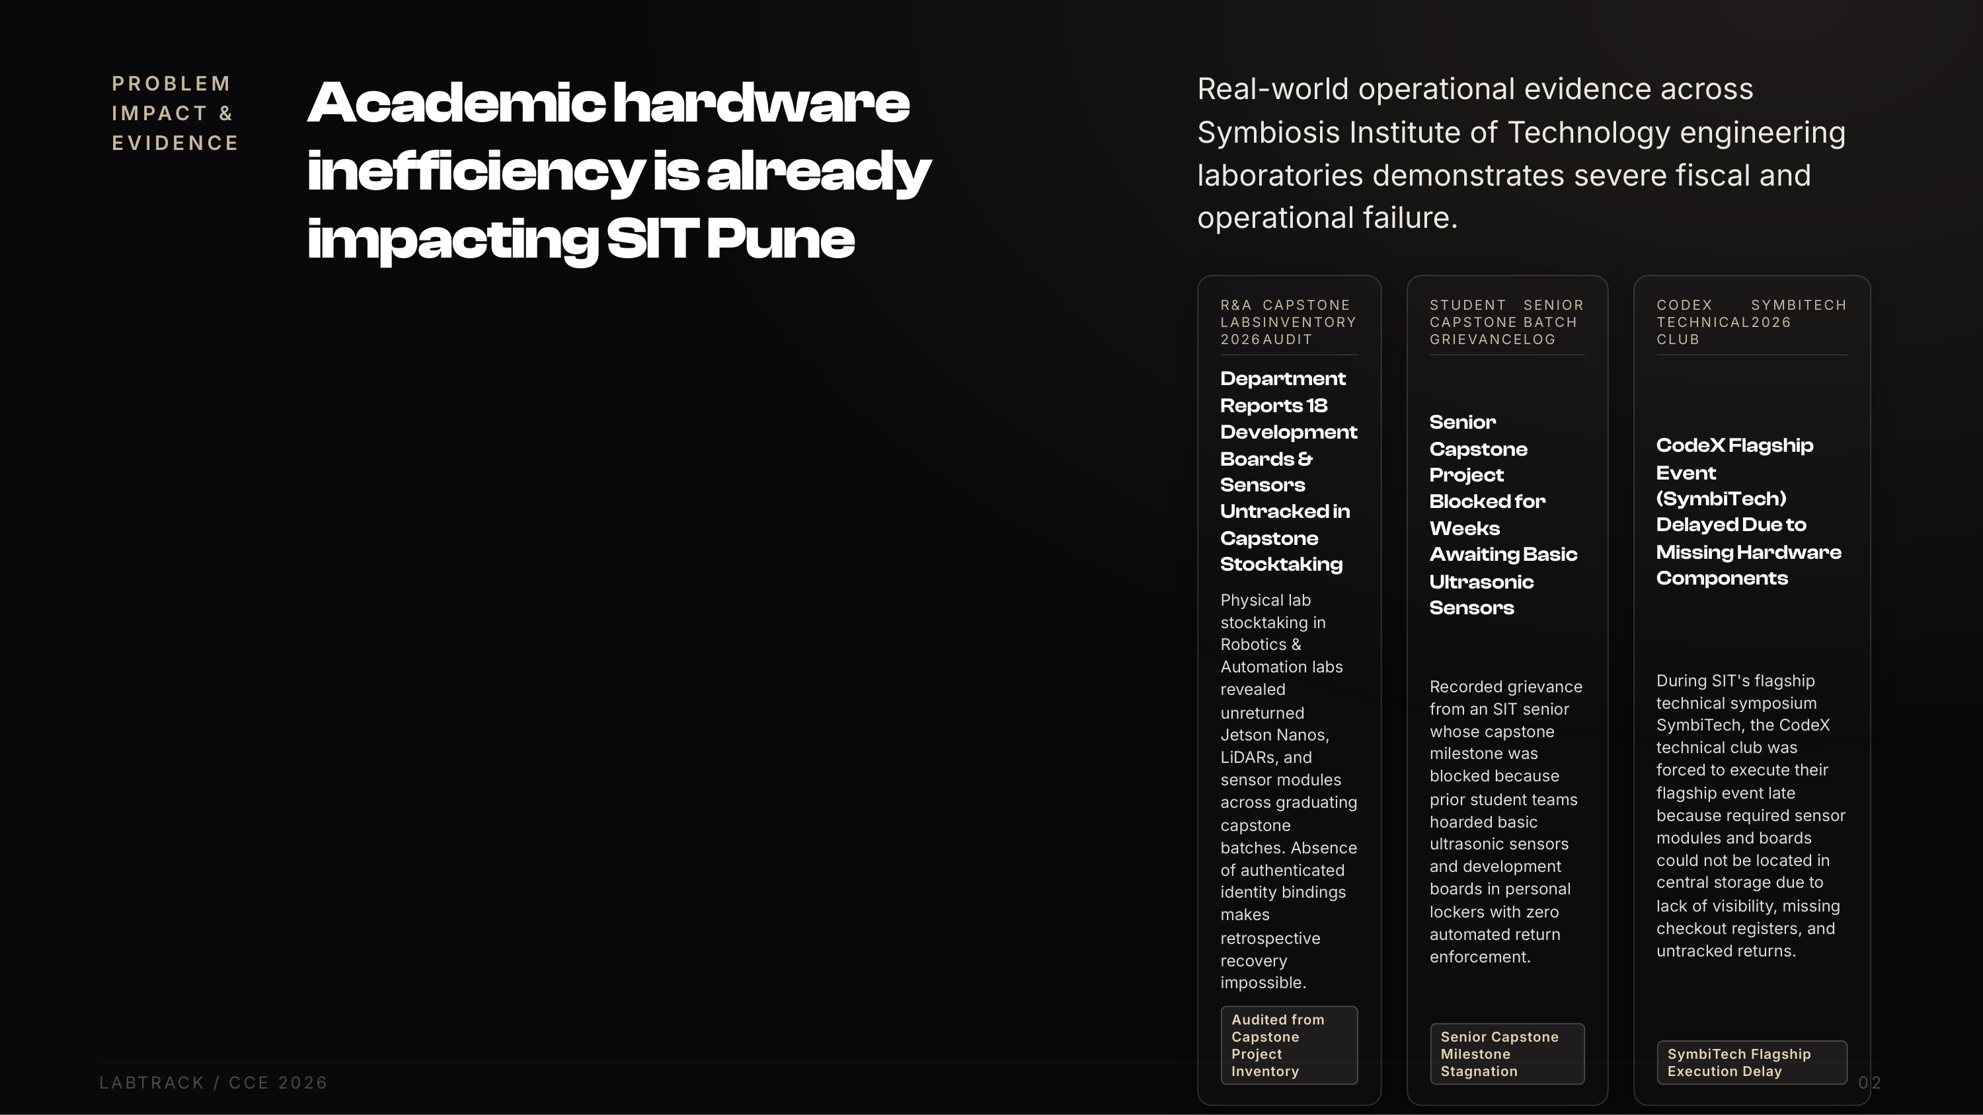
Notes:
Look at the real evidence from SIT Pune engineering labs: untracked capstone inventory leading to missing Jetson Nanos, graduating senior projects blocked for weeks due to locker hoarding, and CodeX club forced to delay their SymbiTech flagship event due to missing components in central storage.

Slide 3
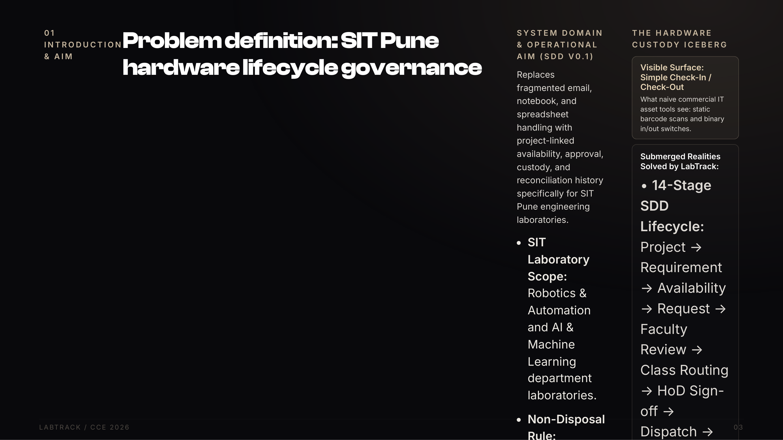
Notes:
Walk through the problem definition from our SDD: In SIT Pune labs, hardware cannot be tracked like office laptops. Consumables are returnable, custody must bind to student PRNs and capstone projects, and the 14-stage SDD lifecycle ensures end-to-end accountability.

Slide 4
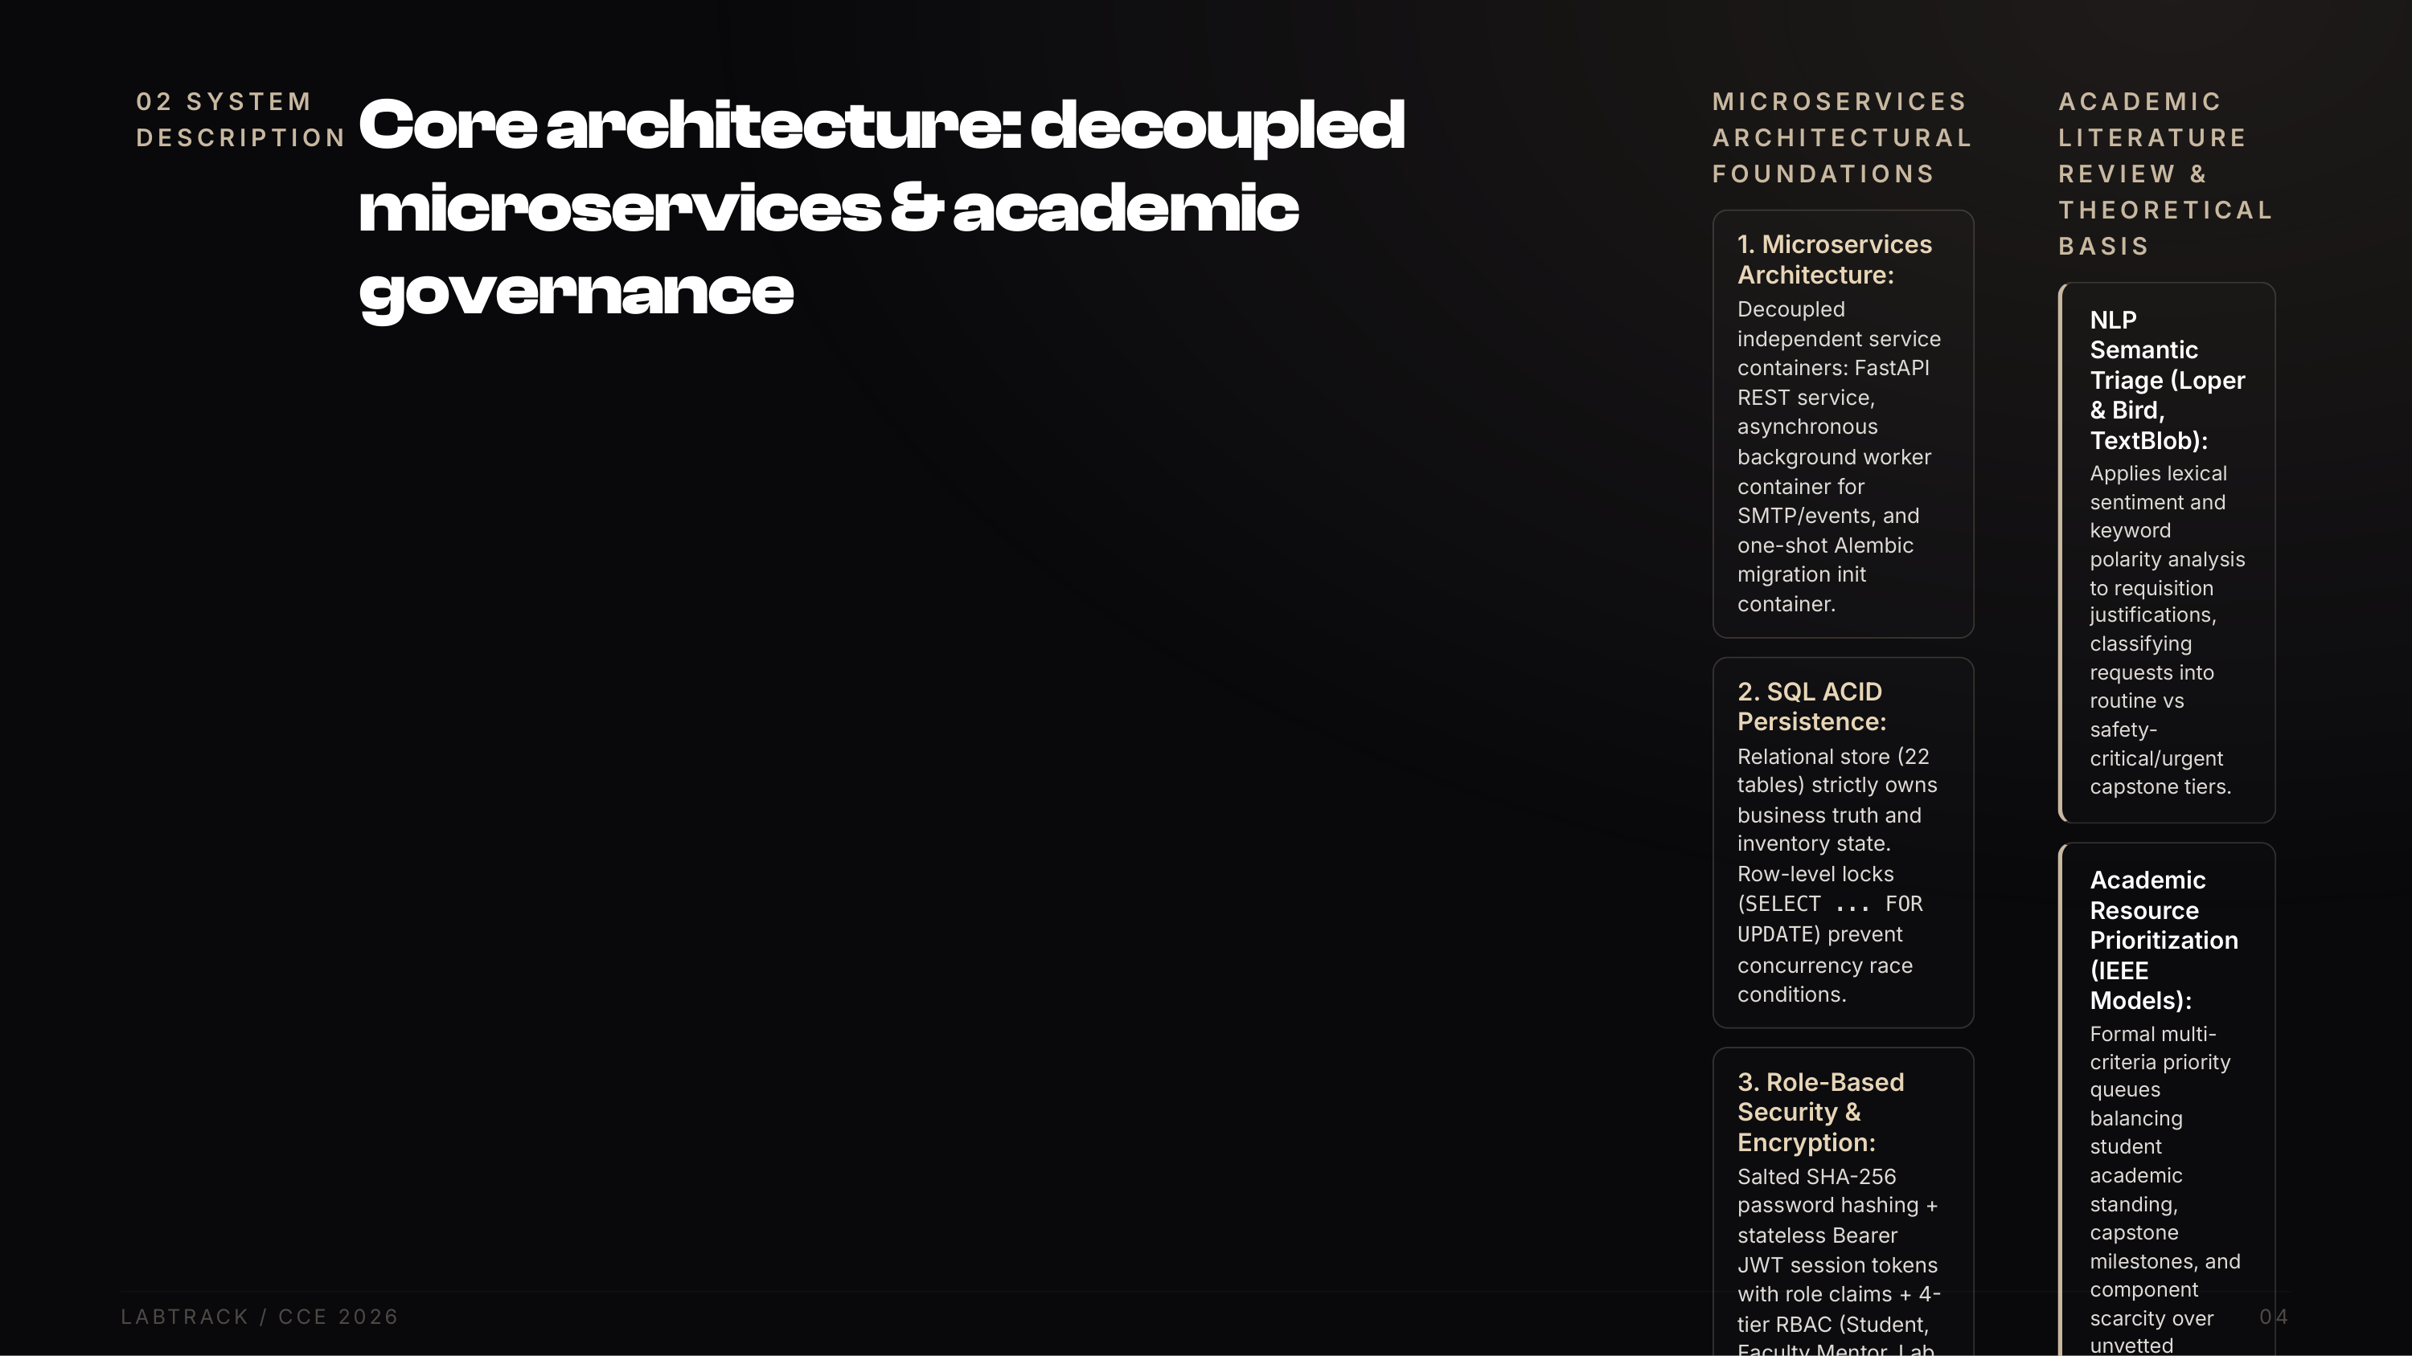
Notes:
Explain our microservices architecture: It is not monolithic. We decouple the FastAPI API service from the background notification worker container. We enforce SQL ACID persistence, salted SHA-256 password hashing, and apply NLP semantic triage grounded in academic literature to prioritize high-value capstone requests for Dr. Reddy and the HoD.

Slide 5
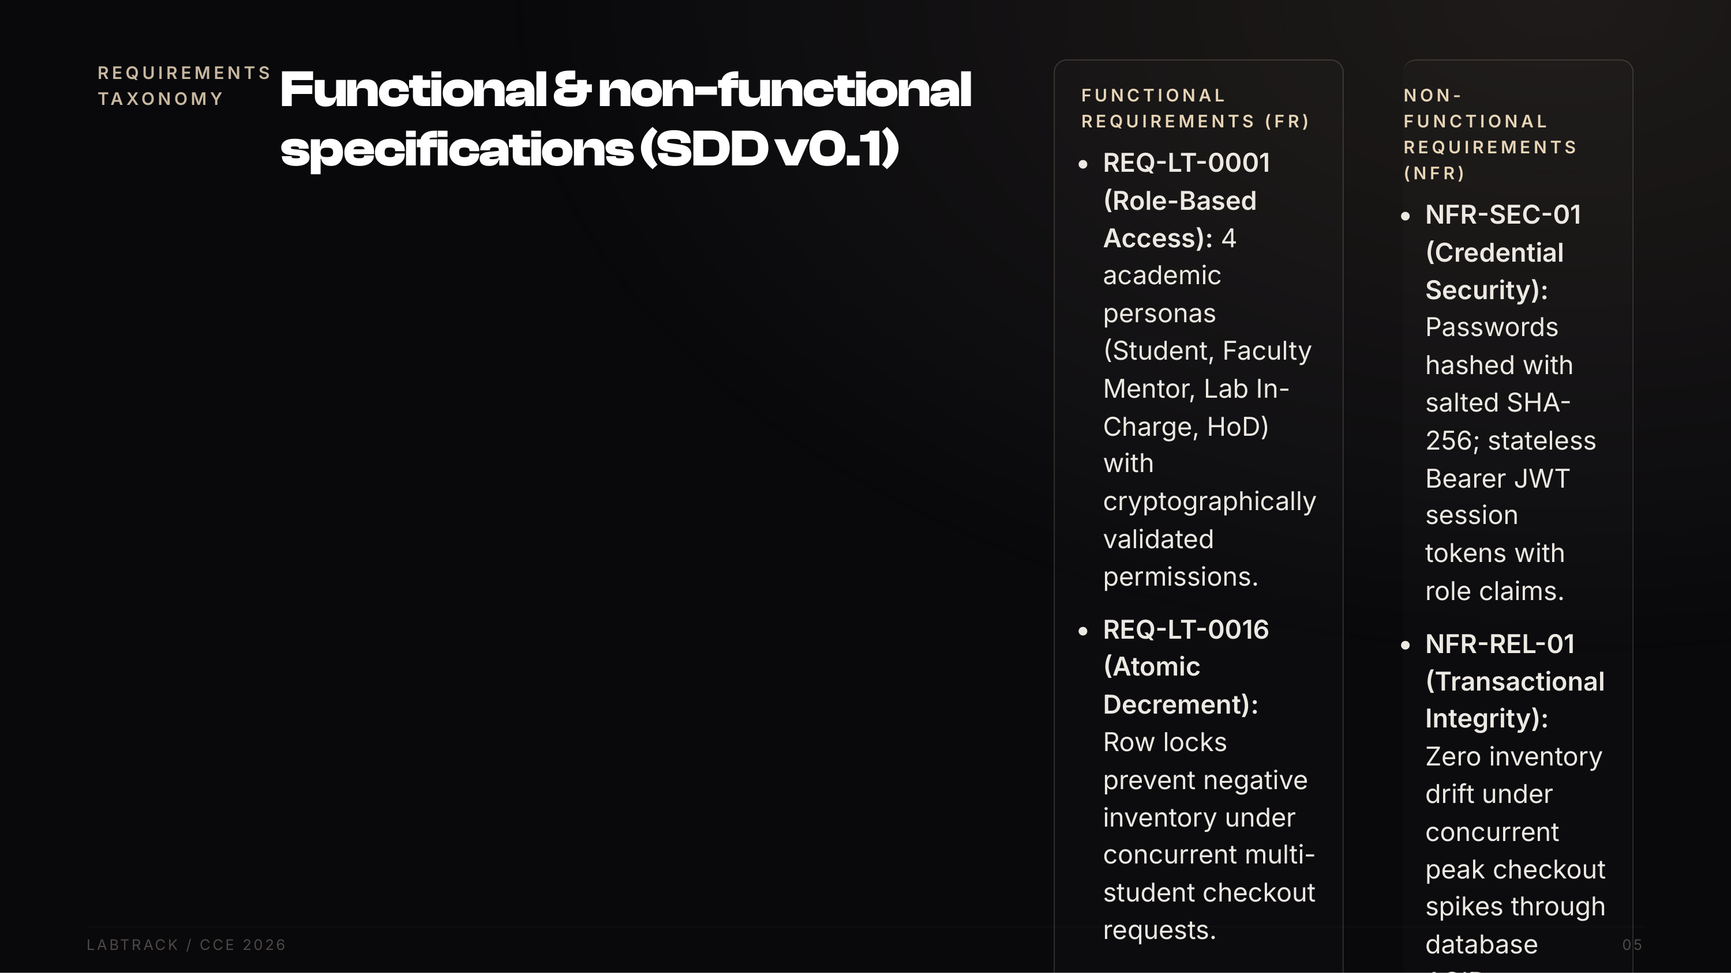
Notes:
Reference our approved Software Design Document (SDD v0.1). These are formal engineering contracts. Functional requirements govern RBAC and inventory math, while Non-Functional requirements guarantee salted SHA-256 password hashing, sub-50ms latency, and container isolation.

Slide 6
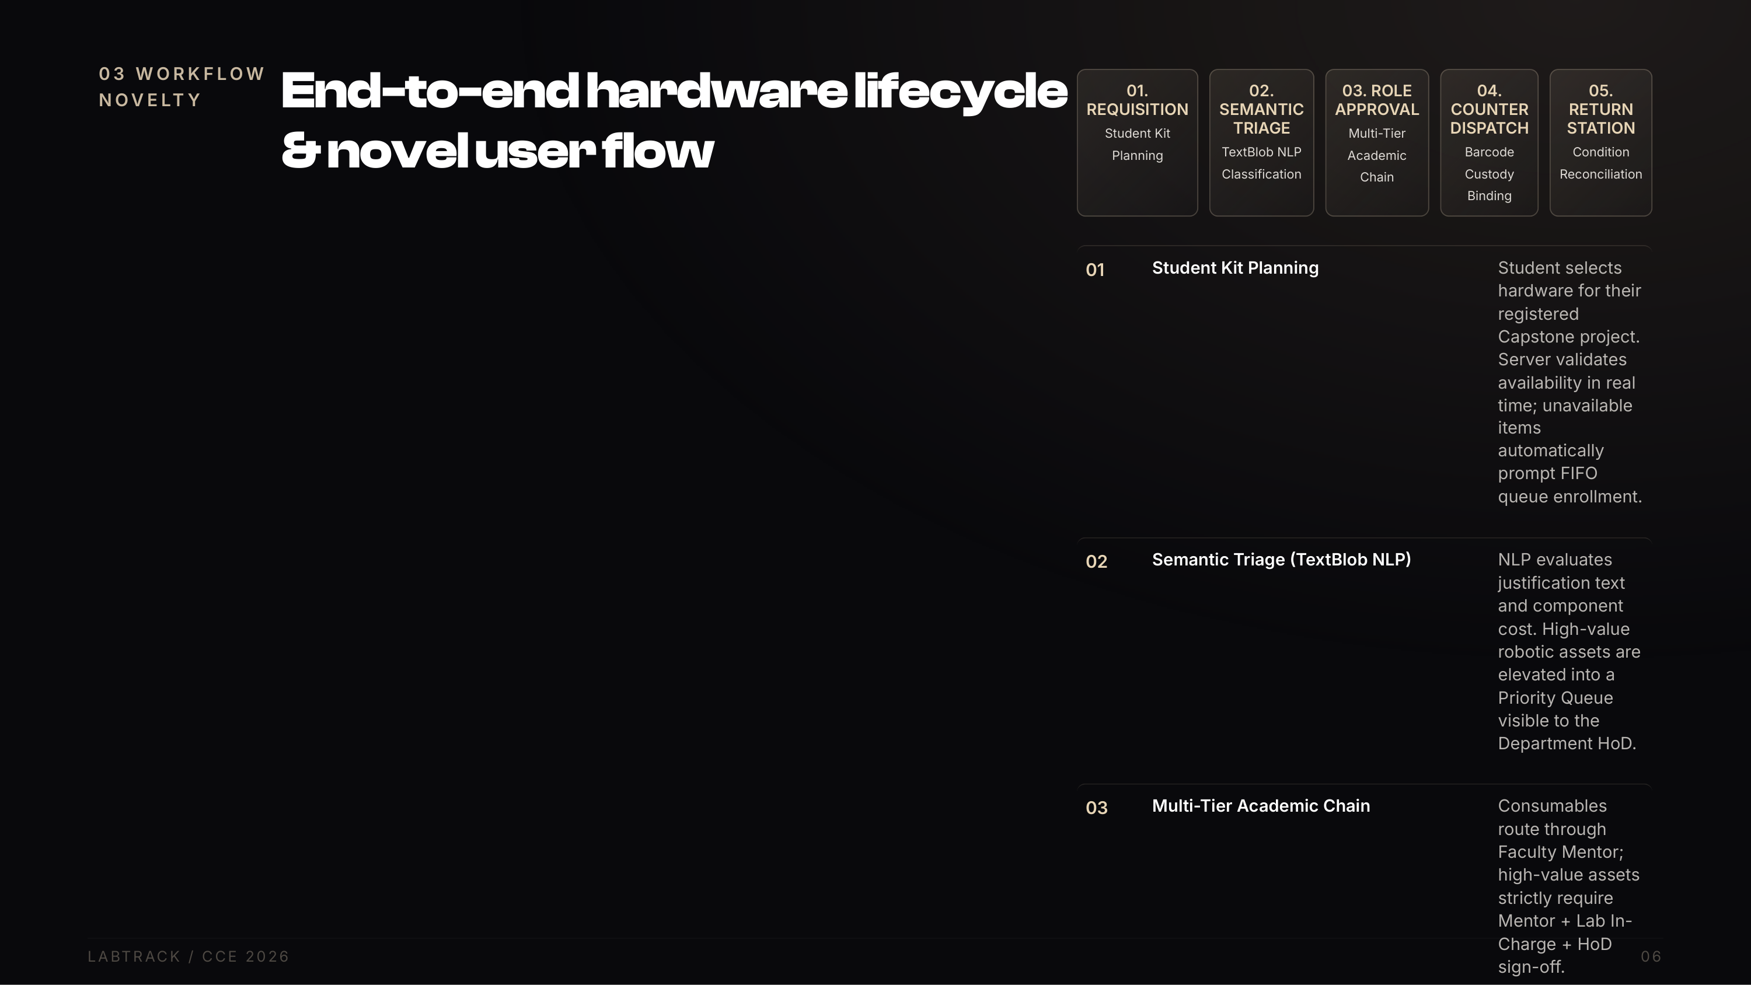
Notes:
Walk through this concrete 5-stage user flow: from student requisition, through TextBlob semantic triage, multi-tier faculty approval, counter barcode scanning, to physical return station condition inspection.

Slide 7
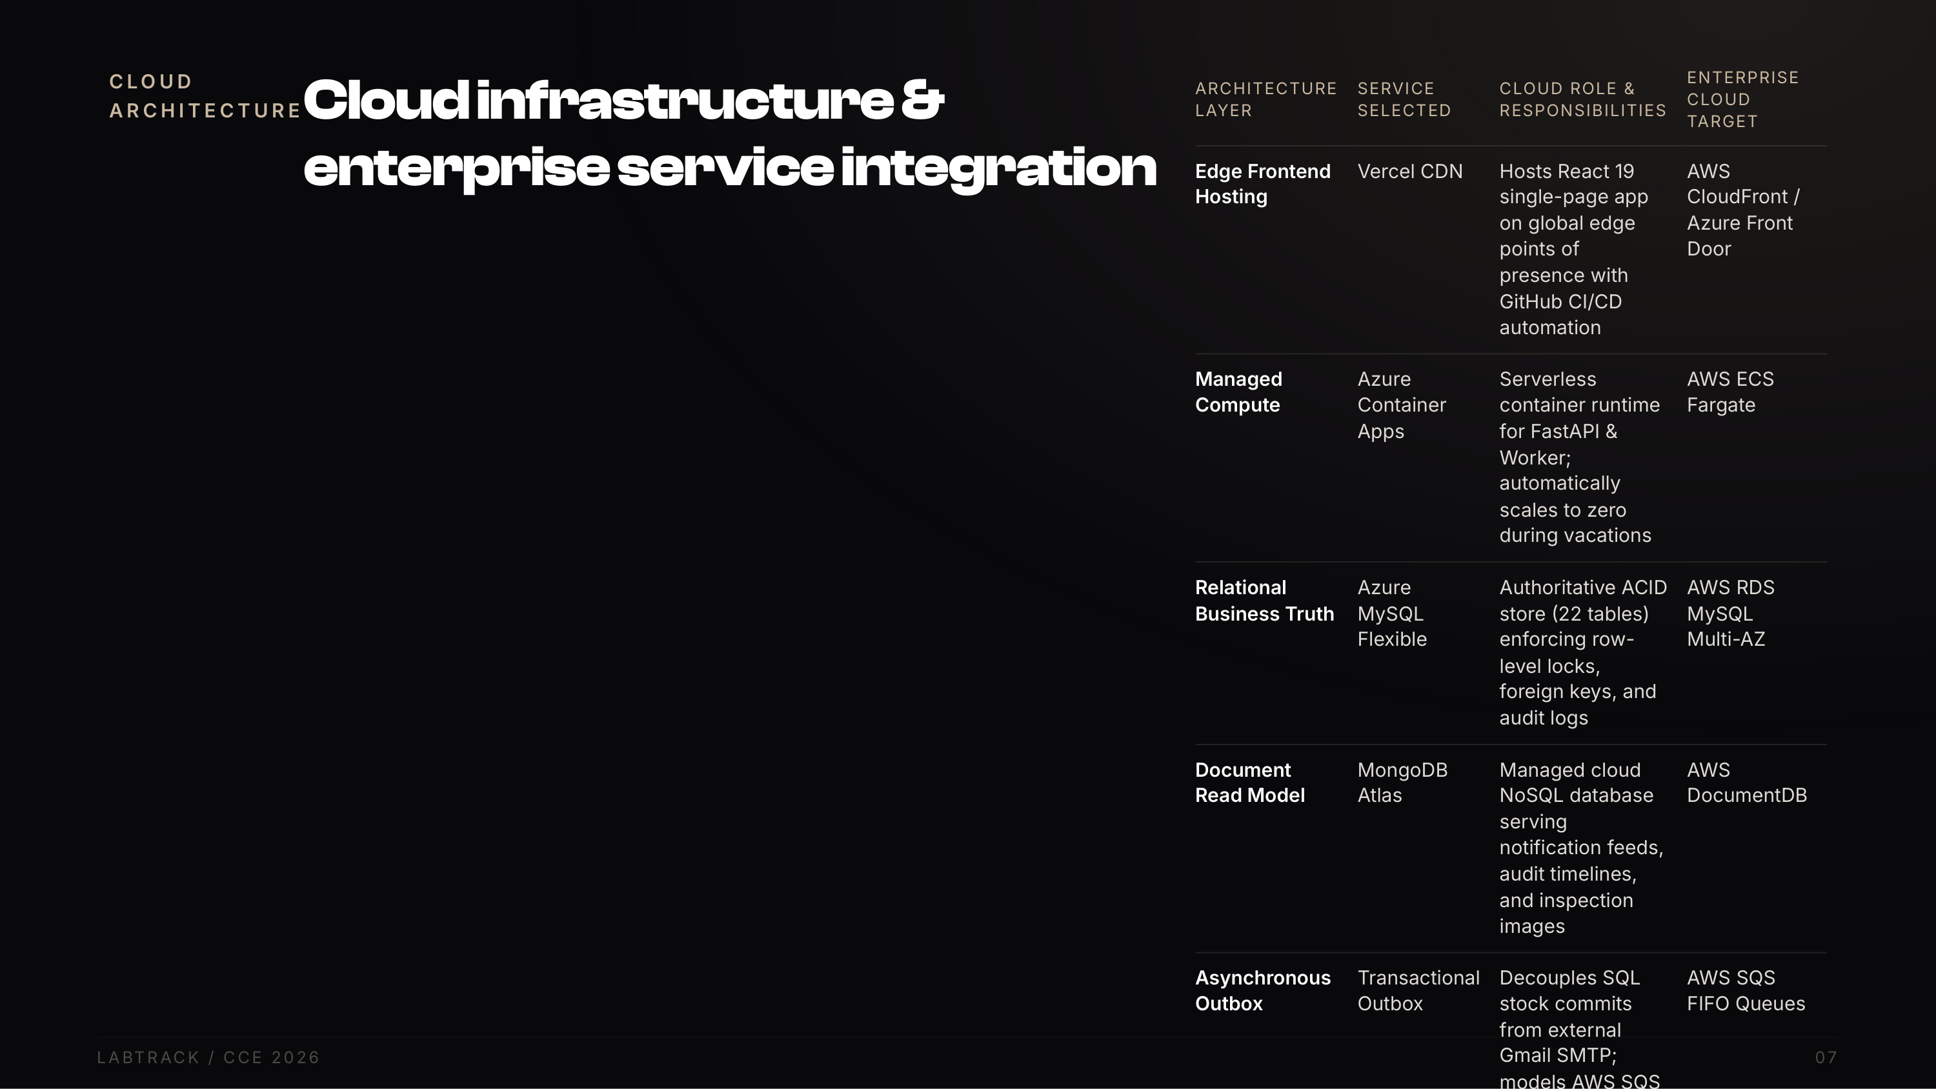
Notes:
Explain our hybrid cloud architecture: Edge hosting on Vercel for fast frontend delivery, serverless Azure Container Apps for compute that scales to zero during university breaks, Azure MySQL for authoritative ACID transactions, and MongoDB Atlas for high-frequency notification feeds.

Slide 8
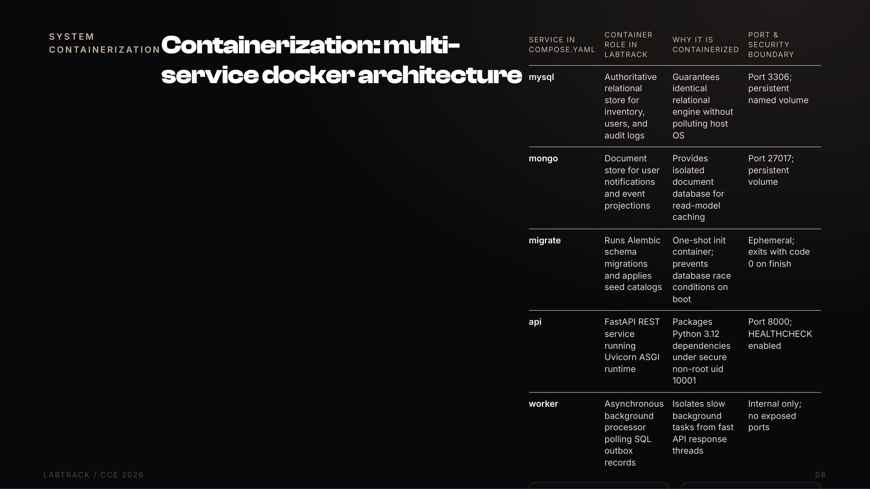
Notes:
Walk through the 5 services in compose.yaml: mysql, mongo, migrate, api, worker. Explain why migrate runs as a separate one-shot init container to prevent database race conditions. Cite literature from Felter et al. demonstrating container virtualization performance advantages over hypervisors.

Slide 9
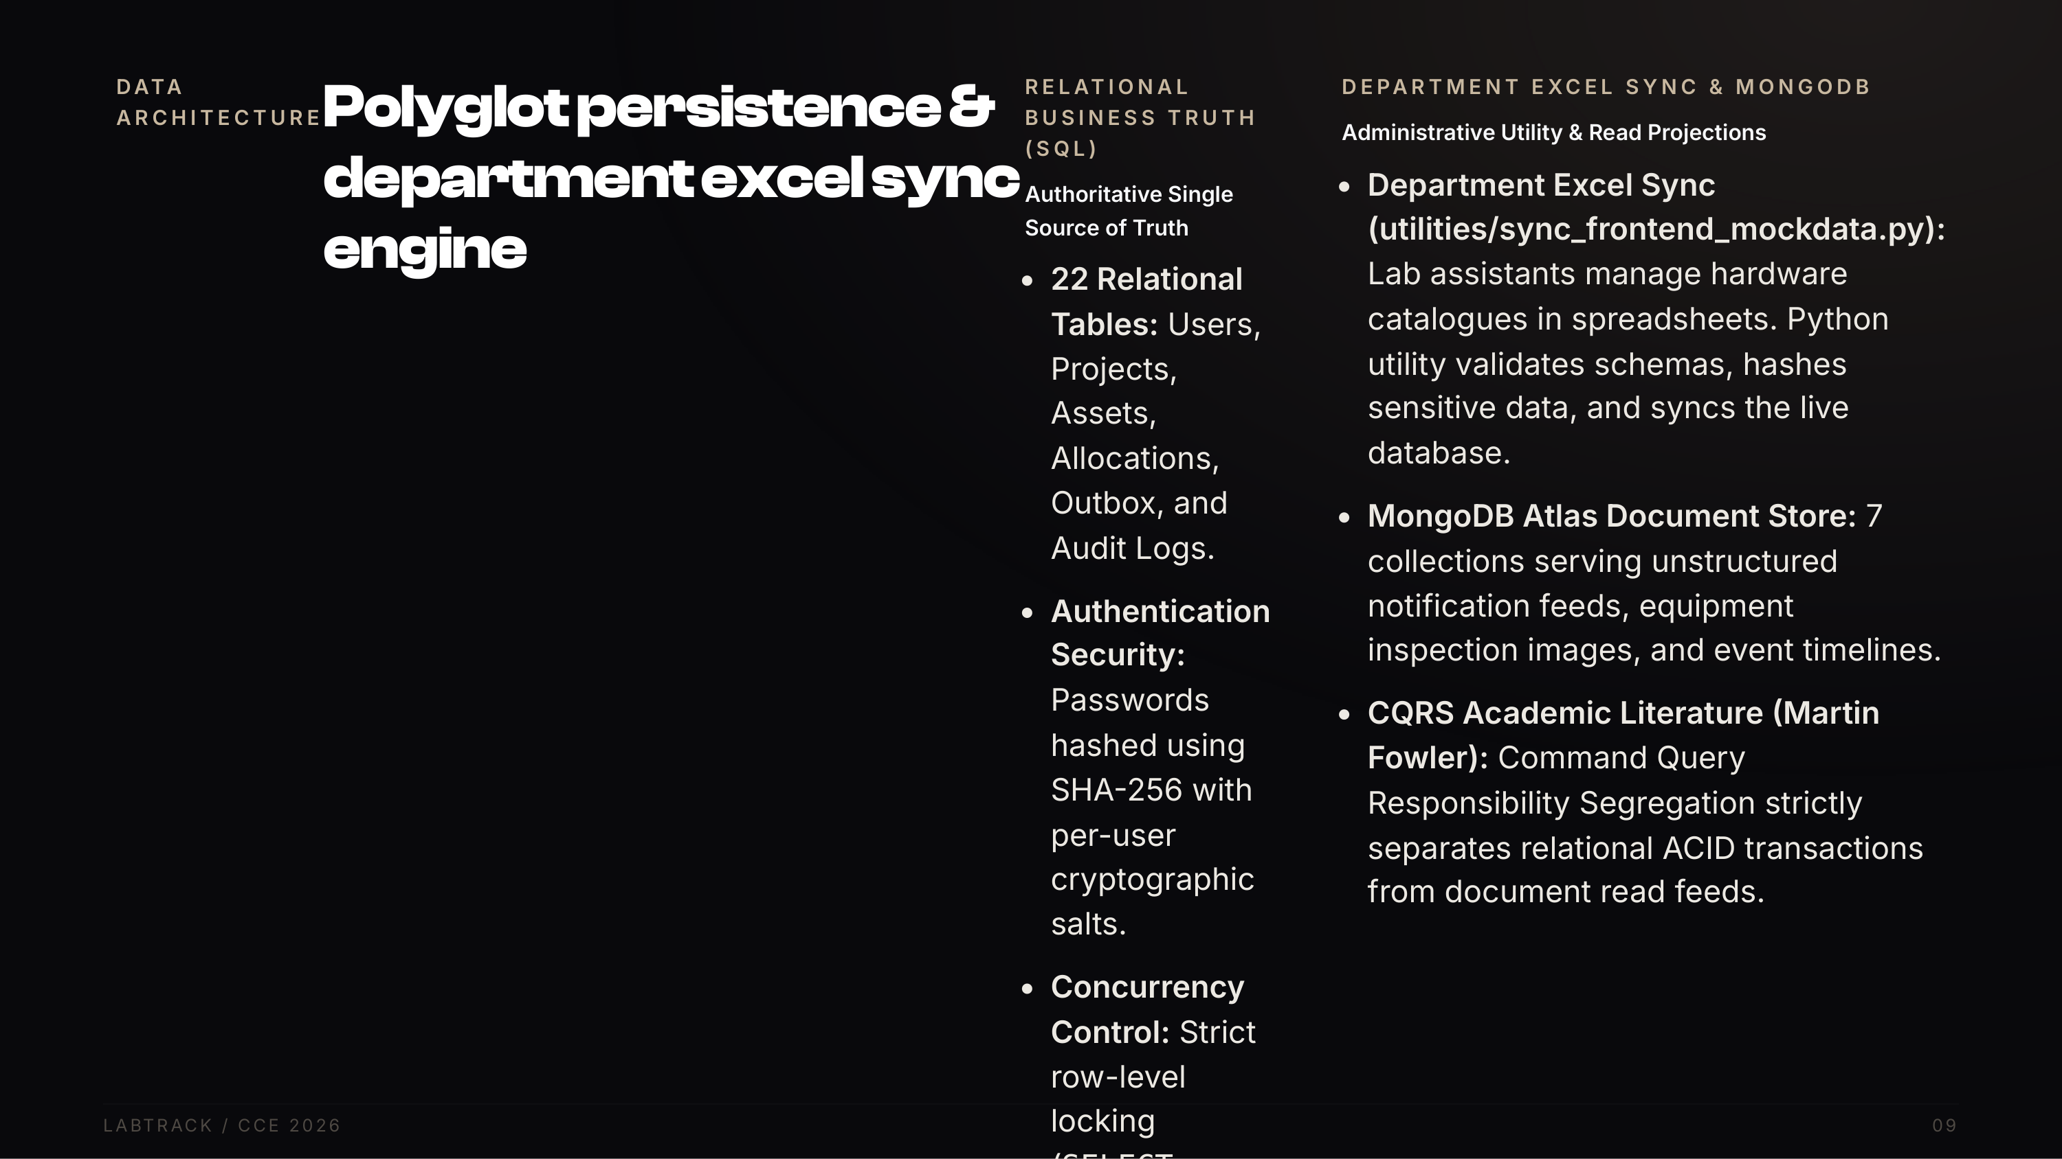
Notes:
Explain our polyglot data architecture: SQL owns all business truth with row-level locks and salted SHA-256 credentials. For administrative usability, our Excel sync utility allows department staff to maintain catalogs while keeping the database synchronized. MongoDB Atlas stores read-optimized notification feeds following Fowler CQRS pattern.

Slide 10
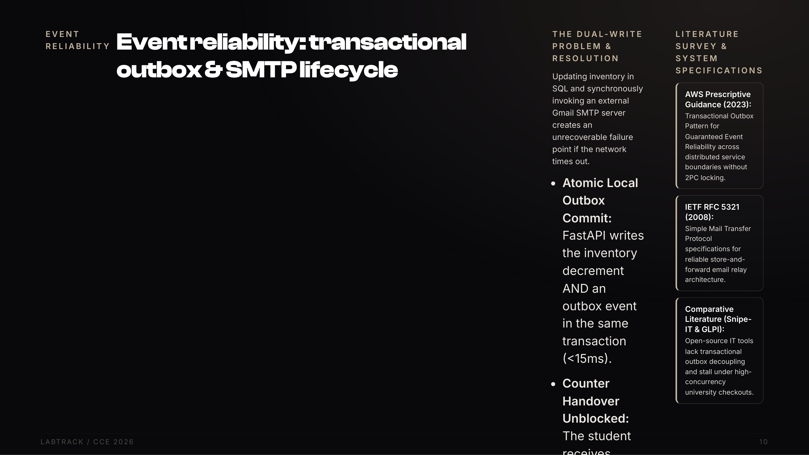
Notes:
Explain how this directly applies AWS Prescriptive Guidance: In distributed systems, decoupling atomic SQL commits from network notifications protects data consistency. If Gmail is down, the student still gets their sensor. Live demo link is on Slide 15.

Slide 11
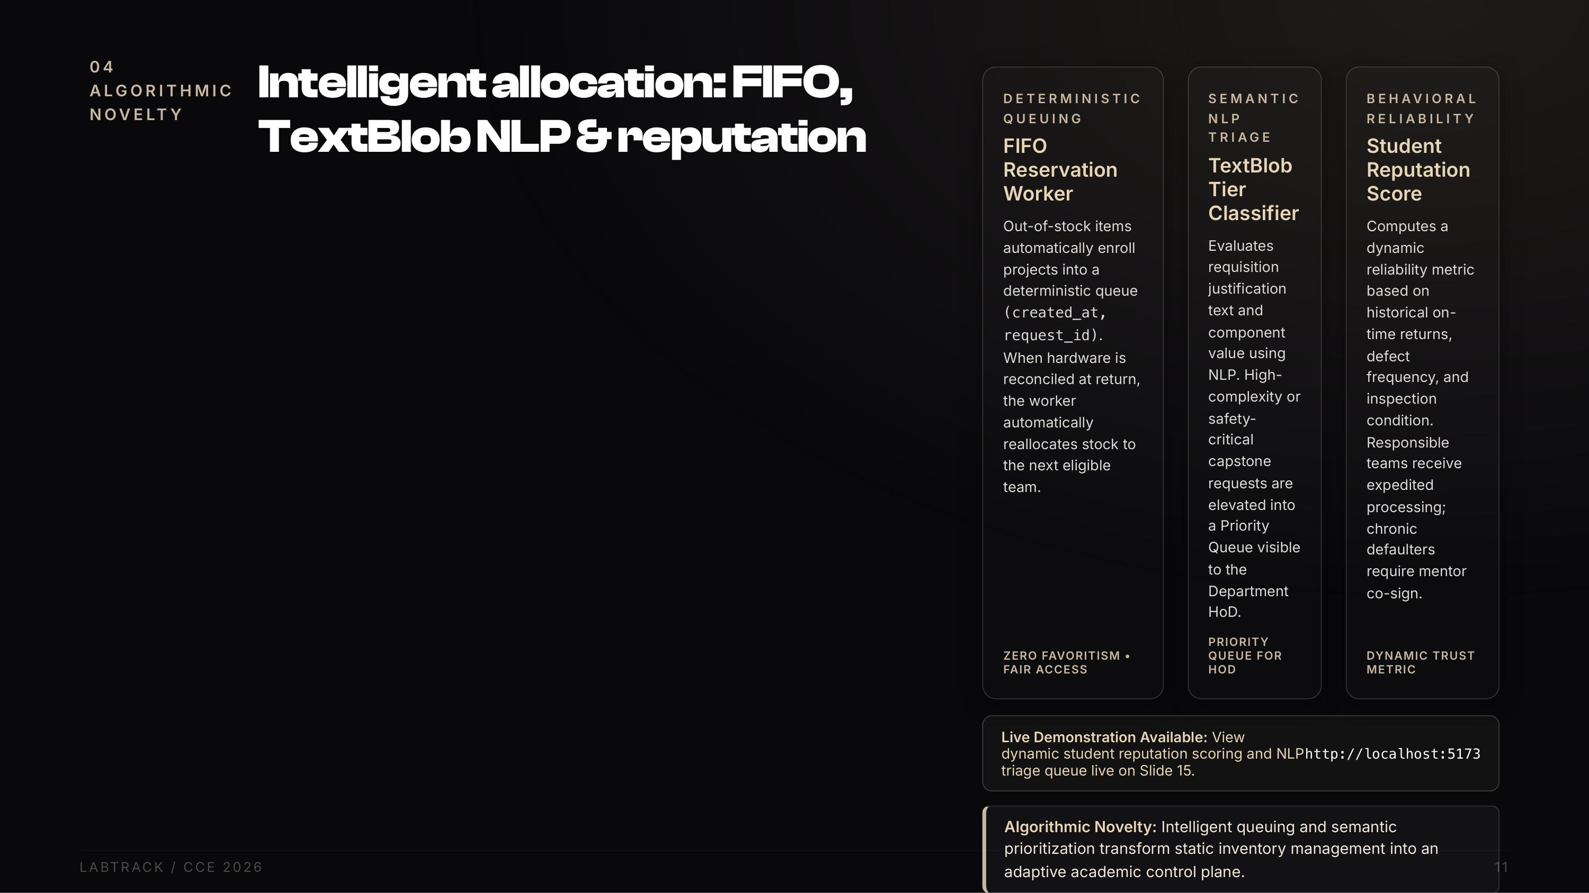
Notes:
Highlight our three algorithmic novelties: Deterministic FIFO reservation queuing to eliminate student bias, TextBlob semantic analysis to elevate high-value capstone items to the HoD priority queue, and dynamic student reputation scoring. Live demo link is on Slide 15.

Slide 12
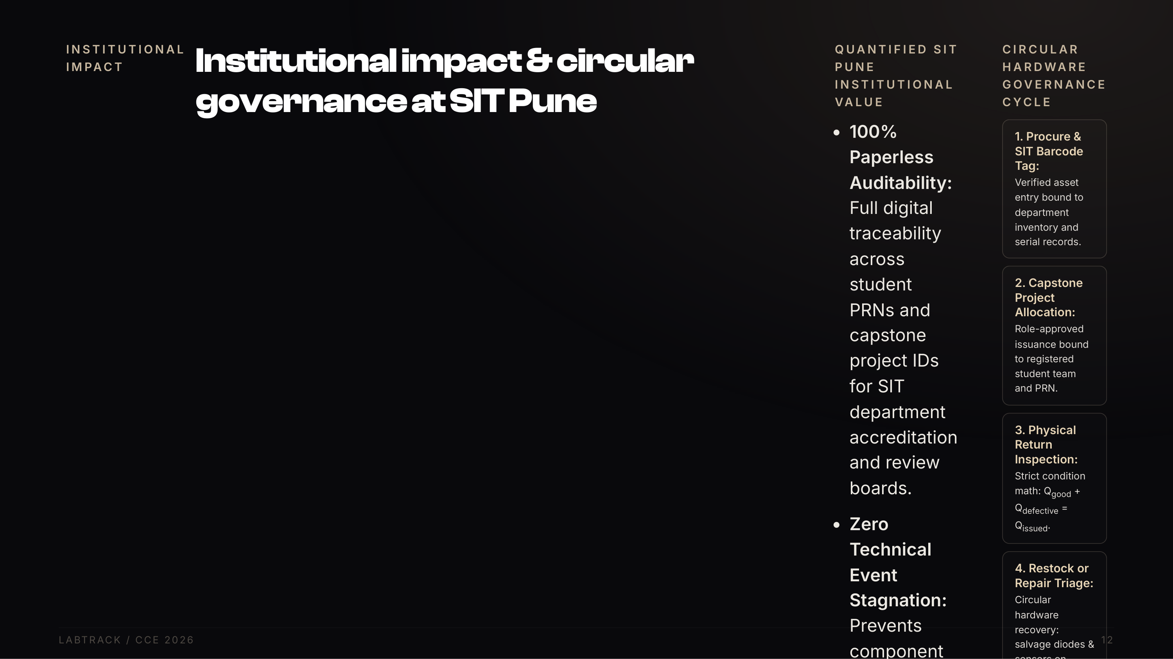
Notes:
Explain our verified SIT institutional value: 100% paperless auditability for department accreditation, zero SymbiTech delays, 120+ staff hours saved annually, and circular defect triage that rescues salvageable components. All running cost-free on SIT bare metal servers.

Slide 13
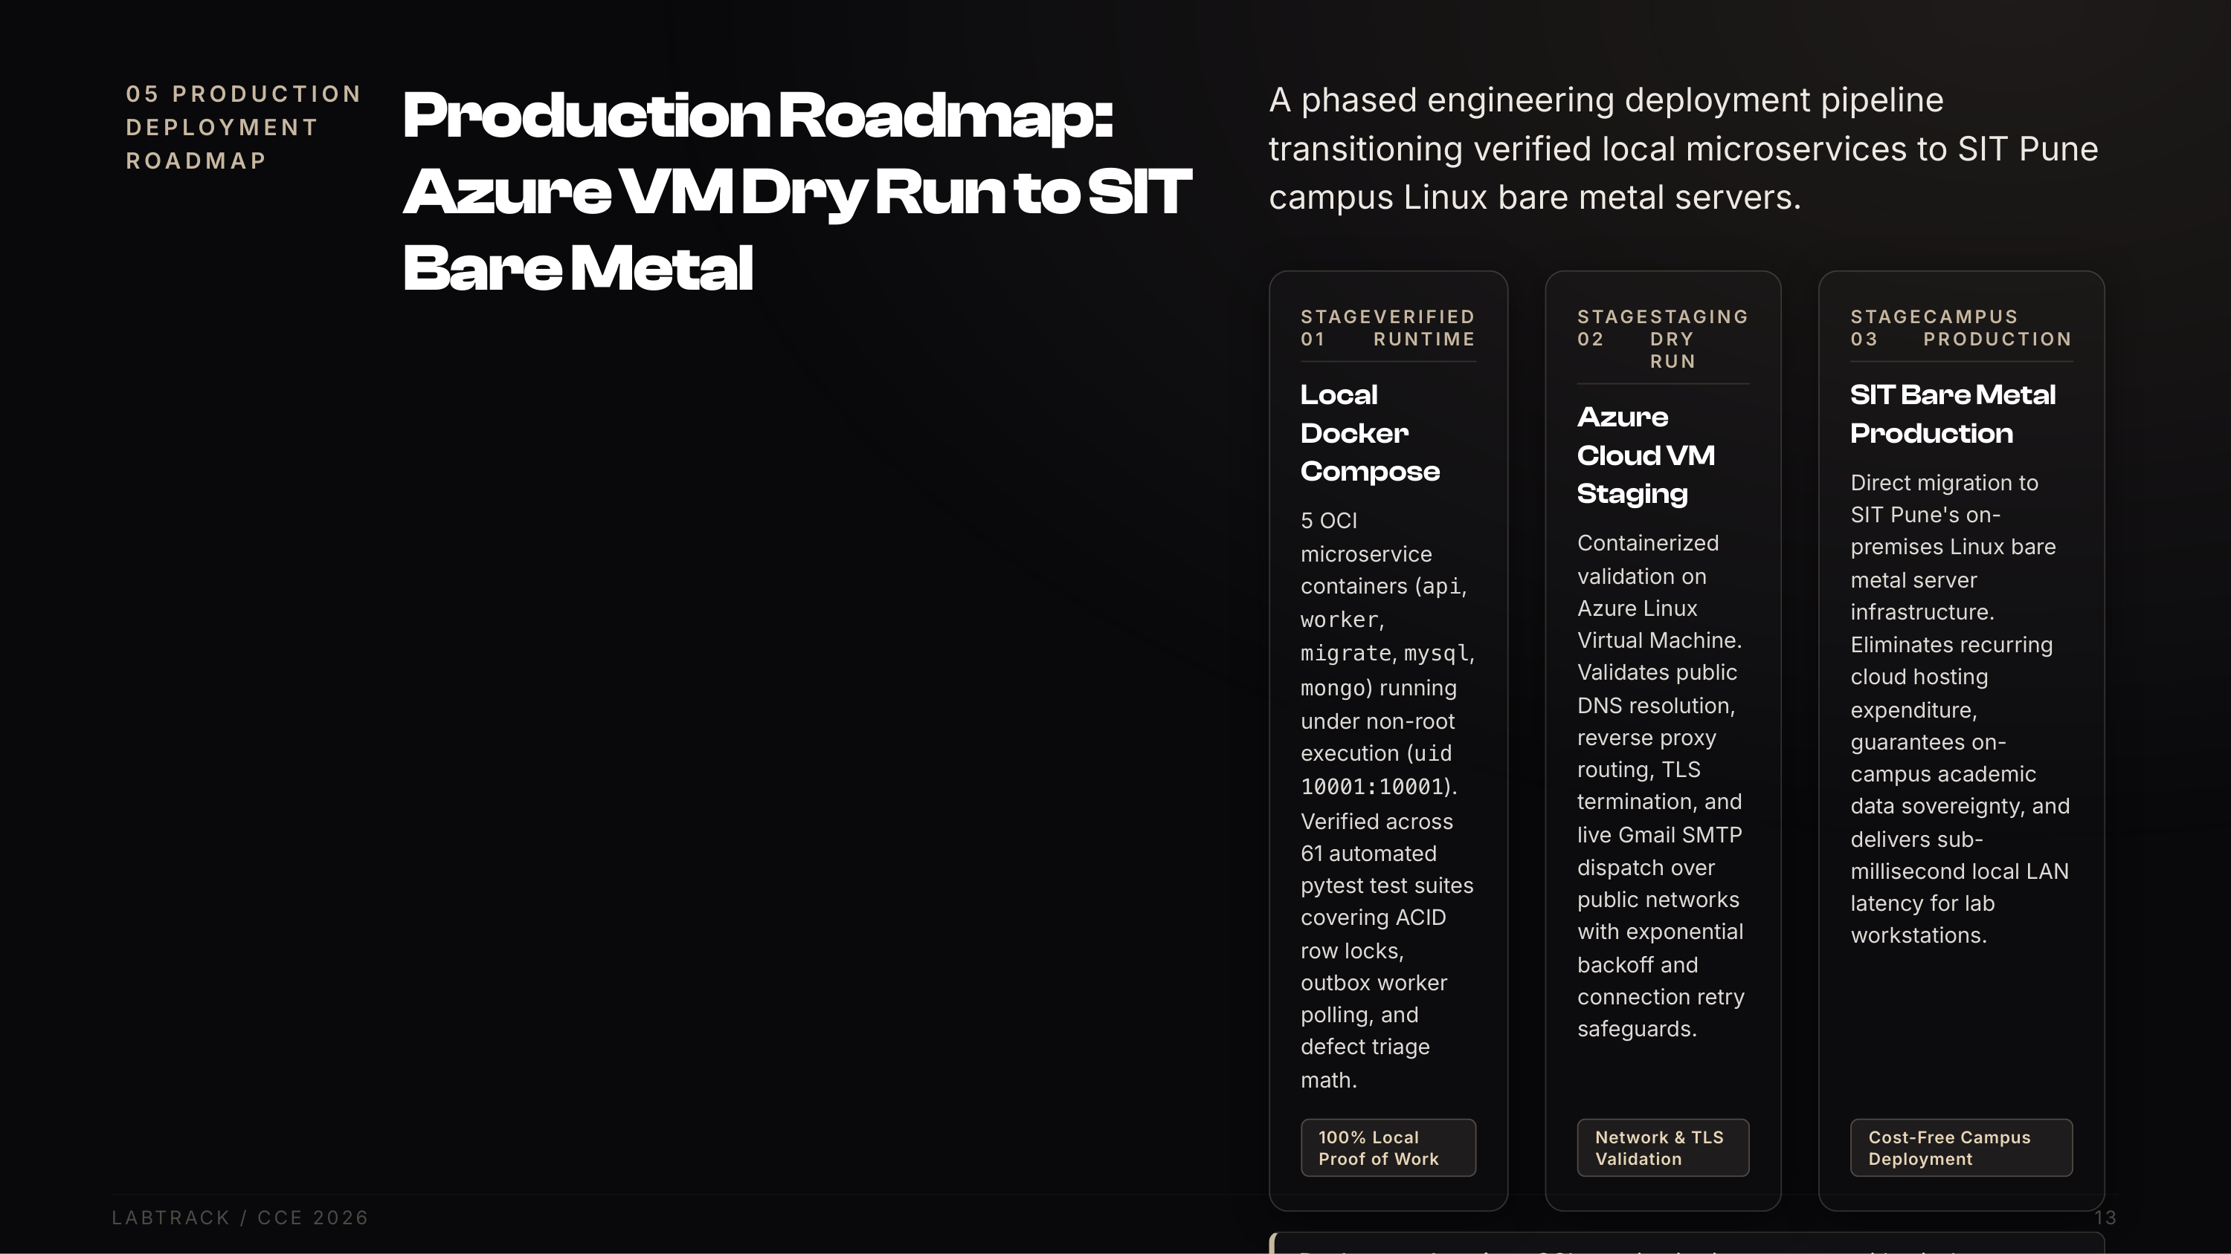
Notes:
Explain our 3-stage production deployment pipeline: We start with verified local Docker Compose (61 tests passing), dry-run in an Azure VM to validate public DNS and SMTP, then deploy directly onto SIT Pune existing bare metal server infrastructure on campus. This eliminates cloud hosting fees and ensures full data sovereignty.

Slide 14
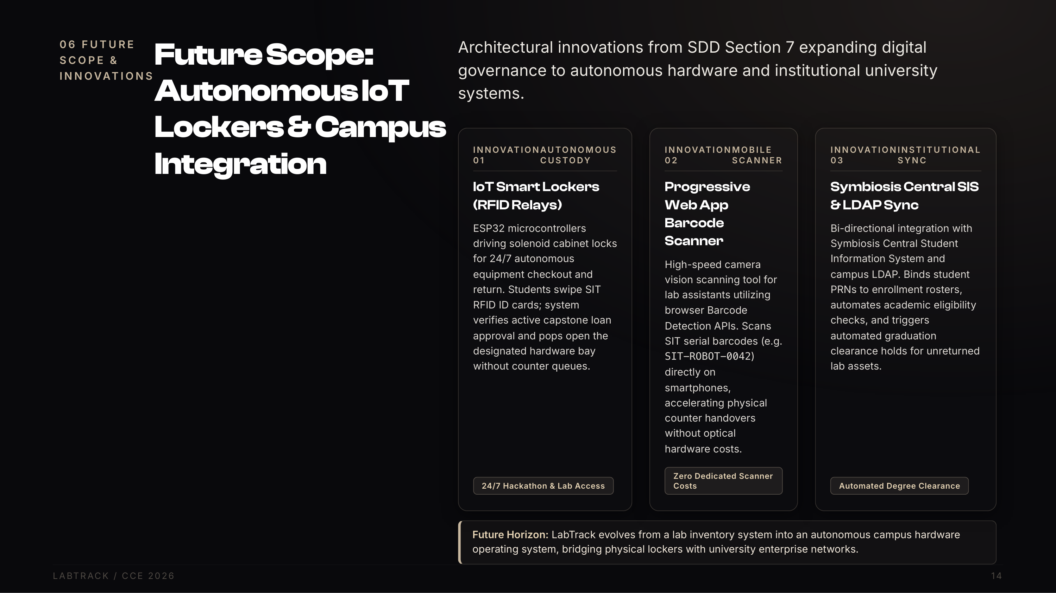
Notes:
Walk through our dedicated future scope: IoT smart lockers driven by ESP32 microcontrollers for 24/7 RFID checkout, a progressive web app mobile barcode scanner for lab assistants, and bi-directional integration with Symbiosis Central SIS to automate graduation holds on unreturned assets.

Slide 15
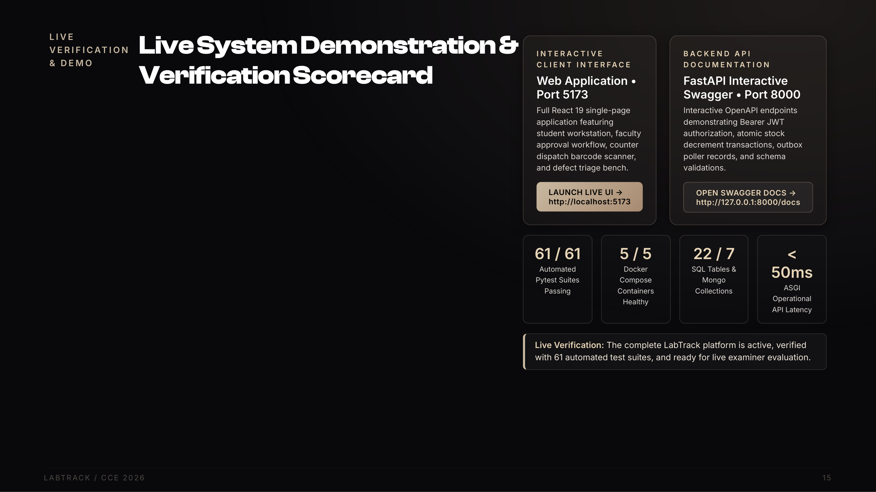
Notes:
Invite Dr. Mahender Reddy and committee members to inspect the running system: Direct link to our live web interface on port 5173, Swagger documentation on port 8000, and our 61 passing automated test suites.

Slide 16
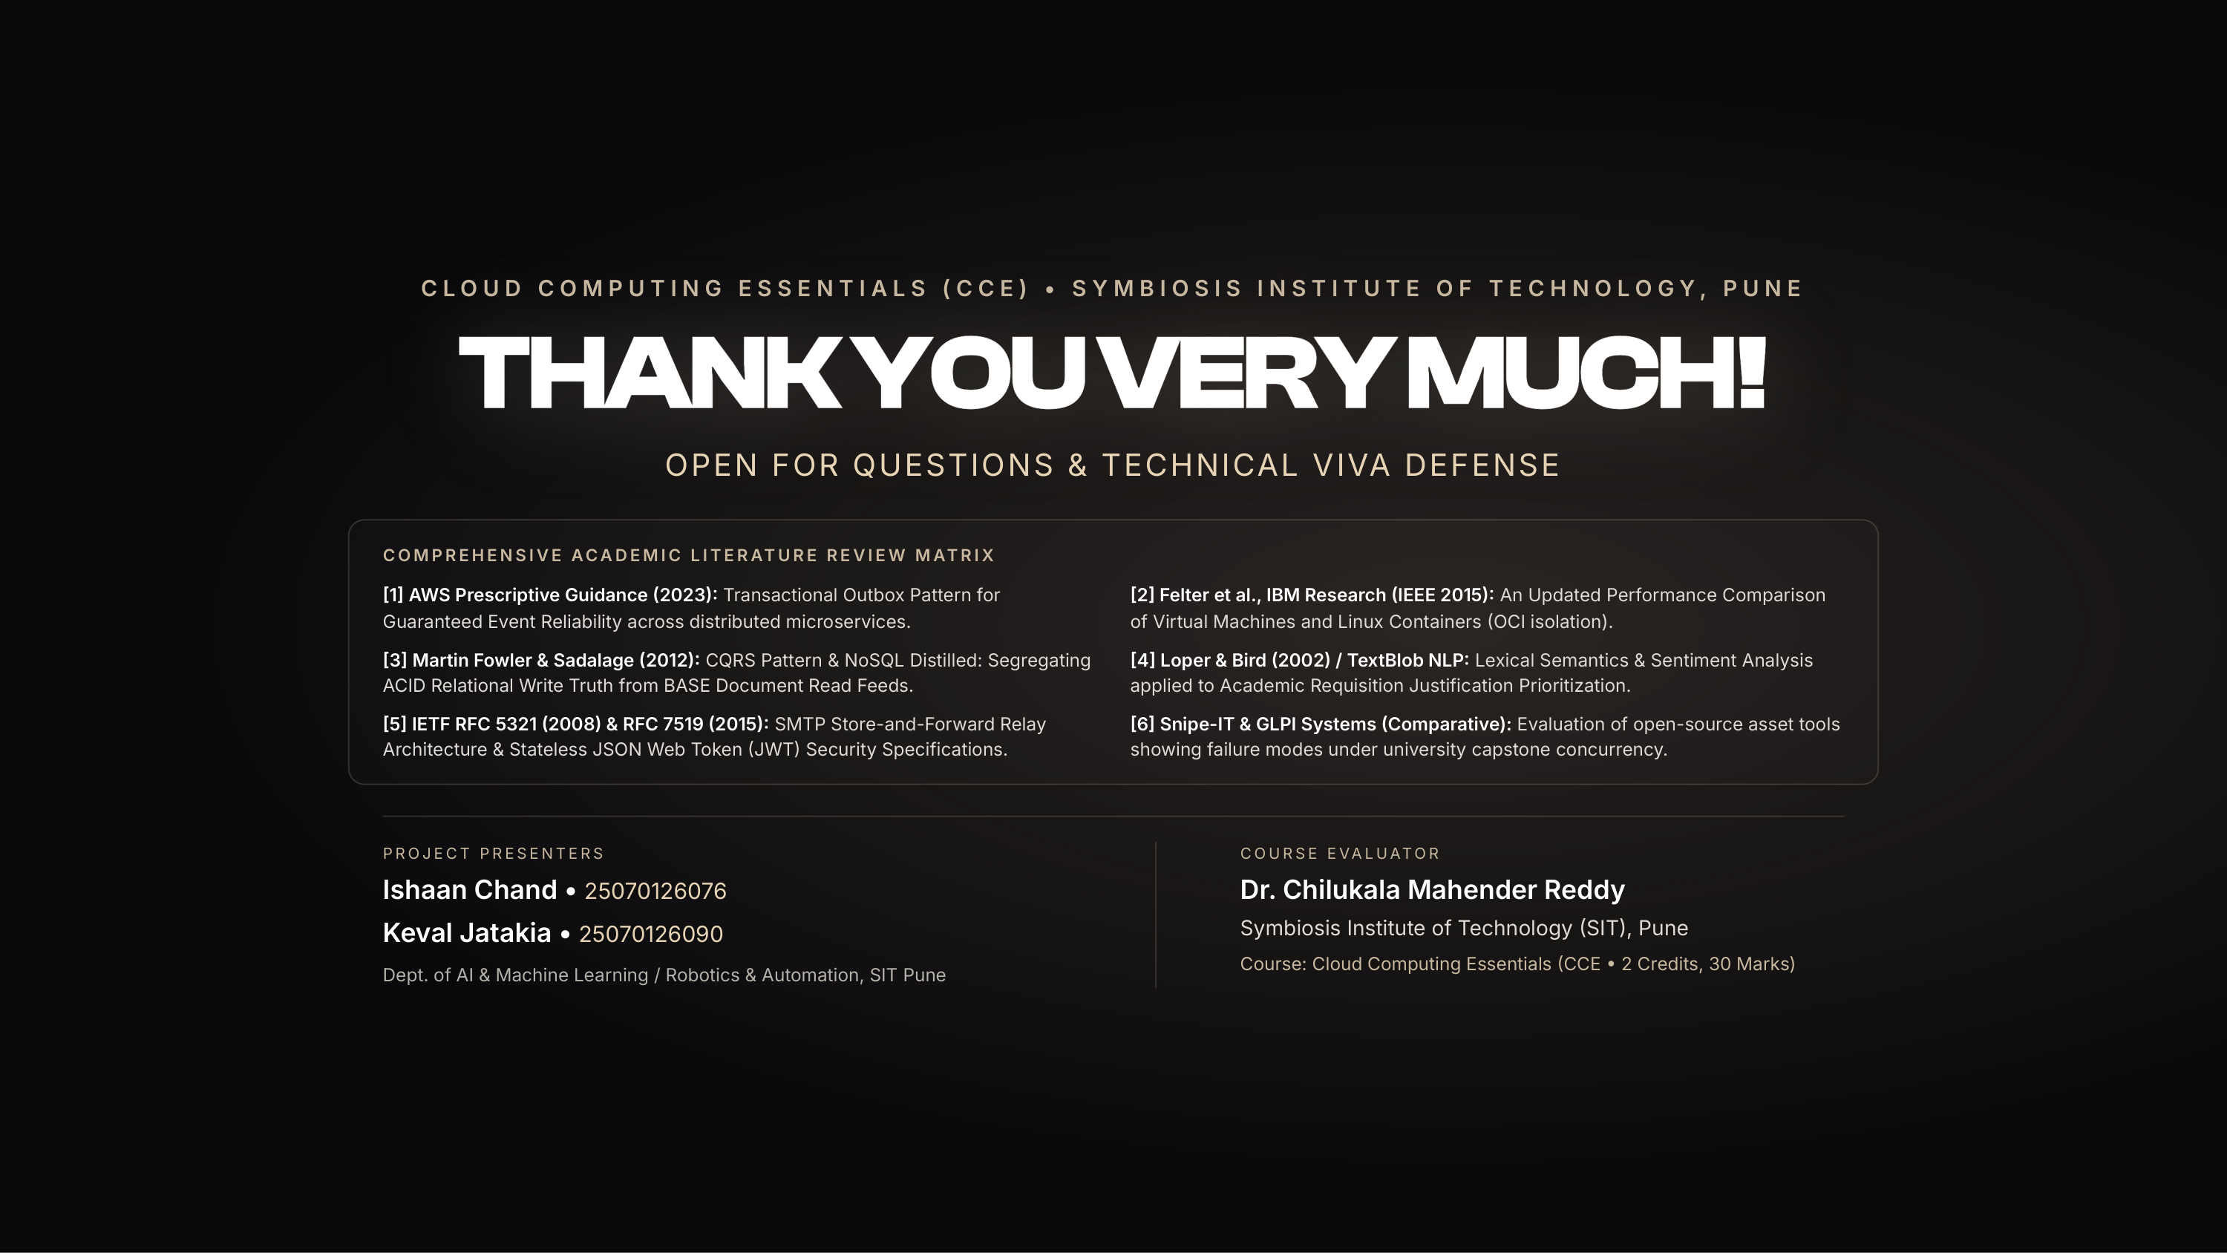
Notes:
Conclude the presentation. Thank Dr. Mahender Reddy and committee members. Highlight our comprehensive literature review covering AWS Outbox, IBM container performance, Martin Fowler CQRS, and TextBlob NLP. Open the floor for technical viva voce defense.

