Slide 1
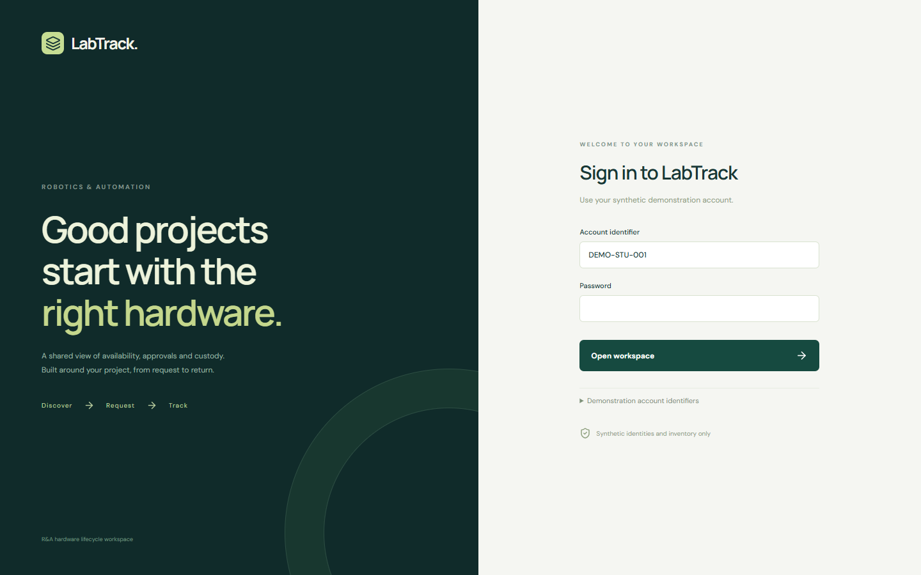
CCE + DCDS · WORKING PROTOTYPE
LabTrack.
Hardware component availability,
issuance & tracking
Project context. Physical custody.
A complete history.
Ishaan · backend / database / integration
Raghu · frontend
LABTRACK / ROBOTICS & AUTOMATION
01
Notes:
Introduce the unified R&A project. The screenshots show the implemented local prototype, not a deployed institutional system. No SDD is being presented.
Source: docs/EXECUTION_PLAN.md; docs/LabTrack_MASTER_CONTEXT.md A/D/AL
Execution date: 2026-10-15. Synthetic prototype evidence only.

Slide 2
PROBLEM & CURRENT MANUAL PROCESS
The record is spread across tools.
01
Email: project requirements and approval conversations
02
Excel: inventory availability and lab quantities
03
Notebook: physical issue and custody history
04
Manual follow-up: due dates, return checks and exceptions
LABTRACK / ROBOTICS & AUTOMATION
02
Notes:
These are the project team’s documented observations. Do not claim independently measured time savings or error rates.
Source: docs/LabTrack_MASTER_CONTEXT.md B
Execution date: 2026-10-15. Synthetic prototype evidence only.

Slide 3
RESEARCH & LITERATURE CONTEXT
Existing patterns, a department-specific workflow.
Primary reference | Established pattern | LabTrack application
Snipe-IT documentation | Asset check-in / check-out | Physical-unit custody history
GLPI reservations | Equipment reservation slots | R&A inventory queue context
AWS outbox guidance | Database + event consistency | SQL transaction / notification boundary
Project contribution: academic project ownership, class-specific faculty routing
and quantity-aware lab fulfilment in one R&A lifecycle.
LABTRACK / ROBOTICS & AUTOMATION
03
Notes:
References show existing patterns; no claim of absent competitor features or first-of-kind novelty. Snipe-IT: https://snipe-it.readme.io/docs/overview ; GLPI: https://help.glpi-project.org/documentation/modules/tools/reservations ; AWS: https://docs.aws.amazon.com/prescriptive-guidance/latest/cloud-design-patterns/transactional-outbox.html
Source: docs/RESEARCH_REFERENCES.md
Execution date: 2026-10-15. Synthetic prototype evidence only.

Slide 4
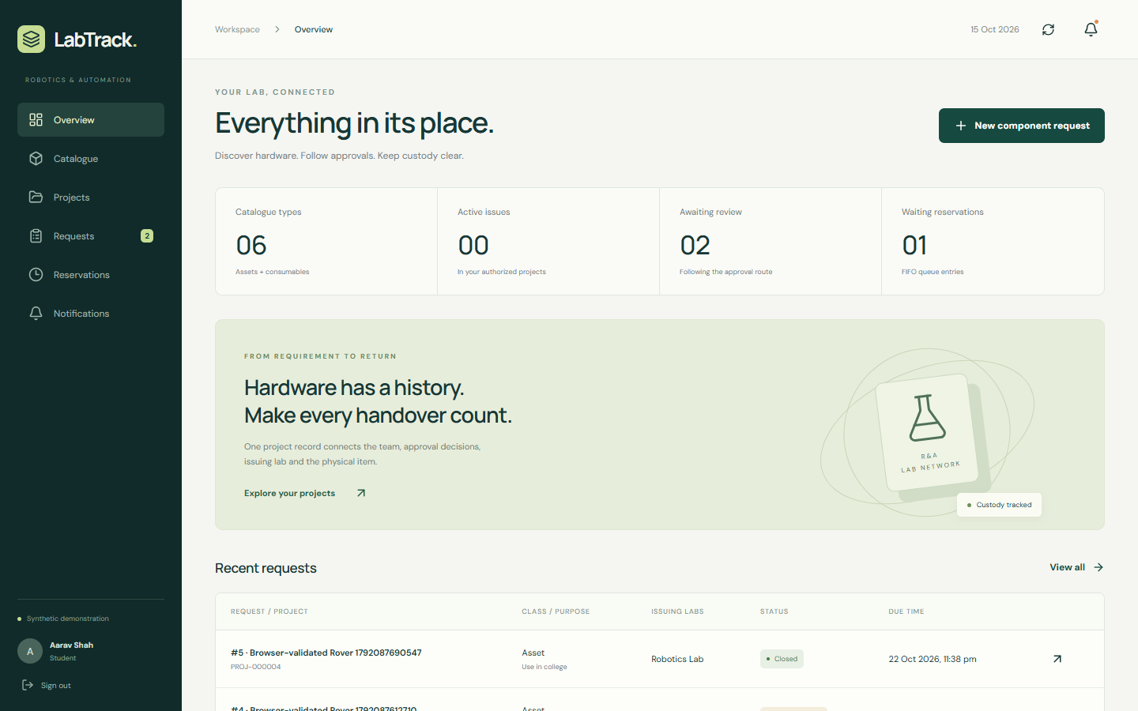
IMPLEMENTED SOLUTION
One workspace for the hardware lifecycle.
Discover stock
Submit a project request
Follow its approvals
Verify issue and return
Running local prototype
Synthetic data throughout
LABTRACK / ROBOTICS & AUTOMATION
04
Notes:
Show the running app and distinguish it from historical pitch material. Overview values are actual synthetic records, not real departmental performance statistics.
Source: src/frontend/src/main.tsx; .artifacts/demo-evidence.json
Execution date: 2026-10-15. Synthetic prototype evidence only.

Slide 5
USERS & RESPONSIBILITY
The right actor at each step.
Actor | Recorded responsibility
Student / Project Lead | Project team, requirements and request submission
Faculty Mentor | First approve / reject review
Lab In-Charge | Asset-side faculty review; assigned labs
HoD | Normal final approval; R&A-wide visibility
Lab Assistant | Physical verification, issue and inspection
Technical Admin | Setup, configuration and deployment support
LABTRACK / ROBOTICS & AUTOMATION
05
Notes:
Central Store is a system/inventory-management stage, not a separate user role. General HoD overwrite, discretionary reordering and administrative stock changes remain policy-bounded; the app does not expose an unrestricted editor.
Source: docs/LabTrack_MASTER_CONTEXT.md E/O/UAQ23–25
Execution date: 2026-10-15. Synthetic prototype evidence only.

Slide 6
APPROVAL WORKFLOW
Approval and physical issue stay distinct.
CONSUMABLES
Student → Mentor → Central Store → HoD
→ Lab Assistant → Physical issue
ASSETS
Student → Mentor → Lab In-Charge → HoD
→ Lab Assistant → Asset use / issue
LABTRACK / ROBOTICS & AUTOMATION
06
Notes:
These single-class routes are executable. Mixed-class approvals and multiple asset In-Charges remain open. Email links to the website; it does not authorize approval. Normal HoD stage cannot be skipped.
Source: docs/LabTrack_MASTER_CONTEXT.md L/O; src/backend/labtrack/service.py
Execution date: 2026-10-15. Synthetic prototype evidence only.

Slide 7
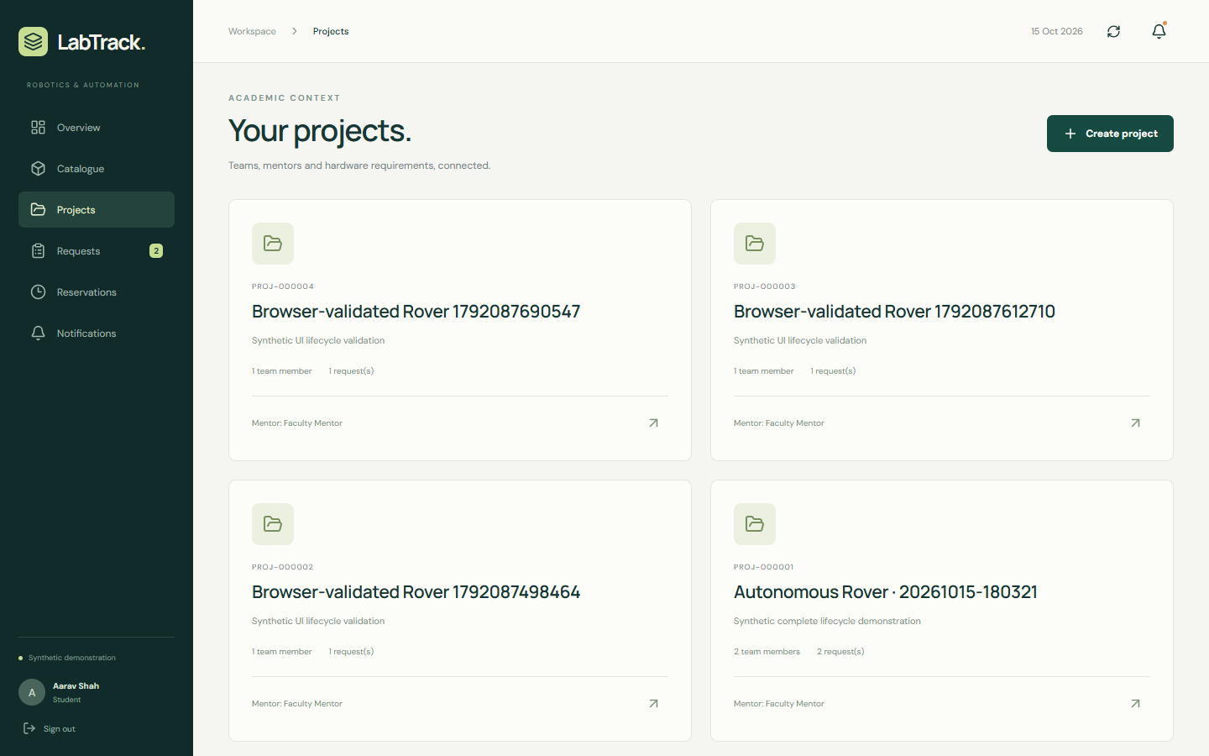
PROJECT-BASED MANAGEMENT
Hardware requests belong to a project.
01
Immutable Project ID
02
Student lead and members
03
Assigned Faculty Mentor
04
Linked request history
LABTRACK / ROBOTICS & AUTOMATION
07
Notes:
The UI creates a synthetic project with a sequential PROJ identifier. Post-submission editing, lead transfer and custody-affecting membership changes are held at the open business boundary.
Source: docs/LabTrack_MASTER_CONTEXT.md PART A3/F/UAQ23; src/backend/labtrack/models.py
Execution date: 2026-10-15. Synthetic prototype evidence only.

Slide 8
INVENTORY MODEL
Assets and Consumables are different.
Concern | Assets | Consumables
Identity | SIT Barcode / physical unit | Catalogue type / per-lab quantity
Procurement | Default ID + shared Bill Number | Optional procurement metadata
Examples | Jetson Nano, Robotic Arm | Sensors, motors, batteries
Availability | Unit state and lab | Good quantity by lab
Return | Unit condition + functional test | Good / bad / missing quantities
Consumables are returnable. Active physical lab stock = good + bad.
LABTRACK / ROBOTICS & AUTOMATION
08
Notes:
Assets retain individual history. A bill may cover multiple physical units. Consumables are not forced into per-unit identity and are not defined as disposable.
Source: docs/LabTrack_MASTER_CONTEXT.md G/H/W
Execution date: 2026-10-15. Synthetic prototype evidence only.

Slide 9
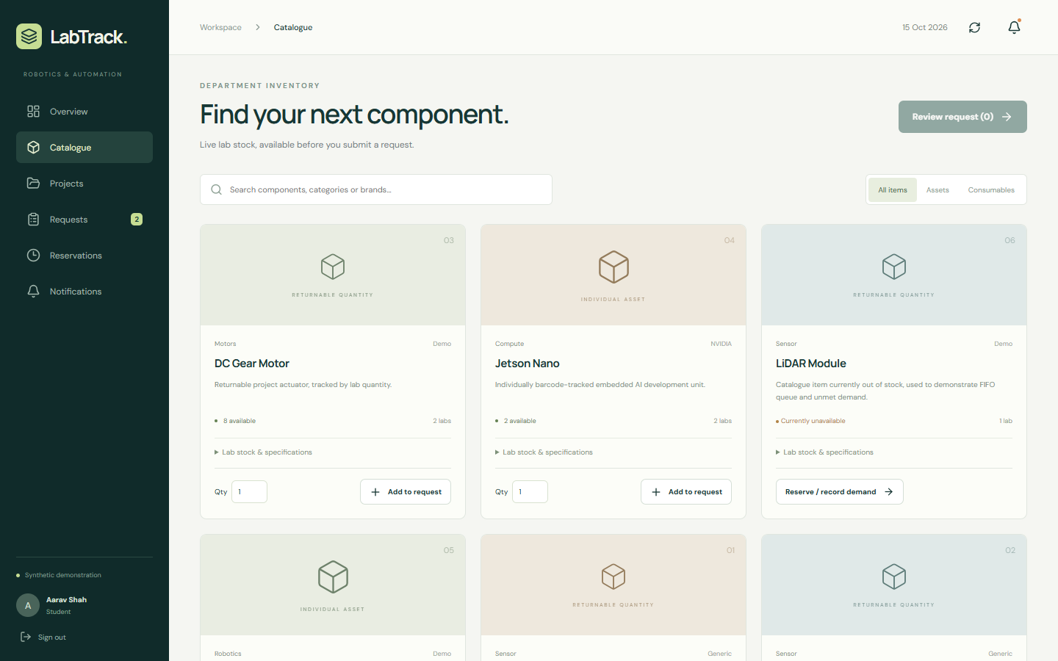
AVAILABILITY & REQUESTS
Check stock before submitting.
Current quantity and candidate labs are informative; issue-time revalidation is authoritative.
LABTRACK / ROBOTICS & AUTOMATION
09
Notes:
The screenshot shows the implemented catalogue, class filters and lab detail controls. Out-of-stock items can be enrolled in FIFO or recorded as demand. Reservation pickup/holds are not represented as complete.
Source: docs/LabTrack_MASTER_CONTEXT.md J/K/L1; src/frontend/src/main.tsx
Execution date: 2026-10-15. Synthetic prototype evidence only.

Slide 10
MINIMUM-LAB FULFILMENT
Use the fewest feasible issuing labs.
Synthetic example | Robotics Lab | Automation Lab | Required
HC-SR04 sensors | 8 good | 5 good | 4
DC gear motors | 2 good | 6 good | 4
Automation Lab can supply both quantities.
One lab is sufficient; Robotics Lab alone is not.
Objective order: lab count → stock concentration → stable lab ID.
LABTRACK / ROBOTICS & AUTOMATION
10
Notes:
All quantities are synthetic fixture values. Exact subset search is practical at the documented prototype scale. Plans do not reserve stock. Allocation within the selected set is deterministic; no automatic replan occurs after approval.
Source: fixtures/demo.json; docs/LabTrack_MASTER_CONTEXT.md I1; tests/test_workflows.py::test_plan_optimizes_labs_and_does_not_mutate
Execution date: 2026-10-15. Synthetic prototype evidence only.

Slide 11
PHYSICAL PROCESSING
The full request commits together.
ALL LABS. ALL APPROVED LINES.
01
Assistant claims and verifies the operational order.
02
Backend locks and rechecks every stock row / asset.
03
Inventory + issue + audit + outbox commit atomically.
04
A shortage in any line prevents every inventory mutation.
LABTRACK / ROBOTICS & AUTOMATION
11
Notes:
User explicitly confirmed “Entire request across all labs” on 2026-10-15. Race tests validate the software boundary. Actual physical handover must be confirmed together; multi-operator coordination remains open and is not solved by a SQL transaction alone.
Source: docs/ASTRA/EXECUTION_AUTHORIZATION.md; tests/test_workflows.py::test_whole_request_shortage_never_partially_mutates
Execution date: 2026-10-15. Synthetic prototype evidence only.

Slide 12
DUE DATES & EXTENSIONS
History stays intact when time changes.
Capability | Current execution status
Requested duration | Student input; due time starts at confirmed issue
Extension request | Original class-specific approval path
Pending extension | Current due date remains authoritative
Approved extension | New due-date version; previous date retained
Reminder policy | T−5 and daily overdue documented; calendar automation held
V1 configuration | 2 extensions; 48h collection; 24h reservation expiry value
LABTRACK / ROBOTICS & AUTOMATION
12
Notes:
Do not describe an active automatic reminder service. Calendar boundaries, catch-up semantics and overdue extensions remain OD-11. Reservation fulfilment/hold rules remain OD-04, independent of the configured expiry value.
Source: docs/LabTrack_MASTER_CONTEXT.md R/S/T/U/V; docs/EXECUTION_DECISIONS.md
Execution date: 2026-10-15. Synthetic prototype evidence only.

Slide 13
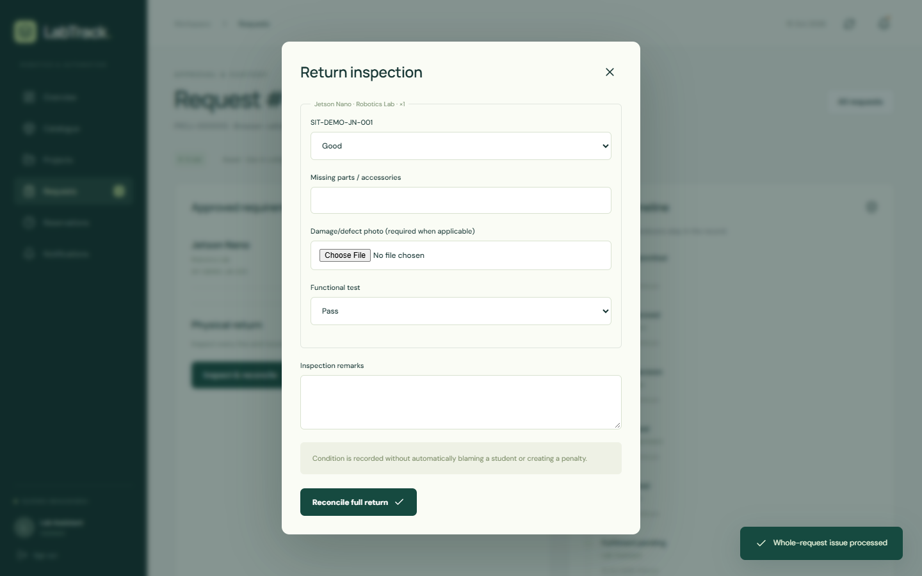
RETURN & INSPECTION
Close custody with physical evidence.
01
Inspect every issued line.
02
Record good, bad or missing quantities.
03
Verify each asset and its condition.
04
Reconcile stock and preserve the incident record.
LABTRACK / ROBOTICS & AUTOMATION
13
Notes:
Damaged/defective asset inspection requires a photo; upload uses a replaceable storage boundary. Full ordinary returns are executable. Staged/cross-lab returns, repair authority and retained-project approval remain open.
Source: docs/LabTrack_MASTER_CONTEXT.md W; tests/test_workflows.py::test_asset_damage_requires_evidence_and_no_auto_blame
Execution date: 2026-10-15. Synthetic prototype evidence only.

Slide 14
ACCOUNTABILITY
Record the incident before assigning blame.
01
Inspection records link the item, project and original issue.
02
Condition history is preserved without automatic student fault.
03
Authorized faculty can review relevant incident records.
04
No automatic fine, access block or FIFO penalty is created.
Numeric REPO / NLP and retention authorization remain explicit business decisions.
LABTRACK / ROBOTICS & AUTOMATION
14
Notes:
The numeric score has contradictory scope statements in the supplied context. This presentation does not announce it as implemented. Normal wear cannot automatically be treated as misconduct. Retained-in-project no-second-decrement rule is preserved as a guardrail, but the action awaits an authorized acceptance role.
Source: docs/ASTRA/05_OPEN_DECISIONS.md OD-13/16; docs/LabTrack_MASTER_CONTEXT.md X/Y/Z
Execution date: 2026-10-15. Synthetic prototype evidence only.

Slide 15
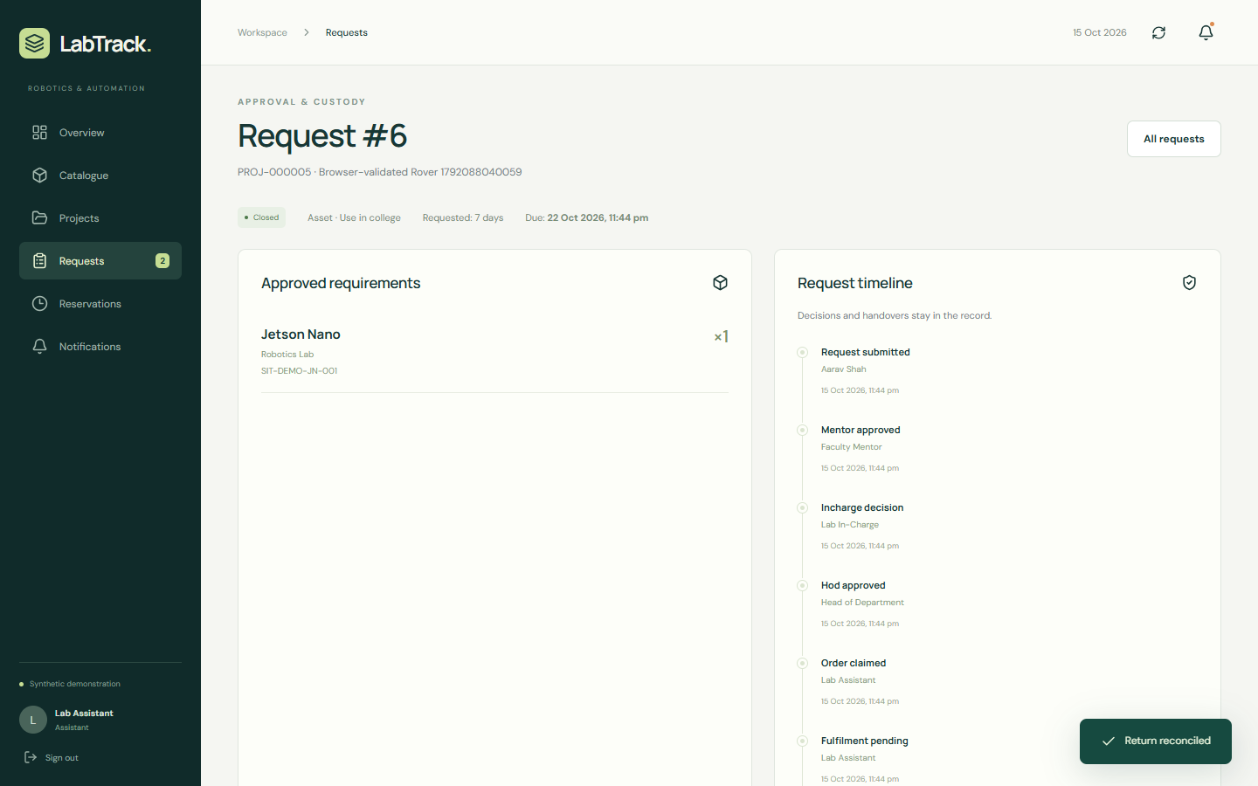
AUDIT & HISTORY
Every decision remains traceable.
Actor and timestamp
Previous and new state
Approval remarks
Issue and return events
Due-date versions
Raw audit records are append-only.
LABTRACK / ROBOTICS & AUTOMATION
15
Notes:
The screen is from the browser-validated asset lifecycle. Audit is in SQL with domain state and outbox; Mongo receives non-authoritative projections. No silent historical overwrite endpoint is provided.
Source: src/backend/labtrack/models.py Audit; src/backend/labtrack/service.py; .artifacts/browser/browser-evidence.json
Execution date: 2026-10-15. Synthetic prototype evidence only.

Slide 16
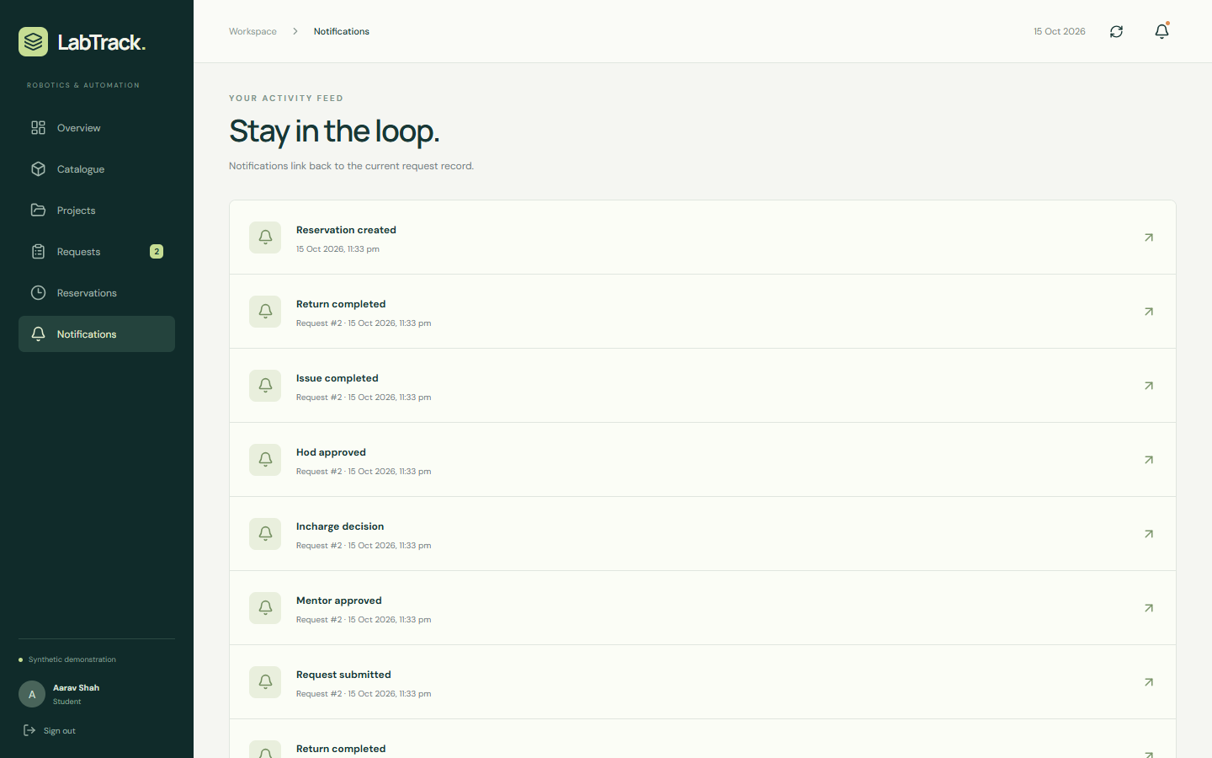
NOTIFICATIONS & UNMET DEMAND
One event, independent delivery channels.
Domain transaction
↓
SQL outbox
↓
In-app + email delivery
Local mail previews are working.
Gmail and Mongo require configured services.
Shortages feed demand analytics.
LABTRACK / ROBOTICS & AUTOMATION
16
Notes:
Outbox replay tests validate independent local channel recovery and deduplication. A failed channel does not reverse domain state. External Gmail ambiguous sends require operator review; exactly-once email is not claimed. Central Store is not a new application role.
Source: docs/LabTrack_MASTER_CONTEXT.md AA/AB; src/backend/labtrack/worker.py
Execution date: 2026-10-15. Synthetic prototype evidence only.

Slide 17
TECHNICAL ARCHITECTURE
Business truth has one owner.
Layer | Recorded direction | What ran in this session
Web | React + Vite + TypeScript | Built client + browser lifecycle
API | FastAPI / Pydantic / OpenAPI | Authenticated API + generated types
Transactional data | MySQL 8.4 / SQLAlchemy / Alembic | SQLite local profile + migration checks
Documents / analytics | MongoDB projections / aggregations | Local adapter; Mongo artifacts prepared
Packaging / delivery | Docker / GitHub Actions | Configuration prepared; engine unavailable
AWS primary · Azure isolated staging · GCP read-only — documented roles, no live deployment claim.
LABTRACK / ROBOTICS & AUTOMATION
17
Notes:
The local profile is explicitly distinct from MySQL/Mongo integration. Docker Desktop engine was unavailable; container builds and cloud service behavior were not verified. No institutional production rollout or DR readiness is claimed.
Source: docs/LabTrack_MASTER_CONTEXT.md AK/AF/BL; docs/RUN_GUIDE.md
Execution date: 2026-10-15. Synthetic prototype evidence only.

Slide 18
AI-ASSISTED SUPPORT
Advice stays behind inventory validation.
01
Curated alternatives are matched against technical metadata.
02
Current MySQL / local SQL stock is checked before display.
03
Optional AI may explain and rank the allowed candidates.
04
AI never approves, issues, changes stock or reorders FIFO.
Implemented: deterministic catalogue alternatives.
External BrowserAPIFree / ChatGPT adapter remains unconnected.
LABTRACK / ROBOTICS & AUTOMATION
18
Notes:
AI is not the product authority or the main project identity. Metadata compatibility filtering is intentionally conservative; advice is not a guarantee of electrical/mechanical suitability. No external AI service was exercised.
Source: docs/LabTrack_MASTER_CONTEXT.md M/N; src/backend/labtrack/api.py alternatives
Execution date: 2026-10-15. Synthetic prototype evidence only.

Slide 19
ACADEMIC RELEVANCE
A running application supports the rubric.
DCDS criterion | Evidence prepared | Marks
Design + functionality | Project-based lifecycle and role boundaries | 2
Python implementation | Modular API/services, validation, file handling | 2
SQL + NoSQL | MySQL/Mongo artifacts; local runtime disclosed | 2
Advanced querying | Joins/grouping, stored routine, Mongo aggregation | 2
Code / docs + testing / security | Execution docs, contracts, race/negative tests | 1 + 1
CCE: topic 5 · research 5 · presentation 5 · running example 10 · viva 5
LABTRACK / ROBOTICS & AUTOMATION
19
Notes:
Official DCDS: 10 marks, 40%, tentative 26–30 Oct 2026. CCE: 30 marks, tentative 19 Oct 2026. SQL/NoSQL connection and stored routine still require the actual database services; do not claim that local substitute validates those scoring criteria.
Source: docs/DCDSL Evaluation Plan_with detailed rubrics.pdf pp1–3; docs/Evaluation_Plan_Cloud_Computing_Essentials.pdf pp1–2
Execution date: 2026-10-15. Synthetic prototype evidence only.

Slide 20
RUNNING EXAMPLE
Autonomous rover: request to return.
01
Student creates project, selects mentor and enters components.
02
Mentor → class-specific stage → HoD approval.
03
Assistant claims, verifies and confirms full issue.
04
Extension preserves due-date history; return closes custody.
05
Unavailable LiDAR demonstrates FIFO enrollment and demand.
LABTRACK / ROBOTICS & AUTOMATION
20
Notes:
Use docs/DEMO_RUNBOOK.md or scripts/demo_flow.py. API demo completed 13 checks; browser script exercises actual forms and roles. Both asset and consumable branches use synthetic data. Open http://127.0.0.1:8000 for the current local demo.
Source: scripts/demo_flow.py; scripts/browser_demo.mjs; .artifacts/demo-evidence.json
Execution date: 2026-10-15. Synthetic prototype evidence only.

Slide 21
BOUNDARIES & FUTURE SCOPE
Finish the policy before expanding automation.
Needs department decision | Future / institutional integration
Reservation holds and pickup progression | Institutional authentication and master data
Calendar catch-up and late extensions | College-managed infrastructure / cloud approval
Retention approval and staged returns | Asset transfers / cross-department governance
REPO score, attribution and optional NLP | Mobile / Play Store, procurement and payments
The working prototype continues independently at every defined boundary.
LABTRACK / ROBOTICS & AUTOMATION
21
Notes:
These boundaries are explicit rather than silently invented. The user authorized project execution independently of the pending canonical SDD gate. The presentation is not itself an implementation specification.
Source: docs/EXECUTION_DECISIONS.md; docs/ASTRA/EXECUTION_AUTHORIZATION.md
Execution date: 2026-10-15. Synthetic prototype evidence only.

Slide 22
LABTRACK · QUESTIONS & DEMONSTRATION
A project record you can follow.
From the component requirement
to the physical handover
to the complete return history.
Open the running prototype.
Trace one request together.
LABTRACK / ROBOTICS & AUTOMATION
22
Notes:
Invite questions about authority, concurrency, database ownership, replaceable adapters and the boundaries of current execution. Do not claim adoption, measured benefits or live cloud deployment.
Source: docs/EXECUTION_PLAN.md; docs/DEMO_RUNBOOK.md
Execution date: 2026-10-15. Synthetic prototype evidence only.

