Slide 1
Divvy bike share system 2022
Presented by: Iryna Bilotil

Slide 2
Objective
Identify key differences in the use of bikes by casual users and members to improve marketing strategy.

Slide 3
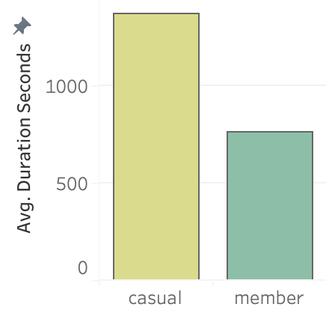
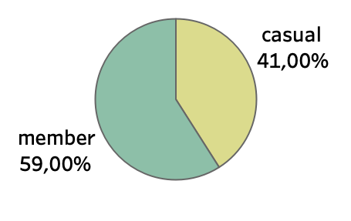
Percentage of total number of rides
Average ride duration
Users who have annual membership make rides more often, but their overall duration is shorter.
Casual users make longer rides but the total number is less.

Slide 4
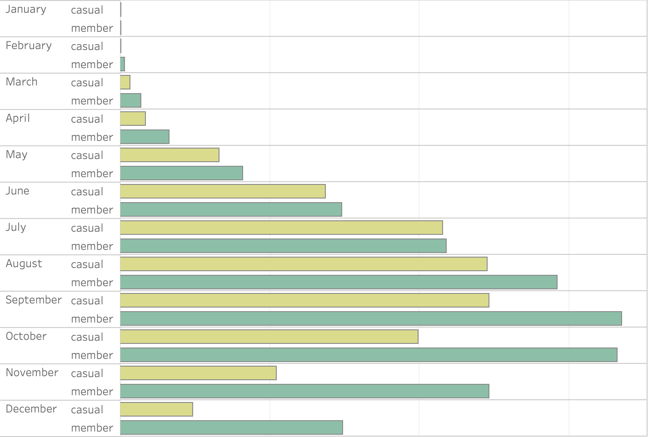
Rides grouped by month and membership
Rides depend on the season.
However, the number of trips by users who have a membership is still much higher.
.

Slide 5
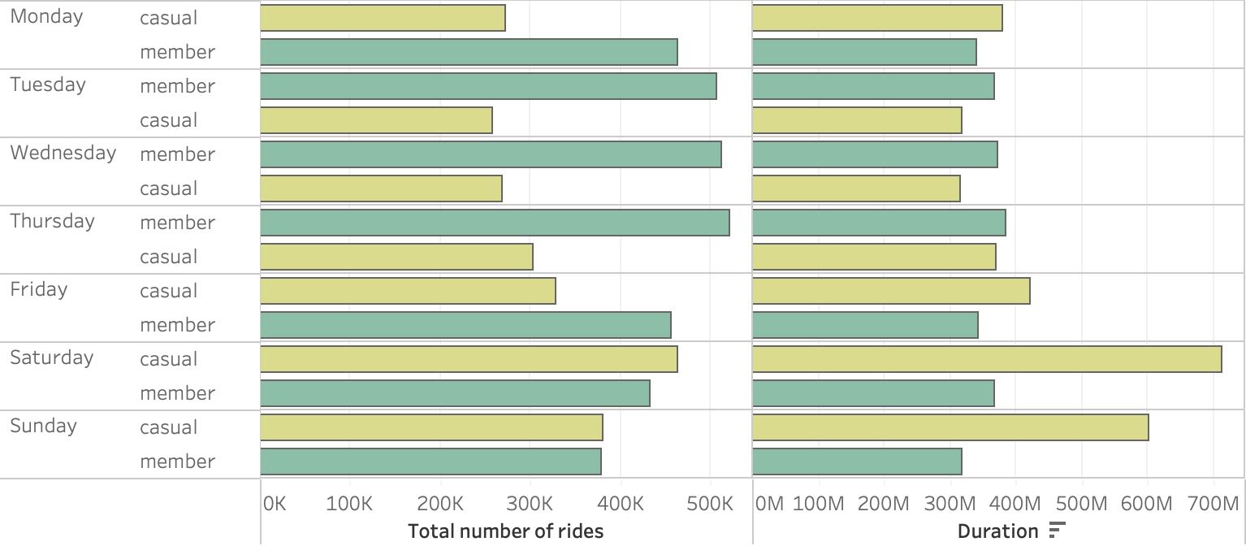
Total number of rides and duration grouped by the day of week
Users who have annual membership mostly use rides for regular daily purposes, while casual users make trips for certain special events.

Slide 6
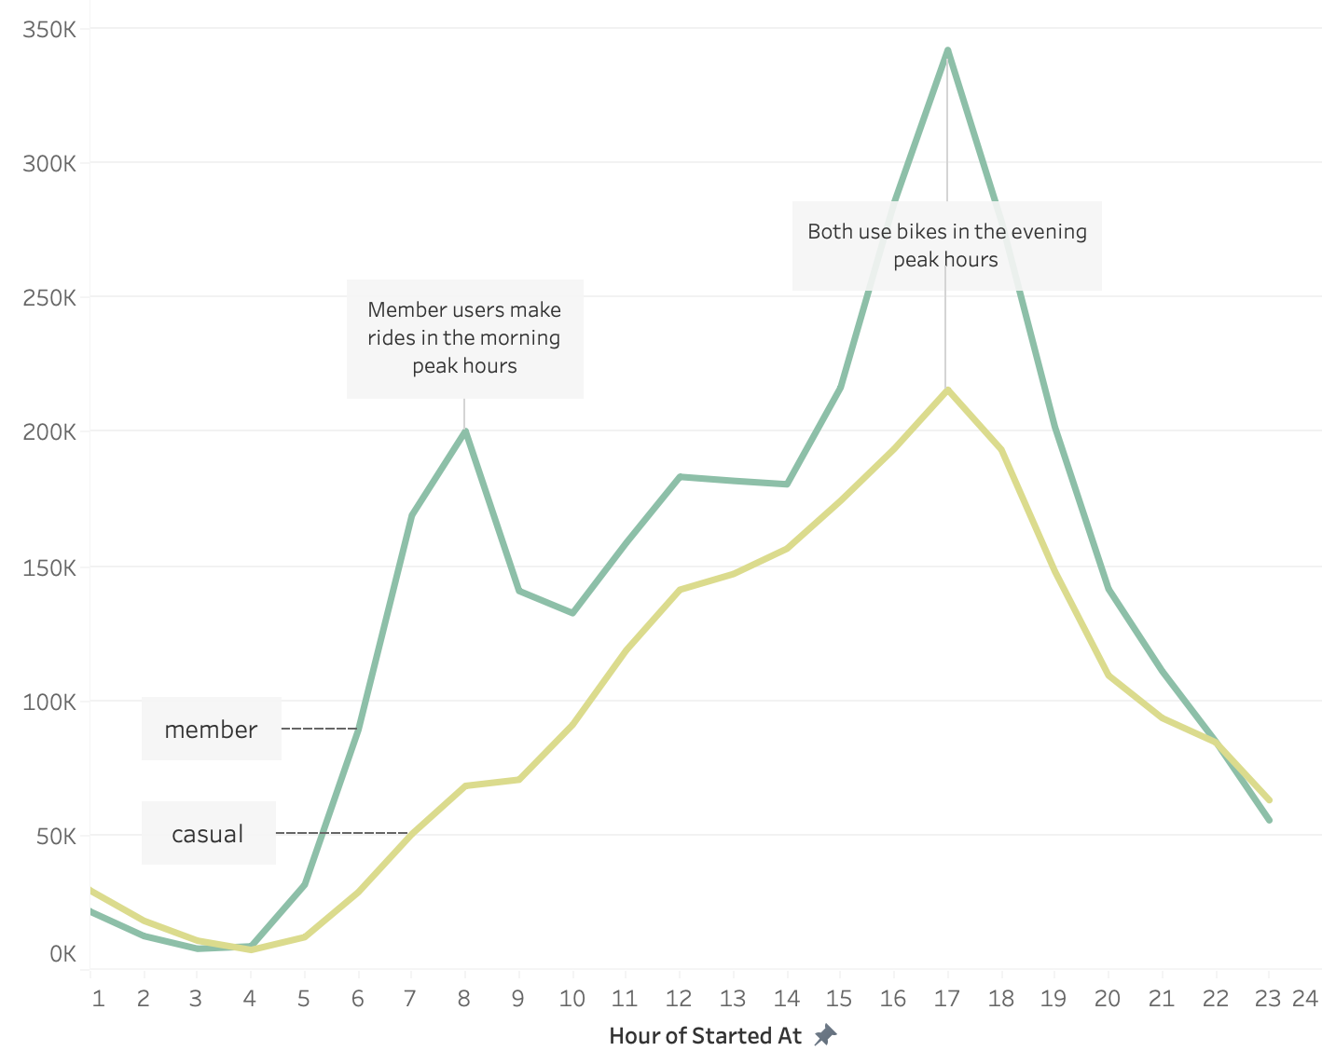
The number of casual and membership trips based on the time of day.
Most member rides are between 7am and 8am and 4pm and 8pm.
Casual users also take trips between
4 pm and 8 pm, but the number of morning trips is very low.
One more evidence that users who have a membership are people who work and commute by bike.

Slide 7
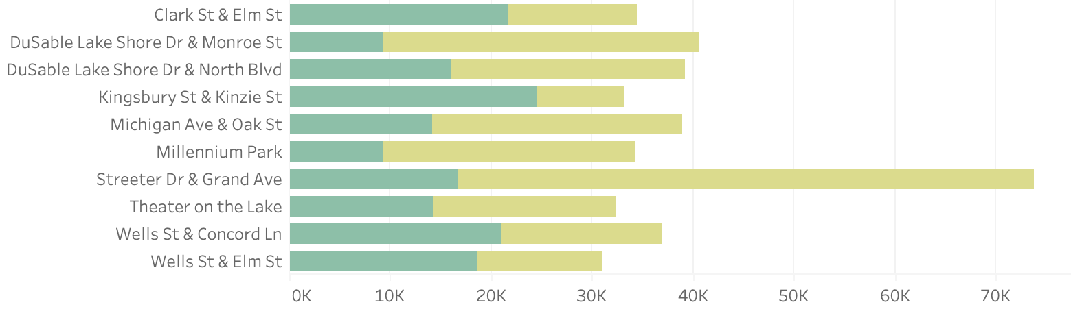
Most popular start and end stations
On these stations company can make special advertising campaigns targeted on different types of users.

Slide 8
Conclusions
The following conclusions came from the analysis on the data:
As casual users use bikes mainly during non-working hours company can make special promotions for them. For example special type of membership with lower price for trips on weekends or membership program for summertime.
Also, the company can try to attract a larger number of users to the membership program among those who want to change their commute to work. For example, introduce a special tariff for electric bikes from 6 to 9 in the morning.
Divvy can make special advertising campaigns for different types of users on the most popular stations among the certain type of users.

Slide 9
Thank you!

