Slide 1

Logging and Monitoring
Presentation created by Iryna Diudiuk

Slide 2

Plan
Purpose of Logging and Monitoring
Log Management Best Practices
Tools
Zabbix Monitoring Tool Overview
Splunk Logging Tool Overview
Practical Task
Presentation created by Iryna Diudiuk

Slide 3

Purpose of Logging and Monitoring
Need of real-time system health check
Need to react on security threat
Need to resolve infrastructure problems asap
Need for analysis of the system state (statistics)
Need for prediction of the system behavior
Need for the system to be compliant to governing regulations and standards (e. g. PCI DSS, Sarbanes-Oxley, HIPAA, GLBA, and FISMA)
Presentation created by Iryna Diudiuk
Notes:
Federal Information Security Management Act (FISMA)
The Gramm–Leach–Bliley Act (GLBA), also known as the Financial Services Modernization Act of 1999,
Payment Card Industry Data Security Standard (PCI DSS) — стандарт безпеки даних індустрії банківських платіжних карток, сукупність 12 деталізованих вимог щодо забезпечення безпеки даних про власників платіжних карток
The Health Insurance Portability and Accountability Act of 1996 (HIPAA;Preventing Health Care Fraud and Abuse; establishes policies and procedures for maintaining the privacy and the security of individually identifiable health information, outlines numerous offenses relating to health care, and establishes civil and criminal penalties for violations.

Slide 4
Log Management Best Practices
Stages of Log Management Cycle:
Policy definition
Configuration
Collection
Normalization
Indexing
Storage
Correlation
Baselining
Alerting
Reporting
Presentation created by Iryna Diudiuk

Slide 5
Log Management Best Practices
Types of logs to collect:
APPLICATIONS
AUTHENTICATION SERVERS
FIREWALLS
NETWORK DEVICES (ROUTERS, SWITCHES, ETC.)
HARDWARE MONITORING
OPERATING SYSTEMS
WEB PROXIES
Presentation created by Iryna Diudiuk

Slide 6
Log Management Best Practices
Main Challenges:
Log data is varied
Log data sources are distributed
Log data sources change constantly
Log data may contain sensitive information
Advantages of Automated Log Management:
Log collection across all IT infrastructure
Sophisticated parsing of logs
Use of Reporting tools
Ability to Perform Post-incident Analysis
Automated Regular Review
Presentation created by Iryna Diudiuk

Slide 7
Tools
Most Widely Used Tools for Monitoring:
Zabbix
Nagios
NewRelic (APM tool)
Prometheus
Monitoring for Cloud:
CloudWatch
StackDrive
Most Widely Used Tools for Logging:
ELK
Splunk
Presentation created by Iryna Diudiuk

Slide 8

Zabbix Monitoring Tool Overview
Main Components for Monitoring with Zabbix:
Zabbix Server
Zabbix Proxy
Zabbix Agent
Zabbix Web
DataBase (MYSQL, Postgre)
Presentation created by Iryna Diudiuk

Slide 9
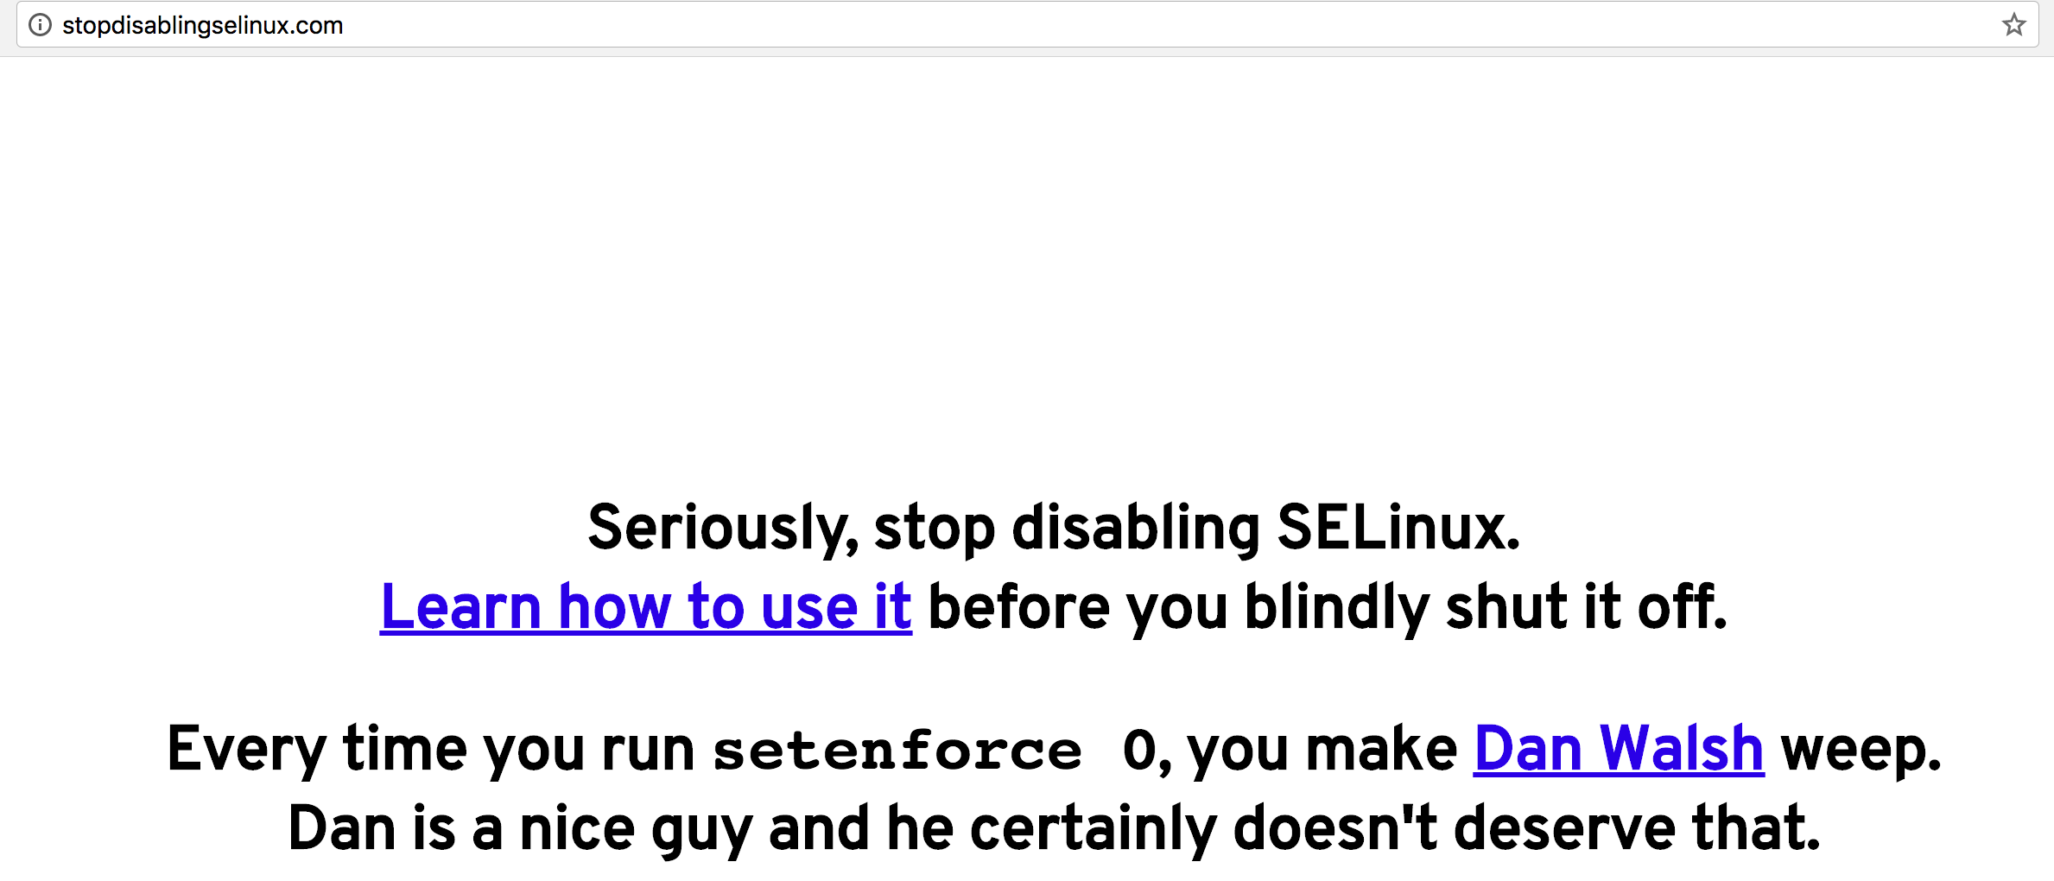

Zabbix Monitoring Tool Overview
Key points on installation:
extra PHP plugins need to be installed;
optional repository needs to be enabled (rhel-7-server-optional-rpms);
for Zabbix server and proxy daemons a database is required.
SELinux has to be disabled or properly configured :)
there can only be one Zabbix server, the load is reduced with use of proxy servers
two types of logs files: history and trends
Presentation created by Iryna Diudiuk
Notes:
history keeps each collected value
trends keep averaged information on hourly basis and therefore are less resource-hungry.
older data will be removed by the housekeeper.

Slide 10
Zabbix Monitoring Tool Overview
Zabbix Server
is the central process of Zabbix software;
performs the polling and trapping of data, calculates triggers, sends notifications;
central repository for configuration, statistical and operational data;
components of Zabbix server are: server, web frontend and database storage;
Zabbix server is designed to run as a non-root user;
UNIX is the only operating system that can consistently deliver the necessary performance, fault tolerance and resilience;
by default listens on port 10051
Presentation created by Iryna Diudiuk

Slide 11
Zabbix Monitoring Tool Overview
Zabbix Agent
gathers operational information locally and reports data to Zabbix server;
performs two types of checks:
passive - responds to a data request;
active - retrieves a list of items from ZS, and periodically sends the response.
uses two types of items 'Zabbix agent' or 'Zabbix agent (active)’.
parameters have to be configured in zabbix_agentd.conf:
Server - (e.g. 127.0.0.1)
Hostname - required for active checks, matches hostname in web interface
LogFilePath = /var/log/messages
listens on port 10050
Presentation created by Iryna Diudiuk
Notes:
file - write log to file specified by LogFile parameter,
system - write log to syslog,
console - write log to standard output.

Slide 12
Zabbix Monitoring Tool Overview
Zabbix Proxy
collects performance and availability data on behalf of Zabbix server.
an optional part of Zabbix deployment;
beneficial to distribute the load of a single Zabbix server.
if Zabbix server and proxy are installed on the same host, their databases must be created with different names
vi /etc/zabbix/zabbix_proxy.conf DBHost=localhost DBName=zabbix DBUser=zabbix DBPassword=<password>
Presentation created by Iryna Diudiuk

Slide 13

Zabbix Monitoring Tool Overview
Zabbix Web Key Notions:
Item – gather data as metrics from a host, uses keys and parameters system.cpu.load[avg5] to retrieve data.
Template - set of entities for multiple hosts (items, triggers, graphs)
Visualizations:
graph - visual representation of info based on history and trends;
network maps - overview of your infrastructure;
screen - is a table that groups information from various sources for a quick overview
Trigger - expression that defines a threshold of what state of data is “acceptable”.
Event - discovery event, trigger event, auto registration events and internal events
Presentation created by Iryna Diudiuk
Notes:
graph - visualization of data gathered by items
All users in Zabbix (including non-admin users) can create screens. Screens have an owner - the user who created them.
Screens can be made public or private. Public screens are visible to all users.
screen= simple graphs +network map, system status, data overview, clock, history of events, history of recent actions;
For both public and private screens a user must have at least read permissions to all screen elements in order to see the screen. To add an element to a screen a user must also have at least read permission to it.

Slide 14
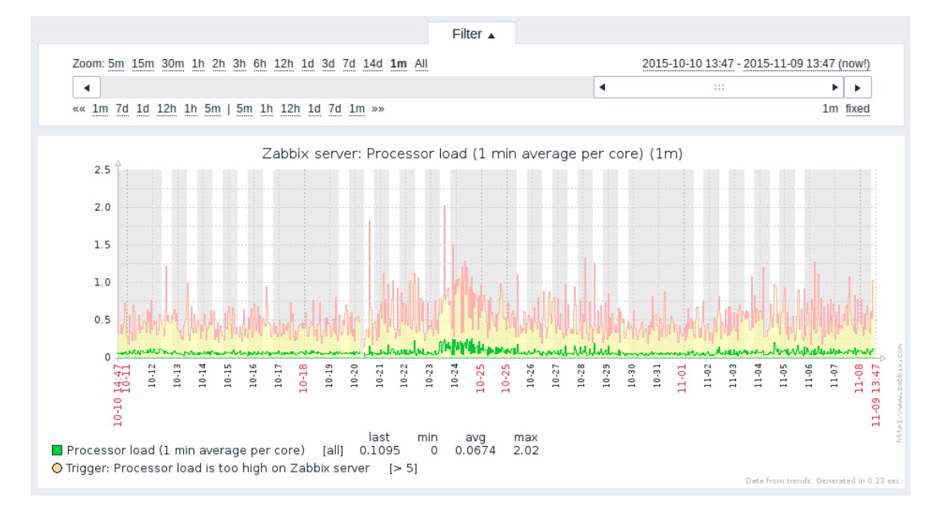
Zabbix Monitoring Tool Overview
Graph view —>
Presentation created by Iryna Diudiuk
Notes:
graph - visualization of data gathered by items

Slide 15
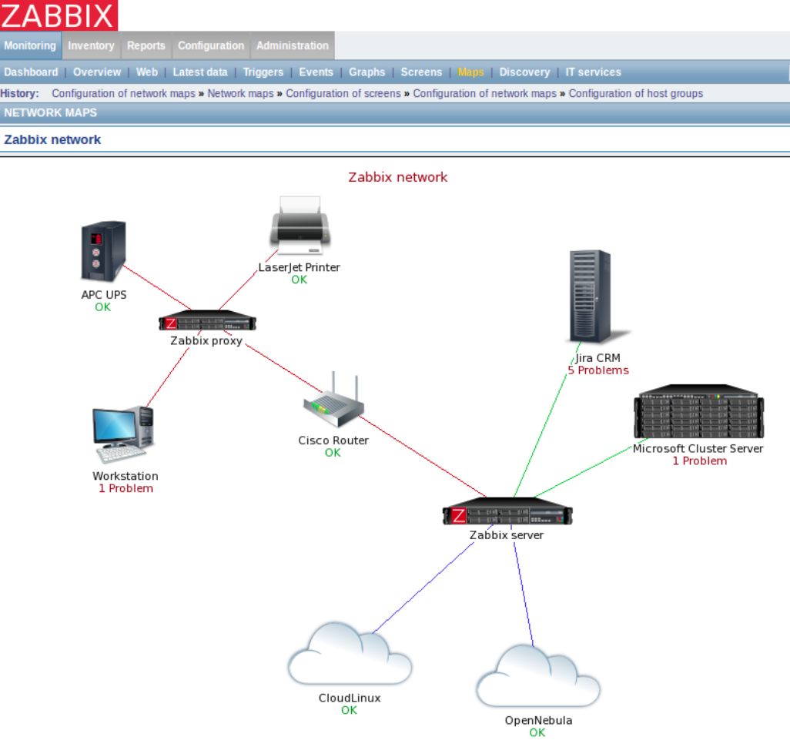
Zabbix Monitoring Tool Overview
Network Map view —>
Notes:
graph - visualization of data gathered by items

Slide 16
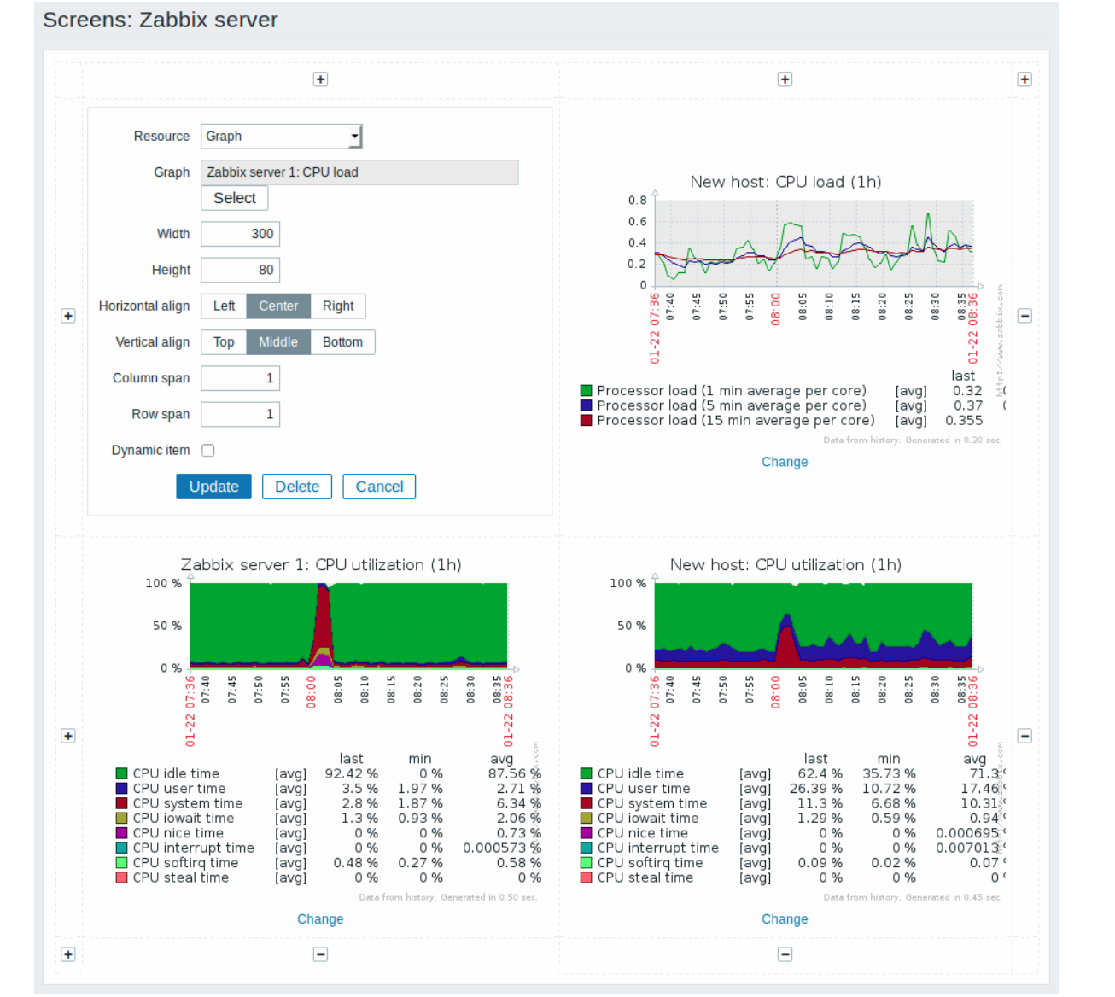
Zabbix Monitoring Tool Overview
]
Screen view —>
Notes:
graph - visualization of data gathered by items

Slide 17
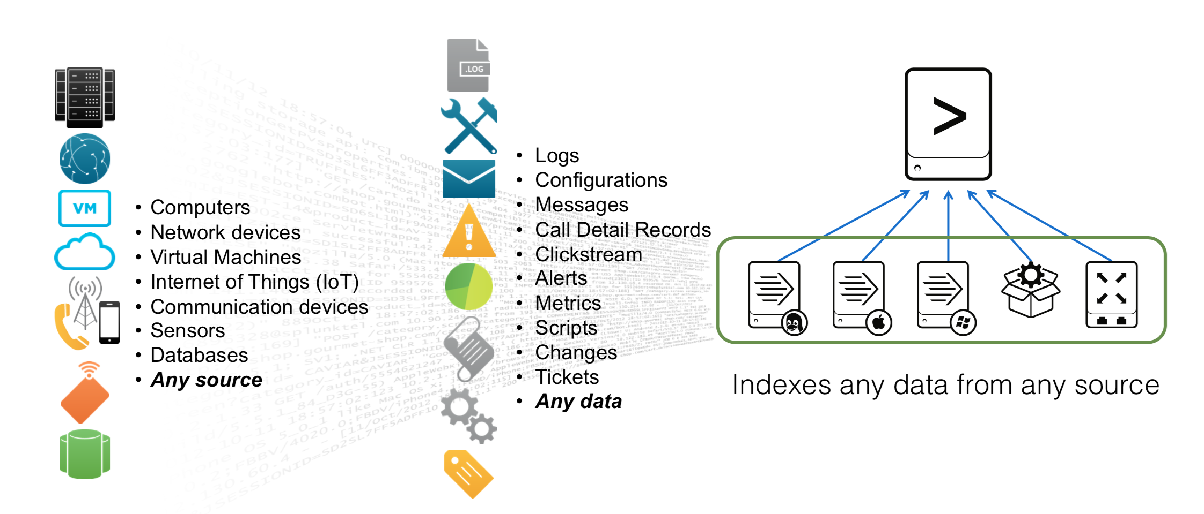
Splunk Logging Tool Overview
Splunk as log management tool
Splunk architecture
Concepts
Stages of App Development

Slide 18
Splunk Logging Tool Overview
is log management tool used to build solutions for various systems
is used to collect machine data from all kinds of sources
works with Hadoop-based data, as well as data from relational databases
uses various ways to get inputs (modular, scripted inputs, agent based inputs)
has its own query languege - SPL
provides reporting, alerting and real-time dashboards based on saved searches
Supports SAML
has different indexing options (unused storage can roll to Hadoop)
scales easily (horizontically and vertically)
Presentation created by Iryna Diudiuk
Notes:
HTTP Event Collector (HEC pronounced H-E-C) is a new, robust, token-based JSON API for sending events to Splunk from anywhere without requiring a forwarder. HTTP Event Collector (HEC pronounced H-E-C) is a new, robust, token-based JSON API for sending events to Splunk from anywhere without requiring a forwarder.
With a variety of standard and custom input methods, Splunk software can ingest all kinds of data types and sources. File-based data can be sent via forwarders that reside directly on the data sources, while DevOps, IoT and other data can be directly ingested using the Event Collector API, or a TCP/UDP port. You can pull data from API-based sources using Modular Inputs and other methods. Common IT, security and application data sources can also be onboarded and analyzed directly with hundreds of free apps and add-ons.
140 analytical commands - Splunk Search Processing Language (SPL™)
Use scheduled searches to create the real-time dashboards and visualizations that keep the team and management informed.
Splunk software supports SAML integration for single sign-on via most popular identity providers and comes pre-configured for a growing number of providers like Okta, PingFederate, Azure AD, CA SiteMinder, OneLogin and Optimal IdM. Splunk can also integrate with other authentication systems, including LDAP, Active Directory and e-Directory, and supports integration with Duo two-factor authentication.
You can keep historical data within Splunk and reduce the data footprint of seldom-analyzed, cold data. Or, you can roll your data to an existing Hadoop or Amazon Simple Storage Service (Amazon S3) data lake.

Slide 19
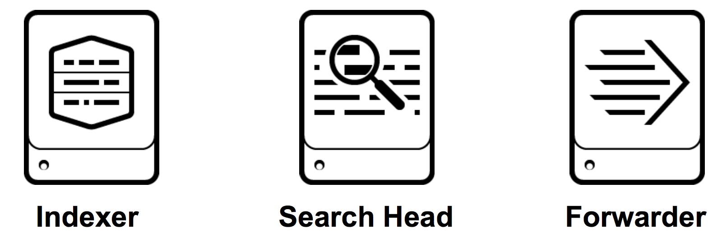
Splunk Logging Tool Overview
Splunk architecture
Date goes through the cycle —>
Key components of Splunk —>
Presentation created by Iryna Diudiuk

Slide 20
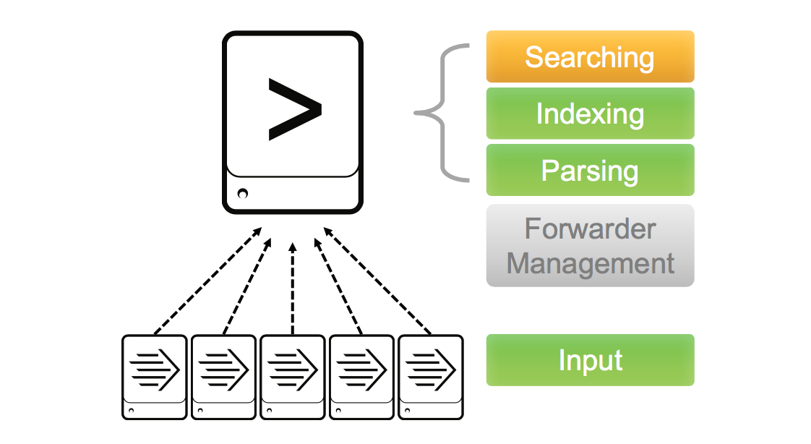
Splunk Logging Tool Overview
Simple architecture —>
Presentation created by Iryna Diudiuk

Slide 21
Splunk Logging Tool Overview
Distributed
deployment
architecture —>

Slide 22
Splunk Logging Tool Overview
Concepts:
index - repository for data in Splunk Enterprise. Resides in files on the Splunk Enterprise instance known as the indexer;
source - shows event origin;
sourcetype - determines how Splunk formats the data during the indexing process;
precendence - Splunk uses configuration files to determine aspects of its behavior;
app - offers user interfaces to work with your data, often uses additional add-ons;
add-on - enables Splunk app to ingest or map a particular type of data.
Presentation created by Iryna Diudiuk
Notes:
The repository for data in Splunk Enterprise. When Splunk Enterprise indexes raw event data, it transforms the data into searchable events. Indexes reside in flat files on the Splunk Enterprise instance known as the indexer.
In the case of data monitored from files and directories, the source consists of the full pathname of the file or directory. In the case of a network-based source, the source field consists of the protocol and port, such as UDP:514. Each event has a source field. The indexer generates the source field at index time. Searches often use the source as a criterion.
Splunk Enterprise comes with a large set of predefined source types, and it assigns a source type to your data. You can override this assignment by assigning an existing source type or creating a custom source type.
The indexer identifies and adds the source type field when it indexes the data. As a result, each indexed event has a sourcetype field.
Three important default fields are host, source, and source type, which describe where the event originated.
A Splunk platform deployment can have many copies of the same configuration file. These file copies are usually layered in directories that affect either the users, an app, or the system as a whole.
• App or user: Some activities, like searching, take place in an app or user context. The app and user context is vital to search-time processing, where certain knowledge objects or actions might be valid only for specific users in specific apps.
• Global: Activities like indexing take place in a global context. They are independent of any app or user. For example, configuration files that determine monitoring behavior occur outside of the app and user context and are global in nature.
Apps generally offer extensive user interfaces that enable you to work with your data, and they often make use of one or more add-ons to ingest different types of data. Add-ons generally enable the Splunk platform or a Splunk app to ingest or map a particular type of data.

Slide 23
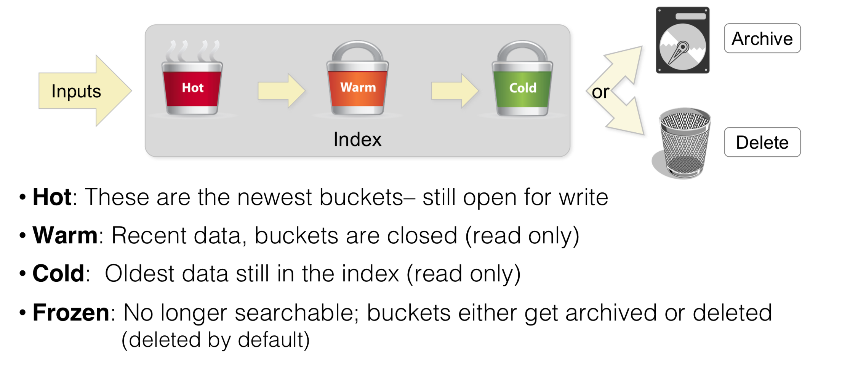
Splunk Logging Tool Overview
Index Buckets:

Slide 24
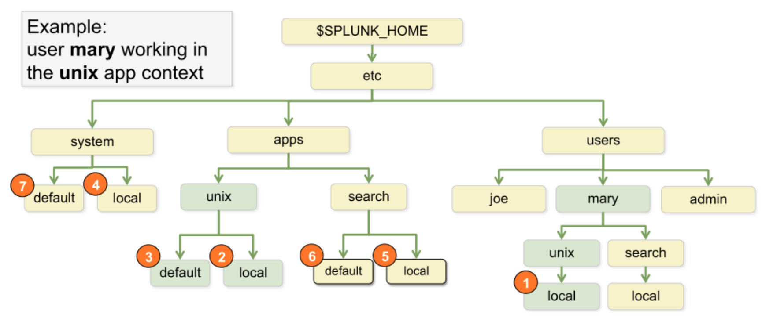
Splunk Logging Tool Overview
Precedence:
Notes:
The repository for data in Splunk Enterprise. When Splunk Enterprise indexes raw event data, it transforms the data into searchable events. Indexes reside in flat files on the Splunk Enterprise instance known as the indexer.

Slide 25
Splunk Logging Tool Overview
End of theory…time for practice:
The instructions are in Task file following the link:
https://goo.gl/huF73s
Notes:
The repository for data in Splunk Enterprise. When Splunk Enterprise indexes raw event data, it transforms the data into searchable events. Indexes reside in flat files on the Splunk Enterprise instance known as the indexer.

Slide 26
Resources
https://www.infoworld.com/article/2625977/security-management/living-the-log-management-lifecycle.html
https://www.zabbix.com/documentation/3.4/manual/appendix/items/activepassive#active_checks
https://splunkbase.splunk.com
https://answers.splunk.com
http://docs.splunk.com/
Presentation created by Iryna Diudiuk

