Slide 1


Software Development Methodologies
March 1, 2018
Presentation created by Iryna Diudiuk

Slide 2

Plan:
1
Waterfall development
2
Agile development
3
Spiral development
4
Scrum
5
Kanban
6
Resources

Slide 3
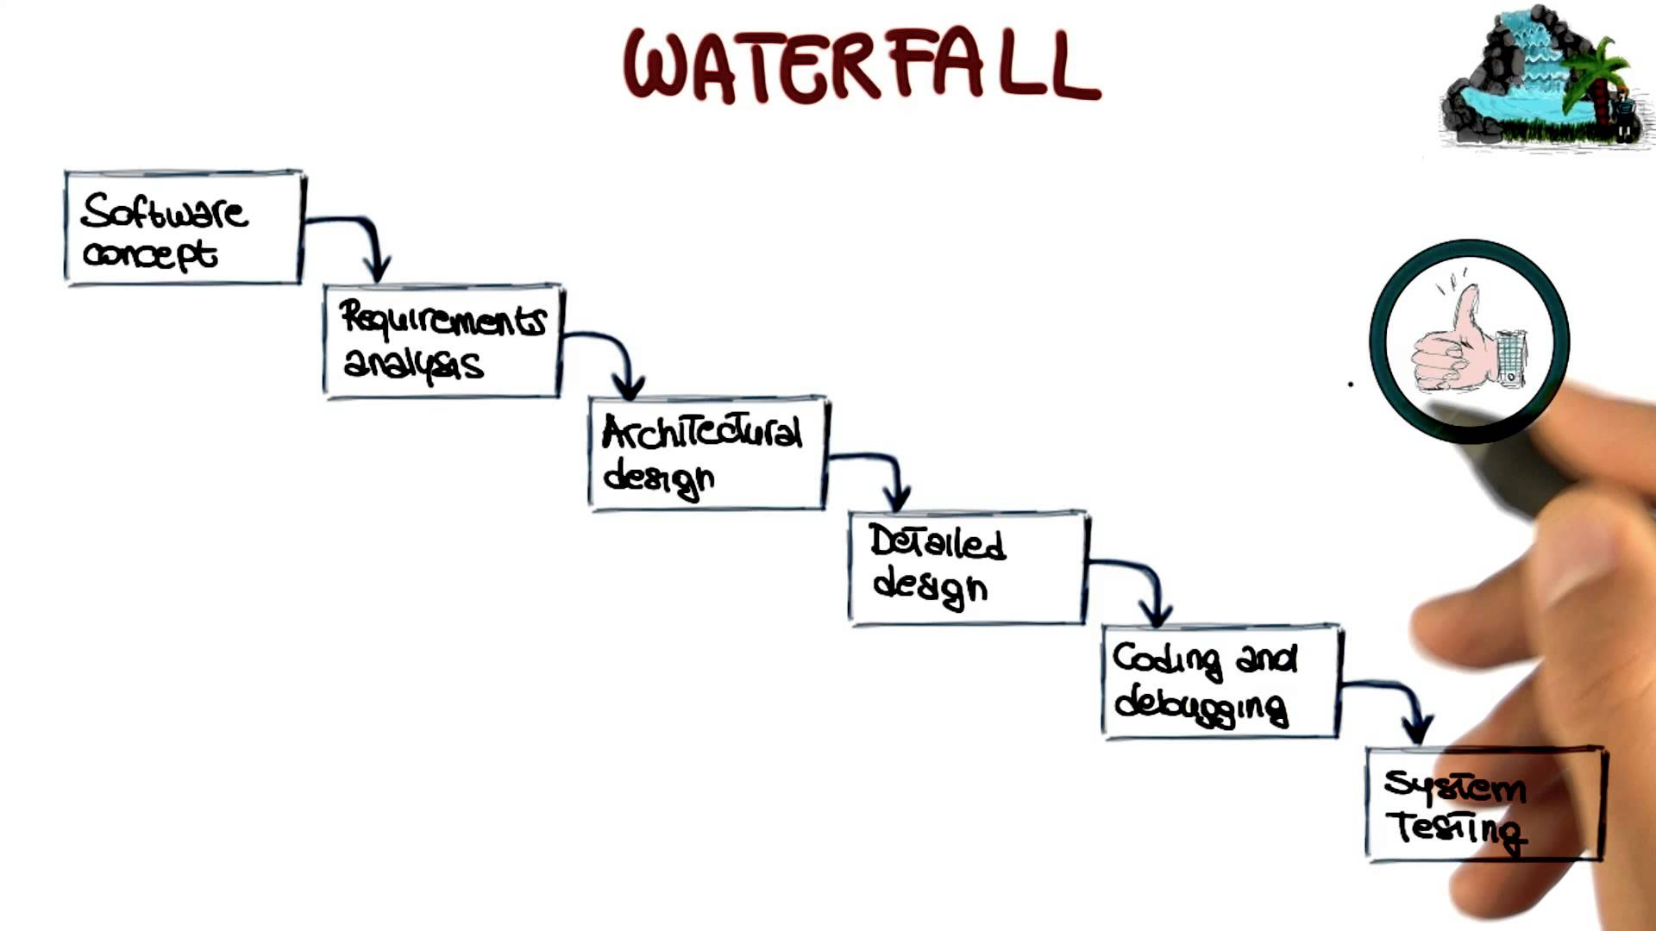
Waterfall development
Waterfall is a linear approach to software development.
Development is done sequencically in the following phases:
Gather and document requirements
Design
Code and unit test
Perform system testing
Perform user acceptance testing (UAT)
Fix any issues
Deliver the finished product

Slide 4
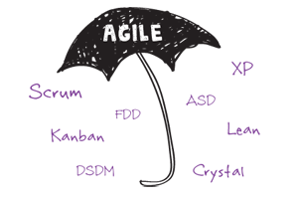
Agile development
Agile is an iterative, team-based approach to development. This approach emphasizes the rapid delivery of an application in complete functional components.
"Agile software development" refers to a group of software development methodologies based on iterative development, where requirements and solutions evolve via collaboration between self-organizing cross-functional teams.
There are many agile methodologies, including:
Kanban
Scrum

Slide 5
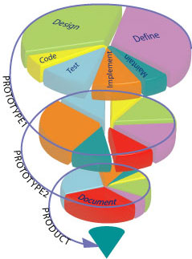
Spiral development
It is similar to the incremental model, with more emphasis placed on risk analysis.
The spiral model has four phases:
Planning
Risk Analysis
Engineering
Evaluation
A software project repeatedly passes through these phases in iterations (called Spirals in this model).
The baseline spiral, starting in the planning phase, requirements are gathered and risk is assessed.
Each subsequent spirals builds on the baseline spiral.

Slide 6
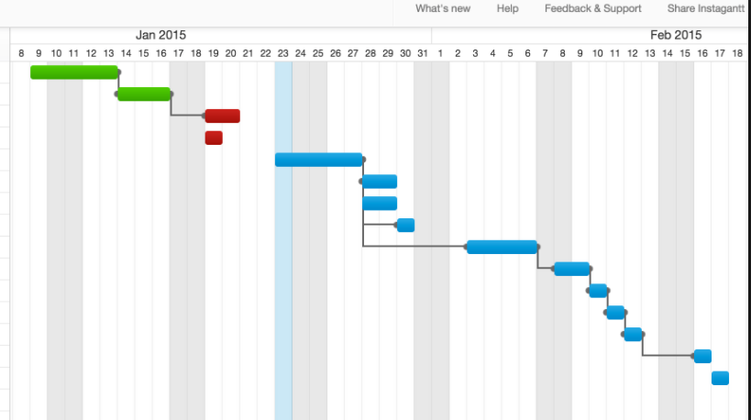
Scrum
Scrum is a subset of Agile.
It is a tool used to organize work into small, manageable pieces that can be completed by a cross-functional team within a prescribed time period (called a sprint, generally 2-4 weeks long).
To plan, organize, administer, and optimize this process, Scrum relies on at least three prescribed roles:
Product Owner (responsible for initial planning, prioritizing, and communication with the rest of the company),
Scrum Master (responsible for overseeing the process during each sprint), and the
Team Members (responsible to carry out the purpose of each sprint, such as producing software code.)
Scrum Board – a visual representation of the work flow, broken down into manageable chunks called “stories”, with each story moved along the board from the “backlog” (the to-do list), into work-in-progress (WIP), and on to completion.

Slide 7
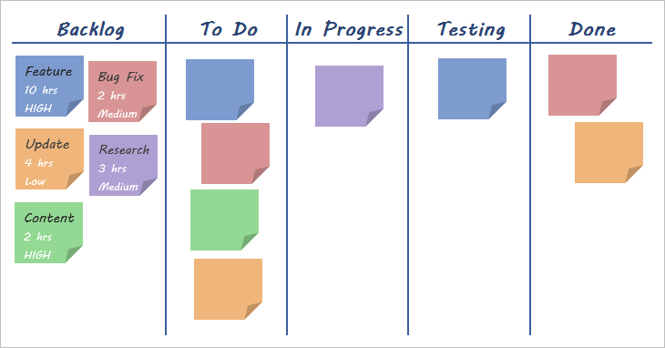
Kanban
Kanban is a subset of Agile
It encourages work to be broken down into manageable chunks and uses a Kanban Board (very similar to the Scrum Board) to visualize that work as it progresses through the work flow.
Where Scrum limits the amount of time allowed to accomplish a particular amount of work (by means of sprints), Kanban limits the amount of work allowed in any one condition (only so many tasks can be ongoing, only so many can be on the to-do list.)

Slide 8
Resources
1
https://www.seguetech.com/waterfall-vs-agile-methodology/
2
https://en.wikipedia.org/wiki/Software_development_process
3
http://istqbexamcertification.com/what-is-spiral-model-advantages-disadvantages-and-when-to-use-it/
4
https://www.cprime.com/2015/02/3-differences-between-scrum-and-kanban-you-need-to-know/

