Slide 1


Software Development Environment (SDE)
February 28, 2018
Presentation created by Iryna Diudiuk

Slide 2

Plan:
1
Types of Environments
2
Sandbox
3
Common Deployment Strategies
4
Resources

Slide 3
Types of Environments
Local | Developer's workstation
Development/Trunk | Development server aka sandbox. This is where unit testing is performed by the developer.
Integration | Clean environment where the repository's copy of the source code is getting built
Test/QA/Internal Acceptance | This is the stage where interface testing is performed. Quality assurance team makes sure that the new code will not have any impact on the existing functionality and they test major functionalities of the system once after deploying the new code in their respective environment.
Stage/Pre-production/External-Client Acceptance /UAT/Stable | Mirror of production environment
Production/Live | Serves end-users/clients

Slide 4
Types of Enviroments
Non-Production environments:
Developer Integrated Test (DIT)
System Integrated Test (SIT)
User Acceptance Test (UAT)
Performance Acceptance Test environments (PAT)
Production Services are dependent on the successful execution of installed applications to provide value to the user.
Non-production services support the life cycle of a development process where environment allocation is one of the first steps.
While Production servers are dedicated to specific applications, test servers may be shared among different users or projects.

Slide 5
Sandbox
A sandbox is a testing environment that isolates untested code changes and outright experimentation from the production environment or repository.
The term sandbox is commonly used for the development of Web services to refer to a mirrored production environment for use by external developers.

Slide 6

Canary Deployment
When deploying a new release to production, rather than immediately deploying to all instances or users, it may be deployed to a single instance or fraction of users first, and then either deployed to all or gradually deployed in phases, in order to catch any last-minute problems. This is similar to staging, except actually done in production, and is referred to as a canary release.

Slide 7
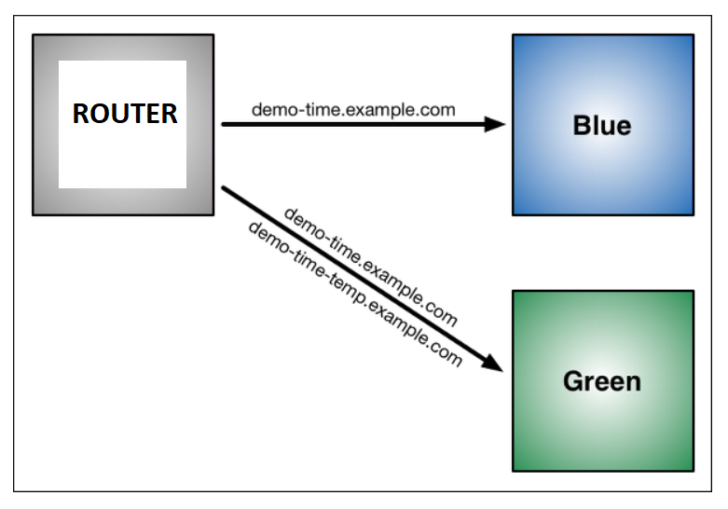
Blue-green Deployment
Blue-green deployment is a technique that reduces downtime and risk by running two identical production environments called
At any time, only one of the environments is live, with the live environment serving all production traffic.
If something unexpected happens with your new version on Green, you can immediately roll back to the last version by switching back to Blue.

Slide 8
Other Common Deployment Strategies
Recreate: Version A is terminated then version B is rolled out.
Ramped (also known as rolling-update or incremental): Version B is slowly rolled out and replacing version A.
A/B testing: Version B is released to a subset of users under specific condition.
Shadow: Version B receives real-world traffic alongside version A and doesn’t impact the response
When releasing to development/staging environments, a recreate or ramped deployment is usually a good choice. When it comes to production, a ramped or blue/green deployment is usually a good fit.

Slide 9
Resources
1
https://docs.cloudfoundry.org/devguide/deploy-apps/blue-green.html
2
https://en.wikipedia.org/wiki/Sandbox_(software_development)
3
https://thenewstack.io/deployment-strategies/
4
https://stackoverflow.com/questions/5285731/best-practice-for-test-and-production-environments

