Slide 1
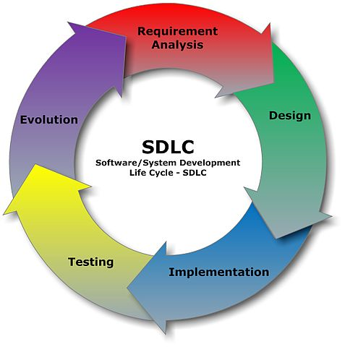
SYSTEM DEVELOPMENT LIFECYCLE
Presentation created by Iryna Diudiuk

Slide 2

Phases of SDLC
Planning
Requirements & Analysis
Design
Development
Testing
Implementation
Maintenance

Slide 3

Planning
Key questions:
Is there a need for a new system?
What is wrong with existing system and which problems should a new one solve?
What would it take to implement a new system (resources, costs, time)?
What are the business needs?

Slide 4

Requirements & Analysis
Key questions:
Who is going to use the system?
How will they use the system?
What data should be input into the system?
What data should be output by the system?
How can the needs of the business be met?
Who will be responsible for implementation of the new system?
---------------------------------------------------------------------------------
Requirement Specification document is created as a guideline for the next phase of the model.
The testing team follows the Software Testing Life Cycle and starts the Test Planning phase after the requirements analysis is completed.

Slide 5

Design
Defined at this stage are:
overall system architecture
essential components
structure (networking capabilities)
procedures for the system to accomplish its objectives

Slide 6

Development
At this stage:
Objectives of the project are devided into small modules
Tickets are created and assigned
Code is being written and send out to testing

Slide 7

Testing
At this stage:
QA team carries out automated and manual testing procedures against the requirements
testers cooperate with developers to solve issues
each bug goes through its own lifecycle
testing process may be repeated if necessary
code is verified and validated

Slide 8
Implementation
At this stage:
beta testing is done by customer
any necessary changes are implemented and bugs fixed
approved version of software is moved to production

Slide 9

Maintenance
At this stage:
The software is maintained and updated to new versions.

Slide 10
Resources
1. https://www.innovativearchitects.com/KnowledgeCenter/basic-IT-systems/system-development-life-cycle.aspx
2. http://istqbexamcertification.com/what-are-the-software-development-life-cycle-sdlc-phases/
3. https://www.slideshare.net/fentrekin/week4-lecture

