Slide 1
Transfer Learning for Image Classification
Hackathon Project – Dataset 2 (Reduced CIFAR-10)
Aim:
• Build an image classifier using transfer learning
• Evaluate model performance
• Compare generative AI tools

Slide 2
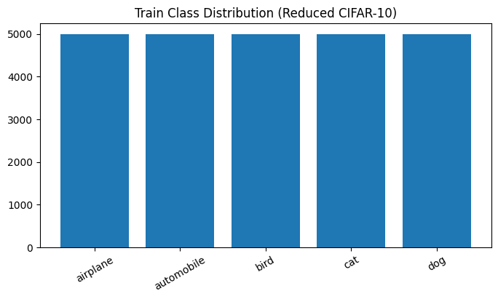
Dataset & Exploration
• Reduced CIFAR-10 dataset
• Classes: airplane, automobile, bird, cat, dog
• Balanced: 1,000 images per class
• 32×32 RGB images resized to 224×224
• Challenge: low resolution & similar animal classes

Slide 3
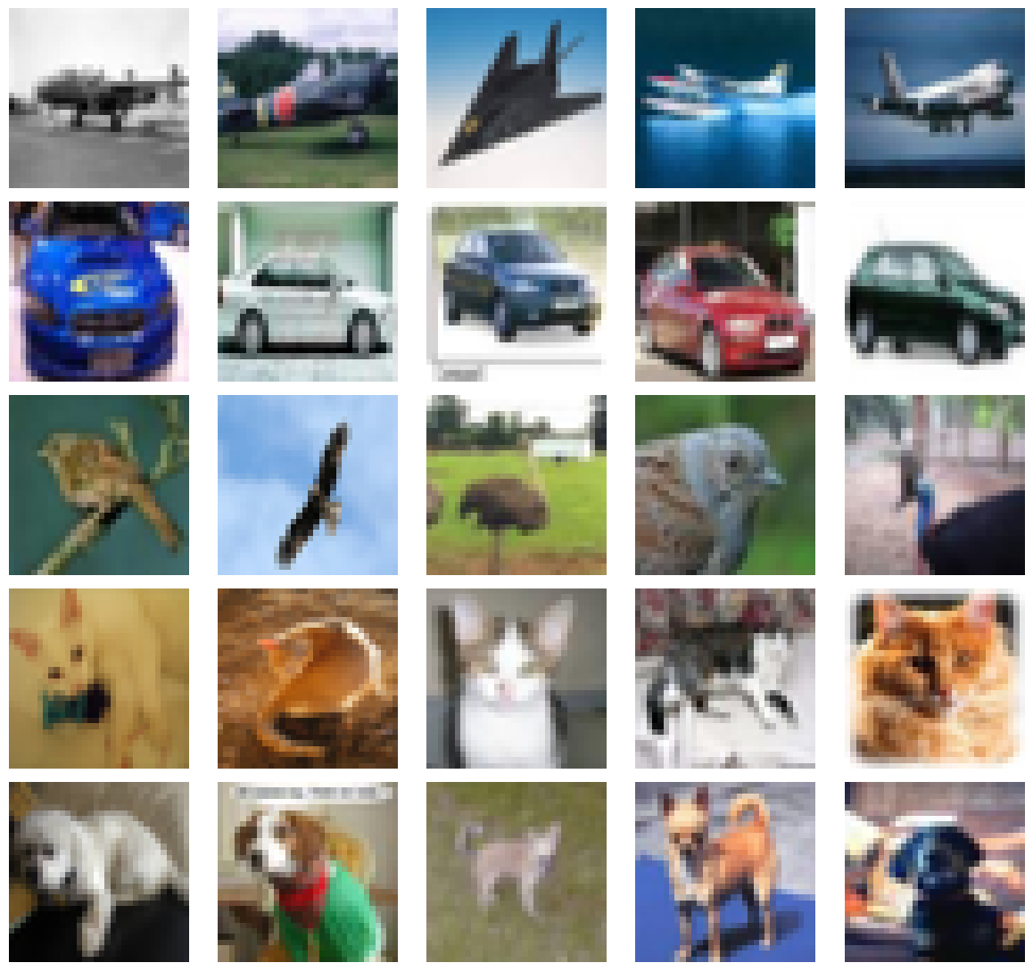
Methodology: Transfer Learning
• Used EfficientNetB0 pre-trained on ImageNet
• Reused learned visual features
• Faster training & better generalisation
• Ideal for hackathon constraints

Slide 4
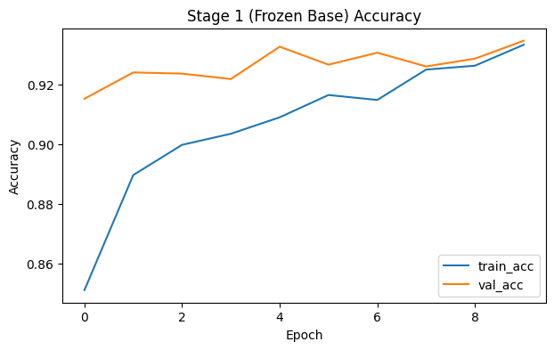
Model Architecture & Training
• EfficientNetB0 as feature extractor
• Global Average Pooling
• Dense + Dropout
• Softmax output (5 classes)
• Data augmentation & early stopping

Slide 5
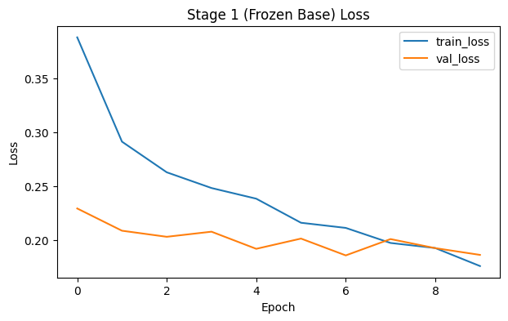
Stage 1 vs Stage 2 Training
Stage 1 (Frozen base):
• Validation accuracy: 93.46%
Stage 2 (Fine-tuned):
• Validation accuracy: 95.62%
• Improvement: +2.16%

Slide 6
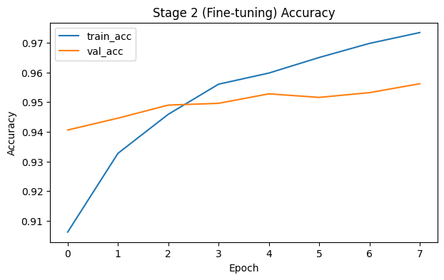
Test Set Evaluation
• Test accuracy: 95.4%
• Macro F1-score: 0.95
• Airplane & automobile: near-perfect
• Cat & dog: most confusion

Slide 7
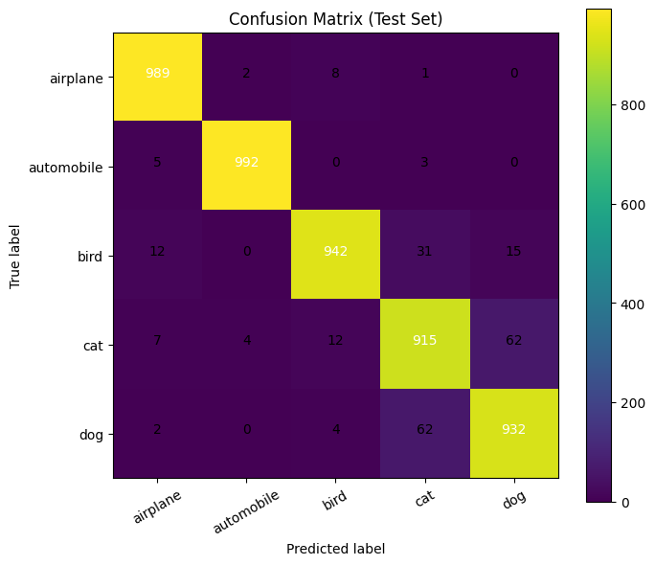
Random Predictions & Error Analysis
• Majority of random samples classified correctly
• Errors mainly between cat and dog
• Errors caused by visual similarity, not instability

Slide 8
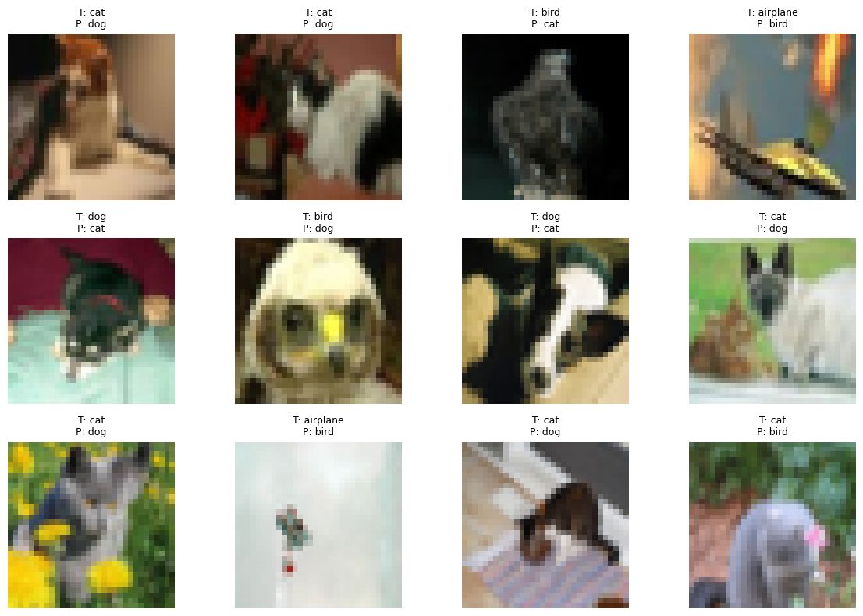
AI Tools, Conclusion & Future Work
AI Tools:
• ChatGPT – structure & explanations
• Copilot – fast coding
• Gemini & DeepSeek – conceptual support
Conclusion:
• Transfer learning highly effective
• Fine-tuning improved accuracy
Future Work:
• Try other architectures
• Higher-resolution data

