Slide 1


Analysing and Resolving Deadlocks
Erland Sommarskog
Data Platform MVP

Slide 2



Erland
Sommarskog
SQL Server MVP since 2001
Independent consultant based in Stockholm
esquel@sommarskog.se
Slides and scripts: https://www.sommarskog.se/present

Slide 3
Agenda
Introduction to deadlocks.
How to get information about deadlocks?
Understanding the deadlock XML.
Recap on locking and isolation levels.
Means to prevent deadlocks.
Ways to mitigate deadlocks.

Slide 4
What Is a Deadlock?
01_FirstWindow.sql 01_SecondWindow.sql
A deadlock is when two or more processes are blocking each other in such a way that neither can continue.
SQL Server checks for this condition every five seconds.
If a deadlock is found, SQL Server injects an error in one of the processes, the deadlock victim, and rolls back its transaction.
The deadlock victim is selected based on the amount of log records.

Slide 5
What Resources Can Cause Deadlock
Message 1205 in sys.messages:
Transaction (Process ID %d) was deadlocked on %.*ls resources with another process and has been chosen as the deadlock victim. Rerun the transaction.
According to the Deadlocks Guide in the SQL Server Docs, these are the resources that can deadlock:
Locks.
Worker threads.
Memory.
Parallel query execution-related resources.
Multiple Active Result Sets (MARS) resources.
The only one I will talk about.

Slide 6
Are Deadlocks a Problem?
Deadlocks occur in the best of families.
An occasional deadlock is no cause for alarm.
But many deadlocks per day often are.
Users don’t like errors about being “deadlock victims”.
Too many deadlocks can reduce throughput, since it takes a few seconds until a deadlock is resolved.

Slide 7
Getting Information about Deadlocks
Easiest is to query the system_health session which is always running.
SELECT CAST(event_data AS xml), timestamp_utc
FROM sys.fn_xe_file_target_read_file(
N'system_health*.xel',
DEFAULT, DEFAULT, DEFAULT)
WHERE object_name = 'xml_deadlock_report'
ORDER BY timestamp_utc DESC
02_query_system_health.sql
Observe the asterisk – without it you get no output.
timestamp_utc only available on SQL 2017 and later.

Slide 8
Azure SQL Database
For Azure SQL DB, run in your master database:
; WITH CTE AS (
SELECT CAST(event_data AS xml) AS xml, timestamp_utc
FROM sys.fn_xe_telemetry_blob_target_read_file(
'dl', NULL, NULL, NULL))
SELECT timestamp_utc, xml.query(
'/event/data[@name="xml_report"]/value/deadlock')
FROM CTE
WHERE xml.exist(
'/event/data[@name="database_name"]/value[.="DBname"]')=1

Slide 9
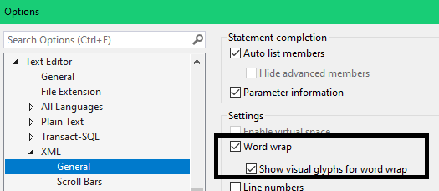
Tip for SSMS
To avoid having to scroll sideways, turn on word wrap for XML:

Slide 10
Defining Your Own XEvent Session
Include the event xml_deadlock_report.
Useful if:
On Azure SQL Managed Instance (write to BLOB store) where you only can access system_health through ring buffer which is unreliable.
You find that querying system_health session is slow.
You want low latency.
Query it in the same way as the system_health session. (Don’t forget the asterisk!)

Slide 11
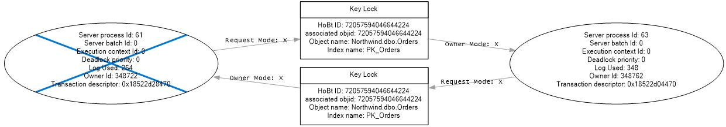
Other Means to Get Information
Turn on TF 1222 to get XML in the SQL Server errorlog.
Simple, but litters the errorlog, and information is difficult to read.
Trace/Profiler. Mainly an option on SQL 2005/2008.
Profiler gives you a graph that looks pretty:
But it’s confusing and important information is missing. Discard!
The TextData column has the actual XML.

Slide 12
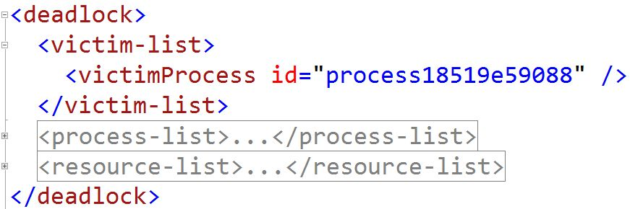
The Deadlock XML
victim-list – The process(es) that were rolled back.
process-list – Information about the processes.
resource-list – The locks involved in the deadlock.

Slide 13
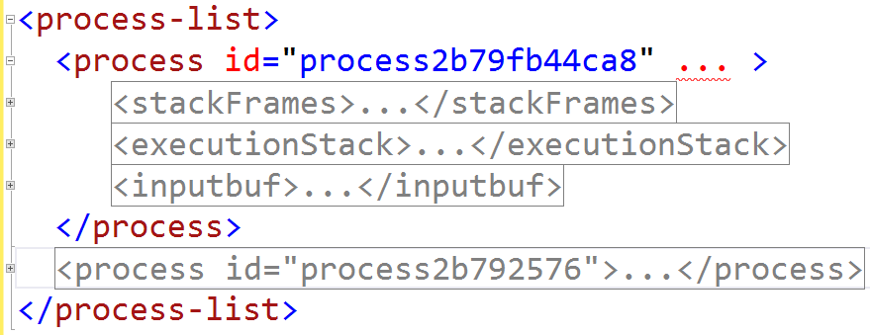
The Process List
One tag for each process in the deadlock.
Many attributes about the processes.

Slide 14
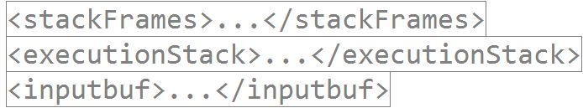
Nested Elements in the Process Tag
stackFrames – SQL Server call stack, only of interest to support engineers. (New in SQL 2022).
executionStack and inputbuf – information about the submitted command and current statement.

Slide 15
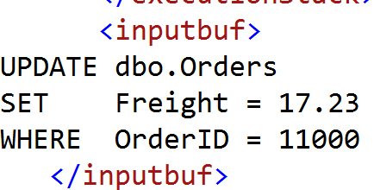
The inputbuf Tag, take one
For ad-hoc commands, the inputbuf tag often suffices.
For multi-statement batches, you may have use for the line numbers in the executionStack tag.

Slide 16
The inputbuf Tag, Take Two
You may be looking at:
This is a stored procedure called through RPC.
You need to look at the executionStack tag for more information.

Slide 17
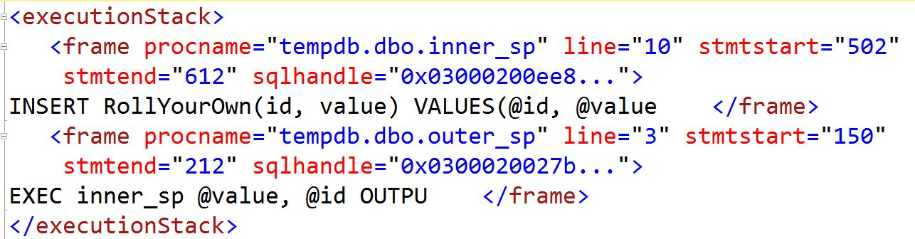
The executionStack Tag
You see the statement of the deadlock, and the call stack.
In this example: the application called outer_sp.
Last character in statement is stripped off on SQL 2014+.

Slide 18
Advanced: Find the Query Plan
<executionStack>
<frame procname="tempdb.dbo.inner_sp" line="12" stmtstart="884" stmtend="990" sqlhandle="0x0300020027b3813a ...">
INSERT RollYourOwn(id, data) VALUES(@id, @data </frame>
<frame ...
SELECT convert(xml, etqp.query_plan) AS query_plan
FROM sys.dm_exec_query_stats qs
CROSS APPLY sys.dm_exec_text_query_plan(qs.plan_handle,
qs.statement_start_offset, qs.statement_end_offset) AS etqp
WHERE qs.sql_handle = 0x0300020027b3813a...
AND qs.statement_start_offset = 884
AND qs.statement_end_offset = 990

Slide 19
Find the Query Plan - Caveats
Execution plan may have changed since the deadlock.
Plan may have fallen out of the cache entirely.
The query may return multiple rows, because there are cache entries for different SET options etc.
Tip: look at sys.dm_exec_query_stats.execution_count.
Searching Query Store may be a better option.

Slide 20
All the Process Attributes
<process id="process26eab72f848" taskpriority="0" logused="244" waitresource="KEY: 6:72057594047889408 (fadcdcb5e33c)" waittime="2728" ownerId="4260688" transactionname="UPDATE" lasttranstarted="2022-01-30T14:57:47.787" XDES="0x270d78b8428" lockMode="X" schedulerid="1" kpid="9744" status="suspended" spid="53" sbid="0" ecid="0" priority="0" trancount="2" lastbatchstarted="2022-01-30T14:57:47.783" lastbatchcompleted="2022-01-30T14:57:47.783" lastattention="1900-01-01T00:00:00.783" clientapp="slask.pl" hostname="SOMMERWALD" hostpid="6632" loginname="PRESENT10\sommar" isolationlevel="read committed (2)" xactid="4260688" currentdb="6" currentdbname="Northgale" lockTimeout="4294967295" clientoption1="671088672" clientoption2="128056">

Slide 21
The Relevant Ones
<process id="process26eab72f848" taskpriority="" logused="" waitresource="" waittime="" ownerId="" transactionname="UPDATE" lasttranstarted="2022-01-30T14:57:47.787" XDES="" lockMode="" schedulerid="" kpid="" status="" spid="53" sbid="0" ecid="0" priority="" trancount="2" lastbatchstarted="2022-01-30T14:57:47.783" lastbatchcompleted="2022-01-30T14:57:47.783" lastattention="1900-01-01T00:00:00.783" clientapp="slask.pl" hostname="SOMMERWALD" hostpid="" loginname="PRESENT10\sommar" isolationlevel="read committed (2)" xactid="" currentdb="" currentdbname="Northgale" lockTimeout="" clientoption1="" clientoption2="">

Slide 22
Process Identification
<process id="process26eab72f848" taskpriority="" logused="" waitresource="" waittime="" ownerId="" transactionname="UPDATE" lasttranstarted="2022-01-30T14:57:47.787" XDES="" lockMode="" schedulerid="" kpid="" status="" spid="53" sbid="0" ecid="0" priority="" trancount="2" lastbatchstarted="2022-01-30T14:57:47.783" lastbatchcompleted="2022-01-30T14:57:47.783“ lastattention="1900-01-01T00:00:00.783" clientapp="slask.pl" hostname="SOMMERWALD" hostpid="" loginname="PRESENT10\sommar" isolationlevel="read committed (2)" xactid="" currentdb="" currentdbname="Northgale" lockTimeout="" clientoption1="" clientoption2="">

Slide 23
Process Identification Details
id="process26eab72f848" Mapping between process-list, resource-list and victim-list.
spid="53" The one we know and love.
sbid="0" Non-zero if MARS is in use.
ecid="0" Non-zero when there is parallelism.
currentdbname and loginname. Self-explanatory.
clientapp and hostname. Recall that they are set in the connection string.

Slide 24
transactionname Attribute
<process id="process26eab72f848" taskpriority="" logused="" waitresource="" waittime="" ownerId="" transactionname="UPDATE" lasttranstarted="2022-01-30T14:57:47.787" XDES="" lockMode="" schedulerid="" kpid="" status="" spid="53" sbid="0" ecid="0" priority="" trancount="2" lastbatchstarted="2022-01-30T14:57:47.783" lastbatchcompleted="2022-01-30T14:57:47.783" lastattention="1900-01-01T00:00:00.783" clientapp="slask.pl" hostname="SOMMERWALD" hostpid="" loginname="PRESENT10\sommar" isolationlevel="read committed (2)" xactid="" currentdb="" currentdbname="Northgale" lockTimeout="" clientoption1="" clientoption2="">

Slide 25
Multi-Statement Transaction?
In a multi-statement transaction, locks in the deadlock may come from previous statements in the transaction!
If transactionname reads user_transaction, you have a multi-statement transaction.
Same if it is MyTran or some other name. (Someone said BEGIN TRANSACTION MyTran).
implicit_transaction is also a multi-statement transaction. SET IMPLICIT_TRANSACTIONS ON is in effect.

Slide 26
Multi-Statement Transaction? cont’d
If transactionname reads SELECT, INSERT, UPDATE, DELETE etc, likely to be an auto-committed statement.
But check executionStack – the deadlock statement could be in a trigger with multiple statements.
A trigger always executes in the context of a transaction defined by the statement that fired it.
transactionname can read INSERT EXEC. In this case the procedure runs a multi-statement transaction defined by the INSERT statement.

Slide 27
Three Important Timestamps
<process id="process26eab72f848" taskpriority="" logused="" waitresource="" waittime="" ownerId="" transactionname="UPDATE" lasttranstarted="2022-01-30T14:57:47.787" XDES="" lockMode="" schedulerid="" kpid="" status="" spid="53" sbid="0" ecid="0" priority="" trancount="2" lastbatchstarted="2022-01-30T14:57:47.783" lastbatchcompleted="2022-01-30T14:57:47.783" lastattention="1900-01-01T00:00:00.783" clientapp="slask.pl" hostname="SOMMERWALD" hostpid="" loginname="PRESENT10\sommar" isolationlevel="read committed (2)" xactid="" currentdb="" currentdbname="Northgale" lockTimeout="" clientoption1="" clientoption2="">

Slide 28
Transaction Started by Application?
Is lasttranstarted before lastbatchstarted? Typically, it’s a multi-batch transaction started by the application.
But it could be a runaway transaction without a COMMIT.
Are lastbatchcompleted and lastbatchstarted far apart in a multi-batch transaction? Investigate!
Is it doing work elsewhere which increases the length of the transaction – and thus makes the window for a deadlock wider?

Slide 29
The lastattention Attribute
<process id="process26eab72f848" taskpriority="" logused="" waitresource="" waittime="" ownerId="" transactionname="UPDATE" lasttranstarted="2022-01-30T14:57:47.787" XDES="" lockMode="" schedulerid="" kpid="" status="" spid="53" sbid="0" ecid="0" priority="" trancount="2" lastbatchstarted="2022-01-30T14:57:47.783" lastbatchcompleted="2022-01-30T14:57:47.783" lastattention="1900-01-01T00:00:00.783" clientapp="slask.pl" hostname="SOMMERWALD" hostpid="" loginname="PRESENT10\sommar" isolationlevel="read committed (2)" xactid="" currentdb="" currentdbname="Northgale" lockTimeout="" clientoption1="" clientoption2="">

Slide 30
Attention Signals
The application can send an attention signal to SQL Server.
On this signal, SQL Server will:
Roll back the current statement.
Leave any user transaction open (unless XACT_ABORT is on).
Most common reason is the error Timeout Expired. (Most APIs have a default timeout of 30 s.)
Applications must handle this error and roll back any open transactions.
The red button in SSMS also produces an attention signal.

Slide 31
Unhandled Timeout Errors
lastattention reflects the last time an attention signal was received.
Is lastattention later than lasttranstarted? This is a red flag for a runaway transaction!
Most likely the application has experienced a timeout without rolling back.
Stop analysing the deadlock. Instead, review the error-handling code in the application.

Slide 32
Transaction Count
<process id="process26eab72f848" taskpriority="" logused="" waitresource="" waittime="" ownerId="" transactionname="UPDATE" lasttranstarted="2022-01-30T14:57:47.787" XDES="" lockMode="" schedulerid="" kpid="" status="" spid="53" sbid="0" ecid="0" priority="" trancount="2" lastbatchstarted="2022-01-30T14:57:47.783" lastbatchcompleted="2022-01-30T14:57:47.783" lastattention="1900-01-01T00:00:00.783" clientapp="slask.pl" hostname="SOMMERWALD" hostpid="" loginname="PRESENT10\sommar" isolationlevel="read committed (2)" xactid="" currentdb="" currentdbname="Northgale" lockTimeout="" clientoption1="" clientoption2="">

Slide 33
The Deceivable trancount Attribute
For an INSERT, UPDATE, DELETE or MERGE statement, it will always be at least 2, never one or zero.
And it’s 2, regardless if it is a single-statement transaction or a multi-statement transaction.
For a nested transaction it is 3 or higher.
An high value could indicate a runaway transaction.
High value = not really matching the stack depth.
Missing commit or unhandled timeout.

Slide 34
The isolationlevel Attribute
<process id="process26eab72f848" taskpriority="" logused="" waitresource="" waittime="" ownerId="" transactionname="UPDATE" lasttranstarted="2022-01-30T14:57:47.787" XDES="" lockMode="" schedulerid="" kpid="" status="" spid="53" sbid="0" ecid="0" priority="" trancount="2" lastbatchstarted="2022-01-30T14:57:47.783" lastbatchcompleted="2022-01-30T14:57:47.783" lastattention="1900-01-01T00:00:00.783" clientapp="slask.pl" hostname="SOMMERWALD" hostpid="" loginname="PRESENT10\sommar" isolationlevel="read committed (2)" xactid="" currentdb="" currentdbname="Northgale" lockTimeout="" clientoption1="" clientoption2="">
Covered later

Slide 35
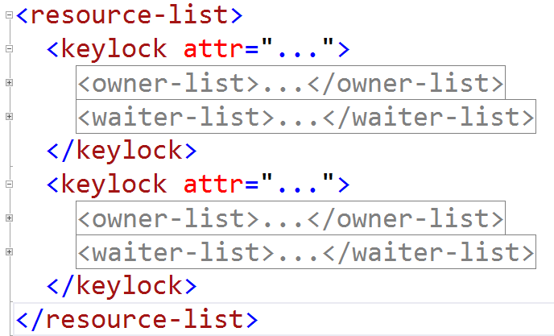
The resource-list Element - Overview
One element for each lock in the deadlock.
Name of element depends on type of lock.
Nested in that element:
owner-list element listing the owner(s) of the lock.
waiter-list element listing processes waiting for the lock.

Slide 36
<keylock attr="...">
<owner-list>
<owner id="process26eabfb68c8" mode="X" />
</owner-list>
<waiter-list>
<waiter id="process26eab72e4e8" mode="S" requestType="wait" />
</waiter-list>
</keylock>
<keylock attr="...">
<owner-list>
<owner id="process26eab72e4e8" mode="S" />
</owner-list>
<waiter-list>
<waiter id="process26eabfb68c8" mode="X" requestType="wait" />
</waiter-list>
</keylock>
Mapping to id in the process elements.

Slide 37
The xxxlock Element
<keylock hobtid="72057594047758336" dbid="6" objectname="Northgale.dbo.Orders" indexname="PK_Orders" id="lock2709eb35780" mode="X" associatedObjectId="72057594047758336">
You need to know table and index name. Ignore the rest.
keylock = Row lock in index, clustered or non-clustered.
ridlock = Row lock in heap when accessing data page.
pagelock = What it says, lock on page level.
objectlock = Lock on table level.

Slide 38
Index Name in Page Locks
In pagelock elements, the index name is missing.
Work from the associatedObjectId attribute with this query:
SELECT object_name(p.object_id) AS table_name,
i.name AS index_name
FROM sys.partitions p
JOIN sys.indexes i ON p.object_id = i.object_id
AND p.index_id = i.index_id
WHERE p.hobt_id = @associatedObjectId

Slide 39
Advanced: Which Row is Locked?
Look in the process element for the waiter: waitresource="KEY: 6:72057594047758336 (3b86dcc184bf)"
Copy the parenthetical part and run:
SELECT * FROM tbl WITH (INDEX = index_name)
WHERE %%LOCKRES%% = '(3b86dcc184bf)'
Must force the index in the keylock element!

Slide 40
Recap on Locking and Isolation Levels
Granularity.
The most important lock types.
Intent locks.
Isolation Levels.

Slide 41
Recap on Locking - Granularity
For DML operations, locks can be taken on four levels:
Row.
Page.
(Partition).
Table.
The higher the level, the bigger the risk for deadlocks.
Normally, SQL Server takes row locks, but if it thinks that a query can touch many rows, it may start with page or table locks to preserve memory.

Slide 42
Lock Escalation
If a query takes more than ~5000 locks on a table, SQL Server attempts to escalate to table level (Or partition, if enabled.)
If escalation is blocked by other locks, SQL Server jogs along with the row locks and tries again later.
Lock escalation is never to page level.
Thus, if you see page locks in a deadlock, they were there when the query started.

Slide 43
Controlling Lock Escalation
You can use ALTER TABLE SET LOCK_ESCALATION to control lock escalation per table.
TABLE – the default, table level.
AUTO – escalation to partition, if table is partitioned.
DISABLE – What it says.
Trace Flags
1224 – Disable lock escalation, unless there is memory pressure.
1211 – Disable lock escalation, period.

Slide 44
The Basic Lock Modes
From strongest to weakest:
Sch-M – Schema-modification locks.
X – Exclusive locks.
U – Update locks.
S – Shared locks.
Sch-S – Schema-stability locks.

Slide 45
Schema-Modification Locks (Sch-M)
Always on table level.
Taken by DDL statements (ALTER TABLE, CREATE INDEX etc.)
Incompatible with all other locks.
Held to the end of transaction.

Slide 46
Exclusive Locks (X)
Can be on any level.
Taken by INSERT, UPDATE, DELETE and MERGE.
Incompatible with all other locks but Sch-S.
Held to the end of transaction.

Slide 47
Schema-Stability Locks (Sch-S)
Always on table level.
Taken by SELECT and other read operations in:
Snapshot isolation.
Read-committed snapshot.
Read uncommitted, a.k.a. NOLOCK.
Compatible with all locks, but Schema-modification.
Prevents schema from changing while query is running.
Held to the end of the query.

Slide 48
Shared Locks (S)
Can be on any level.
Taken by SELECT and other read operations in these isolation levels:
Read Committed without snapshot.
Repeatable Read.
Serializable.
Incompatible with Sch-M and Exclusive locks.
Compatible with Sch-S, Update locks and other Shared locks.

Slide 49
Update Locks (U)
Can be taken on any level.
Taken by UPDATE, DELETE and MERGE.
Compatible with Sch-S and Shared locks.
Incompatible with Sch-M, Exclusive and with other Update locks.
Purpose: reserve a row for update without blocking readers.
Converted to Exclusive or released when not needed.

Slide 50
Intent Locks
A.k.a “I am here” locks.
A process wants to take an exclusive lock on table level. This should be blocked if there is a shared lock on any row.
Check all rows if any is locked?
That would be highly inefficient!
Intent locks to the rescue!

Slide 51
Intent Locks at Work
Consider: SELECT Col1, Col2 FROM tbl WHERE keycol = 987.
First take an Intent Shared (IS) lock on table level.
This will be blocked if another process holds an Exclusive (X) lock on table level.
Once the IS lock is taken, any attempt to take an Exclusive table lock will be blocked.
Repeat on page level. (And partition if enabled.)
Finally, take a Shared (S) lock the row with keycol = 987.

Slide 52
Intent Locks and Compatibility
There are three types of Intent Locks:
Intent Shared (IS).
Intent Update (IU).
Intent Exclusive (IX).
All intent locks are compatible with each other.
IS is incompatible with X and Sch-M.
IU is incompatible with U, X and Sch-M.
IX is incompatible with S, U, X and Sch-M.

Slide 53
Isolation Levels
Read Uncommitted.
Read Committed (the default, has two implementations).
Repeatable Read.
Serializable.
Snapshot.

Slide 54
Controlling Isolation Levels
The isolation level can be controlled with a SET command, for instance: SET TRANSACTION ISOLATION LEVEL REPEATABLE READ
The specified level applies to all queries until there is a new SET TRANSACTION ISOLATION LEVEL command or the module exits.
You can also control the isolation level for a specific table in a query with a hint, for instance: SELECT * FROM tbl WITH (SERIALIZABLE)

Slide 55
Read Uncommitted
Semantics: you accept to read data that is uncommitted and which could be inconsistent.
Also known as “dirty reads”.
In query hints often specified as NOLOCK.

Slide 56
Read Uncommitted, Semantics
Customer | Account | Amount
Jane | 123 | 100
Jane | 234 | 200
Jane | 345 | 300
Jane | 456 | 400
Consider this data and query:
SELECT SUM(Amount)
FROM tbl
WHERE Customer = 'Jane'
As query runs, a transaction books a transfer of 50€ from account 234 to 345.
Our query may return 950, 1050 or something else depending on how the transfer is implemented.

Slide 57
Read Uncommitted, implementation
SELECT statements do not take shared locks on row, page or table level.
They do take Sch-S locks for all tables in the query.
Thus, you can still be blocked by DDL, for instance index rebuild.
INSERT, UPDATE, DELETE and MERGE will take Update/Exclusive locks for their target tables.

Slide 58
Read Committed
Semantics: Guaranteed to read only committed data.
Thus the query SELECT SUM(Amount) FROM tbl WHERE Customer = 'Jane' can only return 1000, even if a transfer is in progress.
Say that while query is running, Jane withdraws 150€ from account 456 the ATM.
Our query may return 850 or 1000. Both are correct under Read Committed.

Slide 59
Read Committed in SQL Server
This is the default isolation level in SQL Server.
There are two implementations: locks and snapshot.
Locks is the default in the box product and Azure SQL Managed Instance.
Snapshot is the default in Azure SQL Database.
Foreign-key validations always use locks.

Slide 60
Read Committed with Locks
SQL Server takes shared locks on row, page or table level.
If the query SELECT SUM(Amount) FROM tbl WHERE Customer = 'Jane' runs while Jane withdraws 150€, the result will be 850, as we wait until withdrawal is committed.
Locks are released when not needed anymore.
Hm, what does that mean exactly?

Slide 61
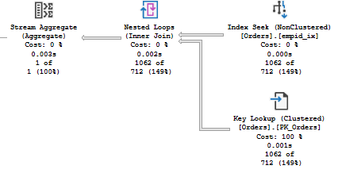
Example: When Not Needed Anymore?
SELECT SUM(Freight) FROM Orders WHERE EmployeeID = 42
Execution plan: Index Seek + Key Lookup.

Slide 62
empid_ix:
EmployeeID: 41
OrderID: 12311
42 / 11
42 / 14
42 / 18
Clustered index:
OrderID: 9
10
11
12
13
14
15
16
17
18
© Erland Sommarskog 2023

Slide 63
Read Committed Snapshot (RCSI)
SELECT statements do not read from the data pages, but from a version store, usually maintained in tempdb.
If Accelerated Database Recovery is enabled, version store is in the database itself.
You read what was committed when query started(*).
SELECT SUM(Amount) FROM tbl WHERE Customer = 'Jane' runs while Jane withdraws 150€. The result will be 1000, the sum before the withdrawal.

Slide 64
Read Committed Snapshot, cont’d
“when query started(*)”: If there are non-inlined user-defined functions, they have their own starting points.
Overall, don’t rely too much on “when query started”. 850 would still be correct with Read Committed.
SELECT queries do not take shared locks with RCSI, but take Sch-S locks on all tables in queries.
UPDATE and DELETE still take Update locks for their target tables without using the version store.
They use the version store for other tables.

Slide 65
Controlling Read Committed Snapshot
To enable/disable Read Committed Snapshot: ALTER DATABASE db SET READ_COMMITTED_SNAPSHOT ON / OFF
Database must be in single-user mode to make the change.
When disabled, Read Committed is always by locks.
When enabled, Read Committed defaults to snapshot.
You can override with the READCOMMITTEDLOCK hint, but there is no SET TRANSACTION ISOLATION LEVEL command.

Slide 66
Repeatable Read
Semantics: if you read the same row twice in a transaction, you will get back the same result.
Use case: Say that we are running SELECT SUM(Amount) FROM tbl WHERE Customer = 'Jane' We intend to use those 1000€ later in the transaction, so we want to make sure that result does not change.
Shared locks are held to the end of the transaction.
Locks on rows filtered out are released directly.

Slide 67
Serializable
With Repeatable Read, deposits or withdrawals to the existing accounts will be blocked.
What if someone adds a new account, for instance a loan with a negative balance?
With Serializable we are guaranteed that rows can not be added to a range we have read.
Rather than plain row locks, SQL Server uses key-range locks, for instance RangeS-S, to implement Serializable.

Slide 68
Snapshot Isolation
Semantics: you see the database as it was when the transaction started. You are blind to all later changes.
Thus, our sum query must return 1000 when Jane is at the ATM.
Implemented in SQL Server through the version store.
SELECT statements take no shared locks, only Sch-S.
UPDATE and DELETE also use the version store for their target tables when searching for rows.

Slide 69
Snapshot Isolation, cont’d
By default, snapshot isolation is not available.
You need to enable it with ALTER DATABASE db SET ALLOW_SNAPSHOT_ISOLATION ON
Does not require single-user mode.
The settings ALLOW_SNAPSHOT_ISOLATION and READ_COMMITTED_SNAPSHOT are independent of each other.
To run a snapshot transaction, you need to say SET TRANSACTION ISOLATION LEVEL SNAPSHOT

Slide 70
The isolationlevel Attribute
<process id="process26eab72f848" taskpriority="" logused="" waitresource="" waittime="" ownerId="" transactionname="UPDATE" lasttranstarted="2022-01-30T14:57:47.787" XDES="" lockMode="" schedulerid="" kpid="" status="" spid="53" sbid="0" ecid="0" priority="" trancount="2" lastbatchstarted="2022-01-30T14:57:47.783" lastbatchcompleted="2022-01-30T14:57:47.783" lastattention="1900-01-01T00:00:00.783" clientapp="slask.pl" hostname="SOMMERWALD" hostpid="" loginname="PRESENT10\sommar" isolationlevel="read committed (2)" xactid="" currentdb="" currentdbname="Northgale" lockTimeout="" clientoption1="" clientoption2="">

Slide 71
Isolation Levels and Locks
If you see Repeatable Read or Serializable, shared locks are held to the end of the transaction.
Locks being held longer → higher risk for deadlock.
Isolation level may be required to ensure correct results.
Beware: some transaction APIs turn on Serializable by default, so it may be “by mistake”.
Don’t forget that the isolation level may change during the transaction or be overridden by hints.

Slide 72
Preventing Deadlocks
Always access resources in the same order.
Query tuning and indexing.
READ_COMMITTED_SNAPSHOT.
Lock hints.
Review application behaviour.
Serialise with application locks.

Slide 73
Access Resources in the Same Order
Standard recommendation. Sounds simple and obvious.
Can be very difficult to implement in practice.
Business rules may mandate different access order.
SQL Server itself does not obey to this rule when building query plans.
Second_window.sql
differentaccessorder.xml

Slide 74
SELECT SUM(Freight) FROM Orders WHERE EmployeeID = @empid
empid_ix:
EmployeeID: 41
OrderID: 12311
42 / 11
42 / 14
42 / 18
Clustered index:
OrderID: 9
10
11
12
13
14
15
16
17
18
UPDATE dbo.Orders SET EmployeeID = @newempid WHERE OrderID = @orderid
© Erland Sommarskog 2023

Slide 75
Preventing Deadlocks
Always access resources in the same order.
Query tuning and indexing.
READ_COMMITTED_SNAPSHOT.
Lock hints.
Review application behaviour.
Serialise with application locks.

Slide 76
The Impact of Page and Table Locks
In the deadlock we just looked at, the processes were fighting about the very same row.
But imagine that there would only be page locks…

Slide 77
SELECT SUM(Freight) FROM Orders WHERE EmployeeID = @empid
empid_ix:
EmployeeID: 41
OrderID: 17
42 / 11
42 / 14
42 / 18
Clustered index:
OrderID: 9
10
11
12
13
14
15
16
17
18
UPDATE dbo.Orders SET EmployeeID = @newempid WHERE OrderID = @orderid
© Erland Sommarskog 2023

Slide 78
The Impact of Page and Table Locks
Lower lock granularity increases the risk for deadlocks, as you now can get conflicts on unrelated rows.
Thus, removing such locks helps to prevent deadlocks.
Recall that intent locks are always on page/table. They are not a problem.
It’s shared/update/exclusive locks on higher levels you should go after.
They are often a token of a query that needs tuning.

Slide 79
Removing Page and Table Locks
Say that you see this query in a deadlock:
SELECT * FROM Orders WHERE dateadd(MONTH, 1, OrderDate) > getdate()
Entangling column in an expression, prevents Index Seek.
You get Index Scan which often results in page locks.
No need to analyse the rest of the deadlock, but rewrite:
SELECT * FROM Orders WHERE OrderDate > dateadd(MONTH, -1, getdate())

Slide 80
Deadlock with Page Locks
01_Second_window.sql
pagelock-deadlock.xml
-- Reader.
SELECT SUM(Freight) FROM TallOrders WHERE OrderDate = @date
-- Writer.
UPDATE TallOrders SET ShipVia = @newshipid WHERE OrderID = @orderid
The index in the deadlock is on (ShipVia, OrderDate). There is no index on OrderDate.
Reader scans this index, taking page locks.
Parallel plan, thus multiple pages locked simultaneously.

Slide 81
Deadlock with Page Locks, cont’d
Writer needs to modify two pages in index on ShipVia, one for the old value, one for the new value.
Thus, writer needs intent locks (IX) on both pages.
Locks the first page, tries to lock the next but is blocked by a reader thread.
Another reader thread wants to read rows from first page, but is blocked by writer.
Possible resolution: add an index on OrderDate.
And we could tell this from the start….

Slide 82
Are Row Locks Permitted?
If you have table or page locks you are not able to understand, run this query:
SELECT * FROM sys.indexes
WHERE object_name(object_id) = 'YourTable'
AND (allow_row_locks = 0 OR allow_page_locks = 0)
If it returns any rows, enable page and row locks with:
CREATE INDEX ix ON tbl(col) WITH
(ALLOW_ROW_LOCKS = ON, ALLOW_PAGE_LOCKS = ON,
DROP_EXISTING = ON)

Slide 83
Only Row Locks, All Good?
Even if there are only row locks, query tuning can still be the solution.
Recall this deadlock:
-- Reader
SELECT SUM(Freight) FROM Orders WHERE EmployeeID = @empid
-- Writer
UPDATE Orders SET EmployeeID=@newempid WHERE OrderID=@orderid
Possible resolution: Add Freight as an included column in index on EmployeeID.

Slide 84
One More Deadlock Case
Consider this:
Process P starts a transaction.
P updates row(s) in table T.
P runs query to populate a temp table for two minutes.
Process Q starts SELECT joining S and T, starting from S.
The rows in T are updated by P, so Q is blocked.
P attempts to update row in S that Q has locked.
DEADLOCK!

Slide 85
The Window for a Deadlock
What if we can tune P’s INSERT query so that in runs 200 ms?
That does not entirely prevent the deadlock.
But the window where the deadlock can occur is drastically reduced.
Shorter transactions → Less risk for deadlocks.
…but that does not mean you should split up a transaction that needs to be atomic in multiple.

Slide 86
Too Many Indexes?
The more indexes there are on a table, INSERT/ DELETE/ UPDATE statements takes longer. → The deadlock window gets wider.
Two DML statements that update indexes in different order may clash.

Slide 87
Too Many Indexes, cont’d.
Check sys.dm_db_index_usage_stats for unused indexes.
Keep in mind that DMV is cleared on server restarts.
You can also trawl query plans in Query Store.
Check for overlapping indexes. For instance:
Indexes on both (a) and (a, b). Drop first index.
Note: indexes on (b) and (a, b) are not overlapping!
Indexes on (a, b, c) INCLUDE (d) and (a, b, c) INCLUDE (e). Consolidate into (a, b, c) INCLUDE (d, e).

Slide 88
Preventing Deadlocks
Always access resources in the same order.
Query tuning and indexing.
READ_COMMITTED_SNAPSHOT.
Lock hints.
Review application behaviour.
Serialise with application locks.

Slide 89
READ_COMMITTED_SNAPSHOT
This is a great way to eliminate all deadlocks between readers and writers.
Readers don’t block writers. Writers don’t block readers.
(Except for readers that use Repeatable Read or Serializable.)

Slide 90
RCSI, Technical Caveats
There is a price: Incurs an overhead to update and delete operations to maintain the version store.
Generally, increases the load on tempdb (unless you have Accelerated Database Recovery turned on).
Adds a 14-byte pointer to updated rows, leading to page splits.
These pointers are removed on index rebuild!
Rebuild indexes with 90% fill factor?

Slide 91
RCSI, Application Caveats
You are reading stale data. Does that matter?
Example: Cannot have an inactivated securable in a portfolio. Cannot inactivate a securable if it’s in at least one portfolio. This is checked by triggers.
Transaction A: adds a securable to a portfolio.
Transaction B: inactivates the same securable.
Triggers read from snapshot and finds that all good.
Business-rule violation!
READCOMMITTEDLOCK hint can prevent this.

Slide 92
If RCSI makes you nervous
Rather than enabling READ_COMMITTED_SNAPSHOT, enable the database for true SNAPSHOT isolation.
Then use SNAPSHOT isolation in places where you know it is safe.

Slide 93
Preventing Deadlocks
Always access resources in the same order.
Query tuning and indexing.
READ_COMMITTED_SNAPSHOT.
Lock hints.
Review application behaviour.
Serialise with application locks.

Slide 94
The UPDLOCK hint
This hint is great to prevent conversion deadlocks.
SELECT @val = col FROM tbl WITH (REPEATABLEREAD)
WHERE id = @id
-- Code that computes a new value for @val
UPDATE tbl SET col = @val WHERE id = @id
Say two processes run this code for the same @id.
Both read the row and keep a shared lock on it.
When they try to update, they block each other.
Change REPEATABLEREAD to UPDLOCK to prevent this.
Now process that comes in second will have to wait until first commits.

Slide 95
The ROWLOCK hint
If you get deadlocks with page or table locks, you can use the ROWLOCK hint to force row locks.
SQL Server chooses page or table locks to preserve memory. Forcing row locks may threaten server stability.
Better to review indexes and/or tune queries.
Can be a temporary measure until you get a better solution in place.
Cannot use ROWLOCK to prevent lock escalation.

Slide 96
NOLOCK?
Sure, NOLOCK can remove plenty of deadlocks.
…and your queries start to produce spurious incorrect results that are difficult to reproduce.
Keep in mind that with NOLOCK you may:
Read uncommitted data.
Fail to read committed data that was moved due to page splits.
Read the same data twice.
NOLOCK is not a solution to deadlocks, period!
Use READ_COMMITTED_SNAPSHOT instead.

Slide 97
Preventing Deadlocks
Always access resources in the same order.
Query tuning and indexing.
READ_COMMITTED_SNAPSHOT.
Lock hints.
Review application behaviour.
Serialise with application locks.

Slide 98
Think of What You Can Do Differently
Is application running a multi-batch transaction with a lot work between the batches?
Rewrite one-by-one processing into set-based.
If two operations clash, can one be rescheduled to a different time?
Disable user updates when you need to run a big import during business hours.
Split up transactions into several in a controlled way. (Not a step to take lightly!)

Slide 99
Preventing Deadlocks
Always access resources in the same order.
Query tuning and indexing.
READ_COMMITTED_SNAPSHOT.
Lock hints.
Review application behaviour.
Serialise with application locks.

Slide 100
Application Locks
You may have an operation where parallel execution isn’t really meaningful.
You can serialise with application locks.
EXEC sp_getapplock @Resource = 'MyLock',
@LockMode = 'Exclusive'
MyLock = name of your lock. Up to 32 characters. Scope of name is the database.
Blocks until lock is available.
Lock is held until end of the transaction.

Slide 101
Application Locks, cont’d
Use application locks when parallel processing should not occur.
But don’t use application locks to prevent occasional deadlocks – can hamper concurrency in the system.
Application locks can also be taken on session level. Great if you want to prevent parallel execution of a stored procedure entirely.
See further Books Online.

Slide 102
Mitigating Deadlocks
SET DEADLOCK_PRIORITY.
Retry on deadlock.
SET LOCK_TIMEOUT.

Slide 103
Deadlock Priority
If a background process clashes with end users, you may prefer the background process to be the deadlock victim.
Use this statement: SET DEADLOCK_PRIORITY LOW
Rather than LOW, you can give HIGH, NORMAL or a number from -10 to 10. LOW is the same as -5.
I’ve never had use for anything but LOW.

Slide 104
Deadlock Priority in the XML
<process id="process26eab72f848" taskpriority="5" logused="244" waitresource="KEY: 6:72057594047889408 (fadcdcb5e33c)" waittime="2728" ownerId="4260688" transactionname="UPDATE" lasttranstarted="2022-01-30T14:57:47.787" XDES="0x270d78b8428" lockMode="X" schedulerid="1" kpid="9744" status="suspended" spid="53" sbid="0" ecid="0" priority="-5" trancount="2" lastbatchstarted="2022-01-30T14:57:47.783" lastbatchcompleted="2022-01-30T14:57:47.783" lastattention="1900-01-01T00:00:00.783" clientapp="slask.pl" hostname="SOMMERWALD" hostpid="6632" loginname="PRESENT10\sommar" isolationlevel="read committed (2)" xactid="4260688" currentdb="6" currentdbname="Northgale" lockTimeout="4294967295" clientoption1="671088672" clientoption2="128056">

Slide 105
Retry on Deadlock
Rather than just displaying an error and quit, we can re-attempt the operation that caused the deadlock.
Some people say: Always retry on deadlock.
I say: Only implement retry in situations where deadlocks are a real problem.
Incorrectly implemented deadlock retry can lead to data errors that are difficult to explain.
Testing is difficult – you need a deadlock to test.

Slide 106
Two Key Rules for Deadlock Retries
Never redo only part of a transaction.
=> Never do deadlock retry when called inside a transaction.
On deadlock, the entire transaction must be rolled back – you cannot only roll back your own part.
Never redo a committed transaction. That could lead to data being doubled.
E.g.: after the transaction there is a SELECT that deadlocks.
These sort of errors occur only very occasionally and can be very difficult to troubleshoot.

Slide 107
Demo on Deadlock Retry
This demo also shows conversion deadlocks and how to prevent them with the UPDLOCK hint.
Additionally, it sports application locks and deadlock priority.
Notice how the deadlock retry clutters the code.
This makes it more difficult to discern the business logic, and makes it more difficult to spot bugs.
03_deadlockdemo_main.sql
03_deadlockdemo2.sql
03_deadlockdemo3.sql

Slide 108
Generic Retry in Data Layer?
Avoids the code clutter – but opens trapdoors.
You must still check for open transactions.
How do you know that all stored procedures run at most one transaction? What if there is code after COMMIT that can deadlock?
Strict coding guidelines?
Retry of read-only operations is OK, if you can discern them.

Slide 109
Retry in the Business Layer?
If that is where transaction starts, you have no choice.
You may be back to the code clutter.
Then again, if you have a background task that runs once a minute – there is an automatic retry.
And for that matter, telling the user to try again is also a retry…

Slide 110
Why Lock Timeouts?
Background processes can lower their deadlock priority and implement good retry.
This saves more important processes from being deadlock victims.
Still, they can be held up for five seconds – that may be bad enough. (Reduced throughput, irritated users etc.)
What if the background process could step out of the clash at an early stage?

Slide 111
SET LOCK_TIMEOUT
SET LOCK_TIMEOUT 100
If blocked by a lock, wait 100 ms to get the lock.
When timeout expires, error 1222 is raised.
Msg 1222, Level 16, State 51, Line 3
Lock request time out period exceeded.
On this error, rollback and retry (after a short wait).
SET LOCK_TIMEOUT 0 = don’t wait. -1 = wait forever.
There is a lockTimeout attribute in deadlock XML.

Slide 112
Advanced: The NOWAIT hint
Frivolous use of SET LOCK_TIMEOUT can lead to the background process never getting work done.
What if there is a table in a specific query that is particularly prone to deadlocks?
You can use the NOWAIT hint to have a lock timeout of zero for that table only:
SELECT ...
FROM TableA A WITH (NOWAIT)
JOIN TableB B ON A.col = B.col

Slide 113
Summary: Key Points of this Session
An occasional deadlock is no cause for alarm.
Get the deadlock XML from the system_health session.
Is any process in a multi-statement transaction? The transaction name will tell you.
Is any process running a multi-batch transaction? Is lasttranstarted before lastbatchstarted?
Remember: The faster your operations are, the smaller the window where a deadlock can occur.

Slide 114
Summary: Don’t Shy the Shortcuts!
Understanding a deadlock in full detail can be hard.
The good news: you only need to understand as much to make a decision on prevention or mitigation.
Is lastattention after lasttranstarted? Troubleshoot the unhandled timeout.
When you see page and table locks, apply query and index tuning before anything else.
READ_COMMITTED_SNAPSHOT to isolate readers and writers.
Use deadlock priority + deadlock retry for background processes.
When things should not run in parallel, serialise or separate.

Slide 115
Concurrency Conflicts in Databases
Deadlocks is just one way they can manifest.
Update errors with snapshot isolation or In-Memory OLTP.
Or the PK error in the demo.
Bad throughput due to too strict isolation level or serialisation in the wrong place.
Worst of them all: Spurious data errors.
Too liberal isolation level (which could be RCSI).
Incorrect transaction scope.
Incorrect deadlock retry.

Slide 116
Summary: Choose Wisely
There is often more than one way to prevent or mitigate a deadlock.
You need to choose wisely.
The cure can be worse than the disease.
Spurious data errors.
Serialisation reducing throughput of the system.
Etc.
Take a holistic view of the situation.

Slide 117


Slide 118
Analysing and Resolving Deadlocks
Erland Sommarskog
esquel@sommarskog.se
Slides and scripts:
https://www.sommarskog.se/present

