Slide 1
Survey on Mental Health Across Programs of Study in University
The Mental Health Maniacs

Slide 2
Introduction
1

Slide 3
What is “Mental Health”?
Mental Health: emotional, psychological, and social well-being
Mental Health Disorder: a wide range of conditions that affect mood, thinking, and behavior
Includes anxiety, mood, psychotic, and eating disorders

Slide 4
What is “Mental Health”?
Depression: a mood disorder that causes a persistent feeling of sadness and loss of interest
Anxiety: a nervous disorder characterized by a state of excessive uneasiness and apprehension
Panic Disorder: an anxiety disorder characterized by unexpected and repeated episodes of intense fear

Slide 5
The Problem
College students often experience symptoms of common mental health disorders, such as anxiety, depression, and panic disorder
Health services may need to be improved to recognize students who are at risk, and to better accommodate those with these conditions

Slide 6
Why did we choose this topic?
Goal: To find a potential relationship between program of study and various mental health disorders (anxiety, depression, and panic disorder, specifically)
To see if this relationship extends to other attributes (GPA, year of study, gender, etc)
Demographic of the topic is relatable - we are all college students!

Slide 7
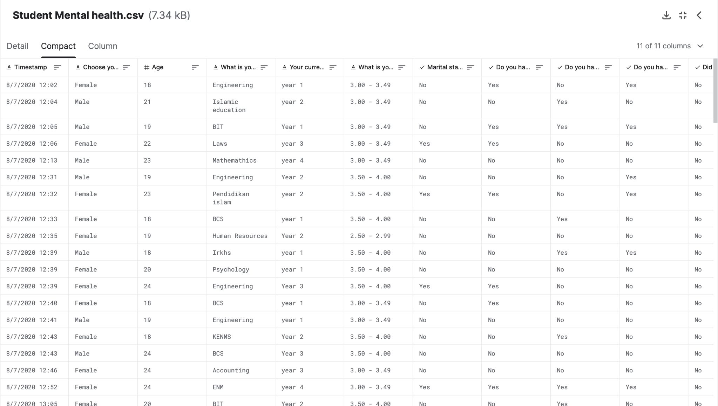
Student Mental Health Dataset
This dataset is the result of a survey conducted at the International Islamic University in Malaysia (MD Shariful Islam)
It has been updated as recent as 7 months ago
Made publicly available via Kaggle

Slide 8
Student Mental Health Dataset
Timestamp - time at which the survey was completed
Choose your gender - gender (male or female) of the participant
Age - satisfies requirements already (no change)
What is your course? - program in which the participant is majoring
Your current year of Study - how many years the participant has attended university
What is your CGPA? - current grade point average (or the ratio of grade points earned to grade points attempted), calculated on a 0.0-4.0 scale
Marital Status - describes whether or not the participant is married
Do you have Depression? - states whether or not the participant has depression G
Do you have Anxiety? - states whether or not the participant has anxiety
Do you have Panic attacks? - states whether or not the participant experiences panic attacks
Did you seek any specialist for a treatment? - states whether or not the participant sought professional treatment for any mental health concerns

Slide 9
Data Cleaning
2

Slide 10
Removing Noisy Data
Noisy Data: any negatives existing in numerical attributes (age, year of study, GPA) or any missing data values in any attribute
One attribute with noisy data: Age had a missing value
Solution: replace missing value with the average of the Age column
Utilized R to accomplish this
Value was replaced with 20.5

Slide 11
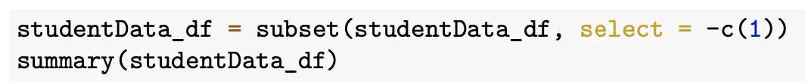
Removing Vanity Metrics
Vanity Metric: a measurable value with little to no impact
The Timestamp column was deemed a vanity metric
Not necessary for analysis
It did not provide relevant information
Created clutter in our dataset
Solution: remove the column from the dataset

Slide 12
Cleaning the Data for Analysis
Binning: categorizing data into smaller groups for easier analysis
Data must have a uniform format for binning
The Your current year of Study column contained the most variations of data entries
Example: “year 1” and “Year 1” would be placed into separate bins, despite holding the same value
Solution: cast each data value in the column to uppercase to remove ambiguity
“year 1” becomes “YEAR 1”

Slide 13
Data Wrangling
3

Slide 14
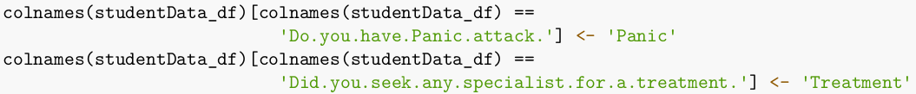
1. Renaming Columns
Short unambiguous titles that still convey the details
11 features, 101 samples each.
For multiple purposes:
Easier for the computer to parse
Easier for us as humans to work with
Easier to present in the report

Slide 15

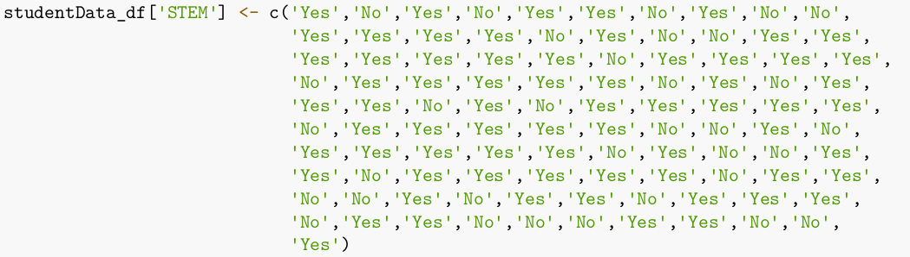
2. Categorizing Ambiguous Data
Data was collected with very loose restrictions
Sought to group all majors into a dichotomous variable
Explored algorithmic ways to do this

Slide 16
Exploratory
Data Analysis
4

Slide 17
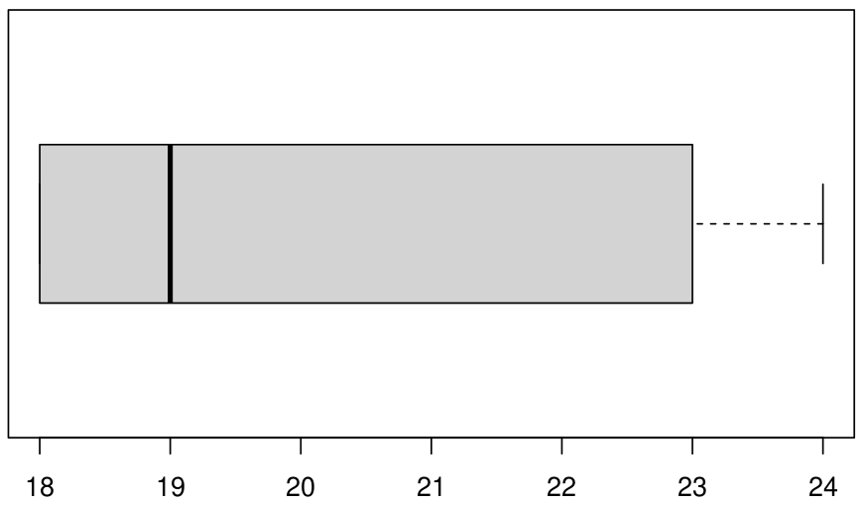

1. Age Distribution
Representative of what we would expect.

Slide 18
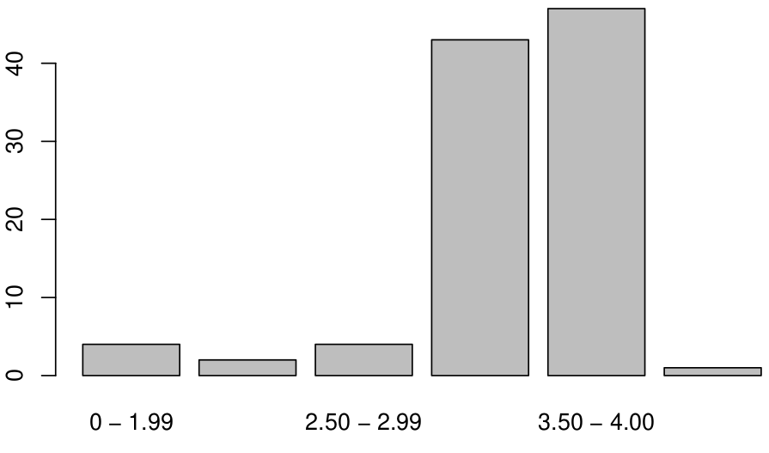
2. CGPA Distribution
Most students seem to be within the 3.00-3.49

Slide 19
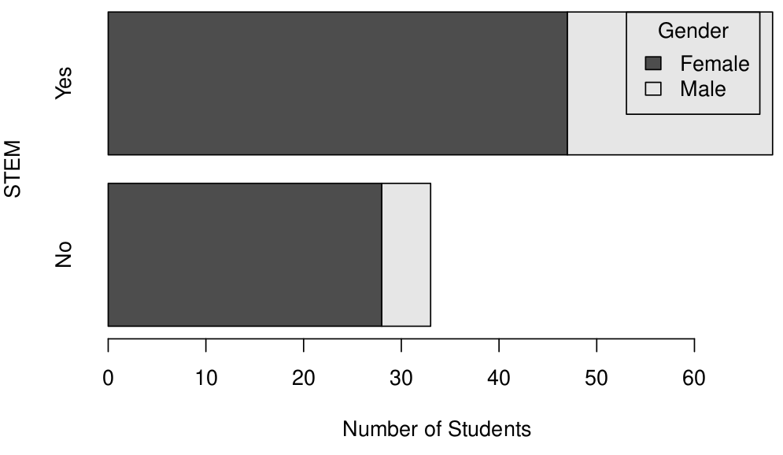
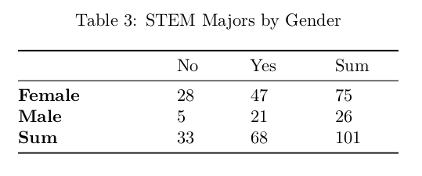
3. Gender and Major
74.25% Women; 25.75% Men
62.67% of Females in STEM
80.77% of Males in STEM

Slide 20
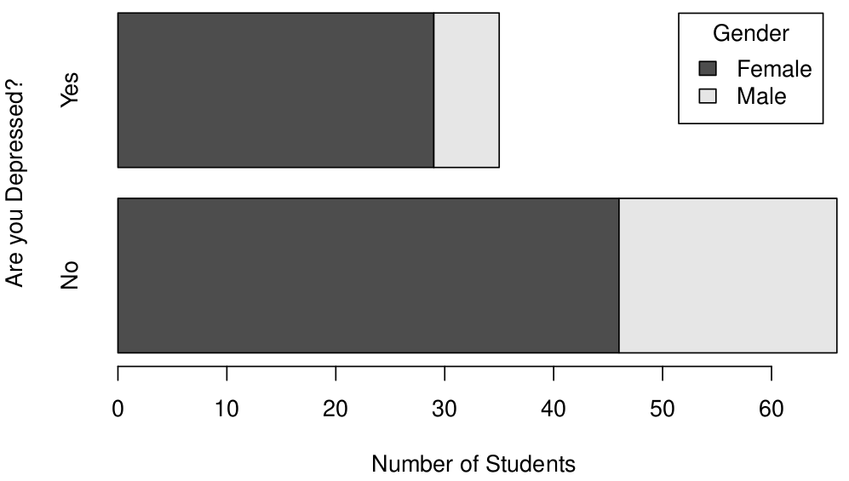
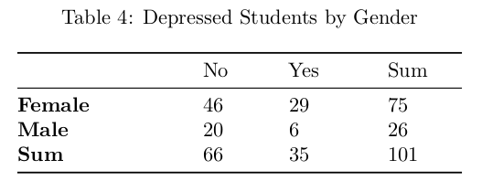
4. Gender and Depression
34.65% Depressed Population
38.67% of Females Depressed
23.08% of Males Depressed

Slide 21
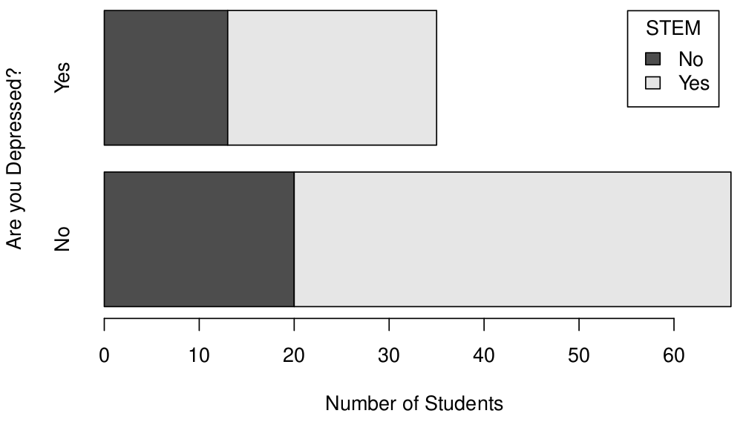
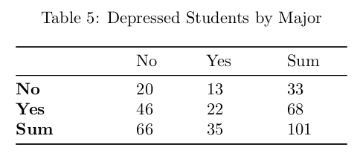
5. STEM and Depression
34.65% Depressed Population
39.39% of !STEM Depressed
32.34% of STEM Depressed

Slide 22
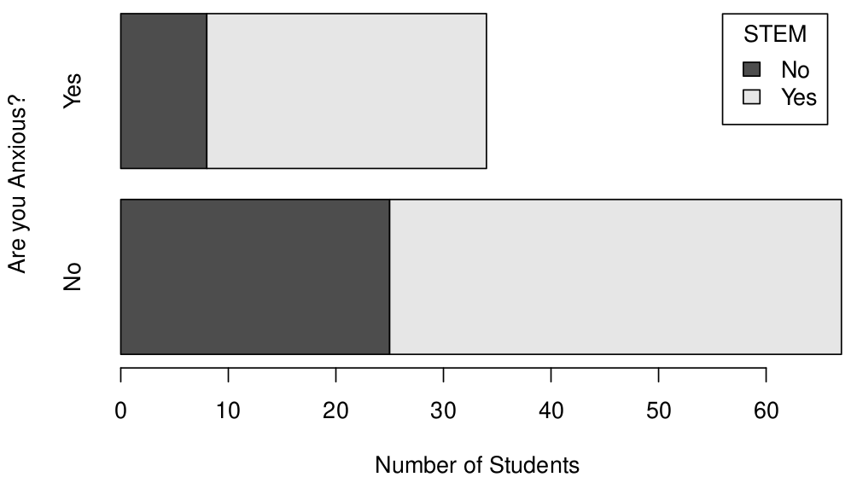
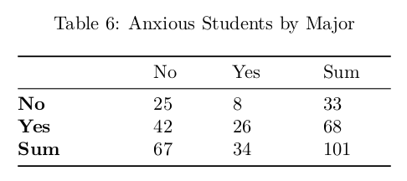
6. STEM and Anxiety
33.66% Depressed Population
34.24% of !STEM Anxious
38.24% of STEM Anxious

Slide 23
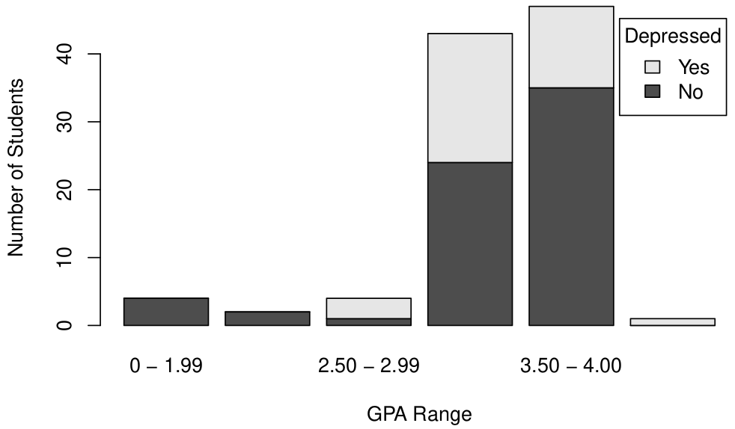
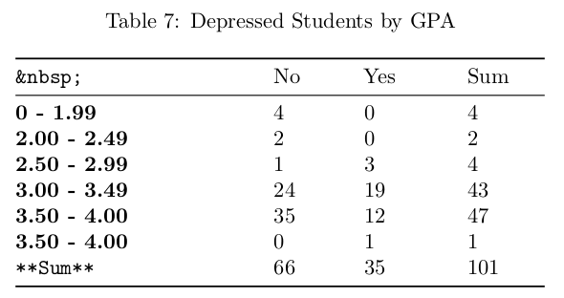
6. GPA and Depression

Slide 24
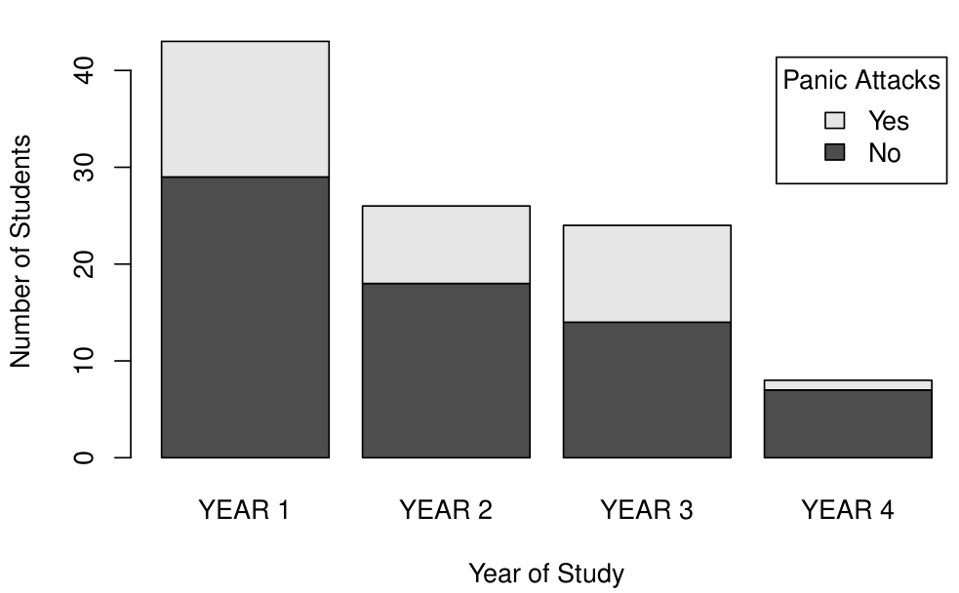
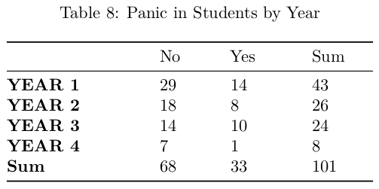
6. Year and Anxiety

Slide 25
Drawing Conclusions
5

Slide 26
Hypothesis Testing
State your research Hypothesis as null hypothesis and Alternative Hypothesis.
Collect data
Perform statistical test.
Decide weather you reject or fail to reject your null hypothesis.
Present your findings.

Slide 27

1. Hypothesis
STEM major has an effect on depression: two variables are dependent.
STEM major has no effect on depression: two variables are independent.
Null hypothesis: our variables are independent
Alternative hypothesis: our variables are dependent.

Slide 28

2. Collecting Data
Since our data is Dichotomous we decided the best thing to do would be base hypothesis on conditional probability
Data from stemDepressedTable
Probability of being depressed given that individual is a STEM Major.
Interested if the probability of individuals being depressed is greater in STEM Majors than in all other majors(all college students. )

Slide 29
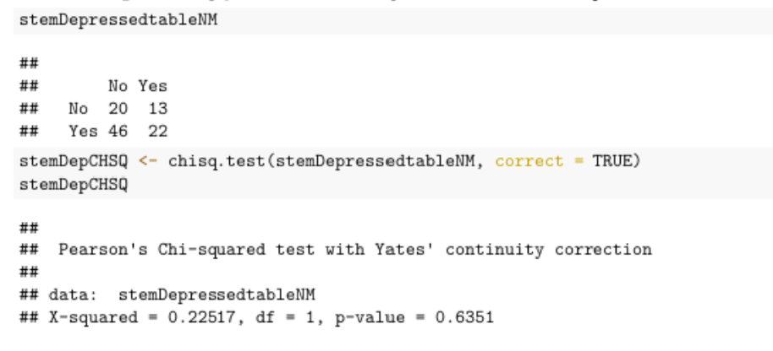
3. Chi-square test
We used the Chi-Square test to determine whether the data is significantly different from what we expected

Slide 30
4 & 5. Decision and Findings
The p-value we got is 0.6351. Since 0.6351 > 0.1.
we choose a relatively high significance level of .1 when making our decision because a Type II error was more harmful..
We reject our alternative hypothesis. And conclude that the events are independent

Slide 31
Conclusion
6

Slide 32
1. Summary
Described our data
Conditioned that data
Explored Possible Correlations
Tested assumptions
What does it all mean?

Slide 33
2. Findings
Sought to find a correlation between mental illness and major.
Could not determine through statistical analysis
Hypothesis testing for Depression and Anxiety correlation failed
At a glance?

Slide 34
3. Possible Pitfalls
Difficult to determine whether our analysis is truly representative
Small sample size, disproportionate samples
Possible over and under representation based on gender and curricula.
75% of samples being Female
66% of samples being STEM

Slide 35
4. Suggested Improvements
Improvements would be most recognized in data collection
Originally collected through Google Forms
Loose restrictions on response fields
Limit user string input
Greater participation is also required
Incentive based responses

Slide 36
Thank you!
Questions?

