Slide 1
Capstone Project - The Battle of the Neighborhoods

Slide 2
Introduction
Moscow is one of the largest cities in the world divided into more than 100 districts. Moscow is the city with growing prices for real estate and developed catering infrastructure.
Required to confirm assumption that there is dependency between price per square meter and catering infrastructure

Slide 3
Data
Moscow split by districts in .geojson found in GitHub (file was cleaned additionally)
latest per square meter real estate price from one of the most popular Moscow real-estate web-site
number of existing catering venues extracted from Forsquare API

Slide 4
Methodology
To confirm this assumption 2 tools were used:
Choropleth map
K-means clustering

Slide 5
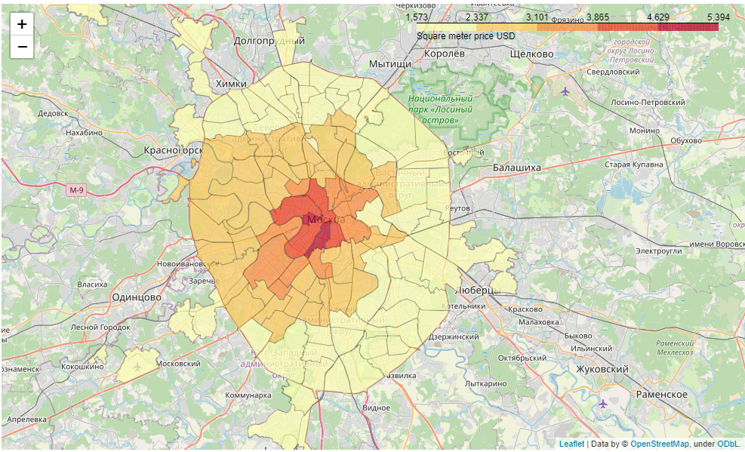
Analysis
Moscow split by districts with distribution of prices per square meter

Slide 6
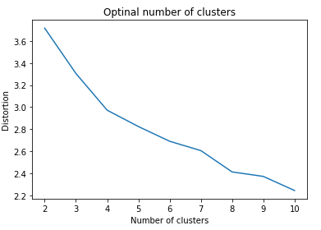
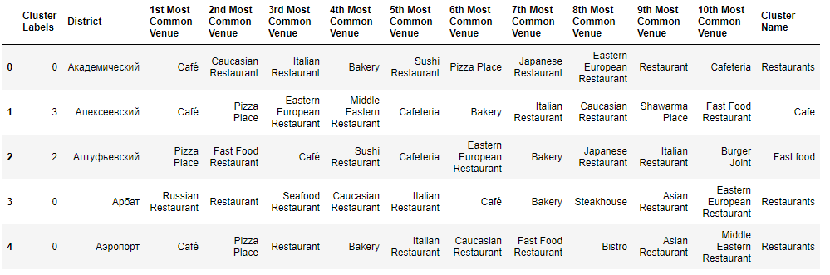
Analysis
4 clusters were identified
Restaurant
Cafeteria
Fast Food
Café
Districts were allocated to these clusters based on most common catering venues located in district

Slide 7
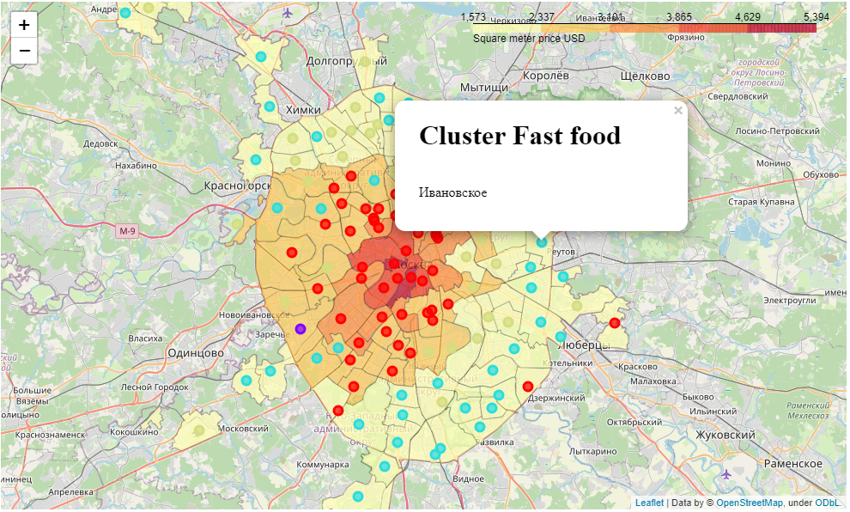
Results
From resulted map with additional details we can observe regularity that the more expensive square meter the higher level of catering venues.
Red - Restaurant
Lilac - Cafeteria
Blue - Fast Food
Yellow - Café

Slide 8
Conclusion
During this analysis the hypothesis was formulated that there is dependency between catering infrastructure and prices of square meters.
The report confirms such assumption and can be used for further analysis by building regression analysis to predict the price of square meter took into account catering infrastructure.

