Slide 1
CLASS-14-PROBABILITY
* Rules of class follow last classes.
* Don’t worry about the syllabus.
* I will complete your syllabus in a better way so that you can perform well in the exam.
* If you have any doubts, please ask. Don’t hesitate
* Thies chapter ends in only one day
BEST OF LUCK!

Slide 2
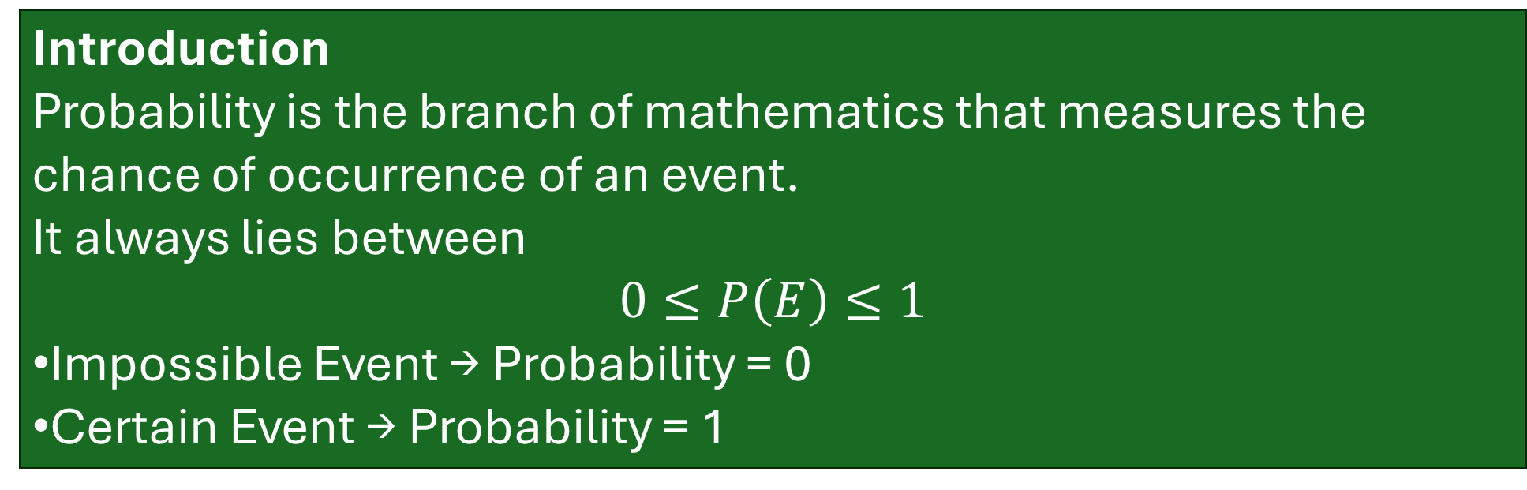
Introduction
Probability is the branch of mathematics that measures the chance of occurrence of an event.
It always lies between
$$0≤P\left(E\right)≤1$$
Impossible Event → Probability = 0
Certain Event → Probability = 1
Random Experiment
Definition
A random experiment is an experiment whose exact outcome cannot be predicted in advance, although all possible outcomes are known.

Slide 3
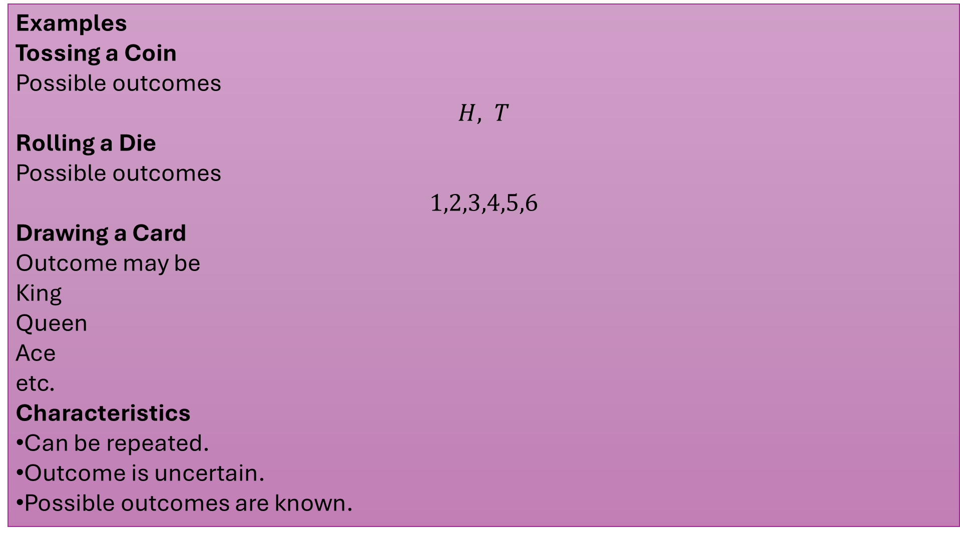
Examples
Tossing a Coin
Possible outcomes
$$H, T$$
Rolling a Die
Possible outcomes
$$1,2,3,4,5,6$$
Drawing a Card
Outcome may be
King
Queen
Ace
etc.
Characteristics
Can be repeated.
Outcome is uncertain.
Possible outcomes are known.

Slide 4

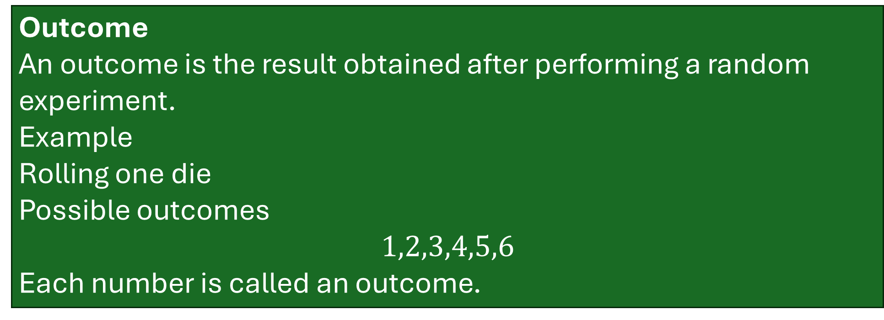
Outcome
An outcome is the result obtained after performing a random experiment.
Example
Rolling one die
Possible outcomes
$$1,2,3,4,5,6$$
Each number is called an outcome.
Sample Space
Definition
The set of all possible outcomes is called the sample space.
It is denoted by
$$S$$

Slide 5
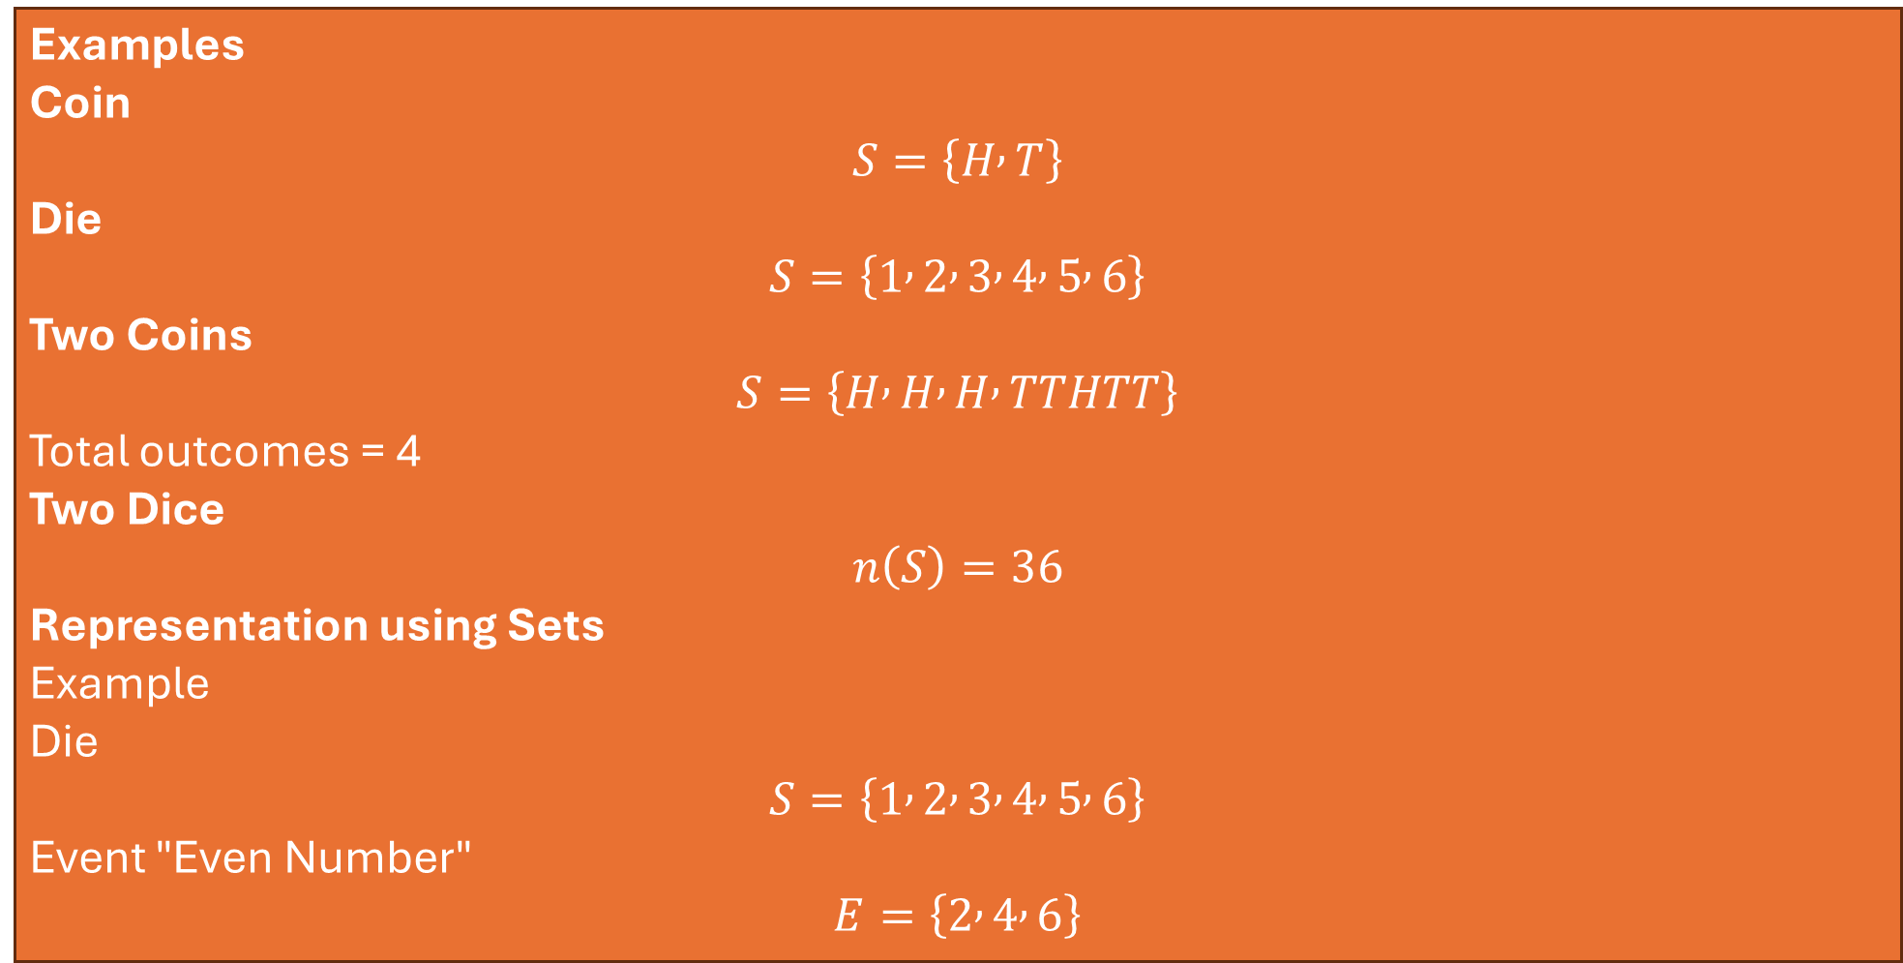
Examples
Coin
$$S=\left\{H , T\right\}$$
Die
$$S=\left\{1 , 2 , 3 , 4 , 5 , 6\right\}$$
Two Coins
$$S=\left\{H , H , H , TTHTT\right\}$$
Total outcomes = 4
Two Dice
$$n\left(S\right)=36$$
Representation using Sets
Example
Die
$$S=\left\{1 , 2 , 3 , 4 , 5 , 6\right\}$$
Event "Even Number"
$$E=\left\{2 , 4 , 6\right\}$$

Slide 6
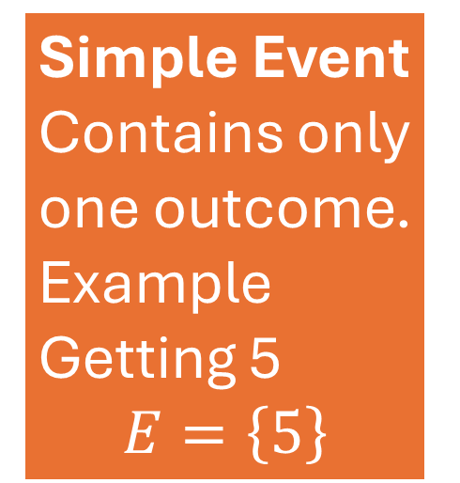

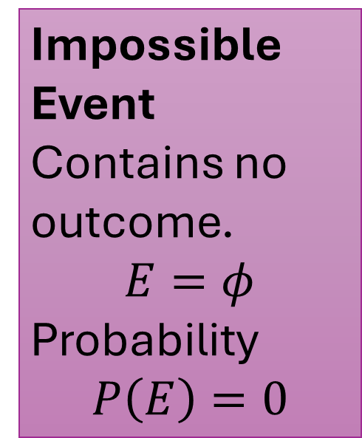
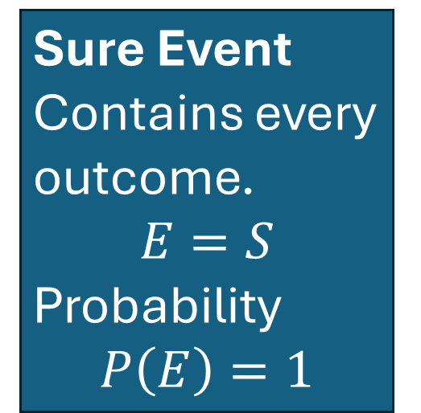
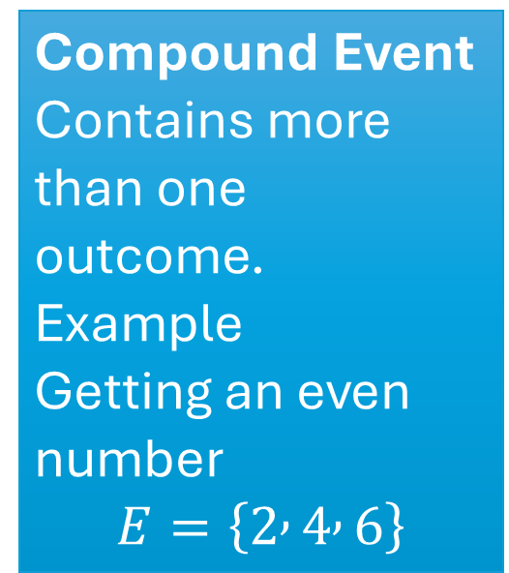
Event
An event is any subset of the sample space.
$$E⊆S$$
Types of Events
Simple Event
Contains only one outcome.
Example
Getting 5
$$E=\left\{5\right\}$$
Compound Event
Contains more than one outcome.
Example
Getting an even number
$$E=\left\{2 , 4 , 6\right\}$$
Sure Event
Contains every outcome.
$$E=S$$
Probability
$$P\left(E\right)=1$$
Impossible Event
Contains no outcome.
$$E=φ$$
Probability
$$P\left(E\right)=0$$

Slide 7
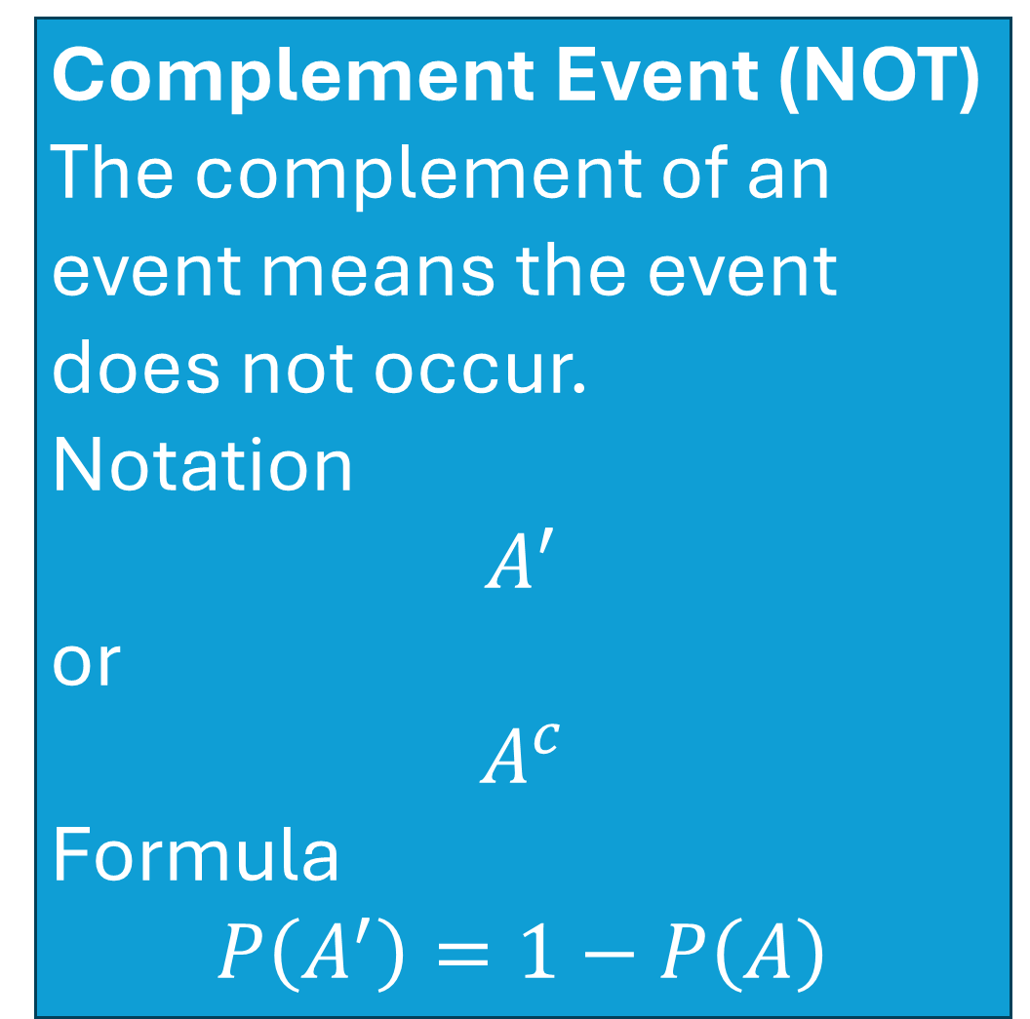
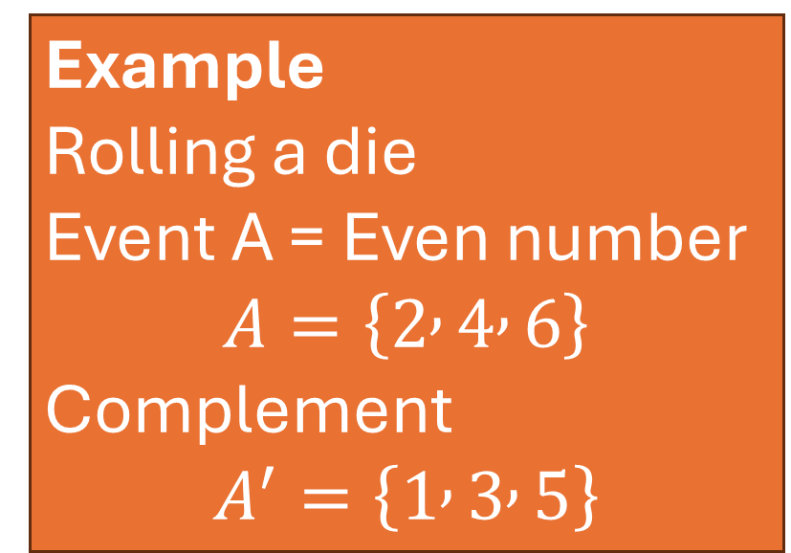
Complement Event (NOT)
The complement of an event means the event does not occur.
Notation
$$A^{′}$$
or
$$A^{c}$$
Formula
$$P\left(A^{′}\right)=1−P\left(A\right)$$
Example
Rolling a die
Event A = Even number
$$A=\left\{2 , 4 , 6\right\}$$
Complement
$$A^{′}=\left\{1 , 3 , 5\right\}$$

Slide 8
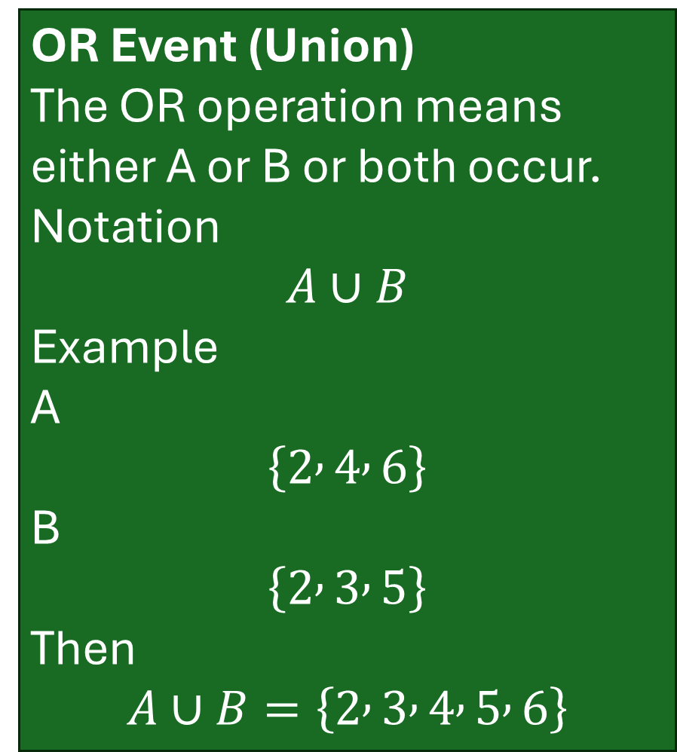
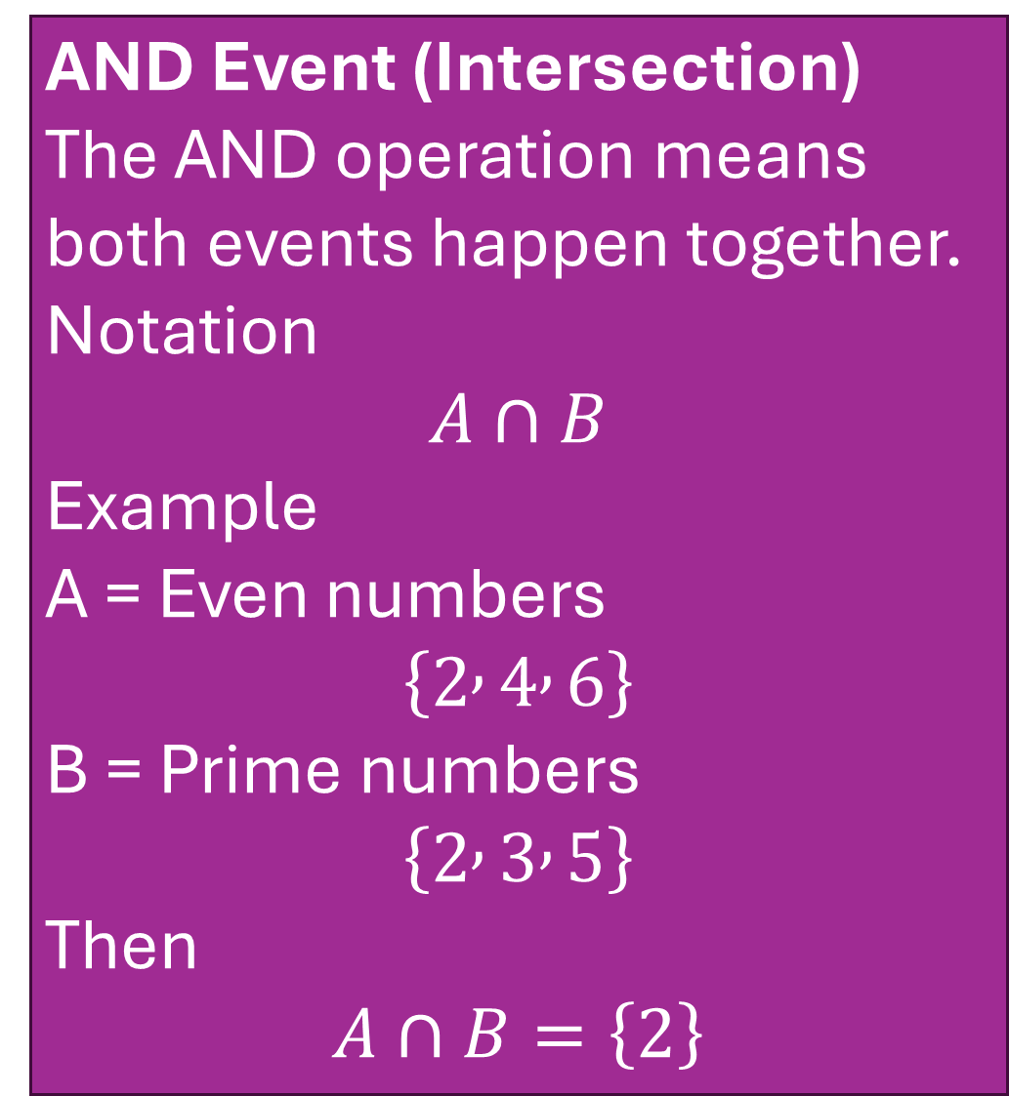
AND Event (Intersection)
The AND operation means both events happen together.
Notation
$$A∩B$$
Example
A = Even numbers
$$\left\{2 , 4 , 6\right\}$$
B = Prime numbers
$$\left\{2 , 3 , 5\right\}$$
Then
$$A∩B=\left\{2\right\}$$
OR Event (Union)
The OR operation means either A or B or both occur.
Notation
$$A∪B$$
Example
A
$$\left\{2 , 4 , 6\right\}$$
B
$$\left\{2 , 3 , 5\right\}$$
Then
$$A∪B=\left\{2 , 3 , 4 , 5 , 6\right\}$$

Slide 9
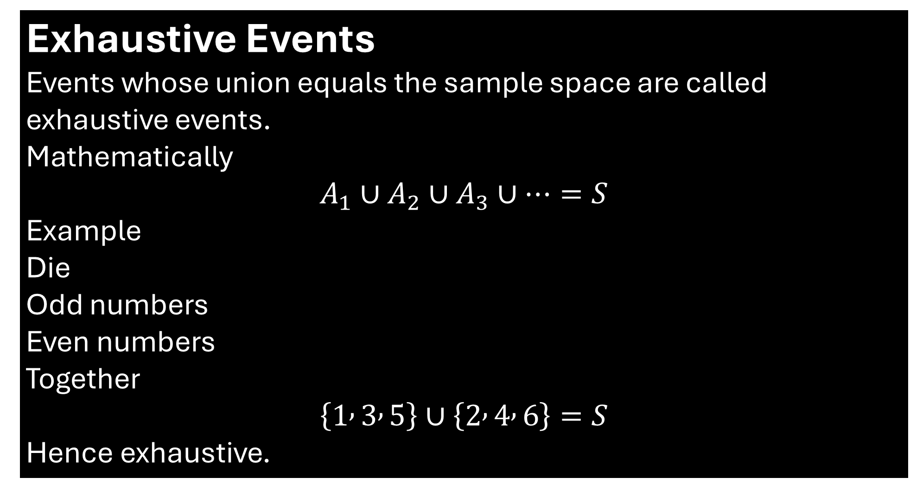
Exhaustive Events
Events whose union equals the sample space are called exhaustive events.
Mathematically
$$A_{1}∪A_{2}∪A_{3}∪⋯=S$$
Example
Die
Odd numbers
Even numbers
Together
$$\left\{1 , 3 , 5\right\}∪\left\{2 , 4 , 6\right\}=S$$
Hence exhaustive.

Slide 10
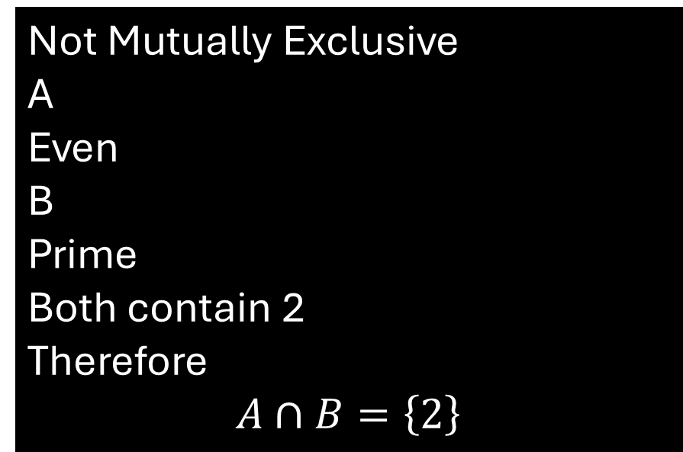
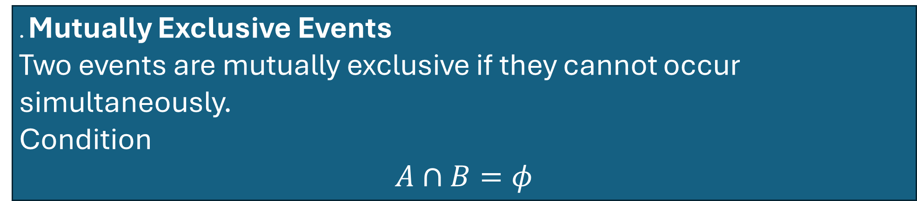
. Mutually Exclusive Events
Two events are mutually exclusive if they cannot occur simultaneously.
Condition
$$A∩B=φ$$
Example
Getting
2
and
5
on one die roll.
Impossible together.
Not Mutually Exclusive
A
Even
B
Prime
Both contain 2
Therefore
$$A∩B=\left\{2\right\}$$

Slide 11
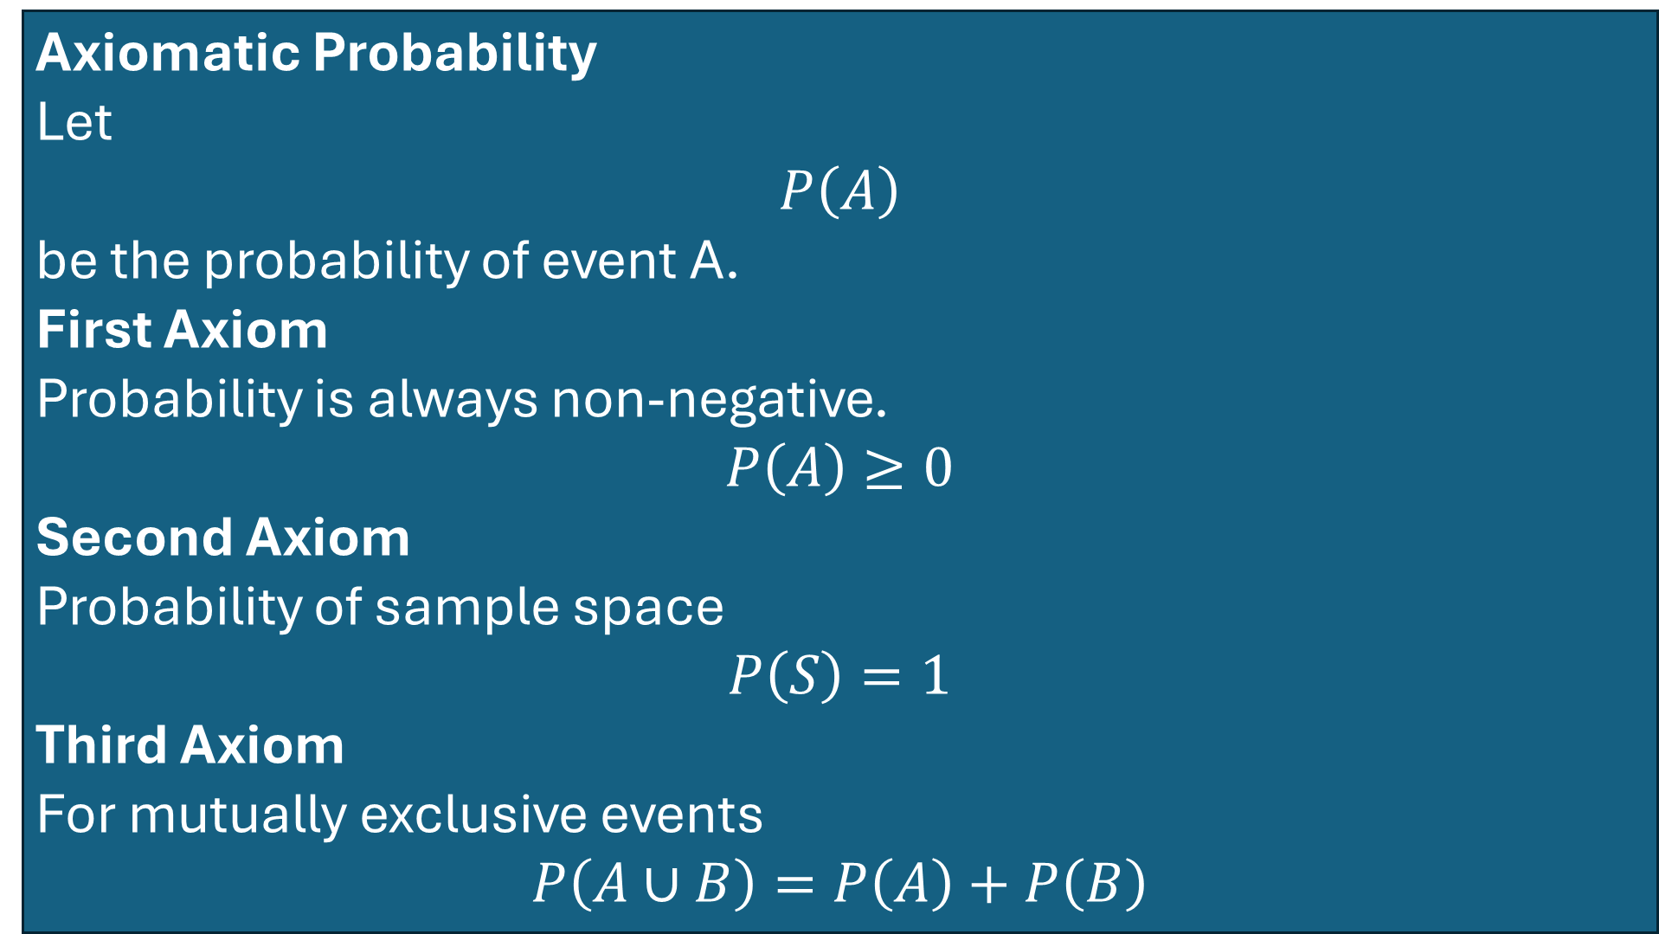
Axiomatic Probability
Let
$$P\left(A\right)$$
be the probability of event A.
First Axiom
Probability is always non-negative.
$$P\left(A\right)≥0$$
Second Axiom
Probability of sample space
$$P\left(S\right)=1$$
Third Axiom
For mutually exclusive events
$$P\left(A∪B\right)=P\left(A\right)+P\left(B\right)$$

Slide 12
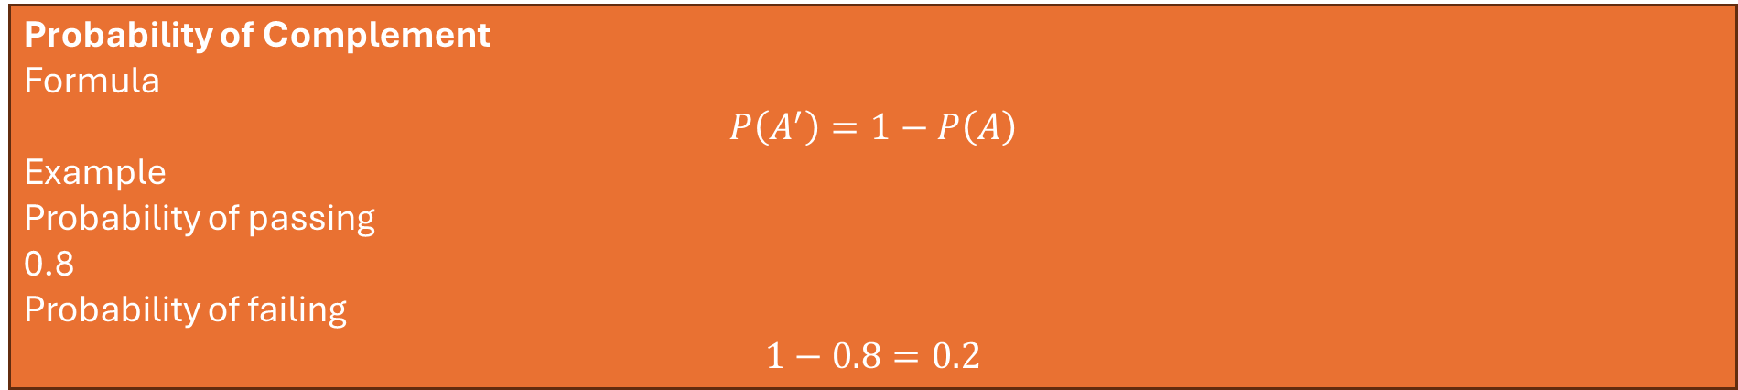
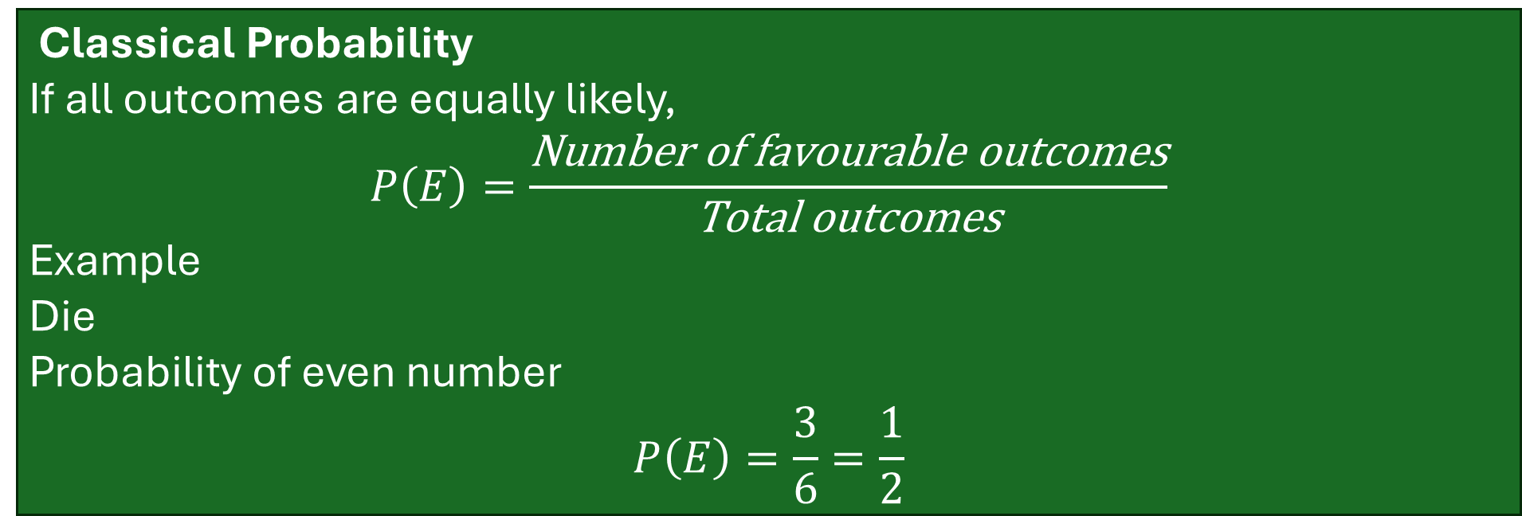
Classical Probability
If all outcomes are equally likely,
$$P\left(E\right)=\frac{\text{Number} \text{of} \text{favourable} \text{outcomes}}{\text{Total} \text{outcomes}}$$
Example
Die
Probability of even number
$$P\left(E\right)=\frac{3}{6}=\frac{1}{2}$$
Probability of Complement
Formula
$$P\left(A^{′}\right)=1−P\left(A\right)$$
Example
Probability of passing
0.8
Probability of failing
$$1−0.8=0.2$$

Slide 13
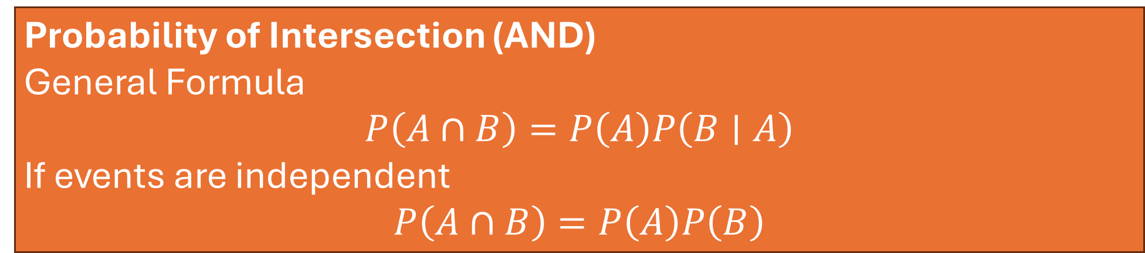

Probability of Union (OR)
General Formula
$$P\left(A∪B\right)=P\left(A\right)+P\left(B\right)−P\left(A∩B\right)$$
If events are mutually exclusive
$$P\left(A∪B\right)=P\left(A\right)+P\left(B\right)$$
Probability of Intersection (AND)
General Formula
$$P\left(A∩B\right)=P\left(A\right)P\left(B∣A\right)$$
If events are independent
$$P\left(A∩B\right)=P\left(A\right)P\left(B\right)$$

Slide 14
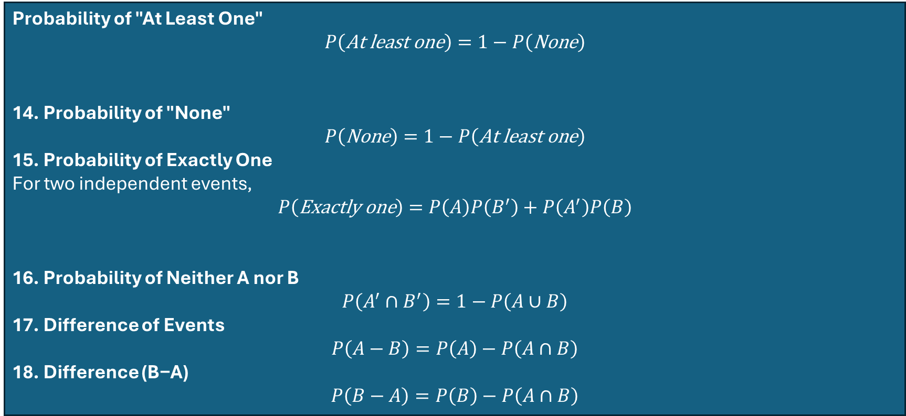

Conditional Probability
$$P\left(A∣B\right)=\frac{P\left(A∩B\right)}{P\left(B\right)}$$
Probability of "At Least One"
$$P\left(\text{At} \text{least} \text{one}\right)=1−P\left(\text{None}\right)$$
14. Probability of "None"
$$P\left(\text{None}\right)=1−P\left(\text{At} \text{least} \text{one}\right)$$
15. Probability of Exactly One
For two independent events,
$$P\left(\text{Exactly} \text{one}\right)=P\left(A\right)P\left(B^{′}\right)+P\left(A^{′}\right)P\left(B\right)$$
16. Probability of Neither A nor B
$$P\left(A^{′}∩B^{′}\right)=1−P\left(A∪B\right)$$
17. Difference of Events
$$P\left(A−B\right)=P\left(A\right)−P\left(A∩B\right)$$
18. Difference (B−A)
$$P\left(B−A\right)=P\left(B\right)−P\left(A∩B\right)$$

Slide 15
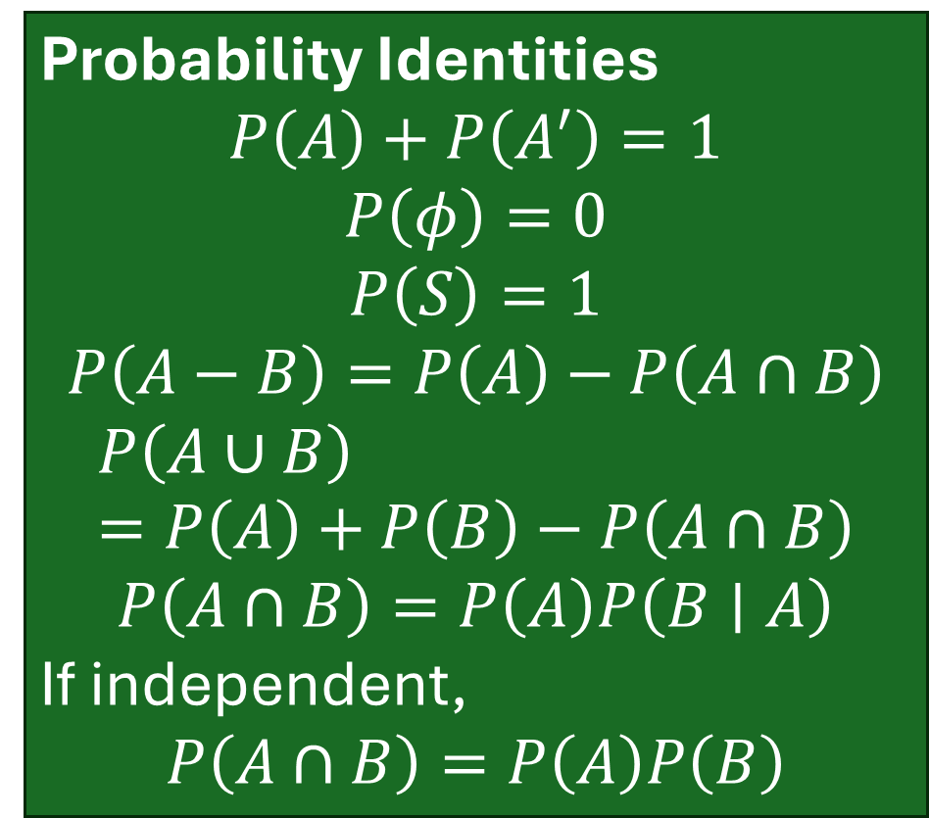
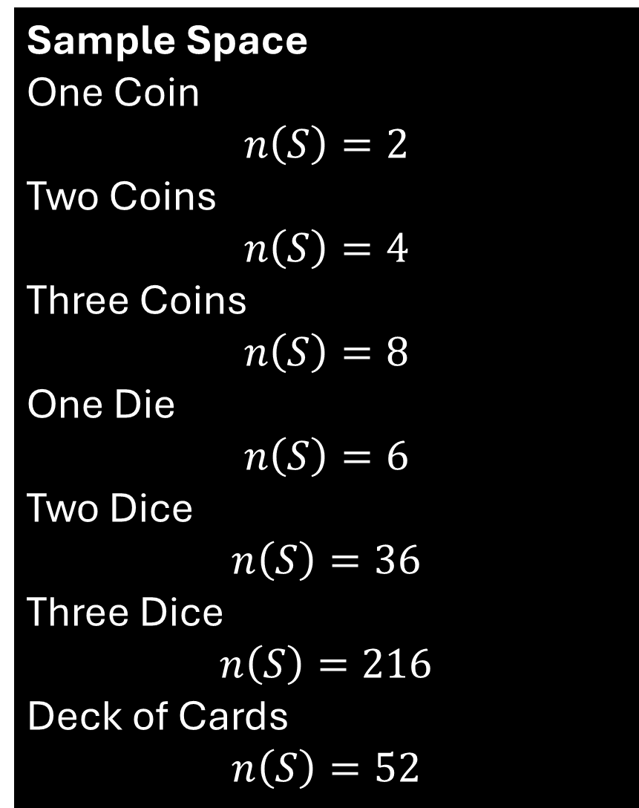
Sample Space
One Coin
$$n\left(S\right)=2$$
Two Coins
$$n\left(S\right)=4$$
Three Coins
$$n\left(S\right)=8$$
One Die
$$n\left(S\right)=6$$
Two Dice
$$n\left(S\right)=36$$
Three Dice
$$n\left(S\right)=216$$
Deck of Cards
$$n\left(S\right)=52$$
Probability Identities
$$P\left(A\right)+P\left(A^{′}\right)=1$$
$$P\left(φ\right)=0$$
$$P\left(S\right)=1$$
$$P\left(A−B\right)=P\left(A\right)−P\left(A∩B\right)$$
$$P\left(A∪B\right)=P\left(A\right)+P\left(B\right)−P\left(A∩B\right)$$
$$P\left(A∩B\right)=P\left(A\right)P\left(B∣A\right)$$
If independent,
$$P\left(A∩B\right)=P\left(A\right)P\left(B\right)$$

Slide 16
Example 1
A fair coin is tossed once. Find the probability of getting a Head.
Example 2
A fair coin is tossed once. Find the probability of getting a Tail.
Example 3
A fair die is rolled once. Find the probability of getting the number 4.
Example 4
A fair die is rolled once. Find the probability of getting an even number.
Example 5
A fair die is rolled once. Find the probability of getting an odd number.
Example 6
A fair die is rolled once. Find the probability of getting a prime number.
Example 7
A fair die is rolled once. Find the probability of getting a multiple of 3.
Example 8
A fair die is rolled once. Find the probability of getting a number greater than 4.
Example 9
A fair die is rolled once. Find the probability of getting a number less than 5.
Example 10
A fair die is rolled once. Find the probability of getting a number greater than 6.
Example 11
A fair die is rolled once. Find the probability of getting a number less than 7.
Example 12
A card is drawn at random from a standard deck of 52 cards. Find the probability of drawing an Ace.
Example 13
A card is drawn at random from a standard deck of 52 cards. Find the probability of drawing a King.
Example 14
A card is drawn at random from a standard deck of 52 cards. Find the probability of drawing a Queen.
Example 15
A card is drawn at random from a standard deck of 52 cards. Find the probability of drawing a Heart.
Example 16
A card is drawn at random from a standard deck of 52 cards. Find the probability of drawing a Spade.

Slide 17
Example 159
A bag contains 5 red, 4 blue, and 3 green balls. Two balls are drawn without replacement. Find the probability that one is red and the other is blue.
Example 160
Three fair coins are tossed and a die is rolled. Find the probability of getting exactly two Heads and an even number on the die.
Example 161
A card is drawn from a deck and a coin is tossed. Find the probability of drawing a face card and getting a Head.
Example 162
Two cards are drawn successively without replacement. Find the probability that both cards are Queens.
Example 163
Two cards are drawn successively without replacement. Find the probability that the first card is a Heart and the second card is a Spade.
Example 164
A die is rolled twice. Find the probability that the first number is even and the second number is greater than 3.
Example 165
A fair coin is tossed three times. Find the probability of getting at least one Head and at least one Tail.
Example 166
Two dice are rolled simultaneously. Find the probability that the product of the numbers obtained is divisible by 6.

Slide 18


Slide 19


