Slide 1
Directing the Audience
Jeremy Morris
Department of Operations and Information Systems
University of Utah

Slide 2
Agenda
Guideline for effective data visualization: Direct the audience
Motivation
Directing the audience
Understanding preattentive attributes
Creating:
Focus and/or a visual hierarchy
A process for directing the audience

Slide 3
Motivation | The challenges
Concept: We have about 3 – 8 seconds with our reader in order to get their attention. Three outcomes post 3 – 8 seconds:
The reader maintains focus on our data visualization/analysis
The reader moves on but got the gist of the data visualization/analysis in the 3 – 8 seconds
The reader moves on and got limited or no value from the 3 – 8 seconds
Concept: Without visual cues, most readers will read in a Z-shaped pattern from left to right, then down a line, and so on.
Question: Is this how you want them to make their way through your data visualization/analysis?

Slide 4
Motivation | Recall “Cognitive Load and Clutter”
Concept: The lecture on removing clutter was about “not hurting” our audience. This lecture is on “enhancing the understanding” of our audience by providing direction.

Slide 5
Motivation | The eye-brain system
We “see” with a combination of our:
Eye(s)
Light comes into the lens and focuses on the retina
Retina is made from brain cells (seeing and thinking are one at this point)
Results from this step travel via the optic nerve to the brain
Optic nerve(s)
Throughput is approx. 10Mbps (each)
Brain
“Editor”: chooses, forgets, summarizes, focuses, etc.
The Eye-brain system has approx. 1000x the resolution of a standard power point slide
How do we take advantage of the eye-brain system with our visual displays?

Slide 6
Directing the Audience | Preattentive Attributes | Overview
Image Source: www.fusioncharts.com, accessed 2016-07-10
Notes:
Preattentive attributes are things that we notice with a minimum of cognitive effort
Things we will notice as different
-Gestalts are ways we perceive groups of things or similarity between elements of a chart (or anything really)
Will talk about how to use these preattentive attributes in charts and graphs

Slide 7
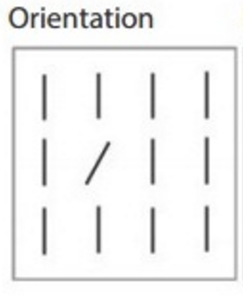
Directing the Audience | Preattentive Attributes | Orientation
Effective for:
Ordered data with a few values
Quantitative data
Ordinal data
Other considerations:
Not a commonly supported feature in data viz tools

Slide 8
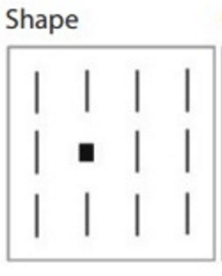
Directing the Audience | Preattentive Attributes | Shape
Effective for:
Unordered data with a medium number of values
Categorical data
Other considerations:
Broadly supported in data viz tools
Notes:
Saw this in some of our labs, this is generally supported. Can help override proximity or enhance it.

Slide 9
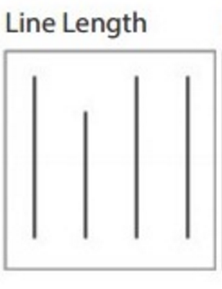
Directing the Audience | Preattentive Attributes | Line Length
Effective for:
Ordered data with many values
Quantitative data
Ordinal data
Other considerations:
This preattentive attribute explains why bar charts are very effective for their use
Broadly supported in data viz tools

Slide 10
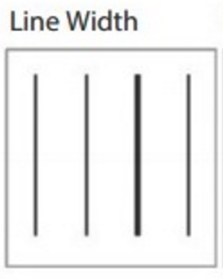
Directing the Audience | Preattentive Attributes | Line Width
Effective for:
Ordered data with a few values
Ordinal data
Other considerations:
Supported in some data viz tools

Slide 11
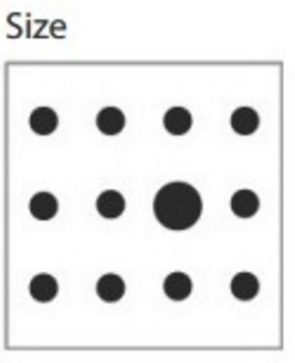
Directing the Audience | Preattentive Attributes | Size
Effective for:
Ordered data with many useful values
Quantitative data
Ordinal data
Other considerations:
Broadly supported data viz tools
Sometimes Size is used when Shape is a better encoding
Notes:
Shape better when data is nominal, size implies quantitative difference.

Slide 12
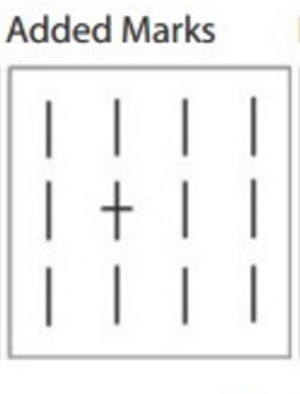
Directing the Audience | Preattentive Attributes | Added Marks
Effective for:
Unordered data with a medium number of values
Categorical data
Other considerations:
Broadly supported data viz tools
Notes:
Call-out or extra label counts as added marks. Even in ggplot, you can drop text directly on a chart if needed. Too many and it gets really cluttered, so use sparingly.

Slide 13
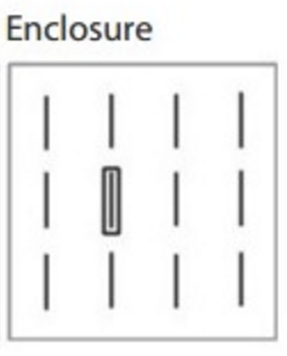
Directing the Audience | Preattentive Attributes | Enclosure
Effective for:
Unordered data with many values
Categorical data
Relationship data
Other considerations:
Supported in some data viz tools
Notes:
Enclosure related to the same item we saw in the lecture about Gestalt principles. You can use it to draw a shape around something to group things and override proximity. You can also use it to draw attention to something. In other words, it doesn’t have to be used with a scatterplot. I use it a ton with bar charts where I want to point out something specific. Often I will group it with an added mark or comment.

Slide 14
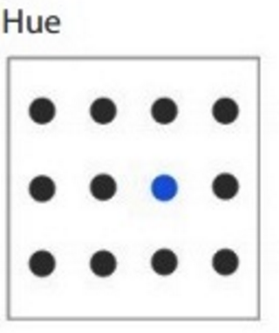
Directing the Audience | Preattentive Attributes | Hue
Effective for:
Unordered data with a few
Categorical data
Other considerations:
Broadly supported in data viz tools

Slide 15
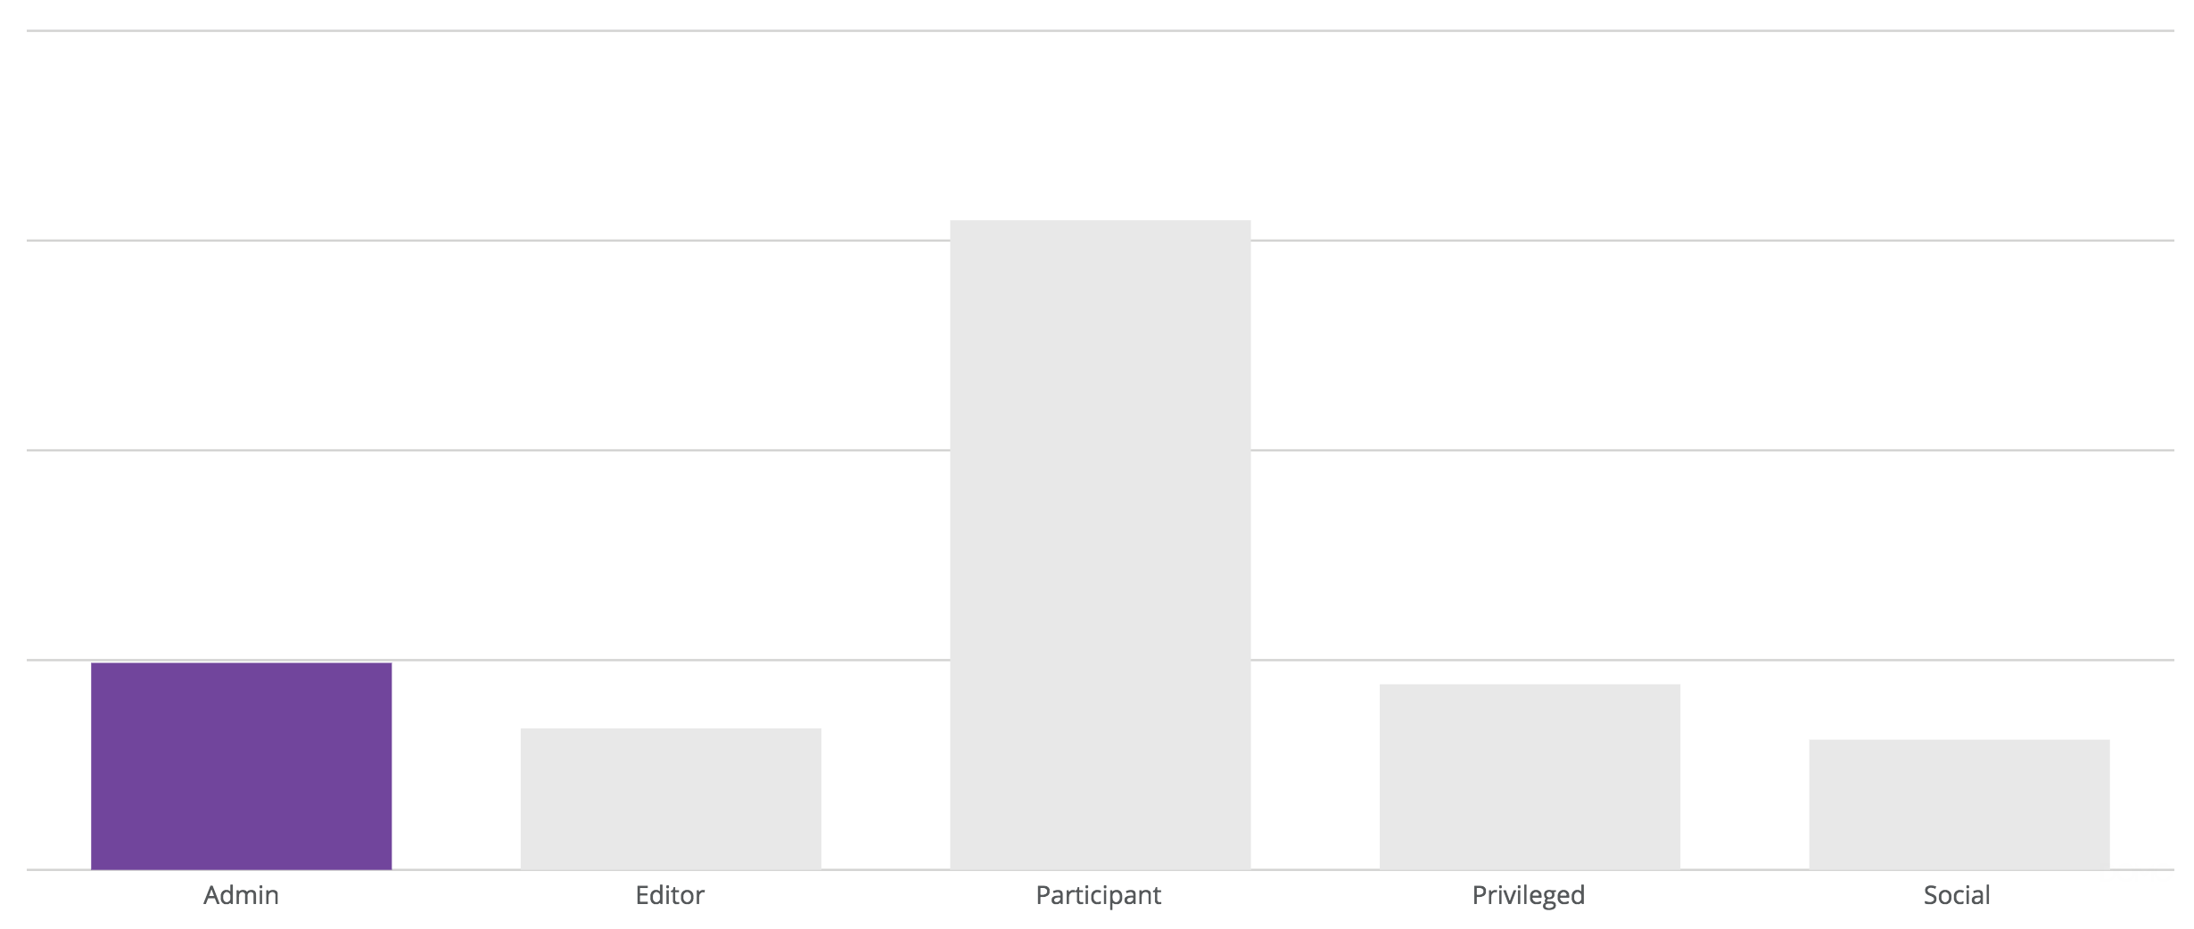

Slide 16
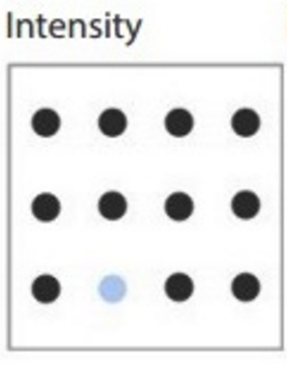
Directing the Audience | Preattentive Attributes | Intensity
Effective for:
Ordered data with a few values
Ordinal data
Other considerations:
Broadly supported by data viz tools

Slide 17
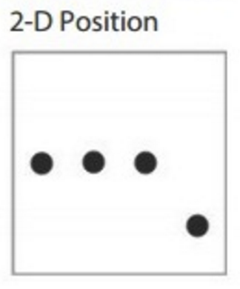
Directing the Audience | Preattentive Attributes | Position
Effective for:
Ordered data with many values
Quantitative data
Ordinal data
Categorical data
Relationship data
Other considerations:
Broadly supported by data viz tools

Slide 18
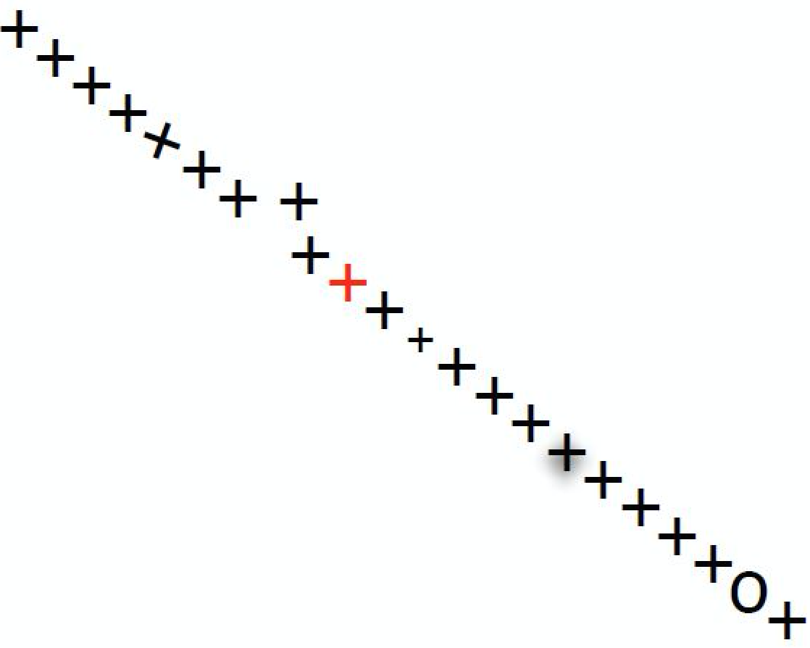
Directing the Audience | Preattentive Attributes | Exercise
Which preattentive attributes are used?
Notes:
Which appear to be strongest vs weakest

Slide 19


Directing the Audience | Effective encodings
Use position first, then consider other encodings
Color is difficult
Intensity (has order)
Hue (does not have order)
Other encodings:
Labels: take advantage of Proximity Gestalt
Pattern Density: similar to Intensity
Pattern Texture: similar to Color
Line Pattern: effective for different relationships

Slide 20
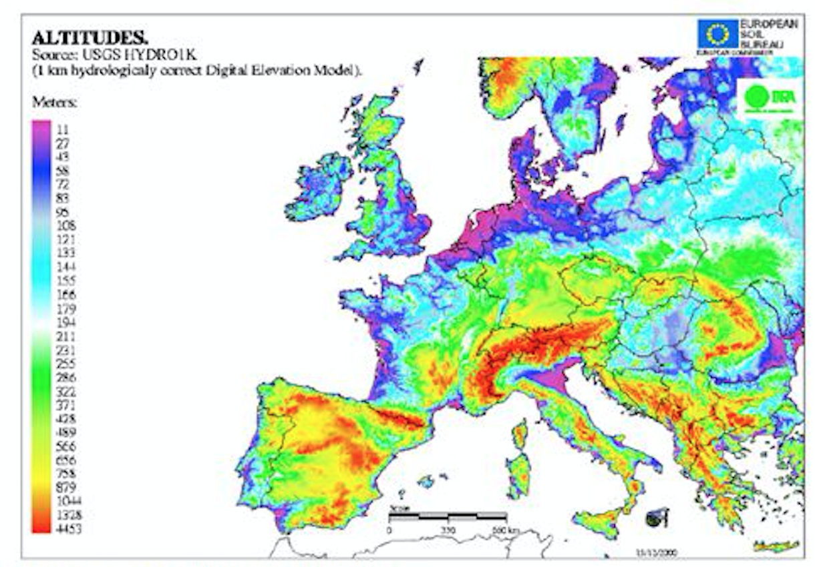
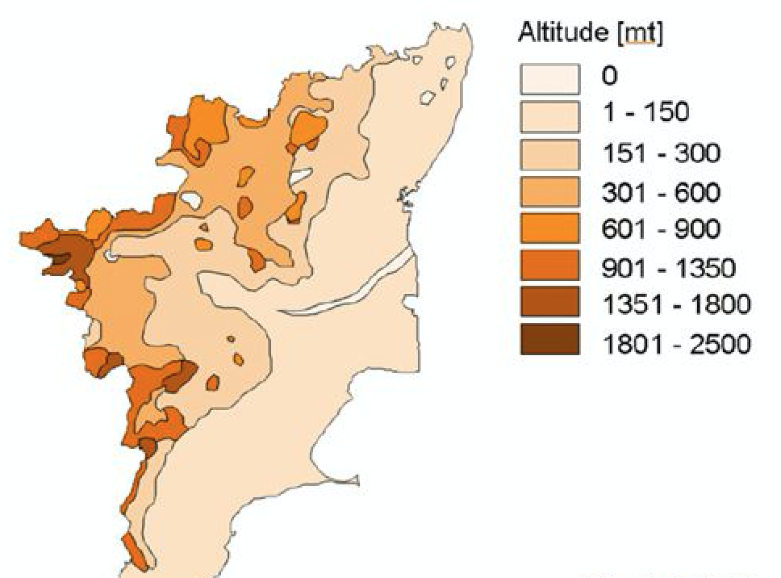
Directing the Audience | Effective encodings | Color is difficult example
Color (Hue) does not have order and is therefore difficult
Saturation (Intensity) does have order and is therefore more effective
Notes:
What is the difference between the two? What do you think when you see the one on the left? And the one on the right?

Slide 21
Directing the Audience | Creating focus/visual hierarchy
Recall explanatory vs. exploratory approaches
When we are directing the audience, our approach is explanatory
For example, “treating” one aspect of the graphic with a preattentive attribute makes ”untreated” aspects relatively less noticeable/understandable to the audience

Slide 22
Directing the Audience | Creating focus/visual hierarchy (cont’d)
Open MS Word
Add:
Title
Subtitle
Heading 1
Heading 2
Heading 3
Heading 4
Body
Discussion:
Which preattentive attributes are used?
Do you agree that the visual hierarchy is effective?

Slide 23
Directing the Audience | The process
Guideline: use preattentive attributes sparingly; too many reduces focus for the audience
Process steps:
Start with everything “untreated”
”Treat” aspects of the data visualization one at a time with an effective preattentive attribute
(Stop before you add too many “treatments”)

Slide 24
References
Nussbaumer Knaflic, C., “storytelling with data”, Wiley (2015)
Illinsky, N., Steele, J., “Designing Data Visualizations: Intentional Communication from Data to Display”, O’Reilly (2014)
Tufte, E., “The Visual Display of Quantitative Data, Second Edition”, Graphics Press (2001)

Slide 25
Appendix

