Slide 1
Using Stories
Jeremy Morris
Department of Operations and Information Systems
University of Utah

Slide 2
Agenda
Guideline for effective data visualization: Consider presenting your data visualization in the context of a story
Motivation
Robert McKee
Kurt Vonnegut
Using stories
Three-act structure
Story Considerations
Verifying Story Clarity
An example

Slide 3
Motivation | Robert McKee | Two ways to persuade people
Conventional rhetoric
Uses compelling facts/metrics
Intellectual engagement (debate) with audience
Problem: even if persuaded (intellectually), people are not inspired to reason/act alone
Stories
Unite an idea with emotion, arousing the audience’s attention and energy
More difficult to create story as compared to conventional rhetoric
Notes:
Combine idea with emotion.
Creating stories actually more difficult. But we live in a world where facts often need to resonate with people to get them to act. Stories help us to achieve that

Slide 4
Motivation | Robert McKee | Two ways to persuade people (cont’d)
Concept: without a story, our data visualization is likely part of a conventional rhetoric approach

Slide 5
Best practices in storytelling | Kurt Vonnegut
 | Written word | Data Visualization
Keep it simple | "I have only made this letter longer because I have not had the time to make it shorter.”, Blaise Pascale | Choosing the common bar chart because it is an effective display
Edit ruthlessly | ”If a sentence, no matter how excellent, does not illuminate your subject in some new and useful way, scratch it out.” | Remove clutter leveraging Gestalts
Be authentic | “I myself trust my own writing most, and others seem to trust it most, too, when I sound most like a person for Indianapolis, which is what I am.” | Be cautious of the extent to which audiences engage/act based on data presented visually. Don’t present it visually if you don’t have confidence in it.
Communicate to your audience | “Our audience requires us to be sympathetic and patient teachers, ever willing to simplify and clarify” | Consider who, what and how
Notes:
The idea here is that we can look at somethings said by more traditional story tellers and relate that back to what we’re doing in data visualization

Slide 6
Using Stories | Three-act structure | Written Word
First act: “setup”
Main character, their relationships and context are introduced
Incident occurs which initiates conflict/tension in main character’s life; called first turning point
Second act: “conflict”
Bulk of the story
Represent main character’s attempts to resolve the conflict/tension from the first turning point
Main character goes through changes in their life as a result of what is happening
Third act: “resolution”
Conflict/tension reaches highest point of intensity (climax)
Story and subplots resolved

Slide 7
Using Stories | Three-act structure | Data Visualization
First act: “setup”
Frame the story in terms of the audience’s problem so they immediately have a stake in the solution (first turning point)
Concept: “the conflict between what is and what could be”
Second act: “conflict”
Consider the following as part of this phase:
Further development of problem description
External context/comparison points
Examples that illustrate problem
Data that demonstrates the problem
What will happen if no action taken
Options for addressing the problem
Benefits for recommended solution
Make it clear why audience is in a position to act
Focusing on “what could be”
This drives the audience to act in an attempt to resolve the conflict/tension from the first turning point
Third act: “resolution”
Call to action which will resolve the conflict/tension
Notes:
the conflict between what is and what could be – conflict between what is and what is expected
Often another tactic is to follow an individual through the problem and pepper their story with facts related to the rest of the population. See this a lot with customer journey discussions

Slide 8
Using Stories | Verifying story clarity
Horizontal logic
If horizontal logic is sound, one can just read the titles of the slides and get the gist of the story
Approach:
Start with an exec summary slide (i.e. titles for all slides on one page)
Then from each bullet on the exec summary, create all of your other slides/titles
Vertical logic
All information on a given slide is self-reinforcing
No “left-over”/misfit concepts
External review
Have it reviewed by a colleague
Ideally a colleague without context so that they better represent the audience

Slide 9
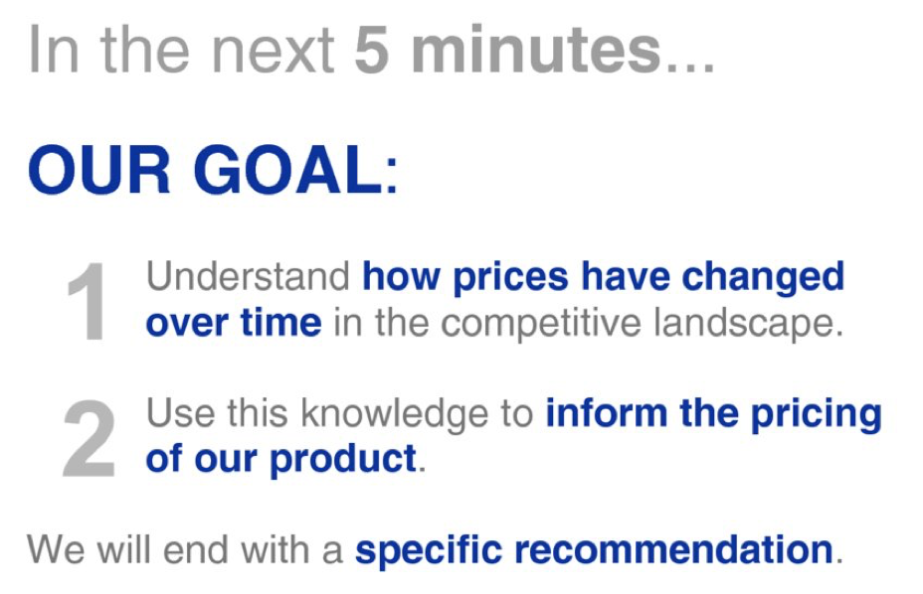
Using Stories

Slide 10
Using Stories (cont’d)
Recall (act 1):
Frame the story in terms of the audience’s problem so they immediately have a stake in the solution
Establish conflict/tension between what could and what could be

Slide 11
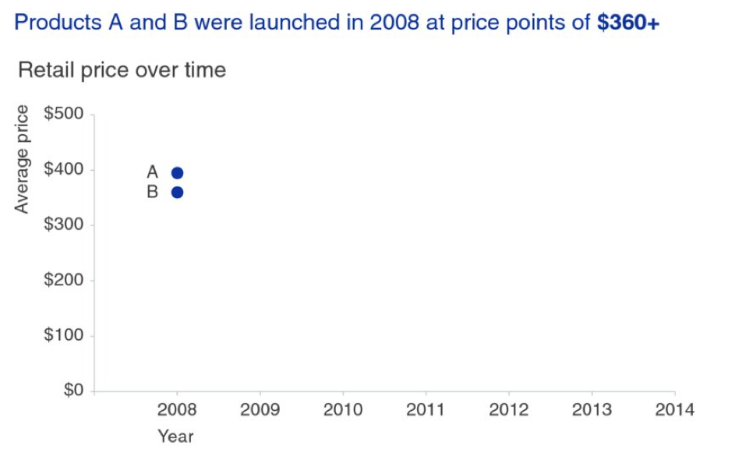
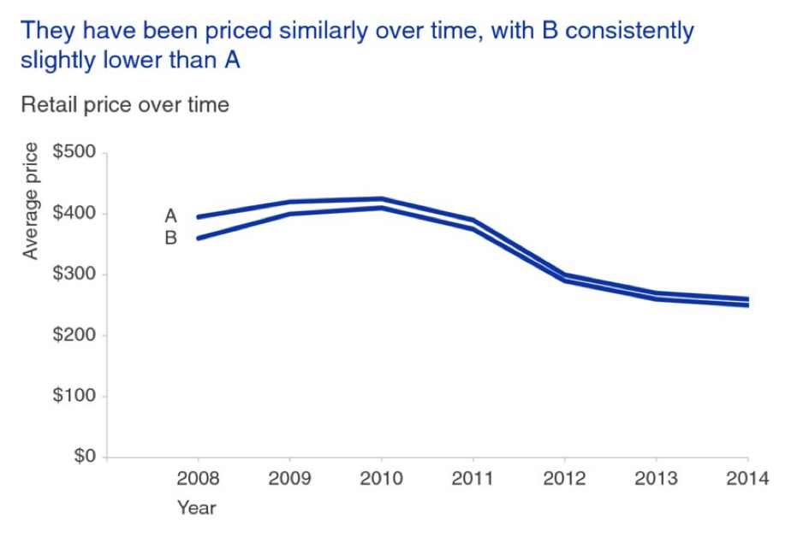
Using Stories (cont’d)

Slide 12
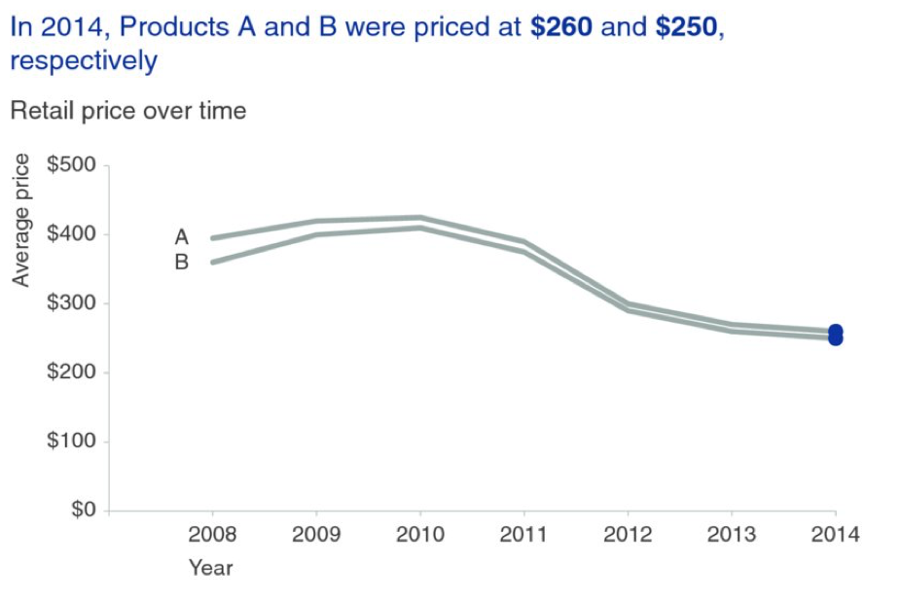
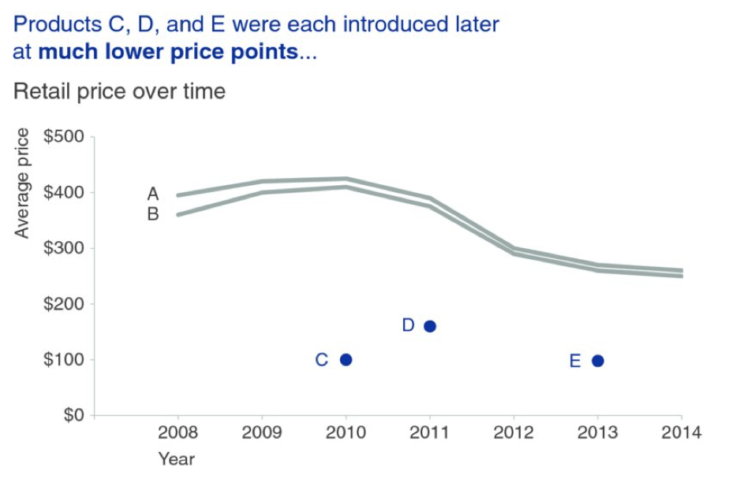
Using Stories (cont’d)

Slide 13
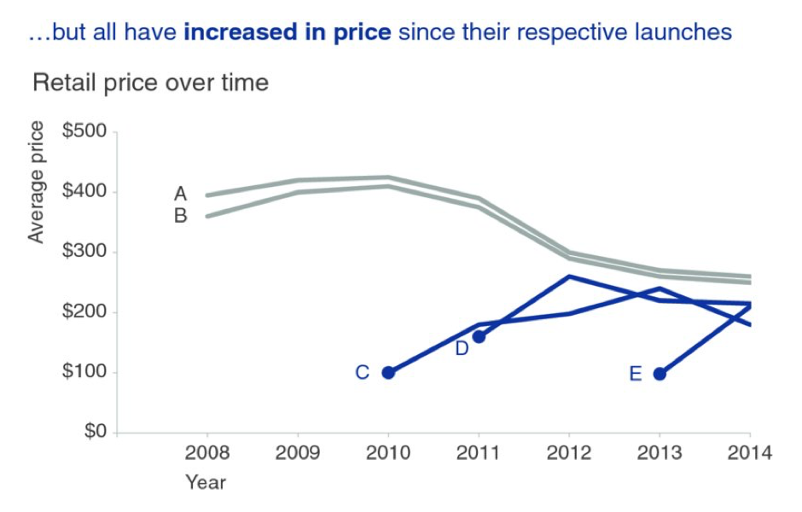
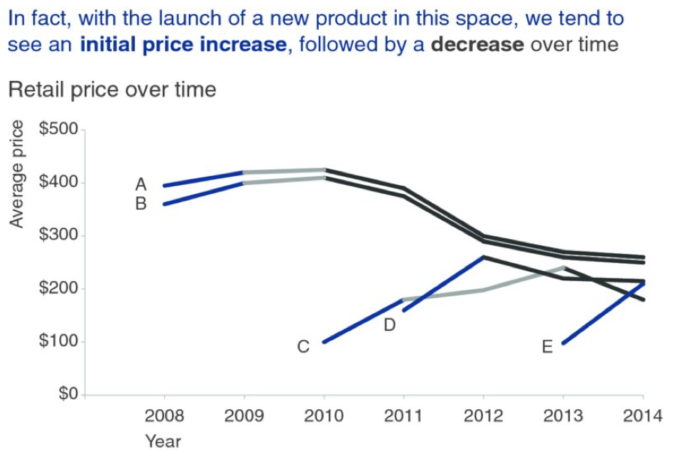
Using Stories (cont’d)

Slide 14
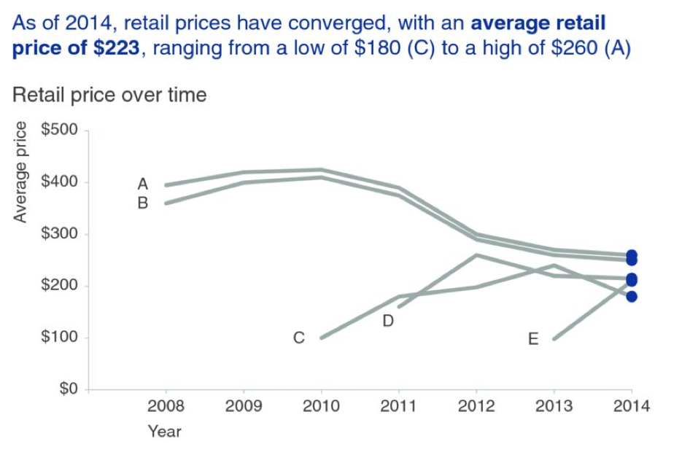
Using Stories (cont’d)

Slide 15
Using Stories (cont’d)
Recall (act 2):
Further development of problem description
External context/comparison points
Examples that illustrate problem
Data that demonstrates the problem
What will happen if no action taken
Options for addressing the problem
Benefits for recommended solution
Make it clear why audience is in a position to act

Slide 16
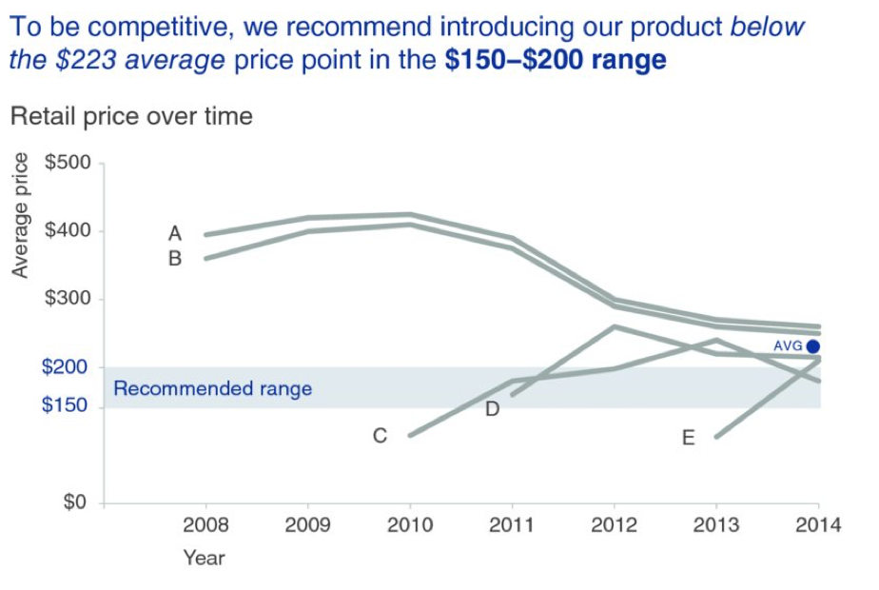
Using Stories (cont’d)

Slide 17
Using Stories (cont’d)
Recall (act 3):
Call to action which will resolve the conflict/tension

Slide 18
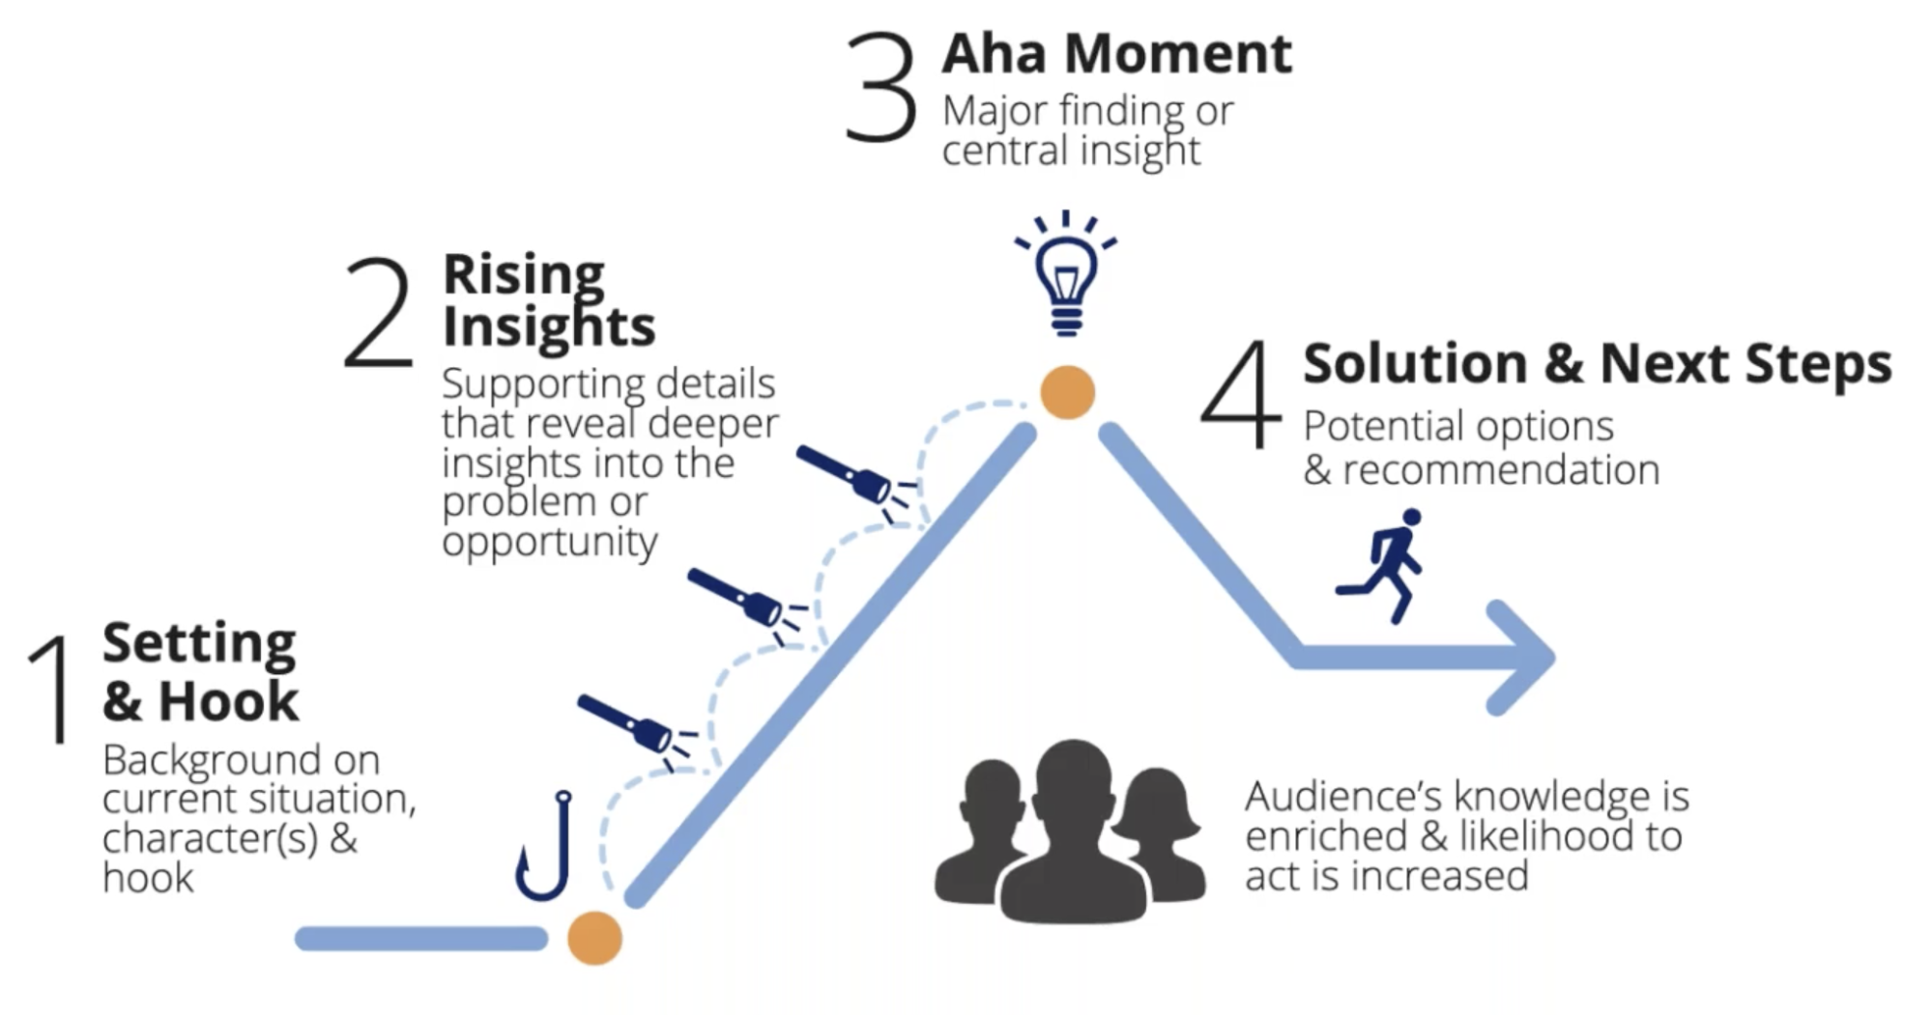
Modify for data storytelling
https://www.youtube.com/watch?v=UGWA7Nuz9e4
Notes:
Hook is the inciting incident – acts as a turning point in the story and begins to reveal a problem or an opportunity

Slide 19
References
Nussbaumer Knaflic, C., “storytelling with data”, Wiley (2015)

Slide 20
Appendix

