Slide 1
Choosing an effective visual
Jeremy Morris
Department of Operations and Information Systems
University of Utah

Slide 2
Introduction
80-20 rule:
A small subset of available visual displays can handle the majority of data visualization requirements

Slide 3
Verbal vs. Visual system
Verbal System
Visual displays: simple text and tables
Interacting with Verbal System == reading; therefore relatively slow in processing information
Visual System
Visual displays: points, bars and area
Interacting with Visual System is relatively fast in processing information
Navigate to: http://neomam.com/interactive/13reasons/
Discuss

Slide 4
Visual displays | practical subset
Verbal System
Simple text
Tables
Table
Heatmap
Visual System
Points
Scatterplot
Line graph
Slopegraph
Bars
Vertical bar
Stacked vertical bar
Waterfall
Horizontal bar
Stacked horizontal bar
Area
Square area
Other
Pies and Donuts
3D
Secondary axes

Slide 5
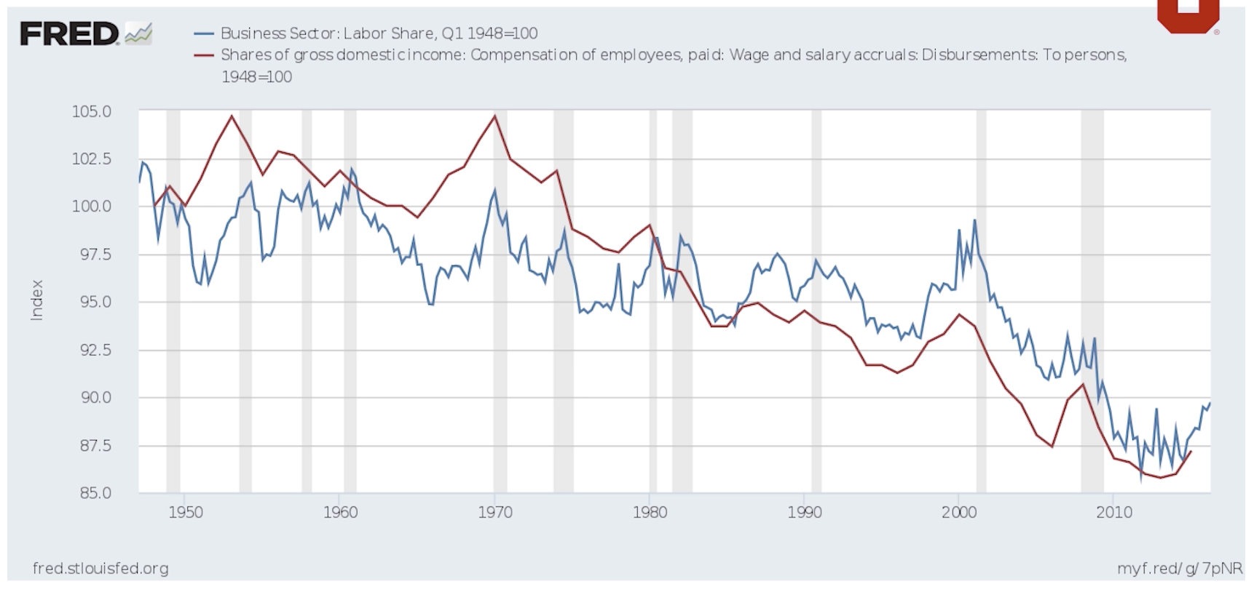
Often some verbal elements in charts

Slide 6
Simple text
One or two numbers to share
Number(s) should be prominent with a few supporting words
If a graph does little or nothing to aid in the interpretation, don’t use it
Considerations:
convert two numbers into a single number (only if important context is not lost)
20%
of children had a
traditional stay-at-home mom
in 2012, as compared to 41% in 1970

Slide 7
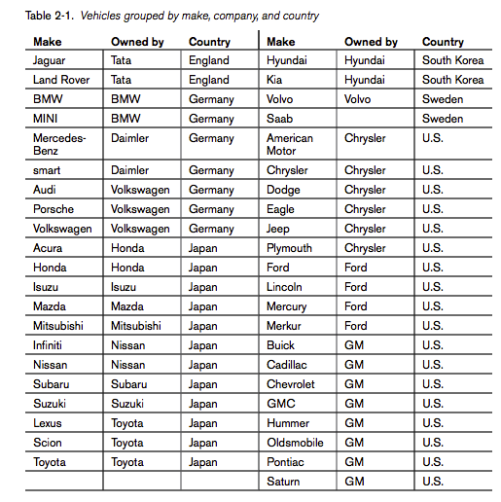
Table | Table
Used for reading across rows and down columns/comparing values
Good for:
mixed audience: each member can examine what they care about most
mixed scales: when data have mixed scales (e.g. age and income) some graphs can be challenging
Not good for:
Live presentations
Considerations:
Borders and shading should enhance the legibility of the table; remove/fade them accordingly
Notes:
Beautiful Visualization Edited by Julie Steele and Noah Iliinsky Copyright © 2010 O’Reilly Media, Inc. All rights reserved. Printed in Canada

Slide 8
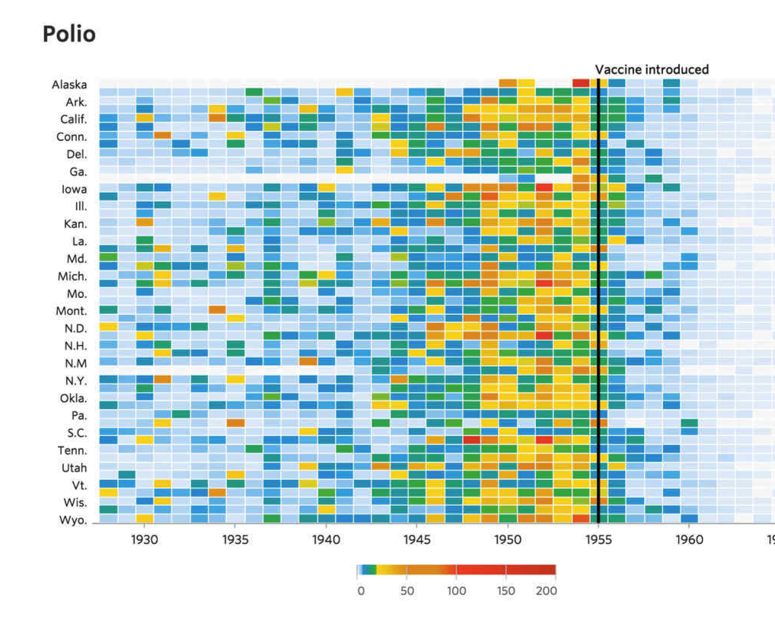
Table | Heatmap
Concept: benefits of a table using color/color saturation is visual cue to improve processing of information

Slide 9
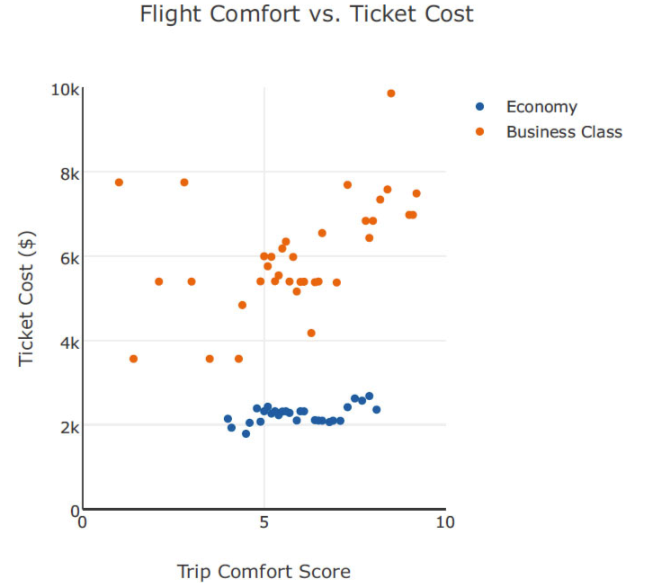
Points | Scatterplot
Useful for showing relationship between two variables

Slide 10
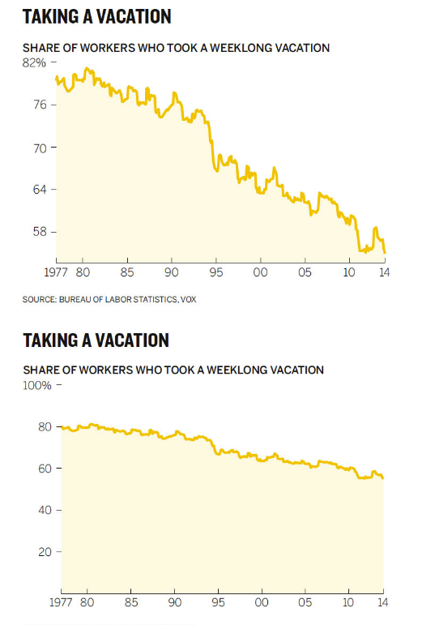
Points | Line graph
Useful for continuous (as opposed to categorical) data
Very common to connect data across time for several time periods
Considerations:
Number of series:
Single, two, more than two
Variance
Consistent time units on x-axis
Non-zero baseline is okay (due to relative comparisons)

Slide 11
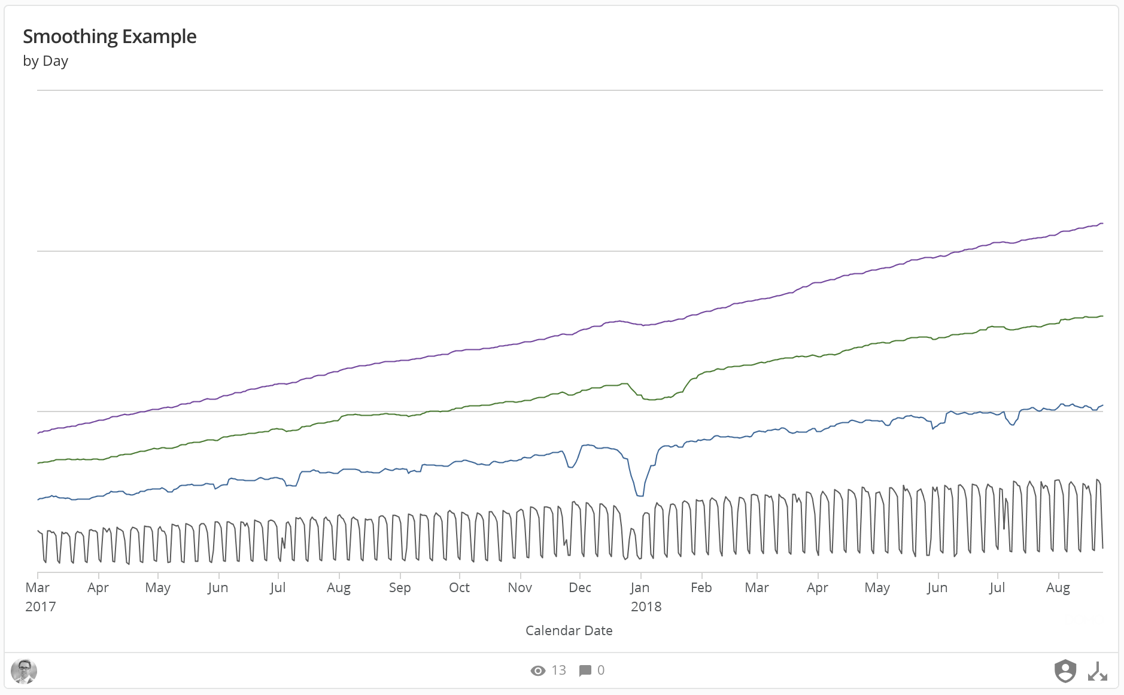

Slide 12
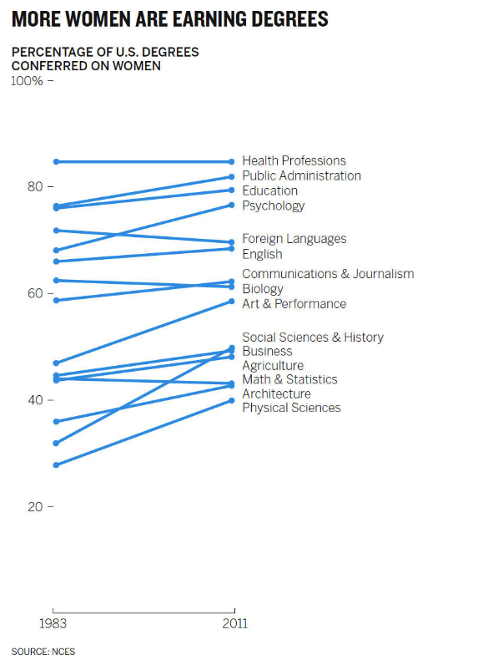
Points | Slopegraph
Useful for two time periods and multiple points of comparison
Can efficiently observe:
increase vs. decrease
relative rates of increase/decrease
absolute values

Slide 13
Bars | general
Concept: Bars sometimes avoided due to them being common
Consider using bars because the are common and will therefore have limited/no learning curve for the audience
Useful for categorical (as opposed to continuous) data
Can efficiently observe:
Largest/smallest value
Differences between categories
Considerations:
Y-axis on the left (as opposed to right based on how people read)
Zero baseline
Reduce redundant information (e.g. bar and axis labels)
Bar labels (detail) vs. axis labels (big picture)
Width of bars (Goldilocks concept: too thin, too thick, just right)
One, two and more than two series
Non-stacked (many use cases) vs. stacked (relative few use cases)
Stacked:
Absolute values vs. percentage of whole
Horizontal bar chart is very easy to read and produce
one reason: labels are on the y-axis

Slide 14
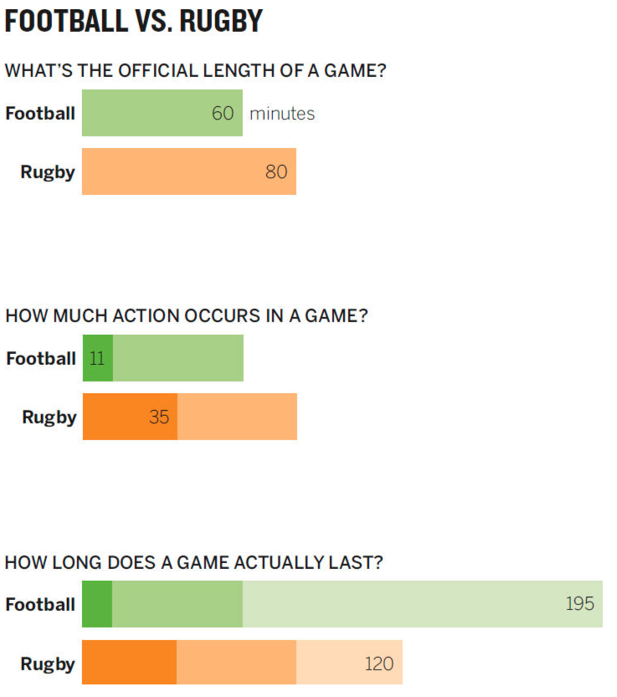
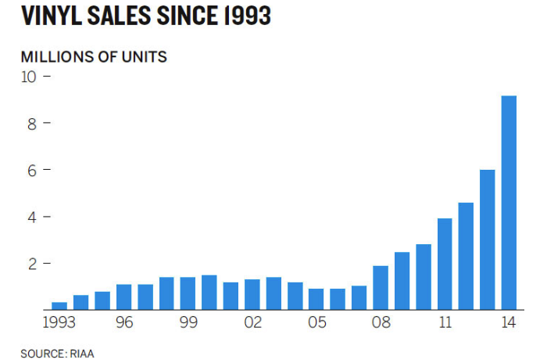
Bars | Vertical and horizonal bar

Slide 15
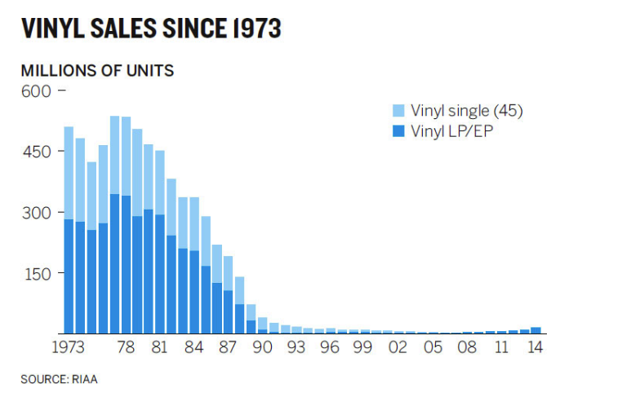
Bars | Stacked bar

Slide 16
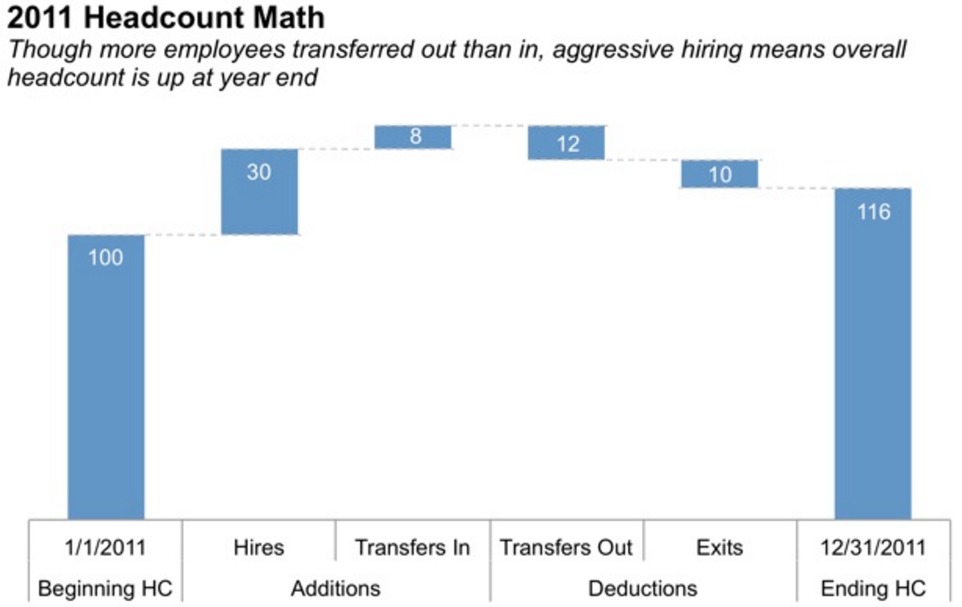
Bars | Waterfall
Useful for examining:
each part of stacked bar chart individually
or, showing a start point, multiple increases/decreases, then an end point

Slide 17
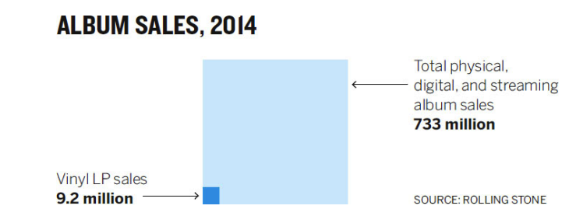
Area | Square area
Useful for visualizing numbers of vastly different magnitudes
Concept:
Squares provide two dimensions (height and width)
Bars just provide height or width)

Slide 18
Other | What not to do
Pies and Donuts
3D – “never do it”
Unnecessary information to process
Secondary y-axis
Users may not interpret series based on the right-hand y-axis properly

Slide 19
What not to do | Pies and Donuts
Simply put, humans struggle to understand relative differences between circles as compared to rectangles

Slide 20
What not to do | Pies and Donuts
How many more times bigger?

Slide 21
What not to do | Pies and Donuts
How many more times bigger?

Slide 22
What not to do | Pies and Donuts
7x (in both cases)
https://www.youtube.com/watch?v=vc1bq0qIKoA, accessed 2016-06-27

Slide 23
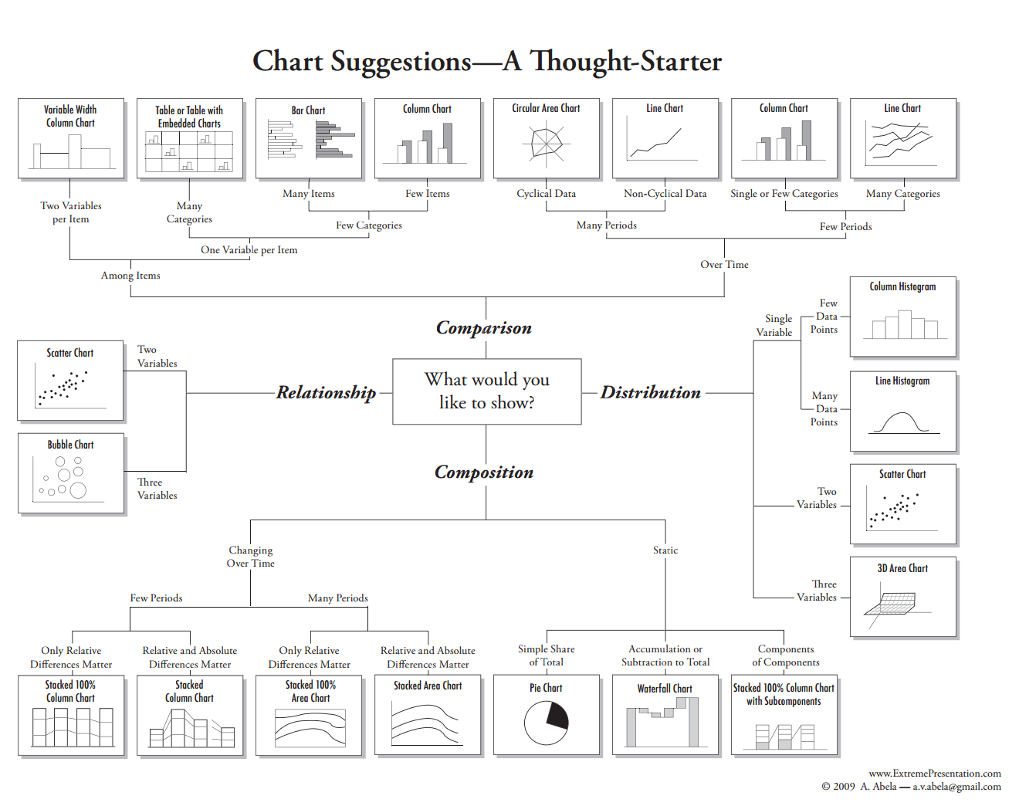
Compare Nussbaumer to Abela
* http://extremepresentation.typepad.com/blog/2006/09/choosing_a_good.html, accesed, 2016-06-20

Slide 24
References
Nussbaumer Knaflic, C., “storytelling with data”, Wiley (2015)
Berinato, S., "Good Charts: The HBR Guide to Making Smarter, More Persuasive Data Visualizations", Harvard Business Review Press (2016)

Slide 25
Appendix

