Slide 1
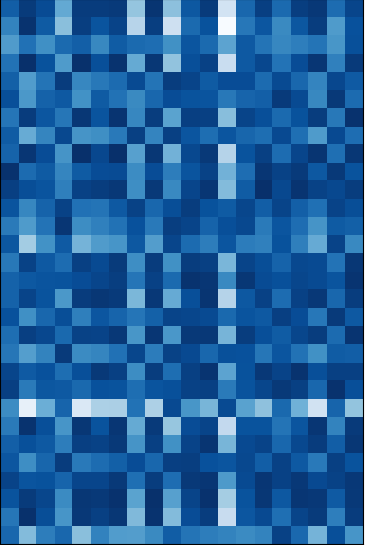
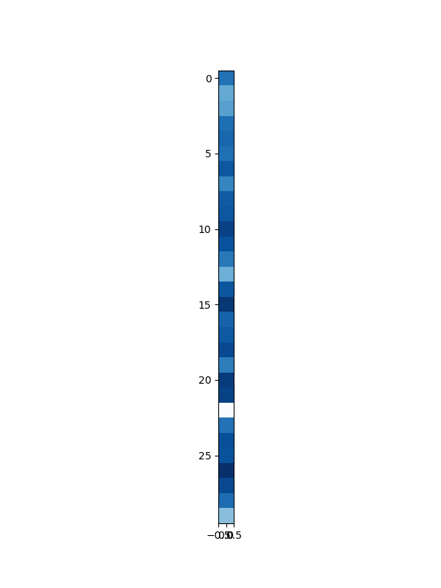
test data
training data
mean

Slide 2
Sentence Embedding
c
Transformer Encoder
[CLS]
101
47
12
66
74
90
0
411
234
79
175
[SEP]
[PAD]
[PAD]
[PAD]
…
[PAD]
[SEP]
Sentence Embedding for Multi-label
c 1
…
c n
Transformer Encoder
[CLS 1]
…
[CLS n]
101
47
12
66
74
90
0
411
234
79
175
[SEP]
[PAD]
…
[PAD]
[SEP]

Slide 3
[CLS 1]
[CLS 2]
[CLS 3]
…
[CLS n]
101
47
12
…
175
[SEP]
[CLS 1]
…
…
[CLS 2]
…
…
[CLS 3]
…
…
…
[CLS n]
…
…
101
…
…
47
…
…
12
…
…
…
175
…
…

Slide 4

Total Loss
Loss
$$+$$
BCE Loss
CE Loss
Batch Matching
Masked LM Head
Model
c 1
…
c n
h 0
h 4
h 8
h 9
Transformer Encoder
[CLS 1]
…
[CLS n]
[M]
47
#12
#66
[M]
90
#0
411
[M]
[M]
175
[SEP]
[PAD]
…
[PAD]
[SEP]
Input
Multi-label classification tokens
Chinese word #1
Chinese word #2
Chinese word #3

Slide 5
Loss
BCE Loss
Linear Head
Model
c 1
…
c n
Transformer Encoder
[CLS 1]
…
[CLS n]
101
47
12
66
74
90
0
411
234
79
175
[SEP]
[PAD]
…
[PAD]
[SEP]
Input
Multi-label classification tokens
(re-initialized)

Slide 6
Training data
Fold #1
Fold #1
Fold #1
Fold #1
Fold #1
Fold #2
Fold #2
Fold #2
Fold #2
Fold #2
Fold #3
Fold #3
Fold #3
Fold #3
Fold #3
Fold #4
Fold #4
Fold #4
Fold #4
Fold #4
Fold #5
Fold #5
Fold #5
Fold #5
Fold #5
Param #N
Train
...
Model #1
Model #2
Model #3
Model #4
Model #5
Train
Param #2
Model #1
Model #2
Model #3
Model #4
Inference
Train
Param #1
Model #5
Testing data
Blending
Model #1
Model #2
Model #3
Model #4
Inference
Train
Result #1
Result #2
Result #3
Result #4
Result #5
Model #5
Final Result
Model #1
Model #2
Model #3
Model #4
Mean
Inference
Result #1
Result #2
Result #3
Result #4
Result #5
Model #5
Result #1
Result #2
Result #3
Result #4
Mean
Inference
Result
Result #5
Mean
Result #1
Result #2
Result #3
Result #4
Result #5
Result
Result
Mean
Result

