Slide 1




Agent
State
$$s_{t+1}$$
State
$$s_{t}$$
Action
$$a_{t}$$
Reward
$$r_{t}$$
Environment

Slide 2











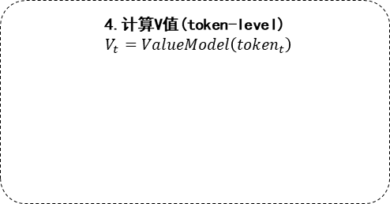



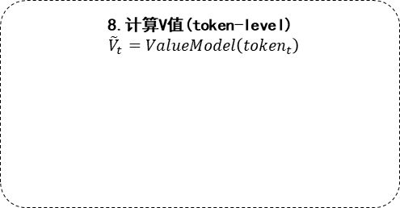





















































































































探索过程
模型优化
1.采样
$$response=π\left(response|query\right)$$
2.计算奖励(sentence-level)
$$R=RewardModel\left(query, response\right)$$
$$r_{0}$$
$$r_{1}$$
$$r_{2}$$
$$r_{3}$$
$$r_{4}$$
$$R$$
Policy Model
Reward Model*
$$q_{0}$$
$$q_{1}$$
$$q_{2}$$
$$q_{3}$$
$$r_{0}$$
$$r_{1}$$
$$r_{2}$$
$$r_{3}$$
$$q_{0}$$
$$q_{1}$$
$$q_{2}$$
$$q_{3}$$
$$r_{0}$$
$$r_{1}$$
$$r_{2}$$
$$r_{3}$$
$$r_{4}$$
7.计算Policy logprob(token-level)
$${\tilde{z}}_{t}^{π}=\log{π\left(token_{t}\right)}$$
3.1.计算Reference logprob(token-level)
$$z_{t}^{π_{ref}}=\log{π_{ref}\left(token_{t}\right)}$$
$${\tilde{z}}_{q_{0}}^{π}$$
$${\tilde{z}}_{q_{1}}^{π}$$
$${\tilde{z}}_{q_{2}}^{π}$$
$${\tilde{z}}_{q_{3}}^{π}$$
$${\tilde{z}}_{r_{0}}^{π}$$
$${\tilde{z}}_{r_{1}}^{π}$$
$${\tilde{z}}_{r_{2}}^{π}$$
$${\tilde{z}}_{r_{3}}^{π}$$
$${\tilde{z}}_{r_{4}}^{π}$$
5.计算奖励(token-level)
$$r_{t}=\left\{\begin{aligned}−kl_{ctl}×kl_{t}+R, t=L−1 \\ &−kl_{ctl}×kl_{t}, otherwise\end{aligned}\right.$$
Policy Model
$$z_{q_{0}}^{π_{r}}$$
$$z_{q_{1}}^{π_{r}}$$
$$z_{q_{2}}^{π_{r}}$$
$$z_{q_{3}}^{π_{r}}$$
$$z_{r_{0}}^{π_{r}}$$
$$z_{r_{1}}^{π_{r}}$$
$$z_{r_{2}}^{π_{r}}$$
$$z_{r_{3}}^{π_{r}}$$
$$z_{r_{4}}^{π_{r}}$$
Reference Model*
$$q_{0}$$
$$q_{1}$$
$$q_{2}$$
$$q_{3}$$
$$r_{0}$$
$$r_{1}$$
$$r_{2}$$
$$r_{3}$$
$$r_{4}$$
$${kl}_{q_{0}}$$
$${kl}_{q_{1}}$$
$${kl}_{q_{2}}$$
$${kl}_{q_{3}}$$
$${kl}_{r_{0}}$$
$${kl}_{r_{1}}$$
$${kl}_{r_{2}}$$
$${kl}_{r_{3}}$$
$${kl}_{r_{4}}$$
8.计算V值(token-level)
${\tilde{V}}_{t}=ValueModel\left({token}_{t}\right)$
$$q_{0}$$
$$q_{1}$$
$$q_{2}$$
$$q_{3}$$
$$r_{0}$$
$$r_{1}$$
$$r_{2}$$
$$r_{3}$$
$$r_{4}$$
$$−kl_ctl$$
3.2.计算Policy logprob(token-level)
$$z_{t}^{π}=\log{π\left(token_{t}\right)}$$
$${\tilde{V}}_{q_{0}}$$
$${\tilde{V}}_{q_{1}}$$
$${\tilde{V}}_{q_{2}}$$
$${\tilde{V}}_{q_{3}}$$
$${\tilde{V}}_{r_{0}}$$
$${\tilde{V}}_{r_{1}}$$
$${\tilde{V}}_{r_{2}}$$
$${\tilde{V}}_{r_{3}}$$
$${\tilde{V}}_{r_{4}}$$
$$r_{q_{0}}$$
$$r_{q_{1}}$$
$$r_{q_{2}}$$
$$r_{q_{3}}$$
$$r_{r_{0}}$$
$$r_{r_{1}}$$
$$r_{r_{2}}$$
$$r_{r_{3}}$$
$$r_{r_{4}}$$
Value Model
$$z_{q_{0}}^{π}$$
$$z_{q_{1}}^{π}$$
$$z_{q_{2}}^{π}$$
$$z_{q_{3}}^{π}$$
$$z_{r_{0}}^{π}$$
$$z_{r_{1}}^{π}$$
$$z_{r_{2}}^{π}$$
$$z_{r_{3}}^{π}$$
$$z_{r_{4}}^{π}$$
Policy Model
$$q_{0}$$
$$q_{1}$$
$$q_{2}$$
$$q_{3}$$
$$r_{0}$$
$$r_{1}$$
$$r_{2}$$
$$r_{3}$$
$$r_{4}$$
Gradient
9.计算损失(仅对respond部分)
$$L=L_{π}+coef⋅L_{V}$$
$$q_{0}$$
$$q_{1}$$
$$q_{2}$$
$$q_{3}$$
$$r_{0}$$
$$r_{1}$$
$$r_{2}$$
$$r_{3}$$
$$r_{4}$$
4.计算V值(token-level)
$V_{t}=ValueModel\left({token}_{t}\right)$
6.计算A值(token-level)
$${a_{t}=r_{t}+γ⋅V_{t+1}−V_{t} \atop \begin{aligned}a_{t}←a_{t}+γ⋅λ⋅a_{t+1} \\ ret_{t}=a_{t}+V_{t}\end{aligned}}$$
$$V_{q_{0}}$$
$$V_{q_{1}}$$
$$V_{q_{2}}$$
$$V_{q_{3}}$$
$$V_{r_{0}}$$
$$V_{r_{1}}$$
$$V_{r_{2}}$$
$$V_{r_{3}}$$
$$V_{r_{4}}$$
$$a_{q_{0}}$$
$$a_{q_{1}}$$
$$a_{q_{2}}$$
$$a_{q_{3}}$$
$$a_{r_{0}}$$
$$a_{r_{1}}$$
$$a_{r_{2}}$$
$$a_{r_{3}}$$
$$a_{r_{4}}$$
Value Model
$${rt}_{q_{0}}$$
$${rt}_{q_{1}}$$
$${rt}_{q_{2}}$$
$${rt}_{q_{3}}$$
$${rt}_{r_{0}}$$
$${rt}_{r_{1}}$$
$${rt}_{r_{2}}$$
$${rt}_{r_{3}}$$
$${rt}_{r_{4}}$$
$$q_{0}$$
$$q_{1}$$
$$q_{2}$$
$$q_{3}$$
$$r_{0}$$
$$r_{1}$$
$$r_{2}$$
$$r_{3}$$
$$r_{4}$$

