Slide 1




EVENT SECURITY MANAGEMENT APPLICATION
Submitted as
Third Year 6 week Training project
towards completion of
B.Tech Computer Science Software Engineering
Project By:
Mr. Sushil Singh
Project Supervisor:
Mr. Devdutta Mahanty

Slide 2
Team Introduction
Devdutta Mohanty (Project Supervisor)
Technical consultant in virtual Design Cell for Platform & Storage
WIPRO InfoTech LTD
May 2005 – Present (11 years 5 months)
Sushil Singh (Me)
B.Tech 4RD YEAR CSE
LINGAYA’S GVKS Institute of management and technology

Slide 3
Project Summary
The project is basically an application that help to manage the entry of guest and viewers to an event. In this application there is a database which is created before the even to occur and at the time of starting guest and viewers are get verified by the main event security guard so that any unwanted viewer (who not register or not paid for it).
This project is has very user friendly Graphic User Interface knowledge to basics of computer is required to operate the application. The application easily recognise the admin and normal security guard, admin has power to manipulate the data as well as security guard but security guard has only power to check already present data and when the viewer approach to enter the event they only just copy pre written data to guest attend database.
The application uses a MySQL database to store its records which has necessary advantages over the file based system. This application also enter the current date and time when the person get entered in the event.

Slide 4
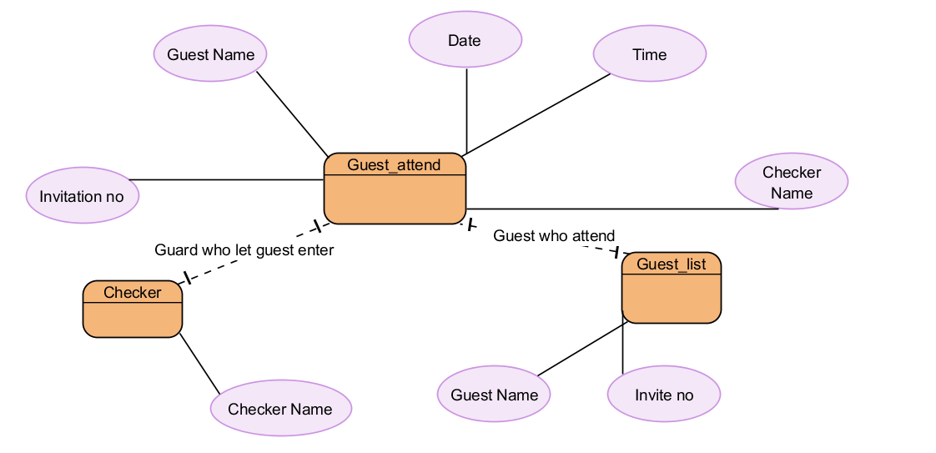
Entity Relation Diagram

Slide 5
System Architecture
CHECKER LIST
Guest list
Guest attended
Admin
Checker
ONLY READ DATA
DATABASE
ONLY WRITE DATA
BOTH READ AND WRITE DATA
Type of User

Slide 6
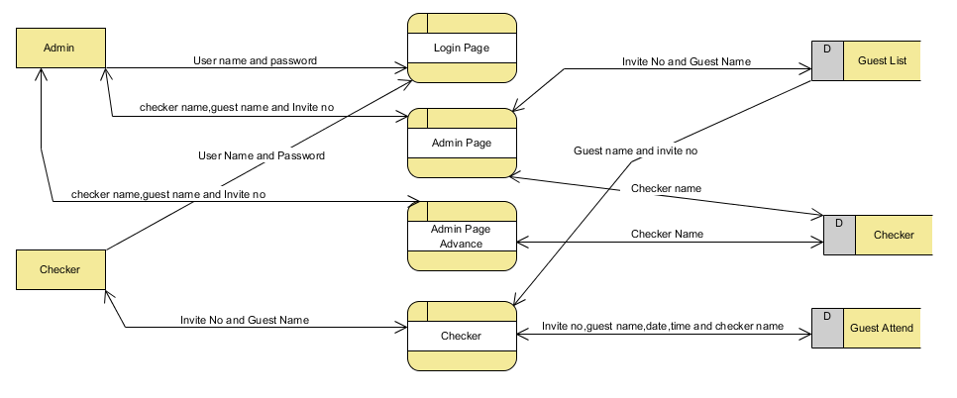
Data Flow Diagram

Slide 7
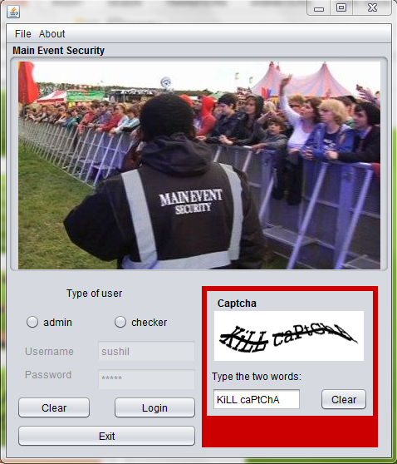
LOGIN PAGE

Slide 8
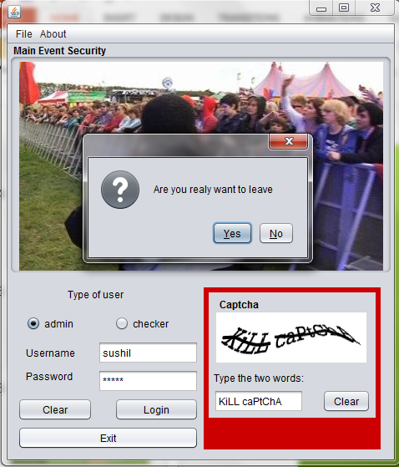
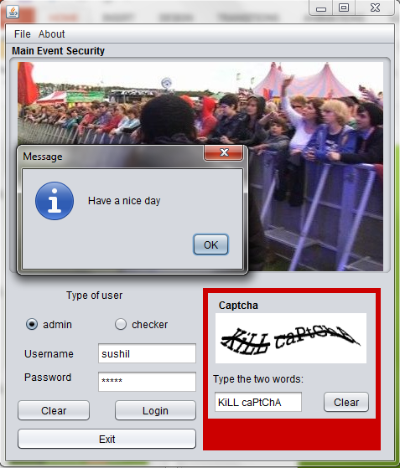
USER WANT TO LEAVE

Slide 9
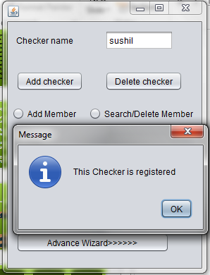
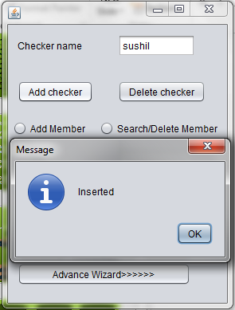
ADMIN PAGE
Search
Insert

Slide 10
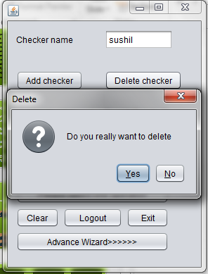
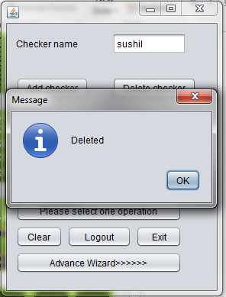
Deletion of checker

Slide 11
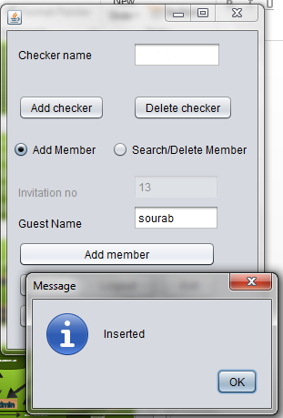
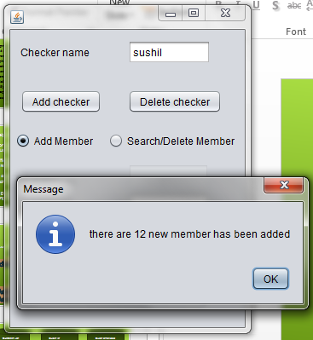
Adding of guest

Slide 12
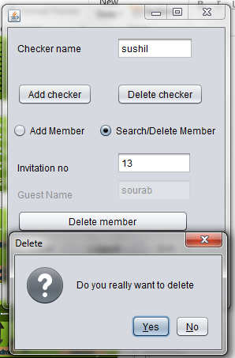
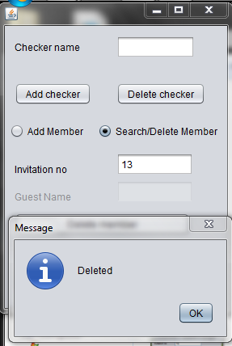
Deletion of guest

Slide 13
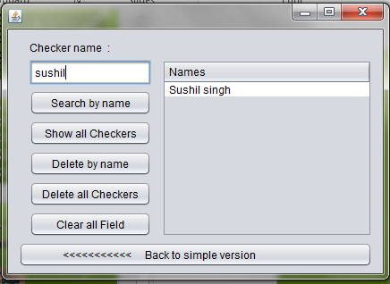
ADVANCE ADMIN PAGE

Slide 14
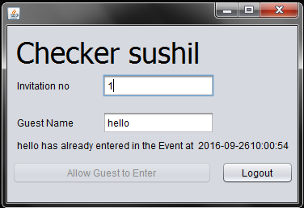
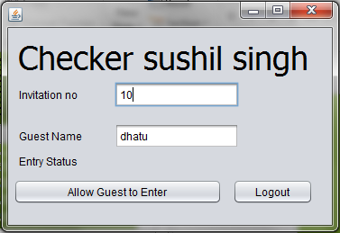
Checker PAGE
Already entered
Yet to get entered

Slide 15
Of course, few snaps cannot explain it all..
Please bear with me for a few moments & let me expose more of the system’s potential!!

Slide 16
Good Bye
We were very excited in our very first class at the department where we were taught the ‘Hello, World!’
We’re even excited and thankful for what the department taught us to step in to the professional world.
HELLO, REAL WORLD!

