Slide 1
MIT Media Lab
Conceptions and Misconceptions
September, 2018

Slide 2
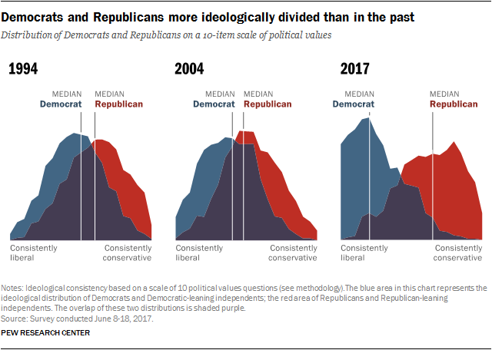
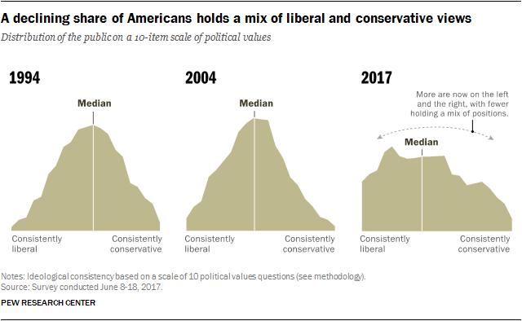
Context: Polarization
http://www.people-press.org/2017/10/05/1-partisan-divides-over-political-values-widen/
Viral Communications
September 2018
Andrew Lippman
Notes:
We are in a highly polarized society. Daniel Hopkins will talk more about some aspects of this, with respect to national issues dominating. They may be inherently more polarizing. It plays out from voting booths to dinner tables. Propaganda may reinforce, as may frictionless access. Isolation certainly hurts.

Slide 3
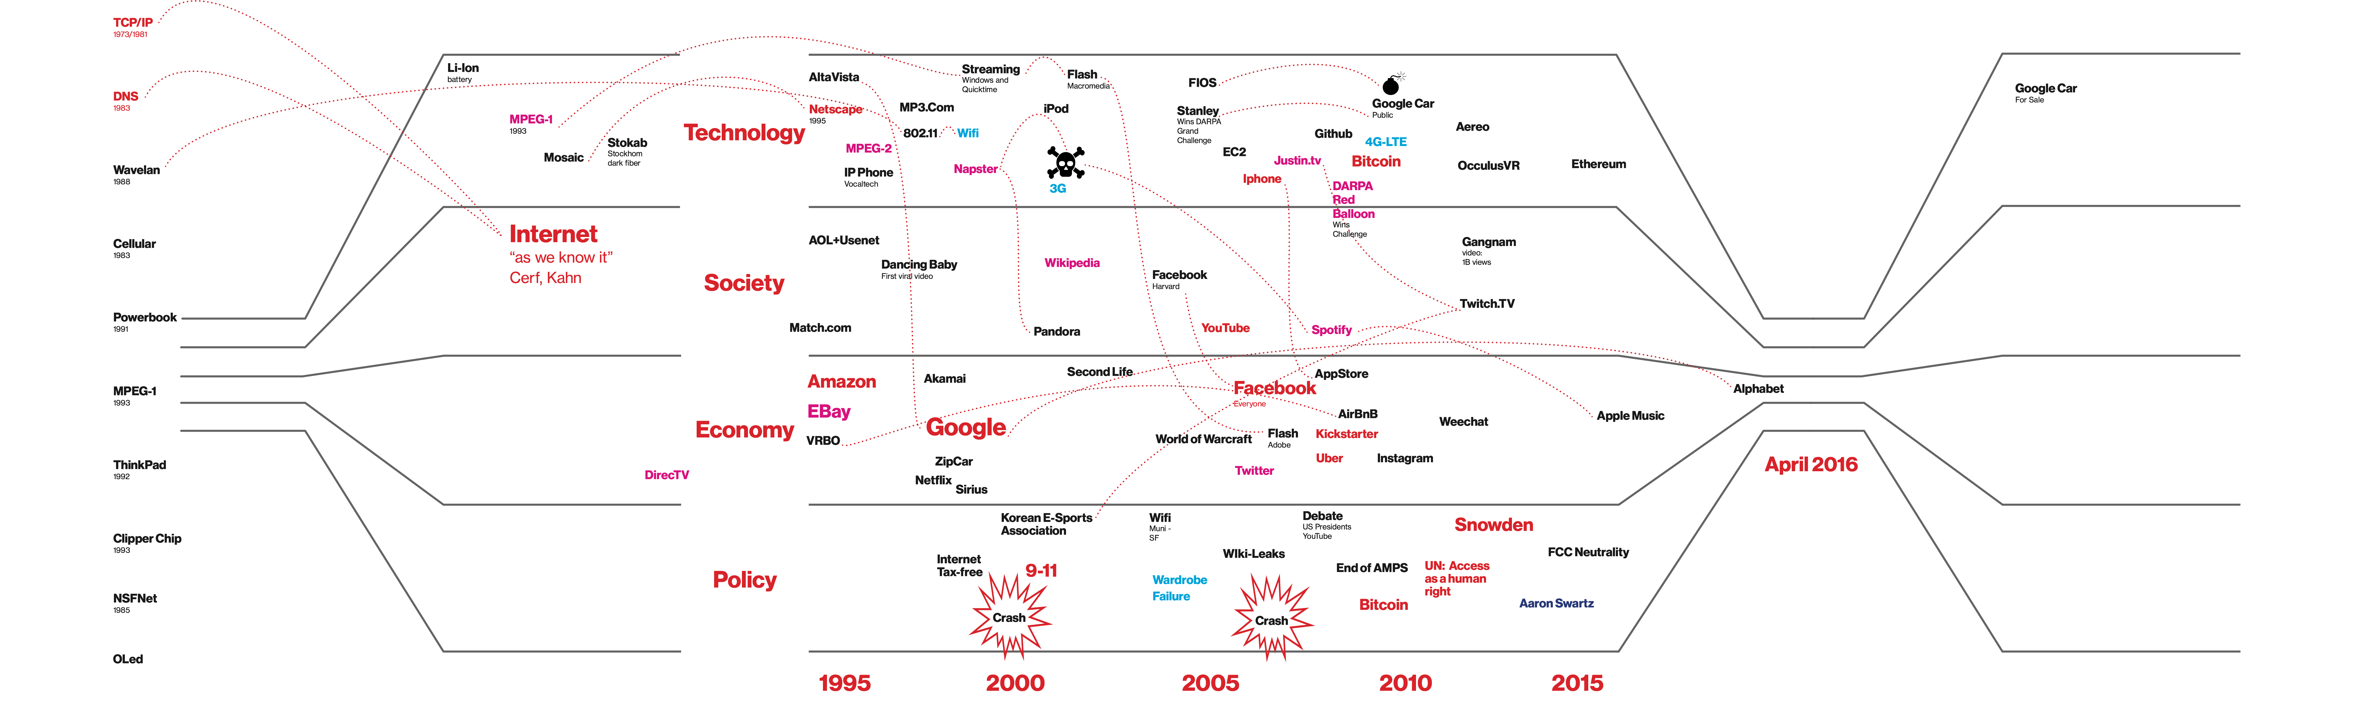
Communications
Viral Communications
September 2018
Andrew Lippman
Notes:
My sense is that trust to the extent we demonstrate it is migrating to networks from institutions.

Slide 4
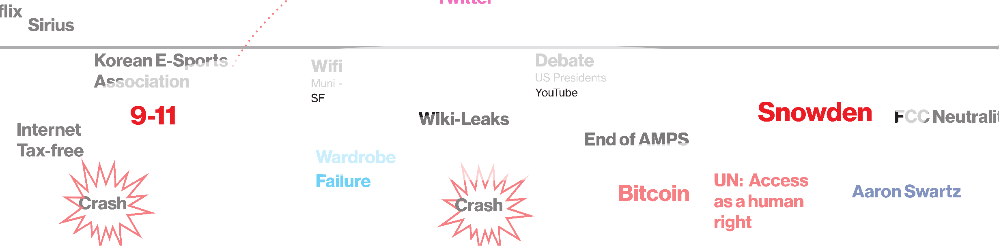
Networks
Viral Communications
September 2018
Andrew Lippman
Notes:
2001 Giuliani: America’s mayor. 2018 Giuliani: Trump’s pit bull

Slide 5
Who Else Says So?
Strangers in Their Own Land, Hochschild We are in line for the American dream and undeserving people are cutting ahead…
The Politics of Resentment, Cramer The city people have all the power, the money, and the don’t respect us…
Capital in the Twenty-First Century, Piketty The divide is getting worse and won’t likely improve
Plus:
Bowling Alone, Putnam, 2000; What’s the matter with Kansas, Frank, 2004
Vosoughi: Bad news travels fast
But you know all this
Viral Communications
September 2018
Andrew Lippman
Notes:
The Social science is analytical but less prescriptive. We are MIT, we build. SO what do we build?

Slide 6
So Why the Abstruse Readings?
Confirmation bias: We accept more of what we believe
Confidence bias: We think we are right more often than we are
Baseline fallacy: We are misled by the specific
(Conjunction fallacy)
and…
How do we change deeply held views?
Viral Communications
September 2018
Andrew Lippman
Notes:
Some of what is influencing people is based in behavioral economics and psychology. Kahneman and Tversky catalogued and quantified some of this. Now it is a tool. Can we make it cut both ways?

Slide 7
Gigerenzer: Frequentists v Probabalists
“Which city is larger, Islamabad or Hyderabad?
“How confident are you in your answer?
Viral Communications
September 2018
Andrew Lippman
Notes:
Example 1. Contrast this with taking a 20 question test and guessing your grade. Most get that right.

Slide 8
Gigerenzer: Frequentists v Probabalists
Linda is 31 years old, single, outspoken and very bright. She majored in philosophy. As a student, she was deeply concerned with issues of discrimination and social justice, and also participated in antinuclear demonstrations. Which of these two alternatives is more probable?
(a) Linda is a bank teller
(b) Linda is a bank teller and active in the feminist movement
Linda is 31 years old, single, outspoken and very bright. She majored in philosophy. As a student, she was deeply concerned with issues of discrimination and social justice, and also participated in antinuclear demonstrations.
There are 100 people who fit the description above. How many of them are:
(a) bank tellers
(b) bank tellers and active in the feminist movement
Viral Communications
September 2018
Andrew Lippman
Notes:
Simple error: A conjunction has to be less probable. But we rely on the specifics.

Slide 9
Last example
The prevalence of breast cancer is 1% (in a specified population). A mammography gives a positive result in 80% of women with breast cancer, and in 10% of women without breast cancer. What is the probability that a woman who tests positive actually has breast cancer? _____%
Baseline fallacy
Viral Communications
September 2018
Andrew Lippman
Notes:
This makes a lot clear. First one identifies with the breast cancer victim.

Slide 10
Obama’s Lost Army
Facebook’s 61 million person test
People follow celebrities
Canvassing works
Actions, respect, grassroots
Viral Communications
September 2018
Andrew Lippman
Notes:
We are in a highly polarized society. Daniel Hopkins will talk more about this

Slide 11
Our Job: Design, Test, Learn
Projects will require all sorts of contributions: coding, data gathering, field work, analysis, writeup. Most of all, sweat and time.
If there are resources needed, we can talk about that individually.
External influence, Lost Army redux
Viral Communications
September 2018
Andrew Lippman
Notes:
Not all data is free. There are various means of testing, etc.

