Slide 1
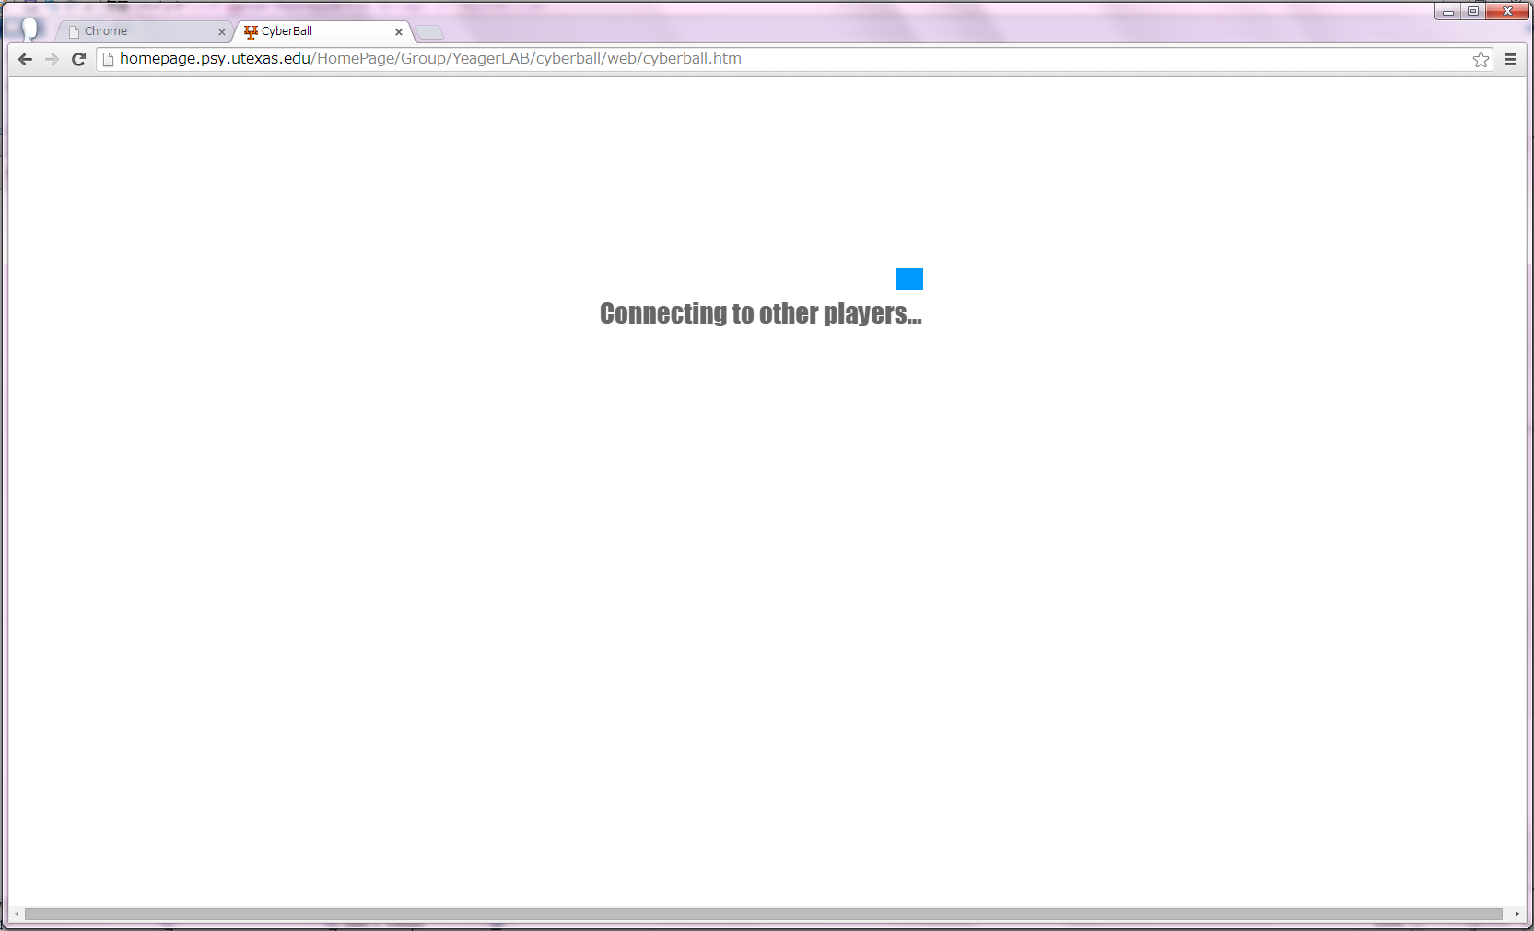
Connecting to other players …

Slide 2
Connecting to other players …

Slide 3
Connecting to other players …

Slide 4
Connecting to other players …

Slide 5
Connecting to other players …

Slide 6
Connecting to other players …

Slide 7
Connecting to other players …

Slide 8
Connecting to other players …

Slide 9
Connecting to other players …

Slide 10
Connecting to other players …

Slide 11
Connecting to other players …

Slide 12
Connecting to other players …

Slide 13
Connecting to other players …

Slide 14
Connecting to other players …

Slide 15
Connecting to other players …

Slide 16
Connecting to other players …

Slide 17
Connecting to other players …

Slide 18
Connecting to other players …

Slide 19
Connecting to other players …

Slide 20
Connecting to other players …

Slide 21
Connecting to other players …

Slide 22
Connecting to other players …

Slide 23
Connecting to other players …

Slide 24
Connecting to other players …

Slide 25
Connecting to other players …

Slide 26
Connecting to other players …

Slide 27
Connecting to other players …

Slide 28
Connecting to other players …

Slide 29
Connecting to other players …

Slide 30
Connecting to other players …

Slide 31
Connecting to other players …

Slide 32
Connecting to other players …

Slide 33
Connecting to other players …

Slide 34
Connecting to other players …

Slide 35
Connecting to other players …

