Slide 1
Big Mountain Resort
Problem Statement
Big Mountain Resort needs to make a decision on whether to make changes for capitalizing its facilities or raise up tickets price so that the resort can compensate for the extra $1,540,000 operating costs caused by installing an additional chair lift this season.
Context
Big Mountain Resort, a ski resort located in Montana,with access to 105 trails, offers 11 lifts, 2 T-bars, and 1 magic carpet for its 350,000 annual visitors. The longest run is 3.3 miles in length. The base elevation is 4,464 ft, and the summit is 6,817 ft with a vertical drop of 2,353 ft. The new installed chair lift has brought up not only the extra operating costs but also the evaluation of price strategy and investment strategy by data science team.

Slide 2
Recommendation and key findings
1. Big Mountain is currently charging $81.00 per ticket while our model is suggesting $95.87.
2. There is no clear pattern for state and ticket price relationship.
3. We can cover the additional chair lift operating cost by raising up price by $0.88.
4. Close one run won't hurt our revenue.

Slide 3
Modeling results and analysis

Slide 4
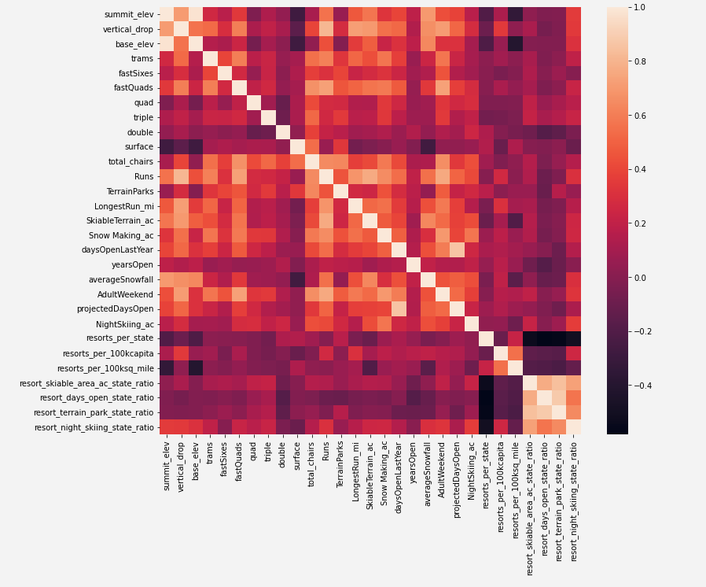
Modeling results and analysis
Notes:
We conducted a heatmap on the combination of resorts data set and state summary data set. Ticket price is highly related to “fastQuads”, “Runs”, “Snow Making_ac”, “vertical_drop” features in a positive way.

Slide 5
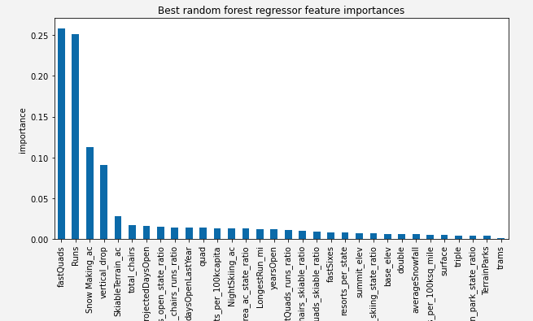
Random Forest Model
This model has the best predicting accuracy.
“FastQuads”, “Runs”, “Snow Making_ac” and “Vertical_drop” are the most important features for pricing

Slide 6
Modeling scenarios
Adding a run, increasing the vertical drop by 150 feet, 2 acres of snow making, and installing an additional chair lift.
Adding a run, increasing the vertical drop by 150 feet and installing an additional chair lift.
Closing up to 10 of the least used runs.
Increasing the longest run by 0.2 miles and adding 4 acres of snow making capability
This scenario increases support for ticket price by $9.90
Over the season, this could be expected to amount to $17.32 million
This scenario increases support for ticket price by $8.61
Over the season, this could be expected to amount to $15.07 million
Close one run won't affect revenue, close ten runs will cut revenue by more than $ 3 million. (see next page)
This scenario won't affect revenue
A
B
C
D

Slide 7
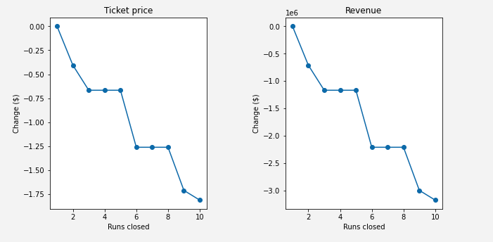
Scenario C

Slide 8
Price strategy
We can boost our price by up to $ 14.87 given the surport of our current facilities.
Summary
Investment strategy
The first thee strategies are worth consideration. Runs and snow making operating cost would be useful for the finanl decision making.
Future scope of work
The validity of our model lies in the assumption that other resorts accurately set their prices. We are able to reuse our model if there are any new investment strategies or updates about market data.

Slide 9
Thank you

