Slide 1
Human-in-the-Loop Congestion Classification
for Multi-Agent Pathfinding
Replacing DDG's hand-tuned threshold with learned, human-aligned segment ranking
Shane Pornprinya · Isabel De Luis · Sparsh Bansal
Algorithmic Human-Robot Interaction · Spring 2026
HRI Final · Human-in-the-Loop Congestion Classification for MAPF
1 / 8
Notes:
[ALL] Brief intros (Sparsh, Shane, Isabel) — keep under 10 seconds. Then hand to Sparsh.

Slide 2
Motivation: where MAPF policies break
• Multi-agent pathfinding (MAPF) coordinates teams of robots in shared spaces: warehouses, delivery, search-and-rescue
• State-of-the-art: MAPF-GPT, a transformer policy imitation-trained on solver demos.
• Failure mode: congestion due to no global view as agents bunched at corridor pinch-points, deadlocks, swap conflicts.
• The HRI question: currently there is no human in this loop. The policy trains on solver demos and is refined by a hand-tuned threshold. Could human judgement help?
HRI Final · Human-in-the-Loop Congestion Classification for MAPF
2 / 8
Notes:
[Sparsh, ~30s] Open with the warehouse / delivery framing. Make the HRI angle explicit — currently zero humans in the loop. End by motivating why human judgement could plausibly help.

Slide 3
Prior work and our contribution
Each prior approach leaves a gap that motivates the next. Our work targets the gap left by DDG.
Approach | What it does | Human in loop? | Limitations
MAPF-GPT [Andreychuk '24] | Imitation-learn a transformer from offline LaCAM demos | No | Long-tail congested cases under-represented in demos
DAgger [Ross '11] | Iteratively roll the policy, expert-relabel every visited state, retrain | No (expert = solver) | Uniform expert calls per state, making it expensive at scale
Original DDG [Andreychuk '25] | Threshold-gated DAgger: invoke expert only when max_diff > 3 | No | Threshold wrong on 44% of borderline cases; midrange discarded
★ Our work | Learned classifier + human override + acquisition-strategy comparison | Yes (replay tool) | Cost of human data generation/labeling;
What we add
• Replace DDG's hand-tuned threshold with a learned segment-ranking classifier trained with human pairwise labels.
• Compare four annotation-acquisition strategies at the same label budget: random human elicitation, warm-start iterative Active Learning, to answer does it matter how we collect human input?
Research Question
Can a small set of human-curated pairwise rankings improve training performance of a MAPF-GPT classifier beyond DDG's threshold by selecting better states with fewer training epochs (than 30,000) and does the strategy used to elicit those rankings matter?
HRI Final · Human-in-the-Loop Congestion Classification for MAPF
3 / 8
Notes:
[Sparsh, ~35s] This is the load-bearing motivation slide. Walk down the four rows: each prior approach has a clear limit, and our work explicitly targets DDG's gap. Pause on row 3 (44% threshold-wrong number — already lands as a punchline). Then read the 'what we add' bullets — these set up the rest of the talk. End with the RQ verbatim. The audience should walk out of THIS slide knowing what we built and why it's a contribution.

Slide 4
Why it's hard
1.
The auto-label is anti-aligned with humans on hard cases.
23/52 (44%) of human-marked (worst, clean) pairs have diff(worst) ≤ diff(clean): the auto pair points the wrong way.
2.
How do we elicit the hard cases.
Defining the features that can classify high versus low entropy [TODO]
3.
Human time is the binding constraint.
≈5 min/episode × 56 budget ≈ 5 hours of human attention. What kind of question to ask?
HRI Final · Human-in-the-Loop Congestion Classification for MAPF
4 / 8
Notes:
[Shane, ~30s] Three open challenges. The 44% number is the empirical hook — say it slowly. Frame challenge 3 as motivating the AL extension we discuss later.

Slide 5
Key insight & method
Insight 1
Override not augment
For each annotated episode, replace the auto-pair list entirely with the single human pair at weight 1.0. 39 train pairs ≈ 0.15% of gradient but placed exactly on the cases auto fits wrong.
Insight 2
Strategy of elicitation matters
Compare random elicitation vs uncertainty × diversity active learning vs iterative active learning at the same label budget.
Method
• Small 3D CNN over a 16-step (4-channel × T × H × W) spatial-temporal volume → scalar segment score. • RankNet pairwise loss on auto-pairs + replacing auto-pair with human labels. • Replay tool: display two animated segments side by side and ask human to mark the worse of the pair. • Active query with acquisition function: H( σ(s_{A} − s_{B}) ) · ‖φ_{A} − φ_{B}‖ (uncertainty × diversity).
HRI Final · Human-in-the-Loop Congestion Classification for MAPF
5 / 8
Notes:
[Shane, ~35s] Two boxed insights side-by-side. Linger on 'override, don't augment' — this is the one technical idea the whole project hangs on. The acquisition formula doesn't need to be read aloud; the audience just needs to register that there IS one.

Slide 6
Demo

Slide 7
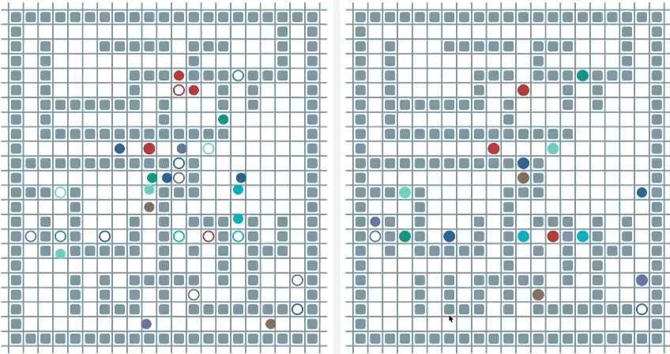
Human labeling demo

Slide 8
Active-learning extension
Same trainer, same data, same ~56-label budget: only the acquisition strategy differs.
 | Stage 1 (auto only) | Stage 2 (random sampling) | Stage 3 (warm-start AL) | Stage 4 (iterative AL · 4×14)
Acquisition rule | — | uniform random | uncertainty × diversity | uncertainty × div., 4 rounds
hp_val (val-map · 12 pairs) | 0.417 (5/12) | 0.417 (5/12) | 0.583 (7/12) | 0.583 (7/12)
DDG argmax_pm1 (val maps 144-147) | 0.565 | 0.556 | 0.562 | 0.541
best round (Stage 4 only) | — | — | — | round 3 (pm1=0.565, hp_val=0.583)
Train labels used | 0 | 56 (random) | 56 (pool AL) | 4 × 14 (iter AL)
Annotator hours | 0 | ≈0.5 | ≈0.5 | ≈0.5
Distinct episodes | 0 | ≤56 (no cap) | ≤28 (cap=2) | ≤28 (cap=2)
Walk-aways
• Random sampling at fixed budget gives zero lift over auto-only on hp_val. Just adding human labels without selection priority is not enough.
• AL with uncertainty × diversity selection: +17 pp on hp_val over random at the same 56-label budget. Selection strategy matters more than label volume.
• Iterative AL ≈ single-shot AL at this budget. 4 rounds of 14 labels with model retrained between matches one batch of 56. Engineering the loop did not pay off here.
• DDG-aligned ranking preserved across all four stages: argmax_pm1 ∈ [0.541, 0.565].
HRI Final · Human-in-the-Loop Congestion Classification for MAPF
7 / 8
Notes:
[Isabel, ~35s] This is the slide that frames our depth contribution. Walk down the columns — Stages 3 and 4 share the same 56-label budget as Stage 2 and only the acquisition rule differs. Stages 3 & 4 are still being collected, but the framework itself is the contribution: any ordering of the [PENDING] cells answers a substantive AL-design question. Once we have the numbers, we can update this single slide in PowerPoint and the whole story crystallises.

Slide 9
Conclusion & limitations
Walk-aways
• 39 human pairs (≈0.15% of gradient) → +23 pp pairwise / +8 pp exact-match human alignment, no DDG cost.
• The save-best criterion is itself a deployment choice: 4 saved checkpoints differ by 31 pp on top-1 metric.
• The acquisition-strategy comparison (Stages 1–4 at fixed budget) matters.
Limitations and Future Work
• Dataset size is still lean and we would like to add more data annotations to try for improvements over more epochs
• No downstream MAPF-GPT impact study yet: does using this classifier in DDG train a better policy on POGEMA?
HRI Final · Human-in-the-Loop Congestion Classification for MAPF
8 / 8
Notes:
[Isabel, ~25s] Three walk-aways, three honest limitations. Don't oversell — the audience respects the variance disclosure. Land softly to invite Q&A.

Slide 10
Thank you!

Slide 11
Results: hand-curation lifts every gold-label metric
On the same 13 held-out human pairs · best checkpoint per stage
Metric | Stage 1 (auto only) | Stage 2 (+39 human) | Δ
Pairwise (hp_v on 13) | 0.615 (8/13) | 0.846 (11/13) | +0.231
Exact-match (h-arg top-1) | 0.538 (7/13) | 0.615 (8/13) | +0.077
DDG argmax_pm1 (auto val maps) | 0.550 | 0.541 | −0.009
DDG top-3 (auto val maps) | 0.578 | 0.559 | −0.019
Walk-away
• +3 of 13 pairs ranked correctly · +1 of 13 worst-segments identified exactly.
• No measurable cost on auto-aligned ranking both DDG metrics within 2 points.
• Deployment-ready checkpoint: with_human_labels.human_argmax_top1.pt (best across all 4 save criteria).
HRI Final · Human-in-the-Loop Congestion Classification for MAPF
6 / 8
Notes:
[Isabel, ~45s] Lead with the top two table rows — those are the headline. Then point at the figure: same data, different views. End on the walk-away: NO auto cost. That sells the override-don't-augment design.

