Slide 1
DETR Network Architecture
From observation tensor to path-parameter estimation
Input observation
XY_grid
B x 2(N_rx+N_tx) x N_sc x N_obs
CNN stem
local features + channel projection
Transformer
Encoder / Decoder attention
Heads
alpha / obj / mu / rho / delta
Outputs
theta, alpha, path_prob, mix_lambda
Narrative: start with the shallow data flow, then expand CNN stem, attention, and the active parameter heads; G head is not part of the used path.
DETR architecture | 01

Slide 2
Backbone view
Overall Shallow Data Flow
Queries
Random init
B x Leff x d_model
XY_grid
B x 2(N_rx+N_tx) x N_sc x N_obs
CNN stem
B x d_model x N_sc x N_obs
Token + Pos
B x T x d_model
Encoder
self-attn over T
Decoder
q queries attend memory
Heads
alpha / obj / mu / rho / delta
Gauge
B x L_eff
Outputs
theta + scores
[B, 16, 48, 2]
[B,128,48,2]
[B,96,128]
[B,96,128]
[B,8,128]
G head / G_hat / gains_all
not used later; not expanded here
The shallow flow only keeps the currently used path, so the unused G branch is not presented as a core output.
Key tensor dimensions move from a grid representation into tokens, then back to L_eff path parameters.
DETR architecture | 02

Slide 3
Symbols and conservative physical labels
Input and Configuration Parameters
Symbol
Meaning
Dimensional role
Input x
B x (N_rx+N_tx) x N_sc x N_obs
N_rx
number of receivers
input channels and delta_rx output
N_tx
number of transmitters
kept as a config symbol; G branch is not expanded
N_sc
number of subcarriers
grid height / pos_k length
B: batch size
N_obs
length of observedSymbols
grid width / pos_n length
2N_rx: complex observations split into real/imag channels for each receiver
L_eff
number of effective paths
top-k output path count
N_sc x N_obs: two-dimensional subcarrier/observed-symbol grid
d_model
Transformer hidden size
CNN stem output channels and token width
shape check raises ValueError on mismatch
q
number of DETR queries
max(L_eff, detrNumQueries)
DETR architecture | 03

Slide 4
From 2D observation grid to token sequence
Tensor Layout and Tokenization
fmap
B x d_model x N_sc x N_obs
permute
B x N_sc x N_obs x d_model
reshape to tokens
T = N_sc x N_obs
fseq: B x T x d_model
Tokenization keeps batch B unchanged; it only flattens the 2D positions into a sequence that the Transformer can process.
N_sc x N_obs grid
T tokens, each token width = d_model
DETR architecture | 04

Slide 5
Local feature extraction and channel projection
CNN Stem Design
Input
B x 2(N_rx+N_tx) x N_sc x N_obs
Conv2d
2N_rx -> d_model
GELU
Conv2d
d_model -> d_model
GELU
[B,128,48,2]
[B,16,48,2]
[B,128,48,2]
3x3, padding=1
B x d_model x N_sc x N_obs
[B,128,48,2]
fuse local patterns across neighboring subcarriers and observed symbols
DETR architecture | 05

Slide 6
Inject grid coordinates into the token sequence
2D Positional Encoding
Initialized from N(0, 0.02²)
pos_k
N_sc x d_model
broadcast add
N_sc x N_obs x d_model
reshape + unsqueeze
pos: 1 x (N_sc x N_obs )x d_model
pos_n
N_obs x d_model
Transformer Encoder
self attention over T tokens
CNN output
B x d_model x N_sc x N_obs
Permute & reshape
encoder_input
B x (N_sc x N_obs) x d_model
memory
B x (N_sc x N_obs) x d_model
The positional encodings are learnable parameters; _sincos_pos is not used in this forward path.
DETR architecture | 06

Slide 7
Query candidate paths from memory
Learnable Queries and Decoder Attention
memory
B x T x d_model
query parameters
L_eff x d_model
unsqueeze + expand
queries: B x L_eff x d_model
Decoder self-attention
queries exchange information
Cross-attention
queries attend encoder memory
q is the number of candidate path slots; each slot is later mapped by heads into path-related parameters.
decoded
B x L_eff x d_model
DETR architecture | 07

Slide 8
decoded -> alpha / objectness / rho
Path Existence and Basic Parameter Heads
alpha_head
Linear d_model -> 1
squeeze + softplus
alpha_all
B x Leff
decoded
B x L_eff x d_model
path probability head
Linear d_model -> 1
squeeze + sigmoid
path_prob_all
B x Leff
rho_head
Linear d_model -> 1
squeeze + sigmoid + scale
rho_raw_all
B x Leff
Range：[rho_min, rho_max]
alpha_all is a nonnegative prediction of path amplitude/weight.
path_prob_all is the probability that a candidate query becomes an effective path.
rho_raw_all is the query-level prediction of the path-position parameter rho.
DETR architecture | 08

Slide 9
free / scaled / grid
Three mu Head Modes
decoded
B x q x d_model
free
scaled
grid
mu_head
B x q x 1
squeeze -> B x q
sigmoid + scale
mu_head
B x q x 1
sigmoid -> frac B x q
mu_head
B x q x num_mu_bins
softmax over bins
mu_raw_all
B x q
frac + extent
mu_min + frac * extent range
weighted sum with mu_dict
frac B x q
cross_path_stats
mean over query dim
B x d_model
s_head MLP
B x d_model -> B x 1
extent
scaled/grid share extent; the free branch predicts mu_raw_all directly.
DETR architecture | 09

Slide 10
From q candidate slots to L_eff effective paths
Top-k Selection and Gauge Fix
alpha_all
B x q
score = alpha_all * path_prob_all
B x q
top-k over query dim
top_idx: B x L_eff
path_prob_all
B x q
mu_raw_all -> mu_raw
B x L_eff
rho_raw_all -> rho_raw
B x L_eff
alpha_all -> alpha
B x L_eff
path_prob_all -> path_prob
B x L_eff
gauge_fix_mu
mu0 = max(mu_raw)
mu_rel = mu_raw - mu0
gauge_fix_rho
rho0 = mean(rho_raw)
rho_rel = rho_raw - rho0
delta path
fmap -> pool -> delta_mlp
B x N_rx -> relative offsets
DETR architecture | 10

Slide 11
Currently used forward path
Output Interface and Closing View
theta dict
alpha
B x L_eff
path_prob
B x L_eff
Field
Shape
Description
mu0
B x 1
reference value for path-position parameter mu
rho0
B x 1
reference value for path-position parameter rho
mix_lambda
1
delta_rx
B x N_rx
receiver-side relative offsets
mu_rel
B x L_eff
relative mu of effective paths
rho_rel
B x L_eff
relative rho of effective paths
G head / G_hat
not expanded as a used path in this version
pack_slope_theta is not used in this forward path; the model returns a dict.
The main story ends at theta, alpha, path_prob, and mix_lambda.
DETR architecture | 11

Slide 12
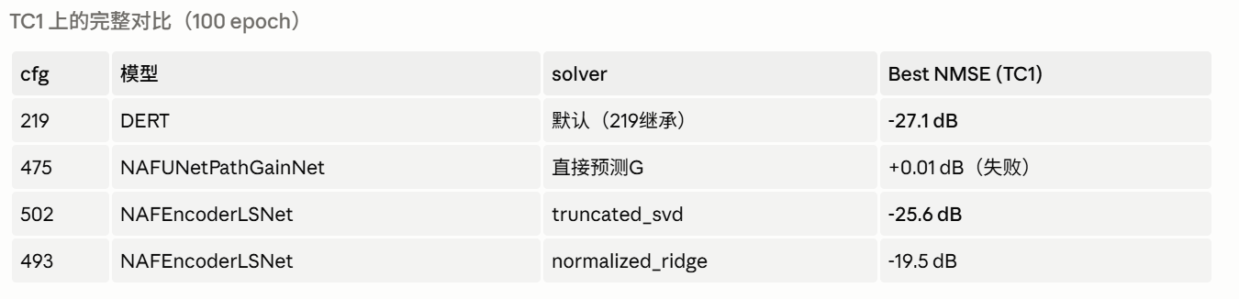

Slide 13
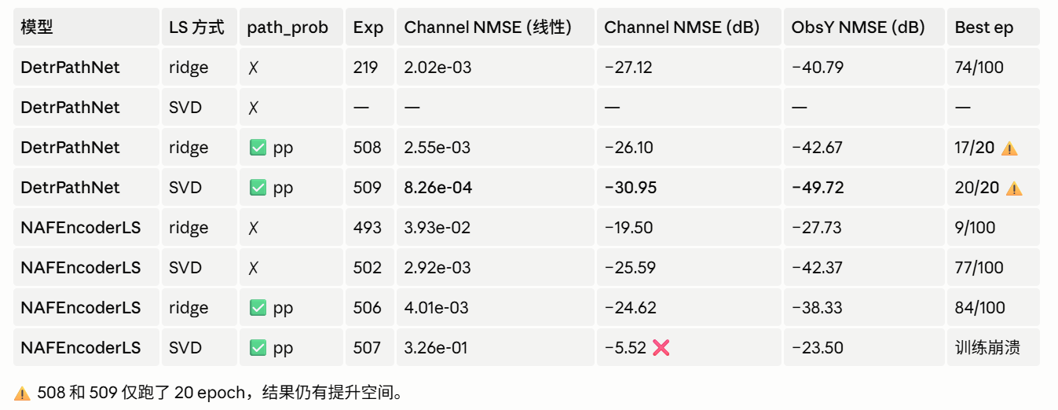

Slide 14


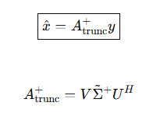
丢掉小的奇异值

Slide 15


Slide 16
