Slide 1
AUTOMATIC GENERATION OF MATRICULATION NUMBER SYSTEM
A SEMINAR REPORT PRESENTED BY
ISAAC CHINONSO GIFT
C190303013

Slide 2
INTRODUCTION
Matriculation is the formal process of entering a university, or of becoming eligible to enter by fulfilling certain academic requirements such as a matriculation examination. Matriculation is the official process of joining an educational institution usually a university. This process is usually carried out if the candidate is qualified for a program. In some cases, an academic prerequisite such as a matriculation examination has to be met before matriculation can take place.

Slide 3
STUDENT MATRICULATION NUMBER
Student matriculation number is a unique identification and authentication number assigned to every student upon first enrollment in an institution. This unique matriculation number assists research and educational institutions to monitor, track, organize and transfer student records efficiently, effectively and reliably. It is also regarded as the student registration number.

Slide 4
STATEMENT OF THE PROBLEM
Matriculation Number Is Forgotten
Matriculation Number Is Lost
Time Consuming to Generate

Slide 5
AIM AND OBJECTIVES OF THE STUDY
To resolve issues associated with manual students’ Matriculation number.
To provide a platform for students to easily retrieve lost or forgotten matric or Matriculation number.

Slide 6
SIGNIFICANCE OF THE STUDY
This project work “the design and implementation of an automated matriculation number system will be of great significance to academic institutions in the sense that it will help in overcoming the problems of manual operations.

Slide 7
ANALYSIS OF THE EXISTING SYSTEM
In the current application system of the Joseph Ayobabalola University, students matriculation number is the major means of identification of students within and outside the University campus. Also, matriculation number is also one of the major criteria of student ID card issuance in the University.

Slide 8
SYSTEM FLOWCHART
START
MAIN PROGRAM WITH HYPERLINKS
A
CLICK ON LINK
IS LINK HOME
DISPLAY HOME PAGE
YES
B
IS LINK ABOUT
DISPLAY ABOUT US
YES
C
IS LINK ADMISSION
DISPLAY ADMISSION
YES
D
Is link
Student registration summary
DISPLAY CONTACT US
NO
YES
E

Slide 9
PROGRAM DEVELOPMENT
The proposed E-Matriculation System will contain : Home Page, Registration Page, Login Page, Student Registration Summary

Slide 10
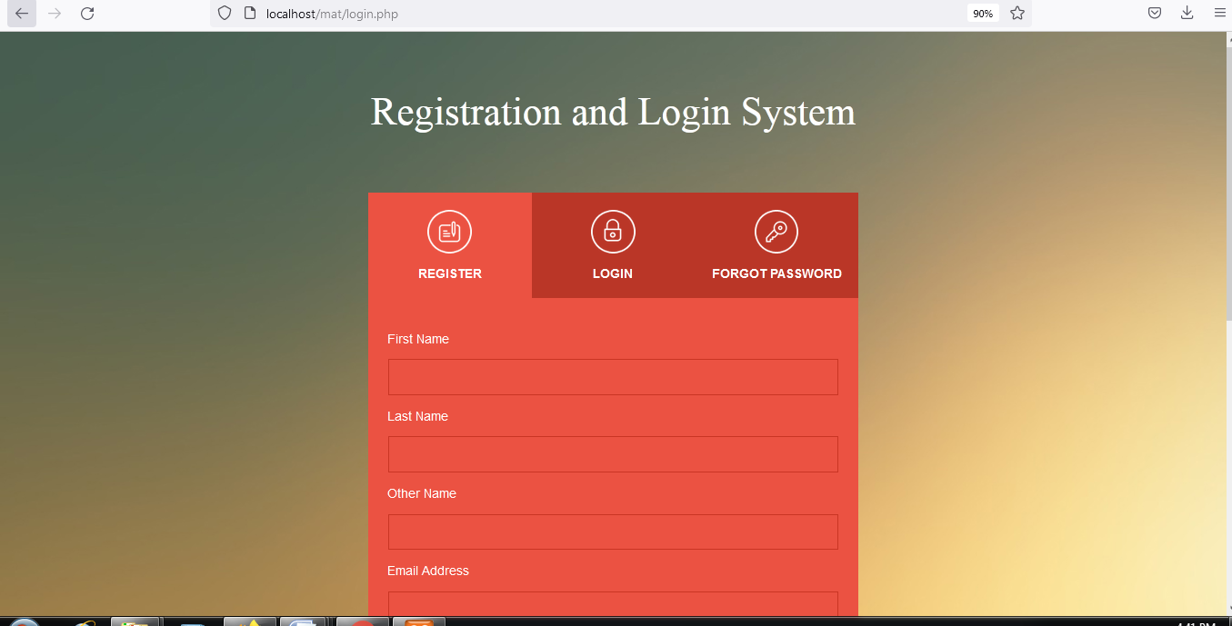
HOME PAGE

Slide 11
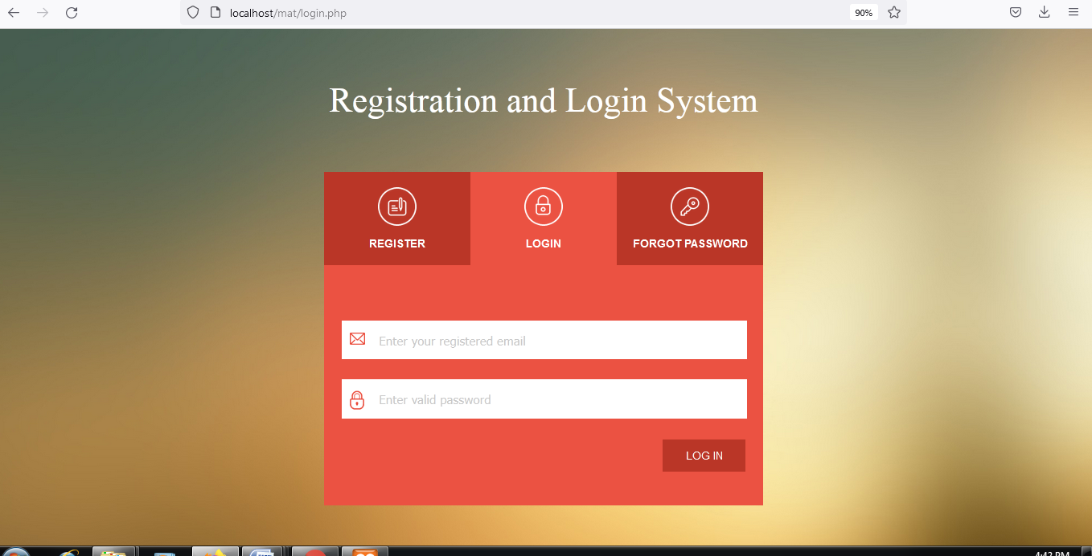
REGISTRATION PAGE

Slide 12
SUMMARY
Student identification refers to the random identifier associated with a student’s academic record. It will not transfer with students should they switch institutions. This number helps institutions track, monitor and organize student records more efficiently. This identifier will often be used in place of personal information such as name. In the Joseph Ayobablola University, students matriculation number is the major means of identification of students within and outside the polytechnic campus.

Slide 13
RECOMMENDATION
Based on the findings of this study it was recommended that the polytechnic management should implement the process of automating the process of assigning matriculation number to newly admitted students. Also, the government and the TETFUND management should consider the policy of adding incentives to students research so as to reduce the various limitations encountered.

Slide 14
CONCLUSION
Due to weakness of the existing system, there is a need to design an Automated Matriculation Generated system which will help enhance the efficiency of data capture and shortens registration processing time and allows for fast payment processing. Therefore this study proposes an automatic matric number generation to help eliminate the problems of the existing system. The new system is designed to solve problem affecting the existing system in use.

