Slide 1
Online Shoppers Intention
Group 3
CECS 456 - Sec. 02
Isaac Cortes
Ryan Lertpichitkul
Abraham David Ungos
Samyak Jain
Jack Hannum

Slide 2
Introduction
Online shopping has increased over the years due to its convenience and accessibility for its users
With the given dataset about online shoppers, we intend to use machine learning algorithms to minimize the attributes and train the algorithms to identify and label data points into certain clusters
SHOP

Slide 3
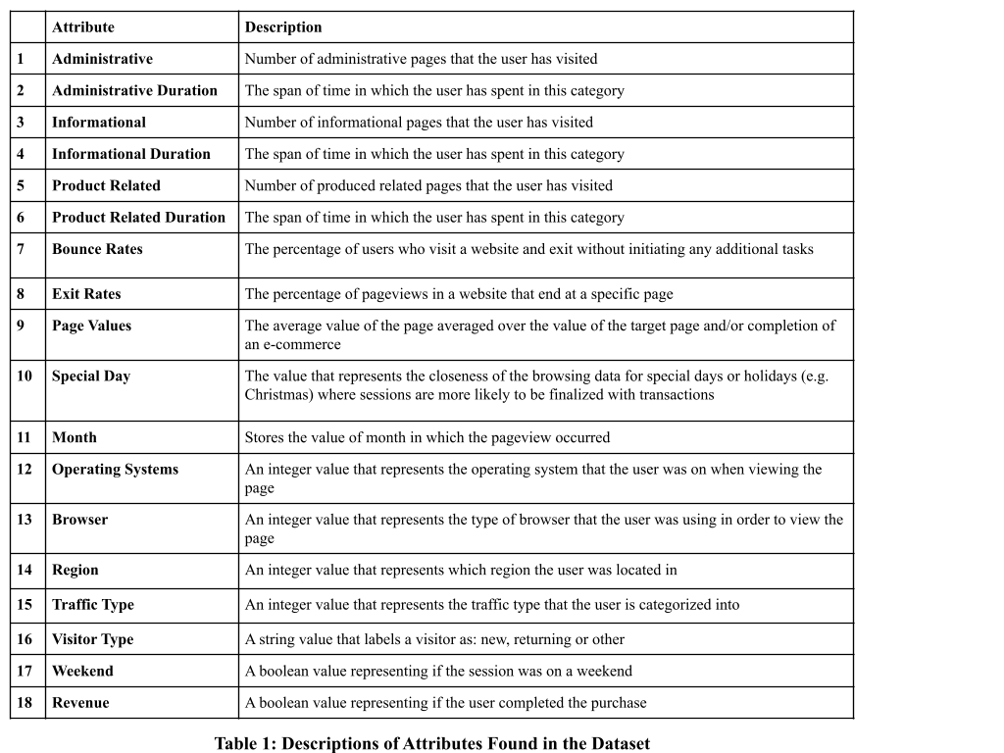
Dataset
The data set has 12,330 different sessions that were recorded
Each session has about 18 attributes

Slide 4
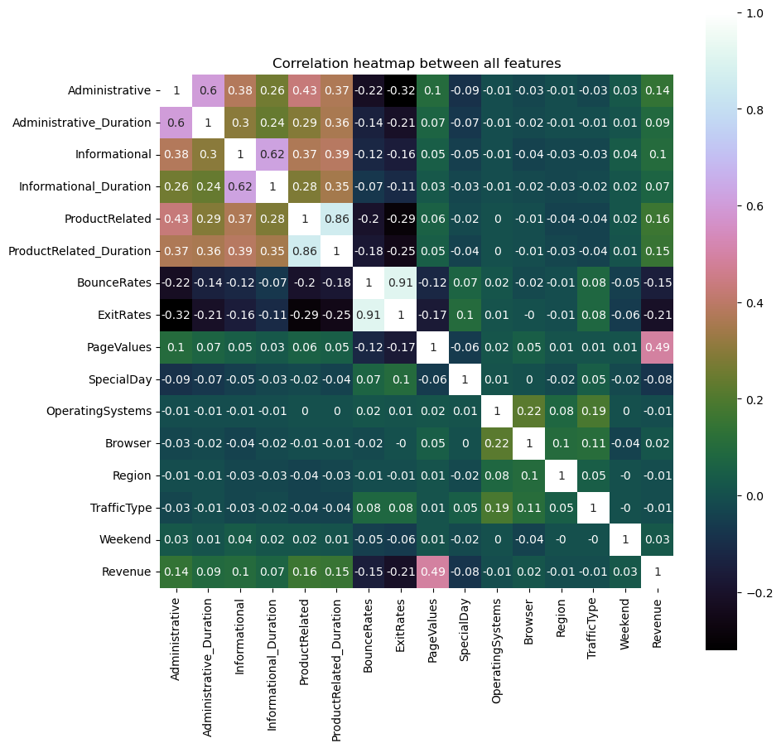
Variable Analysis
Correlation Heatmap Between All Features

Slide 5
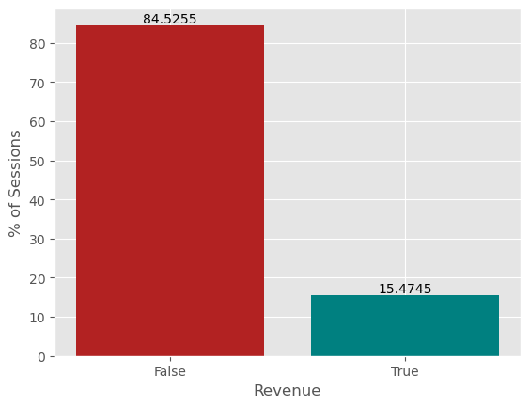
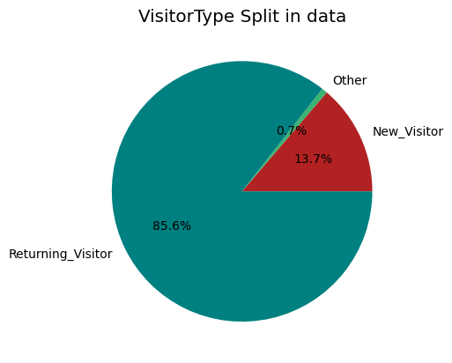
Revenue Analysis
Visitor Type Data

Slide 6
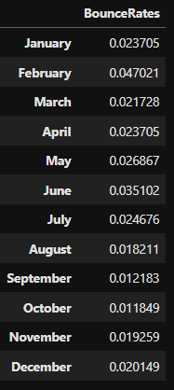
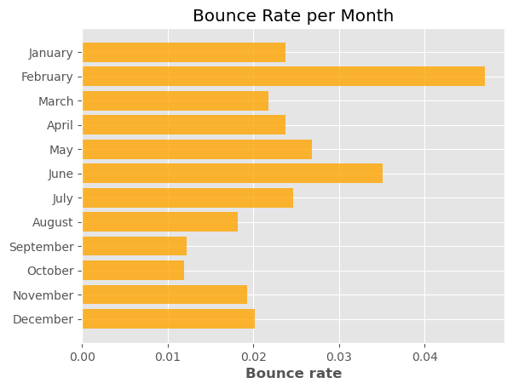
Numerical Value of Bounce Rate Per Month
Bounce Rate Per Month

Slide 7
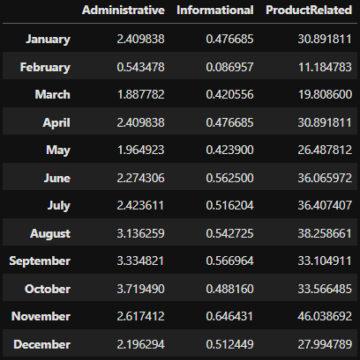
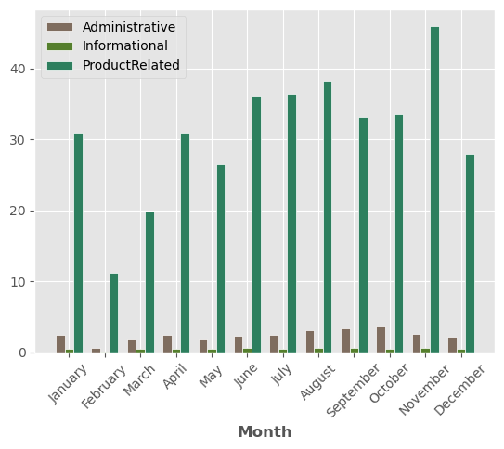
Numerical Values of Visits by Month and Type
Visits by Month and Type

Slide 8
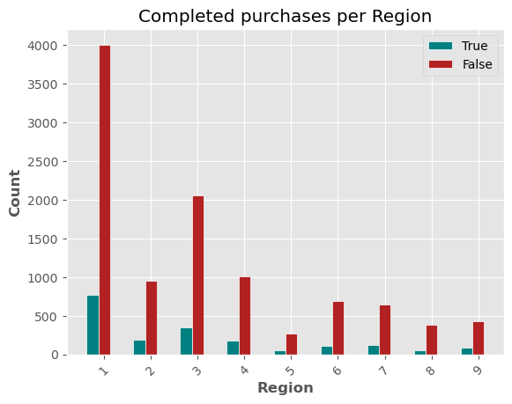
Numerical Values of Visits by Month and Type
Visits by Month and Type

Slide 9
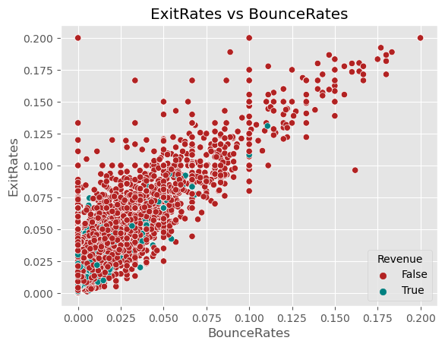

Slide 10
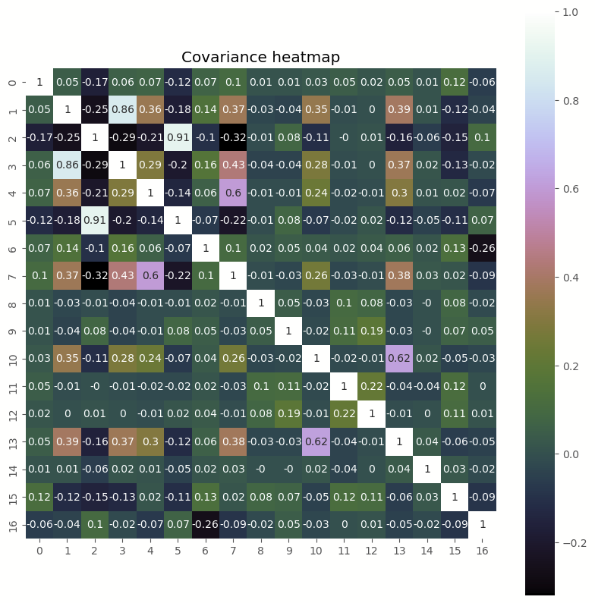
Normalization

Slide 11
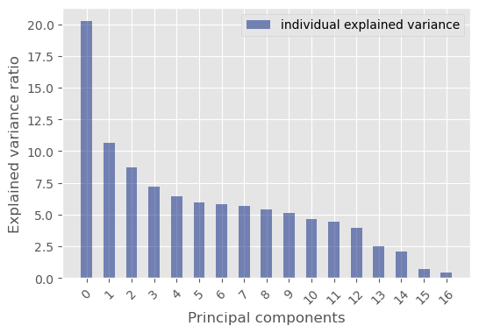
Methodology
Explained Variance and Principal Components

Slide 12
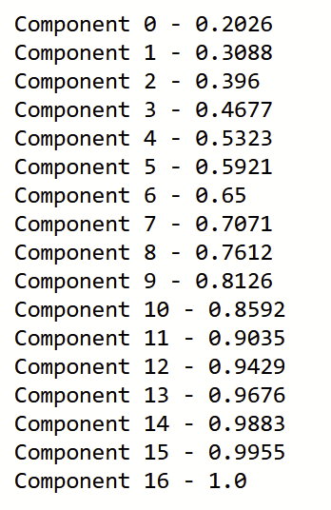
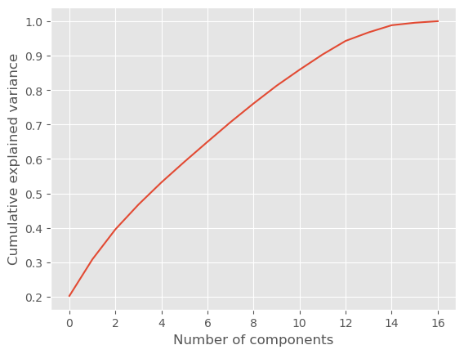
Principal Component Analysis
Reducing the Number of Components

Slide 13
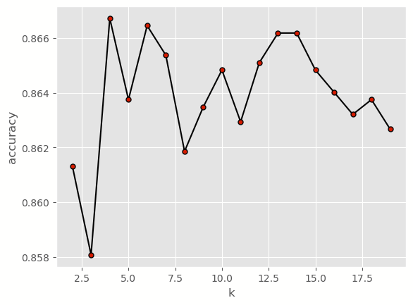
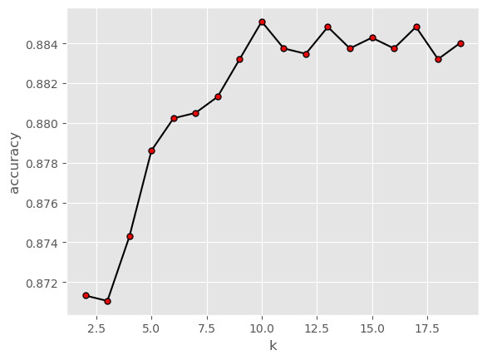
Predicting without PCA
Predicting with PCA
K-nearest Model Implementation
A
B

Slide 14
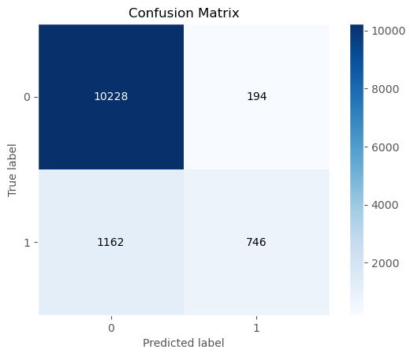
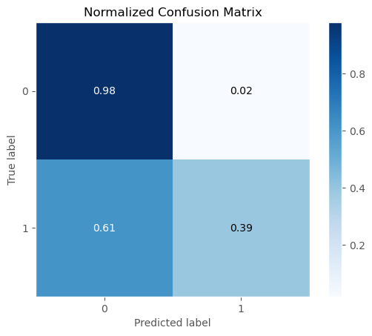
Resultant Model
Confusion Matrix and Normalized Confusion Matrix

Slide 15
Conclusion
Analyzing the dataset can provide data on user behavior and intention
We studied the dataset by analyzing the relationship between the attributes and the impact they have on the data as a whole
Implementing our model with PCA resulted in a higher accuracy in comparison to the model that did not have PCA implemented
SHOP
PAY

Slide 16
References
Baati, K., Mohsil, M. (2020). Real-Time Prediction of Online Shoppers’ Purchasing Intention Using Random Forest. In: Maglogiannis, I., Iliadis, L., Pimenidis, E. (eds) Artificial Intelligence Applications and Innovations. AIAI 2020. IFIP Advances in Information and Communication Technology, vol 583. Springer, Cham. https://doi.org/10.1007/978-3-030-49161-1_4
C. Okan Sakar, Yomi Kastro. Online Shoppers Intention Dataset Data Set. https://archive.ics.uci.edu/ml/datasets/Online+Shoppers+Purchasing+Intention+Dataset
Sakar, Polat, S. O., Katircioglu, M., & Kastro, Y. (2018). Real-time prediction of online shoppers’ purchasing intention using multilayer perceptron and LSTM recurrent neural networks. Neural Computing & Applications, 31(10), 6893–6908. https://doi.org/10.1007/s00521-018-3523-0

