Slide 1
Front-end build tools
"All you need to know”
workshop
Webpack, Gulp, Babel, TypeScript, Sass,
Hot Module Replacement
Taavi Kübar
Notes:
The goal of this workshop is not to compare different build tools but rather to set up a working front end build environment using the most common tools and giving practical information to apply in your own application.
I have set up a very basic React app. Now we need to make it compile so that browsers can understand and display it.
I hope you all have installed Node and downloaded the repo. Please run npm install if you have not done so yet.
[introducing repo files]
[talking about workshop steps]

Slide 2
Why to use build tools

Slide 3
If you're building a complex Front End application with many non-code static assets such as CSS, images, fonts, etc, then yes, Webpack will give you great benefits.
If your application is fairly small, and you don't have many static assets and you only need to build one Javascript file to serve to the client, then Webpack might be more overhead than you need.

Slide 4
To use ES6 modules
To use latest Javascript features
To use TypeScript
To use Sass
To use polyfills for specific target browsers
To simplify, unify and automate build processes

Slide 5
To take advantage of production build optimizations
To speed up local development without the need to refresh the page and lose state
Dead asset elimination
You only build the images and CSS into your dist folder that your application actually needs
Stable production deploys
You can't accidentally deploy code with images missing, or outdated styles

Slide 6
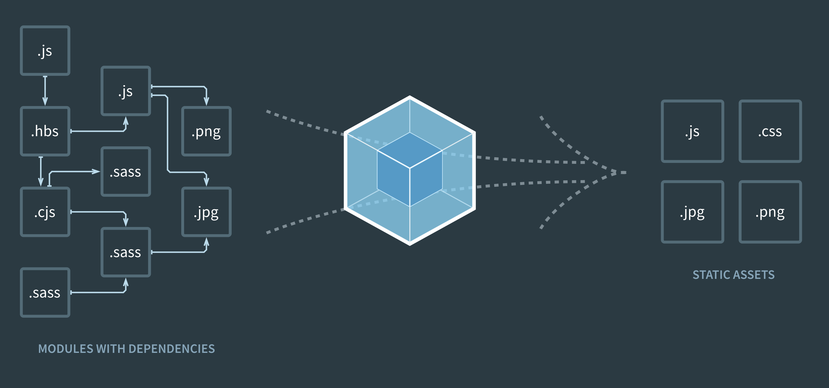
Webpack
Static module builder
Notes:
Webpack (stylised webpack) is an open-source JavaScript module bundler. Its main purpose is to bundle JavaScript files for usage in a browser, yet it is also capable of transforming, bundling, or packaging just about any resource or asset. Webpack takes modules with dependencies and generates static assets representing those modules.
Through "loaders," modules can be CommonJs, AMD, ES6 modules, CSS, Images, JSON, Coffeescript, LESS, ... and your custom stuff.

Slide 7
Webpack is a build tool that puts all of your assets, including Javascript, images, fonts, and CSS, in a dependency graph.
When webpack processes your application, it starts from a list of modules defined on the command line or in its config file.
Starting from these entry points, webpack recursively builds a dependency graph that includes every module your application needs, then bundles all of those modules into a small number of bundles - often, just one - to be loaded by the browser.
Notes:
Any time one file depends on another, webpack treats this as a dependency. This allows webpack to take non-code assets, such as images or web fonts, and also provide them as dependencies for your application.

Slide 8
Features
Ability to bundle all sort of different files
Fairly easy to set up
Production-ready with a lot of optimizations already built-in
Hot Module Replacement for fast development
Lots of advanced customization features
Mature, widely used and constantly developed

Slide 9
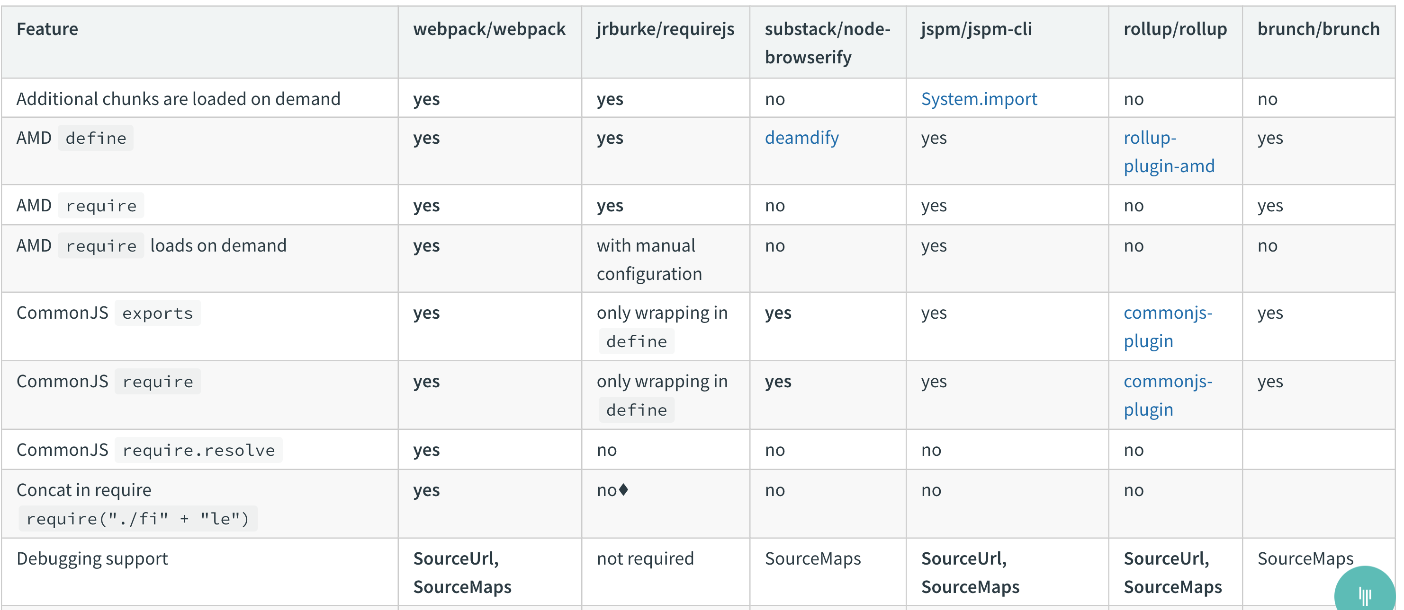
Comparsion
Notes:
Webpack is the most feature rich build tool and usually most suitable for all sizes of applications that need to be production ready and configurable.

Slide 10
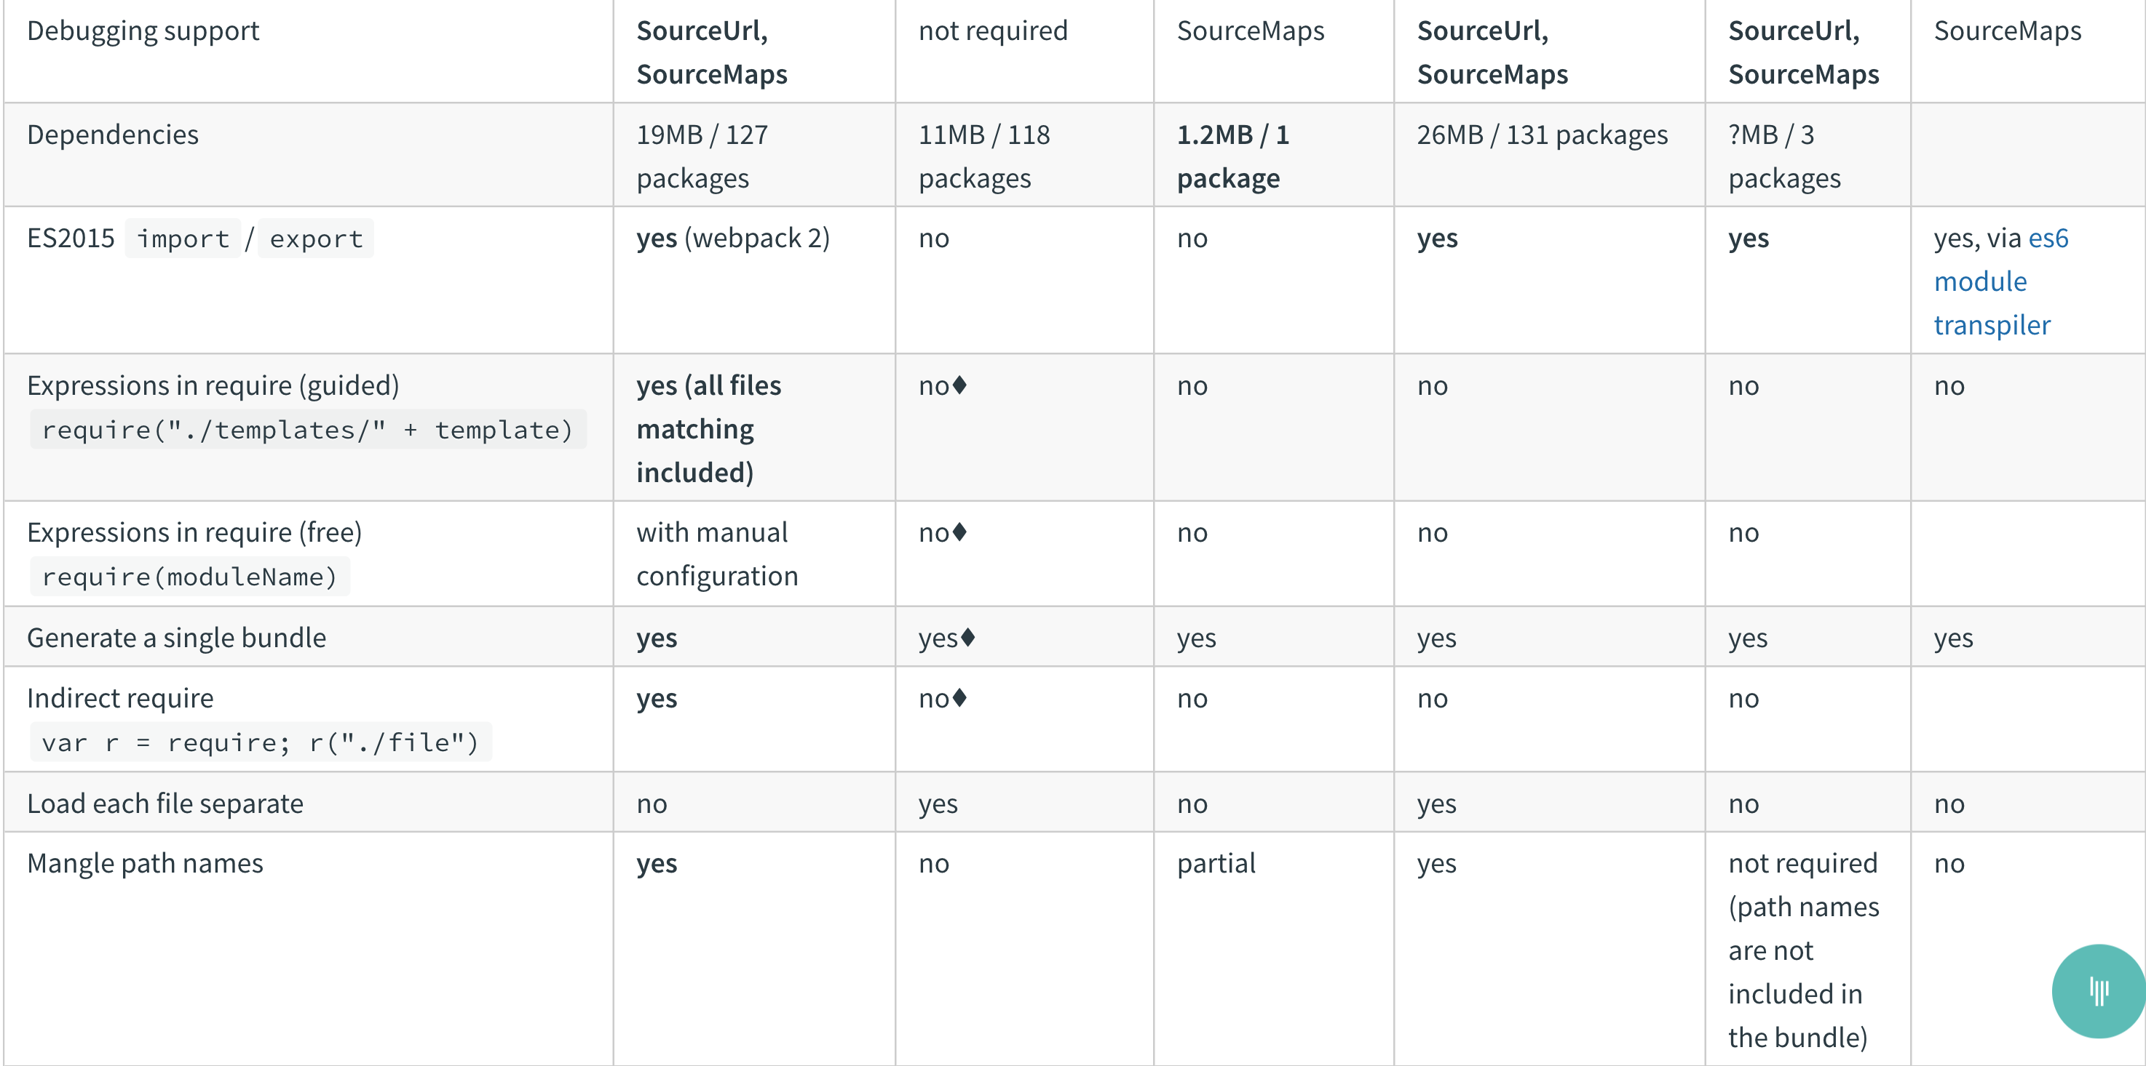
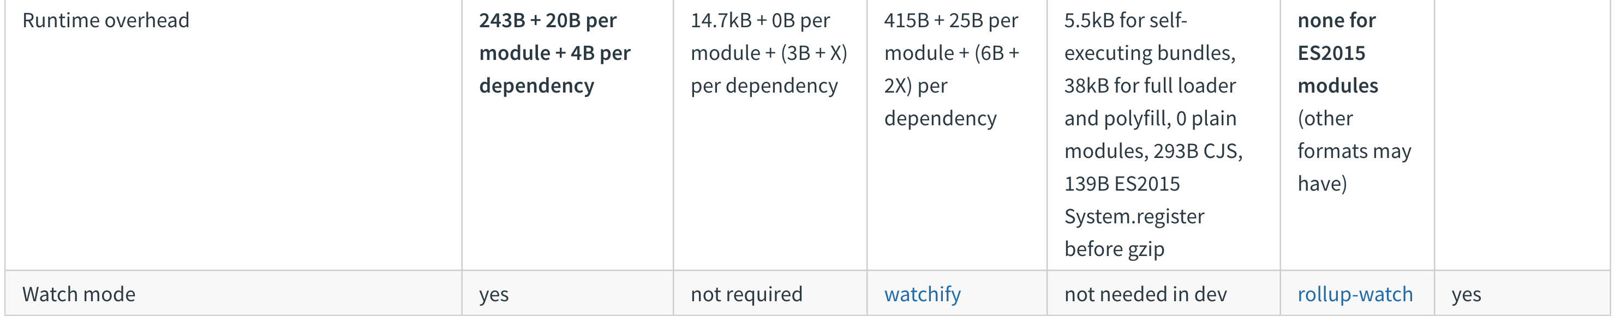
Notes:
As they write on their website, tt's important to note some key differences between loading and bundling modules. A tool like SystemJS, which can be found under the hood of JSPM, is used to load and transpile modules at runtime in the browser. This differs significantly from webpack, where modules are transpiled (through "loaders") and bundled before hitting the browser.

Slide 11

Babel
Javascript compiler / transpiler
Notes:
Babel or Babel.js is a free and open-source JavaScript compiler and configurable transpiler used in web development.
Its a toolchain that is mainly used to convert ECMAScript 2015+ code into a backwards compatible version of JavaScript in current and older browsers or environments.

Slide 12
Features
Developers can use latest JavaScript features
Polyfills features that are missing in target environments
Transforms syntax
Supports plugins for specific environments e.g React JSX
Highly customizable target browsers
Notes:
Babel plugins are available to provide specific conversions used in web development. For example, developers working with React.js, can use Babel to convert JSX (JavaScript eXtension) markup into JavaScript using the Babel preset “react".

Slide 13
Setting up Webpack build and Babel configuration
DEVELOPMENT

Slide 14

TypeScript
JavaScript with types
Notes:
TypeScript is an open-source programming language developed and maintained by Microsoft. It is a strict syntactical superset of JavaScript, and adds optional static typing to the language.
TypeScript is designed for development of large applications and transcompiles to JavaScript. As TypeScript is a superset of JavaScript, existing JavaScript programs are also valid TypeScript programs. TypeScript may be used to develop JavaScript applications for both client-side and server-side (Node.js) execution.

Slide 15
Features
Adds support for type annotations
Adds object oriented features to JavaScript
Compile-time checking
Interfaces, enums, generics, tuples etc…
Decreases potential of bugs
Increases confidence in code refactor
Notes:
Types enable JavaScript developers to use highly-productive development tools and practices like static checking and code refactoring when developing JavaScript applications.
TypeScript offers support for the latest and evolving JavaScript features, including those from ECMAScript 2015 and future proposals, like async functions and decorators, to help build robust components.

Slide 16
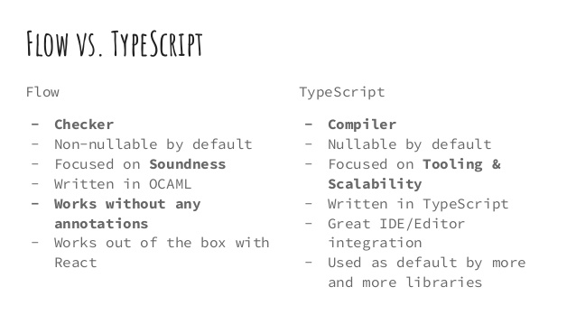
TypeScript vs Flow.js
Notes:
I would recommend using Typescript since it is much more powerful and opens up a new world of possibilites.

Slide 17
Setting up TypeScript compilation
DEVELOPMENT

Slide 18

Sass
CSS with superpowers
Notes:
Sass is the most mature, stable, and powerful professional grade CSS extension language in the world.

Slide 19
Features
Enables writing CSS as modules in separate files
Paired with BEM methodology increases clarity greatly
Adds scripting support to CSS
Variables, nesting, mixins, partials, SassScript etc…
Notes:
Sass is a preprocessor scripting language that is interpreted or compiled into Cascading Style Sheets (CSS). SassScript is the scripting language itself.

Slide 20
Setting up Sass compilation
DEVELOPMENT

Slide 21
Webpack Dev Server (WDS)
+ Hot Module Replacement (HMR)
Hot Module Replacement exchanges, adds, or removes modules while an application is running,
without a full reload.
Notes:
This can significantly speed up development in a few ways:
Retain application state which is lost during a full reload.
Save valuable development time by only updating what's changed.
Modifications made to CSS/JS in the source code results in an instant browser update which is almost comparable to changing styles directly in the browser's dev tools.

Slide 22
How HMR works
The following steps allow modules to be swapped in and out of an application:
The application asks the HMR runtime to check for updates.
The runtime asynchronously downloads the updates and notifies the application.
The application then asks the runtime to apply the updates.
The runtime synchronously applies the updates.

Slide 23
Setting up WDS and HMR
DEVELOPMENT

Slide 24
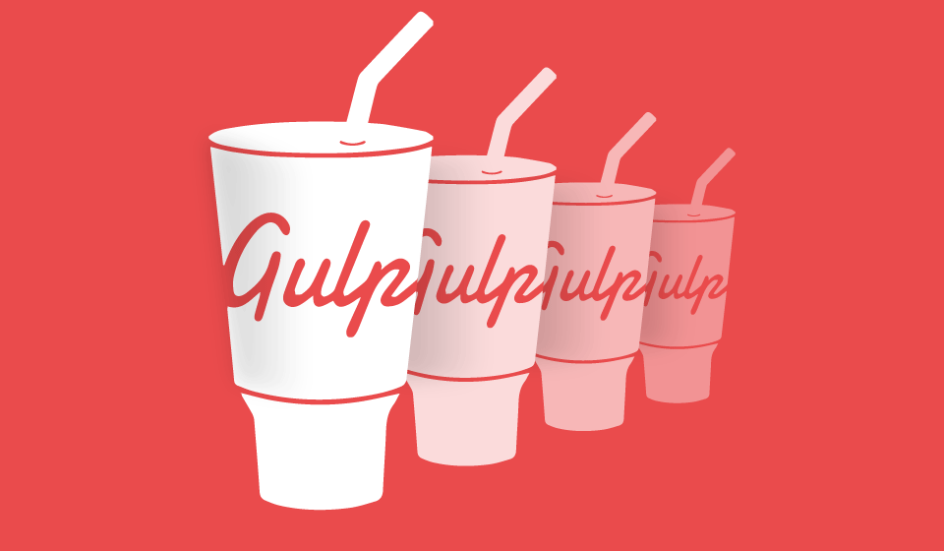
Gulp.js
Task runner
Notes:
It is a task runner built on Node.js and npm, used for automation of time-consuming and repetitive tasks involved in web development like minification, concatenation, cache busting, unit testing, linting, optimization, etc
gulp uses a code-over-configuration approach to define its tasks and relies on its small, single-purposed plugins to carry them out. The gulp ecosystem includes more than 300 such plugins.

Slide 25
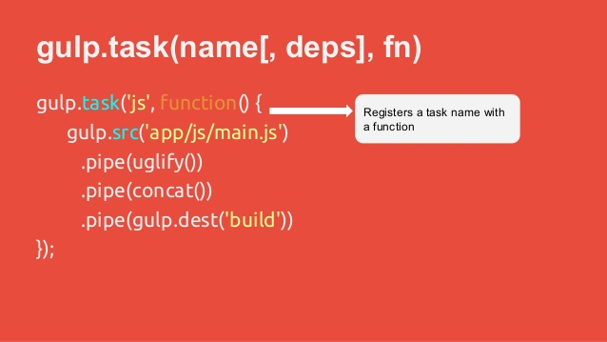
Gulp task
Notes:
Gulp task uses pipes to pass data along and can be used to perform any process using its plugins.

Slide 26
Features
More efficient than npm scripts for IO operations
Possible to define custom tasks that cannot be performed otherwise
Notes:
Task-runners like gulp and Grunt are built on Node.js rather than npm, because the basic npm scripts are inefficient when executing multiple tasks. Even though some developers prefer npm scripts because they can be simple and easy to implement, there are numerous ways where gulp and Grunt seem to have an advantage over each other and the default provided scripts.
Not so much used for compiling and transpiling anymore since Webpack can do most of it on its own.

Slide 27
Setting up Gulp
DEVELOPMENT

Slide 28
Linting
ESLint
TSLint
SassLint
A linter refers to tools that analyze source code to flag programming errors, bugs, stylistic errors, and suspicious constructs.

Slide 29
Features
Agreed upon code syntax and methodologies per team/service
Reduction in potential bugs
Tons of rules that can be configured easily
More readable code

Slide 30
Setting up Linting
DEVELOPMENT

Slide 31
https://blog.andrewray.me/webpack-when-to-use-and-why/https://github.com/webpack-contrib/sass-loader
https://webpack.js.org/configuration/
https://webpack.js.org/concepts/modules/
https://webpack.js.org/configuration/devtool/
https://webpack.js.org/configuration/module/
https://babeljs.io/
https://github.com/TypeStrong/ts-loader
http://chir.ag/projects/name-that-color/
https://github.com/webpack-contrib/css-loader
https://github.com/webpack-contrib/css-loader
https://webpack.js.org/concepts/hot-module-replacement/
https://github.com/webpack-contrib/file-loader
https://github.com/jantimon/html-webpack-plugin
https://github.com/johnagan/clean-webpack-plugin
https://www.npmjs.com/package/url-loader
https://learn.co/lessons/javascript-lodash-templates
https://eslint.org/
Useful resources

Slide 32
Useful resources
https://eslint.org/docs/user-guide/configuring
https://www.npmjs.com/package/eslint-plugin-react
https://www.npmjs.com/package/eslint-plugin-import
https://github.com/babel/eslint-plugin-babel
https://palantir.github.io/tslint/
https://www.npmjs.com/package/sass-lint
https://webpack.js.org/comparison/
https://engineering.velocityapp.com/webpack-vs-browersify-vs-systemjs-for-spas-95b349a41fa0
https://en.wikipedia.org/wiki/TypeScript
https://en.wikipedia.org/wiki/Webpack
https://en.wikipedia.org/wiki/Babel_(compiler)
https://github.com/niieani/typescript-vs-flowtype
https://sass-lang.com/
https://en.wikipedia.org/wiki/Sass_(stylesheet_language)
http://getbem.com/
https://en.wikipedia.org/wiki/Gulp.js
https://en.wikipedia.org/wiki/Lint_(software)

Slide 33
Thank you!
Taavi Kübar
2018

