Slide 1

Effects of Capital Punishment on Homicide Rates
Ryan Granet & Isaac Updike

Slide 2
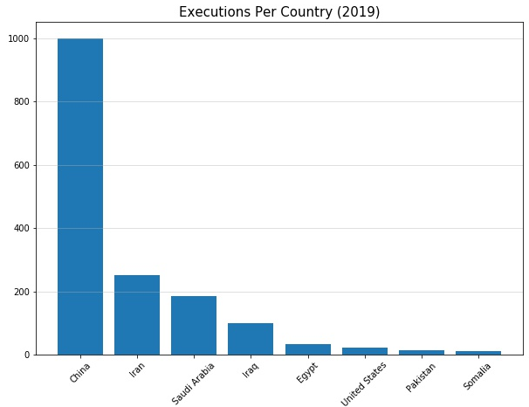
Motivation
Capital punishment has been used as a policy to deter crimes, specifically murder.
The use of capital punishment as a policy has been debated for decades, causing some states to phase it out.
The U.S. is only surpassed in executions by China, Iran, Saudi Arabia, Iraq, and Egypt.
In 2019, the United States executed 22 people for their crimes.

Slide 3
Background
Furman v. Georgia, 408 U.S. 238: In 1972 the court bans capital punishment as cruel and unusual punishment, violating the eighth amendment. Court ruled that a disproportionate application of the death penalty discriminated against the poor and minorities.
Gregg v. Georgia, 428 U.S. 153: In 1976 the courts rule to reinstate the death penalty on the basis that it is not cruel and unusual if it could serve as a gain to society through retribution and deterrence.
Many court cases have shaped capital punishment to what it is today. These cases include changing the authority and circumstances under which a person can be sentenced to death. The courts would then go on to ban the death penalty for minors and remove the restriction that a “low IQ” person is ineligible for execution.
Previous studies tend to focus on state-level analysis and the bans on executions, and a wider definition of crime
The Deterrent Effect of Capital Punishment: Evidence from a “Judicial Experiment” – H. DEZHBAKHSH

Slide 4
Data Sources
Death Penalty Information Center - DeathPenaltyinfo.org
-Non-profit organization based in Washington DC providing data and research related to capital punishment.
-Provided County-level data on executions since 1977
Uniform Crime Reports (UCR)
-FBI Program providing administrative data and analysis on law enforcement and activity
-Provided annual data on number of murders and homicide arrests
U.S. Census Bureau
-Population
County totals, density
Demographic
% age groups 10-19,20-29
Race
Sex
Economic
Per-capita income
Per-capita income maintenance
Per-capita unemployment insurance

Slide 5

Data
Panel data collected at the county level, giving more observations to conduct the analysis.
Previous state-level analysis have focused on statewide policy changes – but most prosecution and executions are carried out on the county-level. Sheriffs offices (who bring charges against suspects), and county prosecutors are elected and appointed county wide, and enforcement and interpretation of capital punishment varies.
Murder rate (murdrate) measures the number of murders out of 10,000 each county experiences year-by-year.
Execution rate (execrate) measures the number of executions per 10,000 people in each county.
A total of 272,159 murders.
A total of 256 executions.
16 years of data collected, a total of 37,349 observations. Years 1980-1996.
Data includes economic, demographic, arrests for murder, and homicide/execution rates.
Due to counties having a value of zero for certain observations, log cannot be used for variables that include zero.

Slide 6
Methods
Scale economic control variables to log form, no observations with a value of zero.
Control for economic and demographic variables.
4 years of lag variables for execrate.
Dummy variables for each year.
Control for country wide changes over time (overall trends)
FE estimation to rid unobserved variables that do not change over time – assist with omitted variable bias.
Cluster robust method to account for heteroskedasticity.
Sum lag variables for long-run effects of execrate on murdrate.

Slide 7
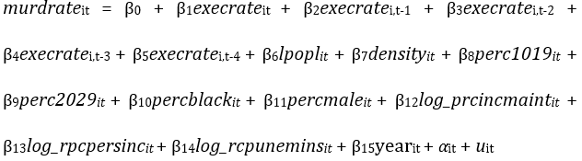
The Model
Regress controls on murdrate
Lincom to estimate long-run effects.
a corresponds to differences between counties that don’t change over time
u corresponds to primarily a combination of random effects and county characteristics that do change relative to one another

Slide 8
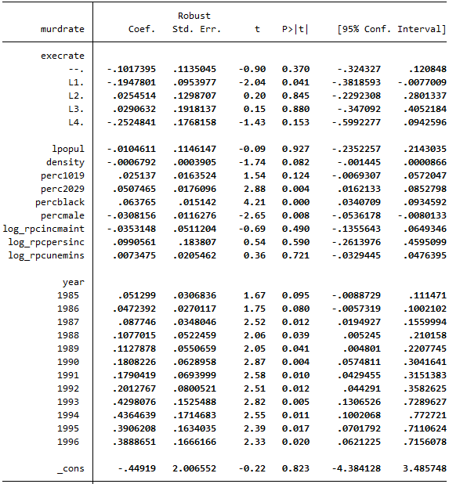

Output

Slide 9
Results
Statistically significant explanatory variables: density, perc1019, perc2029, percblack, and percmale.
Short-run effects of executions do not show impact on murder rates.
Long-run effects of executions estimate that if two inmates are executed today, over the next four years, we would see the murders drop by 1/10000 - all else equal.
density, perc1019, perc2029, percblack, and percmale are statistically significant but lack in terms of coefficient magnitude. For example: the model estimates that it would take a 15.68 percentage point increase in percblack to increase the murder rate by 1/10000.

Slide 10
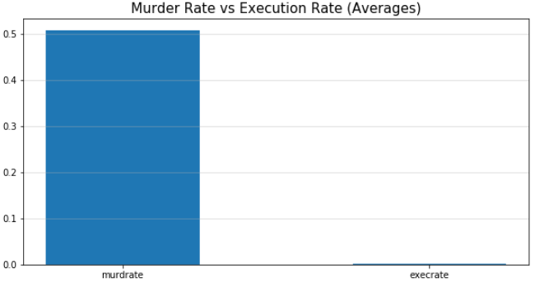
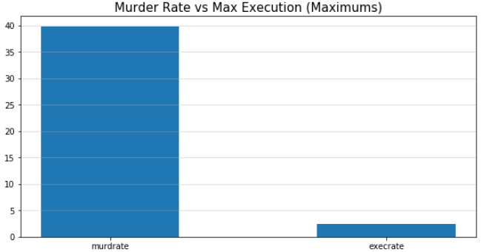
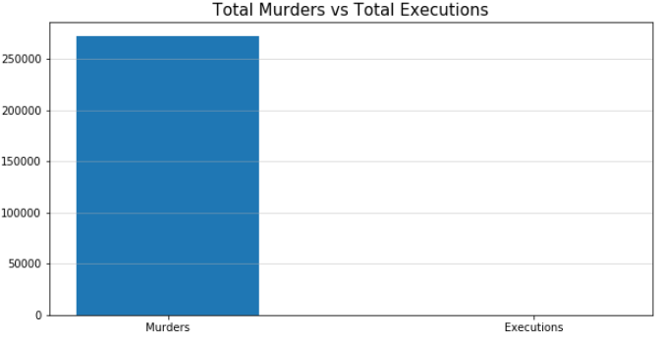
Challenges

Slide 11
Challenges (cont.)
Hard to find more recent data in the same format.
Executions are rare relative to murders.
The United States does not execute many people, so a country with more executions may be more useful.
Executions can be a life-sentence instead, since some inmates will wait most their lives in prison as they wait their execution dates. Some exceptions have been made based on crime.
Difficult to interpret demographic variable coefficients
Endogeneity
We expect homicide arrests to be correlated with murder rates
Policing & enforcement varies widely within counties (ex. Cook County) and may have a partial deterrent or encouraging effect on neighborhoods
The risk of death due to execution is minute relative to the risk incurred committing a crime

Slide 12
Conclusion
As a policy analysis, there will be no normative statements made.
When considering if capital punishment has a deterrent effect on murder rates, the models estimate a long-run effect of 2 executions today will deter 1/10000 murders over the course of 4 years, all else equal.
Economic control variables did not show statistical significance, possibly due to economic troubles lead to more property crime instead of murder.
Demographic control variables show little impact, in terms of coefficient magnitude.
Analysis is not attempting to provide causation to why murders happen. It is just to view the impact of capital punishment.

