Slide 1
Effects of Capital Punishment on Homicide Rates
Ryan Granet & Isaac Updike

Slide 2
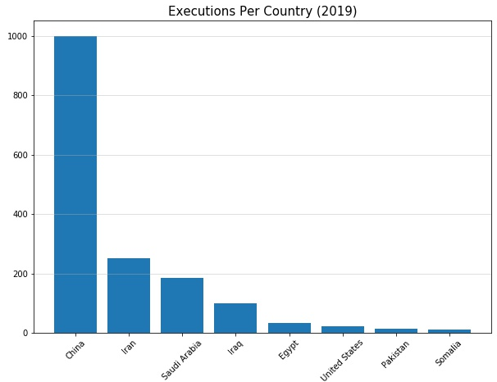
Motivation
Capital punishment has been used as a policy to deter crimes, specifically murder.
The use of capital punishment as a policy has been debated for decades, leading some states to phase it out.
Out of the developed nations, the U.S. is only surpassed in executions by China, Iran, Saudi Arabia, Iraq, and Egypt.

